Slide 1
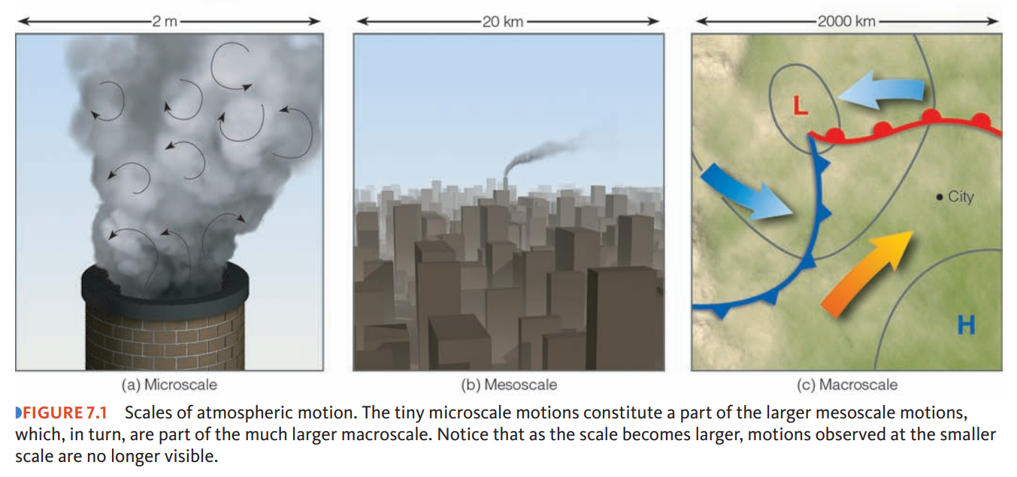
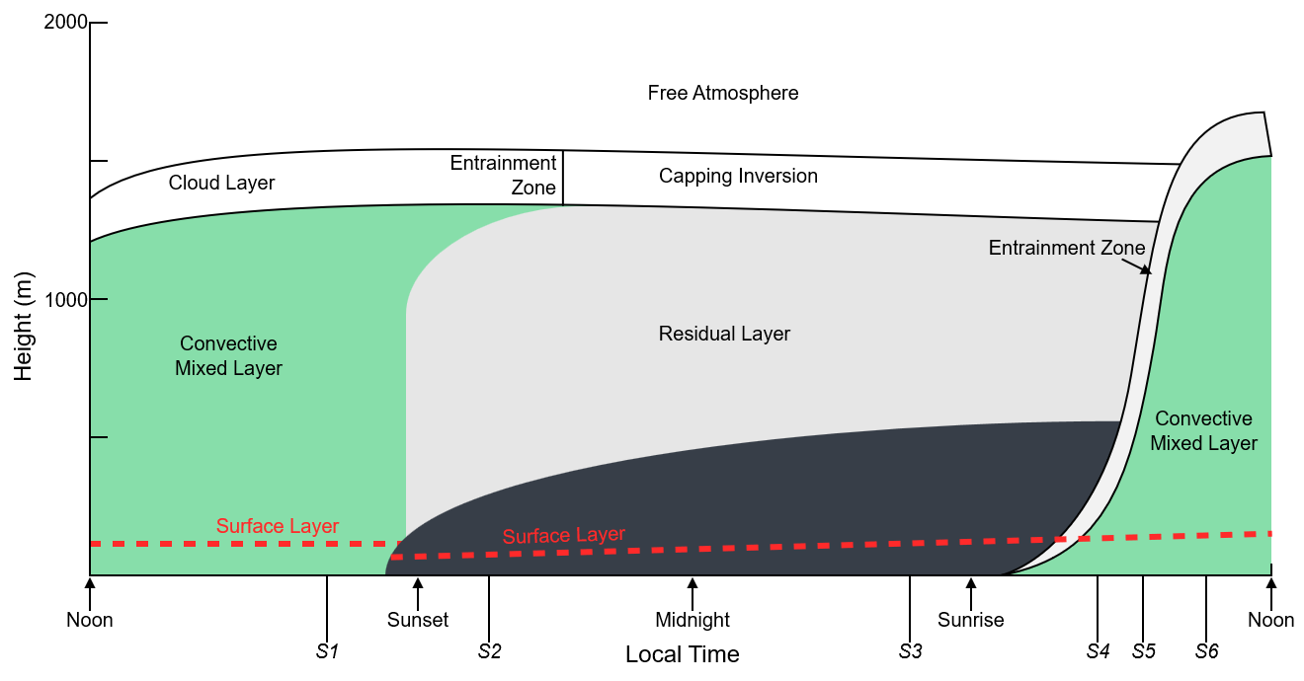
Scale Dependency and Atmospheric Dispersion
Benjamin Marosites
Atmospheric scales of motion
Boundary Layer Meteorology
From Ahrens, C. D., Essentials of Meteorology. 2010. Cengage Learning, 179 pp.
From Stull, R. B., 2012: An introduction to boundary layer meteorology. Springer, 670 pp.
Stable Boundary Layer (SBL)
GEOL 365/599
2025-12-01
Notes:
My research project for this class is looking into atmospheric dispersion and scale dependency.

Slide 2
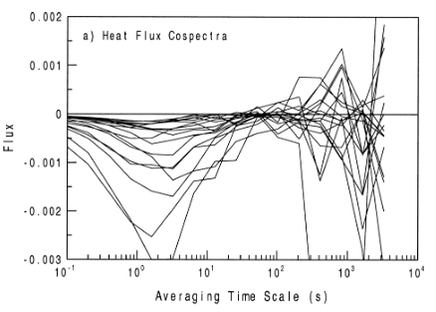
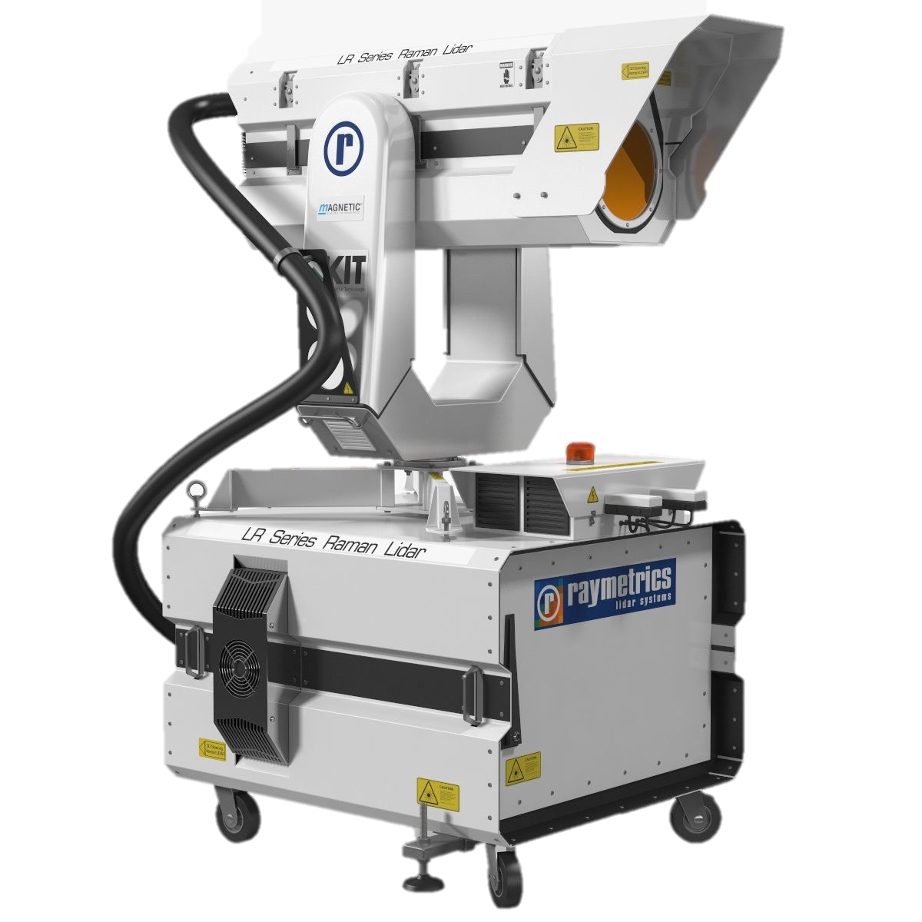
Research Question and Background
How does scale impact plume behavior?
Existing research shows…
  SBLs suppress turbulence (aka mixing)
    Periods of intermittent turbulence and drainage flows.
  Common averaging scales are not valid.
Vickers, D., & Mahrt, L. (2003). The cospectral gap and turbulent flux calculations. Journal of Atmospheric and Oceanic Technology, 20(5), 664.

Slide 3
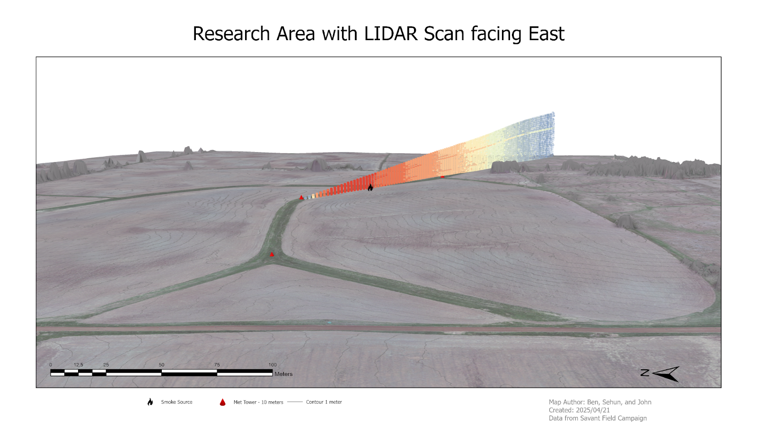
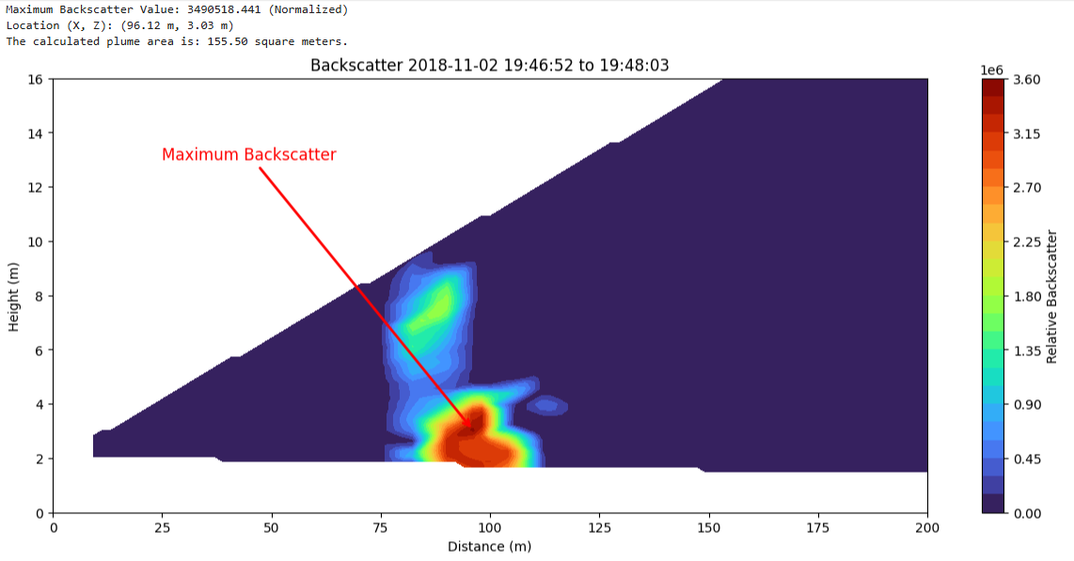
Methodology
2018 SAVANT Campaign.
  Atmospheric Lidar
  Wind data
Extract plume metrics
  Location of Maximum Backscatter
Multiresolution Decomposition (MRD)
  Calculate w’T’
  One-hour periods
  30-second averaging

Slide 4
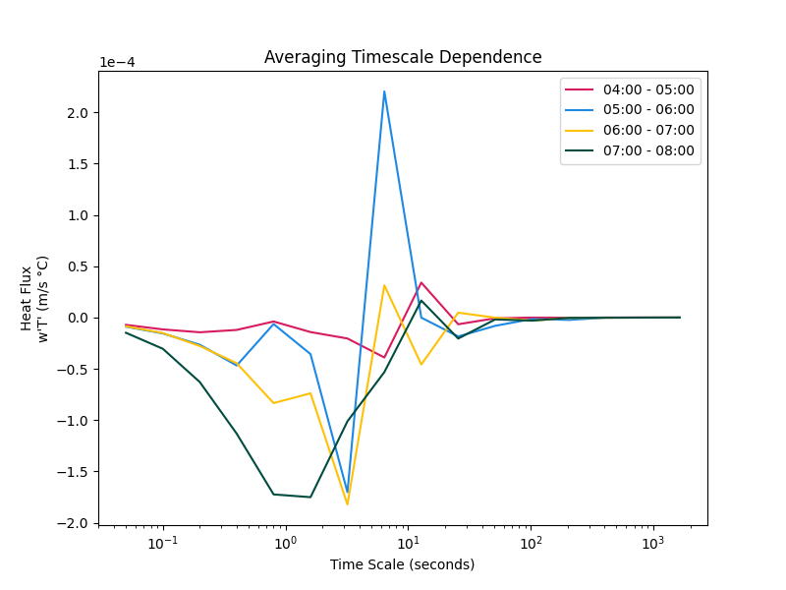
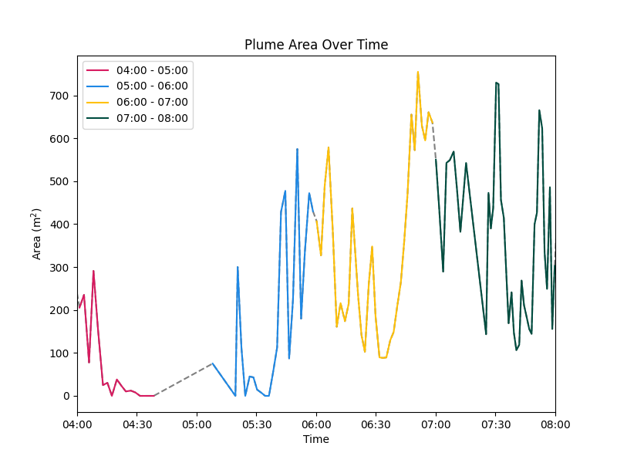
Findings

Slide 5
Conclusions, Limitations, and Importance
Findings
More data and a more robust analysis could confirm roles of scale and advection/dispersion.
Limitations
Data quality, quantity, and notes.
Signal-to-Noise
Importance
Air pollution
Agriculture
Wild and prescribed fires

Slide 6
References
Ahrens, C. D., Essentials of Meteorology. 2010. Cengage Learning, 179 pp.
Stull, R. B., 2012: An introduction to boundary layer meteorology. Springer, 670 pp.

Slide 8
Background/justification: why is this thing important to study?
Scientific question: what do you want to test? This must be framed in a testable way, e.g. how does X affect Y? What is the relationship between A and B?
Dataset: appropriate data for testing your hypothesis
Results: what did you find?
Interpretation: what does this mean?
Limitations: how well could you answer your scientific question. Did anything prevent you?
Conclusion: what is the answer to your scientific question?

Slide 10
