Slide 1
Ness Digital Engineering
Automation on a gauge diet
Nessathon 2018
Lenka Jakubecová
Maroš Kutschy

Slide 2
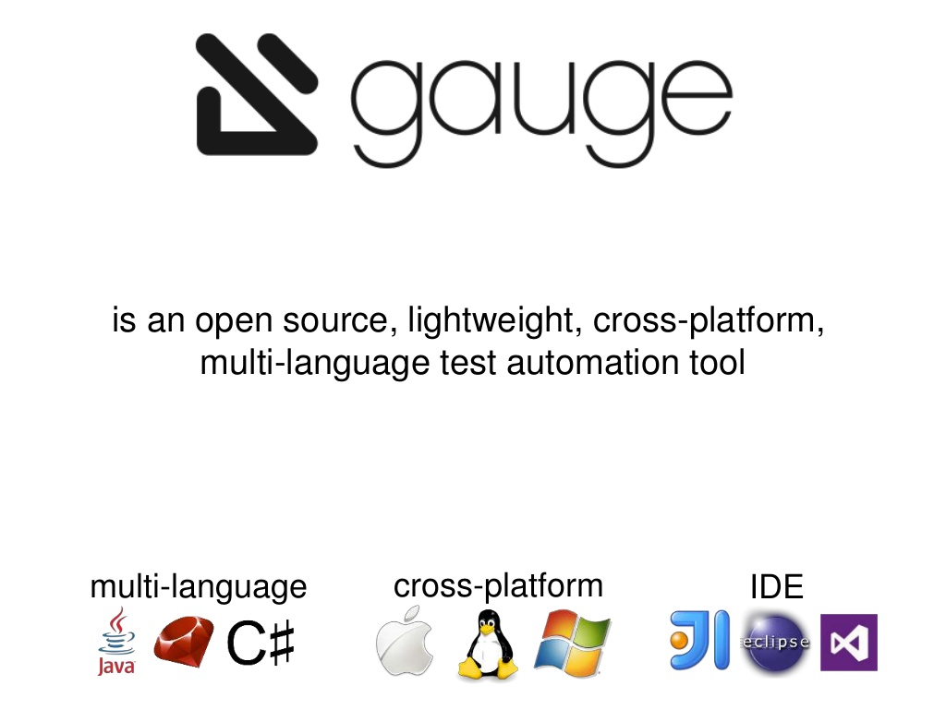

Slide 3
Continue on Failure
Annotation tells Gauge to continue executing other steps even if the current step fails
@ContinueOnFailure
@ContinueOnFailure({AssertionError.class, CustomErr.class})

Slide 4
Data Stores
Data (Objects) can be shared in steps defined in different classes at runtime using DataStores exposed by gauge
ScenarioStore
SpecStore
SuiteStore

Slide 5
Context and Tear Down steps
Contexts or Context steps are steps defined in a spec before any scenario. They are executed before every scenario in the spec.
Tear Down steps are the steps defined in a spec after the last scenario. They are executed after every scenario in the spec.

Slide 6
Concepts
Concepts provide the ability to combine re-usable logical groups of steps into a single unit
It provides a higher level abstraction of a business intent by combining steps
They are defined in .cpt format files in the specs directory in the project

Slide 7
Before and After Execution Hooks
There are available 4 levels of hooks
@BeforeSuite/@AfterSuite
@BeforeSpec/@AfterSpec
@BeforeScenario/@AfterScenario
@BeforeStep/@AfterStep

Slide 8
Thank you

