Slide 1
CSC5002 Micro Project: VlibTour
Amir GHARBI
Marouane KACHOURI

Slide 2
1. Architectural choices

Slide 3
General architecture

Slide 4
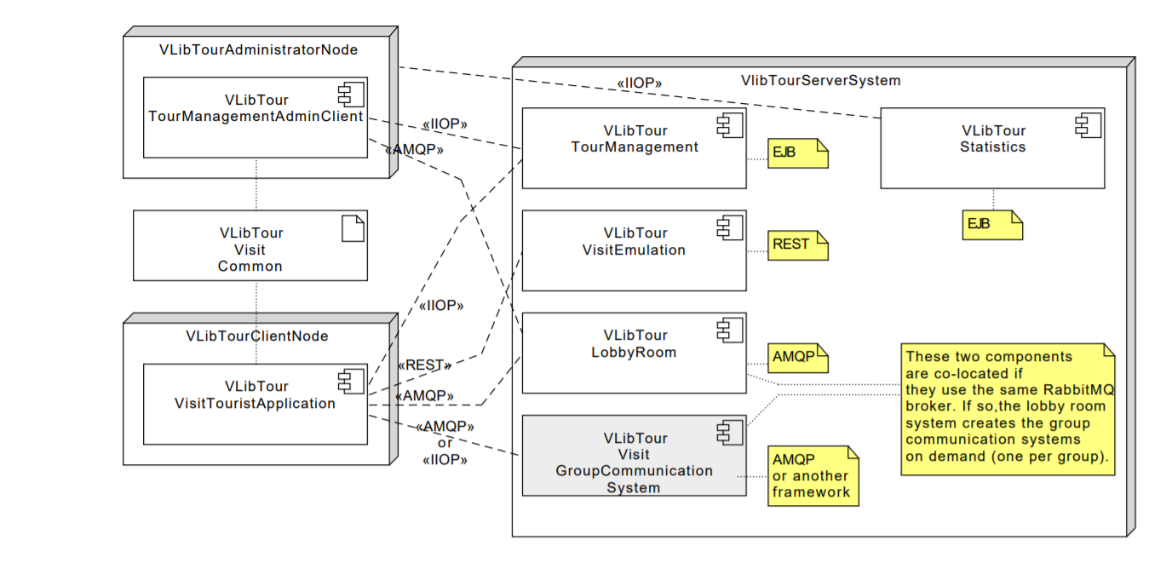

Slide 5
Design patterns

Slide 6
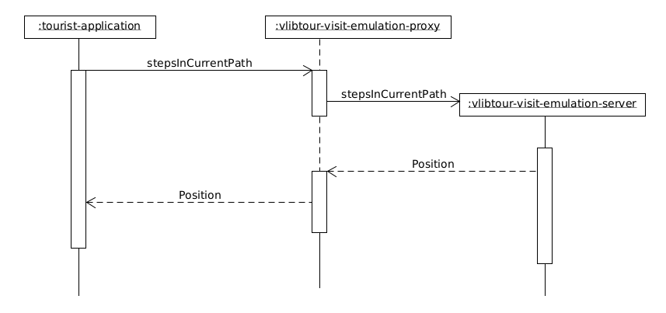

Slide 7
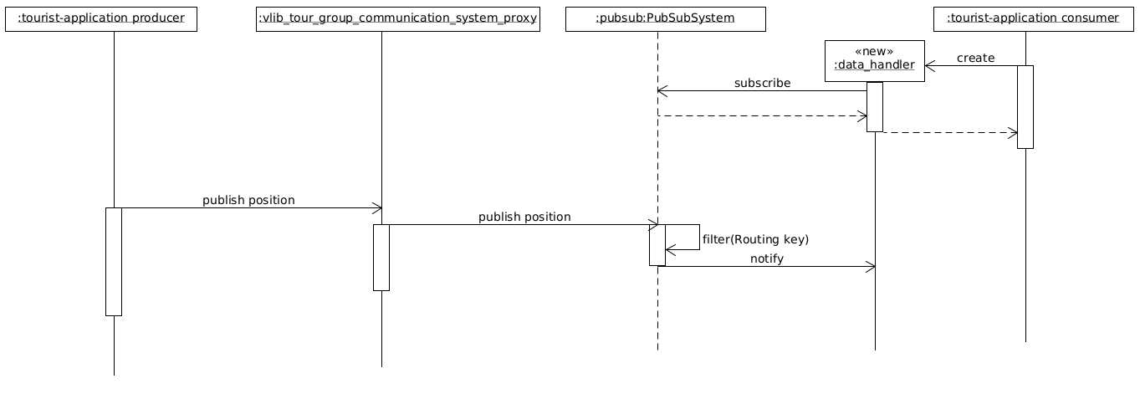

Slide 8
2. Extrafunctional requirements

Slide 9
Interoperability

Slide 10
Python
clients
RabbitMQ clients
RabbitMQ broker
Qpid Java broker

Slide 11
Security

Slide 12
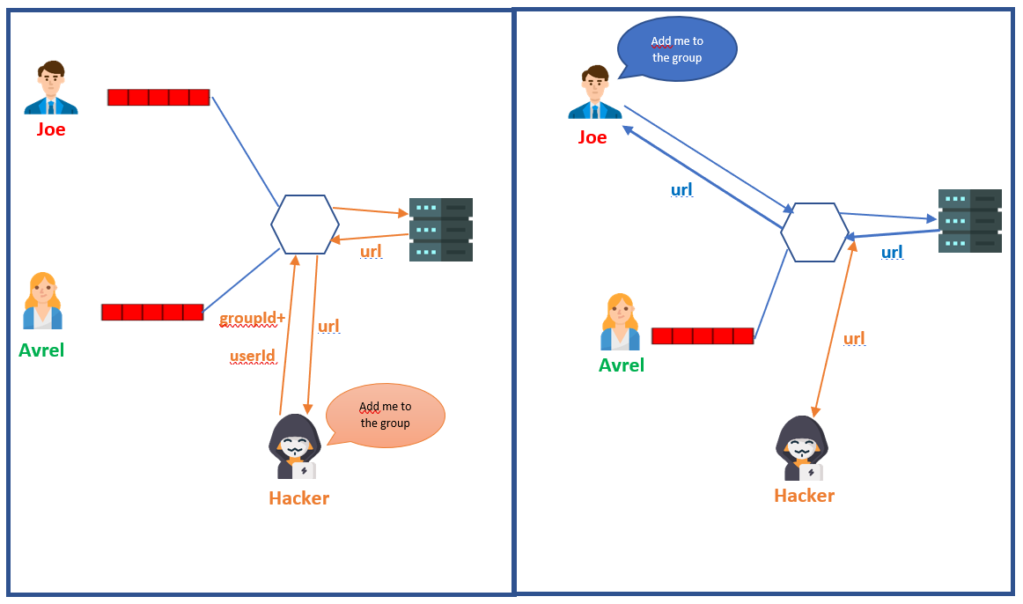

Slide 13
Thank you for your attention!

