Slide 1

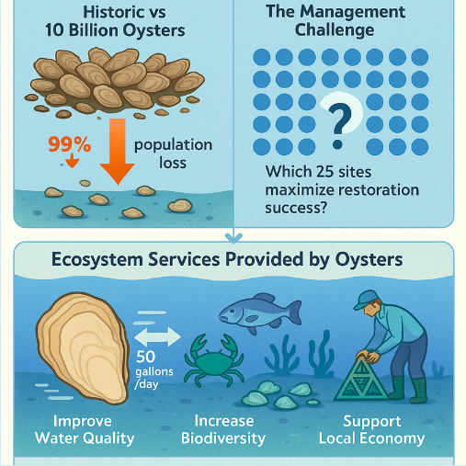
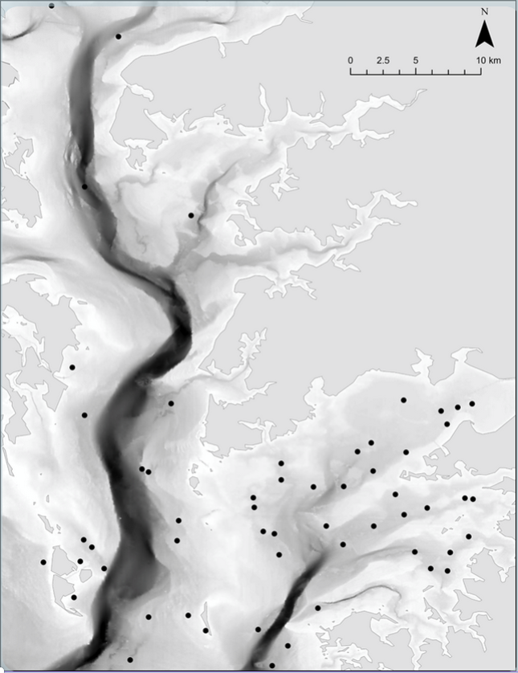
Optimization of Oyster Reef
Restoration in Chesapeake Bay
Greedy Heuristics, MIQP Surrogates, Community Constraints, Variable Sizing, and Network Analysis
Marouf Paul
Computational Operations Research · William & Mary
Advisor: Prof. Rex Kincaid | Collaborators: Leah Shaw, Rom Lipcius, VIMS

Slide 2



The Decision Problem
What drives this research
$Budget
Potential Locations
Sites to
Select
63T
possible combinations C(49, 25) - brute force impossible
Which 25 sites maximize long-run adult oyster biomass
across a spatially connected larval network?
Poor placement creates isolated sinks with minimal larval exchange — wasting limited resources.

Slide 3


Why This Isn't a Simple Ranking
Larval connectivity creates network interdependencies
The Network Effect
Super-Linear Production
Adult oysters release larvae into the water column. Ocean currents carry them to other sites.
The value of site A depends on whether you also restore the sites that receive its larvae.
You're not picking 25 independent locations — you're designing a network.
|A|¹·⁷²
Doubling adults → 3.3× larvae
Concentrating resources on well-connected hubs pays off more than spreading thin.
The biology itself rewards strategic network design.

Slide 4
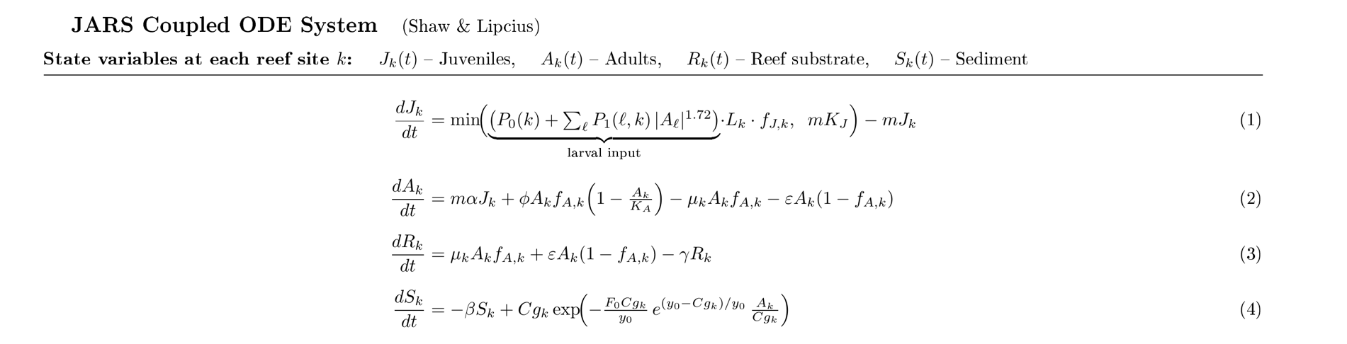
The JARS ODE System
Biological ground truth — developed by Dr. Leah Shaw, Dr. Rom Lipcius https://doi.org/10.1016/j.jtbi.2011.08.013

Slide 5
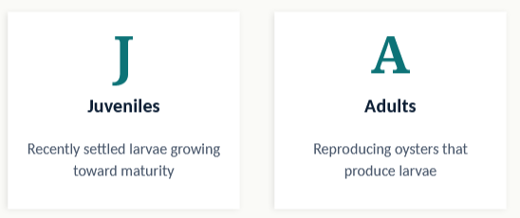
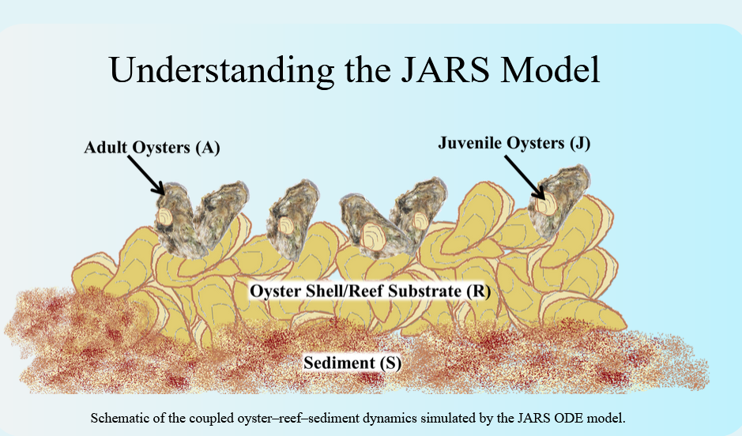
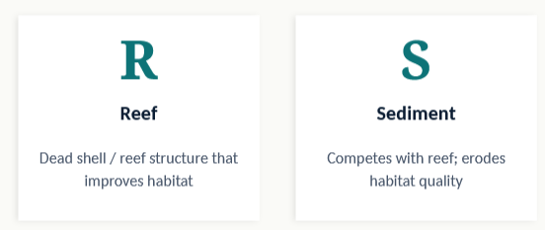
The JARS Metapopulation Model
Our biological "truth engine"

Slide 6
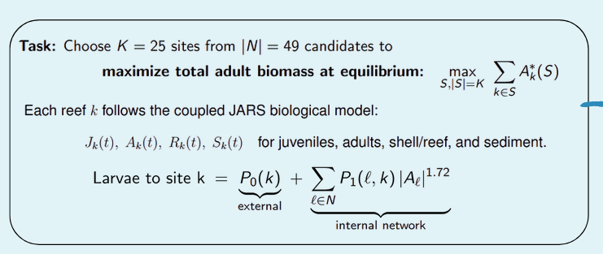

Slide 7
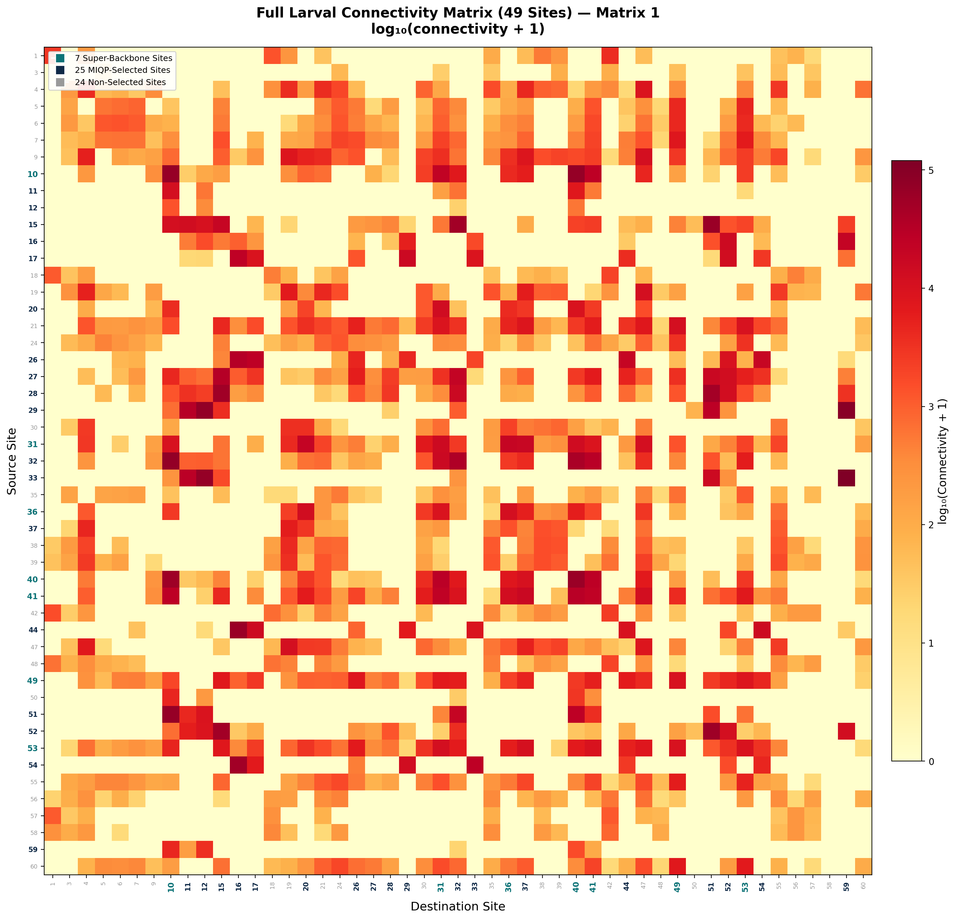
Larval Connectivity Network
What This Shows
56-site connectivity matrix from oceanographic larval transport modeling
Hot cells = strong larval flow between source and destination reefs
Visible clustering: sites 10, 27-29, Off-diagonal structure reveals long-range larval pathways
This network structure drives which sites are most valuable to restore

Slide 8
ODE-Based Heuristic Search
Three approaches to optimize directly on the biological model
Greedy Forward
Start empty. Add the site with highest marginal gain. Repeat 25 times. ~925 ODE evaluations.
Post-Greedy 1-Swap
Take the greedy solution. Try swapping one chosen site for one unchosen. Accept improvements. Repeat until no swap helps.
Stingy Backward
Start with all 49 sites. Remove the one whose removal hurts least. Repeat until 25 remain.
Post-greedy swap and stingy backward converge to the exact same 25 sites
Strong evidence of a stable local optimum under the true ODE objective

Slide 9


Why the ODE Alone Isn't Enough
The motivation for building a surrogate model
Computational Cost
Policy Constraints
925 ODE evaluations per greedy run
~4 minutes per experiment
Sensitivity analysis, parameter sweeps, and scenario testing become prohibitively expensive
Real-world restoration requires:
• Community equity — minimum reefs per region
• Variable reef sizing — 5 to 50 acres per site
• Total acreage budgets
Adding these to greedy search is impractical.
Mathematical programming handles them naturally.
The surrogate isn't a faster version of the same thing — it's a platform for asking richer questions

Slide 10
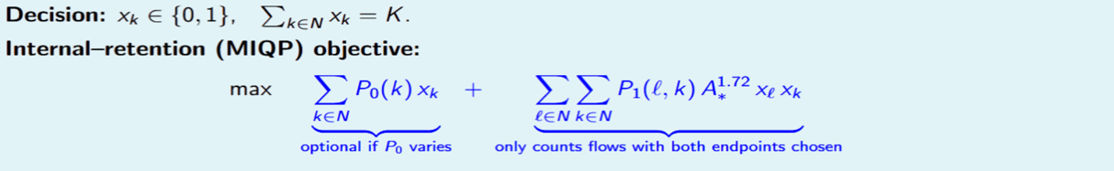


The MIQP Surrogate
Approximating the ODE with a quadratic network-retention objective
external supply internal retention (AND-gate: counts only if both sites selected)
The AND-Gate Intuition
Speed & Extensibility
xᵢ · xⱼ = 1 only when both endpoints are selected. A larval connection between reefs only matters if both reefs exist.
Like a highway between two cities — only useful if both cities are built.
<0.5 second
vs. minutes for ODE heuristics
Adding a constraint = adding one line
to the AMPL model

Slide 11
Four MIQP Model Variants
Building from simple to full real-world planning model
1
Base MIQP
oyster_quad.mod
Maximize internal retention.
Select 25 binary sites.
2
+ Community Equity
oyster_comm.mod
Add minimum reefs per region.
5 community zones with minimums.
3
+ Variable Sizing
oyster_size.mod
Continuous reef areas 5–50 acres.
Total acreage budget constraint.
4
+ Both Combined
oyster_comm_size.mod
Full model: equity + sizing +
budget + connectivity.
Sizing insight: equity-mandated weak sites get 5 acres; strong hubs get 40–50 acres

Slide 12
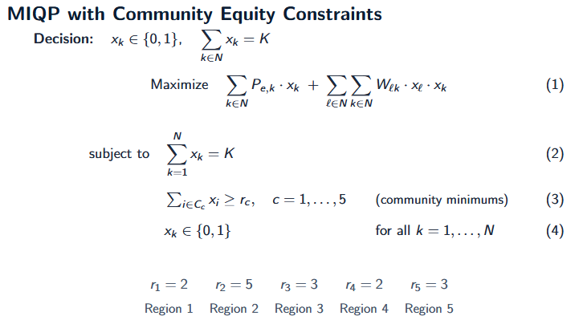
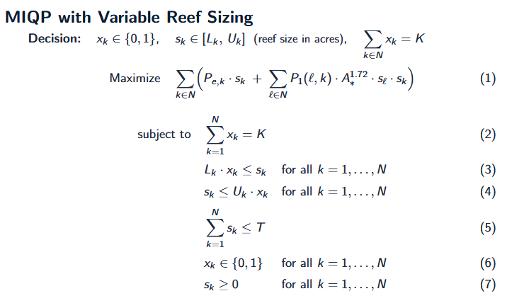
The MIQP Community / Sizing Constraints

Slide 13

Surrogate Validation
Does the MIQP agree with the true biological objective?
Matrix 1
Matrix 2
ODE Heuristic (post-greedy)
1.880
1.733
MIQP → ODE validation
~1.867
~1.72
Gap
~0.7%
~0.8%
Sites in common
23 / 25
23 / 25
The quadratic surrogate captures the main drivers of the full nonlinear dynamics
Base MIQP produces identical 25-site sets for both matrices
ODE and MIQP differ by only 2 sites — small gap validates the surrogate approach
Surrogate is trustworthy enough to explore constrained extensions

Slide 14
Plumbing vs. Faucets
Constant vs. realistic external larval supply
Constant P₀ = 170
Realistic P₀ ∈ {100, 200, 400}
"Pure plumbing" test
"Faucets + pipes"
Every site gets the same external larvae. Differences in performance come solely from the internal connectivity structure.
Reveals the skeleton of the network — which sites form the most retentive, mutually reinforcing cluster.
Used for all MIQP experiments.
Heterogeneous external supply based on empirical regional estimates.
Pulls in sites with large external supply even if less central. Some new sites appear (e.g., 6, 24, 38, 55, 60).
Sites that survive both regimes are simultaneously well-connected AND well-supplied — the safest investment.

Slide 15
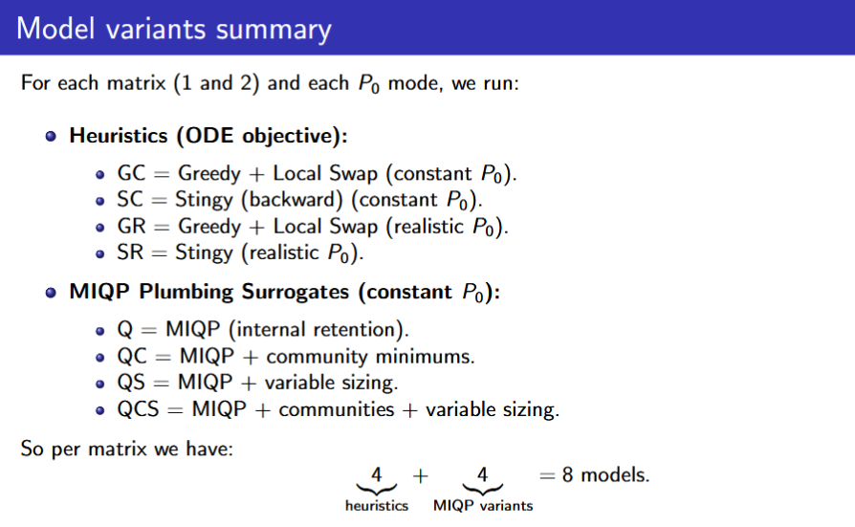

Slide 16
The Backbone Hierarchy
Robustness increases as we intersect across more experimental dimensions
Single Matrics Constant
23 sites
Cross both Matrices
16 sites
10 sites
Survive everything
7
SUPER-BACKBONE
Sites {10, 31, 36, 40, 41, 49, 53}
Survive every model variant, every connectivity matrix, every forcing regime — the reefs the system cannot function without

Slide 17


Network Centrality Explains the Backbone
Why do these sites keep appearing? The connectivity graph tells us.
In/Out-Strength
Eigenvector
PageRank
Betweenness
Total larval flow
in and out of a site
Important if connected
to other important sites
Random-walk importance
under damping
Fraction of shortest
paths through a site
Top Backbone Sites by Average Centrality Rank (Both Matrices)
40
Dominant hub — highest eigenvector centrality and PageRank in both matrices
10
Major importer — highest in-strength in Matrix 2, consistently high PageRank
31
Strong bidirectional hub — high in/out-strength and eigenvector in both
32
Key exporter — very high out-strength, high betweenness in Matrix 1
41
Connected hub — high eigenvector, strong bidirectional flow
36, 53
Network bridges — high betweenness, linking otherwise separate regions

Slide 18
The Complete Pipeline
End-to-end framework from raw data to actionable recommendation
1
2
3
4
5
6
7
Connectivity Data
JARS ODE Model
Heuristic Search
MIQP Surrogate
Policy Extensions
Backbone Analysis
Recommendation
Hydrodynamic matrices from VIMS
Biological ground truth
Greedy, swap, stingy on ODE
Fast, validated approximation
Equity + sizing constraints
Robust sites across all lenses
Defensible restoration plan
Key Contributions
ODE heuristics establish ground truth; MIQP surrogate enables policy exploration neither can do alone
7-site super-backbone robust across all models, matrices, and forcing regimes
Network centrality transparently explains why these sites are structurally critical
Sizing + equity combined model provides actionable compromise for stakeholders

Slide 19
Future Directions
Additional Matrices
Hybrid MIQP + ODE
Test backbone stability across different years, seasons, and climate scenarios
Use MIQP solution as seed, then polish with ODE-based local search
Multi-Objective
Dynamic Control
Balance biomass, equity, cost, recovery time, and resilience to shocks
Phased restoration over time rather than one-shot placement

Slide 20
Thank You
Questions & Discussion
Marouf Paul · Computational Operations Research · William & Mary
mmarouf@wm.edu / maroufpaul1@gmail.com

