Slide 1
Optimal Oyster Reef Site Selection
Combining ODE Modeling, Heuristic Optimization, and Mixed-Integer Quadratic Programming
Paul Marouf
Chesapeake Bay Oyster Restoration Project

Slide 2
The Problem
99%
25 / 48
1.4T
of Chesapeake Bay oysters lost 10 billion -> < 100 million
sites we can restore out of 48 candidates
possible combinations C(48, 25) - brute force impossible
The Optimization Question
Which 25 reef sites should be restored to maximize total adult oyster biomass, given the larval connectivity network between sites?
Challenge: Each site's value depends on which other sites are also restored. Larvae flow between reefs through ocean currents, creating network effects that make this a nonlinear combinatorial problem.

Slide 3
The Biological Model
JARS ODE System | Provided by Dr. Leah Shaw
J
A
R
S
Juveniles
Adults
Reef / Shell
Sediment
Newly settled larvae
Biomass (our objective)
Habitat structure
Smothering factor
How Sites Interact
Computational Cost
Larval input = (P0 + P1' |A|^1.72) * L * f
P0 = external larvae (from outside the network)
P1 = internal connectivity matrix (56 x 56)
|A|^1.72 = nonlinear adult biomass scaling
L, f = habitat quality and survival functions
Each evaluation = solve 4N-dim ODE to t=1000
N = number of sites in the subset (up to 48)
One ODE solve takes ~0.1-0.2 seconds
Greedy needs ~900 evaluations
Need smart methods, not just brute force

Slide 4
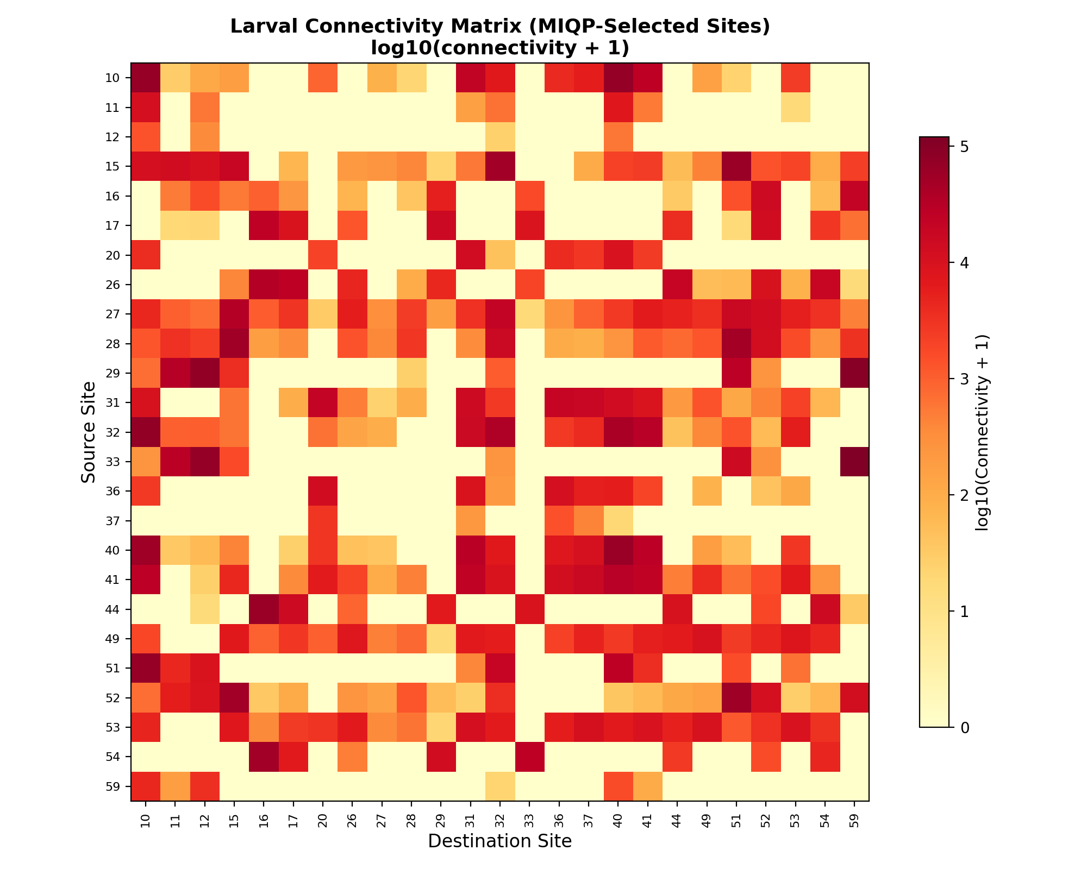
Larval Connectivity Network
What This Shows
56-site connectivity matrix from oceanographic larval transport modeling
Hot cells = strong larval flow between source and destination reefs
Visible clustering: sites 10, 27-29, 31-32, 40-41 form a connected hub
Off-diagonal structure reveals long-range larval pathways
This network structure drives which sites are most valuable to restore

Slide 5
My Contribution: Three Solution Approaches
Heuristic Search
MIQP Surrogate
Constrained MIQP
Uses full ODE model
Forward Greedy
Add best site one at a time across 25 rounds
Backward Elimination
Start with all 48 sites, remove least impactful
Local Search (1-swap)
Refine by swapping sites in and out of the set
Key innovation
Quadratic Objective
max sum Pe_i x_i + sum W_ij x_i x_j
Surrogate Weights
W_ij = P1_ij * (A*)^1.72 approx. network effect
Exact Solution
Gurobi solver: provably optimal in 0.32 seconds
Real-world extensions
Community Constraints
Minimum reefs per geographic region for fairness
Reef Sizing
Optimize area allocation per site under total budget
Combined Model
Communities + sizing in a single formulation

Slide 6
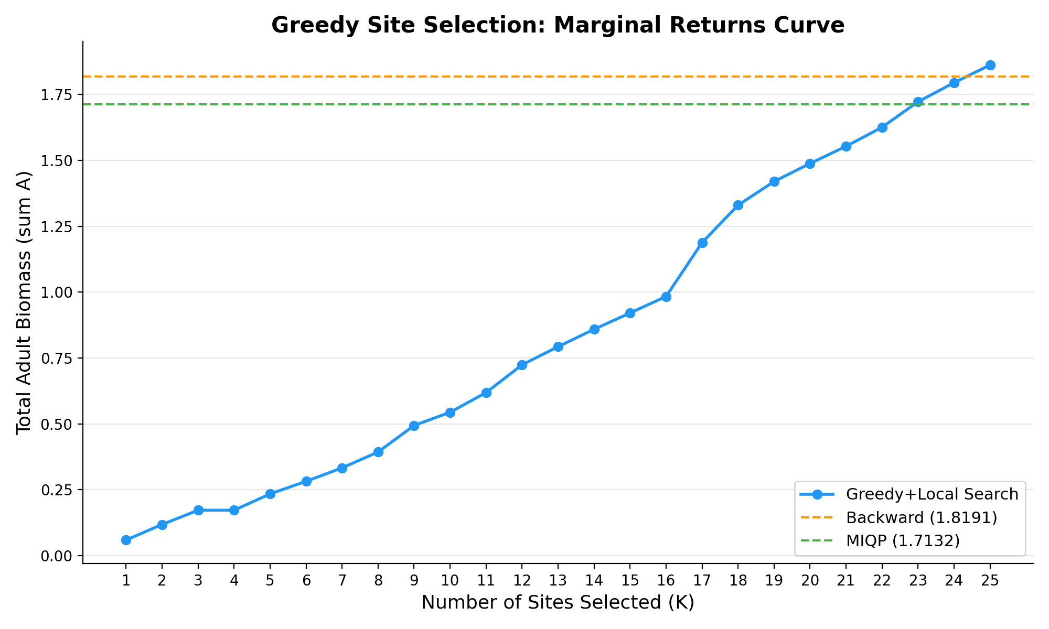
Greedy Selection: Marginal Returns Curve
Each site adds biomass, with a jump at sites 17-18 (hub sites 40, 41). Greedy+Local ultimately achieves the best ODE-validated score of 1.862.

Slide 7
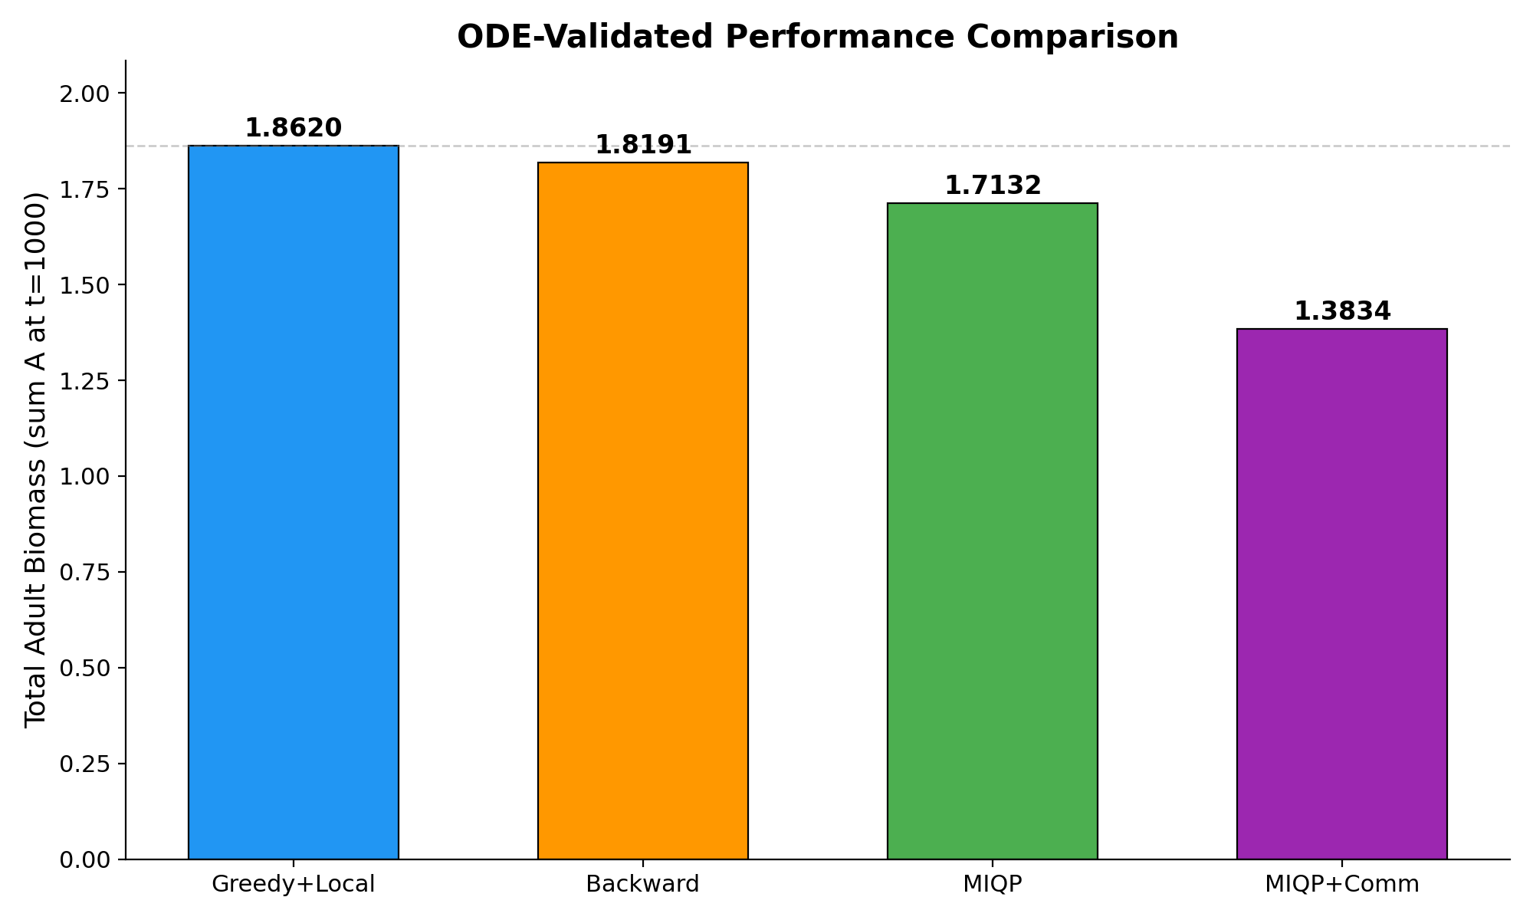
ODE-Validated Performance Comparison
All solutions validated through the full nonlinear JARS ODE (tmax=1000, realistic P0). Greedy+Local achieves highest biomass. MIQP is 8% behind but solves 6,000x faster.

Slide 8
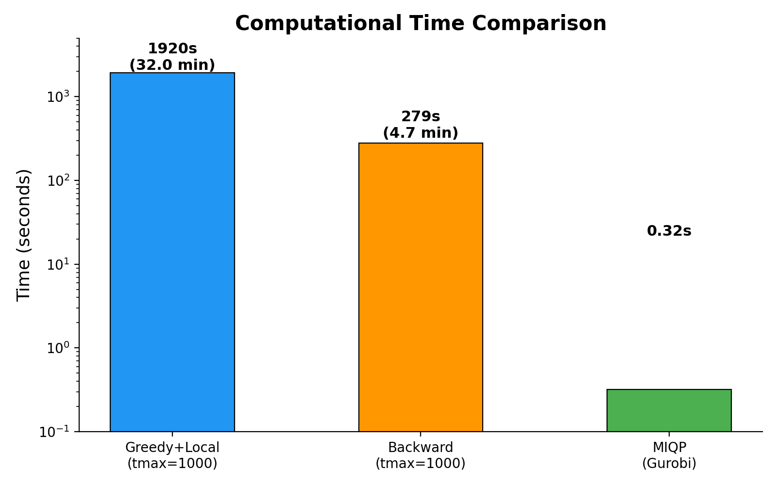
Computational Time: Speed vs Quality
The Trade-off
Greedy+Local: 32 min, best score
Backward: 4.7 min, 2.3% gap
MIQP: 0.32 sec, 8% gap
MIQP is 6,000x faster
Why MIQP Matters
Enables rapid what-if analysis
Test 100s of constraint scenarios
Interactive decision support
Provably optimal (under surrogate)

Slide 9
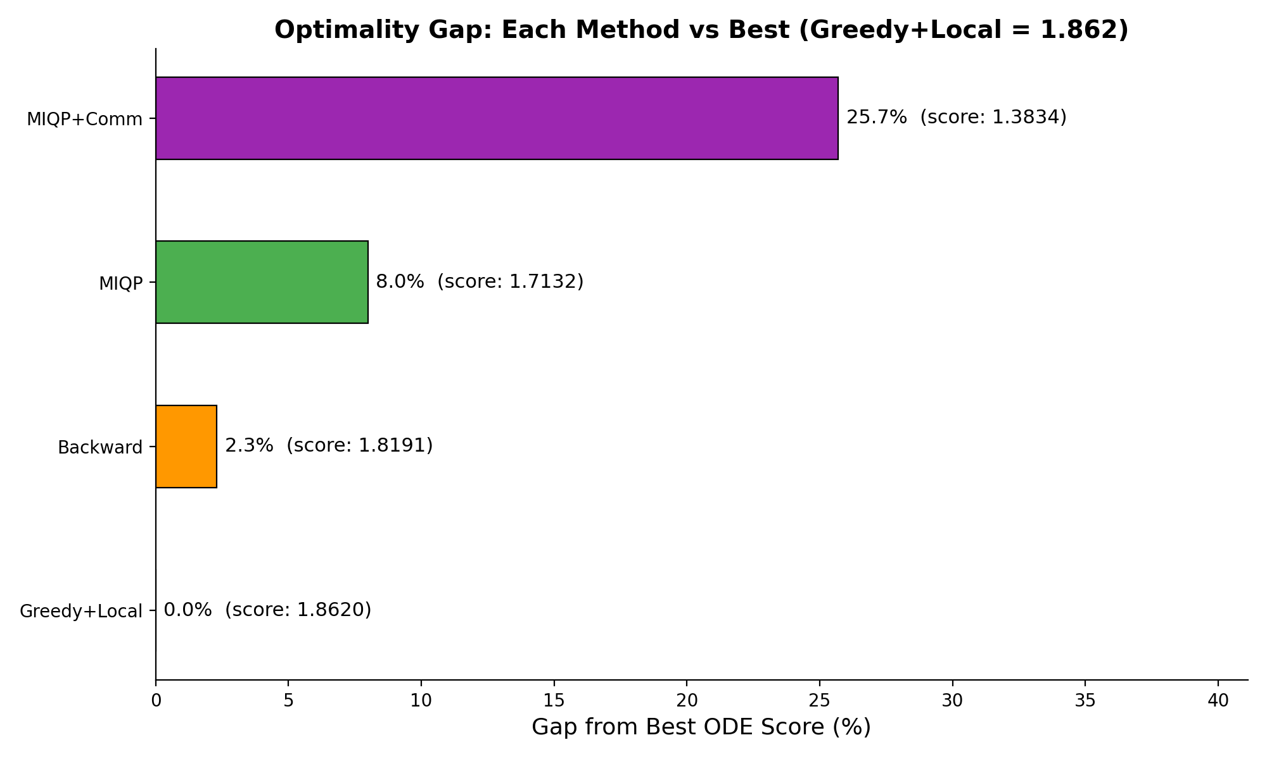
Optimality Gap Analysis
The 8% MIQP gap reflects the surrogate approximation error, not the solver. Community constraints cost ~26% biomass - quantifying the price of geographic fairness.

Slide 10
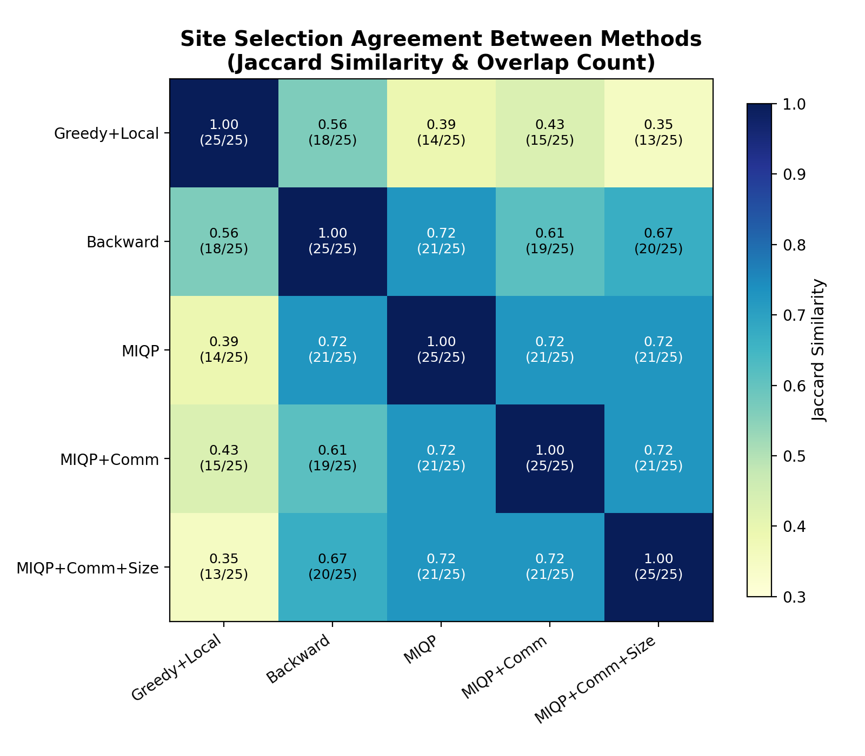
Method Agreement: Which Sites Overlap?
Reading the Heatmap
Jaccard = |intersection| / |union|
MIQP variants agree strongly with each other (J = 0.72)
Backward and MIQP are quite similar (J = 0.72) - they rank site importance similarly
Greedy+Local is most distinct (J = 0.35-0.56) due to local search swaps
Despite different selections, all methods share a consensus core

Slide 11
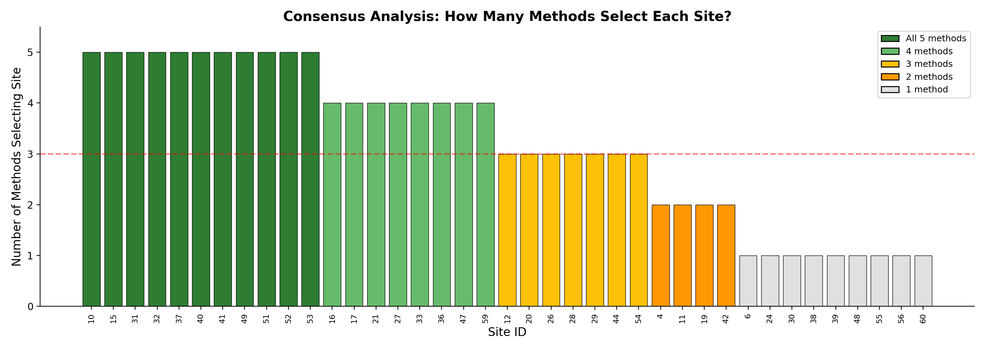
Consensus Core: High-Confidence Restoration Targets
All 5 Methods (10 sites)
4/5 Methods (7 sites)
1-2 Methods (8 sites)
10, 15, 31, 32, 37, 40, 41, 49, 51, 52, 53 Highest-confidence targets regardless of methodology
16, 17, 21, 27, 33, 36, 47, 59 Strong candidates with broad algorithmic support
4, 6, 11, 19, 24, 30, 38, etc. Contested sites where methodology choice matters

Slide 12
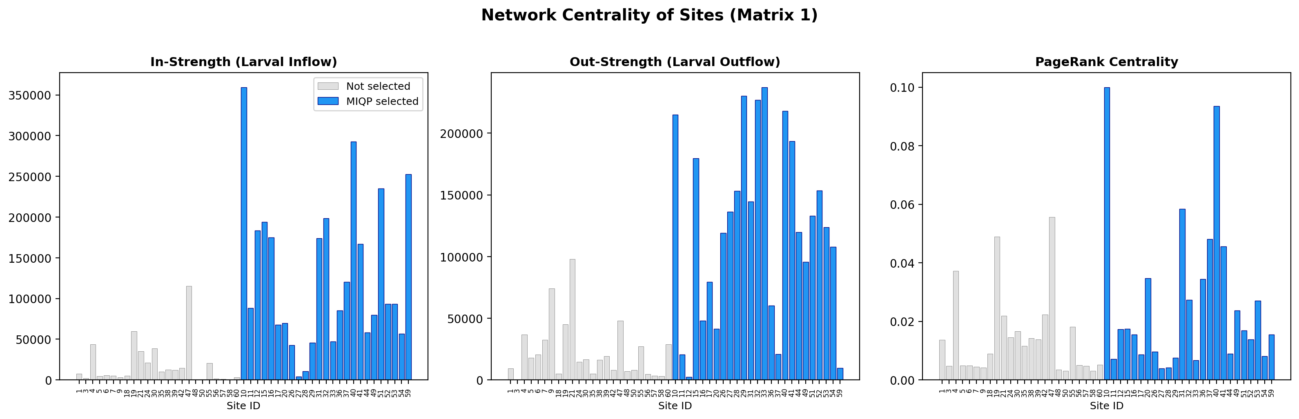
Network Analysis: Why Are These Sites Selected?
Key Insight
MIQP-selected sites (blue) dominate all network centrality metrics - they are the hubs that receive and export the most larvae. The optimization naturally discovers network-central sites. Top hubs (sites 10, 31, 32, 40, 41) are consensus picks across every method tested.

Slide 13
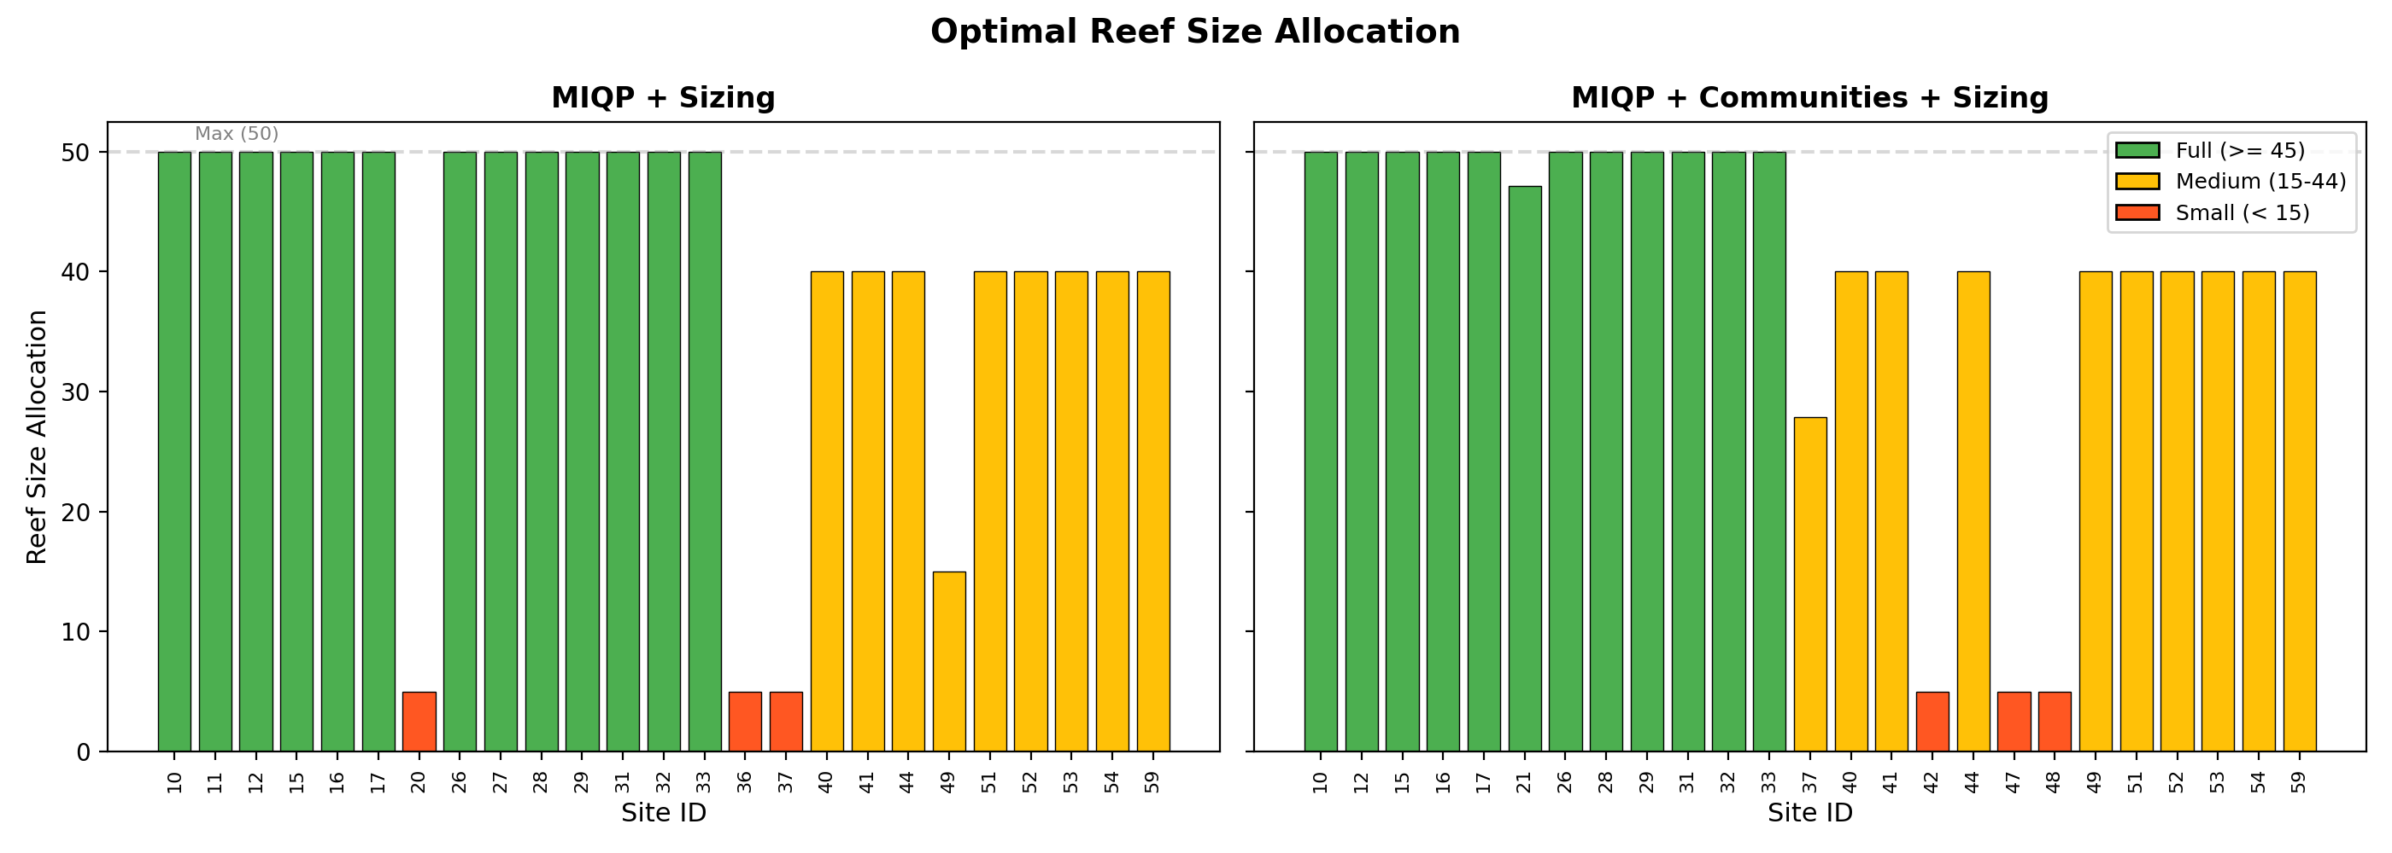
MIQP Extension: Optimal Reef Size Allocation
The MIQP framework naturally extends to variable reef sizing under a total area budget. Network hubs get maximum allocation (50 units). Peripheral sites get minimal allocation - included for connectivity value, not local productivity. Community constraints force inclusion of smaller sites (42, 47, 48) at minimum size.

Slide 14
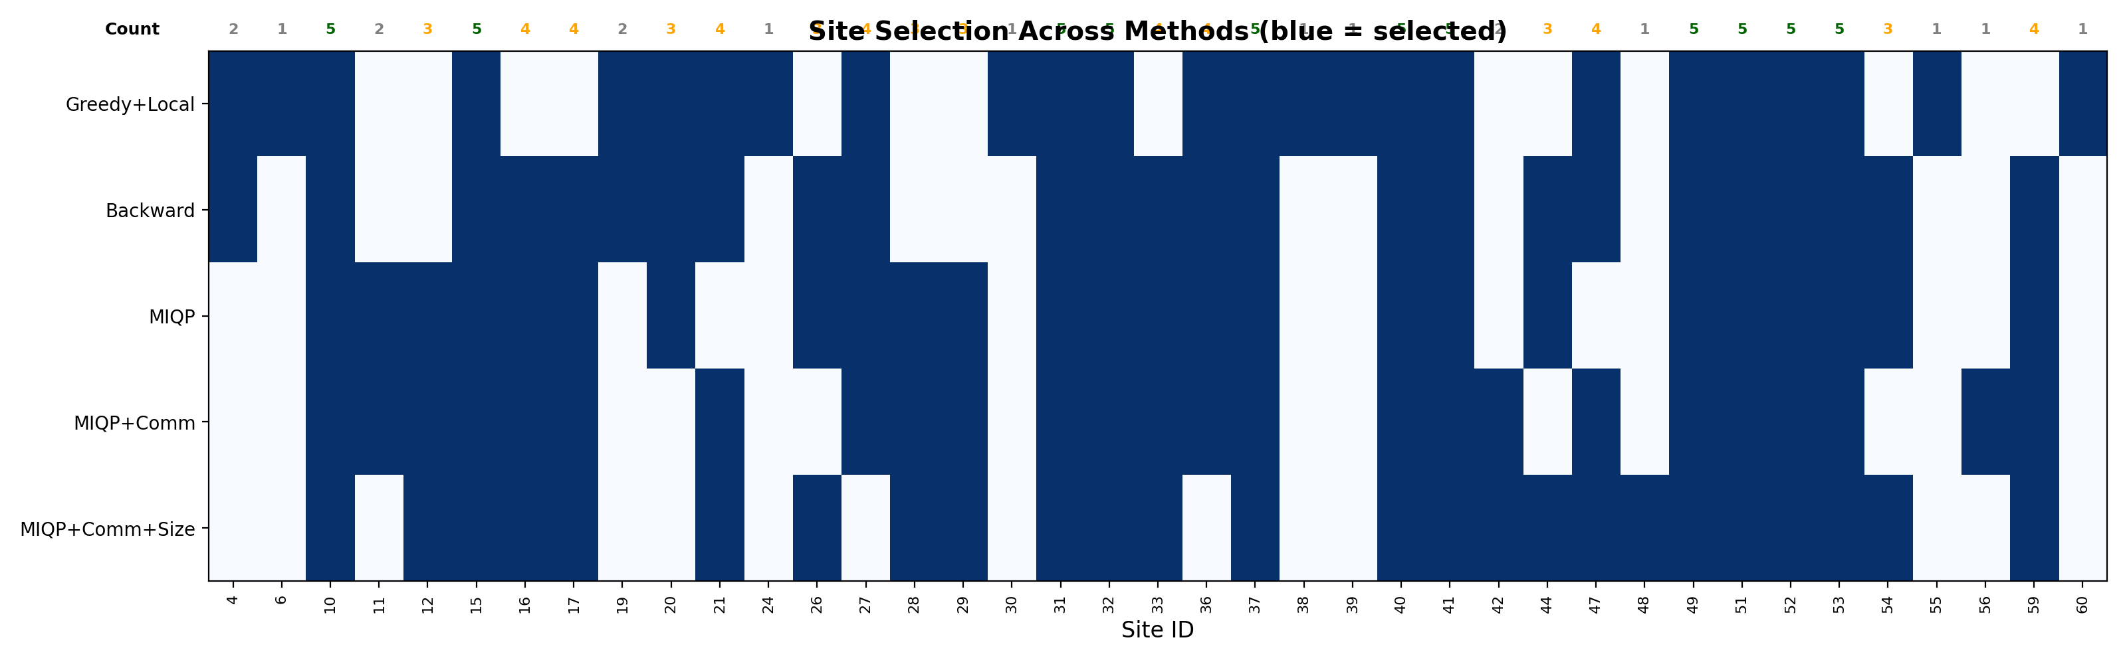
Complete Site Selection Matrix
Blue = selected. Count row shows consensus level. Dense blue columns (10, 15, 31, 32, 40, 41, 49, 51-53) form the indisputable core. Greedy+Local uniquely selects sites 6, 24, 30, 38, 39, 55, 60.

Slide 15
Summary of Results
Method | ODE Score | Time | Overlap w/ Best | Key Trait
Greedy + Local Search | 1.862 (best) | 32 min | - | Best true ODE score
Backward Elimination | 1.819 (-2.3%) | 4.7 min | 18 / 25 | Fast, strong quality
MIQP (plain) | 1.713 (-8.0%) | 0.32 sec | 14 / 25 | Near-instant, exact surrogate
MIQP + Communities | 1.383 (-25.7%) | < 1 sec | 15 / 25 | Geographic fairness
MIQP + Comm + Sizing | - | < 1 sec | 13 / 25 | Full policy model
Key Findings
1.
Greedy+Local achieves the best ODE biomass but requires 32 minutes of compute
2.
MIQP solves in 0.3 seconds - provably optimal under the quadratic surrogate
3.
The 8% gap between MIQP and Greedy quantifies the surrogate approximation error
4.
All methods agree on a consensus core of 10-11 high-value sites
5.
The MIQP framework naturally extends to community fairness and reef sizing constraints

Slide 16
Key Takeaways
MIQP surrogate = fast, exact benchmark
Solves in 0.3 seconds what heuristics need 32 minutes for. Enables rapid exploration of constraints and scenarios.
Heuristics outperform the surrogate on true ODE
Greedy+Local achieves 8% better ODE score than MIQP. The surrogate approximation is the limiting factor, not the solver.
All methods converge on a consensus core
Sites 10, 15, 31, 32, 37, 40, 41, 49, 51, 52, 53 are robust picks regardless of methodology. These are network hubs.
MIQP framework is extensible to real policy
Community fairness, reef sizing, budget constraints integrate naturally. Quantifies the cost of policy: geographic fairness costs ~26% biomass.

Slide 17
Future Work
Improve surrogate approximation (per-site A* instead of median)
Robustness analysis across connectivity matrices and parameters
Parallelize ODE evaluations for faster heuristic convergence
Extend to multi-objective formulations (biomass + biodiversity)
Thank You
Questions?

