Slide 1
Informing Investment Decisions using Facebook Data

Slide 2
Capstone Project Overview
Business Objective:
Analyze facebook foot-traffic data to inform investment decisions for select businesses.
Methodology:
Step 1: Apply clustering algorithms to Thinknum’s Facebook Followers dataset to determine which businesses had a significant amount of foot-traffic for a given time-period.
Step 2: Apply Dynamic Time Warping time series technique to identify similarities between foot-traffic and corresponding stock price timeseries for the business identified in Step 1.
Close similarities yield predictive power.
Data:
Thinknum Facebook Followers dataset
~1mill observations
Facebook foot-traffic counts (ie sum of facebook checkins and location shares) 01/01/2015 – 06/30/2018, for facebook pages corresponding to ~4,000 businesses
Yahoo Stock Price Data

Slide 3
Data Preprocessing
Actions Taken:
Limited data to companies that had 1.5 years of observations or more
Took first differences of foot-traffic observations to attain non-cumulative foot-traffic counts; the original dataset offered day-over-day cumulative foot-traffic
Applied standard scaling to data to ensure consistency of results; data will be treated with two different clustering algorithms
Plotted data to get a picture of foot-traffic patterns (Figure 1)

Slide 4
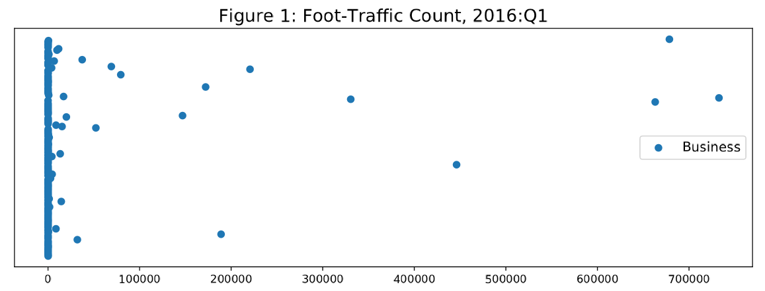
Data Preprocessing (Cont’d)

Slide 5
Clustering
Actions Taken:
Applied KMeans and Gaussian Mixture Models (GMM) clustering algorithms to identify similarities in businesses’ foot-traffic patterns by taking advantage of hard- and soft-clustering properties for the former and latter algorithm respectively
Compared Silhouette score from each algorithm to determine best fit for analysis
KMeans consistently outperformed GMM across all time-periods (Figure 2)
Varied number of clusters (n_clusters=2-5) corresponding to the top Silhouette scores to identify more businesses with significant foot-traffic counts/volumes without overfitting the data (Figures 3a-d)

Slide 6
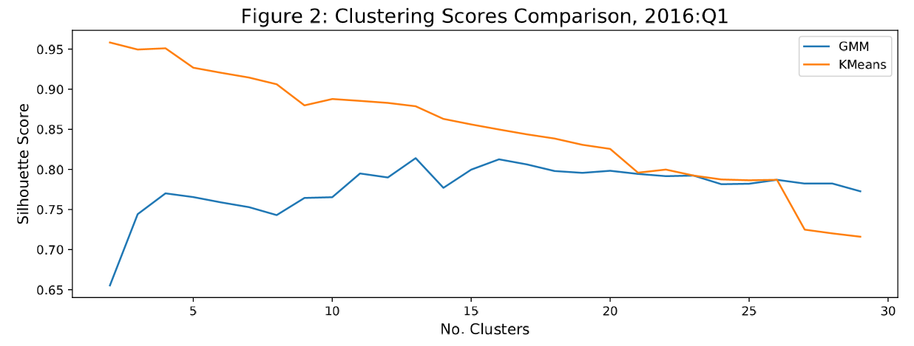
Clustering (Cont’d)
Note: Sharp drop in Kmeans Silhouette score after clusters 4 and 5

Slide 7
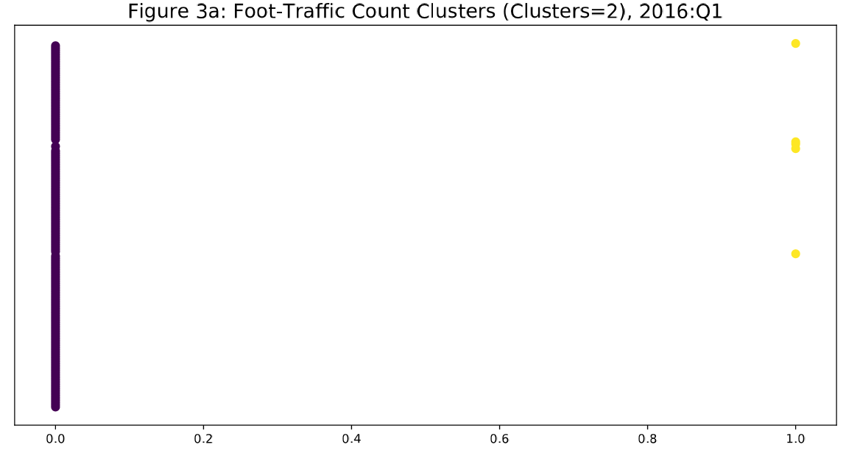
Clustering (Cont’d)

Slide 8
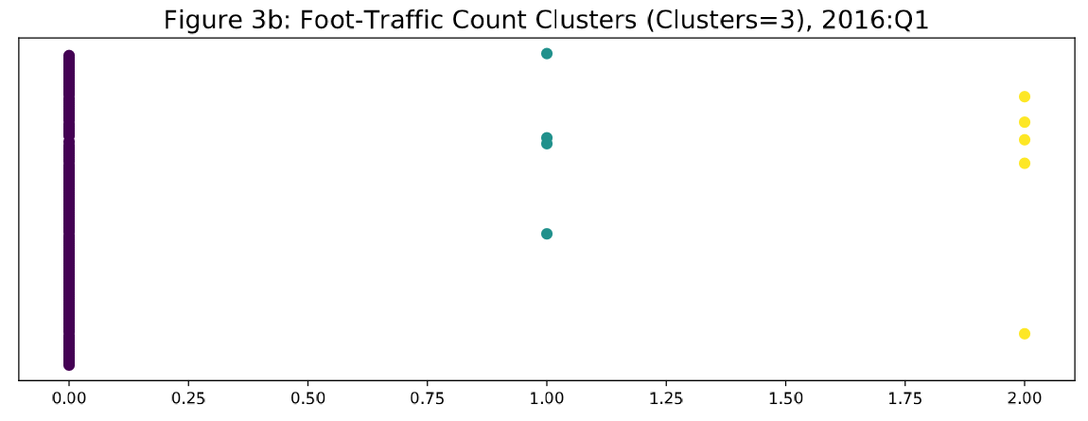
Clustering (Cont’d)

Slide 9
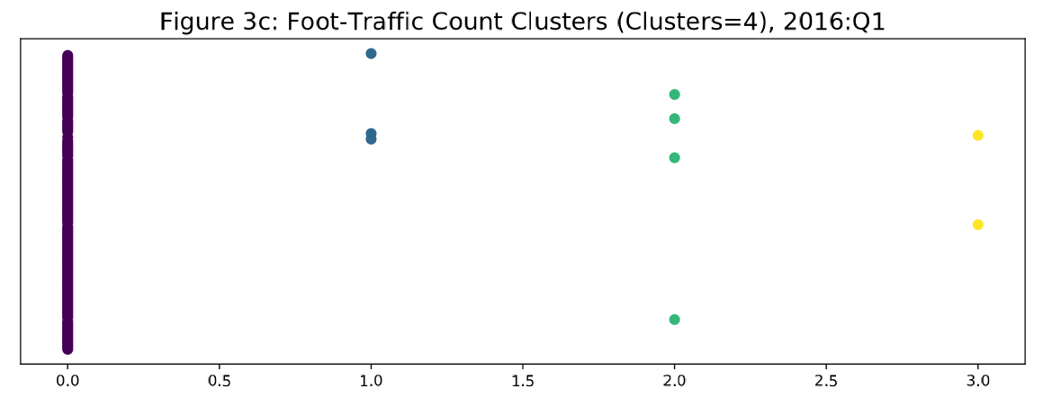
Clustering (Cont’d)

Slide 10
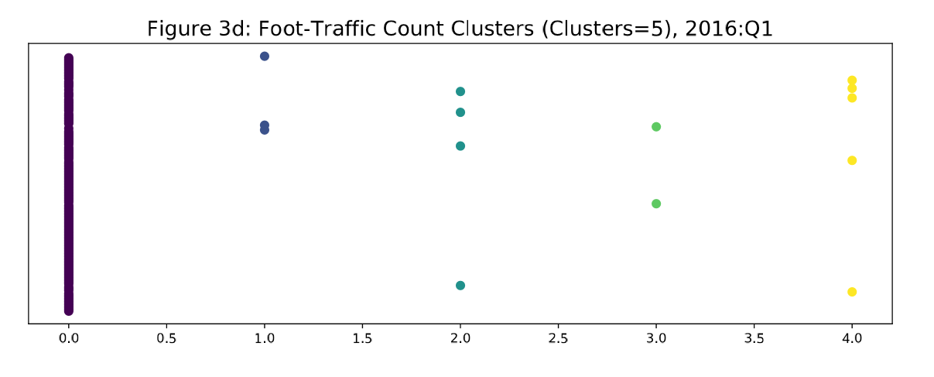
Clustering (Cont’d)

Slide 11
Stock Analysis – Time Series
Pending

