Slide 1

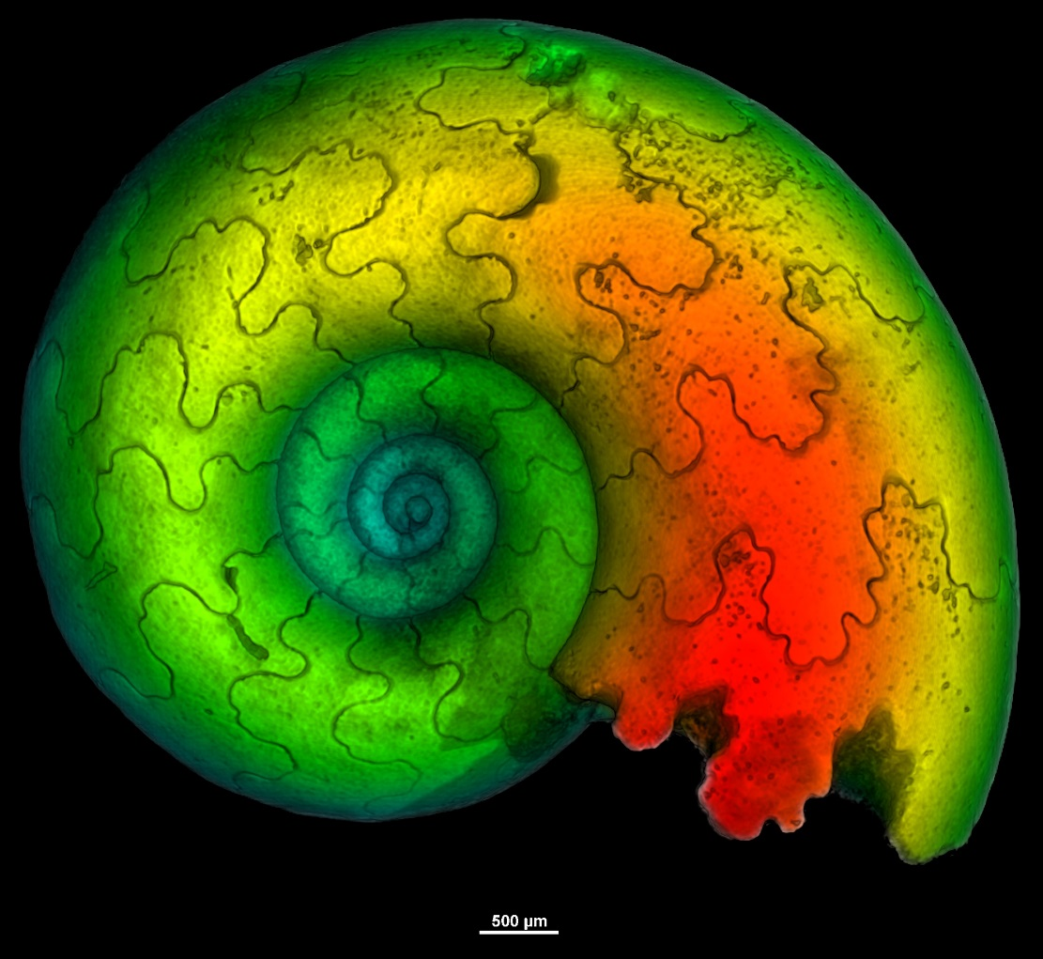
The Fast Azimuthal Integration Python library
Giannis Ashiotis, Jérôme Kieffer
ESRF, 71 avenue des Martyrs, 38000 Grenoble, France
PyFAI is an open­source software package designed to perform azimuthal and radial integration and, correspondingly, 2D­regrouping on area detector frames for SAXS, WAXS and XRPD experiments. It is written in Python, a language widely accepted and used by the scientific community today, which enables the users to easily incorporate the PyFAI libraries into their processing pipeline. We present recent work which focuses both on the accuracy of the results and execution speed.
Introduction
Scientific posters
Experiment Description
PyFAI offers 40 detector definitions (Pilatus, Maxipix...)
Support for opticaly coupled CCD detectors w/ geometric distortion correction
Custom definitions following NeXus convention
sample-detector distance
PONI
3D rotation of detector
Binning of detectors → larger pixel size
This document acts as a loose template from which to design your posters, elements can be cut pasted, duplicated and re-arranged.
PowerPoint
PowerPoint is not a print design or layout tool but is easily accessible to all members of the ESRF.
Because of this you will experience a number of differences between the on screen view and your final output.
The main differences will be colour related, but you may also get pixilation of images that are designed for screen, this will be especially noticeable when printing in large formats (A0, A1, A2).
Colours
Using the colours specified in the ESRF corporate identity guidelines will help posters look coherent with other ESRF material.
The use of rows and columns of colour will help the audience to navigate through the content of a poster. This can also help to designate areas for results and conclusions. Not using bright background colours such as yellow will mean that the posters look more professional, and be easier to read.
Typography
Do not mix different fonts on the same poster. Arial is the recommended font for posters.
Clean and simple typography is specified so that it doesn’t clash with the content. Large areas are given for the introduction and heading.
Layout
Content should be displayed in rows or columns and not a combination of both. The use of 2 or more columns works well. Try to keep elements aligned to a grid system, this will improve the clarity of your poster.
Try to maintain a good proportion of white space on your poster – it will improve lisibility and attractivity.
Imagery
Do not use Clip art or Word art. Keep images within squares or rectangles. Avoid rounded corners.
This is the footer area, used for references and acknowledgements.
ESRF – The European Synchrotron - 6 rue Jules Horowitz - BP220 - 38043 GRENOBLE CEDEX - FRANCE - Tel +33 (0)4 76 88 20 00
Notes:
<number>

