Slide 1








12.11.2025
Titre de la présentation sur 2 lignes de texte maximum
FASC – Avancée projet
Sous-titre ou nom de la personne

Slide 2



Method – General overview
PRODUCTION
DEMAND
Self-sufficiency?
NYMBY?
Relocalisation scenarios?
Energy
Cu, Co, Li, Ni, C, Nd
Material intensity DB
EVs
2 production scenarios:
-Existing production
-Potential production

Slide 3
Method – General overview
1) Production scenarios from Canadian Climate Institute
2 scenarios: existing production and production potential
6 metals covered: Cu, Co, Ni, Li,
Yearly data 2020-2040
2) Scenarios from Canada Energy Regulator
3 scenarios: current measures, Canada net-zero and Global net-zero
Energy sector
Yearly data 2020-2050
3) EVs calculation
EV sales in Canada in 2024 by mode and powertrain (from IEA)
Average size of vehicles (from SAQ)
Battery capacity (mixed sources) and battery chemistry mix (IRENA)
4) Material intensity
From Penelope + CCS from Watari et al. 2019

Slide 4
Method – Scenarios
1) Production scenarios from Canadian Climate Institute
Existing production: production forecasted by mines currently at the production stage
Production potential: production forecasts from mines at the feasibility, preproduction or production stage
2) Scenarios from Canada Energy Regulator
Current Measures: Limited action in Canada to reduce GHG emissions beyond measures in place today and does not require that Canada achieve net-zero emissions
Canada Net-zero: Canada achieves net-zero emissions by 2050 but rest of the world moves more slowly to reduce GHG emissions.
Global Net-zero: Canada achieves net-zero emissions by 2050 and the rest of the world reduces emissions enough to limit warming to 1.5°C, by 2050
Notes:
For "production potential", we gathered production forecasts from mines at the feasibility, preproduction, or production stage (which we've internally referred to as the Post Feasibility Production Pathway). We also took the ratio of market-share-to-reserves of leading critical mineral producing countries, applied it to Canada's reserves, then applied the market share to 2040 demand in the IEA APS pathway, and finally backfilled from 2040 to 2022 using an exponential growth function (which we've referred to as the Leading Market Share Production Pathway). The "production potential" is whichever was higher in that year - generally the Post Feasibility Production Pathway potentials were higher in the first few years, and the Leading Market Share Production Pathway potentials were higher in later years.

Slide 5
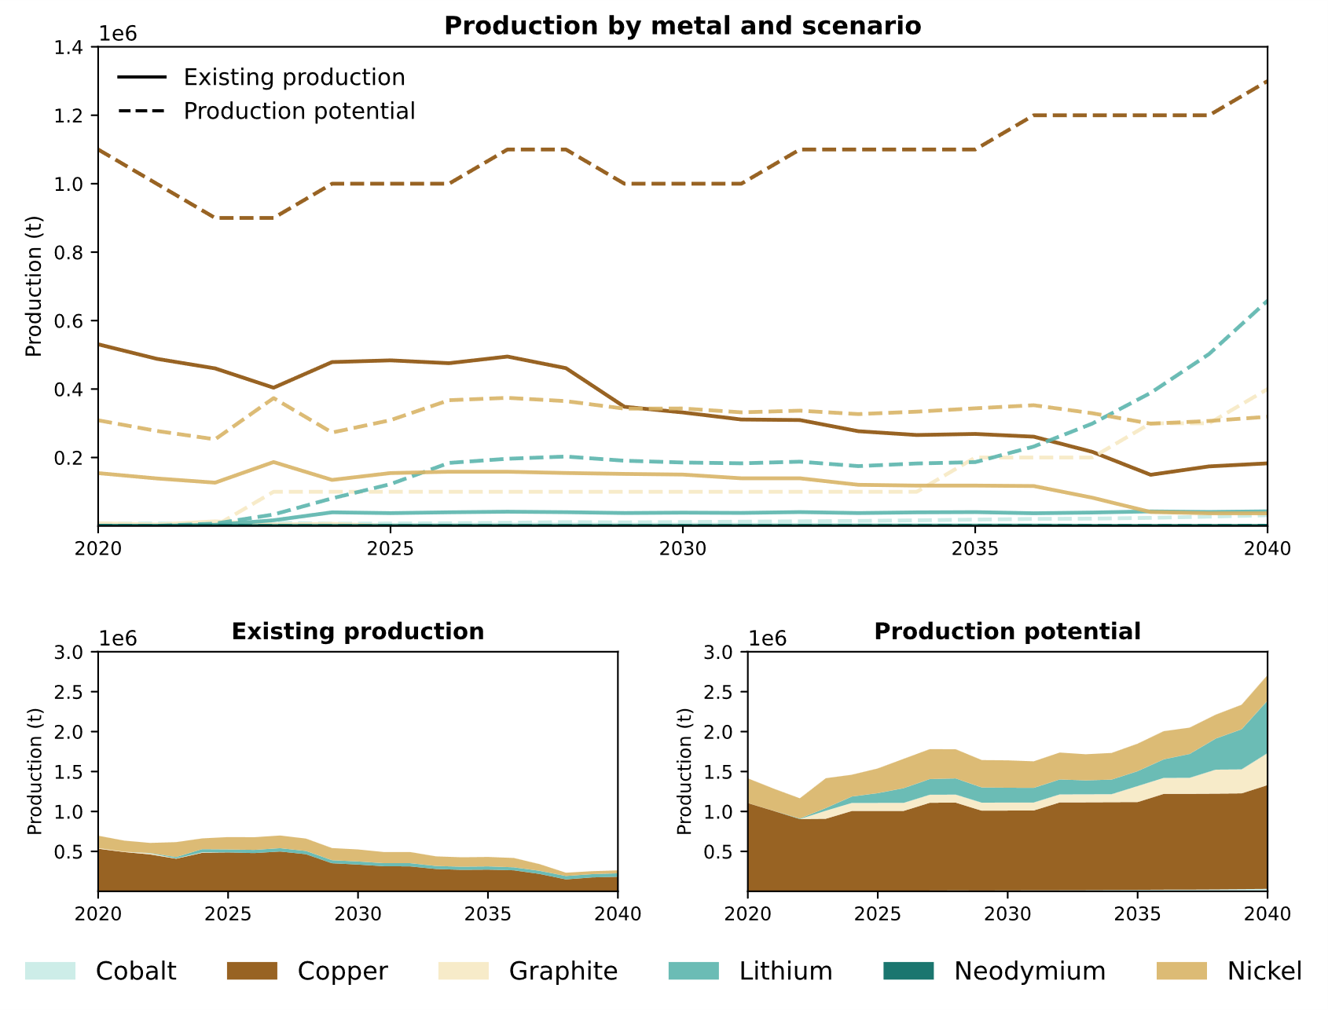
Results – Production scenarios
In metal recoverable,
Later multiplied by production yield from Chartier-Poncelet et al (2022) to compare with metal in finished products

Slide 6
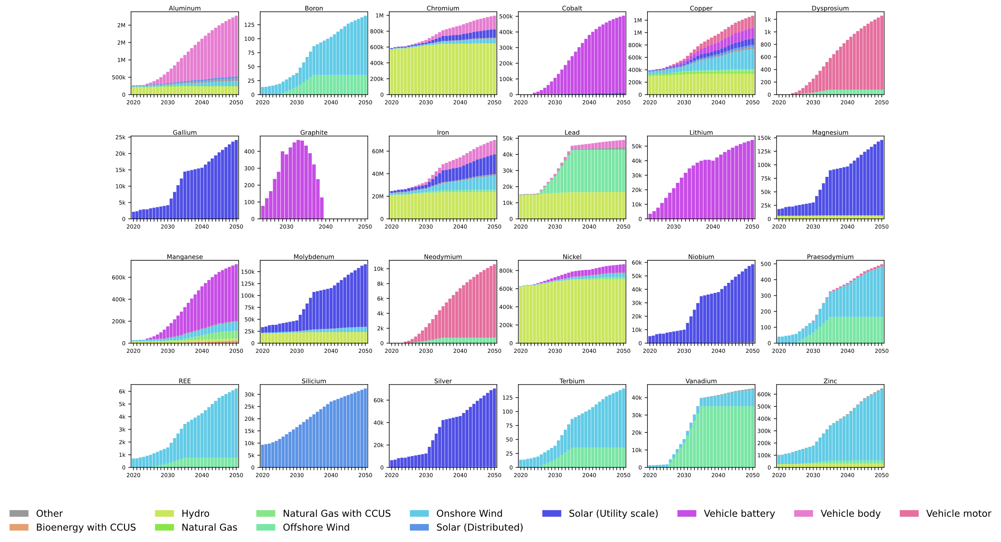
Results – NZ scenario

Slide 7
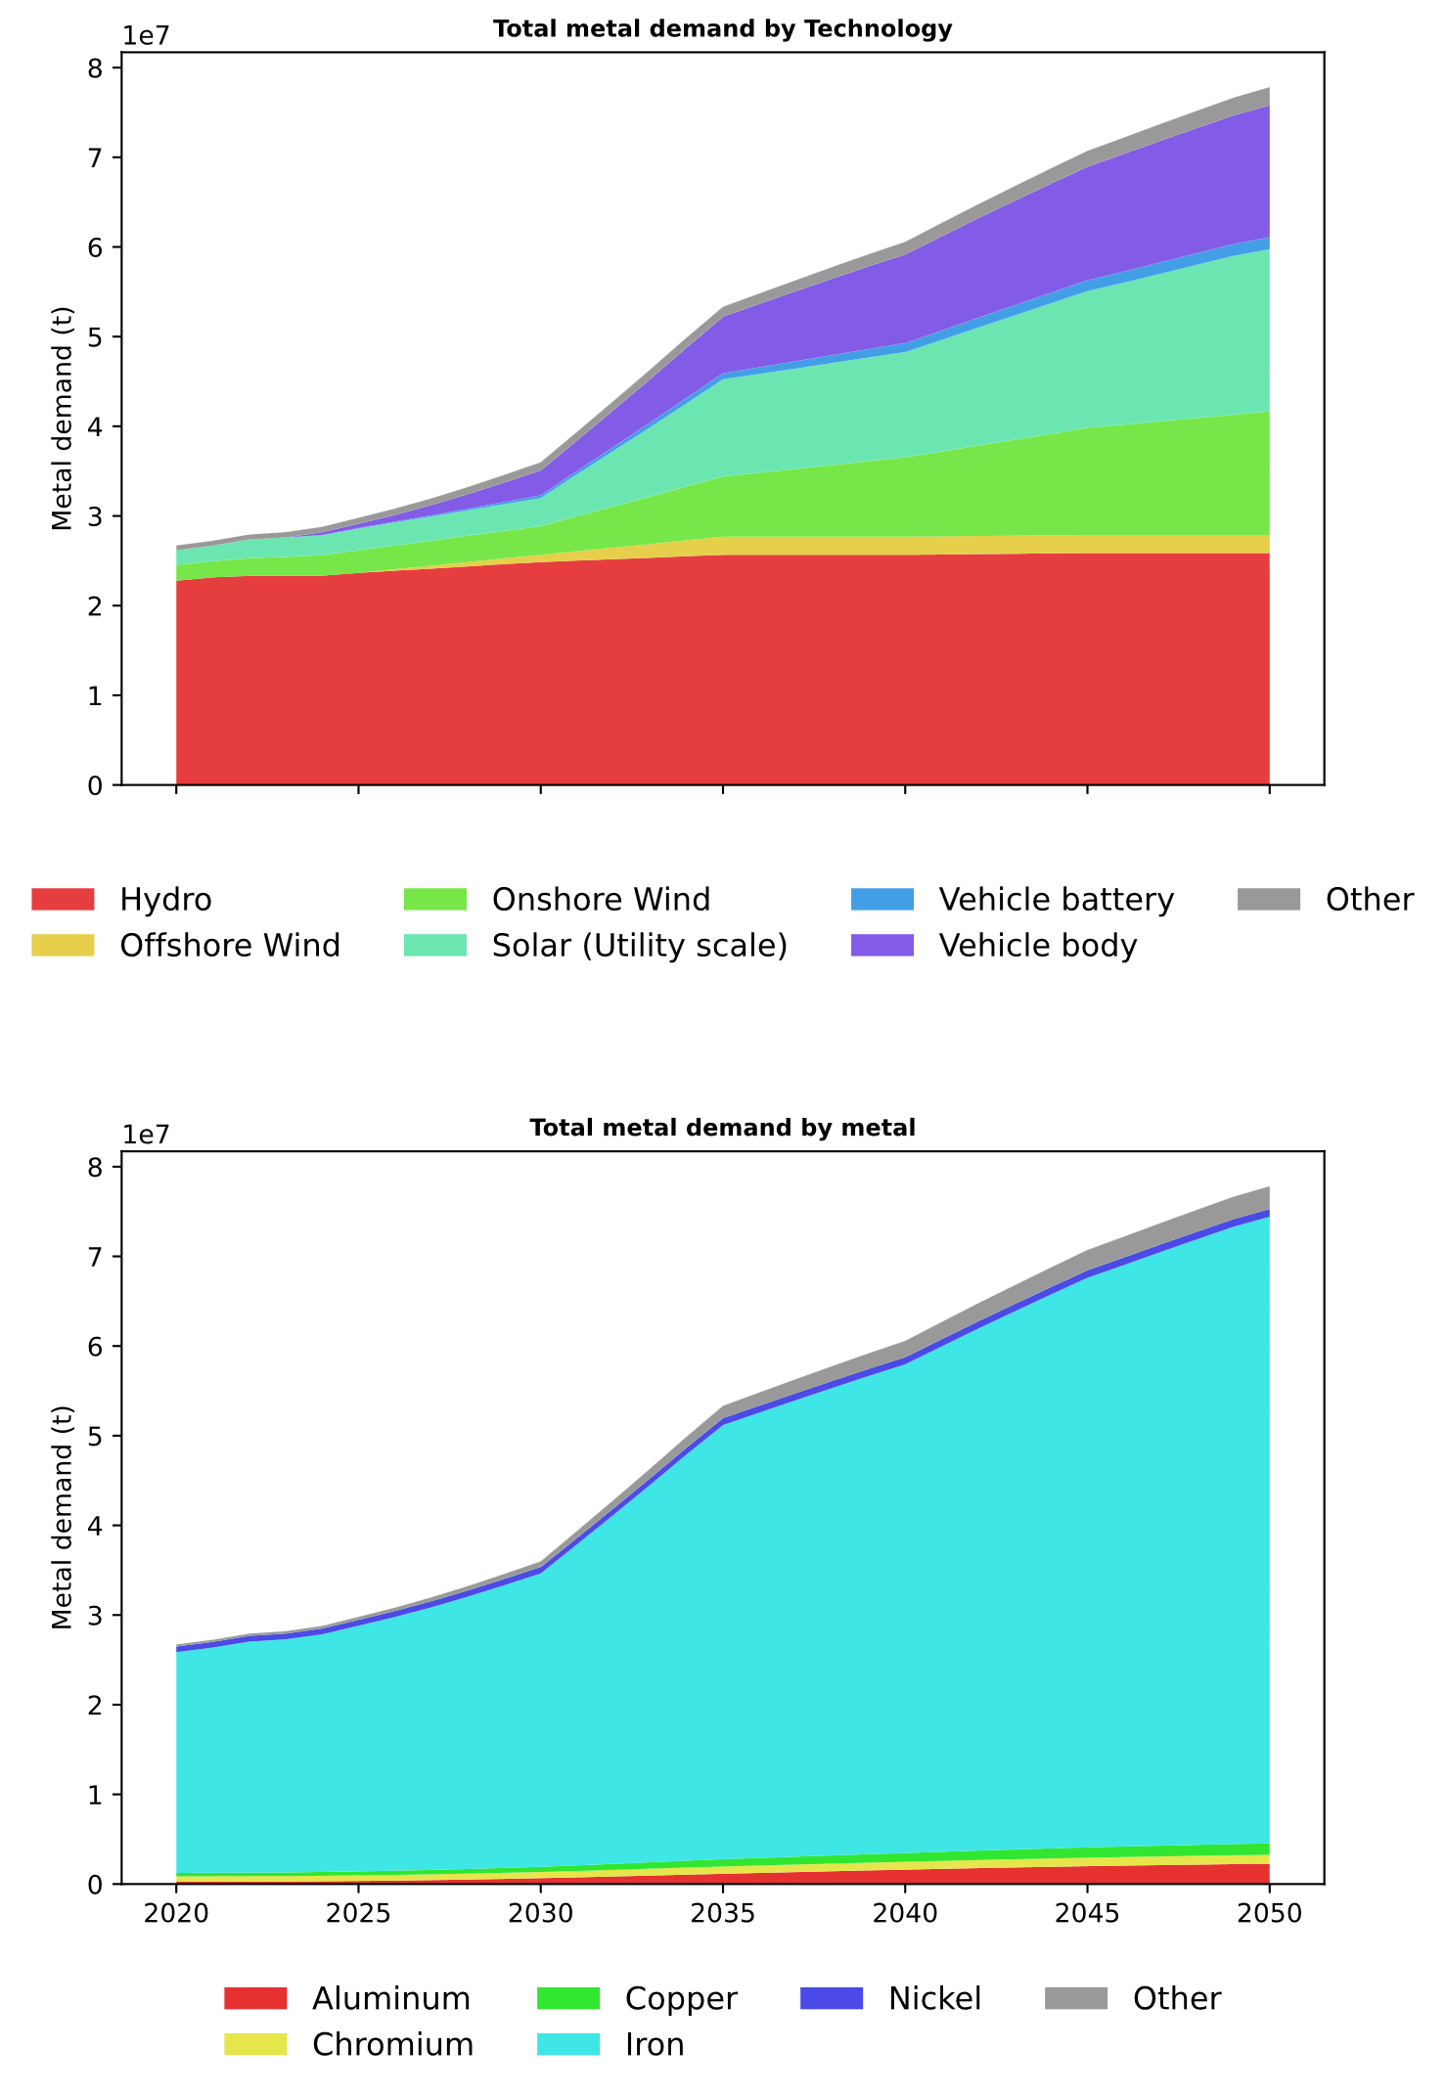
Results – NZ scenario (with iron)

Slide 8
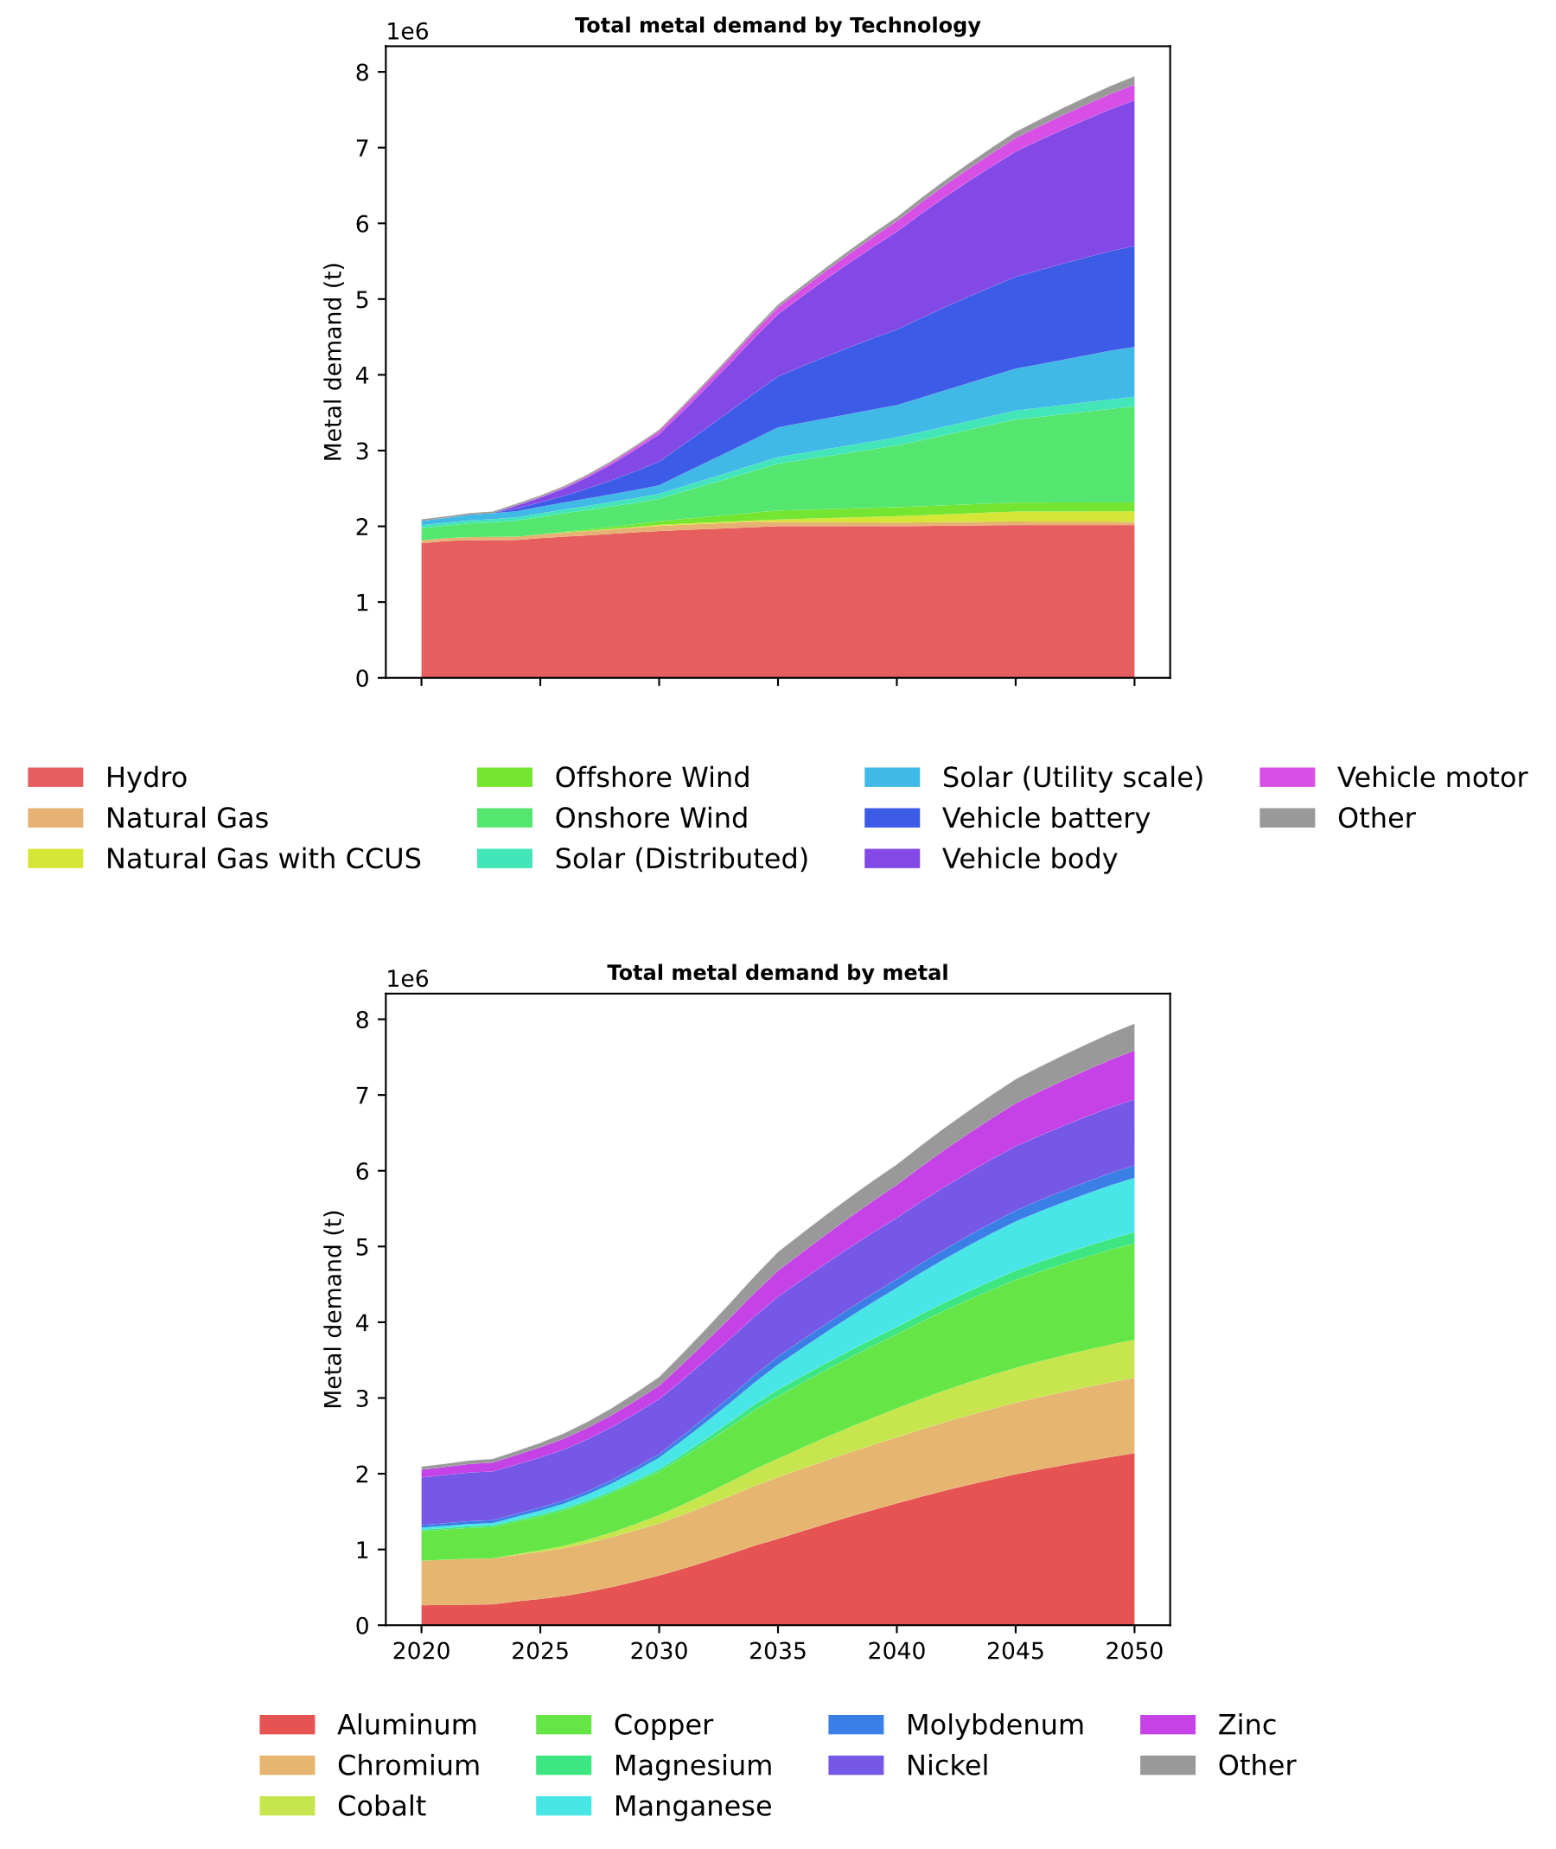
Results – NZ scenario (without iron)

Slide 9
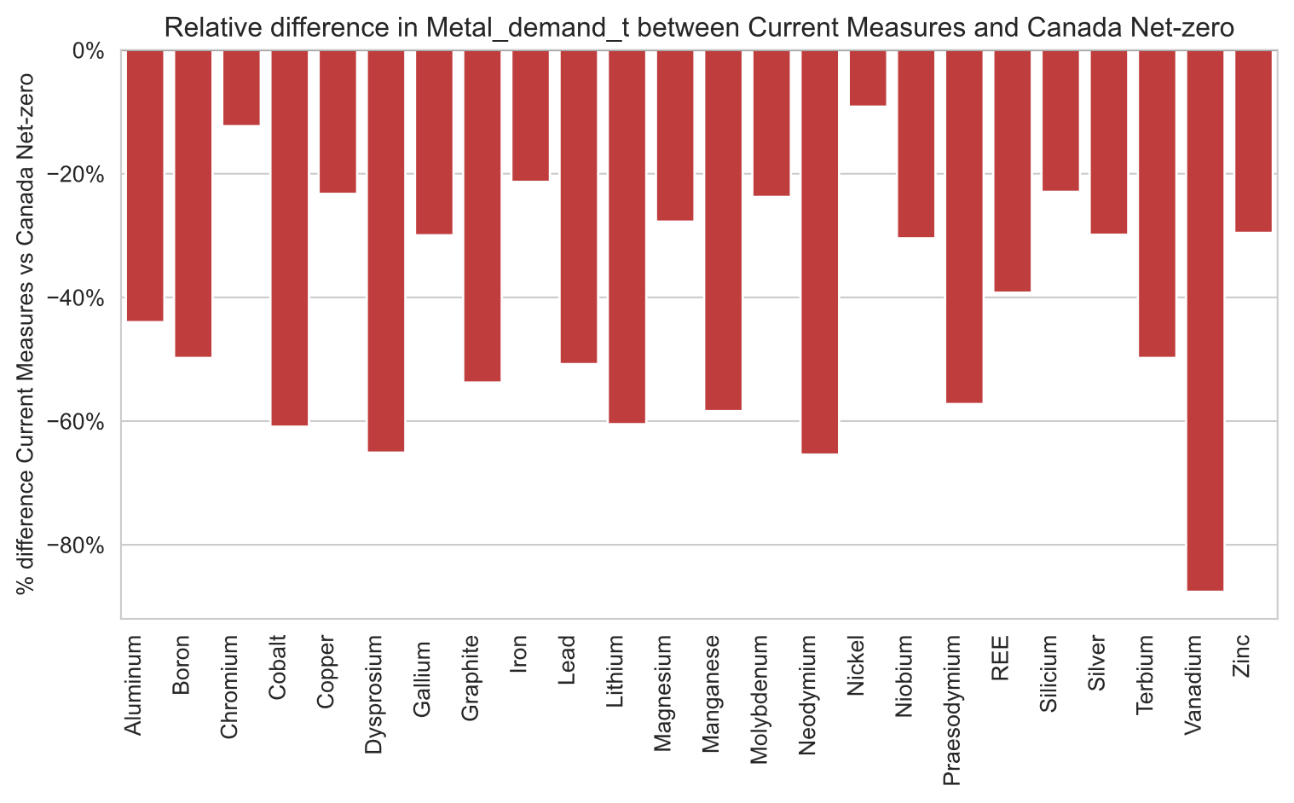
Results – Current measures vs NZ

Slide 10

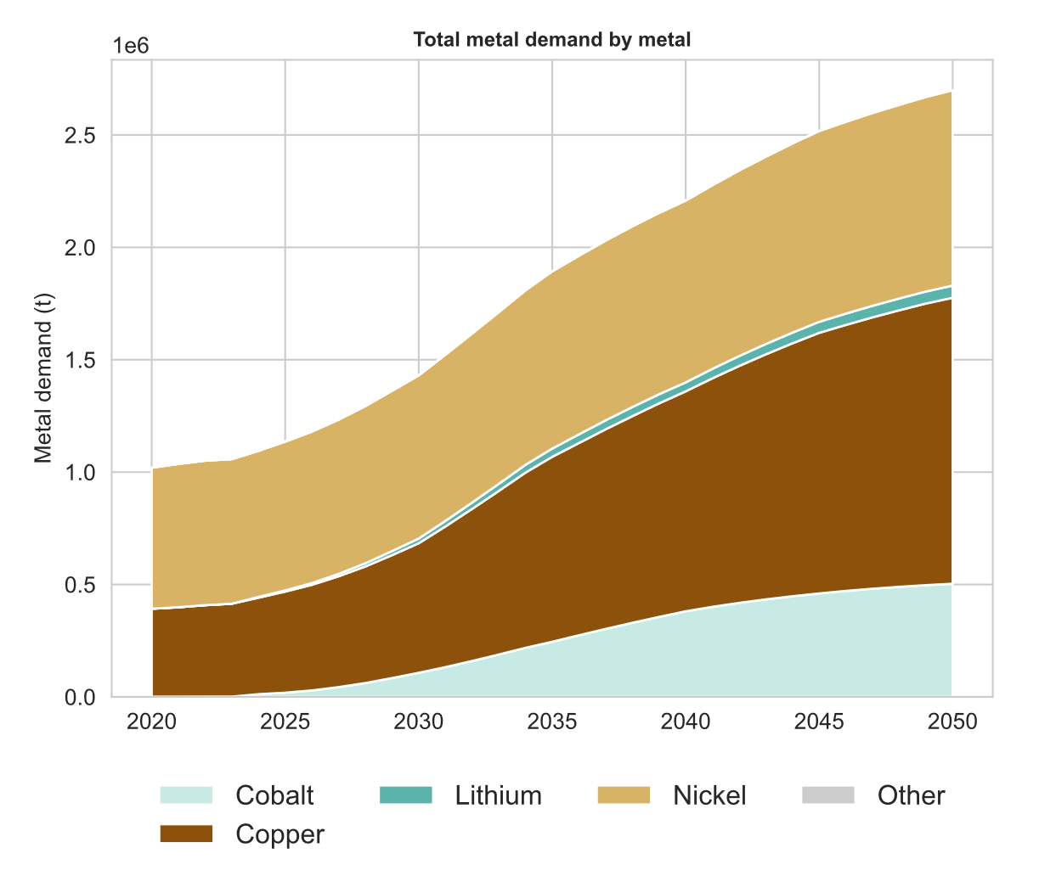
Results – Production vs Demand for selected metals
PRODUCTION
DEMAND

Slide 11
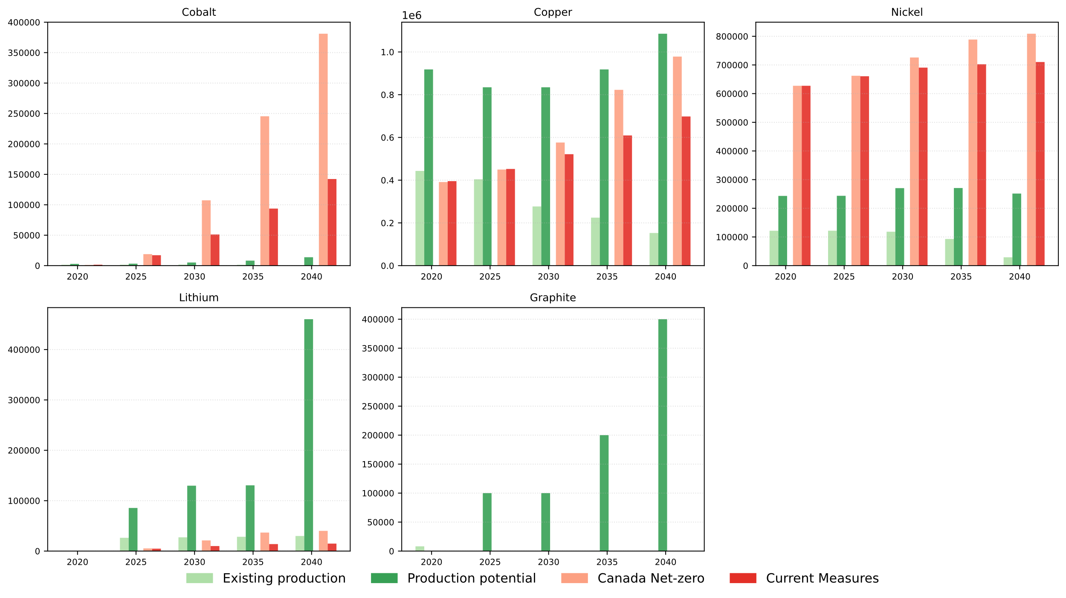
Results – Production vs Demand for selected metals
Graphite and lithium
only in vehicle battery,
but still strange?

Slide 12
Results – Production vs Demand for selected metals
35% difference Co
30% difference Cu
23% difference C
63% difference Li
-0.15% difference Ni

Slide 13
Discussions
1) Quels ICVs associes?
CA LCIs for the production scenarios (not available for all)
Quel IAM pour premise?
Pbm de computational power pour regiopremise avec bcp d’annees
2) Limites
Production scenarios not so good
Grid pas couvert
Hypotheses non prospectives sur le poids, battery capacity
Pas d’ameliorations des material intensity
3) Manque
Scenario d’impacts evites avec LCIs pour raffinage?

Slide 14
2. 2nd meeting

Slide 15
Key points
Integration du grid
Chiffres Titouan vs Kalt et al (2021)
Wind MV gros contributeurs
Graphite
Tjrs gros écart production vs demand, meme avec un production yield = 33%
Gros impact Cu et Ni
Graphite et lithium uniquement dans battery Evs, Neodymium dans Wind et
Premise vs Regioinvent
Pbm de temps et computational time
Creation de marché dans premise, peut être suffisant avec simplement version regionalized de ces DBs

Slide 16
Focus on grid
Chiffres issus de Deetman et al (2021) et Chen et al (2023)
Grid MV gros contributeurs
Wind à recheck?
Kalt et al (2021)
Transmission grid et distribution grid en km
IEA
Grid = 45-61% de la demande en Cu des clean technologies dans Net Zero Scenario,

Slide 17
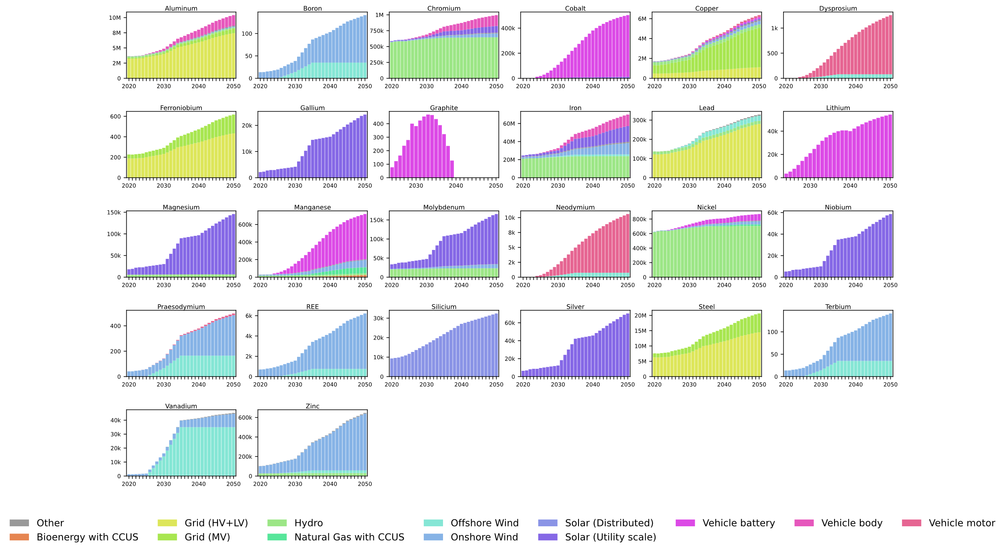
New results with grid

Slide 18
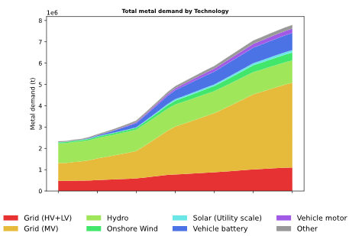
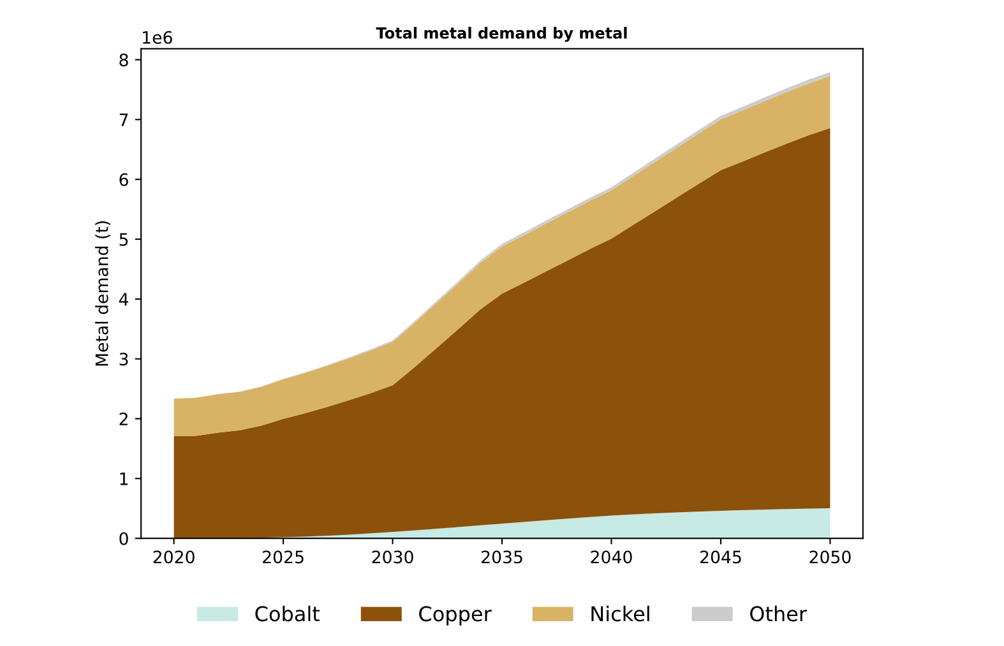
New results with grid

Slide 19
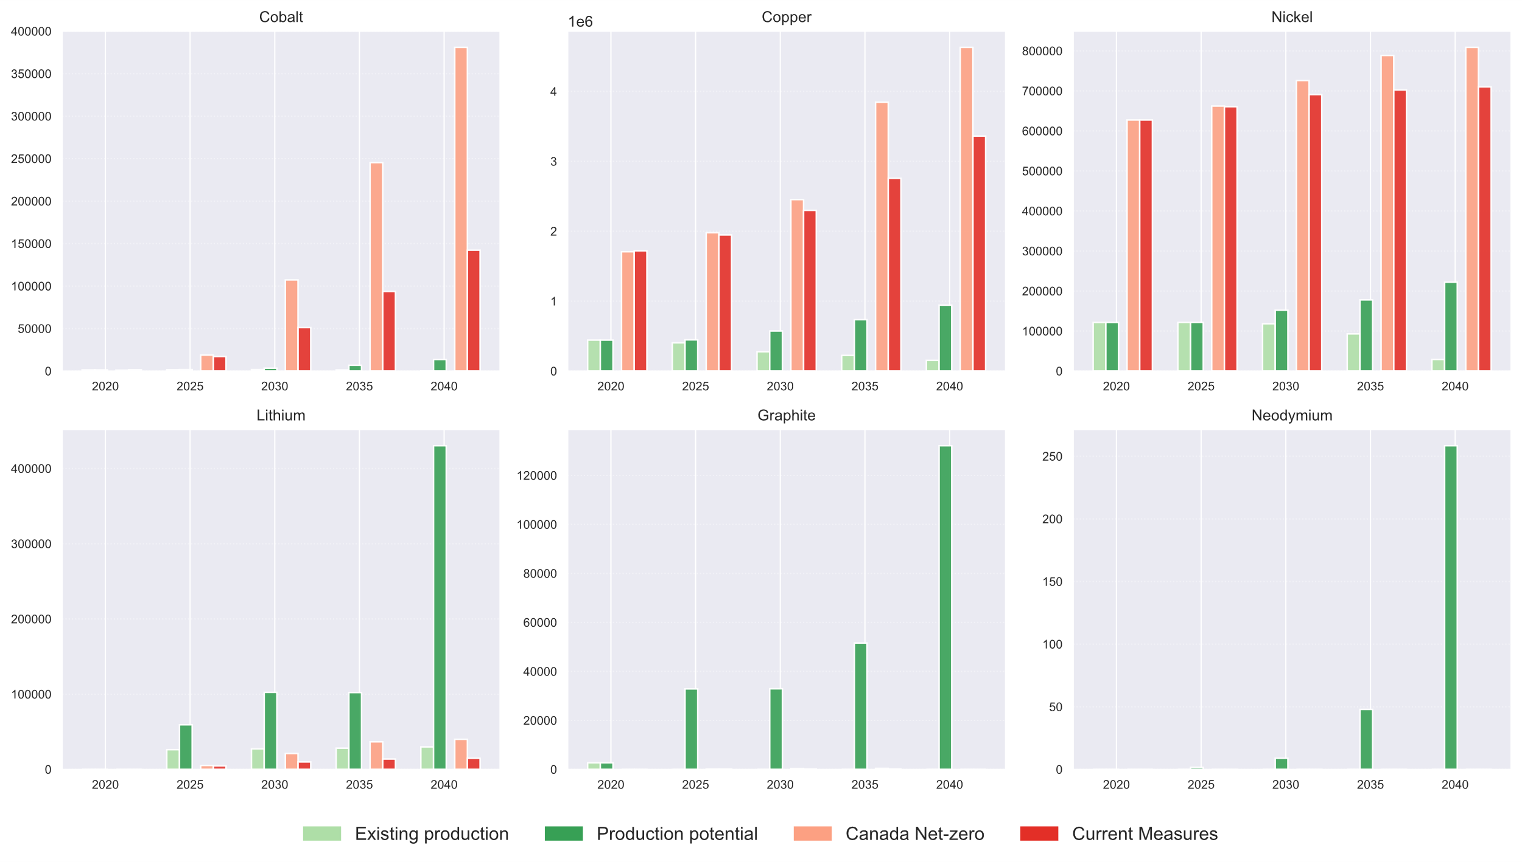
Results – Production vs Demand for selected metals

Slide 20
2023 production data calibration

Slide 21
3. Meeting 14/01/26

Slide 22
Grid
Old approach
t/km * km/GW from Titouan
Scope: HV + MV + LV for lines, substation and transformer
Results: > 75% demand for Cu is for grid (mainly MV), more than 80% Al and Pb is for grid (respectively HV+LV and MV)
Rationale for prospective: grid is capacity-dependent (eg km = a * GW).
Kalt et al
For 2017 from Kalt et al (2017): Circuit-length km transmission and distribution grid, Giga Volt Ampere (GVA) for transformers for Canada for 2017 → we multiply both to get t of steel, aluminium, concrete and copper
Rationale for prospective: stock-driven; grid is not capacity-dependent. In Kalt et al (2022), transmission grid length regression model based on electricity generation technology, population with access to electricity, and distribution grids. BUT only given per world regions every 10 years, not open access

Slide 23
Grid – proposed approach
We derive circuit-length km/GW and GVA/GW in 2017 from Kalt et al and StatCan
We multiply them with MI from Kalt et al
Rationale for prospective: grid is capacity-dependent (eg km = a * GW).

Slide 24
Grid – literature review
“Transmission lines, transformers, and substations require significant Al, cement, Cu, and steel, but these requirements are smaller than electricity generation infrastructure needs. From 2020 to 2050, we estimate that transmission infrastructure drives cumulative demand for Al and Cu that is less than half of that needed for generation infrastructure. For cement and steel, cumulative demand in 1.5 C scenarios is around a sixth and a quarter of generation infrastructure needs, respectively. Annually, Al and Cu consumption in transmission networks is less than half of corresponding requirements in power sector generation infrastructure. These are idealized estimates that do not account for several potentially important sources of error, in particular the varying transmission requirements of different electricity generation technologies. This method likely underestimates transmission material demand for scenarios with a high proportion of wind and solar generation.” Wang et al (2023)
“The expansion of transmission grids also contributes to the rising metal demand but is clearly less relevant than the material requirements for power plants” Kalt et al (2022)

Slide 25
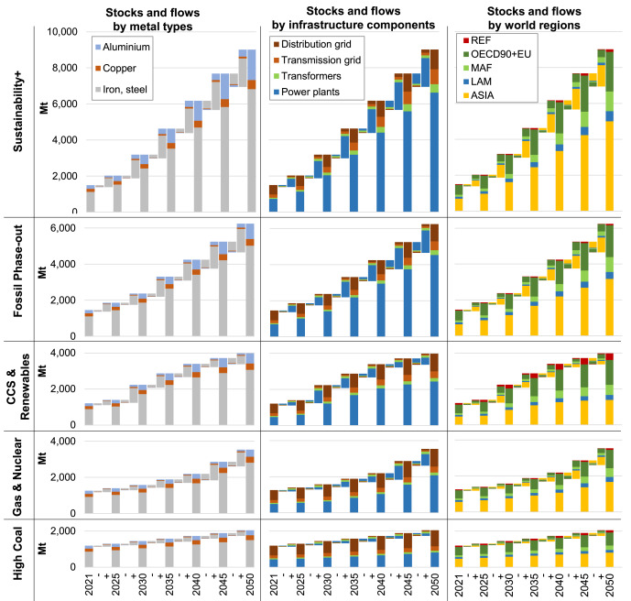
Grid – literature review (from Kalt et al. 2022)

Slide 26
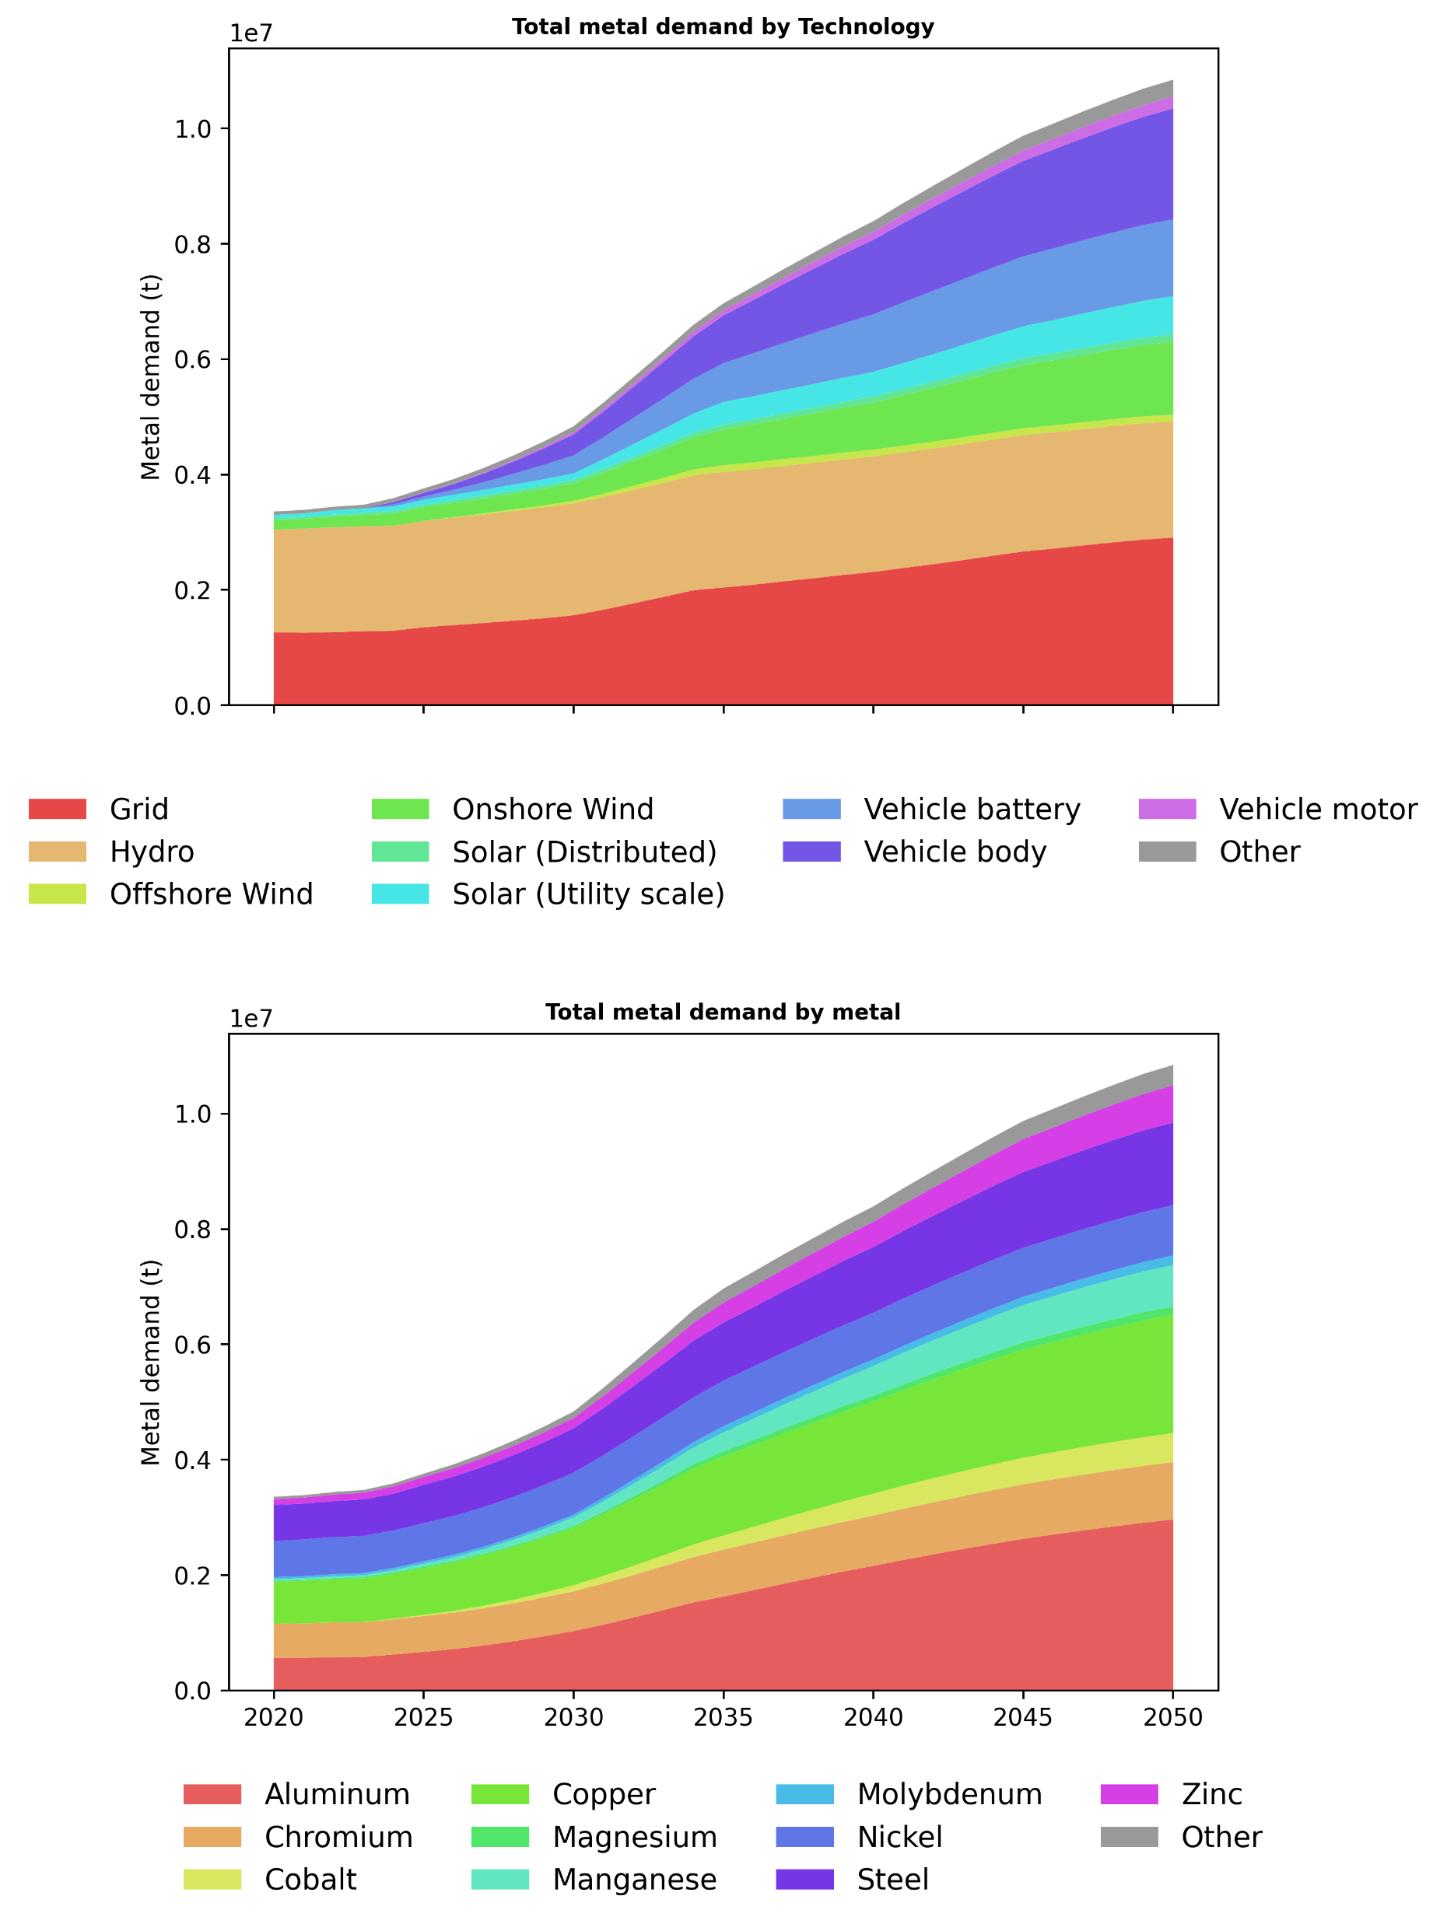
New results (without iron and concrete)

Slide 27
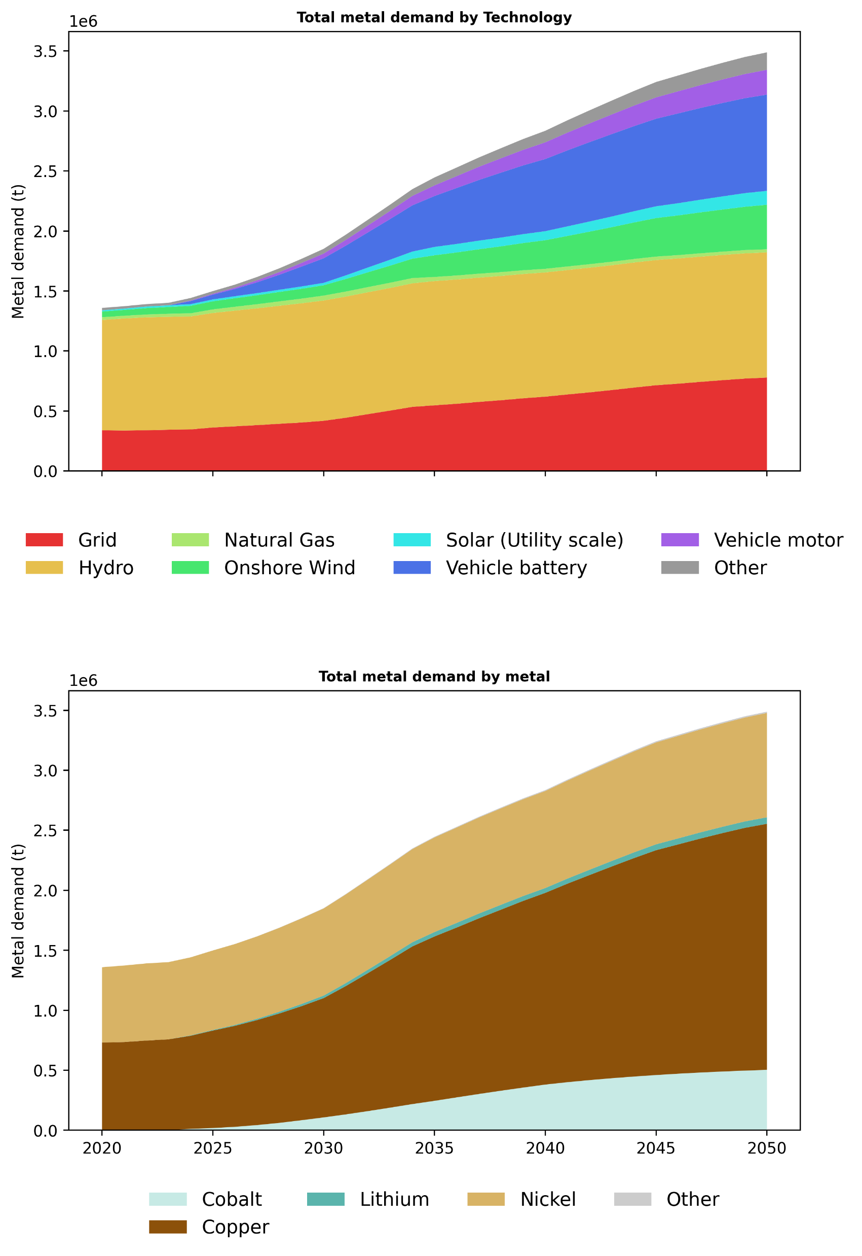
New results (focus on 6 metals)

Slide 28
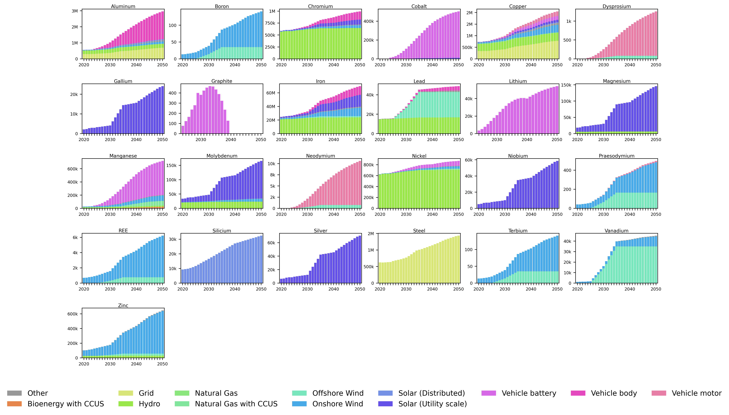
New results

Slide 29
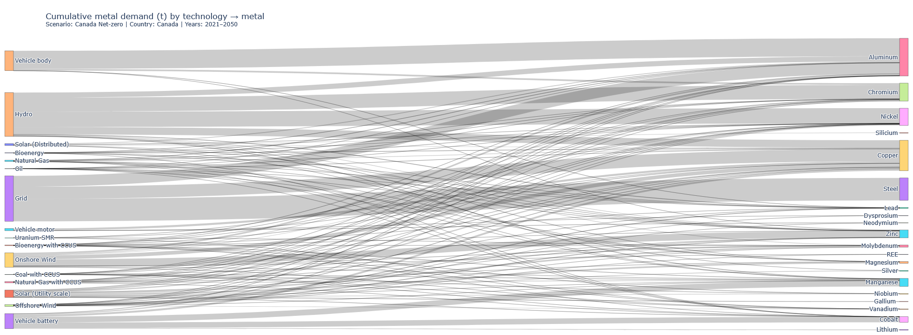
New results - Cumulative

Slide 30
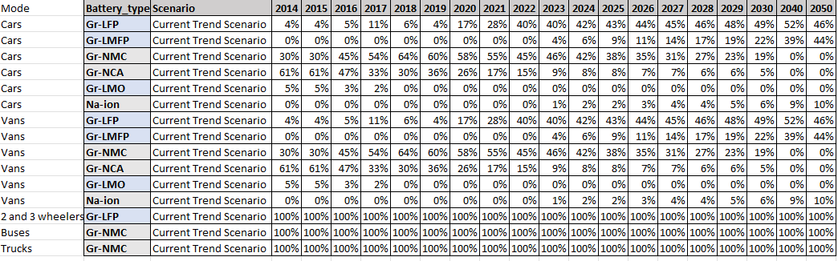
Issue with graphite stopping in 2040
MI from Pénélope gives graphite only for vehicle battery, for Na-NiCl, NCA and NMC sub-technologies
Battery chemistry mix taken from IRENA, where those sub-technologies stop in 2040

Slide 31
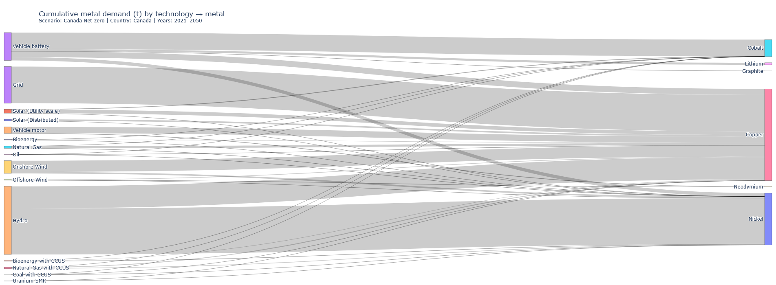
Issue with nickel MI in hydropower
MI for hydro nickel from Pénéloppe seems very high
Nickel Institute gives a ‘low’ importance of nickel for hydroelectricity
Nickel in hydro = appears mainly in stainless / corrosion-resistant steels used for parts in contact with water (turbine runner, wicket gates, shafts, sometimes some piping), and in some specialty alloys.

Slide 32
Issue with nickel MI in hydropower
MI for hydro nickel from Pénéloppe seems very high (source = Open LCA analysis…). No value to compare (no Ni in Titouan’s article)
Nickel Institute gives a ‘low’ importance of nickel for hydroelectricity
Nickel in hydro = appears mainly in stainless / corrosion-resistant steels used for parts in contact with water (turbine runner, wicket gates, shafts, sometimes some piping), and in some specialty alloys.

Slide 33
Refining sites with production data in MetalliCan
Copper Cliff Complex (smelter and refinery) = Ni-Cu smelter and refinery = Pyrometallurgy at the smelter, then hydrometallurgy + electrorefining at the refining stage.
Long Harbour (refinery) = Ni hydrometallurgical refinery
Sudbury (smelter) = Ni-Cu smelter = Pyrometallurgy in Canada, with final refining done in Norway
The Cobalt Refinery Company Inc (refinery) = Ni and Co hydrometallurgical refinery, concentrate from Cuba
Next steps = classification of LCIs extracted from Lai et al (2025) (+ extraction of Roy et al (2025)

Slide 34


Merci!
Questions?
ciraig.org

