Slide 1








07.02.2025
Titre de la présentation sur 2 lignes de texte maximum
Data availability review for mineral sustainability assessments
Marin Pellan
Sous-titre ou nom de la personne

Slide 2




Overview of data linked to metal sustainability assessments
National
pollutant
inventory
GHG
for
large
facilities
USGS
BGS
WMD
NRCan
StatCan
Land
occupation
data
TROPOMI data
Energy
consumption
by sector
CMMI
Company reports
Deposit
data
Site
data
Aggregated-
site
data
National
data
Global
data

Slide 3



Source ID
Material
ID
MAIN
TABLE
MinCan
PARENT ENTITY
TABLE
Indigenous land (proximity)
Climate categories
Pollution
(air, water, soil)
Land occupation
Population density
Water risk
GHG emissions
Land category
Ownership
Production
Protected areas
(proximity)
Environmental Atlas Justice
Tailings
Potential natural vegeration
Reserves
Technical
Peasant land
(proximity)
Energy
(Social)
GHG
Water
Tailings
Historic
Static
Prospective
Clustering
Buffer

Slide 4
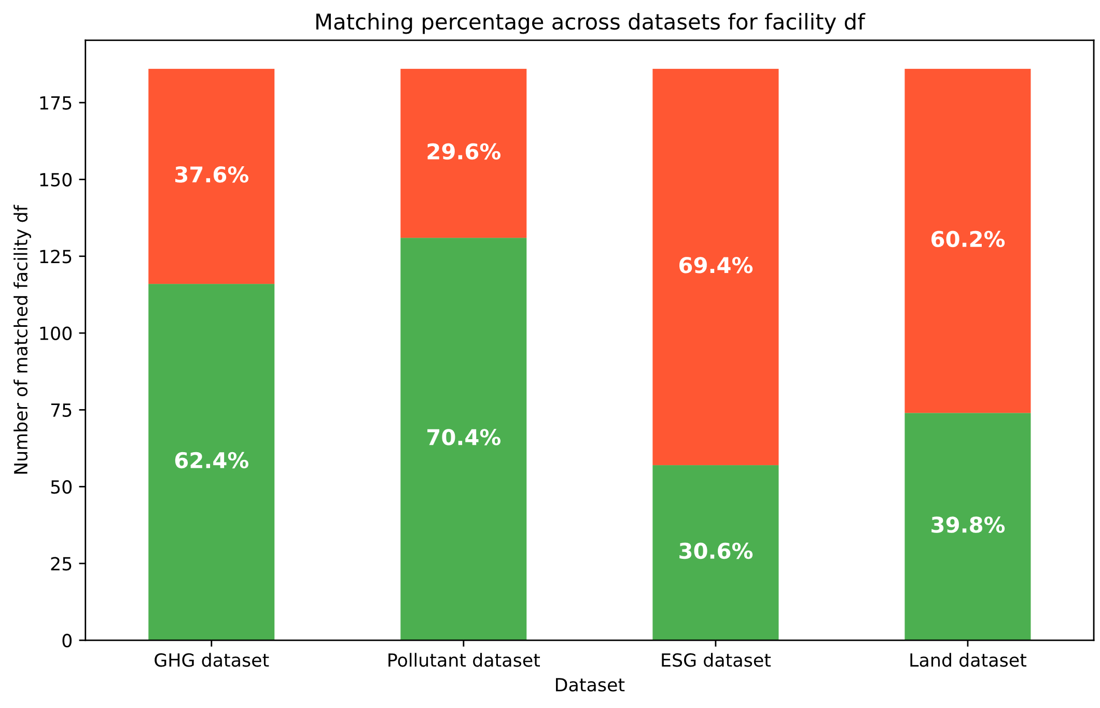
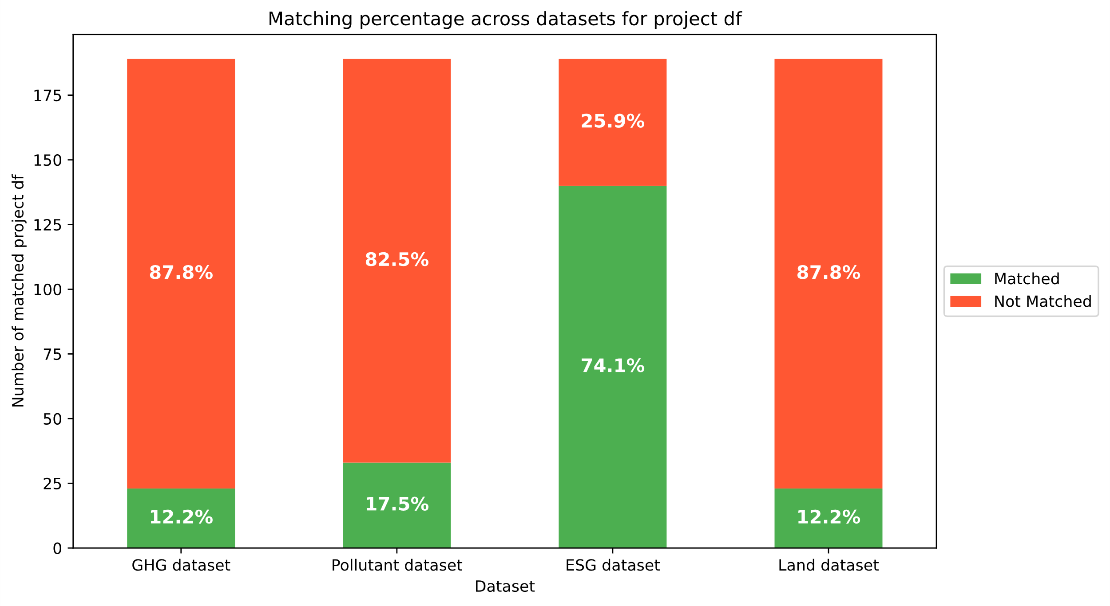
4) Database: matching results

Slide 5


Merci!
Questions?
ciraig.org

