Slide 1
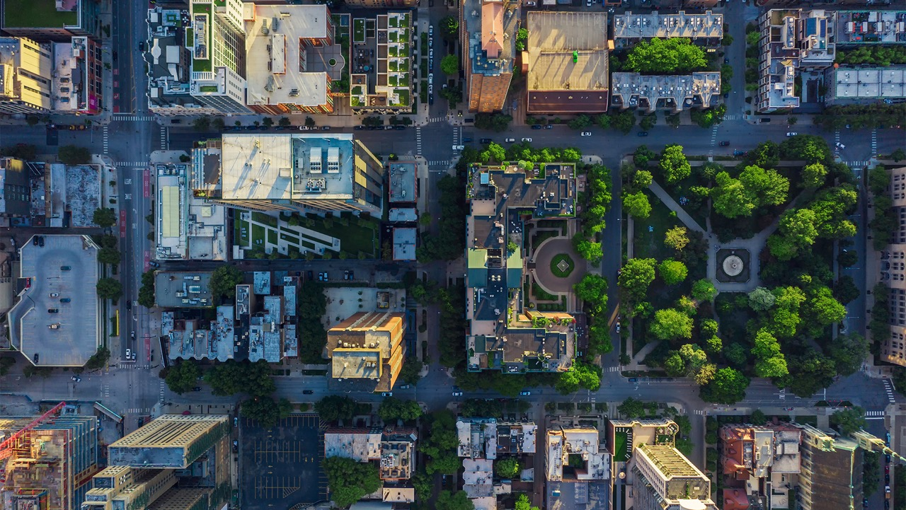







04.2025
Titre de la présentation sur 2 lignes de texte maximum
MetalliCan and its application in LCI
Marin Pellan
Sous-titre ou nom de la personne

Slide 2
MetalliCan database

Slide 3
Current research gaps, review and goal of the study
Research gap
ESG factors are increasingly recognized as significant sources of future supply risks (Jowitt et al, 2020: Lebre et al, 2020)
Site-specific factors affect environmental and social impacts: deposit type, ore grade, mining depth, tailing management… (Schenker et al, 2020)
LCI data: often outdated, lack of information on the different steps (mining, concentration, refining), lack of regionalized data
Scarcity of public and comprehensive database linking different datasets on metal-related production activities
Goal of the study
Develop a database to unify knowledge and data, designed mainly for use in LCI/LCIA, MFA, criticality, ESG and prospective studies with a system boundary = cradle-to-gate
A range of datasets can be linked to metal-related production facilities
Flexible architecture allows to add information, ultimately providing granular data for a range of analysis
Application
Canada, metals

Slide 4




Overview of data linked to metal sustainability assessments
National
pollutant
inventory
GHG
for
large
facilities
USGS
BGS
WMD
NRCan
StatCan
Land
occupation
data
Satellite data
Energy
consumption
by sector
CMMI
Company reports
Deposit
data
Site
data
Aggregated-
site
data
National
data
Global
data

Slide 5
Datasets and tables in MetalliCan
theme | table | table_description | data_source
 | MAIN | General information on the facilities and projects including a unique ID per facility | NRCan
sector | sector | NAICS sector names and codes of the facility | NRCan
ghg | ghg | Scope 1 GHG emission of the facility reported to StatCan | StatCan
pollution | pollution | Data from the National Pollutant Inventory Report (NPRI) | StatCan
land_occupation | land_occupation_maus | Surface of polygons given by Maus et al (2022) | Maus et al (2022)
land_occupation | land_occupation_tang | Surface of polygons given by Tang & Werner (2023) | Tang & Werner (2023)
land_category | npv | Natural Potential Vegetation, serving as proxy for baseline land-occupation | Hengl et al (2018)
land_category | land_category | 2021 land category | MODIS and ESA
water_risk | water_risk | Water stress, water depletion, interannual variability, groundwater decline, coastal eutrophication per scenario by 2080 | World Resource Institute's Aqueduct
population | population | Population data in 2025 and 2030 (Global Human Settlement Layer) | Joint Research Center and Copernicus
tailings | tailings | Location and type of tailings (construction year, current storage, etc) | Global Tailings Portal
historical | mincan | Historical dataset of mines in Canada | Dallaire-Fortin (2024)
climate_category | climate_category | Climate category data per scenario by 2100 | Beck et al (2023)
peatland | peatland | Peatland land | International Mire Conservation Group (IMCG), Greisfwald Moor Centrum
weather | weather | Temperature and precipitation data per scenario by 2100 | Canadian Downscaled Climate Scenarios-Multivariate dataset for CMIP6
indigenous_land | indigenous_land | Indigenous Land | LandMark
protected_areas | protected_areas | World Protected Areas | World Protected Areas
ownership | ownership | Ownership(s) and operator of the facility | Company and technical reports
production | production | Production data | Company and technical reports
reserves | reserves | Reserves and resources data | Company and technical reports
archetypes | archetypes | Deposit type, mining depth, mining/beneficiation/refining method | Company and technical reports
energy | energy | Energy consumption data | Company and technical reports
environment | water, waste, tailings | Environmental data | Company and technical reports
social | social | Social data | Company and technical reports
material_ids | material_ids | Unique IDs for each type of ore, materials etc
source_ids | source_ids | Unique ID for each data or information source
113 mines
73 manufacturing
142 projects
> 20 tables

Slide 6
Datasets and tables in MetalliCan

Slide 7





Datasets and tables in MetalliCan
Ore mined
Ore processed
Concentrate produced
Intermediate metal produced
Refined metal
➡️
📍
⚙️
🧪
Typical location
Typical location
📊
📏

Slide 8
Development of parametrized LCI from site-specific data

Slide 9
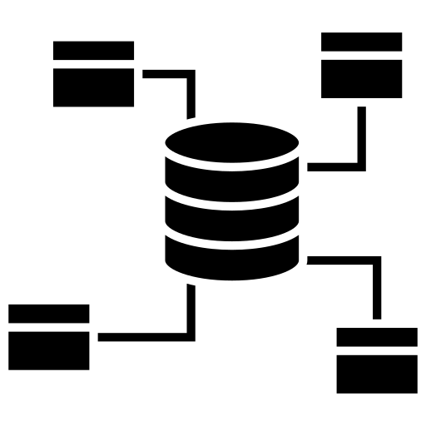











Overall methodology
Open-IO?
MetalliCan
LCI model
LCI blocks
Mining
Beneficiation
Refining
Import site-specific
parameters
MetalliCan
‘LCA-ready’
Parametrization
Data gap filling
Regionalization
and prospective
Biosphere and
technosphere
mappings
Export in BW2 format
LCIs comparison

Slide 10
Expected results for a specific commodity
Site-specific results
Market-weighted average
Environmental impact
Ecoinvent values
Open IO
Commodity x

Slide 11
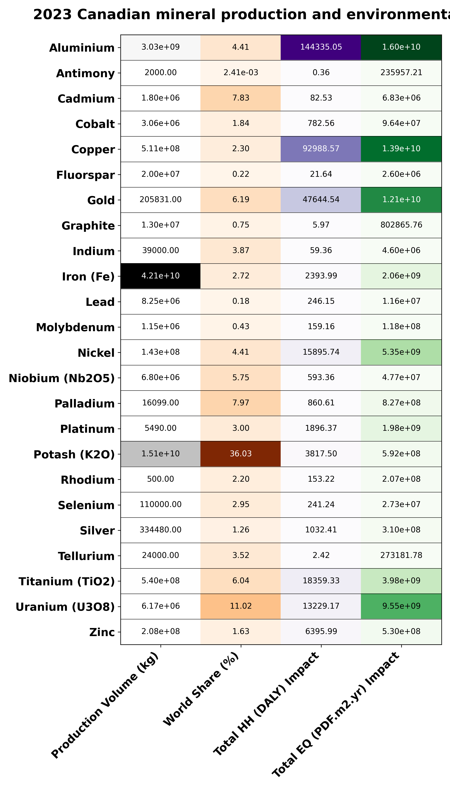
2023 production and environmental impacts in Canada
World share ~ >5%:
Aluminium
Cadmium
Gold
Nickel
Niobium
Palladium
Titanium
Uranium
High environmental impacts:
Aluminium
Copper
Gold
Iron (EQ mostly)
Nickel (EQ mostly)
Titanium (EQ mostly)
Uranium (EQ mostly)

Slide 12
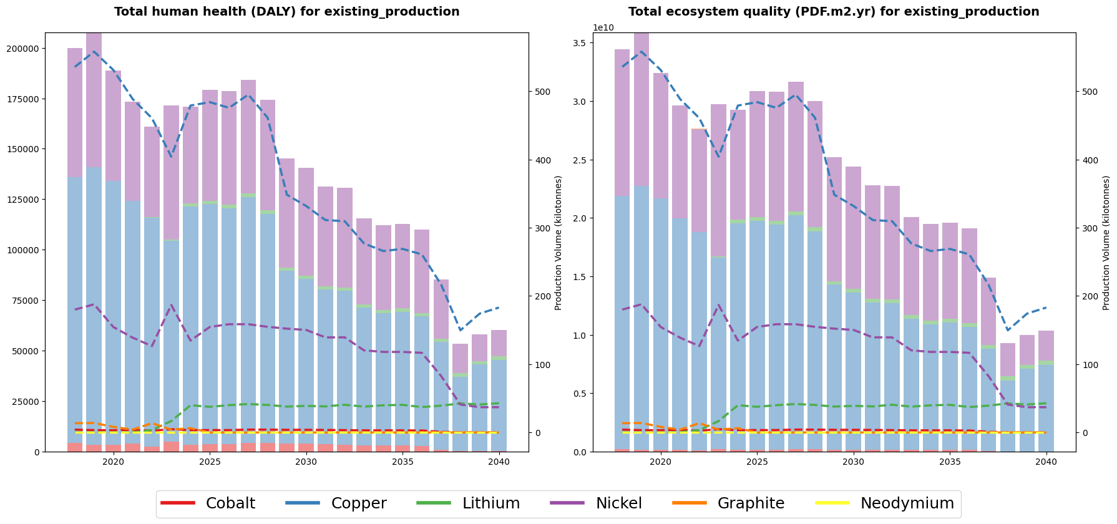
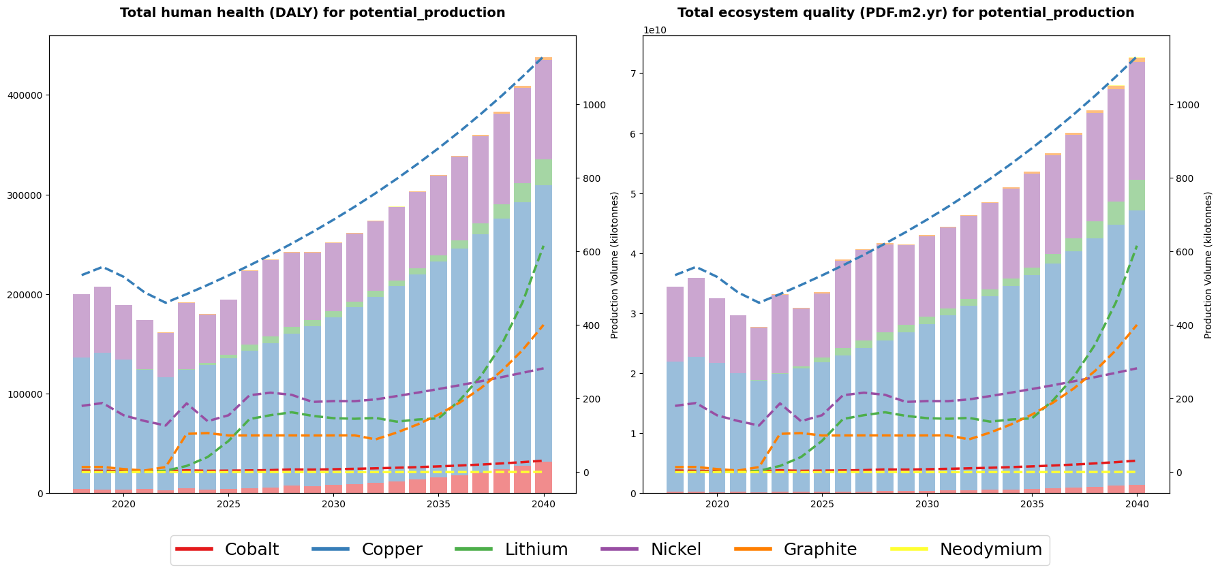
Canadian scenarios – existing and potential production (6 commodities)
Existing production
Potential production
Details of scenarios in Trottier-Chi, Calvin. 2024 https://440megatonnes.ca/insight/canada-critical-minerals-clean-energy-transition/.

Slide 13
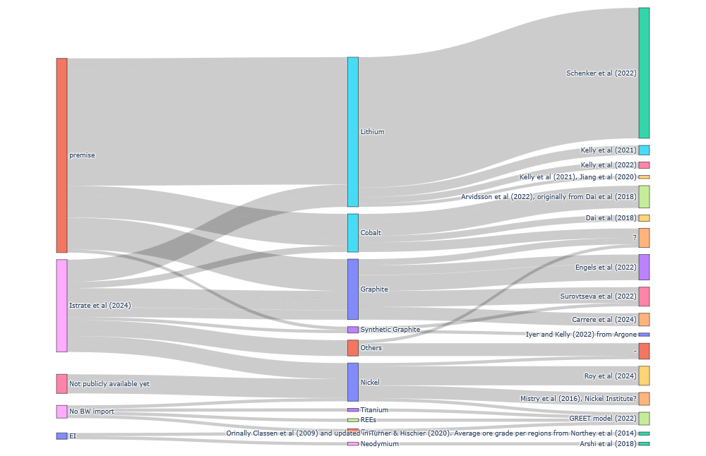
Metal LCI data availability – Imported from and original sources
Notes:
Issue of data availability and FAIR principles

Slide 14


Merci!
Questions?
ciraig.org

