Slide 1
RCN TOOLS
Agreement Checker
Elinor Ostrom's grammar of rules, as plain questions
a group can ask of any agreement it writes.
WHEN?
WHO?
MUST, MAY,
OR MUST NOT?
DO WHAT?
TO WHAT?
HOW?
OR ELSE?
Marc Pierson and Claude Opus 5.5 · September 2026
Notes:
The Agreement Checker turns Ostrom's Institutional Grammar into seven plain questions. Marc Pierson and Claude Opus 5.5, September 2026.

Slide 2
THE PROBLEM
Agreements fail in the same few ways
Two rules in one sentence
A permission that clashes
A penalty nobody carries out
"Gardeners must water only on assigned days and must not use sprinklers, but may hand-water seedlings any day."
Three rules, tangled. You can't change one without touching the others.
"Water only on assigned days" and "hand-water seedlings any day" pull against each other. Which one wins?
"Violators lose watering privileges for a week."
Who takes them away? If nobody is named, nobody does.
None of these shows up when a group reads a paragraph and nods. Each one shows up when you ask the same few questions of every sentence.
RCN · Agreement Checker
2
Notes:
Three failures, all from one real-looking garden bylaw. They are invisible to a group reading the paragraph together; they become visible only sentence by sentence.

Slide 3
WHY IT EXISTS
Ostrom found the questions. The symbols hid them.
Elinor Ostrom showed how communities govern shared resources without a boss or a market. With Sue Crawford she wrote a grammar for the rules those communities make. It is powerful, and almost nobody outside a university uses it.
Ostrom's words
Plain question
Attributes
WHO?
Deontic
MUST, MAY, OR MUST NOT?
Aim
DO WHAT?
Object
TO WHAT?
Activation Condition
WHEN?
"I have never thought that math, logic, or programming has to be for the initiated only. It would just be much more verbose and illustrated, but then democratic."
Execution Constraint
HOW?
Or else
OR ELSE?
— Marc Pierson
RCN · Agreement Checker
3
Notes:
The checker keeps all of Ostrom's logic and shows none of her symbols unless asked. The quote is the design brief.

Slide 4
THE GRAMMAR IN PLAIN WORDS
Every rule answers seven questions
WHEN?
WHO?
MUST, MAY,
OR MUST NOT?
DO WHAT?
TO WHAT?
HOW?
OR ELSE?
when the tank
is below half
gardeners
must not
water
their plots
with
sprinklers
the keeper
suspends watering
Read the green row left to right and you hear the rule:
"When the tank is below half, gardeners must not water their plots with sprinklers, or else the water keeper suspends their watering for a week."
WHO?, MUST / MAY / MUST NOT, and DO WHAT? always need an answer. WHEN?, TO WHAT?, and HOW? are often blank, and that is fine.
RCN · Agreement Checker
4
Notes:
Questions in blue, answers in green, the same colours as the checker and the drawing. Exactly one MUST, MAY, or MUST NOT per sentence.

Slide 5
THE FIRST MOVE
One MUST, MAY, or MUST NOT per sentence
AS WRITTEN
1
Gardeners must water only on assigned days.
"Gardeners must water only on assigned days and must not use sprinklers, but may hand-water seedlings any day. Violators lose watering privileges for a week."
2
Gardeners must not use sprinklers.
3
Gardeners may hand-water seedlings any day.
4
Violators lose watering privileges for a week.
Split apart, each sentence can be read, argued about, and changed by itself. Now the questions have something to hold on to: is 1 really a MUST NOT? Is 3 an exception to 1? Who carries out 4?
RCN · Agreement Checker
5
Notes:
The checker does this split automatically and says so. Sentence 4 is drawn in red because it is a loose consequence: nobody is named to carry it out.

Slide 6
WHAT IT CATCHES
The checker asks, in plain words
A MUST NOT in disguise
A clash
A penalty nobody carries out
No OR ELSE
One sentence limits watering, another allows hand-watering. Is it an exception? Add "unless …".
It holds only as long as goodwill holds. Is there an agreed consequence?
"Must water only on assigned days" means "must not water on other days". Which do you mean?
Name who does it: "The ___ must see that rule breakers lose watering."
A role nobody created
Words people read differently
Soft words
Missing people
The keeper enforces the rules, but nothing says how the keeper is chosen.
"Should" is softer than MUST. Which do you mean?
"Fees must be paid": who pays? "They": who are they?
"Promptly", "reasonable", "as needed". How much, how often, by when?
RCN · Agreement Checker
6
Notes:
Every question comes with a "Leave as is" button. The checker asks; the group decides.

Slide 7
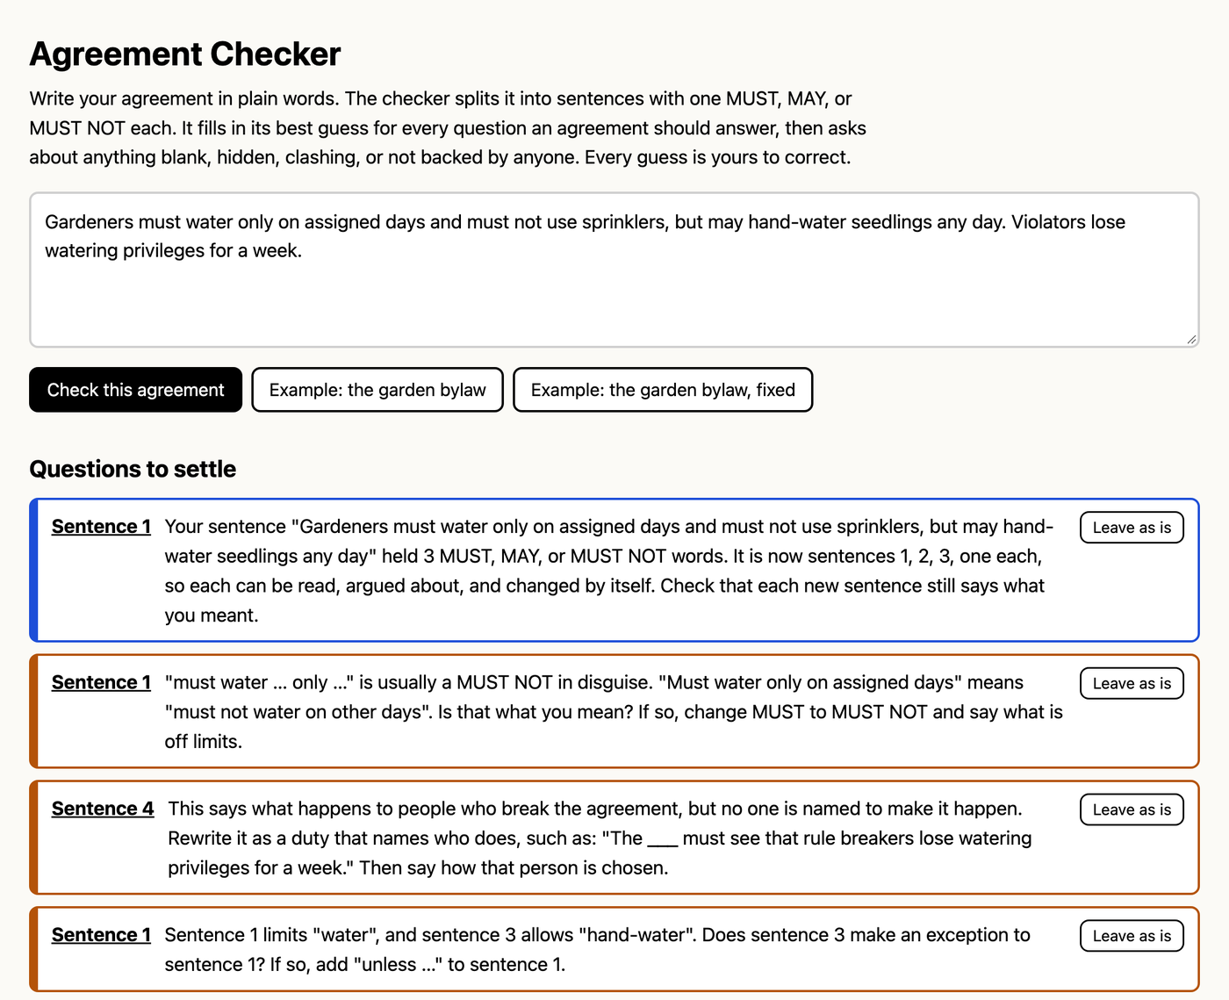
ON SCREEN
Questions to settle, one sentence at a time
1
Paste the agreement
Write it the way you'd say it. Press Check.
2
Read each question aloud
Orange items need settling. Blue items are notes.
3
Settle it or leave it
"Leave as is" once the group has talked it over.
RCN · Agreement Checker
7
Notes:
The garden bylaw as written: one note (the split) and three questions.

Slide 8
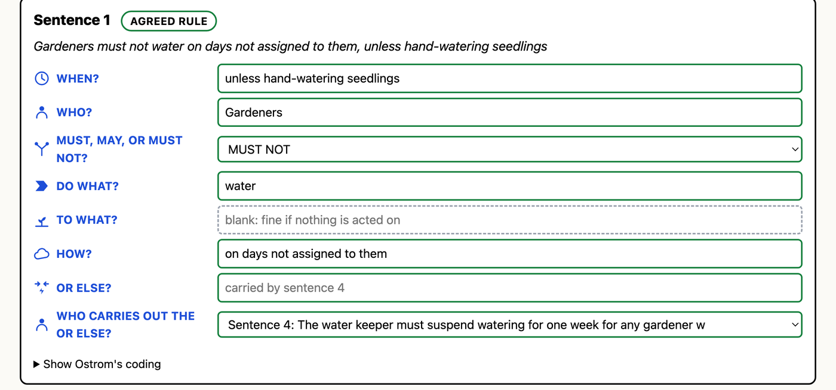
ON SCREEN
Every guess is a box you can change
Answered
Needs an answer
Optional: fine blank
The checker guesses from word patterns, and it will sometimes be wrong. Type over any guess. The questions, the label, and the rewritten agreement update as you type.
RCN · Agreement Checker
8
Notes:
Sentence 1 of the fixed bylaw. OR ELSE says "carried by sentence 4" because the keeper's duty backs it.

Slide 9
WHAT MAKES A CONSEQUENCE AGREED
An OR ELSE needs someone to carry it out
NO SPRINKLERS
KEEPER'S DUTY
CHOOSING THE KEEPER
Gardeners must not water their plots with sprinklers when the tank is below half.
The water keeper must suspend watering for one week for any gardener who breaks these rules.
Each spring, a water keeper must be chosen from the garden members.
backed by
backed by
AGREED RULE
SHARED EXPECTATION
CREATING AGREEMENT
A rule is agreed only when another sentence names who applies the consequence, and that role is itself created by the group. The keeper's duty has no OR ELSE of its own: at some point a group trusts someone. The checker points this out once, and lets the group decide.
RCN · Agreement Checker
9
Notes:
Ostrom calls this vertical nesting: the Or else of one statement is itself a statement. In plain words, "backed by".

Slide 10
THE LABELS
Leave a question blank and the agreement weakens
AGREED RULE
SHARED EXPECTATION
SHARED HABIT
MUST or MUST NOT, with an OR ELSE, and someone named to carry it out.
MUST, MAY, or MUST NOT, with nothing backing it. Holds as long as goodwill does.
No MUST, MAY, or MUST NOT. Just who does what, and when.
no OR ELSE
no MUST
Ostrom: rule
Ostrom: norm
Ostrom: shared strategy
None of these is wrong. Plenty of good agreements are shared expectations. The label shows the group what it has actually agreed to, so nobody is surprised later. A fourth label, CREATING AGREEMENT, marks sentences that set up a role, group, or thing.
RCN · Agreement Checker
10
Notes:
A permission is always a shared expectation: it cannot be broken, so it needs no OR ELSE.

Slide 11
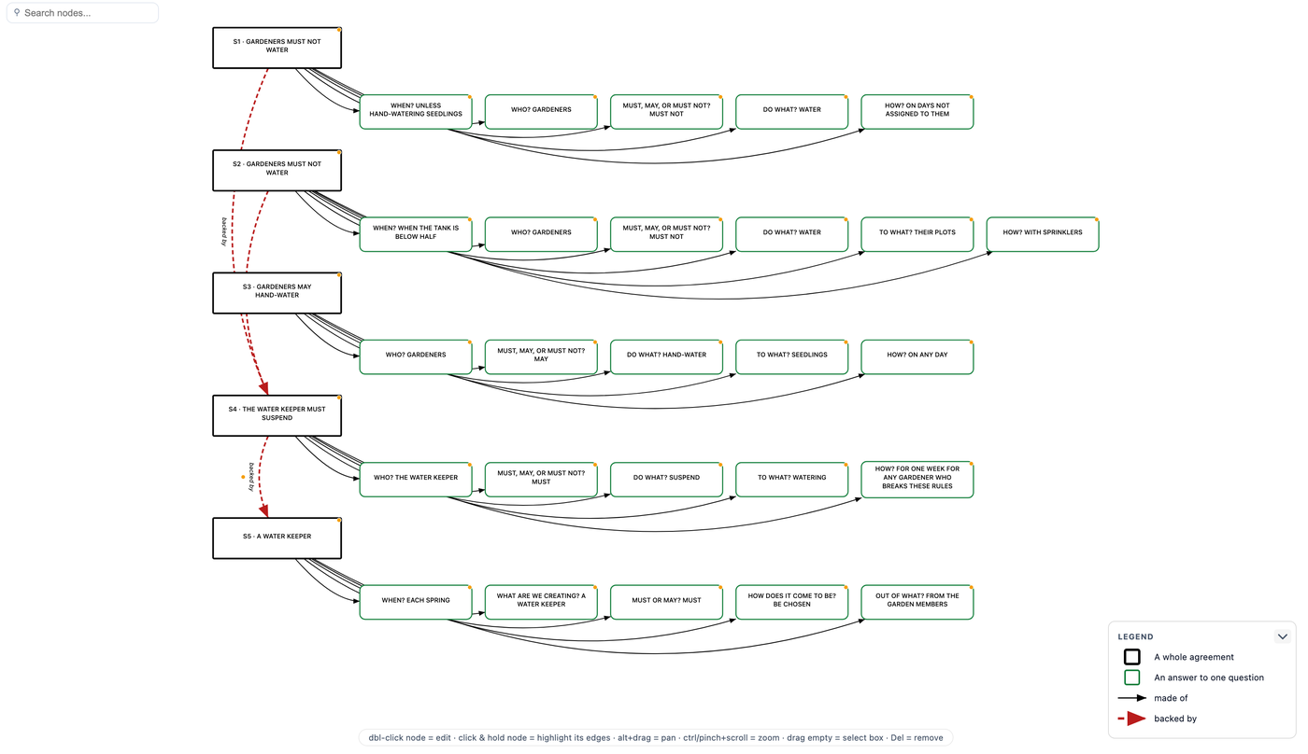
TAKE IT WITH YOU
Rewritten, drawn, and shared
Rewritten
The agreement rebuilt from your answers, one MUST per sentence, ready to read aloud.
Drawn
Opens in the RCN Graph Tool: each sentence with its answers, red arrows for what backs what.
Shared
Copy a link that carries the text, or save the drawing as a file.
Ostrom's coding
One click away on every sentence, for anyone who wants to check the translation.
RCN · Agreement Checker
11
Notes:
The fixed garden bylaw as the Graph Tool draws it.

Slide 12
USING IT WELL
Run it with the group, not for them
1
Put it on a screen everyone can see. One person types.
WHAT IT DOES NOT DO
— It reads English word patterns, not meaning. Check every guess.
2
Paste the agreement as it stands, warts and all.
3
Work down the questions one at a time. Read each aloud.
— It sees only the text you give it: not older bylaws or state law.
4
When the group disagrees, the question has found something.
— It checks whether an agreement is complete and clear, not whether it is fair.
5
Read the rewritten agreement aloud before anyone agrees.
— It never rewrites your agreement for you. The rewrite is built from your answers.
RCN · Agreement Checker
12
Notes:
The checker asks; the people decide.

Slide 13
Open it, paste your agreement,
and read the first question aloud.
tools/agreement-checker.html
Introduction: tools/agreement-checker-intro.html
User Manual: tools/agreement-checker-manual.html
Built on Crawford and Ostrom, "A Grammar of Institutions" (1995), and Frantz and Siddiki, Institutional Grammar 2.0 (2021).
Marc Pierson and Claude Opus 5.5 · September 2026
Notes:
Marc Pierson and Claude Opus 5.5, September 2026.

