Slide 1
The SODOTO Teaching Graph
Who taught whom — made queryable. A Neo4j lens over your SODOTO (See One, Do One, Teach One) badges.
ReLocalize Creativity Network · August 2026

Slide 2
What it is
• Every badge tells one story — a learner earned a skill, a mentor witnessed, a student was taught
• The graph connects all the stories — into one picture you can trace threads through
• Ask across the whole network — lineage · mentors · provenance — not one badge at a time

Slide 3
Badges are the truth. The graph is a lens.
• A projection built from the badges
• Delete it, rebuild it from the portfolios — nothing is lost
• Issuing and verifying never touch it

Slide 4
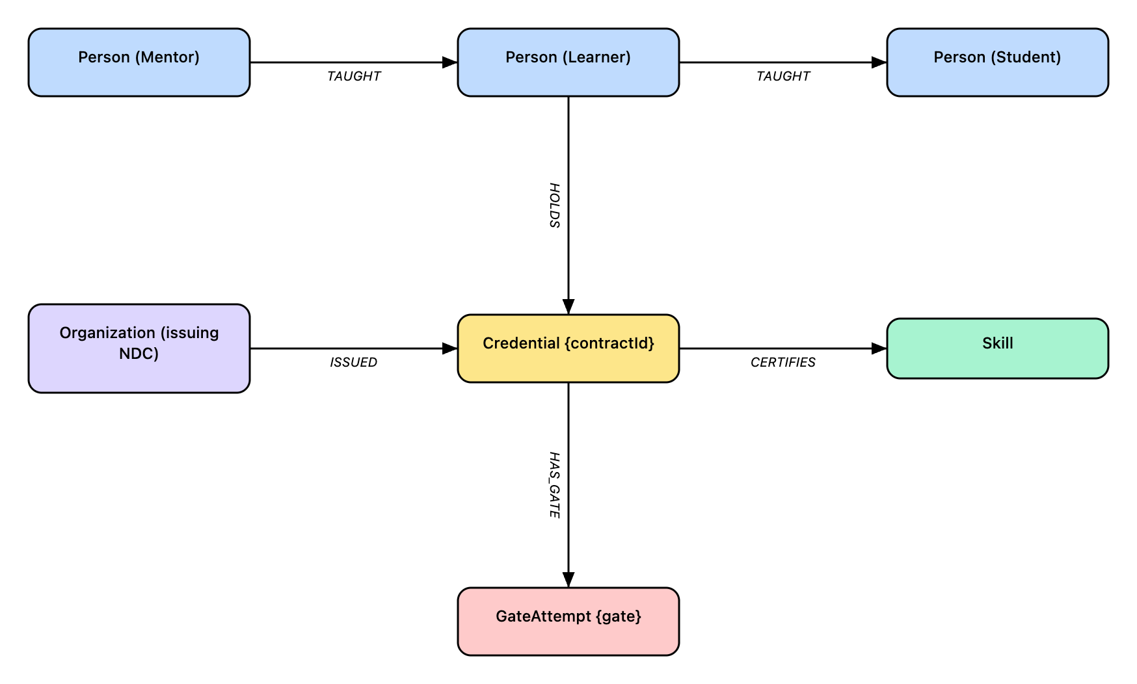
The model
Five node types. The issuer is a Neighborhood Development Center (NDC). Teaching edges (TAUGHT) + provenance (ISSUED / HOLDS / CERTIFIES / HAS_GATE).

Slide 5
What you can ask
• Teaching lineage — trace who taught whom, to any depth
• Most active mentors — who grew the most practitioners
• Where a skill entered the network — the roots of a teaching tree
• A person's full record — every credential and everyone they taught
• Who can do skill X — and how many gates deep
• Provenance — which NDC, which gates, which attestations

Slide 6
Build it — three commands
# dry run — what would project (no database needed)
python3 substrate/sodoto_projector.py --check
# project into Neo4j (idempotent — safe to re-run)
python3 substrate/sodoto_projector.py
# project, then a lineage summary
python3 substrate/sodoto_projector.py --summary
Re-run anytime new badges are issued — existing nodes are untouched.

Slide 7
Ask it anything — two ways
From the terminal
python3 substrate/db.py -q "MATCH (c:Credential) RETURN count(c)"
In the Neo4j Browser
• http://localhost:7474 — draws the graph visually — click around lineages and the whole network

Slide 8
Example — teaching lineage
MATCH path=(root:Person)-[:TAUGHT*]->(leaf:Person)
WHERE NOT ()-[:TAUGHT]->(root)
RETURN [n IN nodes(path) | n.name] AS chain
→ Kerry Turner → Marc Pierson → Noah Williams

Slide 9
Example — most active mentors
MATCH (m:Person)-[:TAUGHT]->(l:Person)
RETURN m.name AS mentor, count(DISTINCT l) AS learners
ORDER BY learners DESC
→ Kerry Turner — 3 learners
→ Marc Pierson — 3 learners

Slide 10
What it's not
• Not a dependency — runs on the Desktop Substrate, separate from live WikiCafe
• No debt or value node — that is the separate currency layer (CfA-dSC)
• Not the source of truth — if the graph and a badge disagree, the badge wins — rebuild

Slide 11
In short
• Badges → projector → Neo4j lens
• Teaching lineage + provenance, queryable
• Idempotent, rebuildable, Desktop-only
• Full how-to + query library — docs/sodoto-teaching-graph-intro.html · …-manual.html

