Slide 1
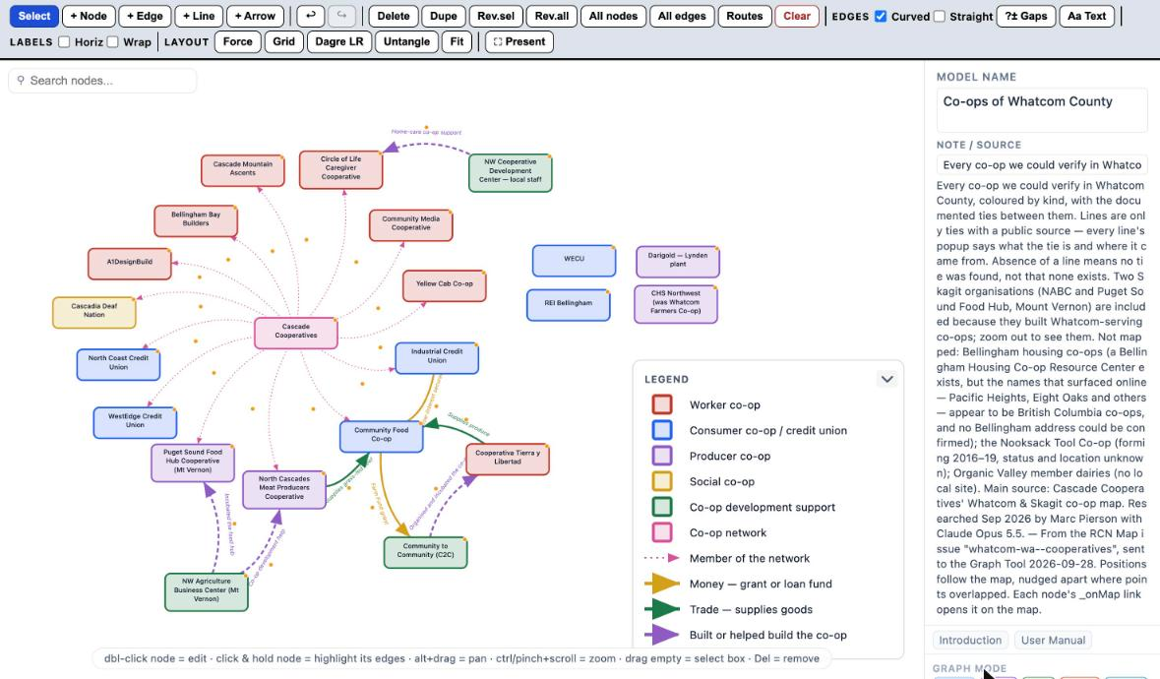
Co-ops of
Whatcom County
One dataset, four RCN lenses —
Map · Graph · Timeline · Table —
and a FedWiki page for every co-op
22 organisations · 21 sourced ties · contacts checked Sep 2026
Marc Pierson with Claude Opus 5.5 · September 2026

Slide 2
THE DATA
One file of co-ops, read four ways
22
21
6
20
organisations
sourced ties
kinds of co-op
reachable by phone or name
Every co-op we could verify in Whatcom, plus two Skagit bodies that built Whatcom-serving co-ops.
Membership, money, trade, and “built or helped build”. A line only where a public source says so.
Worker, consumer / credit union, producer, social, development support, network.
Websites, phones and named leaders, each checked against the organisation’s own site where it could be read.
WHERE EACH LENS GETS IT
— Map — the issue file tools/issue-data/whatcom-wa--cooperatives.json: points, ties, kinds, contact block.
— Graph Tool — the Map’s “Open in Graph Tool” button, then laid out by hand (the layout shown is Marc’s).
— Timeline — tools/whatcom-coops-timeline.json: when each co-op began, converted or merged.
— Table — Neo4j database whatcomcoops, loaded from the same issue file by substrate/load_coops.py.
— FedWiki — one page per co-op: its record, its graph, a map, its website; the table plugin on the index page.
Co-ops of Whatcom County · RCN
2

Slide 3
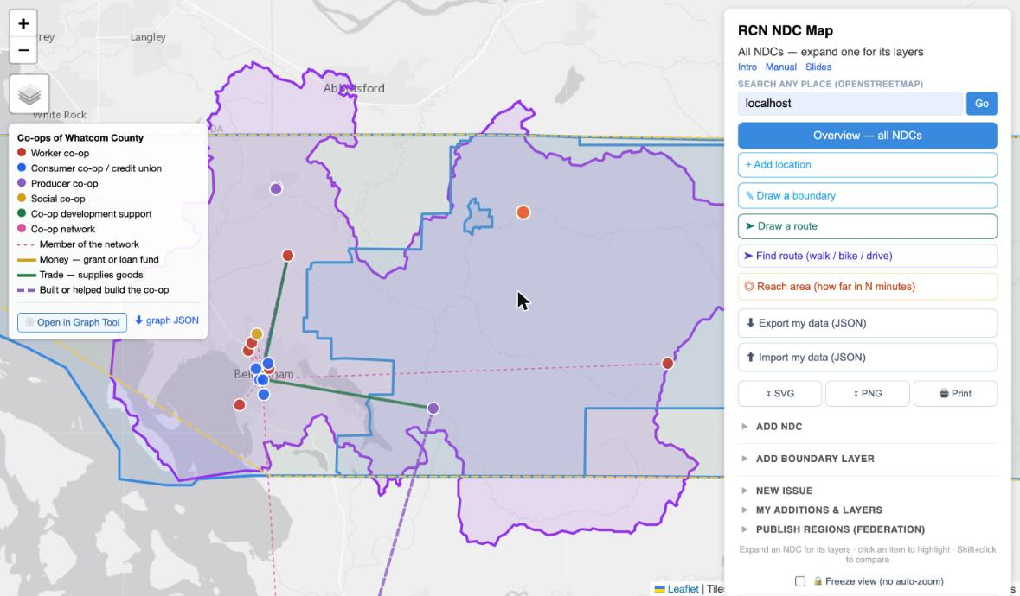
RCN MAP
Where the co-ops are, and who is tied to whom
WHAT YOU ARE SEEING
— Each dot is a co-op, coloured by kind — the legend is top left.
— Lines are ties with a public source: dotted pink for network membership, gold for money, green for trade, dashed purple for “built or helped build”.
— Most co-ops sit in Bellingham; the farm co-ops run out to Lynden, Everson and Acme, and two ties reach south to Mount Vernon.
Screenshot · RCN Map, issue “Co-ops of Whatcom County”, light basemap
Co-ops of Whatcom County · RCN
3

Slide 4
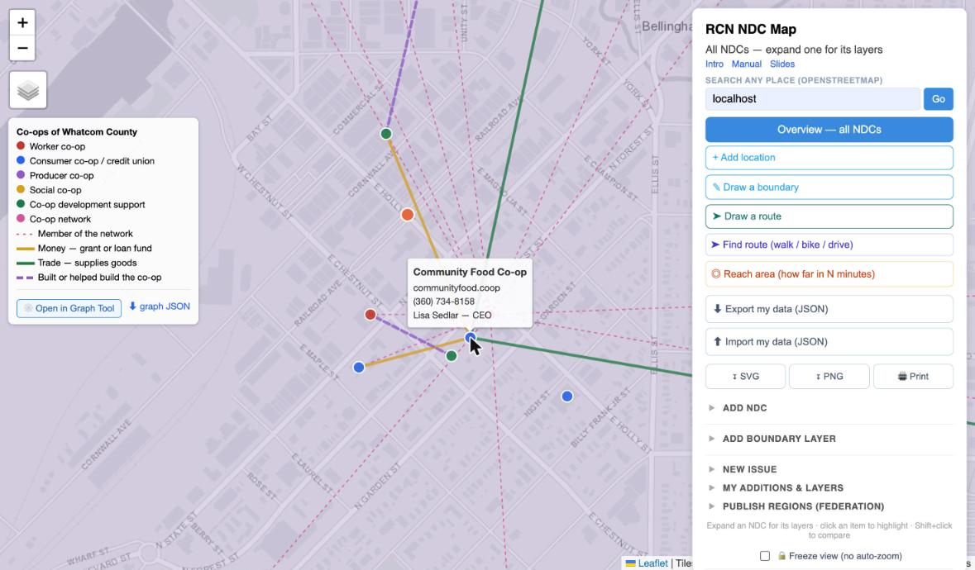
RCN MAP — HOVER
Hover a co-op: its website, phone and lead person
WHAT YOU ARE SEEING
— Downtown Bellingham, zoomed in: the Food Co-op is the hub for money and trade; the pink dotted lines fan out from Cascade Cooperatives to its members.
— Hovering shows the short form — site, phone, first named person.
— Where a contact is doubtful, the hover says so in amber before anyone relies on it.
Screenshot · hover on Community Food Co-op
Co-ops of Whatcom County · RCN
4

Slide 5
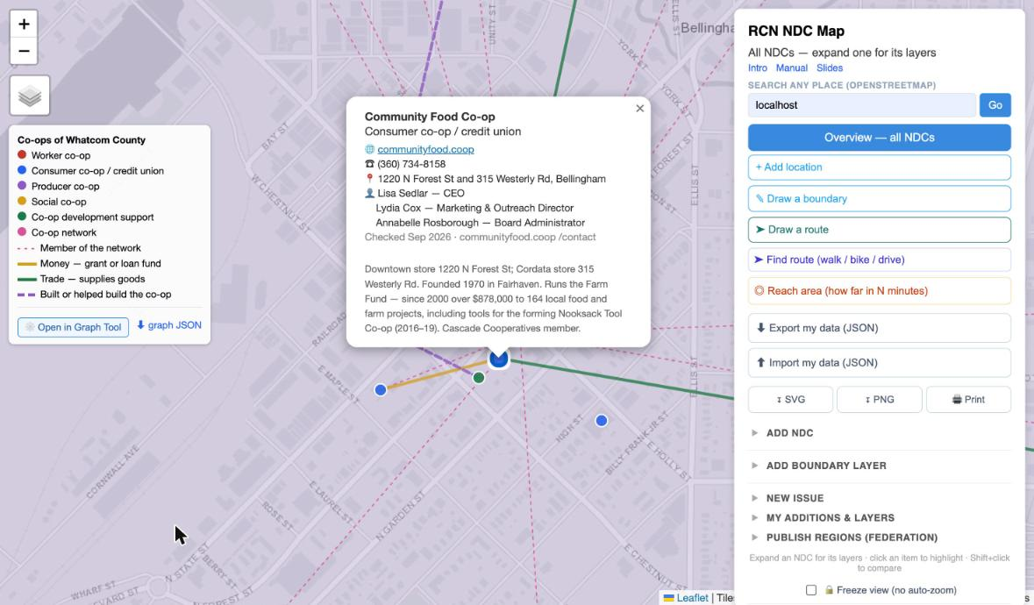
RCN MAP — POPUP
Click for the full record, with where it came from
WHAT YOU ARE SEEING
— Website, phone, address and named people, then the research notes.
— “Checked Sep 2026 · communityfood.coop /contact” — every contact says when and from which page it was read.
— The same fields travel to the Graph Tool as node properties and to Neo4j as columns.
Screenshot · popup on Community Food Co-op
Co-ops of Whatcom County · RCN
5

Slide 6
RCN GRAPH TOOL
The same ties as a diagram, laid out by the person who reads it
WHAT YOU ARE SEEING
— Marc’s layout: Cascade Cooperatives at the centre of its members, the Food Co-op at the centre of money and trade.
— Four large organisations — WECU, REI, Darigold, CHS — have no documented tie to the rest. That empty corner is a finding, not a gap in the drawing.
— Colours and line styles come from the legend, so the diagram and the map say the same thing.
Screenshot · Graph Tool v22, file Co-ops-of-Whatcom-County (1).json
Co-ops of Whatcom County · RCN
6

Slide 7
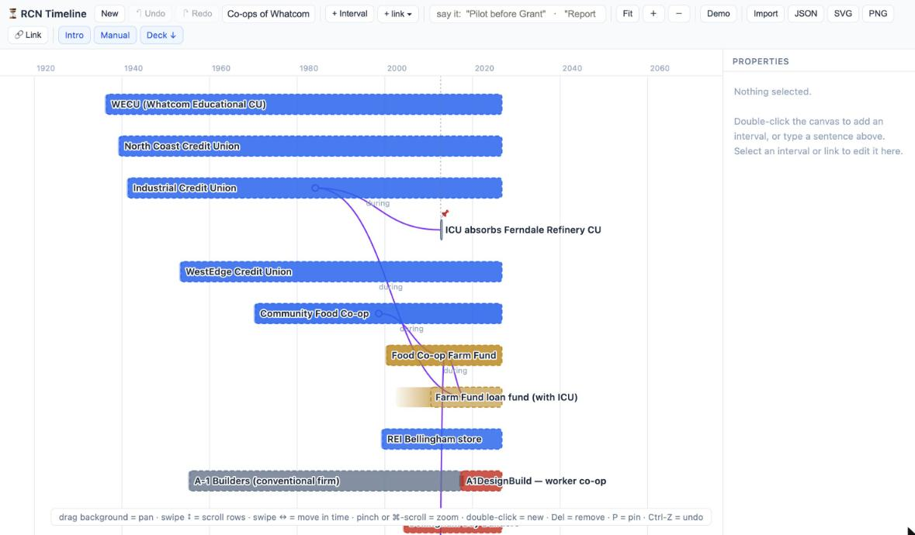
RCN TIMELINE
A century of co-ops, from the 1918 dairymen to the 2023 worker co-ops
WHAT YOU ARE SEEING
— The three credit unions — WECU (1936), North Coast (1939), Industrial (1941) — head the list; only Darigold’s Lynden roots (1918), further down, are older.
— Grey bars are what a co-op was before: A-1 Builders ran as a conventional firm from 1955 until its worker buyout in 2017.
— Swipe up and down to scroll the 29 rows; the date axis stays pinned.
Screenshot · RCN Timeline, Fit, top rows
Co-ops of Whatcom County · RCN
7

Slide 8
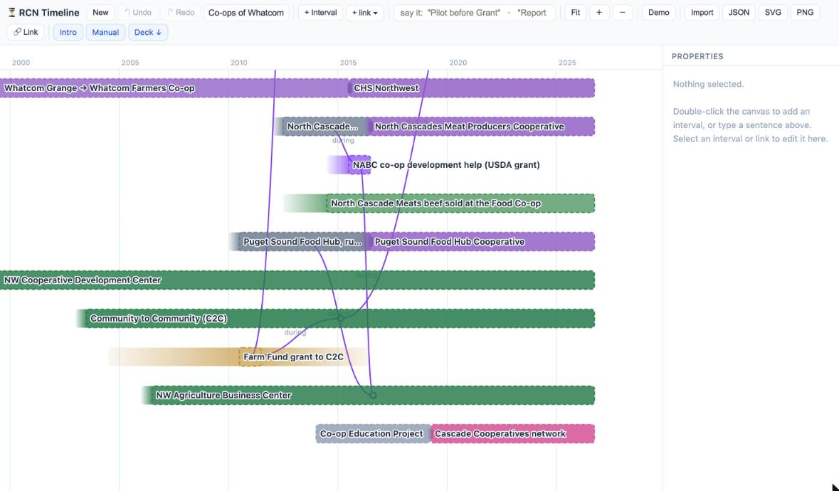
RCN TIMELINE — SINCE 2000
The recent wave: development bodies, then the co-ops they built
WHAT YOU ARE SEEING
— NWCDC, C2C and NABC were working before the co-ops they helped start.
— Purple links show a tie running during both lives: NABC’s USDA-grant help sits inside the meat co-op’s organising years.
— Cascade Cooperatives began in 2014 as the Co-op Education Project and was renamed in 2019.
Screenshot · RCN Timeline zoomed to 2000–2028, scrolled to the lower rows
Co-ops of Whatcom County · RCN
8

Slide 9
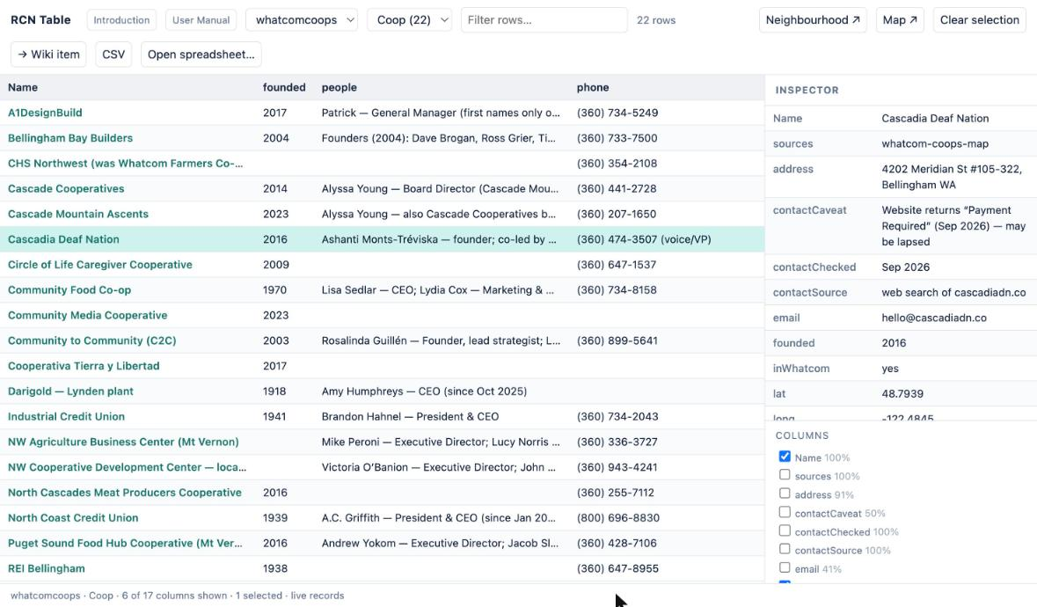
RCN TABLE
In Neo4j: 22 rows, one per co-op, live from the database
WHAT YOU ARE SEEING
— Database whatcomcoops, kind Coop — the footer says “live records”.
— Pick the columns: here founded, people and phone.
— The inspector shows the whole row, warnings included: Cascadia Deaf Nation’s website currently answers “Payment Required”.
Screenshot · RCN Table, ?db=whatcomcoops&kind=Coop
Co-ops of Whatcom County · RCN
9

Slide 10
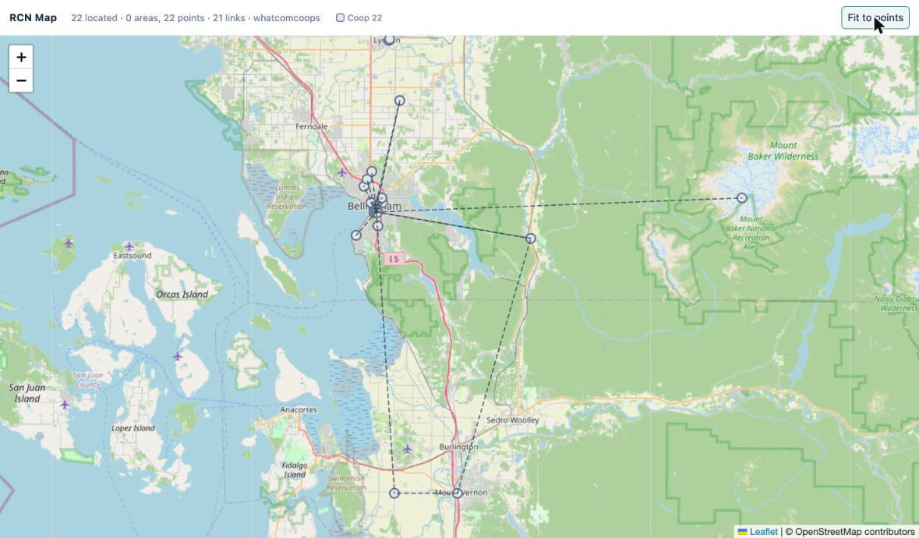
RCN TABLE — MAP
The database draws its own map: 22 points, 21 links
WHAT YOU ARE SEEING
— The Table’s Map button reads location and ties straight from Neo4j, with no issue file.
— Same network, plainer picture: the database holds the facts, and colour belongs to each lens.
— This is the check that the load lost nothing: 22 located, 21 links.
Screenshot · rcn-table-map.html?db=whatcomcoops
Co-ops of Whatcom County · RCN
10

Slide 11
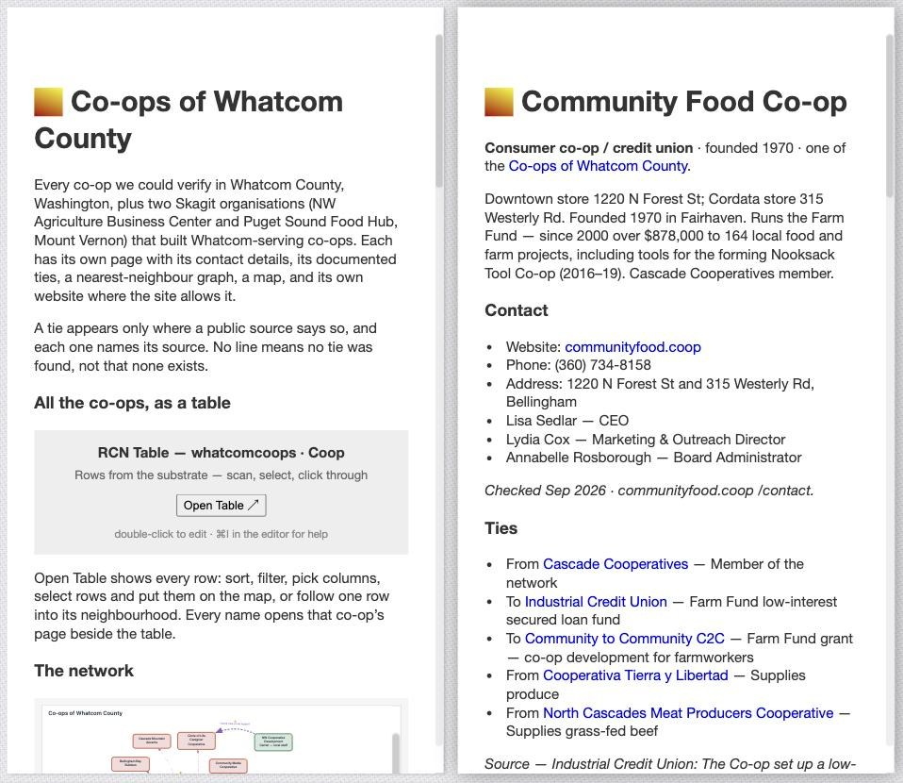
FEDWIKI
A FedWiki page for every co-op
WHAT YOU ARE SEEING
— 23 pages — an index and one per co-op — in one drop file. Drag it onto any lineup, click a page, fork it.
— Each page holds the record, the contact block with when and where it was checked, and the ties as wiki links, each with its source.
— The index sits on the left; clicking a co-op opens its page beside it, the ordinary FedWiki way.
Screenshot · local wiki coops.localhost, index and Community Food Co-op
Co-ops of Whatcom County · RCN
11

Slide 12
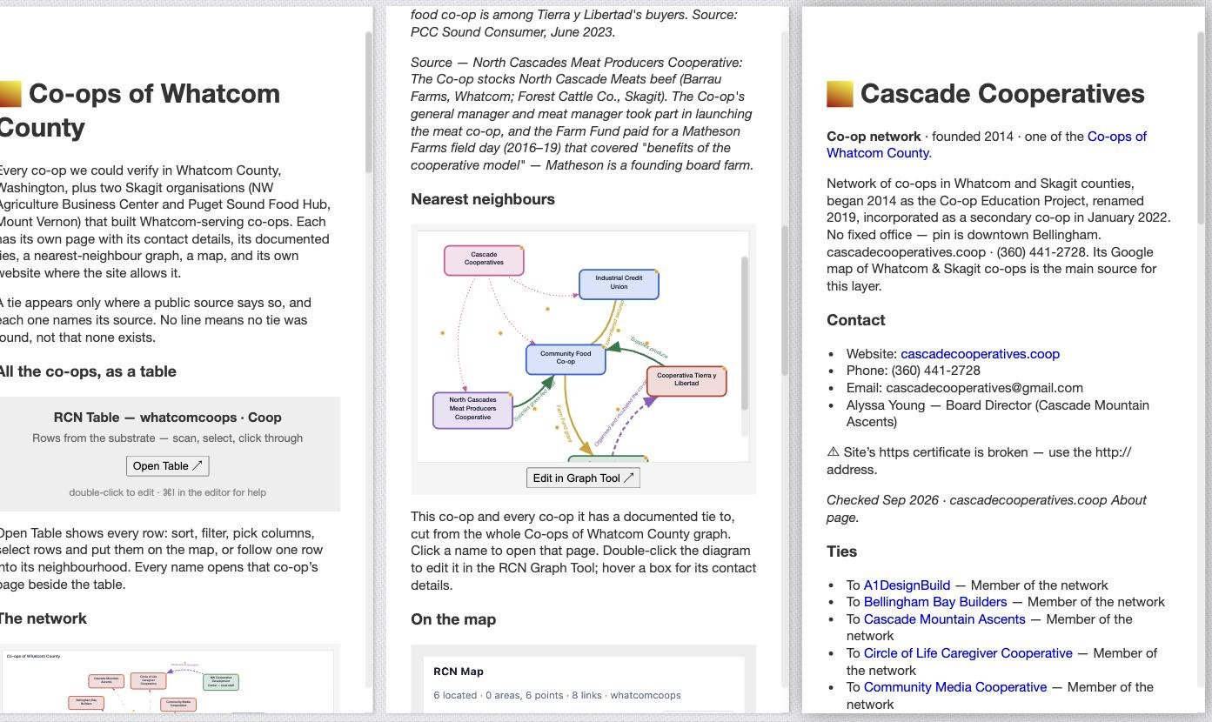
FEDWIKI — RCN GRAPH TOOL
Click a co-op in its graph and its page opens beside it
WHAT YOU ARE SEEING
— Every page carries an rcngraph item: the co-op and its nearest neighbours, cut from Marc’s layout.
— Every box is a wiki link. Here Cascade Cooperatives was clicked in the Food Co-op’s graph and opened on the right.
— “Edit in Graph Tool” reopens the model; hover a box for its contact details, which travel in the model.
Screenshot · click on Cascade Cooperatives in the Food Co-op’s graph
Co-ops of Whatcom County · RCN
12

Slide 13
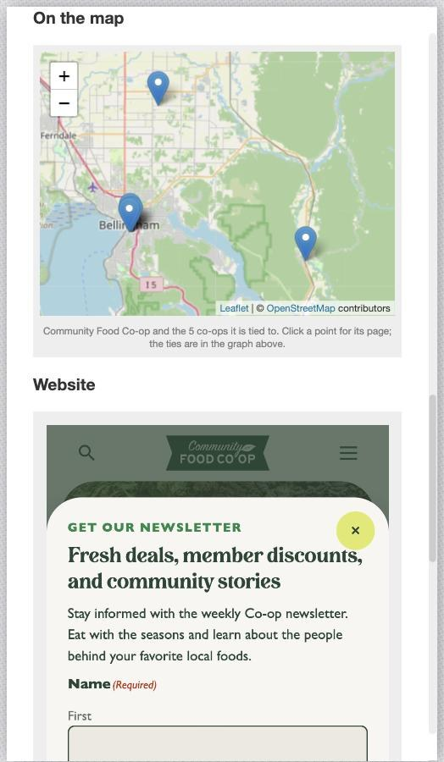
FEDWIKI — MAP AND FRAME PLUGINS
Its map and its own website, inside the page
WHAT YOU ARE SEEING
— A Map item — FedWiki’s own map plugin — shows this co-op and the co-ops it is tied to. Each point is a wiki link to that co-op’s page.
— The map is plain text, one line per point, so anyone can edit it in the page. It works on any wiki with nothing uploaded.
— It draws points, not ties; the graph just above carries the ties. The table’s Map button draws them on a map.
— A Frame item — used only for this — shows the co-op’s own website, live, under the map.
— 11 of the 22 sites show inside the page. The other 11 refuse to be framed, put up a bot check, are down, or have no site; those pages link out and say why.
Screenshot · Community Food Co-op, scrolled to its map and website
Co-ops of Whatcom County · RCN
13

Slide 14
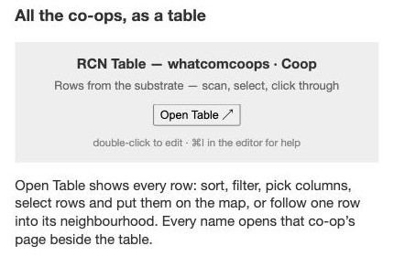
FEDWIKI — TABLE PLUGIN
The FedWiki table plugin: all 22 co-ops on the index page
The rcntable item on the index page
— The item names the records: database whatcomcoops, kind Coop.
— Open Table ↗ opens the RCN Table beside the wiki — the same table as slide 9.
— At home it reads Neo4j live through substrate/api.py. On a hosted wiki it reads the exported folder in the site’s own assets, so each site is its own database.
— Every name in the table opens that co-op’s page in the lineup.
What Open Table shows
Co-ops of Whatcom County · RCN
14

Slide 15
FEDWIKI — HOW IT WENT
Making it work: what broke, and what it cannot do
FIXED
LIMITS
— Clicking a two-line name in a graph did nothing, or reloaded the wiki. Each co-op box is now one link. The real fix belongs in the Graph Tool, for every diagram.
— The maps first ran the RCN Map inside Frame items. That tied the pages to one wiki and needed files uploaded, so they now use FedWiki’s own Map plugin; Frame is kept for the websites only.
— Along the way the table’s map learned to load on its own and to use the Esri basemap, so it also works when framed.
— The per-page map shows points, not ties: we found no way in its text format to draw a line between two points. An RCN map plugin would.
— Half the co-op websites cannot be shown in a page — ICU, REI, North Coast CU, A1DesignBuild and the Food Hub refuse; Bellingham Bay Builders’ bot check never finishes. Those pages link out.
Checked in a real FedWiki (coops.localhost): a graph click opens the page beside, the Food Co-op’s map shows its 6 co-ops, and the websites were tested in the frame plugin’s own sandbox or by their headers — 11 show.
Co-ops of Whatcom County · RCN
15

Slide 16
CONTACTS
What the contact check found — and what to verify before calling
CORRECTED IN THE DATA
VERIFY BEFORE RELYING ON IT
— Community to Community has moved: 1319 Cornwall Ave, Suite 101 (the map pin is moved).
— Cascade Cooperatives incorporated in January 2022, not 2019; it began in 2014 as the Co-op Education Project.
— CHS Northwest in Lynden is at 402 Main St.
— Industrial Credit Union’s website is industrialcu.com.
— Yellow Cab Co-op has its own site, yellowcabcoop.com.
— Community Media Cooperative — media-coop.com no longer resolves; it may have closed.
— Cascadia Deaf Nation — website answers “Payment Required”; it may have lapsed.
— Bellingham Bay Builders — only the 2004 founders are published, not the current owner-members.
— WestEdge CU, Yellow Cab Co-op, Circle of Life, CHS — no leader named on their own sites.
— Tierra y Libertad — no website of its own; reach it through C2C.
Every contact carries “Checked Sep 2026” and the page it was read from. Phones and names change; the date says how far to trust them.
Co-ops of Whatcom County · RCN
16

Slide 17
One dataset, four lenses
— Map: open the RCN Map and choose the “Co-ops of Whatcom County” issue — hover any dot for its contact.
— Graph: “Open in Graph Tool” from the map legend, or load tools/whatcom-coops-graph.json (Marc’s layout, with contacts).
— Timeline: import tools/whatcom-coops-timeline.json into the RCN Timeline.
— Table: rcn-table.html?db=whatcomcoops&kind=Coop, with substrate/api.py running.
— FedWiki: drag docs/whatcom-coops-wiki/whatcom-coops-wiki.json onto any lineup; upload the rcn-table folder for the table.
— To change the data, edit the issue file, then re-run substrate/load_coops.py and build_pages.py so Neo4j and the wiki match.
A line means a public source was found. No line means no tie was found, not that none exists.
Marc Pierson with Claude Opus 5.5 · September 2026

