Slide 1
My Personal Health Supporter · RCN · Open Source CC 4.0
My Personal
Health Supporter
Five open-source tools for neighborhood health — giving people and communities
much of what they need to participate fully in their own health and wellbeing.
Whatcom Wealth and Health · 2026

Slide 2
“The day-to-day choices and actions that create and preserve individual health occur in the home.”
This is not a new idea. It is the idea we now support and organize for.
Neighborhoods are the true health system. The medical system responds to illness.
It does not produce health. These tools help neighbors take better care of themselves.
My Personal Health Supporter · RCN · Open Source CC 4.0 · 2026

Slide 3
THE SUITE
Five tools. One complete system.
MY SHARED
CARE PLAN
MY HEALTH
PICTURE
PANAS
PA-10
MY HEALTH
CHOICES
MY SUPPORT
NETWORK
Person-owned clinical record. No institution holds it.
The active problem view. Every problem at its level of certainty.
Positive affect score. Shapes which problems to surface today.
AI-assisted option exploration. The evidence, in plain language.
27-role completeness view. Makes absence as visible as presence.
SODOTO: skill credentialing for health partners — covered on slide 8
My Personal Health Supporter · RCN · Open Source CC 4.0 · 2026

Slide 4
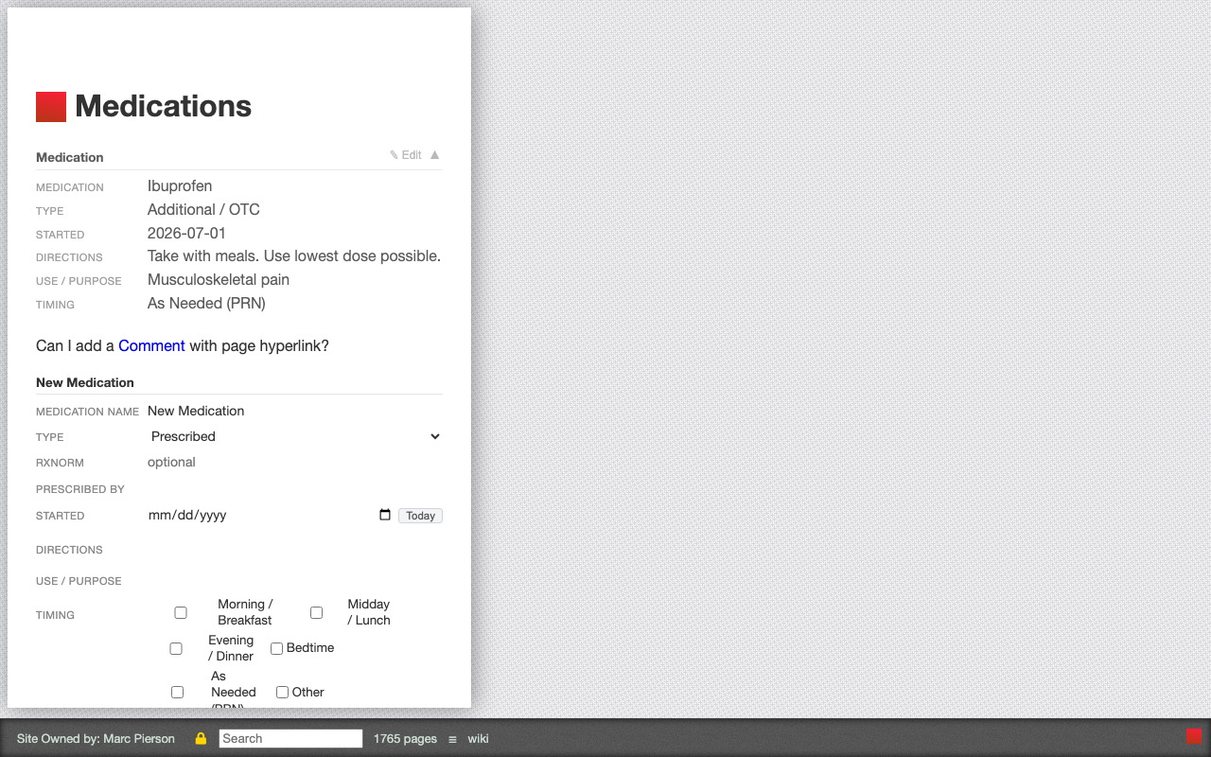
TOOL 1 · MY SHARED CARE PLAN
One record. Person-owned.
No institution holds it.
Every health record before this one was owned by a clinic or hospital. My Shared Care Plan is different at its foundation: a federated, decentralized record held by the person — readable by everyone they choose to include.
• 12 typed record sections: diagnoses, medications, vitals, visits, care team, directives, history, lab results, reactions, next steps, access log, about me
• Commit+fold pattern — every entry is dated and versioned
• Runs on FedWiki — decentralized, person-controlled
• Every entry searchable; item.text indexed automatically
My Shared Care Plan · FedWiki · Medications plugin · live data
Interfaced — not owned
Person-owned — always
Physician receives exactly what they need — and nothing more.
No institution holds it. Follows the person into every relationship.
My Personal Health Supporter · RCN · Open Source CC 4.0 · 2026

Slide 5
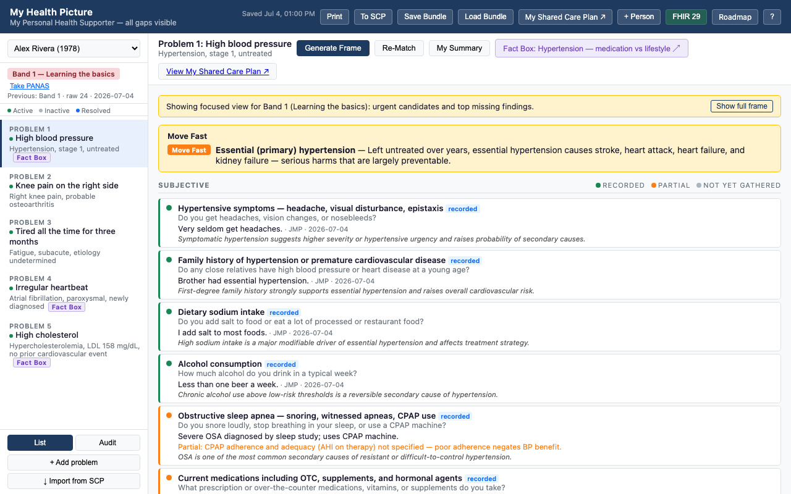
TOOL 2 · MY HEALTH PICTURE
The active problem view.
Every problem at its level of certainty.
CERTAINTY
URGENCY
NEXT BEST QUESTION
Confirmed · Probable · Possible
Unconfirmed · Not Pursuing
1 Act Now · 2 Move Fast · 3 Work On It
4 Watch It · 5 Routine
Most important missing evidence for this problem
Every diagnosis is a probability, not a conclusion.
Computed from probability × danger. Not assigned by AI.
Surfaced automatically — tells the health partner what to gather next.
When escalating: health partner sends problem + certainty level + evidence gathered + one clear question. The physician’s response goes into the Shared Care Plan — written, dated, permanent.
My Personal Health Supporter · RCN · Open Source CC 4.0 · 2026

Slide 6
BUILT INTO MY HEALTH PICTURE · PANAS PA-10
Positive affect score.
Shapes which problems to focus on today.
At each visit the person rates 10 positive-affect words on a 1–5 scale for the past week. The total score maps to one of four activation bands — which determines how much of the problem list to surface.
10–24
Learning the basics
Urgent problems only
25–31
Building awareness
active
alert
attentive
determined
enthusiastic
Urgent + important problems
excited
inspired
interested
proud
strong
32–38
Taking action
Full problem list
39–50
Staying the course
Full list + deeper exploration
‘Show full frame’ always overrides. The record is never withheld from the person.
My Personal Health Supporter · RCN · Open Source CC 4.0 · 2026

Slide 7
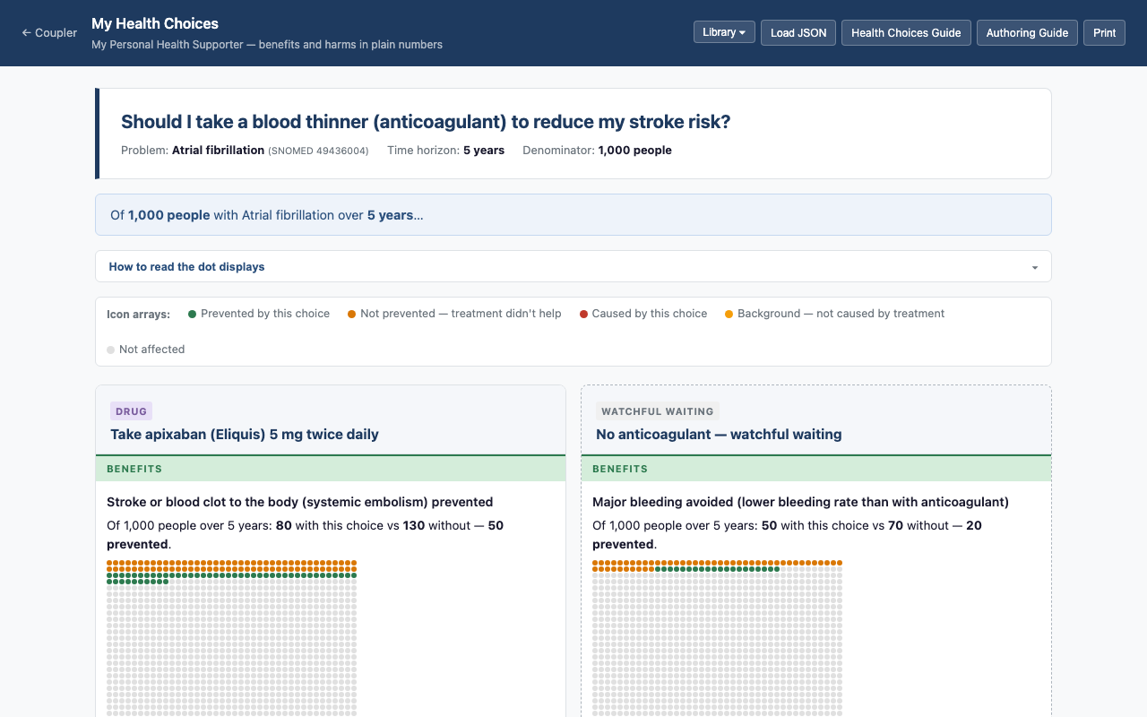
TOOL 3 · MY HEALTH CHOICES
AI-assisted exploration.
The evidence, in plain language.
Opens pre-loaded with the person’s full clinical record and focuses on a specific problem from My Health Picture. The health partner and person ask questions together in plain language. The AI responds from the medical literature.
• Opens from “Explore choices” button in My Health Picture
• Full SCP context pre-loaded automatically
• Suggestion chips after each AI response
• “Document this choice” writes back to the Shared Care Plan
• Three built fact boxes: AF anticoagulation, statin primary prevention, hypertension
My Health Choices · Atrial fibrillation anticoagulation fact box with Option Box dot display
My Personal Health Supporter · RCN · Open Source CC 4.0 · 2026

Slide 8
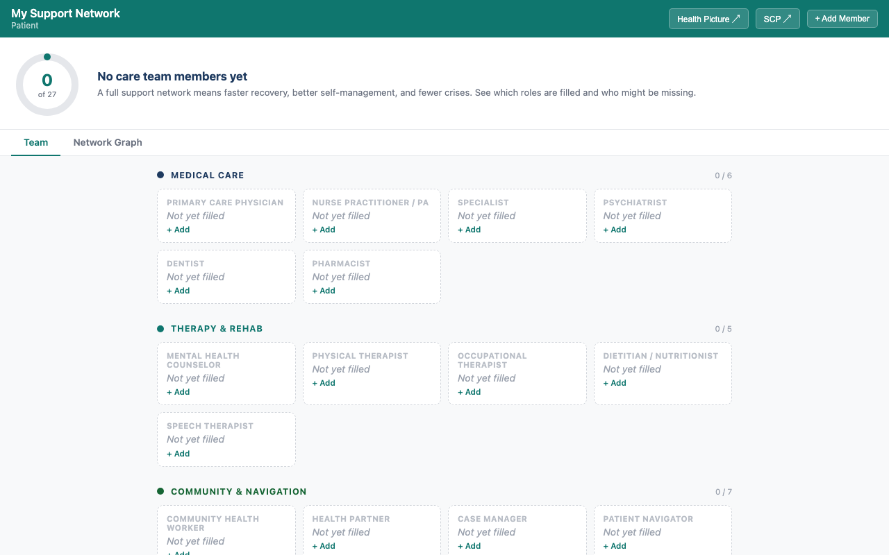
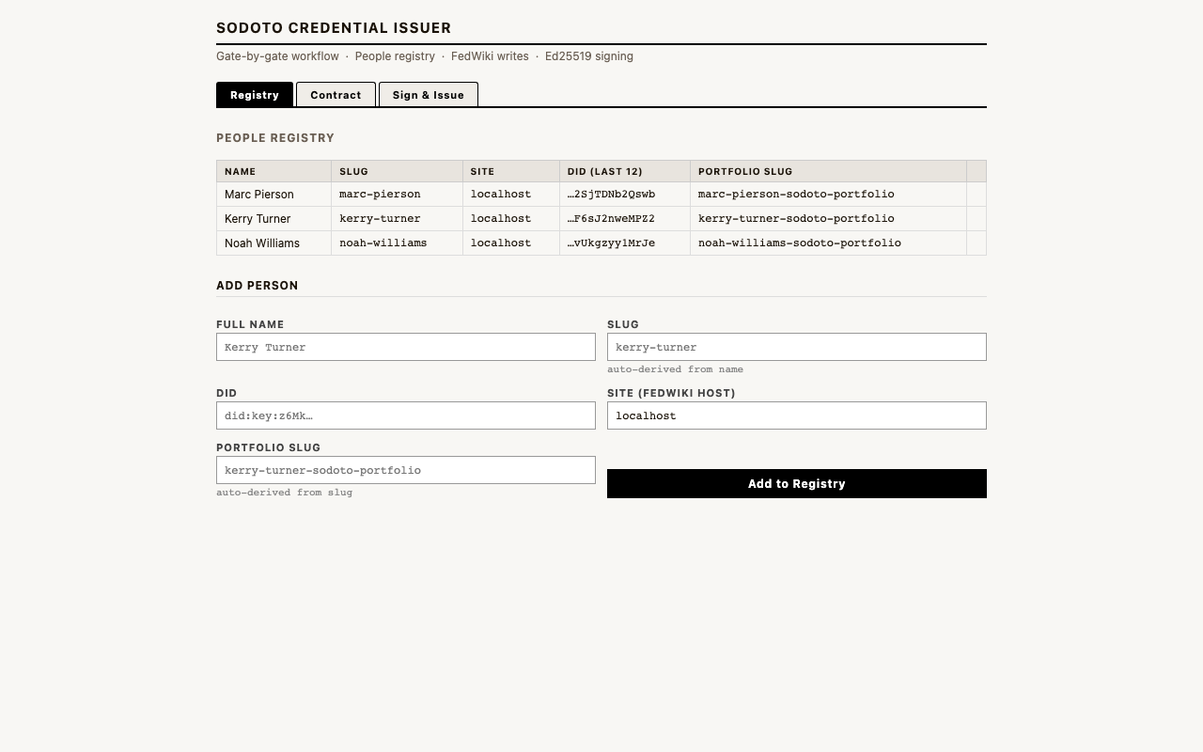
TOOL 4 · MY SUPPORT NETWORK
TOOL 5 · SODOTO
27-role completeness view
See One, Do One, Teach One
Shows the person’s care team against a maximal list of 27 roles across 5 categories: Medical, Therapy & Rehab, Community & Navigation, Informal Support, Practical Support. Empty roles appear as ghost nodes — absence is as visible as presence.
Portable digital skill credentials for health partners. Every skill demonstrated earns a credential. Every skill taught earns a higher credential and a higher pay tier. The network teaches itself.
Observer
Witnessed the skill. Foundation credential.
Many health problems are support problems, not clinical problems. My Support Network makes this visible.
Practitioner
Performed independently. Standard pay tier.
Teacher
Taught a peer. Highest pay tier.
My Personal Health Supporter · RCN · Open Source CC 4.0 · 2026

Slide 9
THE SYSTEM
Five tools. One care relationship.
My Shared
Care Plan
My Health
Picture
PANAS
Score
My Health
Choices
My Support
Network
→
→
→
→
clinical record
active problems
shapes the view
explore options
who is around them
Data flows in:
Data flows out:
SCP → Health Picture
PANAS score stored in SCP
Support Network reads SCP care team
Health Choices writes shared-decision records → SCP
Physician response → SCP Plan
SODOTO credentials: independent, portable
The Shared Care Plan is the source of truth. Every tool draws from it. Every decision writes back to it. The record grows more complete with every visit.
My Personal Health Supporter · RCN · Open Source CC 4.0 · 2026

Slide 10
THE ROLE
A helpful neighbor with real tools.
Health partner uses tools at home
Full SCP in hand. PANAS score shapes the visit. Support Network reviewed.
↓
The health partner is not a healthcare extender. It is a neighborhood role — someone who knows the person, knows the street, and carries the full structured record into every encounter.
Structured package sent to physician
Problem + certainty level + evidence gathered + one clear question.
↓
The Southcentral Foundation proved what this looks like at scale: community health aides at the center of an Alaska Native-owned system. −36% ED visits. −40% specialist visits. Sustained over decades.
Physician responds to a precise question
Not an open-ended chart request. A targeted, documented response.
↓
Southcentral Foundation · Nuka System of Care
Response written into Shared Care Plan
Permanent, dated, searchable. The record is richer after every escalation.
My Personal Health Supporter · RCN · Open Source CC 4.0 · 2026

Slide 11
OPEN SOURCE
COOPERATIVE ECONOMICS
PERMANENT COMMITMENT
The cooperative is the financial sustainability model. Health partner microenterprises — self-managing teams of 5–15 people — are paid for problems resolved, not visits logged.
Every tool in My Personal Health Supporter is open source CC Attribution 4.0. None are for sale. None ever will be. Anyone can use, adapt, or deploy them — without asking anyone’s permission.
Tools + incentives align
The same record that guides care is what generates payment.
Earn more as problems resolve
This is the founding architecture, not a policy choice.
Payment tied to outcomes, not to volume.
Network grows stronger as it grows larger
More partners, more coverage, more teaching.
My Personal Health Supporter · RCN · Open Source CC 4.0 · 2026

Slide 12
Where to begin
Learn to read a Health Picture
Do your first review with someone you know well
1
Start with a completed example. Understand certainty levels before doing your first live visit.
2
In their home. Use the Health Picture to guide what to gather. Take notes in the SCP.
Write your first Shared Care Plan note right after the visit
Complete your first SODOTO foundation credential
3
Date it. Use the structured sections. The habit builds the record.
4
Get it witnessed. Add it to your record. It belongs to you.
Add My Health Choices when a decision is approaching
Map their Support Network
5
Open it from the problem in the Health Picture. Let the AI carry the clinical knowledge.
6
Surface what’s missing. A support gap is often a health gap in disguise.
Detailed guides available for each tool.

Slide 13
“Give people and their communities everything they need and want —
the knowledge, the tools, the economic support —
and watch what human beings do with their own health.”
My Personal Health Supporter · RCN · Open Source CC 4.0 · Marc Pierson MD · 2026

