Slide 1
Governing What We Share
Elinor Ostrom's way of seeing a commons, from the whole system down to one person deciding, for neighbors who want to organize
Marc Pierson and Claude Opus 5.5 · October 2026
Notes:
This deck is for people new to Elinor Ostrom and new to community organizing. It moves from the largest scale (the whole system a shared resource sits in) down to the smallest (one person deciding whether to trust the others). Every technical word on every diagram is translated on the slide that follows it, and there is a full glossary at the end. A companion deck, governing-what-we-share.pptx, tells the same story with everyday words first.
Marc Pierson and Claude Opus 5.5 · October 2026

Slide 2
The question Ostrom answered
OPENING
The old story
Anything shared gets used up. Each person gains by taking a little more, so together they ruin it. The only fixes: the government takes control, or the shared thing is divided into private property.
What Ostrom found
People who share a resource often make their own rules, watch each other, settle disputes, and keep it healthy for generations. Not always. But often enough to ask: what do the ones that last have in common?
1483
the year the Swiss village of Torbel formally organized the meadows it shares
2009
Ostrom becomes the first woman to receive the Nobel Prize in Economics. Her lecture is the source of this deck.
Notes:
Garrett Hardin's 1968 essay 'The Tragedy of the Commons' told a simple story: anything shared will be used up, because each person gains by taking a bit more. The usual answers were: let the government control it, or divide it into private property. Elinor Ostrom spent decades looking at real places (fisheries, forests, irrigation systems, alpine meadows) and found that ordinary people often govern shared things well themselves, sometimes for centuries. The Swiss village of Torbel formally organized its shared alpine meadows in 1483. In 2009 she became the first woman to receive the Nobel Prize in Economics. Her lecture that year is the source of most diagrams in this deck.

Slide 3
How this deck moves: we zoom in, nine steps
OPENING
1
The whole system What surrounds a shared resource?
largest
2
What we share What kind of thing is being shared?
3
One situation in its setting Where do people meet and choose?
4
Layers of decision Who decides the rules, and who decides who decides?
5
Inside one situation What are the working parts of one situation?
6
The rules that shape it Which rule shapes which part?
7
What lasting rules share What do the rules of long-lasting commons have in common?
8
One sentence of a rule How is one rule built?
9
One person deciding Why does a person choose to cooperate?
smallest
Notes:
Think of a camera zooming in. We start with everything around a shared resource, and end with one person in one moment asking 'is it worth it to cooperate?'. Each step is a different question. Problems you see at one scale are often fixed at another, which is one of the main lessons.

Slide 4
One example all the way down: the Elm Street garden
OPENING
30 plots, one water tank
The garden shares a single rain-fed tank. In a dry summer there is not enough for everyone.
A written bylaw
Watering days are assigned. No sprinklers when the tank is below half.
A water keeper
A gardener chosen each spring to watch the tank and enforce the watering rules.
A spring meeting
Where gardeners change the rules. The city leases them the land.
Notes:
An imagined community garden we will follow through every scale. Ostrom studied fisheries and irrigation systems, but the same ideas fit a garden, a tool library, a neighborhood fund, or a health co-op. A second example, a community health worker who is never at the table, appears in step 4.

Slide 5
The whole system
ZOOMING IN
largest scale
1 The whole system
2 What we share
3 One situation in its setting
4 Layers of decision
5 Inside one situation
Everything around a shared resource: nature, people, rules, and the wider world they sit in.
6 The rules that shape it
7 What lasting rules share
8 One sentence of a rule
9 One person deciding
smallest scale
Notes:
We start as wide as possible. Ostrom's last major framework, the social-ecological system, puts the commons inside its whole setting.

Slide 6
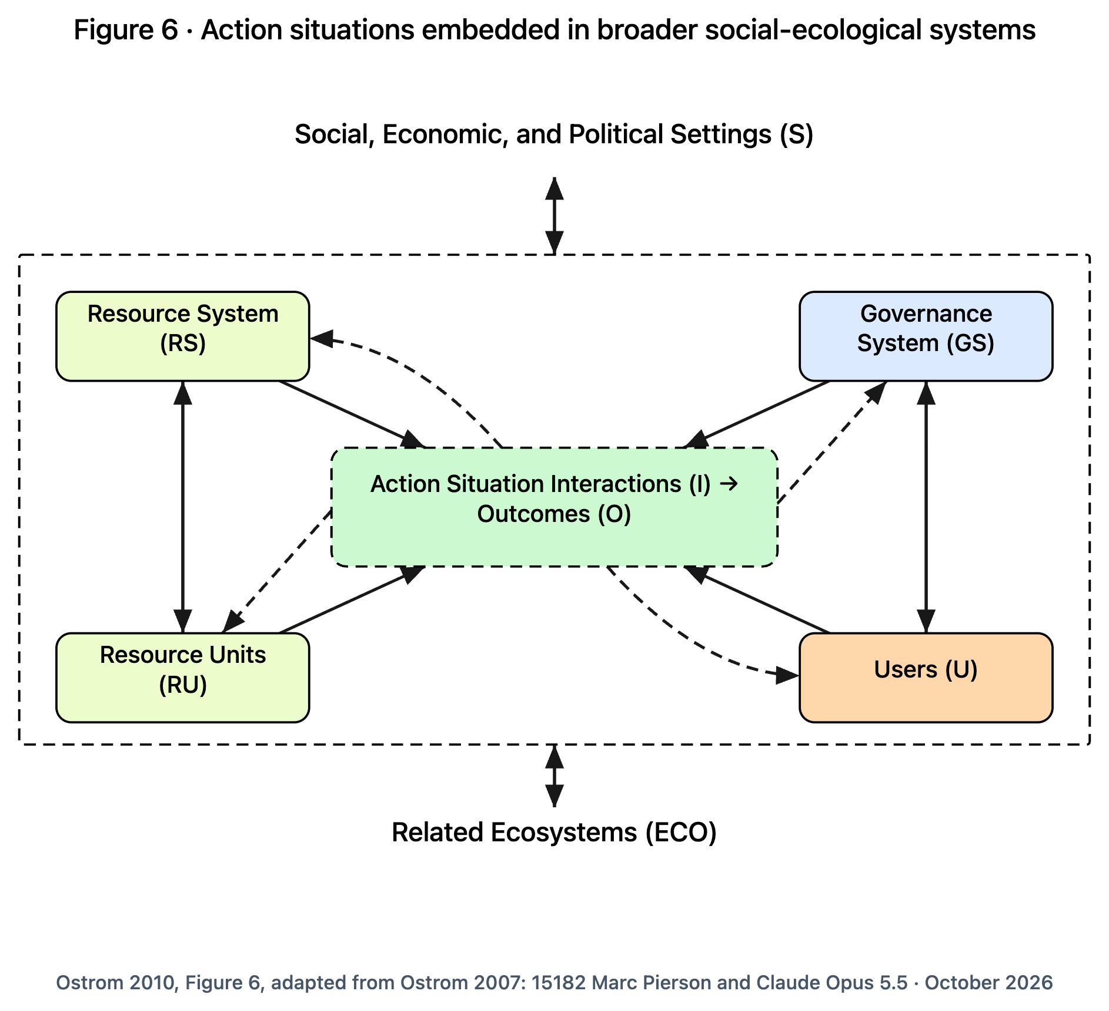
Every commons sits inside a larger system
SCALE 1 · THE WHOLE SYSTEM
HOW TO READ IT
Four parts meet in the middle: the shared resource, the units taken from it, the people who use it, and the rules and bodies that govern it.
Where they meet is an "action situation": people making choices that affect each other.
Solid arrows: this affects that. Dashed arrows: results come back around and change things.
Above and below: the wider world of money, law and politics, and neighboring ecosystems.
Ostrom 2010, Figure 6, adapted from Ostrom 2007
Notes:
Ostrom's Figure 6. Read it from the middle out. The centre box is where people actually act. The four corners shape what they do, and what they do changes the four corners (the dashed arrows). Around everything are the wider social, economic and political settings, and related ecosystems.

Slide 7
Words on this diagram, in plain language
SCALE 1 · THE WHOLE SYSTEM
Every term on the Figure 6 diagram, translated.
Social-ecological system (SES)
People and nature tangled together, studied as one system rather than separately.
Action situation
Any setting where people meet and make choices that affect each other. Step 3 opens it up.
Resource system (RS)
The shared thing as a whole: the garden, the lake, the forest, the fund.
Interactions (I) and outcomes (O)
What people do there (take, share news, argue, invest), and what results, for people and for nature.
Resource units (RU)
The pieces people take or use from it: gallons of water, fish, plots, hours, dollars.
Social, economic and political settings (S)
The wider world: the economy, laws, politics, population change, markets, the news.
Governance system (GS)
The rules, and whoever makes and enforces them: the bylaw, the spring meeting, the city, the water keeper.
Related ecosystems (ECO)
Natural systems next door that affect this one: weather, pollution, water flowing in and out.
Users (U)
The people who use the resource. Ostrom later called them "actors".
Direct causal link / feedback
Solid arrow: one thing affects another. Dashed arrow: results loop back and change what caused them.
Notes:
Every term on the Figure 6 diagram, translated. Read the terms aloud with the diagram on screen; each card is the plain-language meaning.

Slide 8
The four parts at Elm Street
SCALE 1 · THE WHOLE SYSTEM
Resource system
The garden and its rain-fed tank.
Resource units
Gallons of water. Plots. The harvest.
Governance system
The bylaw, the spring meeting, the water keeper, the city lease.
Users
30 gardeners, their families, and newcomers on the waiting list.
Wider settings
City budget and drought policy. Rents. Who has time to garden.
Related ecosystems
The watershed. Rainfall. Heat waves.
Notes:
Bring the diagram home. Each corner of Figure 6 has an Elm Street answer. Ask your own group to fill in the four corners for whatever you share.

Slide 9
Ten things that make it more likely people organize at all
SCALE 1 · THE WHOLE SYSTEM
Size of the resource
Not so big no one can see all of it.
Productivity
Not so ruined it is hopeless, not so plentiful no one cares.
Predictability
People can tell how it will behave.
Mobility of the units
Water and fish move; plots stay put. Moving units are harder.
Collective-choice rules
Users can change their own rules.
Number of users
Enough to do the work, few enough to know each other.
Leadership
Someone willing to start and organize.
Norms and social capital
Shared expectations and trust already exist.
Knowledge of the system
People understand how the resource works.
Importance to users
It matters enough to their lives to be worth the effort.
Notes:
From Ostrom's 2009 Science paper and the Nobel lecture. Across many field studies these ten made it more likely that users would organize themselves to protect a shared resource. They are not a recipe, but they are good questions to ask of your own situation.

Slide 10
What we share
ZOOMING IN
largest scale
1 The whole system
2 What we share
3 One situation in its setting
4 Layers of decision
5 Inside one situation
Not every shared thing is the same kind of thing. The kind decides the problem.
6 The rules that shape it
7 What lasting rules share
8 One sentence of a rule
9 One person deciding
smallest scale
Notes:
Before rules, ask what kind of thing is shared. Ostrom's Figure 1 sorts goods by two questions.

Slide 11
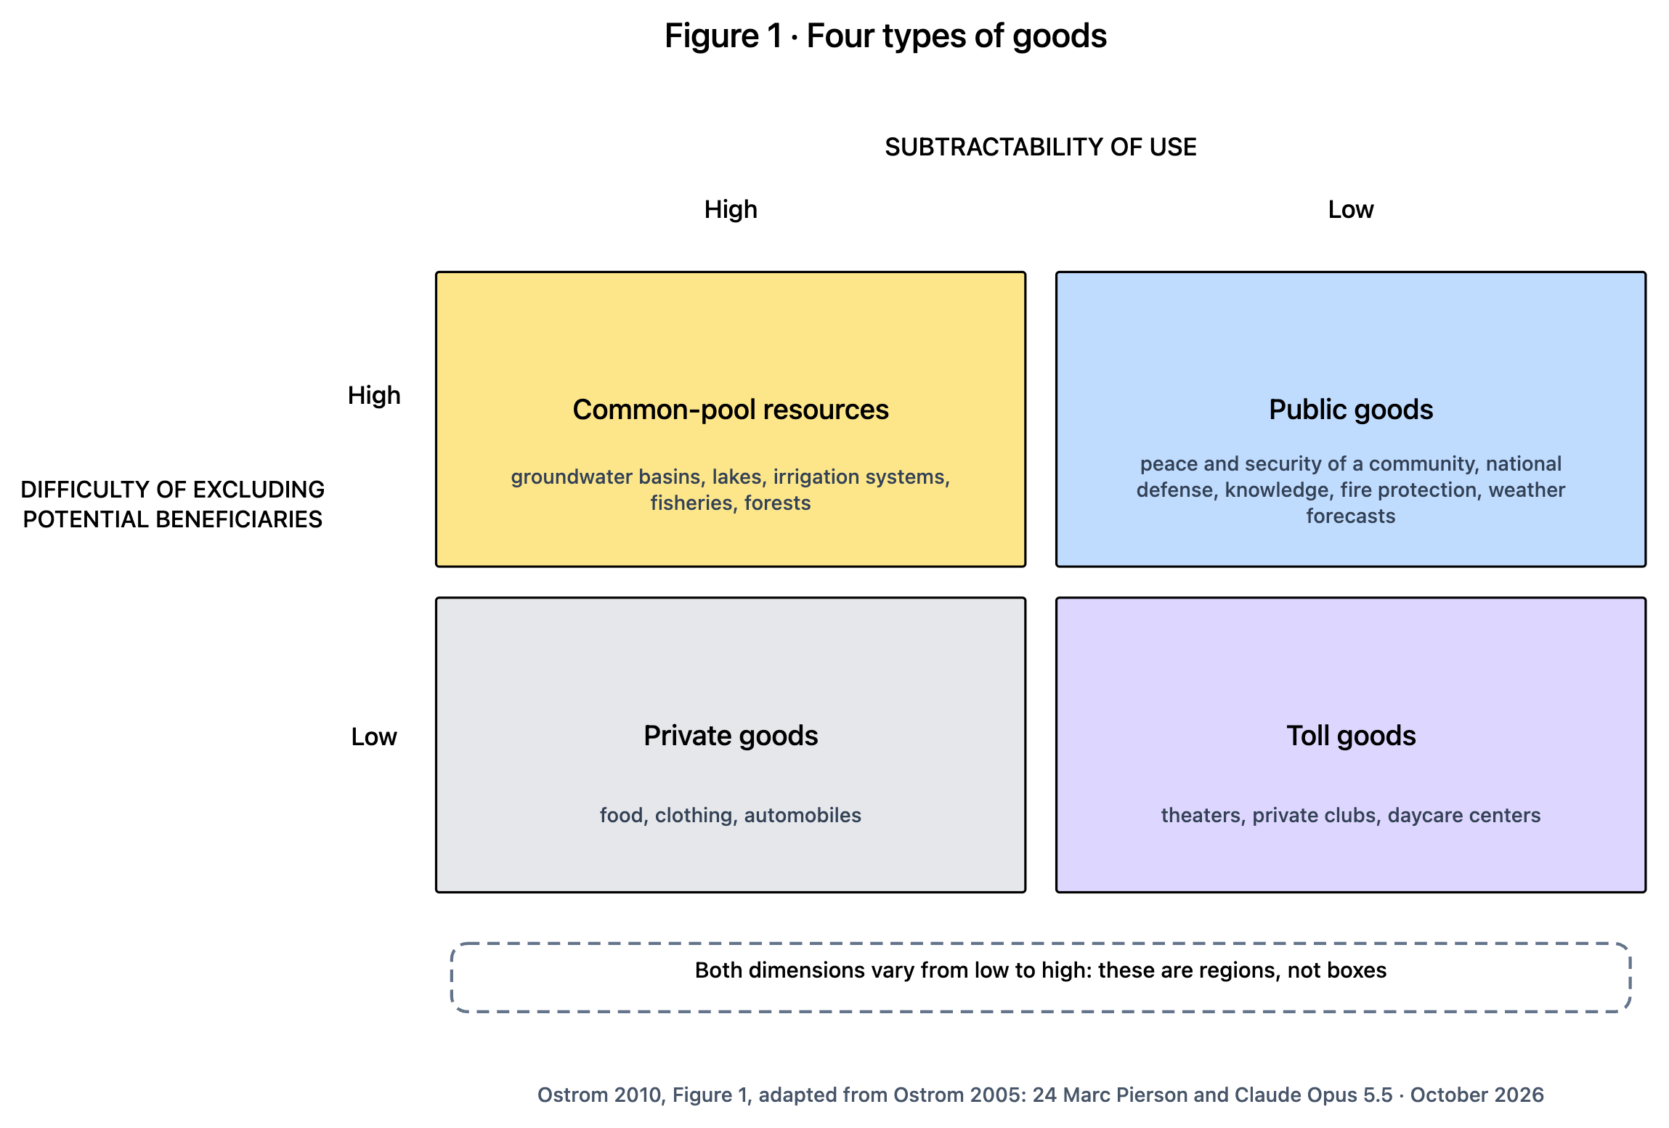
Two questions sort everything people share
SCALE 2 · WHAT WE SHARE
HOW TO READ IT
Across the top: does one person using it leave less for others?
Down the side: how hard is it to keep out people who did not pay or help?
The answers give four kinds of good, each with its own problem.
Ostrom found her design principles in the top-left box: common-pool resources.
Both questions are matters of degree. Things move between boxes.
Ostrom 2010, Figure 1, adapted from Ostrom 2005
Notes:
Figure 1 is the first figure of the lecture. Ostrom took the old two-way split of goods (private and public) and showed there are at least four kinds, because two separate questions are involved. Her work was mostly about the common-pool box.

Slide 12
Words on this diagram, in plain language
SCALE 2 · WHAT WE SHARE
Every term on the Figure 1 diagram, translated.
Goods
Anything people value and use, not only things for sale. Water, safety, knowledge, a meeting hall.
Public good
Hard to keep people out, but use leaves just as much: neighborhood safety, knowledge, weather forecasts.
Subtractability of use
Does my use leave less for you? Economists also call this "rivalry".
Toll good (also "club good")
Easy to keep people out, little is used up until it gets crowded: a theater, a club, a daycare.
Difficulty of excluding potential beneficiaries
How hard it is to keep people who did not pay or help from benefiting anyway.
Private good
Easy to keep people out and use leaves less: food, clothing, a car.
Common-pool resource
Hard to keep people out AND use leaves less: groundwater, fisheries, forests, the garden tank in August.
Free-riding
Enjoying the benefit without doing your share. The main problem with public goods.
Notes:
Every term on the Figure 1 diagram, translated. Read the terms aloud with the diagram on screen; each card is the plain-language meaning.

Slide 13
Neighborhood things, sorted
SCALE 2 · WHAT WE SHARE
Common-pool: the garden water, a shared fund, volunteer hours
Two problems at once: people taking too much, and not enough people putting back. Rules about both taking and contributing matter.
Public: neighborhood safety, a shared local-knowledge wiki
Everyone benefits whether or not they helped, so the problem is getting enough people to contribute.
Toll: a tool library, a co-op's member services, a meeting hall
Membership does most of the work: who is in, what they pay, what happens when it gets crowded.
Private: the vegetables from your own plot
Markets and personal choice handle these. Little to govern together.
These are regions, not boxes. In a wet spring the garden water is hardly contested. In a drought, every gallon is.
Notes:
Ask the group to place the things it shares. The point is not the box; it is the problem each box brings. And note that drought moves the garden water from "plenty" toward "fiercely contested".

Slide 14
One situation in its setting
ZOOMING IN
largest scale
1 The whole system
2 What we share
3 One situation in its setting
4 Layers of decision
5 Inside one situation
Zoom in to one place where people meet and choose, and what shapes it from outside.
6 The rules that shape it
7 What lasting rules share
8 One sentence of a rule
9 One person deciding
smallest scale
Notes:
Now we zoom in from the whole system to a single 'action situation' and the three kinds of thing outside it that shape it. This is the core picture of Ostrom's Institutional Analysis and Development framework.

Slide 15
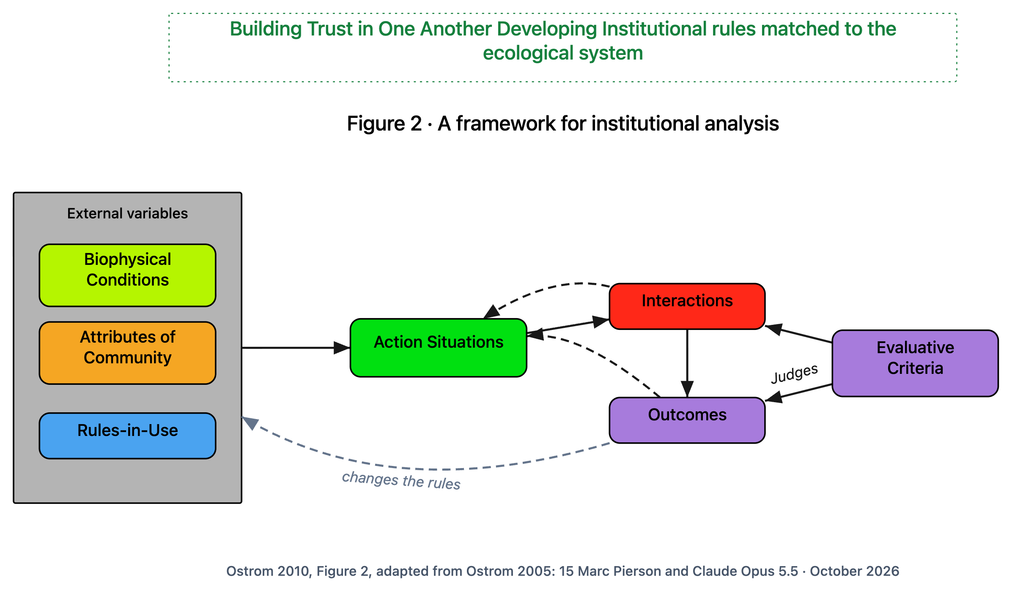
What shapes what people do together
SCALE 3 · ONE SITUATION IN ITS SETTING
HOW TO READ IT
Left box: three things set the scene. The physical world, who the people are, and the rules they actually follow.
Middle: the action situation, where people meet and choose.
Right: what they do (interactions), what results (outcomes), and the yardsticks used to judge both.
Dashed arrows: results feed back. The long one is people changing their own rules.
Ostrom 2010, Figure 2, adapted from Ostrom 2005. Green title: Marc's
Notes:
Ostrom's Figure 2. The green title at the top is Marc's: the two halves of the lecture, building trust, and making rules that fit the place. The dashed arrow labelled 'changes the rules' was added from Ostrom's text; it is where step 4 lives.

Slide 16
Words on this diagram, in plain language
SCALE 3 · ONE SITUATION IN ITS SETTING
Every term on the Figure 2 diagram, translated.
IAD framework
Institutional Analysis and Development framework: Ostrom's map for studying how rules shape what people do.
Rules-in-use
The rules people actually follow, which may differ from what is written down.
Institution
In Ostrom's sense, not a building or an organization: the rules, norms and shared habits people live by.
Action situation(s)
Any setting where people meet and choose things that affect each other: a meeting, watering day, a market.
External variables (also "exogenous")
Things outside the situation that shape it, which people in the moment cannot change.
Interactions and outcomes
What people actually do, and what results from it.
Biophysical conditions
The physical and natural facts: the water, the soil, the weather, the building.
Evaluative criteria
The yardsticks for judging results: Is it fair? Efficient? Accountable? Will it last?
Attributes of community
Who the people are: their history together, how alike or different they are, what they know, how much they trust.
Feedback (dashed arrows)
Results loop back and change the situation, and sometimes the rules themselves.
Notes:
Every term on the Figure 2 diagram, translated. Read the terms aloud with the diagram on screen; each card is the plain-language meaning.

Slide 17
Rules on paper and rules in use
SCALE 3 · ONE SITUATION IN ITS SETTING
Rules on paper (the bylaw)
Water only on your assigned day.
No sprinklers when the tank is below half.
The water keeper suspends anyone who breaks the rules.
Rules in use (what people do)
Early risers water any day; nobody minds.
Nobody reads the tank, so "below half" never triggers.
The keeper has never suspended anyone; a quiet word works.
The gap between the two is the subject. A rule nobody follows has drifted. A habit everybody follows is a rule nobody wrote down. Both are found only by watching, asking, and keeping records over time.
Notes:
Ostrom insisted on 'rules-in-use': the rules people actually follow. A written bylaw is a first guess at them. You only find the real ones by watching and asking. This is why coding a document is never the whole story.

Slide 18
Layers of decision
ZOOMING IN
largest scale
1 The whole system
2 What we share
3 One situation in its setting
4 Layers of decision
5 Inside one situation
Rules come from somewhere. Each layer decides the rules for the layer below it.
6 The rules that shape it
7 What lasting rules share
8 One sentence of a rule
9 One person deciding
smallest scale
Notes:
The dashed 'changes the rules' arrow in Figure 2 hides a stack of decision layers. Ostrom called them levels of action. This drawing is an added panel: the lecture mentions the levels in one sentence and has no figure for them.

Slide 19
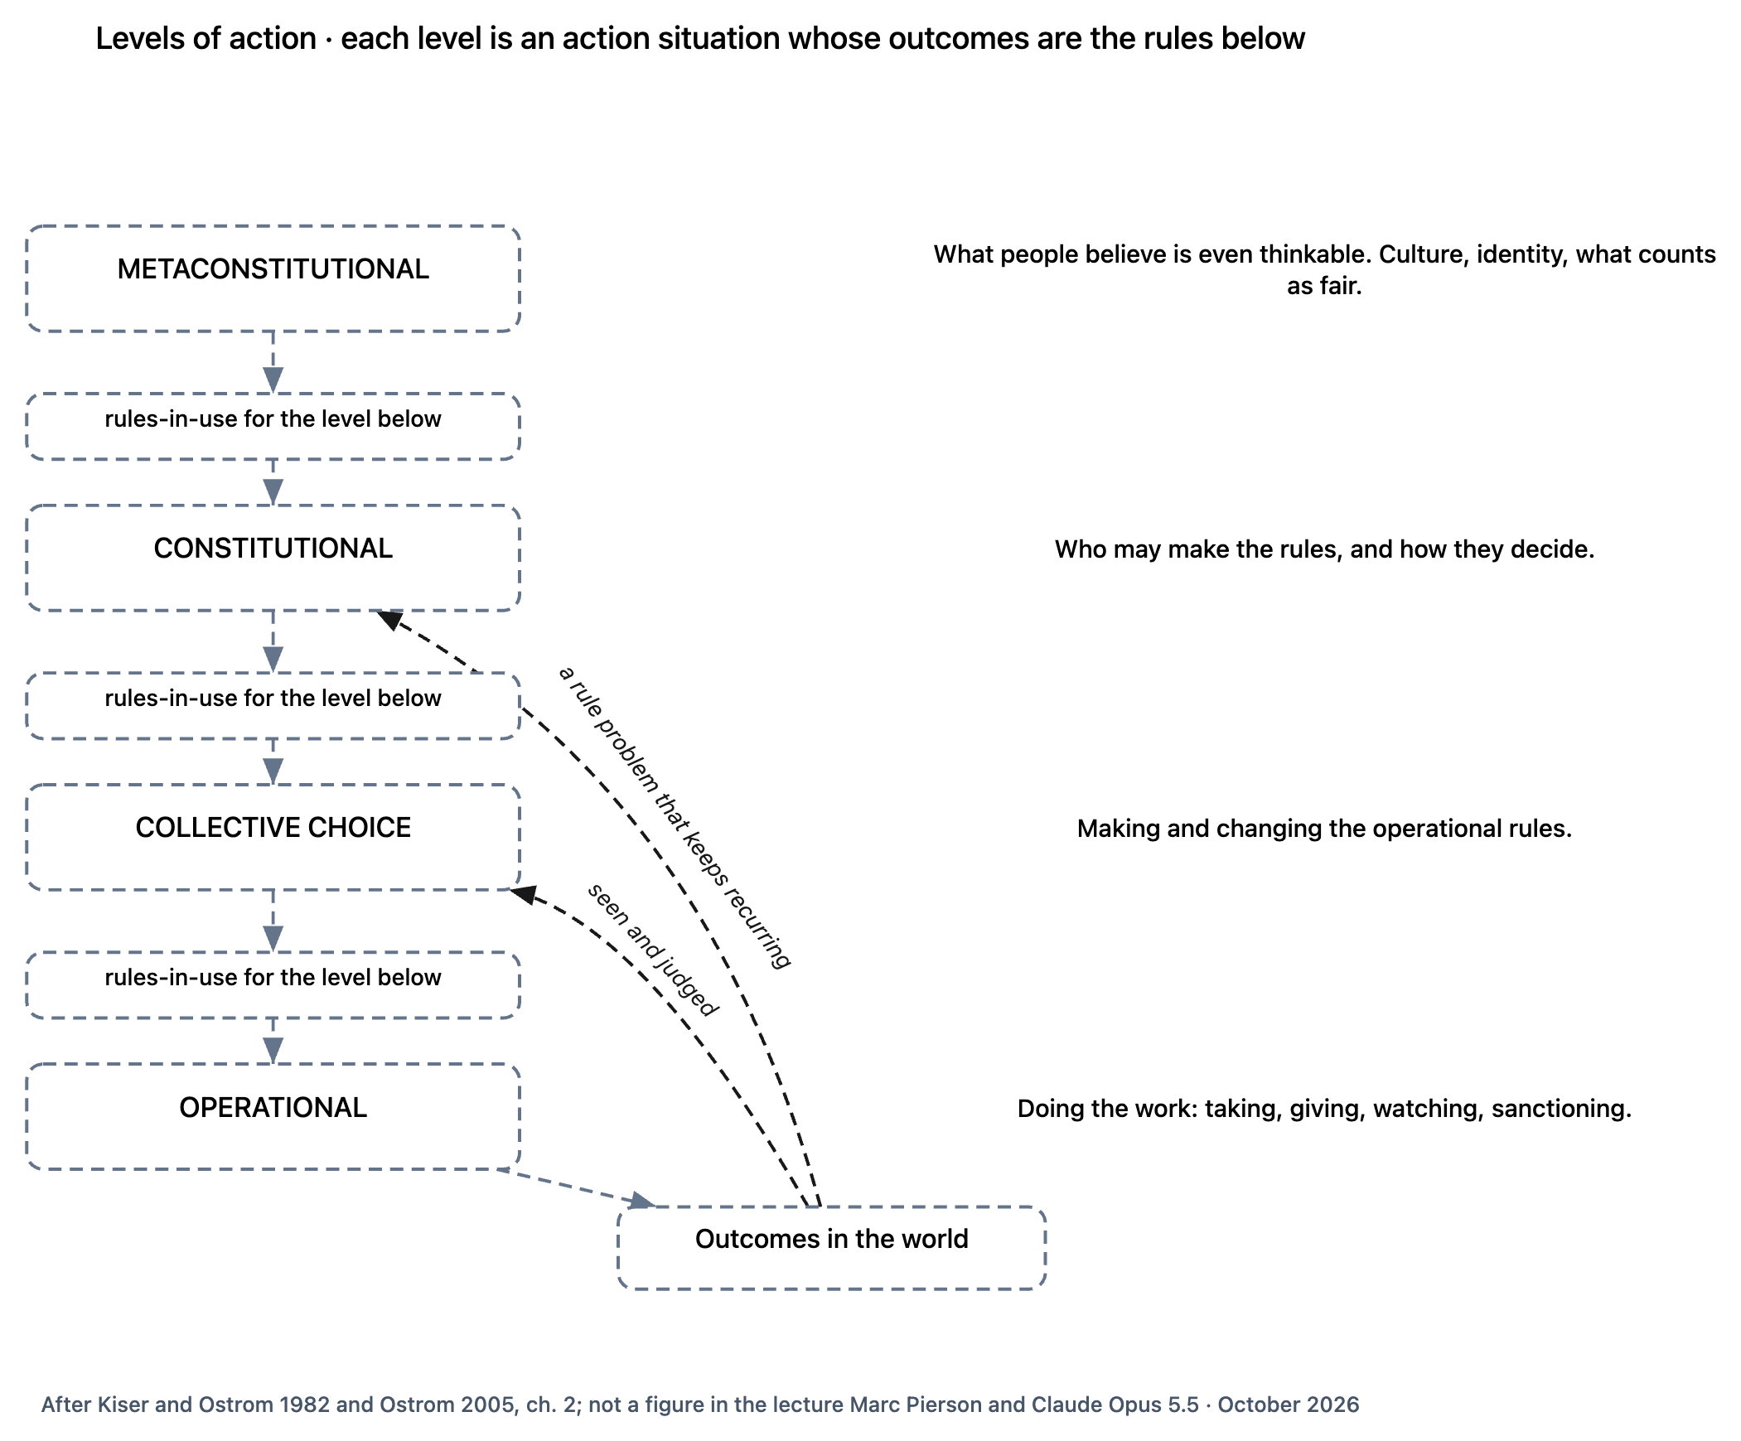
Each level decides the rules for the level below
SCALE 4 · LAYERS OF DECISION
HOW TO READ IT
Read down: what is decided at each level becomes the working rules of the next one.
Read up: people see results in the world and take them to the level that can change the rule.
The higher the level, the fewer the decisions, and the more each one changes.
Added panel, after Kiser and Ostrom 1982 and Ostrom 2005; not a lecture figure
Notes:
Four levels. Metaconstitutional: culture and what people think is even possible. Constitutional: who may make the rules and how. Collective choice: making and changing the everyday rules. Operational: doing the work. Each is itself an action situation. Its outcomes are the rules for the level below.

Slide 20
Words on this diagram, in plain language
SCALE 4 · LAYERS OF DECISION
Every term on the levels drawing, translated.
Levels of action
Layers of decision making. Each layer decides the rules for the layer below it.
Metaconstitutional
The unwritten culture underneath: what people think is fair, who counts, what a rule can even be.
Operational
Day-to-day doing: watering, harvesting, paying, watching, applying a penalty.
Rules-in-use for the level below
What one layer decides becomes the working rules of the next one down.
Collective choice
Making and changing the everyday rules: a meeting votes to change the watering days.
Seen and judged / a rule problem that keeps recurring
The upward arrows: results are noticed, judged, and taken to a level that can change things.
Constitutional
Deciding who gets to make the rules, and how they decide: who is a member, how the meeting votes.
Outcomes in the world
What actually happens: water used, plots tended, care given, money moved.
Notes:
Every term on the levels drawing, translated. Read the terms aloud with the diagram on screen; each card is the plain-language meaning.

Slide 21
The four levels at Elm Street
SCALE 4 · LAYERS OF DECISION
Metaconstitutional
Do we think newcomers deserve a plot at all?
Unwritten. Strongest.
Constitutional
Who counts as a member, and how does the spring meeting vote?
Most leverage
Collective choice
The spring meeting changes the watering days.
A rule changes
Operational
Watering on your day. The keeper speaks to someone who did not.
A number changes. Least leverage, most effort
Notes:
Same garden, four levels. Notice how much more each higher decision changes, and how rarely it is made.

Slide 22
A one-question test: which level am I standing on?
SCALE 4 · LAYERS OF DECISION
Does it change a number?
Operational
Least leverage. Where most effort goes.
Does it change a rule?
Collective choice
Real change, made by the group.
Does it change who may change the rule?
Constitutional
Most leverage. Rare, and lasting.
Donella Meadows found the same thing in systems: numbers are the weakest place to push, and the power to change a system's structure is among the strongest.
Notes:
A quick test you can use in any meeting. When someone proposes a change, ask which of these three it is. The leverage rises as you go right.

Slide 23
One complaint, three levels: the missing seat
SCALE 4 · LAYERS OF DECISION
The higher you read, the more leverage the fix has.
Constitutional reading
"There is no health-worker seat at all." You cannot seat someone in a role that does not exist. Only a constitutional decision, creating the role, fixes it.
Collective-choice reading
"The health worker is not seated where rules are made." A membership problem. Fix: invite them. Still they have no vote.
Operational reading
"Nobody asks the health worker." Sounds like a communication problem. Fix: ask more often. It does not hold.
Notes:
Our second example. A neighborhood health co-op. Its community health worker (CHW) is never part of decisions. Read at each level, the same complaint means something different, and only the top reading points to the fix.

Slide 24
Inside one situation
ZOOMING IN
largest scale
1 The whole system
2 What we share
3 One situation in its setting
4 Layers of decision
5 Inside one situation
Open up the action situation. Every one has the same seven working parts.
6 The rules that shape it
7 What lasting rules share
8 One sentence of a rule
9 One person deciding
smallest scale
Notes:
Now we open the action situation box itself. Ostrom built these seven parts with the game theorist Reinhard Selten so that field studies, experiments and mathematical models could all use one vocabulary.

Slide 25
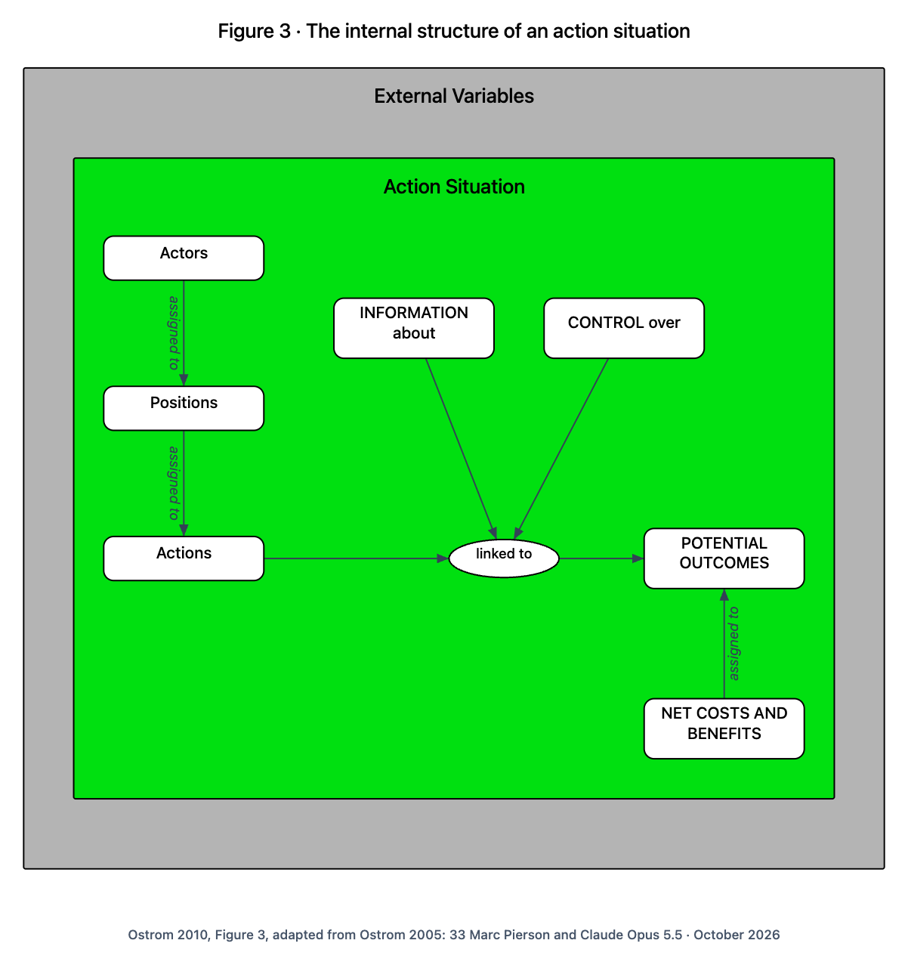
The seven working parts of any situation
SCALE 5 · INSIDE ONE SITUATION
HOW TO READ IT
People (actors) are put into roles (positions).
Roles come with actions they can take.
Actions lead to possible results, shaped by what people know (information) and how choices combine (control).
Each result carries costs and benefits for each role.
Ostrom 2010, Figure 3, adapted from Ostrom 2005
Notes:
Ostrom's own one-sentence version: participants are assigned to positions; in those positions they choose among actions, in light of their information, the control they have over how actions lead to outcomes, and the costs and benefits assigned to actions and outcomes. That sentence names all seven parts. The small 'linked to' oval is a drawing convenience: in her figure, Information and Control point at the arrow between Actions and Potential Outcomes.

Slide 26
Words on this diagram, in plain language
SCALE 5 · INSIDE ONE SITUATION
Every term on the Figure 3 diagram, translated.
Actors
The people or organizations taking part. At Elm Street: gardeners, the keeper, the city.
Potential outcomes
The results that are possible here: a full tank, dead tomatoes, a fight.
Positions
Roles or seats: gardener, water keeper, chair. A role outlasts the person in it.
Net costs and benefits
What each role pays and gains. "Net" means gains minus costs.
Actions
What someone in a position can do: water, harvest, propose, vote, report.
Assigned to / linked to
Who goes in which seat, and which actions lead to which results.
INFORMATION about
What each person knows when they choose: the tank level, who watered, what others did.
External variables
The outside things from Figure 2 that set up the situation.
CONTROL over
How individual choices combine into a result: one person decides, a vote, everyone must agree.
Action situation
The setting where all seven parts come together.
Notes:
Every term on the Figure 3 diagram, translated. Read the terms aloud with the diagram on screen; each card is the plain-language meaning.

Slide 27
The rules that shape it
ZOOMING IN
largest scale
1 The whole system
2 What we share
3 One situation in its setting
4 Layers of decision
5 Inside one situation
Seven kinds of rule, one for each working part. Plus Marc's questions from inside the seat.
6 The rules that shape it
7 What lasting rules share
8 One sentence of a rule
9 One person deciding
smallest scale
Notes:
Figure 4 wraps the seven parts in a blue box of rules. Each kind of rule shapes exactly one part. The green labels are Marc's additions: the questions a person asks from inside their seat.

Slide 28
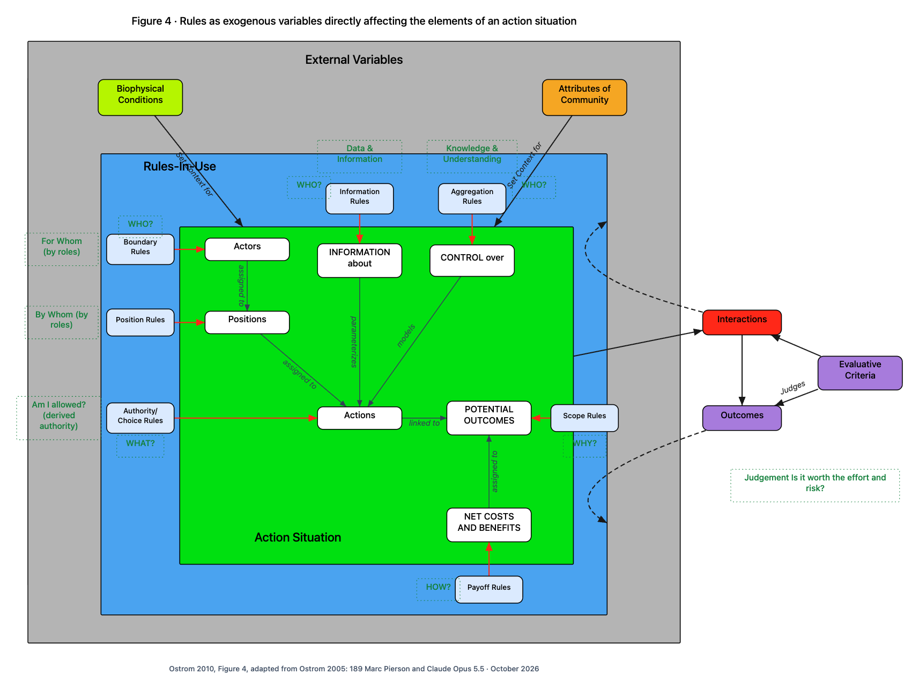
Each kind of rule shapes one part of the situation
SCALE 6 · THE RULES THAT SHAPE IT
HOW TO READ IT
Blue box: the rules people actually follow. Green box: the situation from Figure 3.
Each red arrow: one kind of rule shaping one working part.
Green dotted labels are Marc's: the same rules seen from inside the seat.
Outcomes are judged and loop back into the rules (dashed arrows).
Ostrom 2010, Figure 4, adapted from Ostrom 2005. Green dotted labels: Marc's
Notes:
Ostrom's Figure 4: rules as outside variables directly affecting the elements of an action situation. Her advice was to ask of any rule: which part of the situation does it affect? That sorts every rule into one of seven kinds. Ostrom found many versions of each kind; 27 different boundary rules in common-pool resource cases alone.

Slide 29
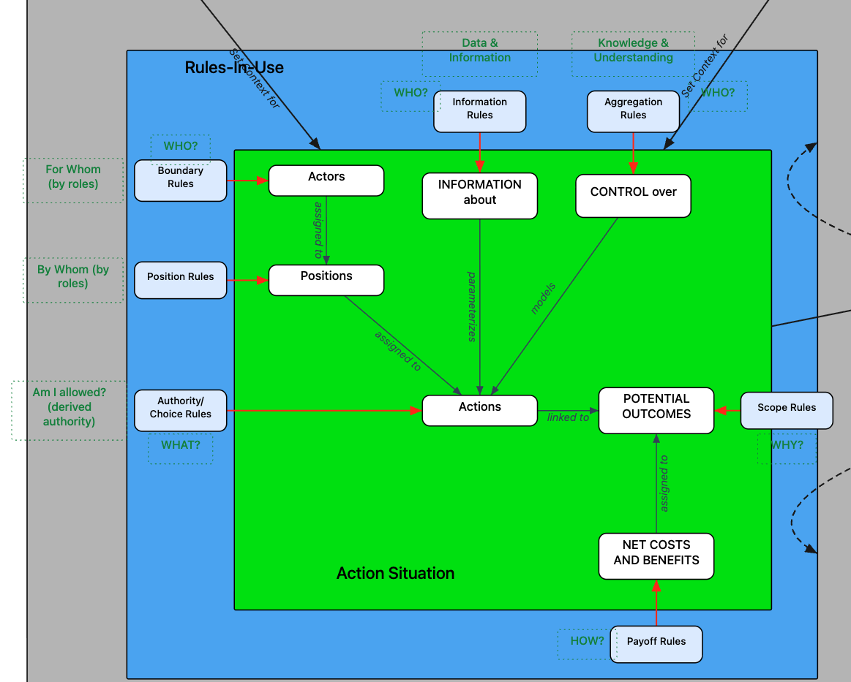
Close-up: the rules box, and Marc's questions
SCALE 6 · THE RULES THAT SHAPE IT
Blue boxes
the seven kinds of rule
Red arrows
which part each rule shapes
White boxes
the seven working parts from Figure 3
Green dotted
Marc's questions: WHO? WHAT? HOW? WHY?, For whom, By whom, Am I allowed?
Detail of Figure 4. Green dotted labels: Marc's
Notes:
The same Figure 4, enlarged. Point to each blue rule box and the red arrow leaving it: that is the part of the situation it shapes. Then read the green dotted label beside it: Marc's question from inside the seat. The next two slides translate every word.

Slide 30
The seven kinds of rule, in plain language
SCALE 6 · THE RULES THAT SHAPE IT
The rule names on the Figure 4 diagram, translated, with Elm Street examples.
Boundary rules
Who may enter or leave. Who counts as a gardener, how you join, how you leave.
Aggregation rules
How choices combine into a decision. Majority, two-thirds, consensus, the keeper alone.
Position rules
What roles exist, and how many people hold each. One water keeper; a chair.
Payoff rules
Who pays, who gains, and what happens to rule breakers. Four work hours a season; a week without water.
Authority / choice rules
What each role must, may, or must not do. Gardeners may water on their day.
Scope rules
Which outcomes may be affected, and what is off limits. The meeting may not sell the land.
Information rules
What must, may, or must not be shared, with whom. The keeper reports the tank level weekly.
Exogenous variables (title)
"Exogenous" means set from outside. The rules come from outside the situation and shape it.
Notes:
The rule names on the Figure 4 diagram, translated, with Elm Street examples. Read the terms aloud with the diagram on screen; each card is the plain-language meaning.

Slide 31
Marc's questions: the same rules, seen from inside the seat
SCALE 6 · THE RULES THAT SHAPE IT
Ostrom draws the situation from outside, like an analyst. Marc's labels draw it from inside, like a participant.
WHO? (boundary, information, aggregation)
Who is in? Who gets told? Who has to agree?
Am I allowed? (derived authority)
My permission comes from a rule, not from me. "Derived" means it comes from somewhere else.
WHAT? (choice rules)
What am I allowed, required, or forbidden to do?
Data & information / Knowledge & understanding
Information rules move data; aggregation turns what people know into a shared decision.
HOW? (payoff rules)
How are costs and benefits shared, and how are breaches handled?
parameterizes / models
Information sets the limits a choice is made within. Control describes how choices turn into results.
WHY? (scope rules)
What outcomes are we here to affect at all?
Judges / Judgement: is it worth the effort and risk?
The yardsticks judge outcomes. Each person also judges: is cooperating worth it? Step 9 answers.
For whom / By whom (by roles)
Who benefits from a role, and who fills it. Asked of roles, not of particular people.
Notes:
Ostrom draws the situation from outside, like an analyst. Marc's labels draw it from inside, like a participant. Read the terms aloud with the diagram on screen; each card is the plain-language meaning.

Slide 32
The rule nobody writes down: how do we decide?
SCALE 6 · THE RULES THAT SHAPE IT
The spring meeting votes on a new watering schedule. 30 members. 17 vote yes, 10 vote no, 3 are absent.
Simple majority of those present
PASSES
17 of 27
Two-thirds of those present
FAILS
needs 18 of 27
Consensus
FAILS
10 objections
The water keeper decides
?
depends on one person
Most conflict is two people silently assuming different aggregation rules. Ask early: who has to agree for this to count?
Notes:
Aggregation rules are the ones groups most often leave unstated. Two people can sincerely disagree about whether something 'passed' because each assumed a different rule. A simple demonstration: one set of votes, four different outcomes.

Slide 33
What lasting rules share
ZOOMING IN
largest scale
1 The whole system
2 What we share
3 One situation in its setting
4 Layers of decision
5 Inside one situation
Ostrom's design principles: patterns found in commons that lasted, and missing in those that failed.
6 The rules that shape it
7 What lasting rules share
8 One sentence of a rule
9 One person deciding
smallest scale
Notes:
Ostrom first looked for specific rules that worked everywhere, and found none: the rules that worked varied enormously from place to place. So she moved up one level of generality and found patterns. She called them design principles, while stressing that people did not have them in mind when building their systems.

Slide 34
Eight design principles, in plain words
SCALE 7 · WHAT LASTING RULES SHARE
1 Clear boundaries
Everyone knows who is in (1A) and what the shared thing is (1B).
2 Rules that fit
Rules suit this place and these people (2A). What you put in matches what you take out (2B).
3 Collective choice
Most people affected by the rules help make and change them.
4 Monitoring
Someone watches how the rules are kept (4A) and the condition of the resource (4B), and answers to the users.
5 Graduated sanctions
Penalties start small and grow with repeated or serious breaches.
6 Conflict resolution
Cheap, quick, local ways to settle disputes, including disputes about the rules.
7 Recognition of rights
Governments and landowners outside the group respect its right to make its own rules.
8 Nested enterprises
When part of something bigger, governance is layered: small self-governing groups inside larger ones.
Notes:
The list as updated by Cox, Arnold and Villamayor Tomas (2010), who reviewed over 100 studies and split three principles in two. About two-thirds of those studies found that robust resource systems had most of the principles and failures did not.

Slide 35
Words in the design principles, in plain language
SCALE 7 · WHAT LASTING RULES SHARE
Terms used in the principles, translated.
Design principle
A pattern found in long-lasting commons. Not a blueprint, and not something people consciously followed.
Monitoring
Watching: who takes what, and how the resource is doing. Best done by users or people who answer to them.
Congruence with local conditions
The rules fit the place: its weather, its resource, its people. "Congruent" means fitting together.
Graduated sanctions
"Graduated" means stepping up. "Sanction" means penalty. A warning first, then stronger.
Appropriation and provision
Taking from the resource, and putting work, money or care back into it.
Nested enterprises
Groups inside groups, each governing itself: a garden inside a neighborhood council inside a city.
Notes:
Terms used in the principles, translated. Read the terms aloud with the diagram on screen; each card is the plain-language meaning.

Slide 36
Each principle leans on particular kinds of rule
SCALE 7 · WHAT LASTING RULES SHARE
Principle | Kinds of rule it rests on | Level
1 Clear boundaries | Boundary (who is in); scope (what the thing is) | Operational and constitutional
2 Rules that fit | Payoff matched against choice (2B). 2A: no rule shows it | Operational
3 Collective choice | Boundary, position, information, aggregation, scope | Collective choice
4 Monitoring | Position (a monitor), choice (duty to watch), information (reports) | Operational
5 Graduated sanctions | Payoff: the penalty, stepping up | Operational
6 Conflict resolution | Position (a venue), boundary (who may come), aggregation (how it is settled) | Collective choice
7 Recognition of rights | Scope, set by an outside body | Constitutional
8 Nested enterprises | Boundary and position, linking groups of different sizes | Constitutional
Notes:
Our own synthesis (not Ostrom's): which of the seven rule kinds, and which level, each principle depends on. This is how the frames connect. Principle 2A is the exception: whether rules fit the place is a judgment about the place, not something any rule can show.

Slide 37
Principle 3 is really five questions
SCALE 7 · WHAT LASTING RULES SHARE
1
2
3
4
5
Are they seated?
Boundary rule
Is there a seat for them?
Position rule, set at the constitutional level
Do they see proposals in time?
Information rule
Does their voice count?
Aggregation rule: a vote, consent, or only being asked
What may they change?
Scope rule
The health worker in step 4 failed question 2. No amount of asking (question 3) or inviting (question 1) could fix it.
Notes:
'The people affected help make the rules' sounds simple. The rule kinds split it into five questions, and a group can fail any one of them while sincerely believing it follows principle 3.

Slide 38
One sentence of a rule
ZOOMING IN
largest scale
1 The whole system
2 What we share
3 One situation in its setting
4 Layers of decision
5 Inside one situation
Zoom in on a single written rule. Ostrom and Sue Crawford gave rules a grammar.
6 The rules that shape it
7 What lasting rules share
8 One sentence of a rule
9 One person deciding
smallest scale
Notes:
Rules are made of sentences. Crawford and Ostrom (1995) showed every rule-like sentence has the same few parts, which they called ADICO. A later version, Institutional Grammar 2.0 (Frantz and Siddiki 2021), adds a few more. The Agreement Checker asks these parts as plain questions.

Slide 39
The parts of one rule
SCALE 8 · ONE SENTENCE OF A RULE
"When the tank is below half, gardeners must not water their plots with sprinklers, or else they lose watering for a week."
WHEN?
WHO?
MUST, MAY, OR MUST NOT?
DO WHAT?
TO WHAT?
HOW?
OR ELSE?
when the tank is below half
gardeners
must not
water
their plots
with sprinklers
they lose watering for a week
Condition
Attribute
Deontic
Aim
Object
Condition
Or else
Bottom row: the formal names in ADICO and its successor. A creating sentence ("The water keeper is chosen each spring from the members") answers different questions: WHAT ARE WE CREATING? MUST OR MAY? FORMED HOW? OUT OF WHAT?
Notes:
Take one sentence from the garden bylaw and ask it the plain questions. Each part has a job. The OR ELSE is the part most often missing.

Slide 40
Words of the rule grammar, in plain language
SCALE 8 · ONE SENTENCE OF A RULE
Every term used for the parts of a rule, translated.
Institutional Grammar (IG)
A way to break any rule-like sentence into the same few parts, so rules can be compared and checked.
Aim and object
The action (DO WHAT?) and what it is done to (TO WHAT?).
ADICO
The original five parts (Crawford and Ostrom 1995): Attribute, Deontic, aIm, Condition, Or else.
Condition
When, where and how the rule applies. IG 2.0 splits it into WHEN? and HOW?
Attribute
Who the sentence applies to. WHO?
Or else
The consequence for breaking it. Without one, a sentence is a norm, not a rule.
Deontic
The must, may, or must not. From the Greek for "what is binding".
Constitutive statement ("creating agreement")
A sentence that creates a role, group or thing, rather than telling people what to do.
Notes:
Every term used for the parts of a rule, translated. Read the terms aloud with the diagram on screen; each card is the plain-language meaning.

Slide 41
No OR ELSE, no rule
SCALE 8 · ONE SENTENCE OF A RULE
Agreed rule
All parts, including an OR ELSE.
"...or else they lose watering for a week."
Shared expectation (a norm)
Has MUST or MAY, but no OR ELSE.
"Gardeners should keep paths clear."
Shared habit (a strategy)
No MUST or MAY, no OR ELSE. Just what people do.
"We water early in the morning."
Shared habits are as close as writing gets to the unwritten metaconstitutional level from step 4.
Notes:
The grammar sorts sentences by strength. In real documents the OR ELSE is usually empty, which tells you the sentence is a hope, not a rule, and that what people actually do will drift away from it.

Slide 42
What reading rules this closely finds
SCALE 8 · ONE SENTENCE OF A RULE
Things nobody created
A rule about "gardeners", with no sentence saying who counts as a gardener. A rule about "the tank", with nothing saying which tank.
Penalties nobody carries out
Follow the OR ELSE: who applies it? What creates that role? Whom does the role answer to?
Triggers nobody reads
"When the tank is below half" assumes someone reads the tank. If no sentence gives anyone that job, the rule never switches on.
Principle 1: clear boundaries
Principles 4 and 5: monitoring and sanctions
Principle 4B: monitoring the resource
Notes:
Three gaps the grammar reveals that a quick read misses. Each one ties a single sentence back to a design principle.

Slide 43
One person deciding
ZOOMING IN
largest scale
1 The whole system
2 What we share
3 One situation in its setting
4 Layers of decision
5 Inside one situation
The smallest scale: one person, one moment. Is it worth cooperating?
6 The rules that shape it
7 What lasting rules share
8 One sentence of a rule
9 One person deciding
smallest scale
Notes:
The last zoom. Good rules are not enough on their own. Ostrom's Nobel lecture says cooperation runs on trust: confidence that the others will do their share. Rules matter because they create the conditions in which that trust can grow.

Slide 44
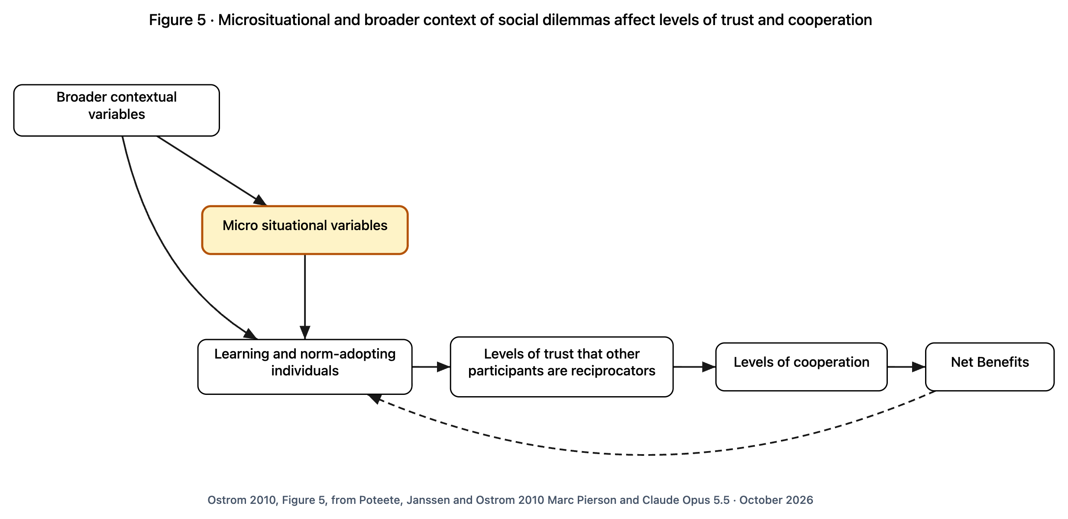
Cooperation runs on trust that others will do their share
SCALE 9 · ONE PERSON DECIDING
HOW TO READ IT
Read left to right: the setting shapes what people learn about each other.
What they learn builds (or destroys) trust that others will reciprocate.
Trust brings cooperation; cooperation brings benefits.
The dashed loop: good results teach trust, bad results teach distrust.
Ostrom 2010, Figure 5, from Poteete, Janssen and Ostrom 2010
Notes:
Ostrom's Figure 5. People are not the narrowly selfish calculators of older theory: they learn and adopt norms. But they will not keep cooperating if they believe others will not. The structure of the situation, especially the small features of it, decides whether trust can grow. Marc's question from Figure 4, 'Is it worth the effort and risk?', is answered here.

Slide 45
Words on this diagram, in plain language
SCALE 9 · ONE PERSON DECIDING
Every term on the Figure 5 diagram, translated.
Social dilemma
A situation where what is best for each person alone is bad for everyone together. Overwatering in a drought.
Norm
A shared expectation about how people should act, usually unwritten.
Broader contextual variables
The big setting from step 1: the resource, the rules, the wider world.
Reciprocators
People who return cooperation with cooperation: I do my share if you do yours.
Microsituational variables
Small features of the immediate situation: can people talk, do they know each other's record. Next slide.
Levels of trust that other participants are reciprocators
How confident I am that the others will do their share if I do mine.
Learning and norm-adopting individuals
People who learn from experience and take on shared expectations, rather than purely selfish calculators.
Levels of cooperation / net benefits
How much people actually work together, and what everyone gains minus what it costs.
Notes:
Every term on the Figure 5 diagram, translated. Read the terms aloud with the diagram on screen; each card is the plain-language meaning.

Slide 46
Six conditions that make trust possible
SCALE 9 · ONE PERSON DECIDING
People can talk, ideally face to face
Faces and tone tell people who is trustworthy.
People's past behavior is known
A track record makes cooperation safer.
Each contribution clearly makes a difference
"Marginal per capita return": my share visibly matters.
Principles 3, 6
Principle 4A
Principle 2B
People can enter or leave at low cost
No one is trapped as the only one still trying.
A long time horizon
Cooperation pays more over years than over weeks.
Sanctions the group agreed to itself
Self-made penalties are rarely needed; imposed ones can backfire.
Principle 1A
Principle 7
Principles 5, 3
Notes:
Ostrom's six (lecture pp. 661-662), from experiments and field studies. The design principles paired with each are our reading, not Ostrom's: they show how the rules from steps 6 and 7 build the conditions for trust in step 9.

Slide 47
What a neighborhood can change this month
SCALE 9 · ONE PERSON DECIDING
1
Meet in person, regularly, with everyone who shares the thing. Not only the organizers.
2
Keep a record people agree to, of who did what. Kept with them, never about them behind their backs.
3
Make contributions visible: a simple chart of tank levels or work hours shows each person their share mattered.
4
Let people leave cheaply, and take their own records with them. Free to leave makes staying a choice.
5
Plan for years, not weeks: secure the lease; write down how the rules can change.
6
Write your own penalties, together, starting small. Agreed sanctions are the ones that rarely need using.
Notes:
You cannot rewrite a constitution this month. You can change these small conditions now, and they are where trust starts. Each matches one of Ostrom's six.

Slide 48
Zooming back out
CLOSING
1
The whole system: The system sets what is possible.
2
What we share: The kind of good sets the problem.
3
One situation in its setting: The situation is where people meet.
4
Layers of decision: The levels say who can change what.
5
Inside one situation: Seven parts make every situation.
6
The rules that shape it: Seven kinds of rule shape the parts.
7
What lasting rules share: The principles describe rules that last.
8
One sentence of a rule: One sentence holds one rule.
9
One person deciding: One person decides whether to trust.
Notes:
The nine scales are one picture seen at different distances. A problem noticed at one scale is often fixed at another: a complaint at the operational level may need a constitutional fix; a rule that never works may be missing the trust it depends on.

Slide 49
Questions to take to your group
CLOSING
1
What is the whole system around what we share?
2
What kind of thing is it, and what problem does that bring?
3
Where do we actually meet and decide?
4
Who decides who decides? Is anyone missing a seat?
5
What roles exist, and what does each know and control?
6
Which of our rules are written, and which are only habits?
7
Which design principles are we missing?
8
Which of our rules has no OR ELSE?
9
What would make each of us more confident the others will do their share?
Notes:
One question per scale. Start anywhere; most groups start with the last one.

Slide 50
Glossary (1 of 2)
CLOSING
Every specialist word in this deck, A to G.
Action situation
Where people meet and choose things that affect each other.
Common-pool resource
Shared, hard to fence off, and used up by use.
Actors / participants
The people or organizations taking part.
Constitutional
The level that decides who makes the rules and how.
Aggregation
How individual choices combine into one decision.
Design principles
Patterns found in long-lasting commons.
Appropriation / provision
Taking from a resource / putting back into it.
Evaluative criteria
Yardsticks for judging results: fair, efficient, lasting.
Biophysical conditions
The physical and natural facts of a place.
Exogenous / external variables
Things set from outside a situation.
Collective choice
The level where everyday rules are made and changed.
Graduated sanctions
Penalties that start small and step up.
Notes:
Every specialist word in this deck, A to G. Read the terms aloud with the diagram on screen; each card is the plain-language meaning.

Slide 51
Glossary (2 of 2)
CLOSING
H to S.
IAD framework
Ostrom's Institutional Analysis and Development framework.
Norm
A shared, usually unwritten, expectation of behavior.
Institution
Rules, norms and shared habits, not a building or an agency.
Operational
The level of day-to-day doing.
Institutional Grammar / ADICO
Breaking a rule sentence into its parts.
Positions
Roles or seats, which outlast the people in them.
Metaconstitutional
The unwritten culture under all written rules.
Reciprocator
Someone who returns cooperation with cooperation.
Microsituational variables
Small features of the immediate situation that build or block trust.
Rules-in-use
The rules people actually follow.
Nested enterprises
Self-governing groups inside larger ones.
Social-ecological system (SES)
People and nature studied as one system.
Notes:
H to S. Read the terms aloud with the diagram on screen; each card is the plain-language meaning.

Slide 52
Sources
Ostrom, E. (2010). Beyond Markets and States: Polycentric Governance of Complex Economic Systems. American Economic Review 100(3). The 2009 Nobel lecture; Figures 1 to 6.
Ostrom, E. (1990). Governing the Commons. Ostrom, E. (2005). Understanding Institutional Diversity.
Ostrom, E. (2009). A General Framework for Analyzing Sustainability of Social-Ecological Systems. Science 325.
Cox, Arnold and Villamayor Tomas (2010), design principles. Crawford and Ostrom (1995), ADICO. Frantz and Siddiki (2021), IG 2.0. Poteete, Janssen and Ostrom (2010), Working Together.
Marc Pierson and Claude Opus 5.5 · October 2026
Notes:
Diagrams: the RCN Graph Tool drawings in docs/ostrom-nobel/, rebuilt from the lecture figures with Marc's annotations. The levels panel and the Elm Street examples are additions, not Ostrom's.
Marc Pierson and Claude Opus 5.5 · October 2026

