Slide 1
Governing What We Share
What people who share things already know, as Elinor Ostrom found it, one step at a time
Marc Pierson and Claude Opus 5.5 · October 2026
Notes:
For people new to Elinor Ostrom and new to community organizing. The deck goes one step at a time, from the widest view (the people and the place) to the narrowest (one person deciding whether to do their share). Each step starts from something everyone has lived through, says the point in plain words, and only then shows Ostrom's picture. Her technical words appear in small type as 'Ostrom's word', for anyone who wants to read her.
Marc Pierson and Claude Opus 5.5 · October 2026

Slide 2
You already know most of this
OPENING
She studied ordinary places
Fishing villages. Farmers sharing water ditches. Villages sharing mountain meadows and forests. Neighbors, not experts.
She found common sense
People who share something make their own rules, keep an eye on each other, settle their arguments, and look after the thing, often for centuries.
Her words came from economics
She was proving economists wrong, so she wrote in their language. Here the everyday words come first; hers are in small type.
If something in this deck sounds strange, the fault is in the words, not in you. Every idea here is something you have seen happen.
Notes:
Ostrom studied ordinary communities: fishing villages, farmers sharing irrigation ditches, villagers sharing mountain pastures and forests. What she found is what people in such places already know. Her words are hard because she was arguing with economists in their own language. In this deck the everyday words come first and her words come second.

Slide 3
What Ostrom set out to show
OPENING
What people were told
Anything shared gets used up. Each person takes a little more, and together they ruin it. So either the government runs it, or it gets divided up and sold.
What she found
Neighbors who share something often run it well themselves, for generations. Not always. So: what do the ones that last do?
1483
the Swiss village of Torbel writes down how it shares its mountain meadows
2009
Ostrom is the first woman to win the Nobel Prize in Economics. Her lecture is where these pictures come from.
Notes:
Garrett Hardin's 1968 essay 'The Tragedy of the Commons' said anything shared gets ruined, because each person gains by taking a little more. The usual answers were: the government takes control, or the thing is divided up and sold. Ostrom went and looked at real places and found that people often look after shared things themselves. The Swiss village of Torbel formally organized its shared meadows in 1483. In 2009 she became the first woman to receive the Nobel Prize in Economics.

Slide 4
Nine steps, from the widest view to one person
OPENING
1
The people and the place What is around the thing we share?
widest
2
What we're sharing Does it run out? Can we keep people out?
3
Where we meet and choose What shapes what happens when we get together?
4
Who sets the rules Who decides the rules, and who decides who decides?
5
What's going on when we meet What are the moving parts of any get-together?
6
The house rules Which rule shapes which part?
7
What long-lasting groups do What do groups that last a long time have in common?
8
How a rule is put together What are the parts of one rule?
9
Do I do my share? Why would I do my share?
one person
Notes:
Like a camera zooming in. Each step asks one plain question. A problem you notice at one step is often fixed at another.

Slide 5
One example all the way down: the Elm Street garden
OPENING
30 plots, one water tank
The garden shares a single rain-fed tank. In a dry summer there is not enough for everyone.
A written bylaw
Everyone has watering days. No sprinklers when the tank is below half.
A water keeper
A gardener chosen each spring to keep an eye on the tank and on the watering.
A spring meeting
Where the gardeners change their rules. The city leases them the land.
Notes:
An imagined community garden we follow through every step. The same ideas fit a tool library, a neighborhood fund, a food pantry, or a health co-op. A second example, a community health worker who is never at the table, comes in step 4.

Slide 6
The people and the place
ZOOMING IN
largest scale
1 The people and the place
2 What we're sharing
3 Where we meet and choose
4 Who sets the rules
5 What's going on when we meet
Nothing shared stands alone. It sits among people, a place, some rules, and the wider world.
6 The house rules
7 What long-lasting groups do
8 How a rule is put together
9 Do I do my share?
smallest scale
Notes:
Step 1, the widest view. Start from the office fridge, then show Ostrom's picture of the same idea.

Slide 7
Think of the office fridge
STEP 1 · THE PEOPLE AND THE PLACE · YOU ALREADY KNOW THIS
The office fridge
Whether it stays clean depends on the fridge itself, how big it is, how many people use it, the sign on the door, who cleans it on Fridays, and the building it sits in. When it gets gross, people change the sign, or start a cleaning rota.
1
Every shared thing has four sides: the thing itself, the bits people take from it, the people, and the rules.
2
They all push on each other. What people do changes the thing; the state of the thing changes what people do.
3
Around it all is a wider world: money, laws, the weather, the neighborhood.
Notes:
The office fridge is a small commons. Ask the room who has seen a shared fridge go bad, and what happened next. Everything on the next slide is already in that story.

Slide 8
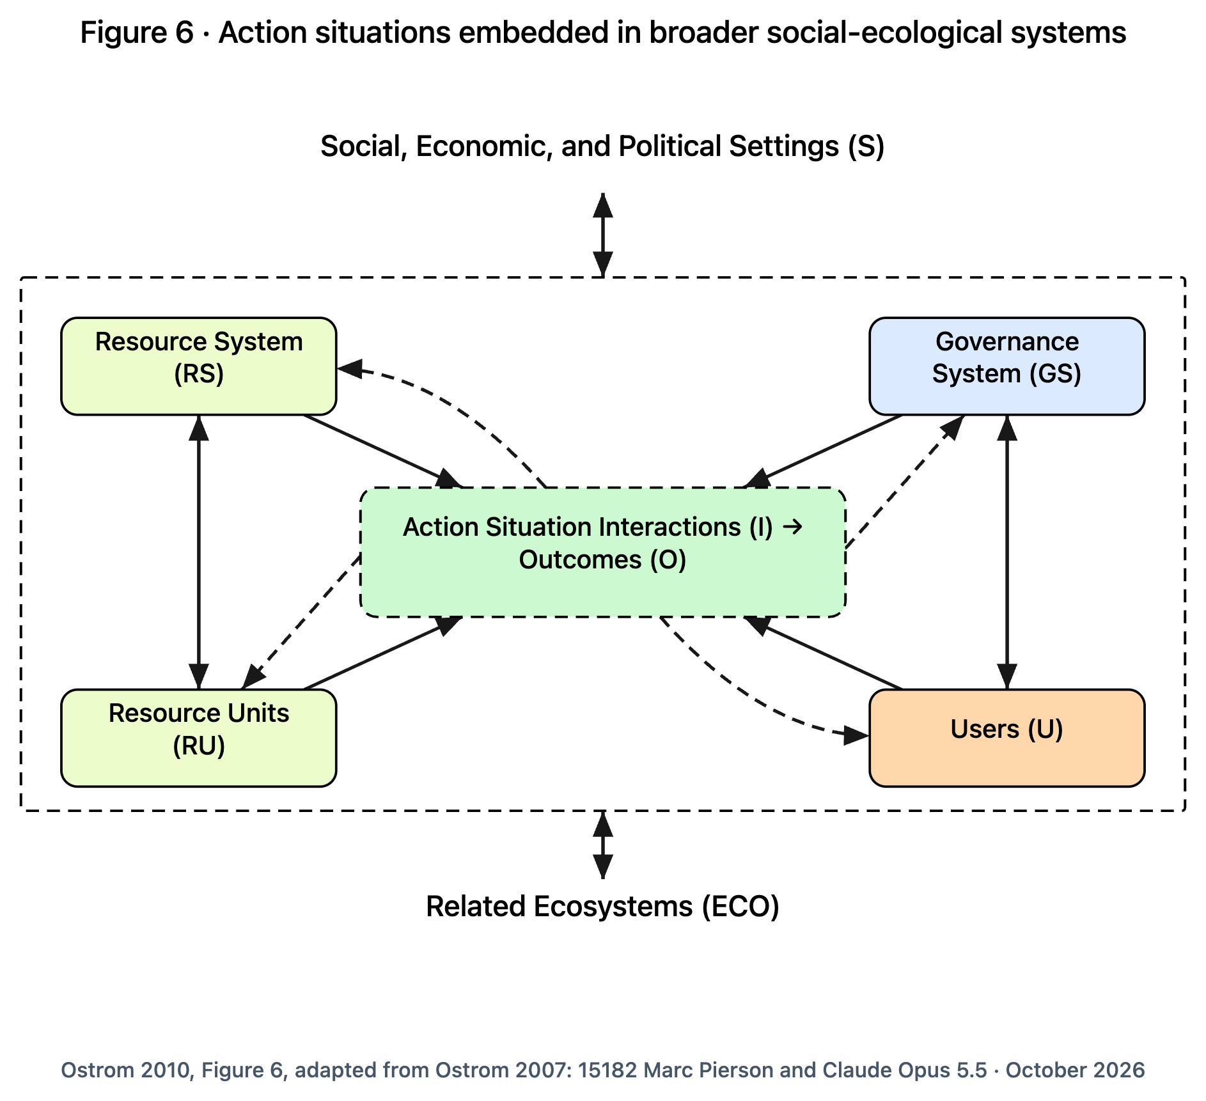
The thing we share, the people, the rules, and the world around them
STEP 1 · THE PEOPLE AND THE PLACE
READING THE PICTURE
Four corners: the shared thing (top left), what people take from it (bottom left), the rules and who makes them (top right), the people (bottom right).
Middle: where people meet and make choices.
Solid arrows: this affects that. Dashed arrows: the results come back around.
Above and below: the wider world, and the nature next door.
Ostrom 2010, Figure 6, adapted from Ostrom 2007
Notes:
Ostrom's Figure 6. Read from the middle out. Point to each corner and name its office-fridge version, then its Elm Street version.

Slide 9
Reading the picture, in everyday words (1 of 2)
STEP 1 · THE PEOPLE AND THE PLACE
Each card: the everyday words first, what they mean, and the word Ostrom used.
The people and the place, together
People and nature tangled up, looked at as one thing rather than two.
Ostrom's word: social-ecological system (SES)
The rules and who makes them
The bylaw, the spring meeting, the water keeper, the city.
Ostrom's word: governance system (GS)
The shared thing
The garden, the lake, the forest, the fridge, the fund.
Ostrom's word: resource system (RS)
The people who use it
Gardeners, coworkers, fishers, neighbors.
Ostrom's word: users (U), later "actors"
The bits we take or use
Gallons of water, fish, plots, shelf space, hours, dollars.
Ostrom's word: resource units (RU)
Notes:
Each card: the everyday words first, what they mean, and the word Ostrom used. Read the terms aloud with the diagram on screen; each card is the plain-language meaning.

Slide 10
Reading the picture, in everyday words (2 of 2)
STEP 1 · THE PEOPLE AND THE PLACE
Each card: the everyday words first, what they mean, and the word Ostrom used.
Where we meet and choose
Any time people get together and make choices that affect each other. Step 3 opens it up.
Ostrom's word: action situation
The nature next door
Weather, the watershed, pollution drifting in.
Ostrom's word: related ecosystems (ECO)
What we do, and what comes of it
Taking, sharing news, arguing, pitching in; and how it turns out for people and the place.
Ostrom's word: interactions (I), outcomes (O)
Solid and dashed arrows
Solid: this affects that. Dashed: results come back and change things.
Ostrom's word: direct causal link; feedback
The wider world
The economy, the law, politics, the news, rents.
Ostrom's word: social, economic and political settings (S)
Notes:
Each card: the everyday words first, what they mean, and the word Ostrom used. Read the terms aloud with the diagram on screen; each card is the plain-language meaning.

Slide 11
The four sides at Elm Street
STEP 1 · THE PEOPLE AND THE PLACE
The shared thing
The garden and its rain-fed tank.
The bits we take or use
Gallons of water. Plots. The harvest.
The rules and who makes them
The bylaw, the spring meeting, the water keeper, the city lease.
The people who use it
30 gardeners, their families, and newcomers on the waiting list.
The wider world
The city budget and drought rules. Rents. Who has time to garden.
The nature next door
The watershed. Rainfall. Heat waves.
Notes:
Same four sides, in the garden. Ask your own group to fill in the four sides of whatever you share.

Slide 12
When do neighbors get organized at all?
STEP 1 · THE PEOPLE AND THE PLACE
It is not too big
People can see and know the whole thing. (Ostrom: size)
It is worth saving
Not ruined, not so plentiful nobody cares. (Ostrom: productivity)
It behaves predictably
People can tell what it will do next. (Ostrom: predictability)
It stays put
Plots stay put; water and fish wander off. (Ostrom: mobility of units)
We can change our own rules
Nobody outside has to sign off. (Ostrom: collective-choice rules)
Not too many of us
Enough to do the work, few enough to know each other. (Ostrom: number of users)
Someone gets it started
A person willing to call the first meeting. (Ostrom: leadership)
We already trust each other
Some shared habits and goodwill are there. (Ostrom: norms, social capital)
We understand how it works
We know how the tank fills and empties. (Ostrom: knowledge of the system)
It matters to us
Enough to be worth the bother. (Ostrom: importance to users)
Notes:
From Ostrom's 2009 paper and her Nobel lecture: ten things that, across many places, made it more likely that people would organize themselves to look after something shared. Each is common sense once it is said out loud.

Slide 13
What we're sharing
ZOOMING IN
largest scale
1 The people and the place
2 What we're sharing
3 Where we meet and choose
4 Who sets the rules
5 What's going on when we meet
Two plain questions tell you what kind of trouble to expect: does it run out, and can you keep people out?
6 The house rules
7 What long-lasting groups do
8 How a rule is put together
9 Do I do my share?
smallest scale
Notes:
Step 2. Before any rules, ask what kind of thing is shared. Start from a party.

Slide 14
Think of a party
STEP 2 · WHAT WE'RE SHARING · YOU ALREADY KNOW THIS
At a party
The pizza runs out: every slice someone eats is gone. The music does not: everyone hears it no matter how many dance. The coat room is easy to guard; the music next door is not.
1
Some things run out when people use them. Some do not.
2
Some things are easy to keep people out of. Some are not.
3
Those two questions tell you what will go wrong: things taken too fast, or nobody pitching in.
Notes:
Two questions, nothing more. Get the room to sort a few things from their own lives before showing the picture.

Slide 15
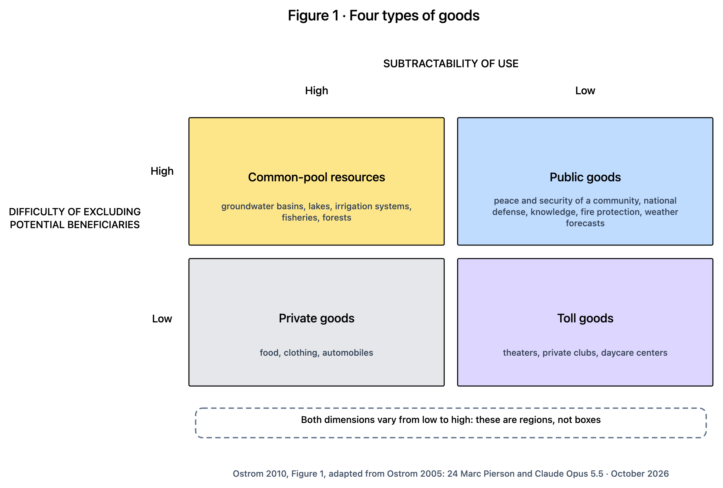
Two questions sort everything people share
STEP 2 · WHAT WE'RE SHARING
READING THE PICTURE
Across the top: does it run out when people use it? (High = yes.)
Down the side: is it hard to keep people out? (High = yes, hard.)
Four boxes, four kinds of trouble.
Ostrom's work was mostly about the top-left box: things that run out and are hard to fence off.
These are regions, not boxes. Things slide between them.
Ostrom 2010, Figure 1, adapted from Ostrom 2005
Notes:
Ostrom's Figure 1. Translate the long labels out loud: 'subtractability of use' is 'does it run out', and 'difficulty of excluding potential beneficiaries' is 'can we keep people out'.

Slide 16
Reading the picture, in everyday words
STEP 2 · WHAT WE'RE SHARING
Each card: the everyday words first, what they mean, and the word Ostrom used.
Things we value
Anything people want or use, not only things for sale: water, safety, know-how, a hall.
Ostrom's word: goods
Something everyone gets, helped or not
Hard to keep people out, and it doesn't run out: safety, know-how, a weather forecast.
Ostrom's word: public good
Does it run out?
Does my use leave less for you?
Ostrom's word: subtractability of use
Members only
Easy to keep people out, and it only runs short when crowded: a theater, a club, a daycare.
Ostrom's word: toll good (club good)
Can we keep people out?
How hard it is to stop people who didn't pay or help from getting it anyway.
Ostrom's word: difficulty of excluding potential beneficiaries
Mine
Easy to keep people out, and it runs out: food, clothes, a car.
Ostrom's word: private good
Something we all draw from that can run out
Hard to keep people out, and it gets used up: groundwater, fish, the garden tank in August.
Ostrom's word: common-pool resource
Getting a free ride
Enjoying it without doing your share.
Ostrom's word: free-riding
Notes:
Each card: the everyday words first, what they mean, and the word Ostrom used. Read the terms aloud with the diagram on screen; each card is the plain-language meaning.

Slide 17
Neighborhood things, sorted
STEP 2 · WHAT WE'RE SHARING
Can run out, hard to fence off: the garden water, a shared fund, volunteer hours
Two troubles at once: some take too much, too few put back. You need rules for both taking and giving.
Everyone gets it: neighborhood safety, a shared know-how wiki
Everyone benefits whether or not they helped, so the trouble is getting enough people to chip in.
Members only: a tool library, a co-op's services, a meeting hall
Most of the work is deciding who is a member, what they pay, and what happens when it gets crowded.
Mine: the vegetables from your own plot
Little to sort out together. Your plot, your tomatoes.
In a wet spring nobody fights over the garden water. In a drought, every gallon counts. The same thing can slide from one box toward another.
Notes:
Ask the group to place the things it shares. The point is not the box; it is the trouble each box brings.

Slide 18
Where we meet and choose
ZOOMING IN
largest scale
1 The people and the place
2 What we're sharing
3 Where we meet and choose
4 Who sets the rules
5 What's going on when we meet
What happens when people get together depends on the place, the people, and the rules they really follow.
6 The house rules
7 What long-lasting groups do
8 How a rule is put together
9 Do I do my share?
smallest scale
Notes:
Step 3. Zoom in from the whole picture to one get-together. Start from a family dinner.

Slide 19
Think of a family dinner
STEP 3 · WHERE WE MEET AND CHOOSE · YOU ALREADY KNOW THIS
A family dinner
What happens depends on what's in the fridge, who's at the table and how they get along, and the house rules (phones away, kids clear the plates). Afterwards everyone has an opinion on how it went. Next time, something changes.
1
Three things set the scene: the stuff, the people, and the rules people really follow.
2
Then people do things, and something comes of it.
3
People judge how it went, and that changes the next time. Sometimes it changes the rules.
Notes:
Everything in the next picture is in the dinner story. The judging afterwards, and the changing of rules, is the part that matters most for organizing.

Slide 20
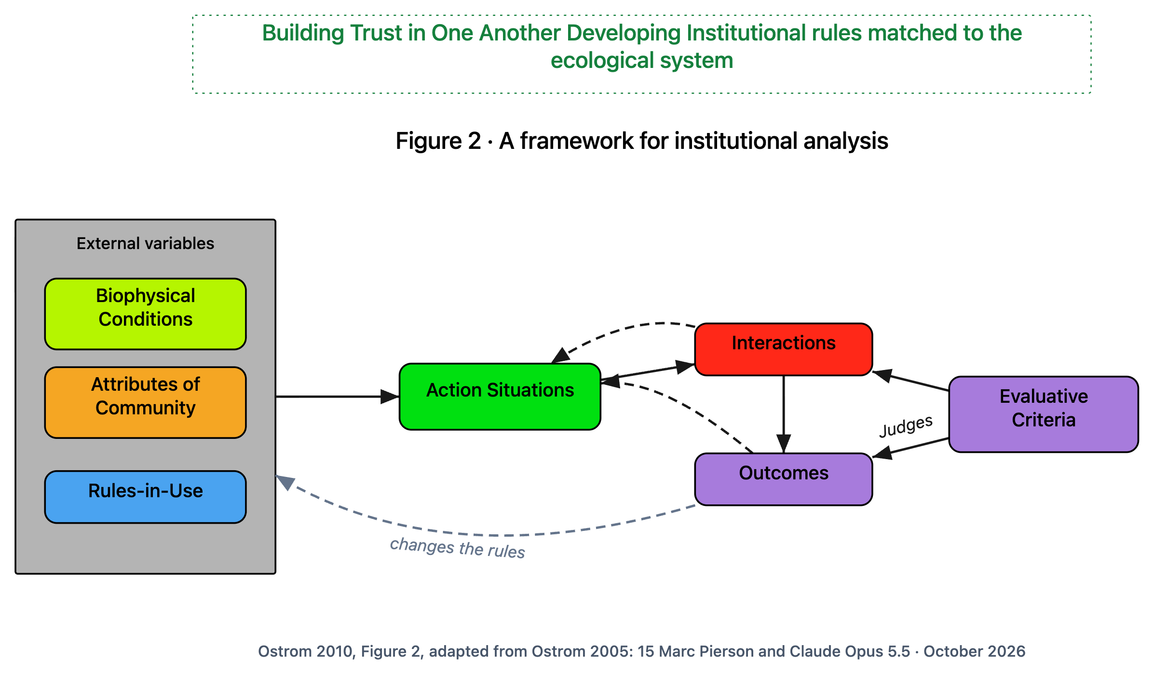
What shapes what happens when we get together
STEP 3 · WHERE WE MEET AND CHOOSE
READING THE PICTURE
Left: the stuff, the people, and the rules they really follow.
Middle: the get-together, where people choose.
Right: what people do, how it turns out, and how we judge whether it worked.
Dashed arrows: how it went comes back around. The long one is people changing their own rules.
Ostrom 2010, Figure 2, adapted from Ostrom 2005. Green title: Marc's
Notes:
Ostrom's Figure 2. The green title is Marc's: the two halves of the story, building trust and making rules that fit the place.

Slide 21
Reading the picture, in everyday words (1 of 2)
STEP 3 · WHERE WE MEET AND CHOOSE
Each card: the everyday words first, what they mean, and the word Ostrom used.
How rules shape what people do
Ostrom's whole way of looking at things, named after the job it does.
Ostrom's word: IAD (Institutional Analysis and Development) framework
The stuff
The physical facts: the water, the soil, the weather, the room.
Ostrom's word: biophysical conditions
The ways we do things here
Rules, habits and expectations. Not a building or an agency.
Ostrom's word: institution
The people
Who they are, their history together, what they know, how far they trust each other.
Ostrom's word: attributes of community
Things set from outside
What the people at the table can't change in the moment.
Ostrom's word: external variables (exogenous)
Notes:
Each card: the everyday words first, what they mean, and the word Ostrom used. Read the terms aloud with the diagram on screen; each card is the plain-language meaning.

Slide 22
Reading the picture, in everyday words (2 of 2)
STEP 3 · WHERE WE MEET AND CHOOSE
Each card: the everyday words first, what they mean, and the word Ostrom used.
How things really work here
The rules people actually follow, which may not be the ones written down.
Ostrom's word: rules-in-use
How we judge whether it worked
Was it fair? Did it waste anything? Can we see who did what? Will it last?
Ostrom's word: evaluative criteria
Where we meet and choose
Any get-together where choices affect each other: a meeting, watering day, a market.
Ostrom's word: action situation
Coming back around
How it went changes the next time, and sometimes the rules.
Ostrom's word: feedback
What we did, and what came of it
What people actually did, and how it turned out.
Ostrom's word: interactions, outcomes
Notes:
Each card: the everyday words first, what they mean, and the word Ostrom used. Read the terms aloud with the diagram on screen; each card is the plain-language meaning.

Slide 23
The rules on paper, and how things really work
STEP 3 · WHERE WE MEET AND CHOOSE
The rules on paper (the bylaw)
Water only on your day.
No sprinklers when the tank is below half.
The water keeper suspends anyone who breaks the rules.
How things really work
Early risers water any day; nobody minds.
Nobody reads the tank, so 'below half' never kicks in.
The keeper has never suspended anyone; a quiet word does it.
The gap is where to look. A rule nobody follows has gone stale. A habit everybody follows is a rule nobody wrote down. Both turn up only when you watch, ask, and keep track over time.
Notes:
Everyone knows the difference between the rule on the wall and how things really work. Ostrom said: study how things really work. You find it by watching and asking.

Slide 24
Who sets the rules
ZOOMING IN
largest scale
1 The people and the place
2 What we're sharing
3 Where we meet and choose
4 Who sets the rules
5 What's going on when we meet
Rules come from somewhere. Someone makes them, and someone decides who gets to make them.
6 The house rules
7 What long-lasting groups do
8 How a rule is put together
9 Do I do my share?
smallest scale
Notes:
Step 4. Start from a household: who follows bedtime, who sets it, and who counts as a parent.

Slide 25
Think of bedtime
STEP 4 · WHO SETS THE RULES · YOU ALREADY KNOW THIS
Bedtime in a household
The kids go to bed at 8 (that's doing). The parents set 8 o'clock (that's making the house rules). Whether Grandma also gets a say is a different question: who gets to make the rules at all. And underneath, everyone assumes things about what a family is that nobody ever wrote down.
1
Doing the thing.
2
Making the house rules.
3
Deciding who gets to make the house rules.
4
What everybody takes for granted, underneath it all.
Notes:
Four layers. Each one decides the rules for the one below. That's the whole idea of the next picture.

Slide 26
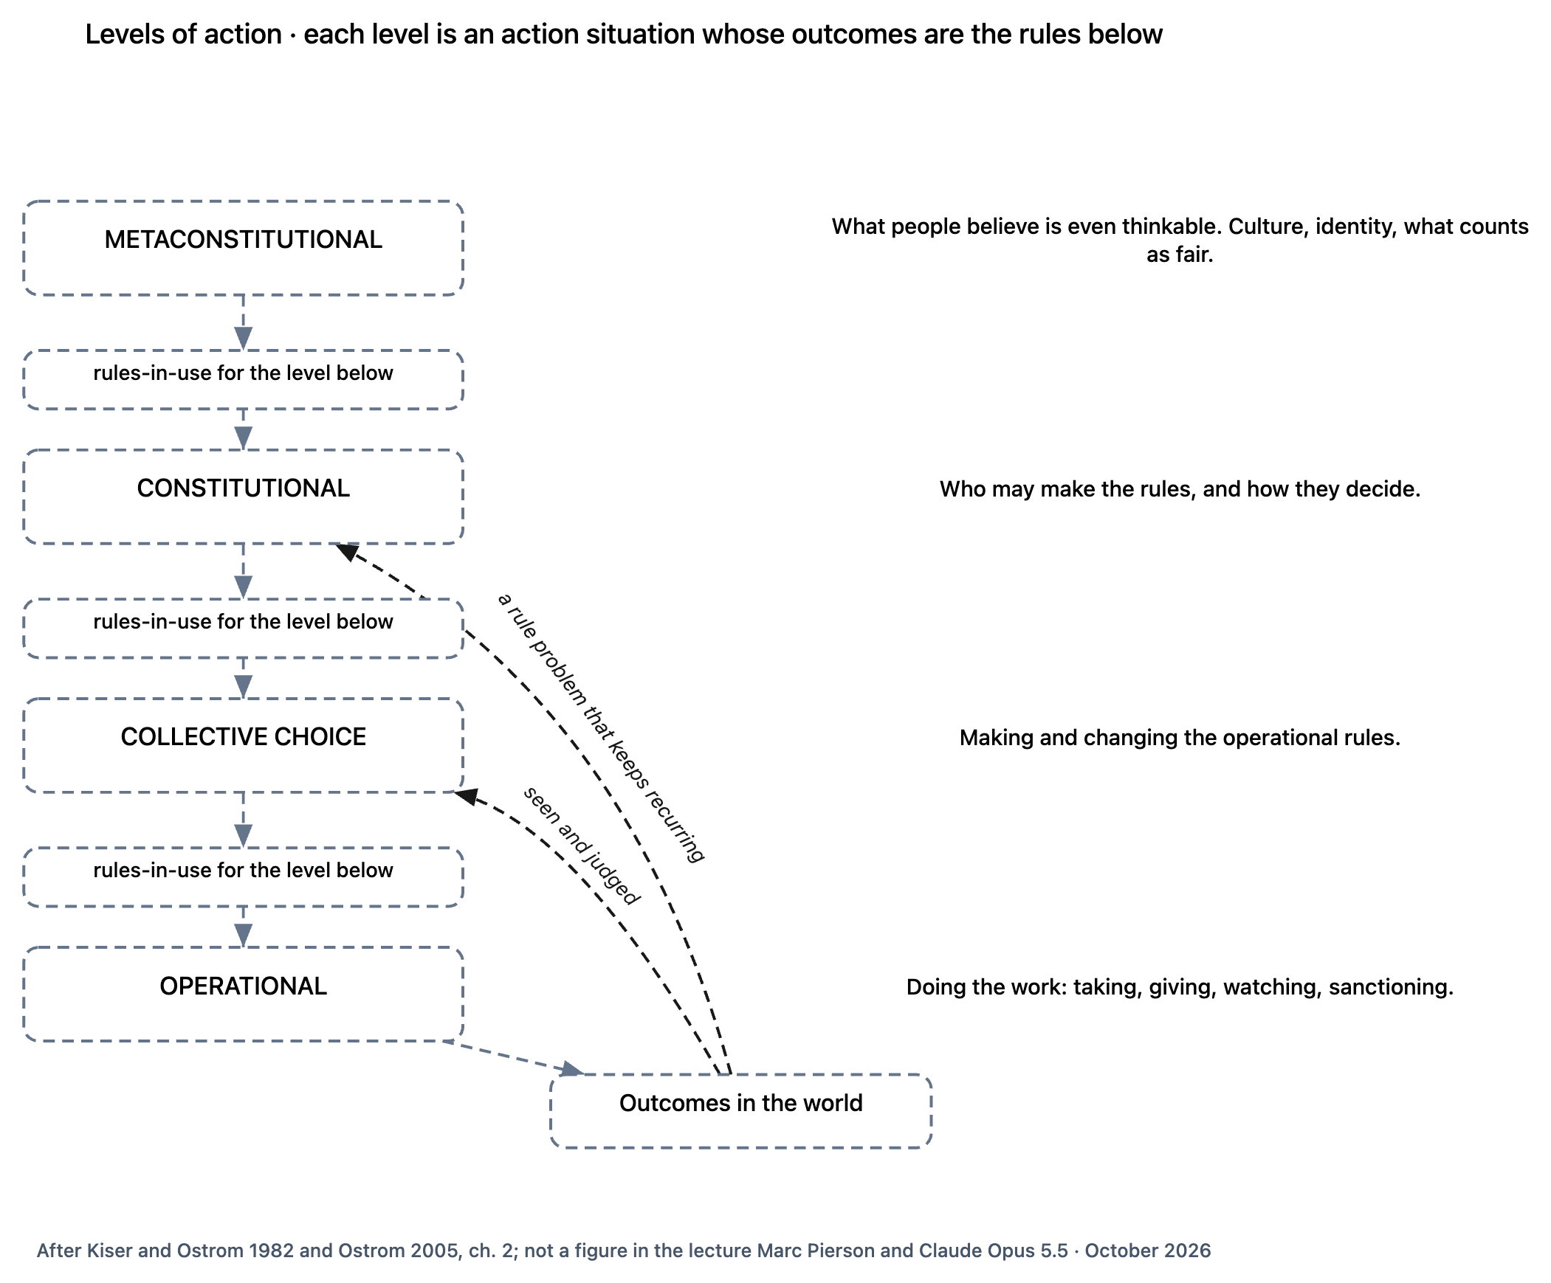
Each layer decides the rules for the layer below
STEP 4 · WHO SETS THE RULES
READING THE PICTURE
Read down: what each layer decides becomes the rules the next layer follows.
Read up: people see how things turn out and take it to the layer that can change the rule.
The higher the layer, the rarer the decision, and the more it changes.
Added panel, after Kiser and Ostrom 1982 and Ostrom 2005; not a lecture figure
Notes:
An added panel. The lecture mentions these layers in one sentence and has no picture for them.

Slide 27
Reading the picture, in everyday words
STEP 4 · WHO SETS THE RULES
Each card: the everyday words first, what they mean, and the word Ostrom used.
Layers of deciding
Each layer sets the rules for the one below it.
Ostrom's word: levels of action
What we all take for granted
What feels fair, who counts, what a rule can even be. Never written down.
Ostrom's word: metaconstitutional
Doing the work
Watering, harvesting, paying, keeping an eye out, giving someone a warning.
Ostrom's word: operational
The rules handed down
What one layer decides becomes the rules of the next.
Ostrom's word: rules-in-use for the level below
Setting the house rules
A meeting changes the watering days.
Ostrom's word: collective choice
Noticed and taken upstairs
How things turn out gets noticed, judged, and taken to a layer that can change things.
Ostrom's word: feedback between levels
Deciding who sets the house rules
Who counts as a member, and how the meeting decides.
Ostrom's word: constitutional
How it turns out
Water used, plots tended, care given, money moved.
Ostrom's word: outcomes
Notes:
Each card: the everyday words first, what they mean, and the word Ostrom used. Read the terms aloud with the diagram on screen; each card is the plain-language meaning.

Slide 28
The four layers at Elm Street
STEP 4 · WHO SETS THE RULES
What we all take for granted
Do newcomers deserve a plot at all?
Unwritten, and the strongest.
Deciding who sets the rules
Who counts as a member, and how does the spring meeting decide?
Changes the most
Setting the house rules
The spring meeting changes the watering days.
Changes a rule
Doing the work
Watering on your day. The keeper has a word with someone who did not.
Changes a number. Most of the effort, least of the change
Notes:
Same garden, four layers. Each higher decision is rarer and changes more.

Slide 29
A quick test: which layer am I on?
STEP 4 · WHO SETS THE RULES
Does it change a number?
Doing the work
Easiest to do, smallest effect.
Does it change a rule?
Setting the house rules
Real change, made by the group.
Does it change who gets to change the rules?
Deciding who sets the rules
Rare, hard, and lasting.
Donella Meadows saw the same thing in all kinds of systems: changing numbers is the weakest push, and changing who can change things is among the strongest.
Notes:
Use it in any meeting. When someone proposes a change, ask which of these three it is.

Slide 30
One complaint, three layers: the missing seat
STEP 4 · WHO SETS THE RULES
The higher you read it, the more the fix changes.
Read as who sets the rules
"There is no health-worker seat at all." You can't seat someone in a seat that doesn't exist. Only creating the seat fixes it.
Read as house rules
"The health worker isn't at the table where rules are made." Fix: invite them. They still have no vote.
Read as doing the work
"Nobody asks the health worker." Sounds like a communication problem. Fix: ask more. It doesn't stick.
Notes:
A second example: a neighborhood health co-op whose community health worker is never part of decisions. Read at each layer, the same complaint means something different, and only the top reading points to the fix.

Slide 31
What's going on when we meet
ZOOMING IN
largest scale
1 The people and the place
2 What we're sharing
3 Where we meet and choose
4 Who sets the rules
5 What's going on when we meet
Every get-together has the same moving parts, like a game.
6 The house rules
7 What long-lasting groups do
8 How a rule is put together
9 Do I do my share?
smallest scale
Notes:
Step 5. Open up one get-together. Ostrom built these parts with a game theorist, so start from a game everyone knows.

Slide 32
Think of a pickup basketball game
STEP 5 · WHAT'S GOING ON WHEN WE MEET · YOU ALREADY KNOW THIS
Pickup basketball
There are players. There are positions: guard, center. Each position can do certain things. You can see some things and not others. How the points add up decides who wins. Some scores are possible and some aren't. And winning or losing costs and pays something, even if it's just pride.
1
Who is playing, and in which spot.
2
What each spot can do.
3
What each player can see.
4
How the moves add up to a result.
5
What results are possible, and what each player gets out of them.
Notes:
Seven moving parts. Every meeting, market, watering day and family dinner has the same seven. The next picture just names them.

Slide 33
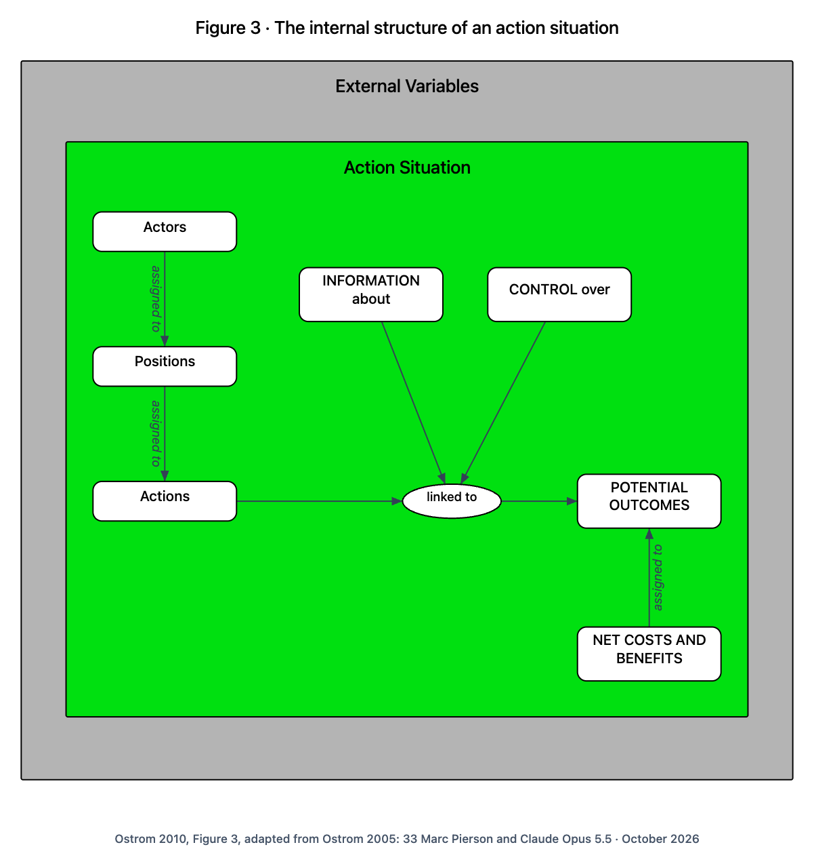
The seven moving parts of any get-together
STEP 5 · WHAT'S GOING ON WHEN WE MEET
READING THE PICTURE
People are put into roles.
Roles come with things they can do.
What people do leads to possible results, depending on what they know and how their choices add up.
Each result costs and pays each role something.
Ostrom 2010, Figure 3, adapted from Ostrom 2005
Notes:
Ostrom's Figure 3. Her one-sentence version: people in roles choose what to do, depending on what they know, how their choices add up, and what it costs and pays them.

Slide 34
Reading the picture, in everyday words
STEP 5 · WHAT'S GOING ON WHEN WE MEET
Each card: the everyday words first, what they mean, and the word Ostrom used.
The people taking part
Gardeners, the keeper, the city. Players.
Ostrom's word: actors (participants)
How our choices add up
One person decides? A vote? Everyone must agree?
Ostrom's word: control over
Roles
Gardener, water keeper, chair. A role outlasts the person in it.
Ostrom's word: positions
What could happen
A full tank, dead tomatoes, a fight.
Ostrom's word: potential outcomes
What each role can do
Water, harvest, propose, vote, report.
Ostrom's word: actions
What each role gets out of it, minus what it costs
"Net" just means after taking away the costs.
Ostrom's word: net costs and benefits
What people know
The tank level, who watered, what others did.
Ostrom's word: information about
Who goes where; what leads to what
Who sits in which seat, and which moves lead to which results.
Ostrom's word: assigned to; linked to
Notes:
Each card: the everyday words first, what they mean, and the word Ostrom used. Read the terms aloud with the diagram on screen; each card is the plain-language meaning.

Slide 35
The house rules
ZOOMING IN
largest scale
1 The people and the place
2 What we're sharing
3 Where we meet and choose
4 Who sets the rules
5 What's going on when we meet
Seven kinds of rule, one for each moving part. And the same rules seen from your own seat.
6 The house rules
7 What long-lasting groups do
8 How a rule is put together
9 Do I do my share?
smallest scale
Notes:
Step 6. Every board game comes with rules for each moving part. So does every group.

Slide 36
Think of the rules of a board game
STEP 6 · THE HOUSE RULES · YOU ALREADY KNOW THIS
The box lid of a board game
How many can play. What pieces or roles there are. What moves each can make. Which cards are face down. How the score is counted. What you win or pay. When the game is over. Change any one and you've got a different game.
1
Who can play. What roles there are. What each can do.
2
What you can see. How it adds up.
3
Who wins and pays what. What the game is about.
4
Groups have the same seven kinds of rule, written or not.
Notes:
Each kind of rule shapes one moving part from step 5. The next picture draws exactly that.

Slide 37
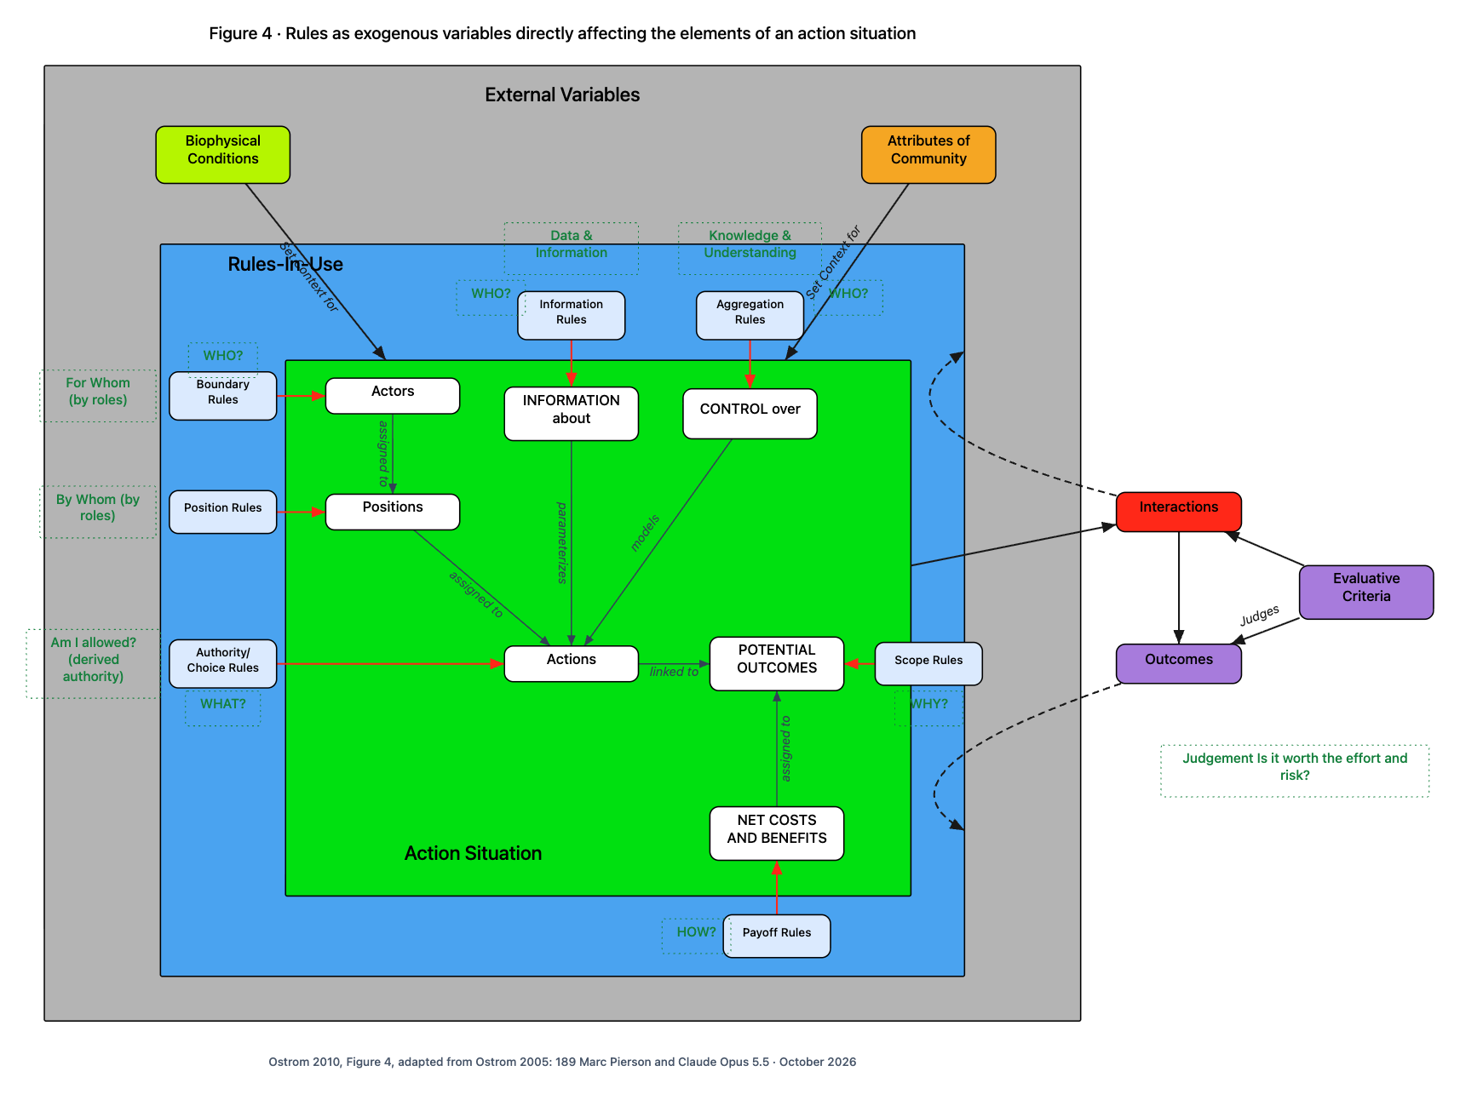
Each kind of rule shapes one moving part
STEP 6 · THE HOUSE RULES
READING THE PICTURE
Blue: the rules people really follow. Green: the get-together from step 5.
Each red arrow: one kind of rule shaping one moving part.
Green dotted labels are Marc's: the same rules as you'd ask them from your own seat.
How it turns out gets judged, and comes back around to the rules.
Ostrom 2010, Figure 4, adapted from Ostrom 2005. Green dotted labels: Marc's
Notes:
Ostrom's Figure 4. Her advice: ask of any rule, which moving part does it shape? That sorts every rule into one of seven kinds.

Slide 38
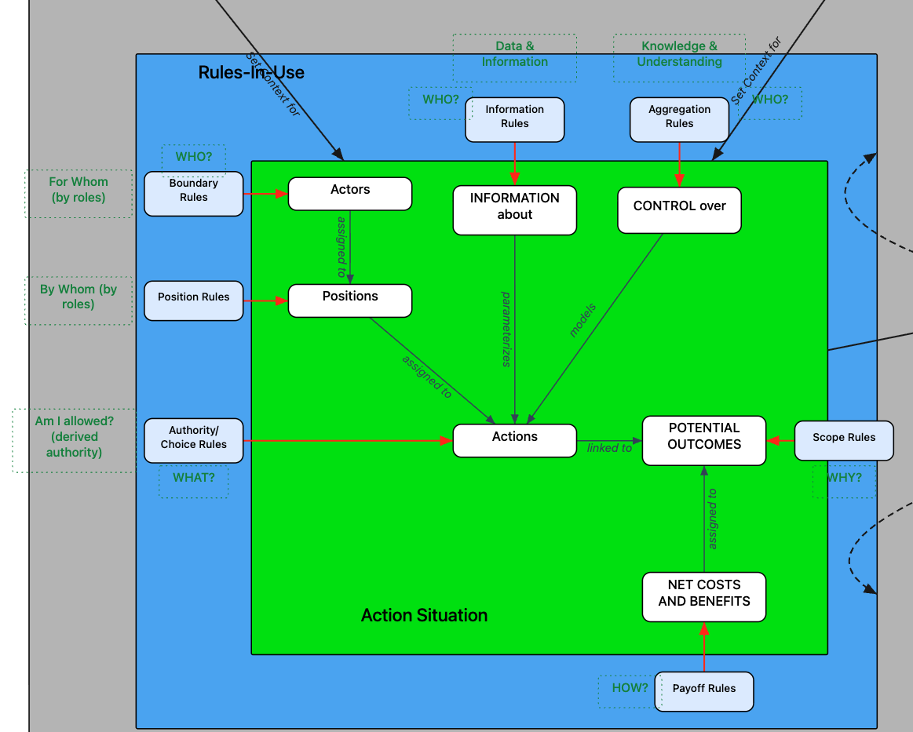
Close-up: the rules, and Marc's questions
STEP 6 · THE HOUSE RULES
Blue boxes
the seven kinds of rule
Red arrows
which part each rule shapes
White boxes
the seven moving parts from step 5
Green dotted
Marc's questions from your own seat: WHO? WHAT? HOW? WHY? For whom? By whom? Am I allowed?
Detail of Figure 4. Green dotted labels: Marc's
Notes:
The same picture, enlarged. Point to a blue rule box, follow its red arrow to the part it shapes, then read Marc's green question beside it.

Slide 39
The seven kinds of house rule, in everyday words
STEP 6 · THE HOUSE RULES
Each card: the everyday words first, a garden example, and the word Ostrom used.
Who's in
Who counts as a gardener, how you join, how you leave.
Ostrom's word: boundary rules
How we decide
A vote? Two-thirds? Everyone agrees? The keeper alone?
Ostrom's word: aggregation rules
What jobs there are
One water keeper, a chair, how many of each.
Ostrom's word: position rules
Who pays, who gains
Four work hours a season; lose watering for a week if you break the rule.
Ostrom's word: payoff rules
Who may do what
Gardeners may water on their day; nobody may use sprinklers below half.
Ostrom's word: choice (authority) rules
What's on the table
The meeting may change watering days, but may not sell the land.
Ostrom's word: scope rules
Who gets told what
The keeper posts the tank level every week.
Ostrom's word: information rules
Set from outside the get-together
The rules come from outside the moment and shape it.
Ostrom's word: exogenous variables (in the title)
Notes:
Each card: the everyday words first, a garden example, and the word Ostrom used. Read the terms aloud with the diagram on screen; each card is the plain-language meaning.

Slide 40
Marc's questions: the same rules, from your own seat (1 of 2)
STEP 6 · THE HOUSE RULES
Ostrom draws the get-together from outside, like an observer. Marc's labels draw it from inside, like a participant.
WHO?
Who's in? Who gets told? Who has to agree?
Ostrom's word: boundary, information and aggregation rules
WHY?
What are we here to change at all?
Ostrom's word: scope rules
WHAT?
What am I allowed, expected, or not allowed to do?
Ostrom's word: choice rules
For whom? By whom?
Who a role serves, and who fills it. Asked about roles, not particular people.
Ostrom's word: position rules
HOW?
How are costs and benefits shared, and how are slip-ups handled?
Ostrom's word: payoff rules
Notes:
Ostrom draws the get-together from outside, like an observer. Marc's labels draw it from inside, like a participant. Read the terms aloud with the diagram on screen; each card is the plain-language meaning.

Slide 41
Marc's questions: the same rules, from your own seat (2 of 2)
STEP 6 · THE HOUSE RULES
Ostrom draws the get-together from outside, like an observer. Marc's labels draw it from inside, like a participant.
Am I allowed?
My permission comes from a rule, not from me.
Ostrom's word: "derived authority"
Sets the limits; describes how it adds up
What you know sets the limits of your choice. How choices combine describes how they turn into results.
Ostrom's word: "parameterizes", "models"
Know-how and know-what
Information rules pass facts around; deciding together turns what people know into a shared choice.
Ostrom's word: "data & information", "knowledge & understanding"
Is it worth the effort and risk?
The question each person asks before pitching in. Step 9 answers it.
Ostrom's word: "judgement", "judges"
Notes:
Ostrom draws the get-together from outside, like an observer. Marc's labels draw it from inside, like a participant. Read the terms aloud with the diagram on screen; each card is the plain-language meaning.

Slide 42
The rule nobody writes down: how do we decide?
STEP 6 · THE HOUSE RULES
The spring meeting votes on a new watering schedule. 30 members. 17 vote yes, 10 vote no, 3 stay home.
Most of those who came
PASSES
17 of 27
Two-thirds of those who came
FAILS
needs 18 of 27
Everyone agrees
FAILS
10 said no
The water keeper decides
?
up to one person
Most quarrels are two people quietly assuming different ways of deciding. Ask early: who has to agree for this to count?
Notes:
Groups rarely write down how they decide. Two people can honestly disagree about whether something passed because each assumed a different way of deciding. One set of votes, four results.

Slide 43
What long-lasting groups do
ZOOMING IN
largest scale
1 The people and the place
2 What we're sharing
3 Where we meet and choose
4 Who sets the rules
5 What's going on when we meet
Eight things Ostrom found again and again in groups that lasted, and missing in the ones that fell apart.
6 The house rules
7 What long-lasting groups do
8 How a rule is put together
9 Do I do my share?
smallest scale
Notes:
Step 7. Ostrom looked for the one rule that always works and found none: what works differs from place to place. So she looked one step up, at what lasting groups have in common. She was clear the people in them never had a list.

Slide 44
Think of a group that has lasted fifty years
STEP 7 · WHAT LONG-LASTING GROUPS DO · YOU ALREADY KNOW THIS
A choir, a club, a congregation that has lasted fifty years
Everyone knows who's a member. The dues feel fair for what you get. Members vote on the big things. Someone keeps track. Lateness gets a word before it gets a fine. Arguments get settled over coffee, not in court. The city leaves them alone. And they belong to something bigger.
1
You've seen all of this.
2
Nobody there had a list. They worked it out over time.
3
Ostrom found the same eight things in fishing villages, irrigation ditches and mountain meadows.
Notes:
Ask the room to name a group they know that has lasted, and what it does. You will usually hear most of the eight.

Slide 45
Eight things long-lasting groups do
STEP 7 · WHAT LONG-LASTING GROUPS DO
1 We know who's in, and what's ours
Who belongs (1A), and where the shared thing begins and ends (1B).
Ostrom's words: clear boundaries
2 Rules that fit here, and a fair share
Rules suit this place (2A). What you put in matches what you take (2B).
Ostrom's words: congruence; proportional costs and benefits
3 The people affected make the rules
Most people living under the rules help make and change them.
Ostrom's words: collective-choice arrangements
4 We keep an eye out
On each other (4A) and on the thing itself (4B), by people who answer to us.
Ostrom's words: monitoring
5 A word first, then step up
Small penalties at first, bigger for repeats.
Ostrom's words: graduated sanctions
6 Settle it close to home
Quick, cheap, local ways to sort out arguments.
Ostrom's words: conflict-resolution mechanisms
7 Outsiders let us run our own affairs
The city or landowner respects our right to make our rules.
Ostrom's words: minimal recognition of rights
8 Groups within groups
Each small group runs itself, and links to the bigger ones it belongs to.
Ostrom's words: nested enterprises
Notes:
Ostrom's design principles, as updated by Cox, Arnold and Villamayor Tomas (2010), who checked them against more than 100 studies. About two-thirds found that lasting groups had most of these, and failed ones did not.

Slide 46
Each of the eight leans on certain house rules
STEP 7 · WHAT LONG-LASTING GROUPS DO
What lasting groups do | House rules it leans on | Layer
1 We know who's in, and what's ours | Who's in; what's on the table | Doing the work; deciding who sets the rules
2 Rules that fit, and a fair share | Who pays, who gains, matched to who may do what | Doing the work
3 The people affected make the rules | Who's in, what jobs, who's told, how we decide, what's on the table | Setting the house rules
4 We keep an eye out | A job for it; a duty to do it; who gets told | Doing the work
5 A word first, then step up | Who pays: the penalty, stepping up | Doing the work
6 Settle it close to home | A job (someone to go to); who may come; how it gets decided | Setting the house rules
7 Outsiders let us run our affairs | What's on the table, set by someone outside | Deciding who sets the rules
8 Groups within groups | Who's in and what jobs, linking small groups to big ones | Deciding who sets the rules
Notes:
Our own summary, not Ostrom's: which of the seven kinds of house rule each one depends on, and which layer from step 4 it sits on. Number 2A is the exception: whether rules fit a place is something you judge by looking at the place.

Slide 47
"The people affected make the rules" is really five questions
STEP 7 · WHAT LONG-LASTING GROUPS DO
1
2
3
4
5
Are they at the table?
Who's in
Is there a seat for them?
What jobs there are, decided by whoever sets the rules
Do they hear about it in time?
Who gets told what
Does their say count?
How we decide: a vote, a yes, or just being asked
What may they change?
What's on the table
The health worker in step 4 failed question 2. No amount of telling (3) or inviting (1) could fix it.
Notes:
It sounds simple. The house rules split it into five questions, and a group can miss any one while sincerely believing it includes everyone.

Slide 48
How a rule is put together
ZOOMING IN
largest scale
1 The people and the place
2 What we're sharing
3 Where we meet and choose
4 Who sets the rules
5 What's going on when we meet
Every rule answers the same few questions. Ask them, and you can see what is missing.
6 The house rules
7 What long-lasting groups do
8 How a rule is put together
9 Do I do my share?
smallest scale
Notes:
Step 8. Sue Crawford and Ostrom showed that every rule has the same few parts. Start from a parking sign.

Slide 49
Think of a parking sign
STEP 8 · HOW A RULE IS PUT TOGETHER · YOU ALREADY KNOW THIS
A parking sign
"No parking, 8am to 6pm, Monday to Friday. Violators will be towed." It says when, who it is for (drivers), what you must not do (park), where (here), and what happens if you do (towed).
1
When does it apply? Who is it for?
2
Must, may, or must not? Do what, to what, and how?
3
Or else what?
4
Take away the "or else" and it is a polite request.
Notes:
Every rule-like sentence has these parts. A missing part is a gap you can point to.

Slide 50
The parts of one garden rule
STEP 8 · HOW A RULE IS PUT TOGETHER
"When the tank is below half, gardeners must not water their plots with sprinklers, or else they lose watering for a week."
WHEN?
WHO?
MUST, MAY, OR MUST NOT?
DO WHAT?
TO WHAT?
HOW?
OR ELSE?
when the tank is below half
gardeners
must not
water
their plots
with sprinklers
they lose watering for a week
Ostrom: condition
Ostrom: attribute
Ostrom: deontic
Ostrom: aim
Ostrom: object
Ostrom: condition
Ostrom: or else
A sentence that creates something ("The water keeper is chosen each spring from the members") asks different questions: what are we creating? must or may? how is it formed? out of what?
Notes:
Take one sentence from the garden bylaw and ask it the questions. Each part does a job. The OR ELSE is the one most often missing.

Slide 51
The rule questions, in everyday words
STEP 8 · HOW A RULE IS PUT TOGETHER
Each card: the everyday words first, what they mean, and the word Ostrom used.
How a rule is put together
Breaking any rule into the same few parts, so rules can be compared and checked.
Ostrom's word: Institutional Grammar (IG); ADICO
When, and how?
When and where it applies, and the manner.
Ostrom's word: condition (IG 2.0: activation condition, execution constraint)
Who is it for?
The people the rule applies to.
Ostrom's word: attribute
Or else what?
What happens if you break it. Without one, it is a hope, not a rule.
Ostrom's word: or else (sanction)
Must, may, or must not?
Whether it is required, allowed, or forbidden.
Ostrom's word: deontic (Greek for "what binds")
A sentence that creates something
Creates a role, a group or a thing, rather than telling people what to do.
Ostrom's word: constitutive statement
Do what, to what?
The action, and what it is done to.
Ostrom's word: aim; object
The original five parts
Attribute, Deontic, aIm, Condition, Or else: A-D-I-C-O.
Ostrom's word: ADICO (Crawford and Ostrom 1995)
Notes:
Each card: the everyday words first, what they mean, and the word Ostrom used. Read the terms aloud with the diagram on screen; each card is the plain-language meaning.

Slide 52
No "or else", no rule
STEP 8 · HOW A RULE IS PUT TOGETHER
A rule
It has an "or else".
"...or else they lose watering for a week."
Ostrom: rule
An expectation
Must or should, but no "or else".
"Gardeners should keep paths clear."
Ostrom: norm
A habit
No must, no 'or else'. Just what people do.
"We water early in the morning."
Ostrom: shared strategy
Habits are as close as writing gets to "what we all take for granted" from step 4.
Notes:
Sentences come in three strengths. In real bylaws the "or else" is usually missing, which tells you what will actually happen: people will drift away from it.

Slide 53
What reading a rule this closely turns up
STEP 8 · HOW A RULE IS PUT TOGETHER
Things nobody created
A rule about "gardeners", but nothing says who counts as a gardener. A rule about "the tank", but nothing says which tank.
Penalties nobody carries out
Follow the "or else": who applies it? What makes that their job? Who do they answer to?
Triggers nobody checks
"When the tank is below half" assumes someone reads the tank. If nothing makes it anyone's job, the rule never kicks in.
1: we know who's in, and what's ours
4 and 5: keeping an eye out; a word first
4: keeping an eye on the thing itself
Notes:
Three gaps the questions find that a quick read misses. Each connects one sentence back to what lasting groups do.

Slide 54
Do I do my share?
ZOOMING IN
largest scale
1 The people and the place
2 What we're sharing
3 Where we meet and choose
4 Who sets the rules
5 What's going on when we meet
The last step: one person, one moment. I pitch in if I trust the others will too.
6 The house rules
7 What long-lasting groups do
8 How a rule is put together
9 Do I do my share?
smallest scale
Notes:
Step 9, the smallest scale. Rules matter, but people pitch in when they trust others will too. Start from a group project.

Slide 55
Think of a group project, or the office coffee fund
STEP 9 · DO I DO MY SHARE? · YOU ALREADY KNOW THIS
The coffee fund
You put in your dollar if you think the others do. Once you notice people drinking without paying, you stop paying too. When everyone can see the jar and knows who paid, it keeps going for years.
1
People will pitch in, but not to be the only one.
2
Whether I pitch in depends on whether I trust you will.
3
Trust grows from what we can see of each other.
4
Good results build trust; bad ones wear it down.
Notes:
Everyone has been in this spot. Ostrom's Figure 5 draws exactly this.

Slide 56
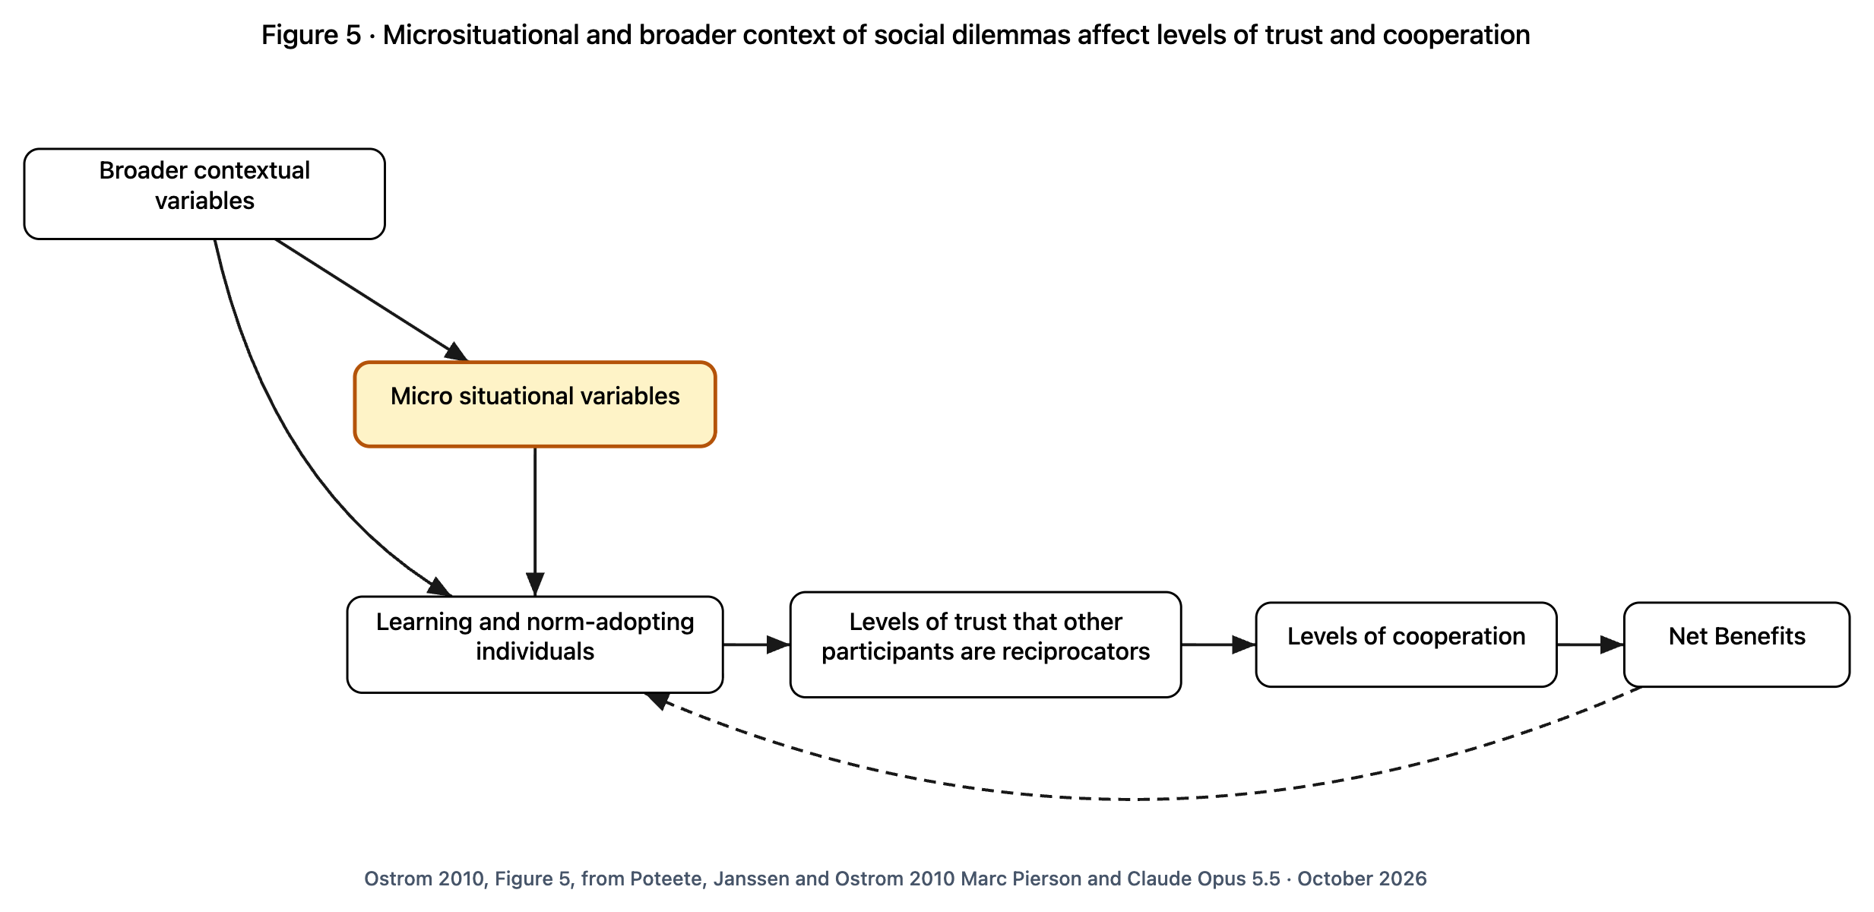
I do my share when I trust you will too
STEP 9 · DO I DO MY SHARE?
READING THE PICTURE
Left: the wider setting and the small details of the moment.
They shape what people learn about each other.
That builds trust (or wears it down) that others will do their share.
Trust means pitching in; pitching in pays off for everyone.
Dashed loop: good results teach trust, bad results teach distrust.
Ostrom 2010, Figure 5, from Poteete, Janssen and Ostrom 2010
Notes:
Ostrom's Figure 5. People are not the pure money-grubbers of older economics: they learn and they pick up shared habits. But they will not keep pitching in if they think others won't. Marc's question from step 6, 'Is it worth the effort and risk?', is answered here.

Slide 57
Reading the picture, in everyday words
STEP 9 · DO I DO MY SHARE?
Each card: the everyday words first, what they mean, and the word Ostrom used.
When what's good for me is bad for us
Watering extra in a drought: fine for my tomatoes, bad for the garden.
Ostrom's word: social dilemma
Someone who does their share
I pitch in if you pitch in.
Ostrom's word: reciprocator
The big picture
Step 1: the shared thing, the people, the rules, the wider world.
Ostrom's word: broader contextual variables
How sure I am the others will do their share
The trust in the middle of the picture.
Ostrom's word: levels of trust that other participants are reciprocators
The small details of the moment
Can we talk? Do we know who did what? Next slide.
Ostrom's word: microsituational variables
How much we pitch in
How much people actually work together.
Ostrom's word: levels of cooperation
People who learn and pick up habits
Not pure calculators. We learn from what happens and take on shared expectations.
Ostrom's word: learning and norm-adopting individuals
What we all get out of it
What everyone gains, after what it cost.
Ostrom's word: net benefits
Notes:
Each card: the everyday words first, what they mean, and the word Ostrom used. Read the terms aloud with the diagram on screen; each card is the plain-language meaning.

Slide 58
Six things that make trust possible
STEP 9 · DO I DO MY SHARE?
We can talk, face to face
Faces and tone tell us who to trust.
Ostrom's words: communication
We know who has done what
A track record makes pitching in safer.
Ostrom's words: reputations known
My part clearly matters
I can see my share made a difference.
Ostrom's words: high marginal per capita return
Lasting groups 3, 6
Lasting groups 4
Lasting groups 2
I can walk away
Nobody's stuck being the only one still trying.
Ostrom's words: entry and exit
We'll be here a long time
Pitching in pays more over years than weeks.
Ostrom's words: long time horizon
We made our own penalties
Penalties we agreed to are rarely needed; ones forced on us backfire.
Ostrom's words: agreed-upon sanctioning
Lasting groups 1
Lasting groups 7
Lasting groups 5, 3
Notes:
Ostrom's six, from experiments and real places (lecture pp. 661-662). The link to the eight things lasting groups do (step 7) is our reading, not hers: it shows how house rules build trust.

Slide 59
What a neighborhood can change this month
STEP 9 · DO I DO MY SHARE?
1
Meet in person, regularly, with everyone who shares the thing. Not only the organizers.
2
Keep a record people agree to, of who did what. Kept with them, never about them behind their backs.
3
Make contributions visible: a simple chart of tank levels or work hours shows each person their share mattered.
4
Let people leave easily, and take their own records with them. Free to leave makes staying a choice.
5
Plan for years, not weeks: secure the lease; write down how the rules can change.
6
Write your own penalties, together, starting small. Agreed penalties are the ones that rarely need using.
Notes:
You can't rewrite who sets the rules this month. You can change these six small things now, and they are where trust starts.

Slide 60
Zooming back out
CLOSING
1
The people and the place: What is around the thing decides what is possible.
2
What we're sharing: Whether it runs out, and whether we can keep people out, decides the trouble.
3
Where we meet and choose: The stuff, the people and how things really work shape every get-together.
4
Who sets the rules: Each layer sets the rules for the one below.
5
What's going on when we meet: Every get-together has the same seven moving parts.
6
The house rules: Seven kinds of house rule shape those parts.
7
What long-lasting groups do: Lasting groups do eight things.
8
How a rule is put together: Every rule has the same few parts; look for the missing "or else".
9
Do I do my share? I do my share when I trust you will.
Notes:
The nine steps are one picture seen from different distances. A problem noticed at one step is often fixed at another.

Slide 61
Questions to take to your group
CLOSING
1
What is around the thing we share?
2
Does it run out? Can we keep people out?
3
Where do we really meet and decide?
4
Who decides who decides? Is anyone missing a seat?
5
What roles are there, and what does each know?
6
Which of our rules are written down, and which are just habits?
7
Which of the eight are we missing?
8
Which of our rules has no "or else"?
9
What would make each of us surer the others will do their share?
Notes:
One question per step. Start anywhere; most groups start with the last one.

Slide 62
Everyday words, and Ostrom's (1 of 2)
CLOSING
Alphabetical by the everyday words, with the word Ostrom used.
Can run out, hard to fence off
Ostrom's word: common-pool resource
How things really work here
Ostrom's word: rules-in-use
Deciding who sets the house rules
Ostrom's word: constitutional
How we decide
Ostrom's word: aggregation rules
Doing the work
Ostrom's word: operational
How we judge whether it worked
Ostrom's word: evaluative criteria
Everyone gets it, helped or not
Ostrom's word: public good
Keeping an eye out
Ostrom's word: monitoring
Groups within groups
Ostrom's word: nested enterprises
Members only
Ostrom's word: toll (club) good
How a rule is put together
Ostrom's word: Institutional Grammar; ADICO
The people and the place, together
Ostrom's word: social-ecological system
Notes:
Alphabetical by the everyday words, with the word Ostrom used. Read the terms aloud with the diagram on screen; each card is the plain-language meaning.

Slide 63
Everyday words, and Ostrom's (2 of 2)
CLOSING
Alphabetical by the everyday words, with the word Ostrom used.
Roles
Ostrom's word: positions
The ways we do things here
Ostrom's word: institution
Setting the house rules
Ostrom's word: collective choice
What lasting groups do
Ostrom's word: design principles
The small details of the moment
Ostrom's word: microsituational variables
What we all take for granted
Ostrom's word: metaconstitutional
Someone who does their share
Ostrom's word: reciprocator
What's on the table
Ostrom's word: scope rules
The stuff
Ostrom's word: biophysical conditions
Where we meet and choose
Ostrom's word: action situation
Taking from it / putting back into it
Ostrom's word: appropriation / provision
A word first, then step up
Ostrom's word: graduated sanctions
Notes:
Alphabetical by the everyday words, with the word Ostrom used. Read the terms aloud with the diagram on screen; each card is the plain-language meaning.

Slide 64
Sources
Ostrom, E. (2010). Beyond Markets and States: Polycentric Governance of Complex Economic Systems. American Economic Review 100(3). The 2009 Nobel lecture; Figures 1 to 6.
Ostrom, E. (1990). Governing the Commons. Ostrom, E. (2005). Understanding Institutional Diversity.
Ostrom, E. (2009). A General Framework for Analyzing Sustainability of Social-Ecological Systems. Science 325.
Cox, Arnold and Villamayor Tomas (2010), design principles. Crawford and Ostrom (1995), ADICO. Frantz and Siddiki (2021), IG 2.0. Poteete, Janssen and Ostrom (2010), Working Together.
Marc Pierson and Claude Opus 5.5 · October 2026
Notes:
Diagrams: the RCN Graph Tool drawings in docs/ostrom-nobel/, rebuilt from the lecture figures with Marc's annotations. The layers panel, the everyday examples and the Elm Street garden are additions, not Ostrom's.
Marc Pierson and Claude Opus 5.5 · October 2026

