Slide 1

developer
developer
security engineer

Slide 2
Pentest
Analyze
Plan
Build
Design
Test
Deploy
Pentest
Analyze
Plan
Build
Design
Test
Deploy
Pentest
Analyze
Plan
Build
Design
Test
Deploy
Release n
Release n+1
Release n+2

Slide 3
Pentest
Design
Build
Test
Analyze
Plan
Deploy
Sprint n
Pentest
Design
Build
Test
Sprint n+1
Analyze
Plan
Deploy

Slide 4

Code
HTTP
UI

Slide 5
Dev
Int
Prod

Slide 6
system
…
user agent
CSRF protection
authorization
authentication
communication
channel

Slide 7


HTTP request
HTTP response
GET http://oasp-ci.cloudapp.net/oasp4j-sample/services/rest/offermanagement/v1/offer HTTP/1.1
User-Agent: Mozilla/5.0 (Windows NT 6.1; rv:37.0) Gecko/20100101 Firefox/37.0
Accept: application/json, text/plain, */*
Accept-Language: en-US,en;q=0.5
X-CSRF-TOKEN: fcbfc729-15d2-4f04-8e50-082f20cb2dfb
Referer: http://oasp-ci.cloudapp.net/oasp4j-sample/jsclient/
Cookie: JSESSIONID=F340544E6AE9078812ECF61139D03C7B
Connection: keep-alive
Host: oasp-ci.cloudapp.net
HTTP/1.1 200 OK
Date: Sat, 11 Jul 2015 20:28:36 GMT
Server: Apache-Coyote/1.1
Content-Type: application/json;charset=UTF-8
Keep-Alive: timeout=5, max=100
Connection: Keep-Alive
[{"id":1,"modificationCounter":1,"revision":null,"name":null,"description":"Schnitzel-Menü","number":null,"mealId":1,"drinkId":10,"sideDishId":5,"state":"NORMAL","price":"6.99"},{"id":2,"modificationCounter":1, (…)

Slide 8
Header | Simplicity | Danger
Cache-Control | easy | low
HTTP Strict Transport Security (HSTS) | easy | medium
X-Frame-Options | easy | low
Content Security Policy (CSP) | difficult | medium
X-Content-Type-Options | easy | low
X-XSS-Protection | easy | low
HTTP Public Key Pinning (HPKP) | medium | high
Referrer-Policy | easy | low

Slide 9
String xml = "<element>" + value + "</element>";
Element element = new Element("element");
element.setText(value);
String sql = "select age from user where name=" + value;
String s = "select age from user where name=?";
PreparedStatement ps = con.prepareStatement(s);
ps.setString(1, value);
String safe = ESAPI.encoder().encodeForHTMLAttribute(unsafe);
// also: encodeForJavaScript, encodeForCSS, encodeForURL, …
if (input.matches(regex)) {
// continue
} else {
// throw exception
}

Slide 10
HTTP/1.1 200 OK
Server: nginx/1.12.1
Date: Sat, 14 Oct 2017 21:17:53 GMT
Content-Type: application/json; charset=UTF-8
Connection: keep-alive
Cache-Control: max-age=2592000
Expires: Mon, 13 Nov 2017 21:17:53 GMT
Vary: Accept-Encoding,User-Agent
{"mailSent":true,"into":"#wpcf7-f375-p28-o1","captcha":null,"message":"Your message was sent successfully. Thanks."}
POST http://demoqa.com/contact/ HTTP/1.1
User-Agent: Mozilla/5.0 (Windows NT 6.1; Win64; x64; rv:56.0) Gecko/20100101 Firefox/56.0
Accept: application/json, text/javascript, */*; q=0.01
Accept-Language: en-US,en;q=0.5
Referer: http://demoqa.com/contact/
Content-Type: application/x-www-form-urlencoded; charset=UTF-8
X-Requested-With: XMLHttpRequest
Content-Length: 210
Connection: keep-alive
Host: demoqa.com
_wpcf7=375&_wpcf7_version=4.5&_wpcf7_locale=en_US&_wpcf7_unit_tag=wpcf7-f375-p28-o1&_wpnonce=59190b1732&your-name=name1&your-email=email%40test.pl&your-subject=subject&your-message=message&_wpcf7_is_ajax_call=1

Slide 11
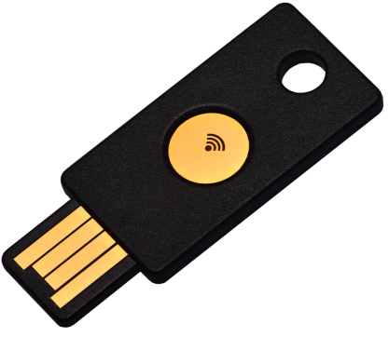
Browser
Server
challenge
origin, c=hash(challenge, channel_id)

