Slide 1


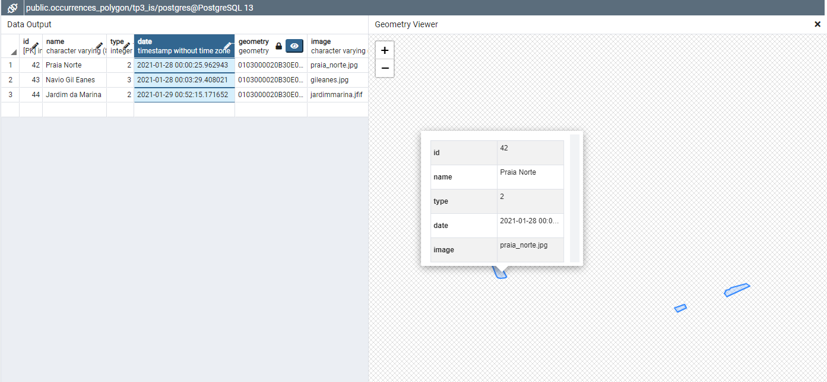
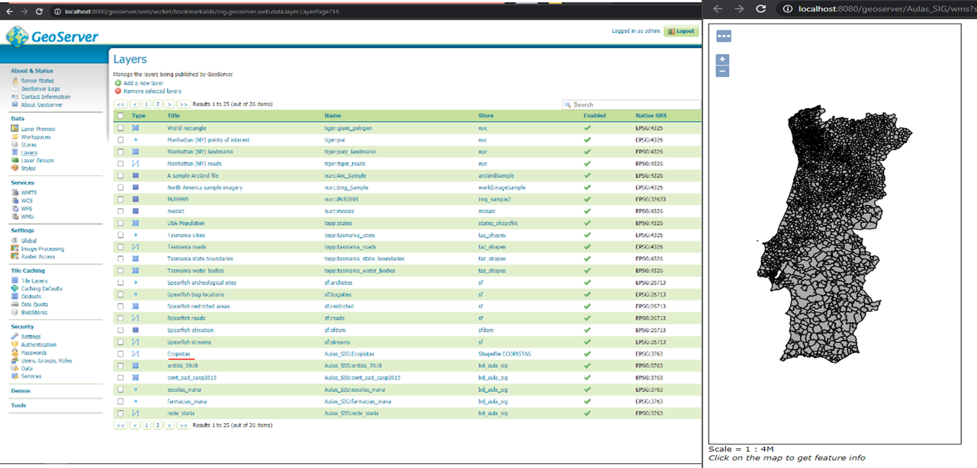
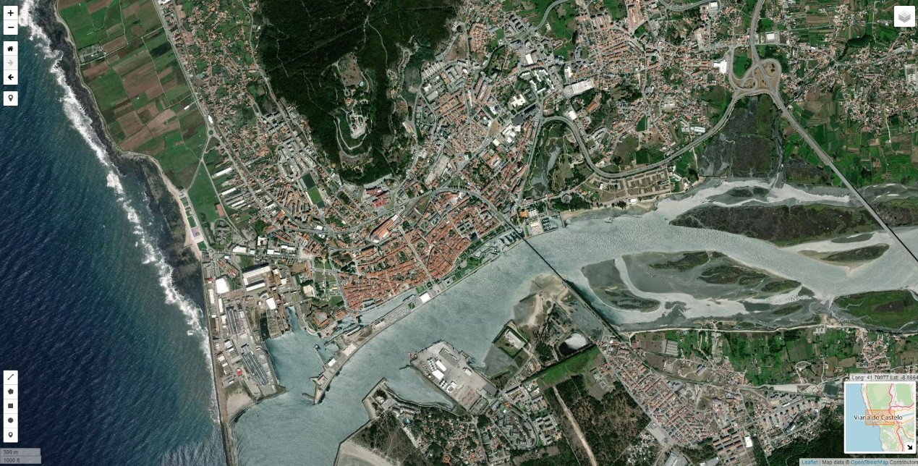
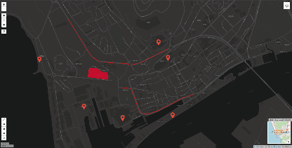
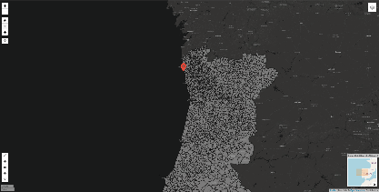
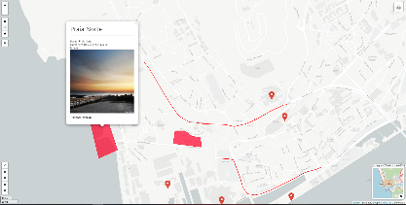

Introduction
Geographic Information Viewer with Interoperability and Information Systems Integration
António José Ribeiro Marques nº21674
Nelson Filipe Faria Campinho nº21751
Graduation in
INFORMATICS ENGINEERING
Polytechnic Institute of Viana do Castelo
Curricular Unit: System Integration
Maps represent a huge source of information for the viewer. They show different streets, ground elevations, rivers, borders and other types of information in order to provide its viewers with enough data to become useful. When maps became digital, representation possible using geographic data and constructing the maps using layers, the amount of information that could be provided increased greatly and its usage became more accessible.
PostgreSQL page
Geoserver page
Objectives
The following project had the main goal to develop a webpage with integration / interoperability of information and geographic information systems using standards, web services, geographic databases and map servers.
This webpage contains a Leaflet map with layers from geoserver with 3763 Native SRS
Leaflet map allows you to add points, lines, and polygons that are later inserted into the PostgreSQL database with PostGIS component that enables geometry component.
Leaflet Map in HTML page
Markers, polylines and polygons on map
ShapeFiles on leaflet Map (Caop_2015)
Popup created with information about marker
Discussion / Conclusion
By integrating multiple platforms and tools, for example by integrating a PostgreSQL database with geospacial data features into Lealeft and an open-source map provider alongisde Geoserver, it was possible to build a functioning WebSIG that not only is able to call different layers and build them on top of the existing map but also is able to provide features for users to use.
These features, like inserting, deleting and visualyzing data, make the WebSIG a powerful information provider tool to be provided to everyone.
Professor Coordenador Jorge Ribeiro
School Year 2020/2021;
References
Orientation
Leaflet: https://leafletjs.com/examples/geojson/
PostgreSQL: https://www.postgresql.org/
dados.gov: https://dados.gov.pt/pt/

