Slide 1

Acoustic Analysis of
Spotify Music
Using Machine Learning
Marques Chacon, Sung Min Park

Slide 2
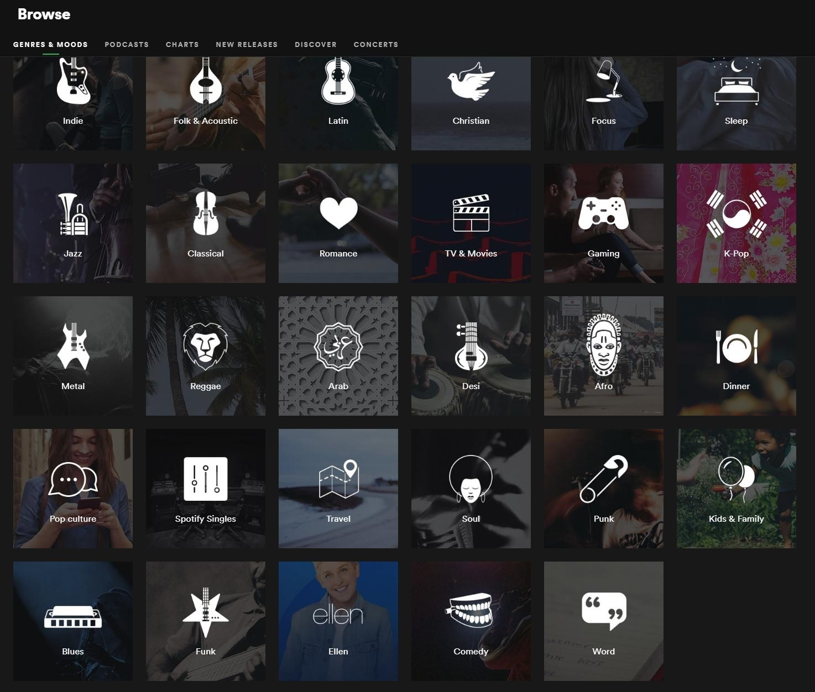
Motivation
Why do we like the music that we do?
What makes a song popular?
What defines a genre?
What are the commonalities in the music that we prefer?
We hope to make people more aware of their musical preferences on a fundamental level. This would allow people to have a more streamlined approach finding songs that are relevant to them

Slide 3
Research Questions
Are there any correlations between a song’s popularity and its acoustic features? Can we use this to predict a song’s popularity based off the acoustic features?
Can we train a model to classify a song’s genre solely on its acoustic features?
Can we identify correlations in acoustic features in similar sounding songs recommended in a Spotify playlist?
How would the playlists outputted by our algorithms compare to the list of recommended songs that Spotify generates?

Slide 4
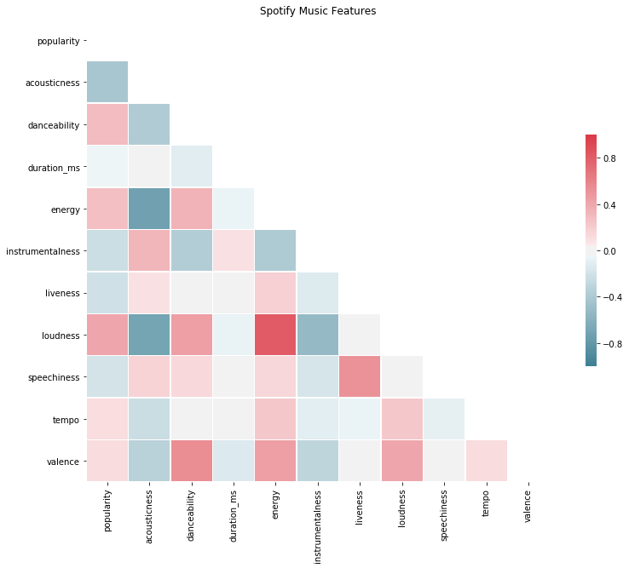
Results - Question 1
Are there any correlations between a song’s popularity and its acoustic features? Can we use this to predict a song’s popularity based off the acoustic features?
 | SVM Regression | Lasso Regression
RMSE | 52.145 | 51.880
R^2 Score | 0.00548 | -0.000117

Slide 5
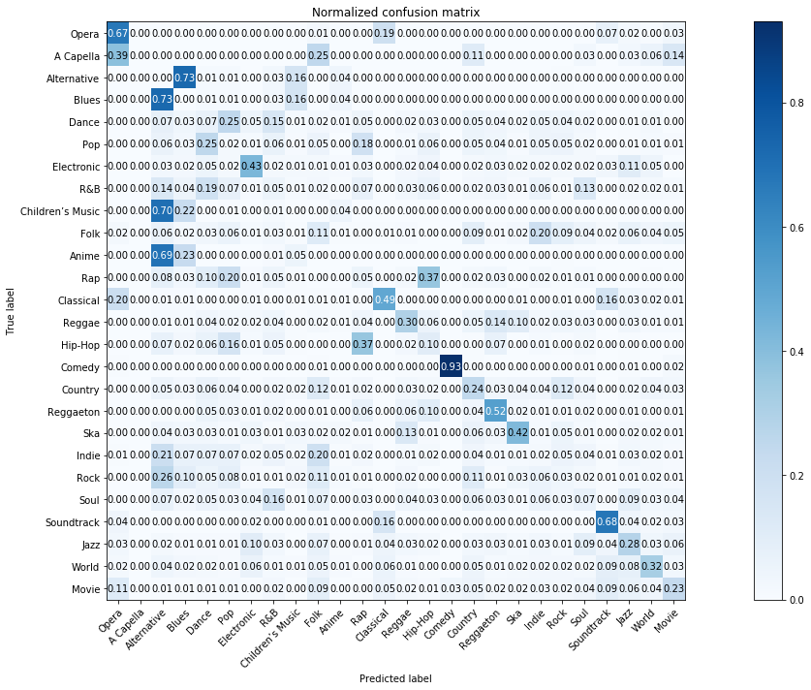
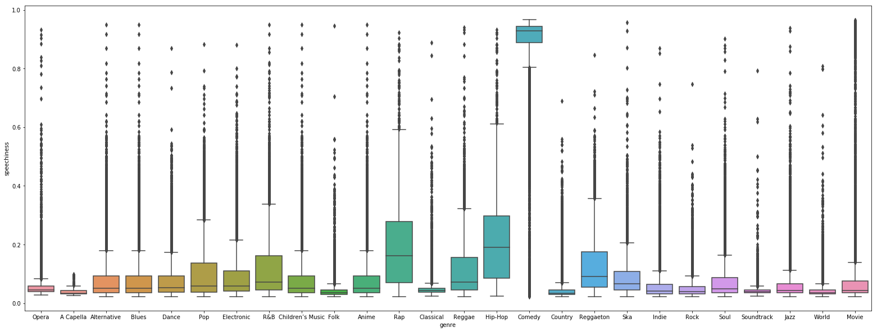
Results - Question 2
2. Can we train a model to classify a song’s genre solely on its acoustic features ?
ans) Only for Comedy Genre !

Slide 6
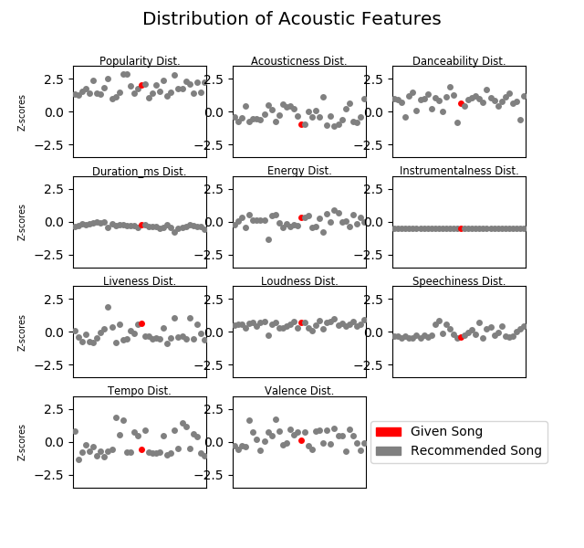
Results - Question 3 (Quantitative Data)
Manually added songs on Spotify to create playlists
Highest correlations among “Loudness”, “Duration_ms”, and “Speechiness”
“Instrumentalness” defaults to certain values, causing perfect uniformity when plotting

Slide 7
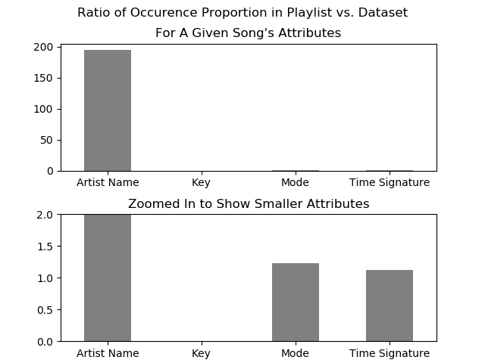
Results - Question 3 (Categorical Data)
For each attribute of the given song, compared ratio of occurrence rate in playlist vs. dataset
Artist Name has a massive influence on the playlist
Bottom graph shows less distinctive attributes more distinctly

Slide 8
Results - Question 4
Had to decide what was considered an “acoustic feature”
Used two different similarity metrics -- Mean Absolute Error (MAE) and Root Mean Squared Error (RMSE)
Using MAE and RMSE, created two separate playlists based off a given song
Results: Significant overlap between two playlists, and less of an emphasis on artist than Spotify Playlist

Slide 9
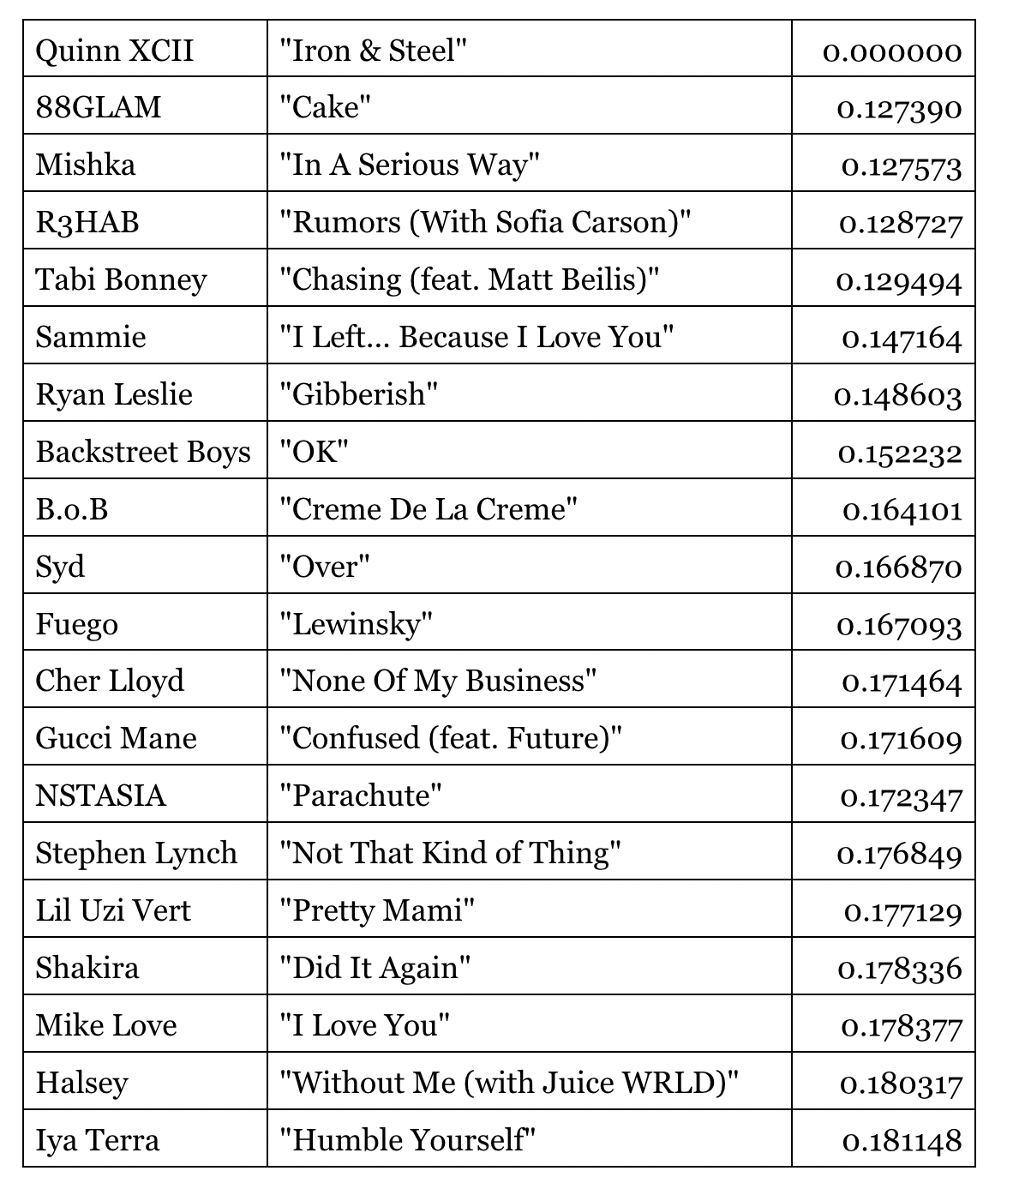
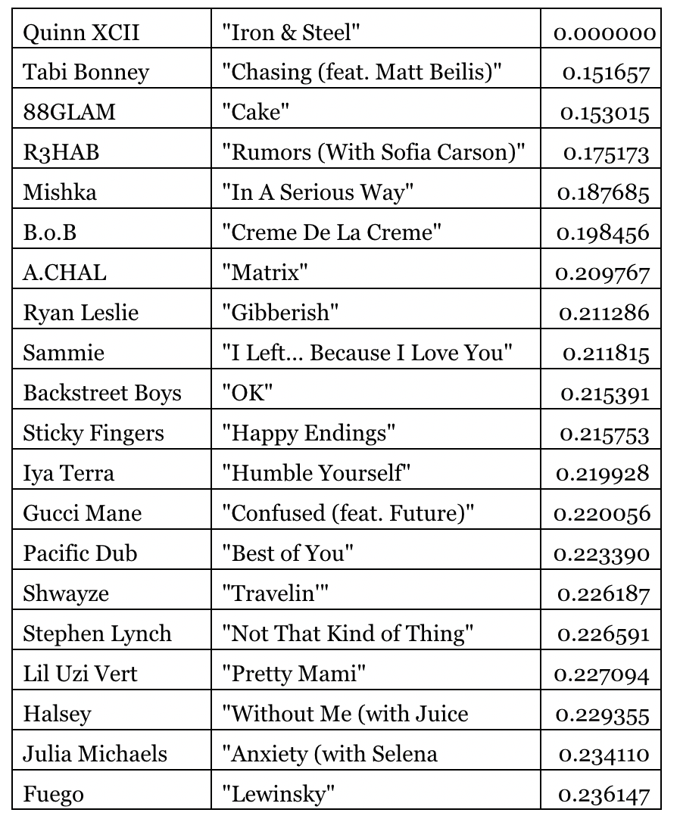
Results - Question 4 (Playlists)
Mean Absolute Error Playlist
Root Mean Sq. Error Playlist
←Input Song →

Slide 10

Thank you :)
* Ariana Grande’s Song 'thank u, next' has popularity score of 95 on Spotify.

