Slide 1
The Math behind Epidemics

Slide 2
Problem Definition
Ebola’s outbreak in 2014.
Designing a credible mathematical model.
Analyzing the best approach methods.
Using SIR model and Vaccination.

Slide 3
Introduction
The Definition of Epidemics.
Difference between Epidemics and Pandemic.
The aim of this study.
Yellow Fever and Plague.

Slide 4
Transmission Methods
Infected Food Supplies
01
Contaminated water
02
04
Insect Bites
Human to human
03
05
Air Transmission

Slide 5
History of infectious disease Modelling
Daniel Bernoulli
Kermack & Mckendrick
1662
1911
1766
1927
John Graunt
Ronald Ross

Slide 6
SIR Model
The Kermack-McKendrick Epidemiological Model.
S
I
R
Susceptible
Still prone to catching the disease
Infected
Caught the disease and can infect others
Recovered
Recovered and immune from the disease

Slide 7
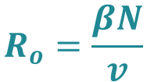
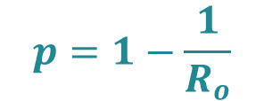
Reproduction number & herd immunity
The number of people an infectious person can pass the disease to.
01 Reproduction number
$$R_{o}=\frac{βN}{v}$$
The number of people required to be vaccinated in order to eradicate a disease.
02 Herd immunity
$$p=1−\frac{1}{R_{o}}$$

Slide 8
Yellow Fever Background
A
The Cause of Yellow Fever.
The time and place where the virus usually occurs.
Symptoms of Yellow Fever.
Thirty to sixty thousand people unfortunately die of Yellow Fever every year.
B
C
D

Slide 9
Methodology
Modeling Yellow Fever:
How is it transmitted?
Suitable type of SIR.
Human population SEIR. (susceptible, infected, exposed and recovered)
Mosquitoes SEI. (susceptible, exposed and infected)
Using differential equations to model the behavior of both parties.

Slide 10










Methodology
Equations of Yellow Fever SEIR model
$${S′}_{h}=−ab\frac{I_{v}}{N_{h}}S_{h}−v(t−t_{0})$$
$${S′}_{v}=B_{v}\left(t\right)−ac\frac{ψA_{h}I_{h}}{N_{h}}S_{v}−μ_{v}S_{v}$$
$${E′}_{h}=ab\frac{I_{v}}{N_{h}}S_{h} − σ_{h}E_{h}$$
$${E′}_{v}=ac\frac{ψA_{h}+I_{h}}{N_{h}}S_{v}−σ_{v}E_{v}−μ_{v}E_{v}$$
$${I′}_{h}=δσ_{h}E_{h}−γ_{h}I_{h}$$
$${I′}_{v}=σ_{v}E_{v}−μ_{v}I_{v}$$
$$R_{0}=\sqrt{\left(ψ\left(1−δ\right)+δ\right).\frac{a^{2}bcm}{γ_{h}}.\frac{σ_{v}}{μ_{v}(σ_{v}+μ_{v})}}$$
${R′}_{h}=v\left(t−t_{0}\right)+γ_{h}A_{h}+(1−θ)K_{h}T_{h}$
$$Y_{h}=\int{θK_{h}T_{h}}dt$$
$$Z_{h}=\int{(θ+p.\left(1−θ\right).γ_{h}I_{h}}dt$$

Slide 11
Spread of yellow fever across the years:
North America (1793)
Africa (2016)
South America (2016)

Slide 12




History of plague.
Cause of Plague.
Transmission method:
Bubonic which is the most common.
Pneumonic which is the most infectious.
Septicemic.
Sub model of Pneumonic plague:
Total number of individuals:
2. Modeling Plague:
$$\frac{{dS}_{n}}{dt}=b_{n}S_{n}−(1−q_{n})\frac{β_{s}S_{n}I_{nj}}{N_{nj}}$$
$$\frac{{dl}_{n}}{dt}=σ_{p}E_{n}−Y_{n}I_{n}−d_{n}I_{n}$$
$$\frac{{dE}_{n}}{dt}=\left(1−q_{n}\right)\frac{β_{p}S_{n}I_{n}}{N_{n}}−σ_{p}E_{n}−d_{n}E_{n}$$
$$N_{n}=S_{n}+E_{n}+I_{n}$$

Slide 13
Spread of Plague across the years:
South America(1648)
Spain(1596-1602)
Asia (1346-1350)
Egypt (1609)

Slide 14
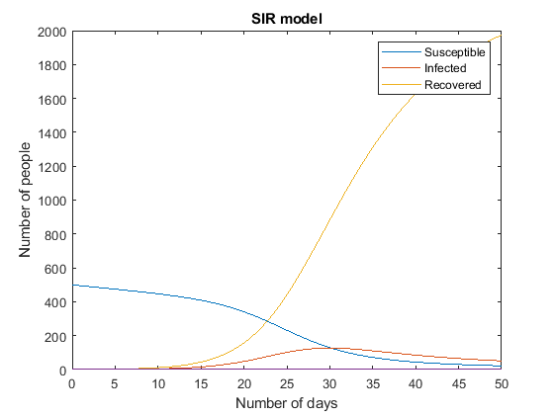
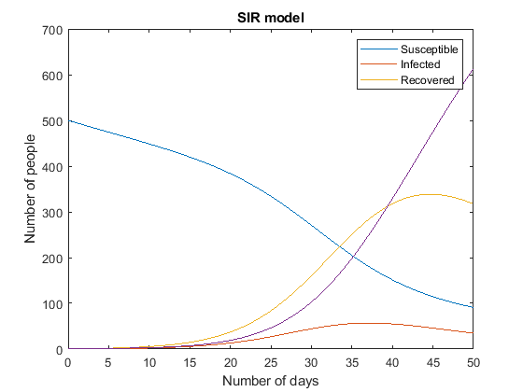
Results
Impact of vaccination on the course of a disease outbreak:
Figure 1 shows SIR model without vaccination when β= 3.5
Figure 2 shows SIR model with vaccination
Fig.1.
Fig.2.

Slide 15
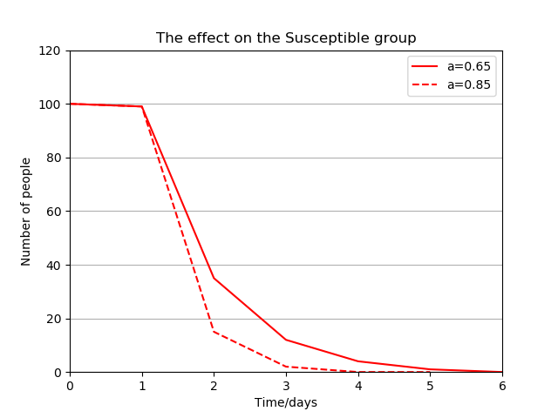
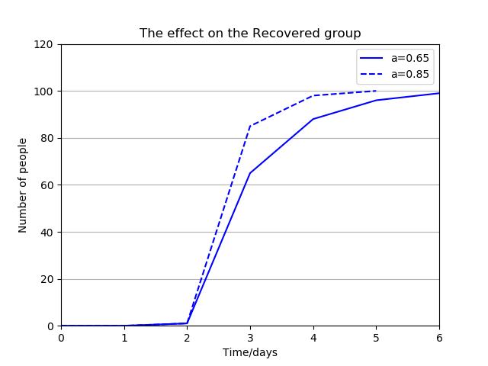
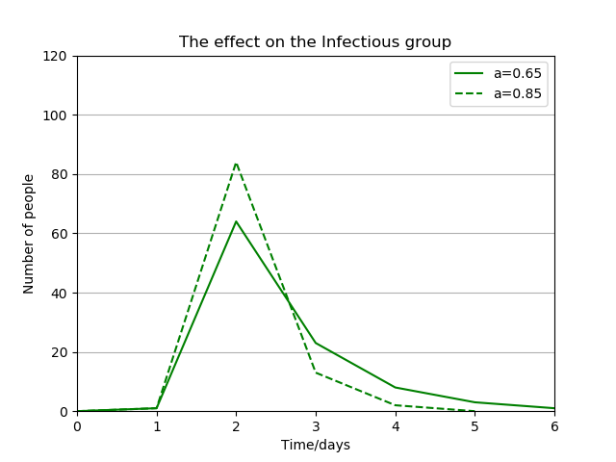
The effects of a higher infectious rate:
Modeling the effects of different infectious rates on susceptible, infected and recovered.
Figure 3 shows the effect on the susceptible group.
Figure 4 shows the effect on the recovered group.
Figure 5 shows the effect on the infected group.
Fig.3.
Fig.4.
Fig.5.

Slide 16
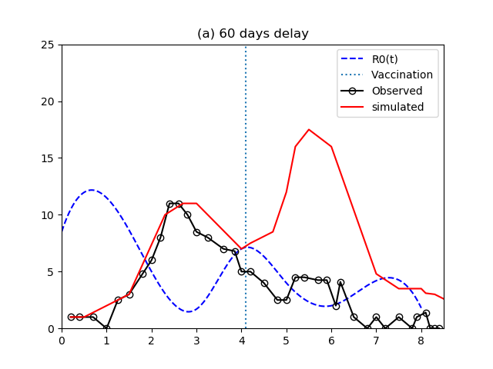
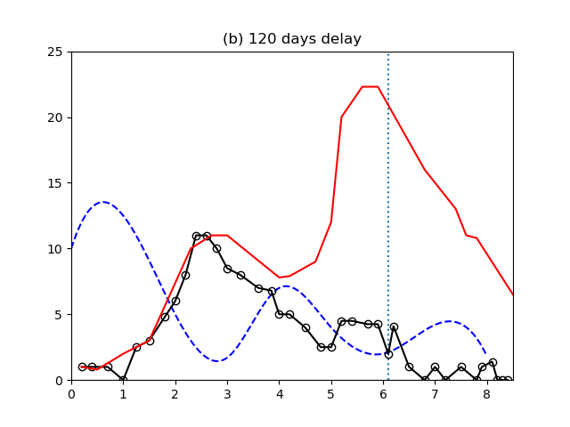
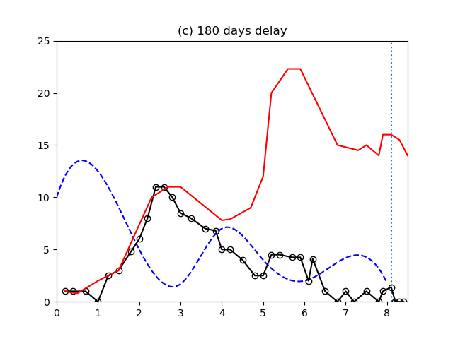
The effects of introducing yellow fever vaccination with different delay periods:
A study to examine the impact of vaccination on the dynamics of the disease outbreak.
Figure 6 shows the number of infection cases at 60 days delay.
Figure 7 shows the number of infection cases at 120 days delay.
Figure 8 shows the number of infection cases at 180 days delay.
Fig.6.
Fig.7.
Fig.8.

Slide 17
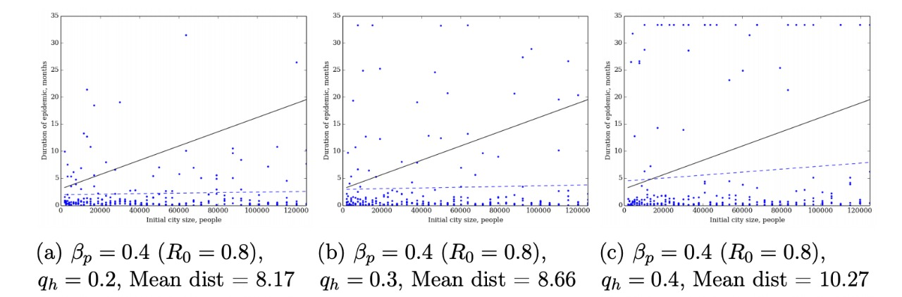
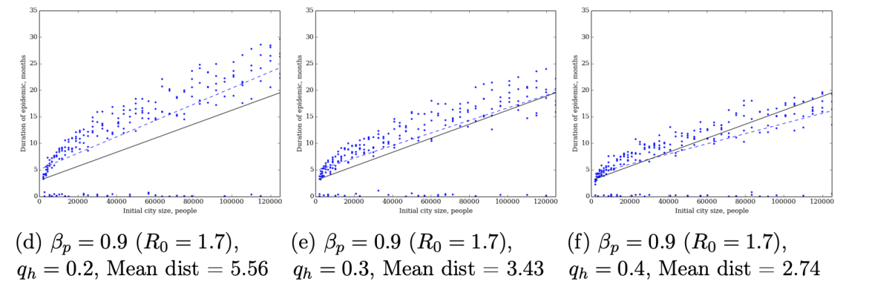
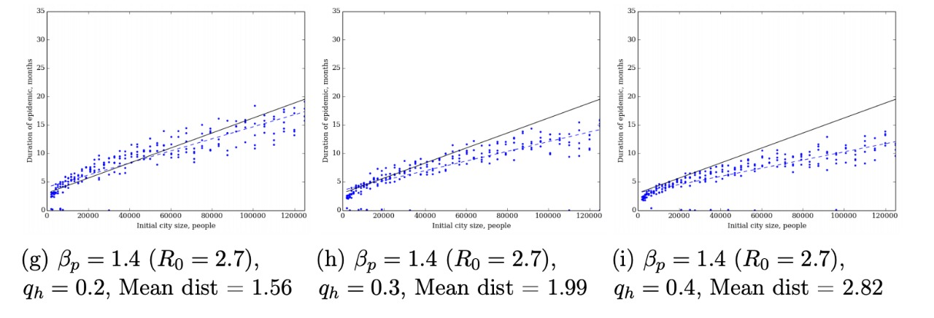
Studying the Effects of different reproduction numbers of plague:
Different combinations of values for R0 and qh, to fit the pneumonic plague model is used.
A threshold of 5% as a minimum mortality threshold is used.
Average distance of the simulated results is used.
Fig.9.

Slide 18
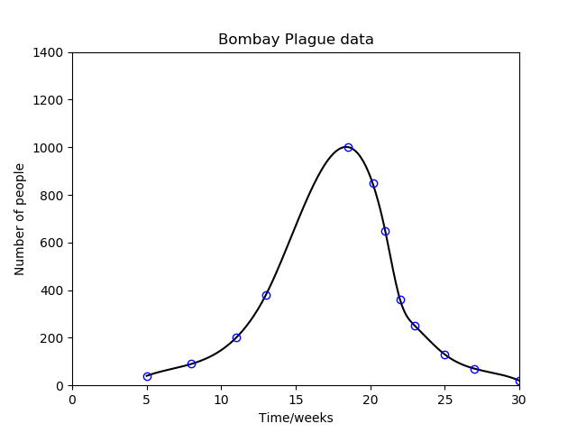
In the attached chart, the ordinate represents the number of deaths per week.
The abscissa represents the time in weeks.
Fig.10.

Slide 19
Conclusion
The study of the outbreak of an infectious disease is a long standing tradition which came to light in the beginning of the 19th century due to the absence of a proper method that predicts the evolution of a disease. Thus, after a period filled with several trials and errors in hope for achieving the most suitable model for this representation, came to light the basic SIR model which studies the dynamics of an infection by calculating the amount of people in a population who are susceptible, infected, or recovered at a given period of time. We discussed real life applications on two infectious diseases which are yellow fever and plague, along with different numerical examples to simulate how the different models behave in different scenarios. To sum up, the SIR models are a great help when a sudden crisis emerges as they are an essential tool that can quickly define the necessary steps to be taken to wisely respond to an emergency.

Slide 20
Acknowledgments:
We Would Like to express our special thanks to Dr. Mohammed Ibrahim wafa as well as TA’s Ahmed Hosny and Amira Ibrahem for their efforts. We would also like to thank our mentors Mohammed Atef and Mohab Hafez who helped us and guided us in each step we made as without them this project wouldn't have been as it is now.

Slide 21




Our Team Information
Maram Jamal
Reem Tarek
Hanya Mostafa
Maha AbdElwareth
M.AbdElwareth@nu.edu.eg
ID:18100498
M.jamal@nu.edu.eg
ID:18100641
R.Tarek@nu.edu.eg
ID:18100743
Ha.Mahmoud@nu.edu.eg
ID:18102059

Slide 22
THANK
YOU

