Slide 1
Retrieval-Augmented Generation (RAG) Pipeline
Engineering Teamwork 1: Applied Computer Science Lab
Leila Abdelelah, Mariam Ahmed,Hasan Abu Hejleh, Verzhinia Achova,Suhaib Abubakar
24.01.2026
BST-BCS-28
Professor Hasan Dag
Notes:
[Sources]
- LangChain RAG / retrieval docs (conceptual framing): https://docs.langchain.com/oss/python/langchain/rag
- RAG paper (original formulation): https://arxiv.org/pdf/2005.11401
[/Sources]

Slide 2
RAG in One Slide: What & Why
RAG = retrieval + generation (LLM) for grounded answers
What RAG does
High-level flow
RAG combines:
Parametric memory (LLM weights)
Non‑parametric memory (retrievable documents)
A retriever that selects relevant chunks for each query
User Question
Why it matters:
Retriever
(find relevant chunks)
Reduces hallucinations by grounding the answer in retrieved context
Adds citations/provenance back to the source documents
Lets us update knowledge by updating the document store (no retraining)
LLM
(generate answer + citations)
Notes:
[Sources]
- RAG paper (definition + motivation): https://arxiv.org/pdf/2005.11401
- LangChain RAG tutorial (retrieval + generation framing): https://docs.langchain.com/oss/python/langchain/rag
[/Sources]

Slide 3
Knowledge Base: 5 Document Types
Diverse sources to reflect real RAG deployments
We ingested five document modalities using LangChain document loaders and standardized metadata (source, type, page/chunk ids) for traceability.
Type
Example(s)
Processing pipeline
Why include it
PDF (papers)
RAG / Transformers / DPR papers
PDF opened page-by-page
Text extracted per page
Each page treated as an independent logical unit
High-quality, structured academic content
Page-level metadata enables precise attribution and citations
Web articles
LangChain docs; Chroma docs; Prompting Guide
HTML downloaded using requests
Parsed with BeautifulSoup
Script, style, and non-content tags removed
Visible text normalized into a single clean string
Reflects real-world RAG usage with noisy HTML
Avoids reliance on external loaders for robustness
Text chapter
Local .txt “chapter” summary
Direct file read
Minimal preprocessing
Clean baseline data
Useful for debugging and controlled experiments
Images (OCR first attempt)
Pipeline diagram + notes screenshot
OCR applied using EasyOCR
Language configuration used to improve recognition
Extracted text normalized
Introduces OCR noise intentionally
Simulates real-world documentation artifacts
Video
videos, mp4 files
Frames sampled from the video
Each frame passed to a vision-capable Ollama model
Model generates short semantic captions
Converts visual information into retrievable text
Demonstrates multimodal RAG beyond text-only pipelines
Implementation note: All document types are normalized into plain text + metadata before any chunking or retrieval logic is applied.
Notes:
[Sources]
- Assignment requirements: document types + loaders + chunking experiments. (uploaded PDF)
- LangChain RAG tutorial (document loading & splitting): https://docs.langchain.com/oss/python/langchain/rag
[/Sources]

Slide 4
Chunking Strategy: Design & Experiments
We tested multiple chunk sizes/overlaps and selected a balanced default
Why chunk at all?
Our measured results
Vector search works on fixed-length text segments (chunks)
Overlap helps preserve context across chunk boundaries
Trade-off: small chunks = precise retrieval, but more indexing cost
Large chunks = richer context, but less precise matches
Chunking strategy
Text is split sequentially by characters
Overlap ensures continuity between adjacent chunks
Same strategy is applied uniformly to:
  PDFs
  web pages
  OCR output
  video captions
This avoids format-specific behavior and keeps retrieval consistent.
Why this works
Small enough for precise semantic retrieval
Large enough to preserve local reasoning context
Overlap prevents losing definitions or explanations at boundaries
Especially effective for:
  noisy OCR text
  short video captions
  heterogeneous data sources
Chunking experiments we performed
We experimented with multiple chunk sizes and overlaps during development:
Larger chunks (~ 1000–1500 characters)
  richer context
  but often retrieved irrelevant surrounding text
Smaller chunks (~ 300–500 characters)
  higher retrieval precision
  better performance on OCR and video-derived text
After empirical testing, we selected ~500 characters as the final default.
Final chunking configuration
Chunk size: ~500 characters
Overlap: ~100–150 characters
Method: character-based sliding window
Chunking is applied after all sources are normalized to text
(PDF, web, OCR, video captions)
Recommended defaults (widely used in practice): Chunk size: 500–800 tokens. Overlap: 10–20% (≈ 50–150 tokens)
Notes:
[Sources]
- LangChain tutorial on loading/splitting docs (chunking rationale): https://docs.langchain.com/oss/python/langchain/rag
[/Sources]

Slide 5
Embeddings + Vector Database
We embed chunks and store them with metadata for semantic search
Embedding model
Vector store (ChromaDB)
Sentence Transformers: nomic-embed-text
Stores vectors + original chunk text + metadata
Similarity metric: cosine (common for normalized embeddings)
Top‑k retrieval parameter controls how many chunks are returned
Higher semantic accuracy
Better for RAG, long documents, nuanced meaning
Common in production-grade RAG systems
Metadata stored with each chunk
Design choice: why cosine?
• source (file/URL)
• type (pdf/web/text/image/video)
• page_number (when available)
• chunk_id
Cosine similarity is widely used for text embeddings because it focuses on direction (semantic meaning) rather than vector magnitude.
Notes:
[Sources]
- Sentence-Transformers docs (model overview and speed/quality notes): https://www.sbert.net/docs/sentence_transformer/pretrained_models.html
- Hugging Face model card (intended uses): https://huggingface.co/sentence-transformers/all-MiniLM-L6-v2
- Chroma docs (collections config / hnsw:space options): https://docs.trychroma.com/docs/collections/configure
[/Sources]

Slide 6
Retrieval: Similarity Search + Top‑k
Selecting the best context is the biggest quality lever in RAG
How retrieval works in our pipeline
1) Encode user query into an embedding vector
2) Query ChromaDB for nearest neighbors (cosine similarity)
3) Return top‑k chunks + metadata (source/type/page)
4) Format them into a context block for the LLM
High relevance
Noise / irrelevant
Default: top_k = 5 (enough coverage without overwhelming the prompt)
Notes:
[Sources]
- LangChain retrieval docs (retrieval pipeline building blocks): https://docs.langchain.com/oss/python/langchain/retrieval
- Chroma docs (querying collections): https://docs.trychroma.com/docs/querying-collections
[/Sources]

Slide 7
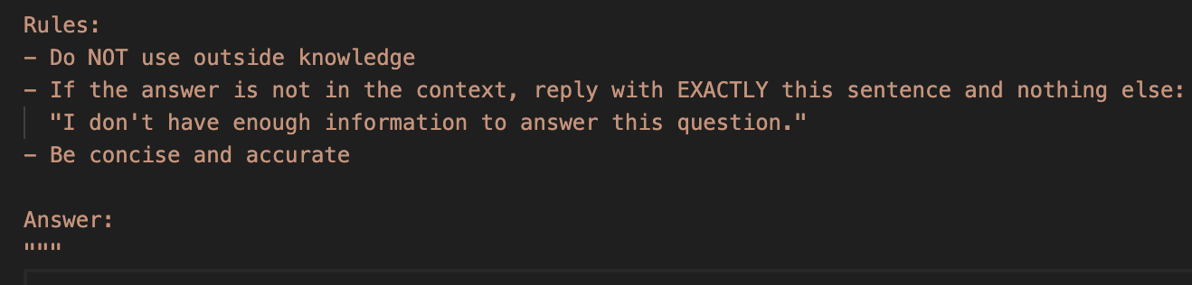
Prompt Engineering: Grounded Answers + Citations
We constrain the model to use only retrieved context and to admit uncertainty
Prompt design goals
Use ONLY provided context (reduce hallucinations)
Return “don’t know” when context is insufficient
Include source citations (from chunk metadata)
Be concise and faithful to the retrieved text
Prompt template
Notes:
[Sources]
- LangChain RAG tutorial (context formatting + generation step): https://docs.langchain.com/oss/python/langchain/rag
[/Sources]

Slide 8
System Architecture (End-to-End)
Indexing pipeline + online query pipeline
Offline: Indexing
Load
Split
Embed
Store
PDF / Web / TXT
Image OCR / Video
Recursive splitter
size + overlap
Uses Ollama text embeddings,
Uses CLIP embeddings for images, video
ChromaDB
+ metadata
Online: Retrieval + Generation
Query
Retrieve
Format
Generate
UI
User question (embedded)
Top‑k chunks
(cosine)
Context +
source labels
LLM answer
+ citations
Notebook /
simple app
Notes:
[Sources]
- LangChain RAG tutorial (indexing + retrieval/generation stages): https://docs.langchain.com/oss/python/langchain/rag
- Chroma docs (collections + querying concepts): https://docs.trychroma.com/
[/Sources]

Slide 9
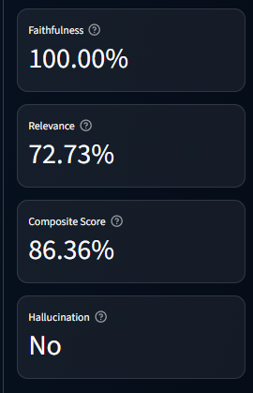
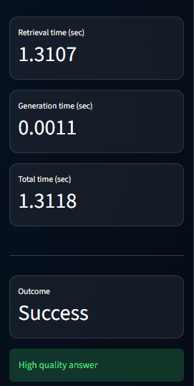
Quantitative Results (What We Measure)
Simple numbers + examples make design trade-offs clear
Metrics we report
Example result table (template)
• Chunking stats (docs → chunks, average chunk length)
• Retrieval quality: inspect top‑k chunks for relevance
• RAG vs base LLM: groundedness / hallucination reduction (examples + optional scoring)
• Latency: retrieval + generation time per query
• Success/failure cases (what works, what breaks, and why)
Query type
Expected
Base LLM
RAG
In-scope
Correct + specific
May be vague
Cited answer
Out-of-scope
Say “don’t know”
May guess
Says “not enough info”
Our Metrics:
Notes:
[Sources]
- LangChain evaluation tutorial (RAG evaluation concepts): https://docs.langchain.com/langsmith/evaluate-rag-tutorial
[/Sources]

Slide 10
Challenges & Solutions
What went wrong, what we changed, and what we learned
Chunk size trade-off
Problem: Too small → many chunks (slow indexing); too large → less precise retrieval
Solution: Ran experiments (500/100 vs 1500/300) and chose 500/100 as balance
Chunk size trade-off
What we would improve next
• Try hybrid search (keywords + vectors) for better precision
• Add automated evaluation (faithfulness/relevance scoring)
Retrieval noise
Problem: Some retrieved chunks may be off-topic if k too high or embeddings mismatch
Solution: Tune top_k; keep metadata; inspect retrieved chunks during testing
Retrieval noise
YouTube transcript errors
Problem: YouTube loader may return HTTP 400 in some environments
Solution: Wrap loader in try/except so pipeline continues; keep other source types
YouTube transcript errors
Notes:
[Sources]
- LangChain RAG tutorial (iteration on chunking/retrieval/prompting is common): https://docs.langchain.com/oss/python/langchain/rag
[/Sources]

Slide 11
Conclusion
We built a complete RAG pipeline:
✔ Data ingestion (5 doc types)
✔ Chunking experiments + chosen default
✔ Embeddings + vector store + retrieval
✔ Prompting with citations + “don’t know”
✔ Demo plan + evaluation approach
Questions?
Notes:
[Sources]
- RAG paper: https://arxiv.org/pdf/2005.11401
- LangChain RAG docs: https://docs.langchain.com/oss/python/langchain/rag
- Chroma docs: https://docs.trychroma.com/
[/Sources]

