Slide 1
Gene expression of lung (LUSC)

Slide 2

INTRODUCTION
we will analyze the gene expression for the healthy and cancerous LUSC

Slide 3
Methods
CONTENTS
Results
Conclusion

Slide 4
1
Methods
We used the packages (scipy.stats , numpy, matplotlib.pyplot, scipy, statsmodels.stats.multitest and tabulate )
The steps are that we made two lists of lists, one for the genes in healthy tissues and the other for genes in cancerous tissues (list of healthy tissues , list of cancerous tissues)
Correlation
Hypothesis

Slide 5
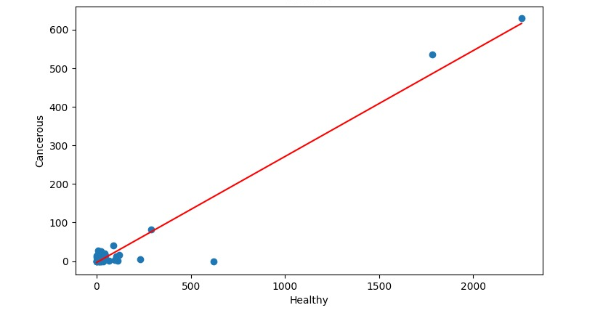
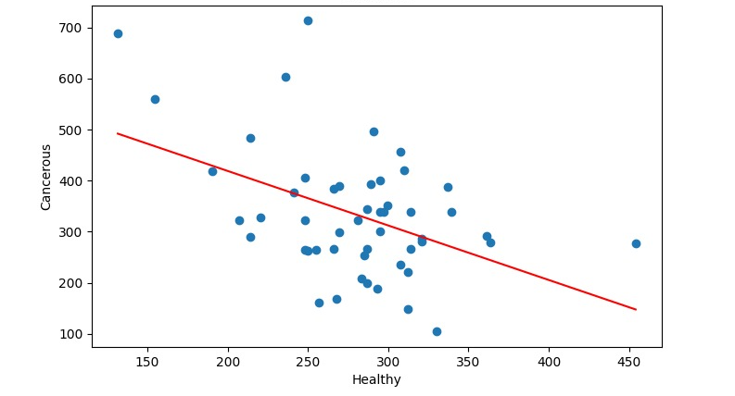
2
Results
The results of the correlation are:
Positive
Negative

Slide 6
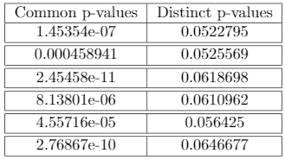
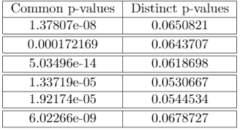
2
Results
The results of the hypothesis are:
Paired sample
Independent sample

Slide 7
Thanks!
Any questions?

