Slide 1
CS 225
Operator Overloading Cont.
Heather Marriott Embry-Riddle Aeronautical University

Slide 2
In Class Exercise – Member Function
class Pokemon{
…
public: ...
int operator+(Pokemon&);
friend ostream& operator<<(ostream &os, const Pokemon&);
};
int Pokemon::operator+(Pokemon& p){
int totalCP;
totalCP= cp + p.cp;
return totalCP;
}

Slide 3
In Class Exercise – Member Function
class Pokemon{
…
public: ...
int operator+(Pokemon&);
…
};
int main(){
Pokemon p("Pikachu");
const Pokemon e("Eevee", 50);
int total=p+e; //COMPILE ERROR !!!!!

Slide 4
Handling Const Variables
int Pokemon::operator+(const Pokemon& p){
int totalCP;
totalCP= cp + p.cp;
return totalCP;
}
int main(){
Pokemon p("Pikachu");
const Pokemon e("Eevee", 50);
int total=p+e; //Fixed

Slide 5
Handling Const Variables
int Pokemon::operator+(const Pokemon& p) {
int totalCP;
totalCP= cp + p.cp;
return totalCP;
}
int main(){
const Pokemon p("Pikachu");
const Pokemon e("Eevee", 50);
int total=p+e; //Compile Error if you don't promise to keep
//p constant
const

Slide 6
In Class Exercise – Friend Function
class Pokemon{
…
friend int operator+(const Pokemon&, const Pokemon&) ;
friend ostream& operator<<(ostream &os, const Pokemon&);
};
int operator+(const Pokemon& p, const Pokemon& p2) {
int totalCP;
totalCP= p.cp + p2.cp;
return totalCP;
}

Slide 7
Multiple Operations in a Statement
Most languages allow you to chain operations, that is, they allow several operators within the same statement
When you write a statement using integers or doubles, such as total = a + b + c;, first a and b are added, creating a temporary value; then, c is added to the temporary value, and the final result is stored in total
The same rules of operations apply when you want to create class objects that can use multiple operations in a statement

Slide 8
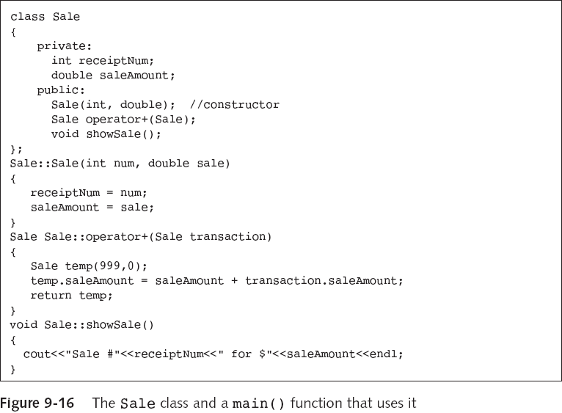
Multiple Operations in a Statement

Slide 9
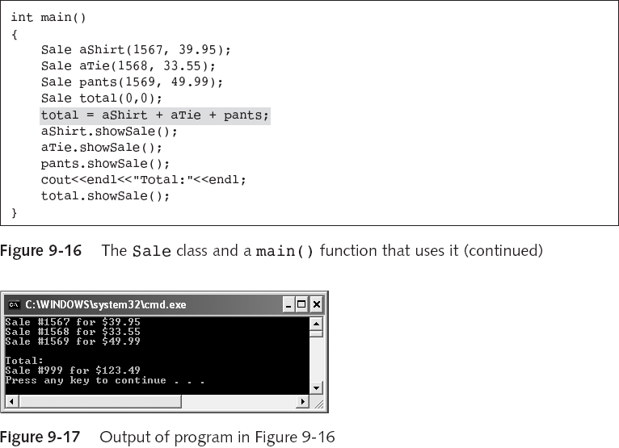
Multiple Operations in a Statement

Slide 10
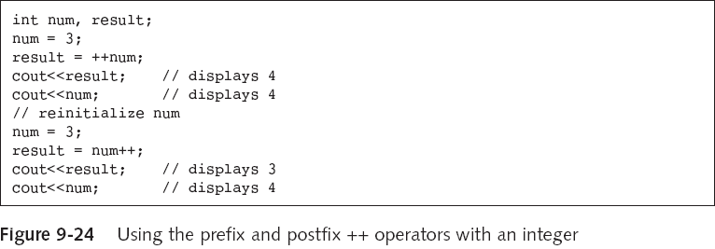
Overloading ++ and --

Slide 11
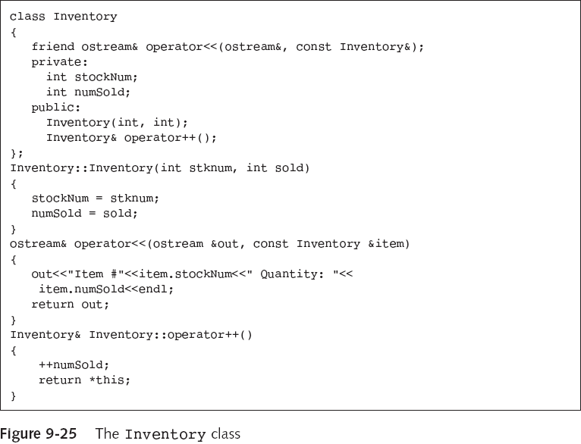
Multiple Operations in a Statement

Slide 12
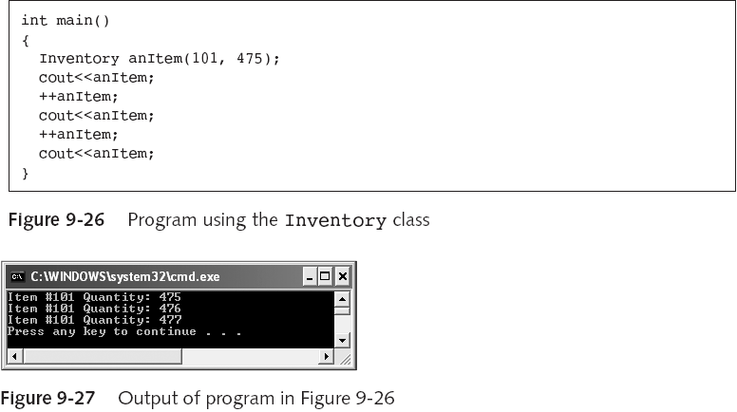
Multiple Operations in a Statement

Slide 13
Overloading the Prefix ++ and --
If the prototype to overload the prefix increments is:
Inventory& operator++();
How can we represent the postfix operator?

Slide 14
Overloading the Postfix ++ and --
The prototype to overload the postfix increments is:
Inventory operator++(int);
The int is a dummy argument, its not actually used in the function, but exists only to provide a different function prototype. You do not actually pass an integer when you call
anItem++;

Slide 15
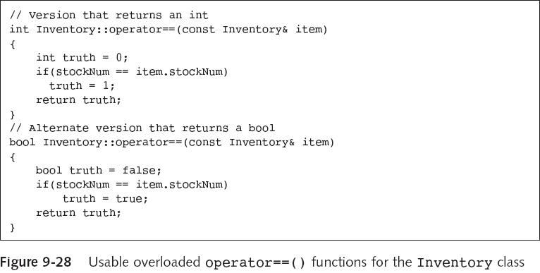
Overloading the == Operator
The operator == usually returns:
an integer value with 0 or 1
or
true or false

Slide 16
Overloading the = Operator
An implementation of the = operator will be provided for you if you don’t write one.
total = aShirt + aTie + pants;
a temporary object holds the sum of aShirt + aTie +pants. The = operator assigns every field of the class object on the right of the = to the field on the left of the =
aShirt=aTie;
All the values for the fields in aTie are assigned to the fields in aShirt;

Slide 17
Overloading the = Operator
If you want the = operator to do something other than assign each member, then you must create a custom operator=() function

Slide 18

In Class Exercises
Copy the file ~marric72/cs225/Lect18/Pizza.cc
Replace the displayValues() function with an overloaded << operator to display each Pizza.
In main, replace : aPizza.displayValues( );
with
cout<<aPizza;

