Slide 1

Project on
SMART CROP PROTECTION SYSTEM USING DEEP LEARNING
Bachelor in Technology
In
Computer Science and Engineering(Data Science)
By
M.ANILKUMAR - 21VE1A6741
G.APOORVA - 21VE1A6724
MANI KANTA - 21VE1A6711
M.DHAN RAJ - 21VE1A6744

Slide 2
Table Of Content:
ABSTRACT
PROBLEM STATEMENT
INTRODUCTION
EXISTING SYSTEM
PROPOSED SYSTEM
SYSTEM ARCHITECTURE
DATA FLOW DIAGRAM
USE CASE DIAGRAM
CLASS DIAGRAM
SEQUENCE DIAGRAM
ACTIVITY DIAGRAM
RESULTS

Slide 3
ABSTRACT.
Crop damage from animal attacks significantly threatens agricultural productivity, leading to major losses for farmers. Local animals such as buffaloes, cows, goats, and birds frequently damage crops, making it impractical for farmers to continuously guard their fields. Traditional methods like physical barriers, electric fences, and manual surveillance are often inadequate. Farmers also use human effigies, which have limited effectiveness against many animals.To address these issues, we propose an AI-based Scarecrow system that uses real-time video analysis to protect crops from wildlife. The system employs a camera to capture video and processes it using YOLOv3, a powerful object detection model, alongside OpenCV and COCO names. When an animal or bird is detected, the system triggers a sound alert to deter the intruder. Additionally, if an animal is detected continuously for over a minute, the system sends an email notification and makes a phone call to the farmer. This approach offers a more effective and automated solution for safeguarding crops, surpassing traditional deterrent methods.

Slide 4
Problem Statement:
In contemporary agricultural landscapes, one of the most pressing and ubiquitous social issues facing rural communities across South India is the relentless assault on crops by wildlife. The adversaries in this ongoing battle are as diverse as they are formidable, ranging from the agile deer and cunning monkeys to the awe-inspiring giants like elephants. Their relentless foraging wreaks havoc on the livelihoods of countless farmers, prompting a sense of urgency and a call for an effective and immediate solution to this profound problem.
The plight of rural communities is particularly dire, as they grapple with the destructive onslaught of these wild animals on their precious crops. This situation has grown increasingly dire, with frequent stories of animal attacks reverberating through the agricultural heartland of the country. This wave of destruction is fueled by the lack of a robust and comprehensive detection and deterrent system that could protect the crops and, by extension, the very livelihoods of these communities.

Slide 5
INTRODUCTION:
The interference of the animals with crops is one of the biggest problems farmers face because it results in massive losses. This approach is time consuming, understandable via manual inspections or mechanical barriers, can only handle a limited number of crops at once and cannot respond in real time to crop threats. To tackle these problems, this project considers Deep Learning for a preventive, self-regulating crop guarding approach. Thus, the system becomes a computer vision-based, continuous and real-time ML system using YOLO to detect and classify threats. This approach has certain main advantages compared to the traditional approaches employed: real-time monitoring, high accuracy in threatening identification and intelligent alarm signaling, including audio playback, e-mail or phone alerts that enable farmers to act even from a distance. Moreover, camera based surveillance allows visual evidence to increase the farmer confidence and thus also allows for learning and evolving threat detection over time.

Slide 6
EXISTING SYSTEM
In current agricultural practices, traditional methods like electric fences, scarecrows, and chemical repellents are widely used to prevent wild animals from entering crop fields. While these methods offer some level of protection, they come with various limitations. Electric fences, for example, are expensive to install and maintain, while scarecrows and chemical repellents have limited effectiveness as animals adapt to them over time. Additionally, these methods are often labor-intensive and environmentally harmful.
Recent advancements in smart agriculture have led to the integration of technology-driven solutions. The most commonly used systems involve passive infrared (PIR) sensors and camera-based monitoring to detect animal movements. These systems can alert farmers when an animal is detected, but they often lack the real-time processing capabilities and accuracy needed for prompt intervention. Additionally, such systems are limited by poor internet connectivity in rural areas, making real-time data transfer and cloud-based processing difficult.

Slide 7
Proposed System
The proposed system is an integrated solution designed to enhance crop protection through advanced animal detection and security features. At its core, the system employs **YOLOv3** and **Tiny-YOLO** models for real-time object detection. These state-of-the-art algorithms enable the accurate identification of various animal species approaching the crop fields, allowing for prompt intervention.
In addition to animal detection, the system incorporates **face recognition technology** using Haar Cascades and ORB algorithms. This feature allows the system to identify authorized personnel, such as farmers, while detecting unauthorized individuals. This dual functionality enhances farm security by providing alerts when unknown faces are recognized.
To ensure immediate response to detected threats, the system implements **multi-channel alert mechanisms**. When an animal or unknown person is detected, the system triggers sound playback to scare off the animals and sends email notifications and phone call alerts to inform the farmer. This comprehensive alerting system enables farmers to take timely action, reducing the risk of crop damage.

Slide 8
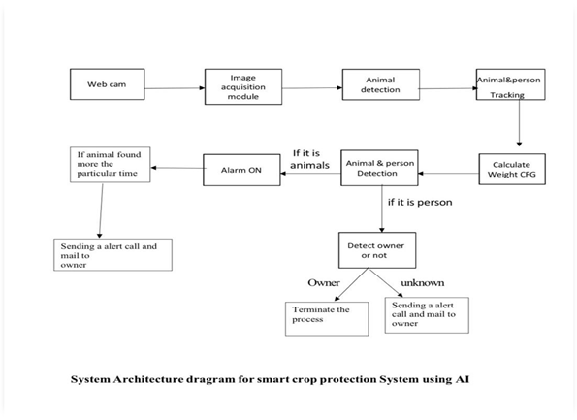
System Architecture :-

Slide 9
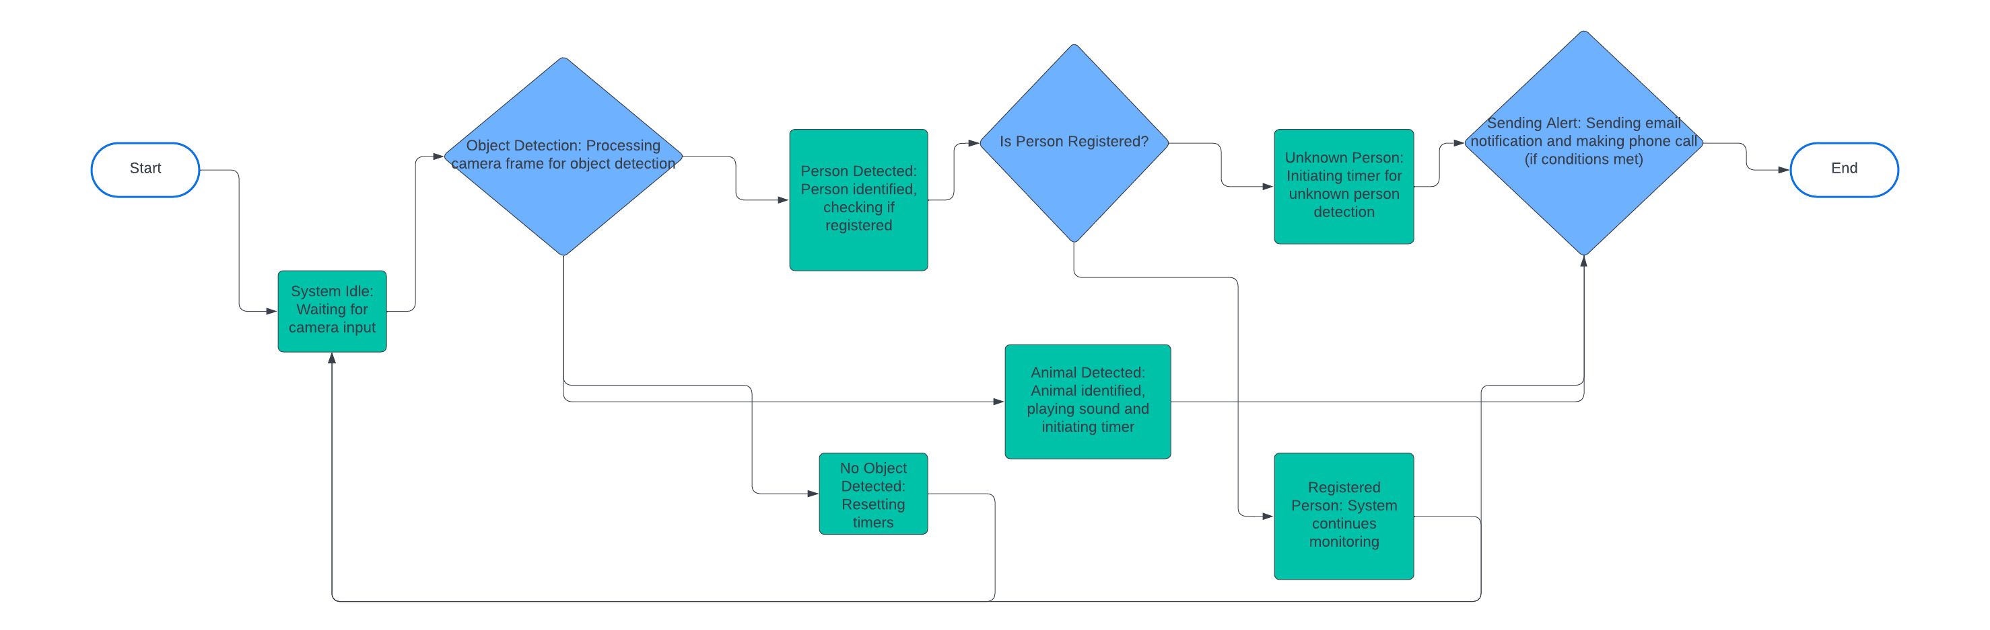
State Uml

Slide 10
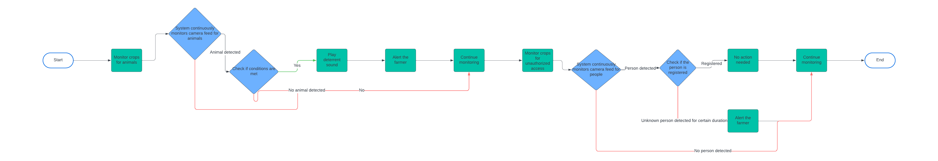
Use Case Diagram:

Slide 11
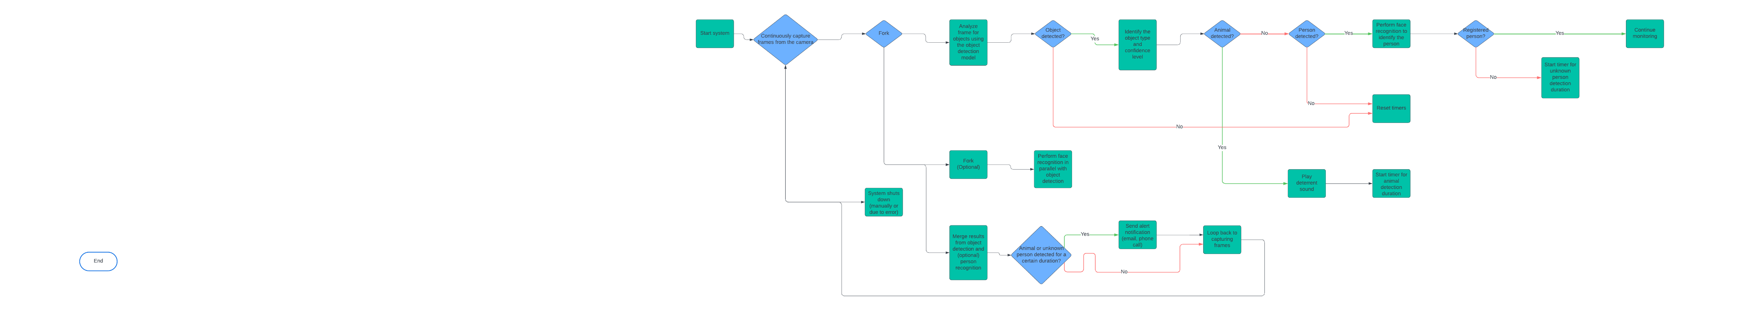
Activity Diagram:

Slide 12
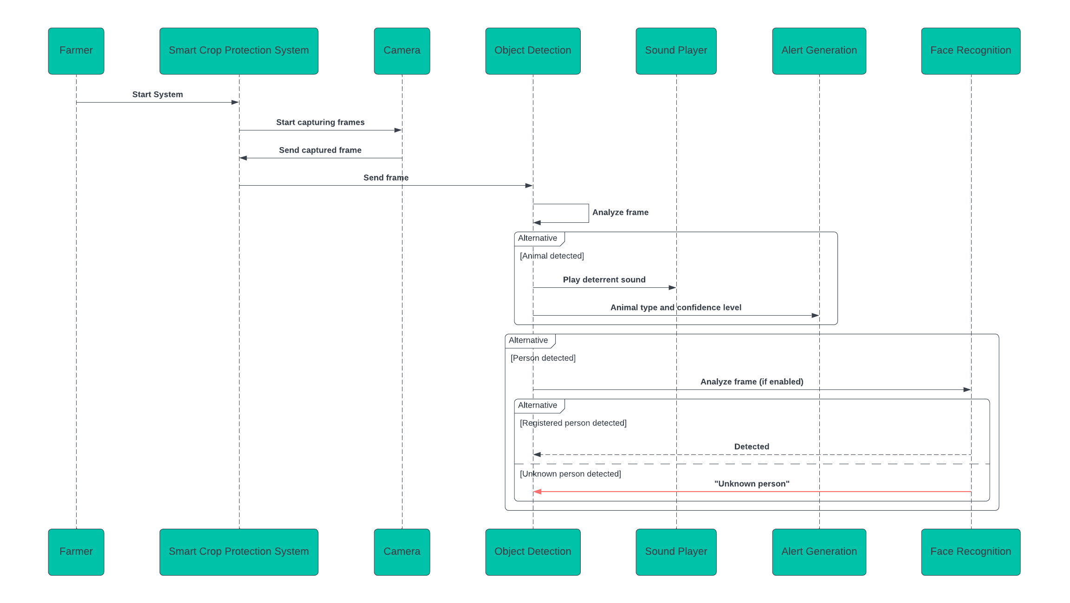
Sequence Diagram

Slide 13
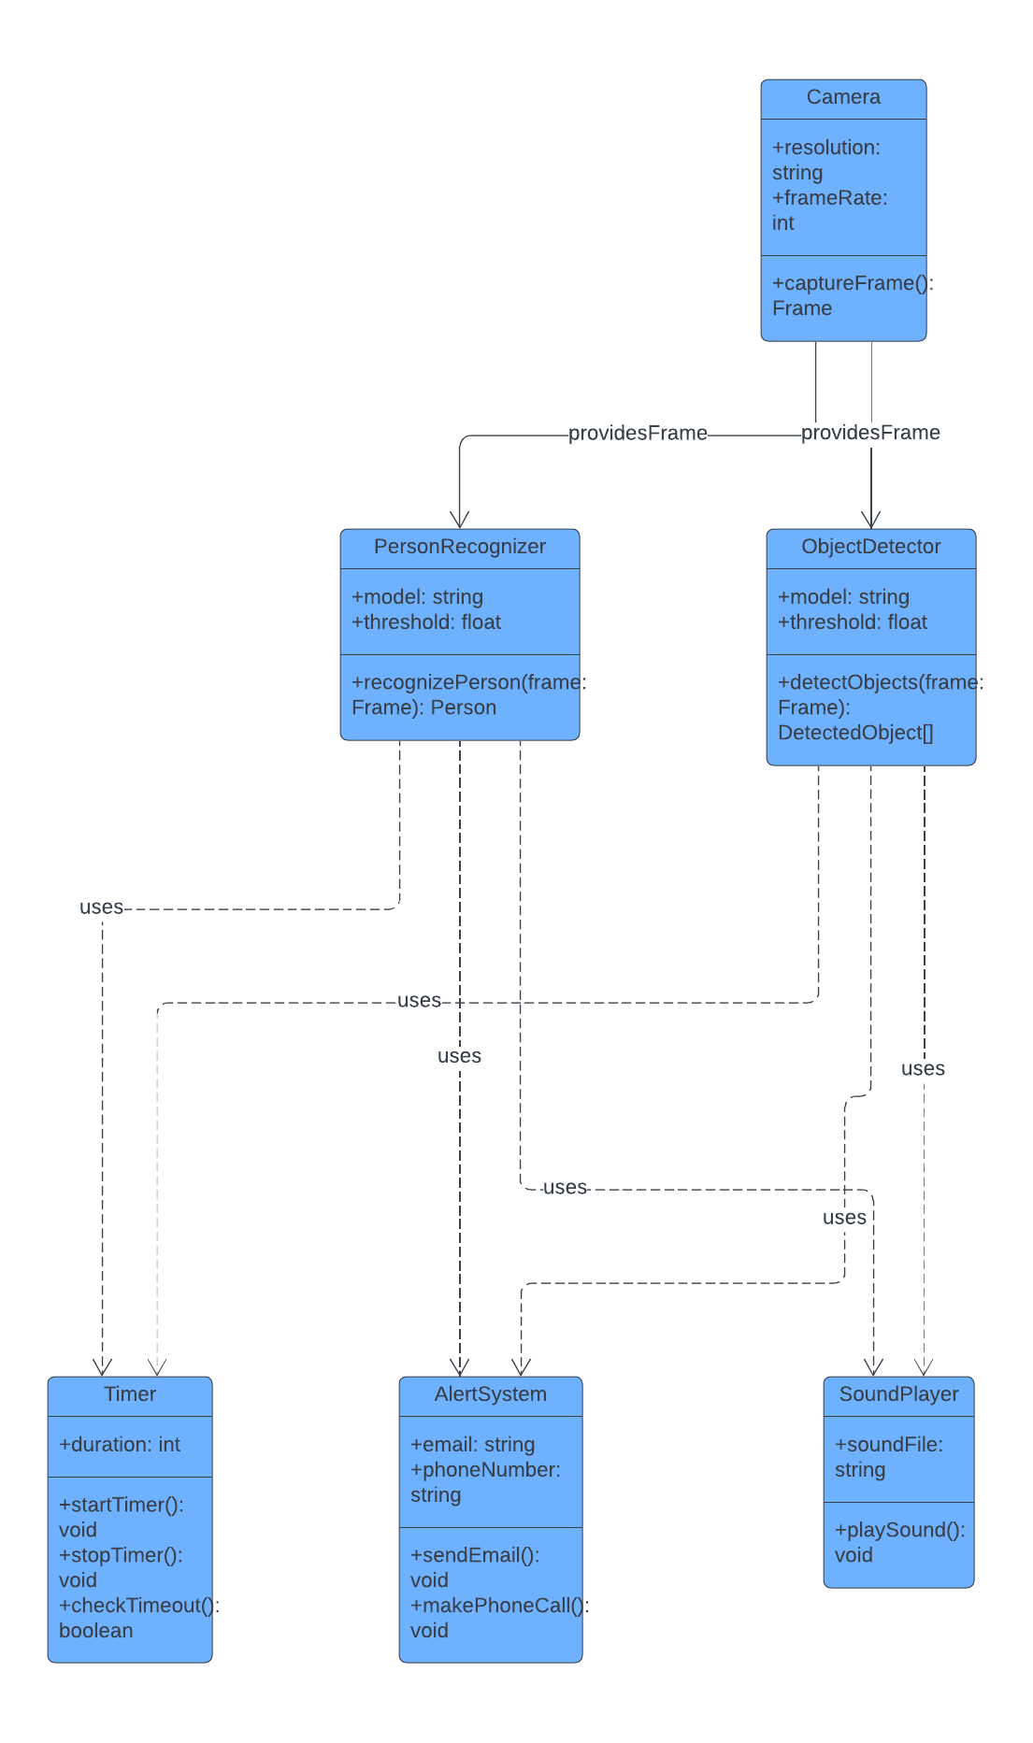
CLASS DIAGRAM UML

Slide 14
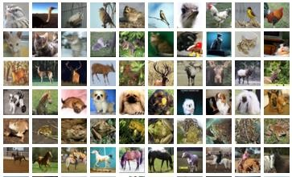

Outputs Related To Projects
Owner Training Image:
In the Smart Crop Protection System the first step is to train the system for identification of th15
e owner of the crops. The employed training phase acquires the owner’s images to develop a perfect identification model. Taking a note of advanced machine learning, the owner and the system understands that only a stranger gets inside the car and makes it alert. The important combination of the owner training is as follows: the owner training must create a zone of safety around the crop area, reduce instances of false alarms, and improve the performance of the system..
Figure 1:Training data owner image and coco. Names dataset

Slide 15
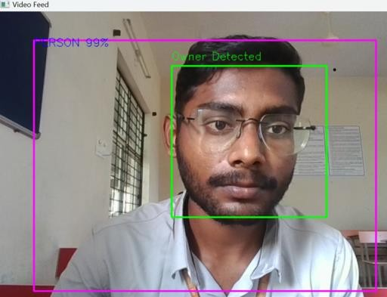
Identifying Owner Image
The subsequent stage in the assessment process is therefore RTI after the owner has been trained in the system. The system uses computer vision algorithms to track videos captured by cameras mounted on the crop field. Owing to the recurrent comparison of the real-time video streams with the trained model, the system properly authenticates the owner. This identification
Figure 2:Identified owner figure

Slide 16
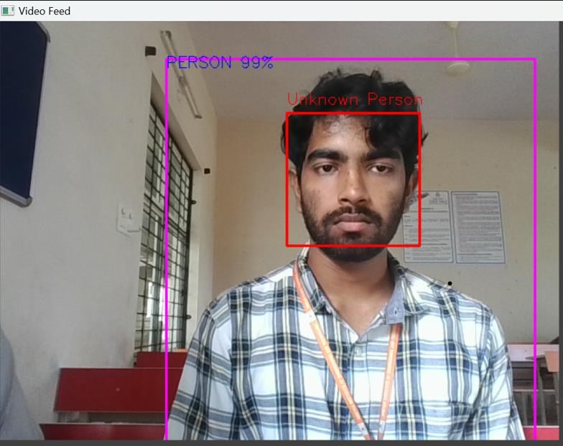
Identifying Unknown Image
When an unknown individual is moving toward the crop area, the system runs its detection procedures. Employing facial recognition algorithms, the system analyzes the incoming images to decide whether the person is known. If no such person is found, then an alarm is raised signifying a probable security infringement in the owner’s compound. This feature is important for the purpose of preventing theft or destruction of the crops which strengthens the need for a protective system for farming produce.
Figure 3:Identifying the unknown image

Slide 17
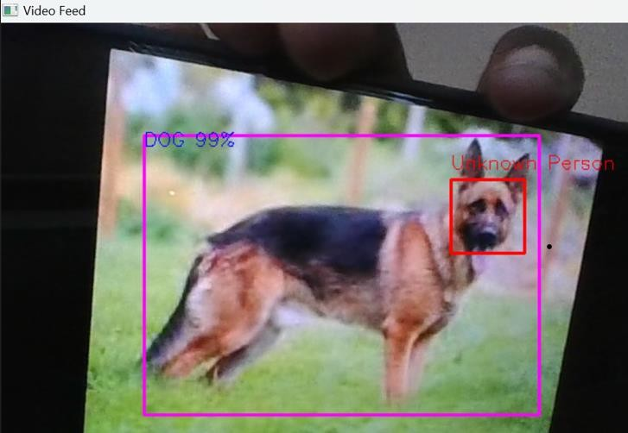
Identifying Animal and Making Sound Image
In addition to detecting unknown individuals, the system is equipped with functionalities to identify animals that may pose a threat to the crops. Utilizing advanced image processing techniques, the system analyzes incoming footage to detect animals such as deer or livestock. Once an animal is identified, the system triggers a sound alert to deter the animal from entering the crop area. This proactive approach minimizes damage and enhances crop protection.
Figure 6.4 : Identifying animal

Slide 18

Call Getting Image
When an unauthorized individual or animal is detected, the system initiates a multi-tiered alert process. The first step involves sending a real-time alert to the owner's mobile device, ensuring they are immediately informed of the situation. The system can initiate a phone call through a notification service, providing live updates and crucial information regarding the security breach.
Figure 5:Call getting image

Slide 19
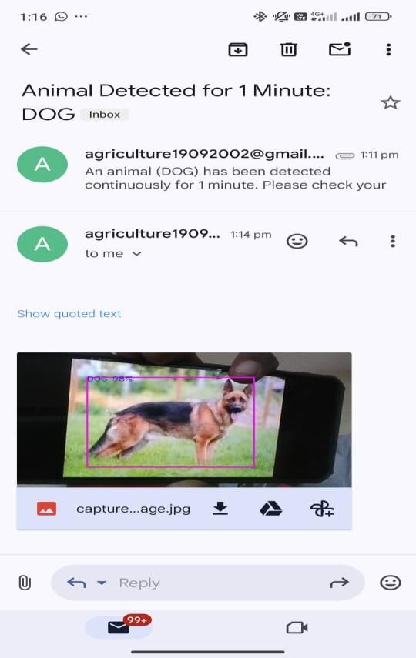
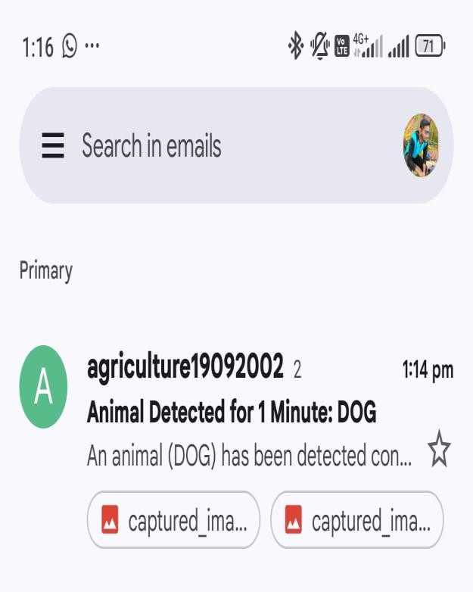
Mail Getting Image
In conjunction with phone alerts, the system also sends an email notification to the owner. This email includes vital details such as the time of detection, images captured of the unknown individual or animal, and the actions taken by the system. This dual alert mechanism ensures that the owner has multiple ways to receive important information, reinforcing their ability to respond quickly to potential threats

Slide 20
THANK YOU

