Slide 1
PERL Part 02 – More PERL
Mark Roberts, IBM

Slide 2
Agenda
PERL Programming
  Hash data
  Regular expressions
  Command line argument processing – revisited from part 1
  Environment Variables
PERL and ClearCase
  CtCmd from www.cpan.org
  ClearCase Automation Library (CAL)
  ClearCase Triggers
PERL and ClearQuest
PERL and Excel

Slide 3
Agenda
PERL Programming
  Hash data
  Regular expressions
  Command line argument processing – revisited from part 1
  Environment Variables
PERL and ClearCase
  CtCmd from www.cpan.org
  ClearCase Automation Library (CAL)
  ClearCase Triggers
PERL and ClearQuest
PERL and Excel

Slide 4
Hash data
A collection of scalar values like an array
Indexed by arbitrary text
Useful for managing data in a ‘look up table’ format
Arrays use a numerical index from zero :
  $MyArray[0] = “Mark”;
  $MyArray[1] = “Fred”;
Hashes use a unique textual tag :
  $MyHash{“Peter”} = “SSSR”;
  $MyHash{“Andy”} = “Consultant”;

Slide 5
Hash data example – script-02-001.pl
keys returns the values in the { } characters when the hash was created
  $RoleHash{“Steve"} = "Consultant";
  $RoleHash{“Andy"} = "Consultant";
  $RoleHash{"Mark"} = "Manager";
  $RoleHash{"Peter"} = "SSSR";
  foreach $Key (keys %RoleHash){
  print "Key : ".$Key."\tValue : ".$RoleHash{$Key}."\n";
  }
  print "CONSULTANTS\n";
  while (($Name, $Role) = each(%RoleHash)) {
  if ($Role eq "Consultant") {
  print "\t".$Name."\n";
  }
  }
Index the has by the current extracted key
each(%HashName) returns the key and value pair for assignment as shown

Slide 6
Agenda
PERL Programming
  Hash data
  Regular expressions
  Command line argument processing – revisited from part 1
  Environment Variables
PERL and ClearCase
  CtCmd from www.cpan.org
  ClearCase Automation Library (CAL)
  ClearCase Triggers
PERL and ClearQuest
PERL and Excel

Slide 7
Simple regular expressions
Pattern matching against strings
Once matched (or not matched) :
  Replace text
  Execute other code
Lots of UNIX utilities that involve regular expressions
  Sed, awk, grep, ed, vi (slight variations on use and syntax !!)
A string becomes a regular expression by enclosing in / chars
  (/abc/)
When comparing generally use the default pattern match variable - $_ (Dollar underscore) as the source to be searched

Slide 8
Regular expression example – script-02-002.pl .. 1
Data to search (similarity to show search options) :
  push (@SearchStrings, "Mark");
  push (@SearchStrings, "Marketing");
  push (@SearchStrings, "Marks & Spencer");
  push (@SearchStrings, "Shops");
  push (@SearchStrings, "shopping");
Loop to iterate over search items :
  foreach $_ (@SearchStrings) {
  print "Searching ".$_."\n";
  if (/Mark/) {
  print "\tfound to contain 'Mark'\n";
  }
  …
Implicit use of the m/<pattern>/ [g] [i] [m] operator. The ‘m’ at the start is optional.

Slide 9
Regular expression example – script-02-002.pl .. 2
Further search capability shown within other if () blocks
  if (/[MS]/) { - One of ‘M’ or ‘S’ (or both)
  if (!/[k]/) { - Does not contain a ‘k’ character
  if (/p+/) { - Contains one or more ‘p’ characters
  if (/p{2,2}/) { - Contains exactly two (adjacent) ‘p’ characters
  if (/^$/) { - Start of line next to the end of line, i.e. empty string
  if (/^S/) { - Contains an ‘S’ at the start of line
  if (/k$/) { - Contains a ‘k’ at the end of the line
  if (/[Ss]hop[s*]\b/) { - Contains Shops, shops, Shop or shop
  if (/s{2,2}$/) { - Contains exactly 2 ‘s’ at the end
  if ((\d{1,8}) { - Contains between 1 and 8 numeric
  if ((\s)*) { - Matches any number of whitespace char
  - (<blank-space> \t \n \r \f)
  if ((\D) { - Matches none-numeric

Slide 10
Regular expressions for data replacement
Search a string for a pattern and replace if found
$Var =~ s/<pattern>/<replacement>/ [g][i][m]
  Pattern can be any regular expression seen previously (and more)
  Optional modifiers (common) :
    [g] global replacement, otherwise replaces just first instance
    [i] ignore case
    [m] let ^ and $ match next to \n in the string

Slide 11
Regular expressions for data replacement
Translate characters
  Not a pattern patch search and replacement, but a translation of characters globally in a string
$Var =~ tr/<search-list>/<replacement-list>/ /d /s
  Optional modifiers (common) :
    /d Delete found but un-replaced characters
    /s Squash duplicate replaced characters
  Examples :
  $Var =~ tr/aeiou/!/ - Change any vowel to !
  $Var =~ tr/a-z/A-Z/ - Upper case the string in $Var
  $Var =~ tr/@~#//d - Delete any instance of @~#

Slide 12
Agenda
PERL Programming
  Hash data
  Regular expressions
  Command line argument processing – revisited from part 1
  Environment Variables
PERL and ClearCase
  CtCmd from www.cpan.org
  ClearCase Automation Library (CAL)
  ClearCase Triggers
PERL and ClearQuest
PERL and Excel

Slide 13
Command line argument processing – example from part 1
Example (script-01-015.pl) :
foreach $Arg (@ARGV) {
print "Argument being processed : ".$Arg."\n";
if (substr($Arg, 0, 4) eq "/set") {
$CQDBSet = substr($Arg, 5);
}
elsif (substr($Arg, 0, 3) eq "/db") {
$CQDB = substr($Arg, 4);
}
Etc.
Execution :
Perl script-015.pl /set=2003.06.00 /db=SAMPL /user=mroberts /password=secret1
Improved version on next page

Slide 14
Command line processing – script-02-003.pl
foreach $_ (@ARGV) {
print "Argument being processed : ".$_."\n";
if (?/set?) {
$CQDBSet = substr($_, length("/set="));
}
elsif (?/db?) {
$CQDB = substr($_, length("/db="));
}
……
Uses ‘?’ characters for search string identification since ‘/’ is a part of the searched string

Slide 15
Agenda
PERL Programming
  Hash data
  Regular expressions
  Command line argument processing – revisited from part 1
  Environment Variables
PERL and ClearCase
  CtCmd from www.cpan.org
  ClearCase Automation Library (CAL)
  ClearCase Triggers
PERL and ClearQuest
PERL and Excel

Slide 16
Environment Variables
Allows interaction with machine settings
Enables the identification of the operating system
Interaction with ClearCase command environment during trigger execution
Use
  ENV{‘<environment-variable>’} returns the value of the variable
  Eg :
    $OperatingSystem = $ENV{'OS'};
    $TempDirectory = $ENV{'TEMP'};
  If the environment variable selected is not set the the assigned variable has a zero length string.
  The use of if (length($ENV('env-I-want'}) > 0) { …… } is recommended.

Slide 17
Environment variables example – script-02-004.pl
$_ = $ENV{'OS'};
if (m/Windows_NT/) {
$TempFileName = $ENV{'TEMP'}."\\tempfile.tmp";
$OS = $_;
}
else {
$TempFileName = "/tmp/tempfile.tmp";
$OS = `uname -rs`;
$OS =~ s/\n//g;
}
print "Operating system in use is : ".$OS."\n";
print "Using temp file : ".$TempFileName."\n";

Slide 18
Execution of script-02-004.pl
On Windows 2000
Operating system in use is : Windows_NT
Using temp file : c:\temp\tempfile.tmp
On Windows XP
Operating system in use is : Windows_NT
Using temp file : C:\DOCUME~1\mroberts\LOCALS~1\Temp\tempfile.tmp
On Red Hat Linux 7.3
Operating system in use is : Linux 2.4.18-3
Using temp file : /tmp/tempfile.tmp

Slide 19
Agenda
PERL Programming
  Hash data
  Regular expressions
  Command line argument processing – revisited from part 1
  Environment Variables
PERL and ClearCase
  CtCmd from www.cpan.org
  ClearCase Automation Library (CAL)
  ClearCase Triggers
PERL and ClearQuest
PERL and Excel

Slide 20
CtCmd from www.cpan.org
Cleartool Command line interface
Available under the common public license (freeware)
Installation requirements for Windows platforms
  Perl interpreter (version 5.004 or above)
    Check version number with perl -v
  Microsoft Visual Studio
  The inc and lib environment variables must identify the appropriate locations within the visual studio directory structure
  The following executables must be accessible from the path
    cl.exe , perl.exe , cleartool.exe , dumpbin.exe

Slide 21
CtCmd from www.cpan.org
Installation requirements for Unix platforms
  Perl interpreter (version 5.004 or above)
    Check version number with perl -v
  GNU C Compiler
  Make

Slide 22
Installing CtCmd - Windows
Download files and extract archive into a ClearCase tools VOB
  Ensure that MVFS settings are case preserving
Cd to directory and enter the following commands
  perl Makefile.pl
  nmake
  nmake test (takes about 10 minutes)
  nmake install

Slide 23
Installing CtCmd - UNIX
Download files and extract archive into a temporary location
  Cd to directory and enter the following commands
  perl Makefile.PL
  make
  make test (takes about 2 minutes)
  make install
Notes
  Make test phase failed when tested within a VOB. Problems creating some of the UCM artefacts when command context was a VOB.
  Alternative solution was to build outside a VOB and then import all files to a VOB later

Slide 24
CtCmd documentation
Prior to installation use (from within the CtCmd directory)
  perldoc -F CtCmd.pm
After installation use (from any directory or drive)
  perldoc ClearCase::CtCmd
Documentation includes
  Synopsis of use
  Description
  Supported ClearCase commands
    -ver and –verall switches are not supported
  String quoting

Slide 25
CtCmd example – script-02-005.pl
Required in all scripts that use CtCmd
use ClearCase::CtCmd;
($Status, $stdout, $stderr) = ClearCase::CtCmd::exec("ls f:\\Dataaa");
print "Status : ".$Status."\n";
print "Stdout : ".$stdout."\n";
print "StdErr : ".$stderr."\n";
($Status, $stdout, $stderr) = ClearCase::CtCmd::exec("ls f:\\Data");
print "Status : ".$Status."\n";
print "Stdout : ".$stdout."\n";
print "StdErr : ".$stderr."\n";
Change the drive letter to a drive mapped on your Windows system
Change the drive letter to a drive mapped on your Windows system and ensure that the VOB reference is valid

Slide 26
CtCmd example – script-02-006.pl
Create a new instance of ClearCase to be used in further commands
use ClearCase::CtCmd;
$inst = ClearCase::CtCmd->new();
$vob="f:\\\Data";
($Status, $OwnerInformation, $err)=$inst->exec(desc,-fmt,"%u %Gu",$vob);
die $err if $inst->status();
print "\nObject Owner Information : ".$OwnerInformation."\n";
Comma separated list of arguments – any number of arguments may be used dependent upon the command required

Slide 27
Performance trial for CtCmd
Scripts to create a series of labels in sets
  10 sets created with 1000 in the first, 2000 in the second etc.
  script-02-007.pl uses cleartool
  Script-02-008.pl uses CtCmd
Can be modified to test other combinations if interested

Slide 28
Cleartool command execution – example – script-02-007.pl
  $VobTag = @ARGV[0];
  for ($MasterCounter = 1; $MasterCounter <=10; $MasterCounter++) {
  $StartTime = time;
  for ($Counter = 1;$Counter <= ($MasterCounter * 1000); $Counter++) {
  $LabelName = "LABEL_STD".sprintf("%02d%05d", $MasterCounter, $Counter);
  $cleartool_MkLbTypeCmd = "cleartool mklbtype -nc $LabelName@".$VobTag;
  `$cleartool_MkLbTypeCmd`;
  }
  $EndTime = time;
  $TimeTaken = $EndTime - $StartTime;
  print "Labels : ".($MasterCounter * 1000)." : Time taken : ".$TimeTaken." seconds \n";
  }

Slide 29
CtCmd example – script-02-008.pl
  use ClearCase::CtCmd;
  $StartTime = time;
  $inst = ClearCase::CtCmd->new();
  for ($Counter = 1;$Counter <= 100;$Counter++) {
  $LabelName = "LABEL_CTCMD".sprintf("%05d", $Counter);
  ($Status, $MkLabelResult, $err)=$inst->exec(mklbtype,-nc,$LabelName."@\\Test1");
  }
  $EndTime = time;
  $TimeTaken = $EndTime - $StartTime;
  print "Time taken : ".$TimeTaken." seconds \n";

Slide 30
Performance results
 |  | Unix |  | Windows
 |  | CtCmd | cleartool | CtCmd | cleartool
 | 1000 | 55 | 134 | 85 | 445
 | 2000 | 126 | 278 | 165 | 870
 | 3000 | 186 | 421 | 264 | 1304
 | 4000 | 252 | 577 | 372 | 1734
 | 5000 | 326 | 744 | 521 | 2180
 | 6000 | 392 | 891 | 636 | 2616
 | 7000 | 468 | 1043 | 791 | 3064
 | 8000 | 608 | 1211 | 926 | 3498
 | 9000 | 806 | 1364 | 1085 | 4020
 | 10000 | 1048 | 1535 | 1261 | 4555
Number of Labels
Note that times are in seconds

Slide 31
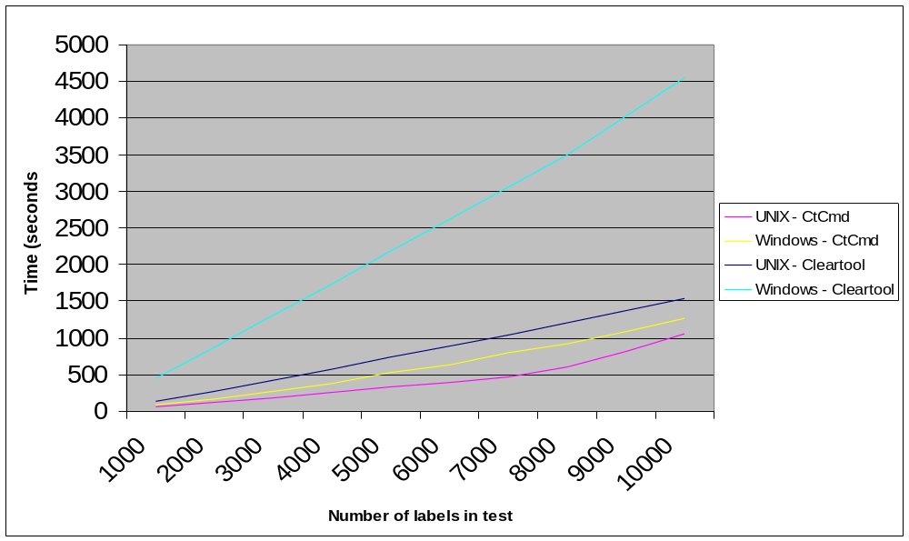
Test results – Time to create labels

Slide 32
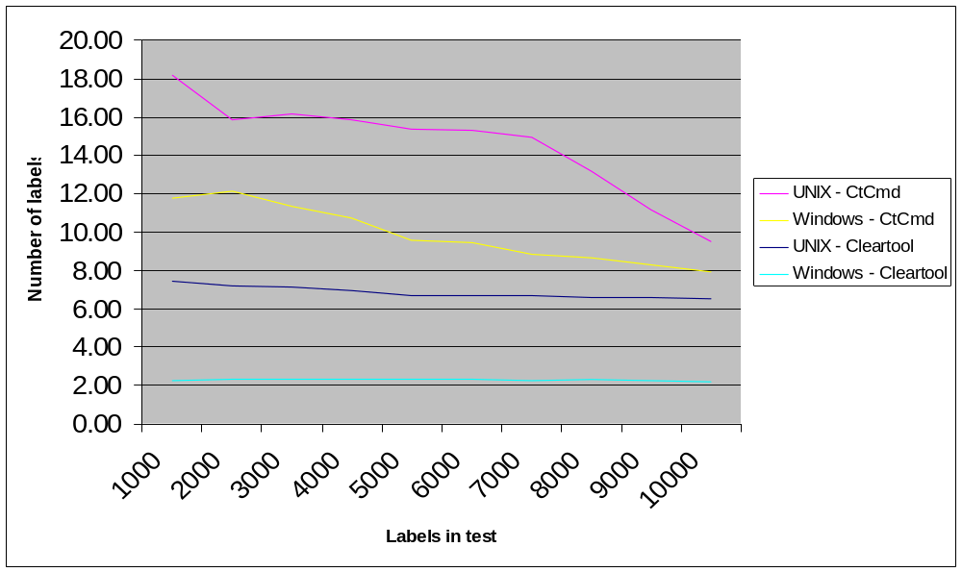
Test results – Labels created per second

Slide 33
Completion of label creation tests
To remove all label types from a VOB use script-02-009.pl
  Ensures that there is no attempt to remove pre-defined labeltypes
    LATEST, CHECKEDOUT and BACKSTOP
  Uses splitting to arrays, for each loops and CtCmd

Slide 34
CtCmd – example script-02-010.pl
CtCmd execution statement is :
($Status, $SearchResult, $err)=$inst->exec(qw(find \\Data -type f -version version(/main/10) -print));
  Uses the qw operator to individually quote a space separated sequence of words
  Result of qw is an array of quoted strings such as
    @Names = qw(mark, james, danny);
    @Names[0] = ‘mark’ , @Names[1] = ‘james’ , @Names[2] = ‘danny’
  Proves that the CtCmd ->exec function can take an array of arguments

Slide 35
Agenda
PERL Programming
  Hash data
  Regular expressions
  Command line argument processing – revisited from part 1
  Environment Variables
PERL and ClearCase
  CtCmd from www.cpan.org
  ClearCase Automation Library (CAL)
  ClearCase Triggers
PERL and ClearQuest
PERL and Excel

Slide 36
ClearCase Automation Library (CAL) .. 1
COM Interface for data access / manipulation
Windows platforms only
Subset of ClearCase functionality
  Cannot :
    Access build information
    Access view profiles
    Access symbolic links and derived objects via IClearTool interface
Obeys all permission rules
Triggers may fire if required
Composed of Objects, Interfaces, Methods and Properties

Slide 37
ClearCase Automation Library (CAL) .. 2
Objects
  Some map to clearcase data : CCVersion
  Some are control objects that manage data
    CCVersions is a collection of version objects
  Objects are typically named ‘CC’ followed by the data that they manage
    CCElement, CCVersion, CCHistoryRecord
Interfaces
  Interfaces allow objects to be interrogated for the data that is required
  For example the CCVersion object can be accessed by :
    ICCVersion – For version specific information
    ICCFile – For file system specific information

Slide 38
ClearCase Automation Library (CAL) .. 3
Methods
  An interface may have methods that allow an action to be initiated by or on the object identified by the interface
Properties
  An interface may have properties that can be read from the object identified by the interface
  Some properties are read-write, but most are read-only
  Properties may be inherited from a parent within the hierarchy (example to follow)

Slide 39
ClearCase Automation Library (CAL) .. 4
Documentation
  A compiled help file at <clearcase-dir>\bin\cc_cal.chm
  Described primarily for Visual Basic and C++
  Search for PERL and look at examples, then figure out how to use an interface
PERL Header syntax – always required
use Win32::OLE;
my $cc = Win32::OLE->new('ClearCase.Application');
Many Windows based information sources accessible via Win32::
Connect to the top level ClearCase object. Then access interfaces via $cc

Slide 40
ClearCase Automation Library – Example – script-02-011.pl
Get version information and a list of all sub branches created from a specific version
use Win32::OLE;
my $cc = Win32::OLE->new('ClearCase.Application');
my $ver = $cc->Version("f:\\<path>\\cc_trigger_co.pl@@\\main\\4") or die("Could not get version: ", Win32::OLE->LastError(), "\n");
my $path = $ver->Path;
my $subbranches = $ver->SubBranches;
my $enum = Win32::OLE::Enum->new($subbranches);
while (defined(my $branch = $enum->Next)) {
print($branch->Path, " branch sprouting from ",
$ver->branch->Type->Name."\/".$ver->VersionNumber, " has ",
$branch->Versions->Count, " version(s); latest version is ",
$branch->LatestVersion->VersionNumber, "\n");
}

Slide 41
ClearCase Automation Library – Example – script-02-012.pl
Get information about an element and any triggers attached to it
use Win32::OLE;
$FileToProcess = $ARGV[0];
my $cc = Win32::OLE->new('ClearCase.Application');
my $ElementObj = $cc->Element($FileToProcess);
print "Element path : ". $ElementObj->Path."\n";
print "Element owner : ". $ElementObj->Owner."\n";
my $TriggerList = $ElementObj->Triggers;
for ($Counter = 1; $Counter <= $TriggerList->Count; $Counter = $Counter + 1)
{
my $TriggerObj = $TriggerList->Item($Counter)->Type;
print "Name : ". $TriggerObj->Name."\n";
}

Slide 42
Agenda
PERL Programming
  Hash data
  Regular expressions
  Command line argument processing – revisited from part 1
  Environment Variables
PERL and ClearCase
  CtCmd from www.cpan.org
  ClearCase Automation Library (CAL)
  ClearCase Triggers
PERL and ClearQuest
PERL and Excel

Slide 43
ClearCase Triggers
Created using the cleartool mktrtype command
Applied to elements / meta data using the cleartool mktrigger command
  Except for triggers defined as :
    -element –all
    -type
    -ucmobject –all
  since these ‘fire’ on the execution of the selected command for all elements, types or objects
Triggers are typically written in PERL
  PERL interpreter is supplied with and used by ClearCase and ClearQuest

Slide 44
ClearCase Triggers
Trigger environment variables (all prefixed CLEARCASE_)
ACTIVITY | COMMENT | FXPN | PN | STREAM | USER
ATTACH | COMPONENT | HLTYPE | PN2 | TO_ACTIVITY | VAL
ATTYPE | COMPONENTS | ID_STR | POP_KIND | TO_FOLDER | VIEW_KIND
BASELINES | DLVR_ACTS | IS_FROM | PPID | TREPLICA | VIEW_TAG
BRTYPE | ELTYPE | LBTYPE | PROJECT | TRTYPE | VOB_PN
CHGRP | FOLDER | MODTYPE | REPLACE | TRTYPE_KIND | VTYPE
CHMOD | FREPLICA | MTYPE | RESERVED | TTEXT | XN_SFX
CHOWN | FTEXT | NEW_TYPE | SLNKTXT | TYPE | XPN
CI_FPN | FTYPE | OP_KIND | SNAPSHOT_PN | TVOB_PN
CMDLINE | FVOB_PN | OUT_PN | SRC_STREAM | TXPN

Slide 45
Creating Triggers
Understand what operation you want to control or manipulate
Identify the firing rules (all elements or selected)
  Often easier to fire on all and then filter within the script
Should the trigger fire before or after the command
Identify the information you need during trigger execution
Create rules for allowing the command to continue (pre-op)
Create rules for executing additional commands (post-op)
Use the manual pages and examples

Slide 46
Trigger examples – Example – script-02-013.pl
Script simply echoes all relevant environment variables to screen
Trigger creation :
  cleartool mktrtype -element -all -nc -preop checkout
  -execwin "perl \Data\perl-course-02\script-02-013.pl" ChecoutTriggerExample
Trigger script (extract) :
print "Object information \n";
print "-------------------------------------------------------\n";
print "Name of element : ".$ENV{'CLEARCASE_PN'}."\n";
print "Element type : ".$ENV{'CLEARCASE_ELTYPE'}."\n";
print "Version - ID : ".$ENV{'CLEARCASE_ID_STR'}."\n";
print "Kind of object : ".$ENV{'CLEARCASE_MTYPE'}."\n";
print "Branch type : ".$ENV{'CLEARCASE_BRTYPE'}."\n";
print "Old name : ".$ENV{'CLEARCASE_PN2'}."\n";

Slide 47
Trigger examples – Example – script-02-013.pl
Execution :
F:\Test1>cleartool co -nc .
--------------------------------------------------------------------
User information
--------------------------------------------------------------------
User name : GB079765
Object information
--------------------------------------------------------------------
Name of element : F:\Test1\.
Element type : directory
Version - ID : \main\0
Kind of object : directory version
Branch type : main
Old name :
Ext. name symbol : @@
VOB ext. name : F:\Test1\.@@\main\0

Slide 48
Trigger examples – Example – script-02-014.pl
Set minimum comment lengths for specific cleartool commands
  To apply the trigger use the following :
cleartool mktrtype –element –all –nc –preop MODIFY_ELEM –exec …
  MODIFY_ELEM ensures that the trigger fires for all commands
  Eliminates the need to create a big list of commands in the mktrtype command
Script
  Create a hash table to associate the command with comment minimum length
  $CommandsWithComments{"checkout"} = 10;
  $CommandsWithComments{"checkin"} = 20;
  $CommandsWithComments{"chevent"} = 10;
  ( etc. for other commands)

Slide 49
Trigger examples – Example – script-02-014.pl
Identify the command in the hash table and then get the comment requirement
foreach $key (keys (%CommandsWithComments))
{
if ((($ENV{'CLEARCASE_OP_KIND'} cmp $key) == 0) && (length($ENV{'CLEARCASE_OP_KIND'}) == length($key))) {
if (length($ENV{'CLEARCASE_COMMENT'}) < $CommandsWithComments{$key}) {
# Error message …
exit(-1);
} else {
exit(0);
}
}
exit(0);
Cause the ClearCase command to stop
Allow the ClearCase command to proceed

Slide 50
Trigger examples – Example – script-02-015.pl
Requirement to save space on versioned derived objects
  Checkin all final deliverable derived objects as versions
  Remove data from all but the last three derived objects on each branch
  Leaves a zero length derived object with a configuration record
Operation
  Identity current version checked in on branch
  If the version number is greater than three the perform an rmver –data operation on the version three less than the version just checked in
  E.g. Checkin program-j.exe@@/main/patch-3/4 and perform an rmver –data operation on program-j.exe@@/main/patch-3/1
  Version 1 still exists as for cleartool catcr operations

Slide 51
Agenda
PERL Programming
  Hash data
  Regular expressions
  Command line argument processing – revisited from part 1
  Environment Variables
PERL and ClearCase
  CtCmd from www.cpan.org
  ClearCase Automation Library (CAL)
  ClearCase Triggers
PERL and ClearQuest
PERL and Excel

Slide 52
Perl and ClearQuest
CQPERL supplied in the ClearQuest executables directory
Must add to the following to the script :
  use CQPerlExt;
    Required to reference the ClearQuest Perl extensions at the start of the script
  $session = CQSession::Build();
    Create the session object for future use
  CQSession::Unbuild($session);
    Required to close the session down properly, else an error is displayed
    Added at the end of the script

Slide 53
Create a new record and add data to it - script-02-016.pl
$EntityObject = $session->BuildEntity("Defect");
$SystemName = sprintf("System %06d", $Counter);
$EntityObject->SetFieldValue("Headline", $SystemName);
$EntityObject->SetFieldValue("Description", "This ...");
$EntityObject->SetFieldValue("Severity", "1-Critical");
$ValidationResult = $EntityObject->Validate();
if (length($ValidationResult) != 0) {
print $ValidationResult."\n";
}
else {
$EntityObject->Commit();
}

Slide 54
Execute a ClearQuest Query - script-02-017.pl – 1 .. 2
$qryDef = $session->BuildQuery("Defect");
$qryDef->BuildField("id");
$qryDef->BuildField("State");
$qryDef->BuildField("Owner");
$qryDef->BuildField("Headline");
push(@UserName, "sandy");
push(@UserName, "chris");
push (@States, "Assigned");
push (@States, "Opened");
$Filter = $qryDef->BuildFilterOperator ($CQPerlExt::CQ_BOOL_OP_AND);
$Filter->BuildFilter("Owner", $CQPerlExt::CQ_COMP_OP_IN, \@UserName);
$Filter->BuildFilter("State", $CQPerlExt::CQ_COMP_OP_IN, \@States);

Slide 55
Execute a ClearQuest Query - script-02-017.pl – 2 .. 2
$resultSet = $session->BuildResultSet($qryDef);
$resultSet->Execute();
$numCol = $resultSet->GetNumberOfColumns();
$status = $resultSet->MoveNext();
while ($status == $CQPerlExt::CQ_SUCCESS) {
for ($Counter = 1; $Counter <= $numCol; $Counter++) {
printf("%12s",
substr($resultSet->GetColumnValue($Counter), 0, 23));
print "\t";
}
print "\n";
$status = $resultSet->MoveNext();

Slide 56
Agenda
PERL Programming
  Hash data
  Regular expressions
  Command line argument processing – revisited from part 1
  Environment Variables
PERL and ClearCase
  CtCmd from www.cpan.org
  ClearCase Automation Library (CAL)
  ClearCase Triggers
PERL and ClearQuest
PERL and Excel

Slide 57
PERL and Excel – example script-02-018.pl
use Win32::OLE;
$ExcelTargetData = Win32::OLE->new("Excel.Application", sub{undef $_[0];});
$bookTargetData = $ExcelTargetData->Workbooks->Open("c:\\temp\\mklbtype_performance.xls");
$sheetTargetData = $bookTargetData->Worksheets(1);
$lastcolTargetData = $sheetTargetData->UsedRange->Columns->{Count};
$lastrowTargetData = $sheetTargetData->UsedRange->Rows->{Count};
foreach ($RowCounter = 4; $RowCounter <= $lastrowTargetData; $RowCounter++) {
foreach ($ColCounter = 1; $ColCounter <= 3; $ColCounter++) {
print $sheetTargetData->Cells($RowCounter, $ColCounter)->{Value}."\t\t";
}
print "\n";
}
$ExcelTargetData->Workbooks->Close("c:\\temp\\mklbtype_performance.xls");
$ExcelTargetData->Quit();

