Slide 1
SMART TICKETS APP
Adil Muhammad, Asma mansur, marks rozanskis

Slide 2
Smart tickets is a project for local trains that allows users to book local train tickets and get ticket receipt online

Slide 3
Formal reqirements
There are various strategies for software development, the main two being the traditional ‘waterfall’ method and an ‘agile’ approach to development strategies

Slide 4
User reqUirements
SECURE LOGIN FUNCTION
TRAIN RESERVATION
PAY FUNCTION
ADMIN ACCESS FUNCTION

Slide 5
SYSTEM reqUirements
FUNCTIONAL
NON-FUNCTIONAL
GROUP INTERVIEWS
SURVEYS

Slide 6
POSSIBLE RISKS

Slide 7
LEGAL reqUirements
ACCESSIBILITY
RIGHT OF USERS
PROTECTING PERSONAL DATA
USER ACCEPTANCE TESTING
SECURITY TESTING
ACCESS CONTROL

Slide 8
Team strategies
IDENTIFYING MEMBER SKILLS, STRENGTHS AND WEAKNESSES EARLY ON
DELIGATING TASKS BASED ON SKILLS
SCHEDULED ONE-TO-ONES AND MEETINGS
REGULAR COMMUNICATION AND FEEDBACK
REGULAR GOAL-SETTING

Slide 9
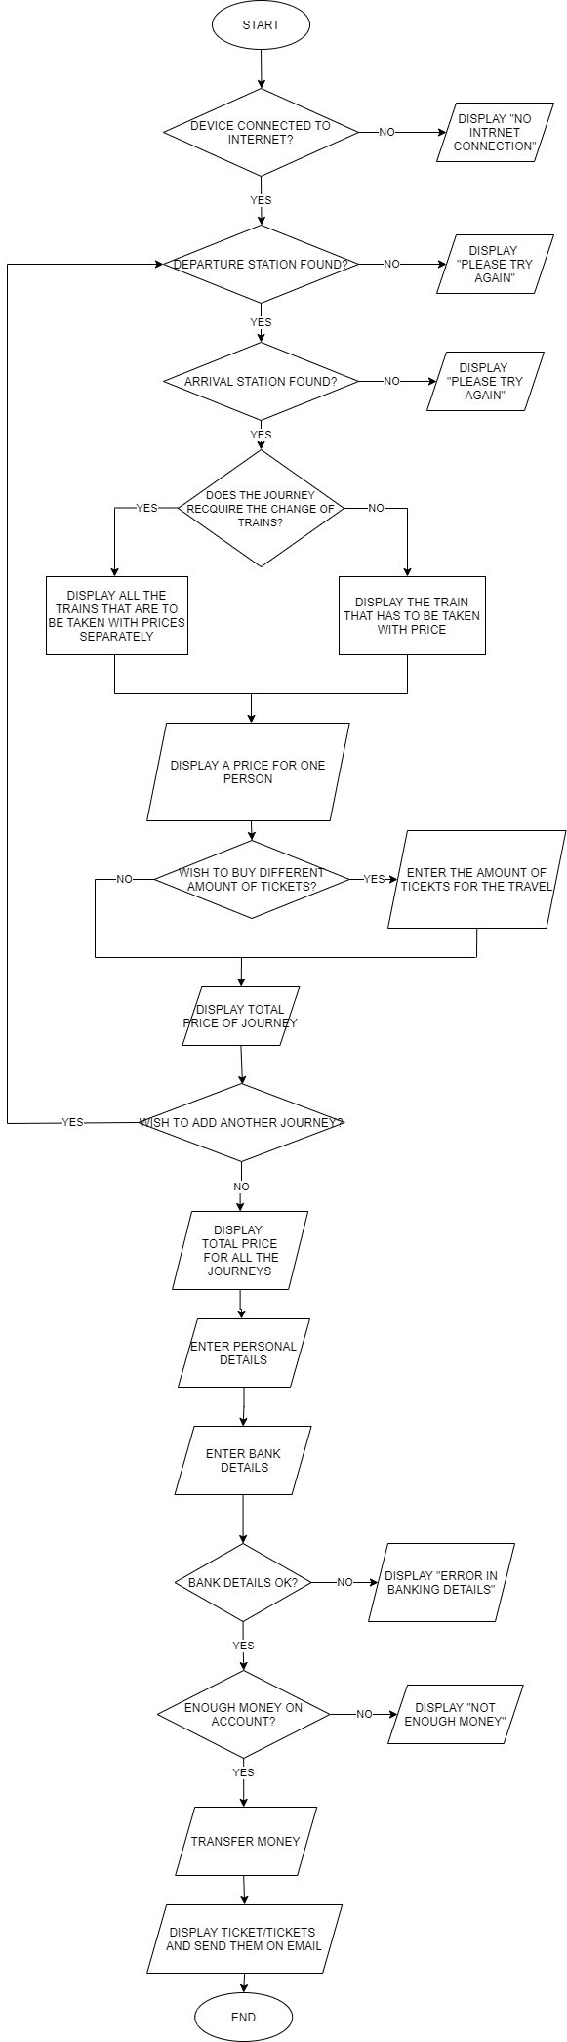

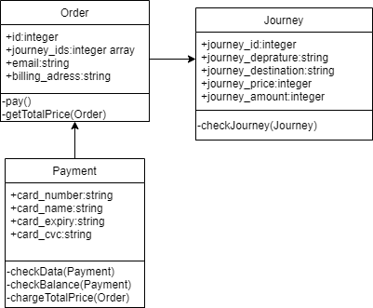
DIAGRAMS PRODUCED

Slide 10
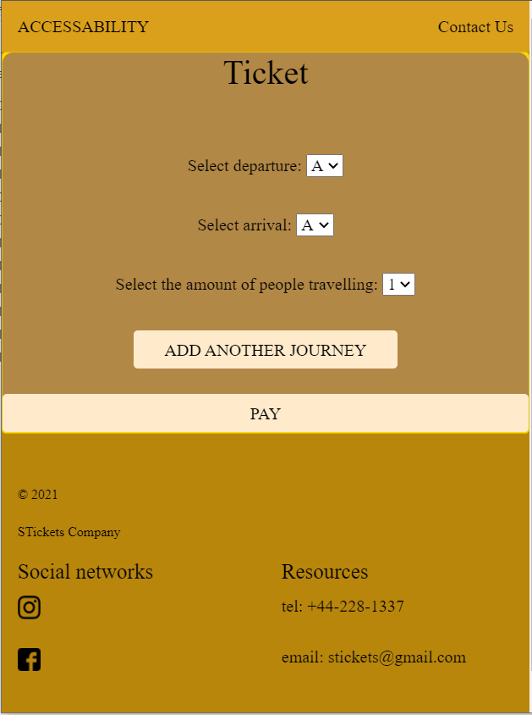
Web demo

Slide 11
Thank you for listening!!1!

