Slide 1
cs5460/6460 Operating Systems Lecture 4: Function invocations, and calling conventions
Anton Burtsev
Janurary, 2025

Slide 2
Recap: stack

Slide 3
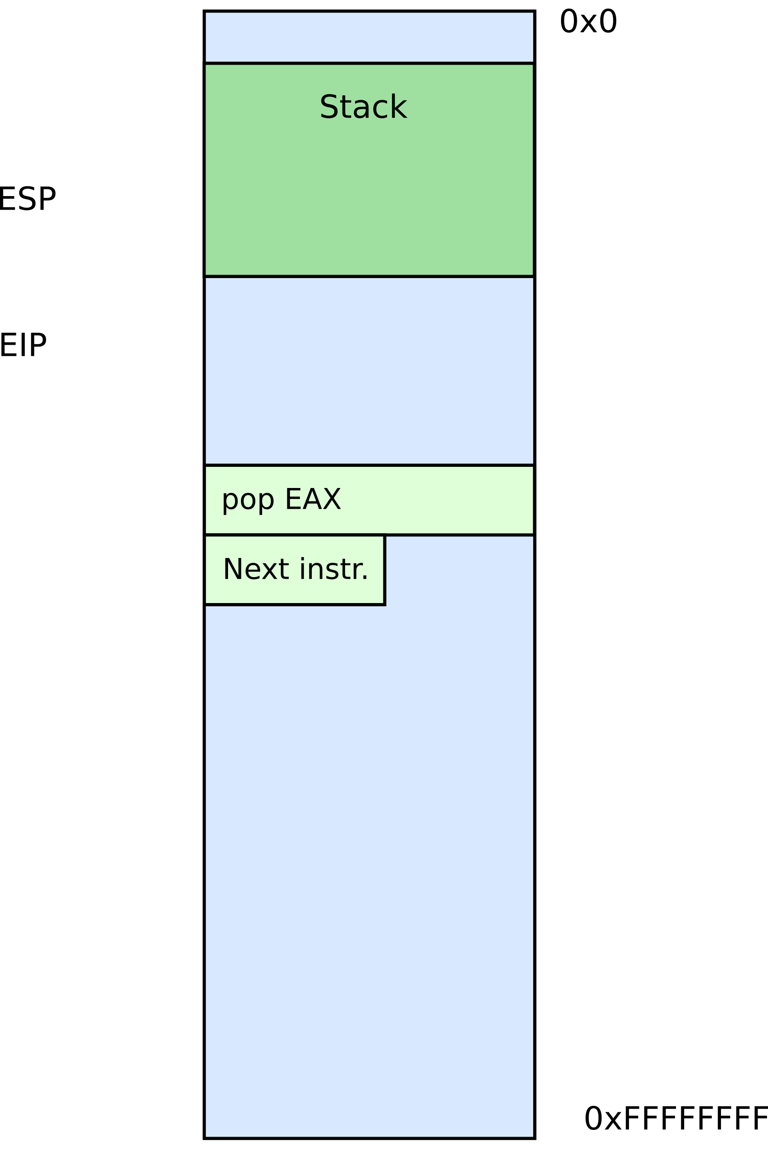



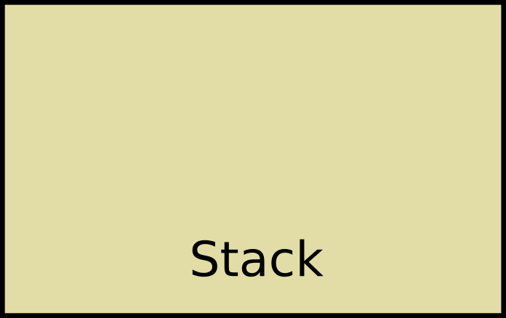
Stack
It's just a region of memory
Pointed by a special register ESP
You can change ESP
Get a new stack

Slide 4
Why do we need stack?

Slide 5
Stack allows us to invoke functions

Slide 6
Calling functions
// some code...
foo();
// more code..
Stack contains information for how to return from a subroutine
i.e., from foo()
Functions can be called from different places in the program
if (a == 0) {
foo();
…
} else {
foo();
…
}

Slide 7
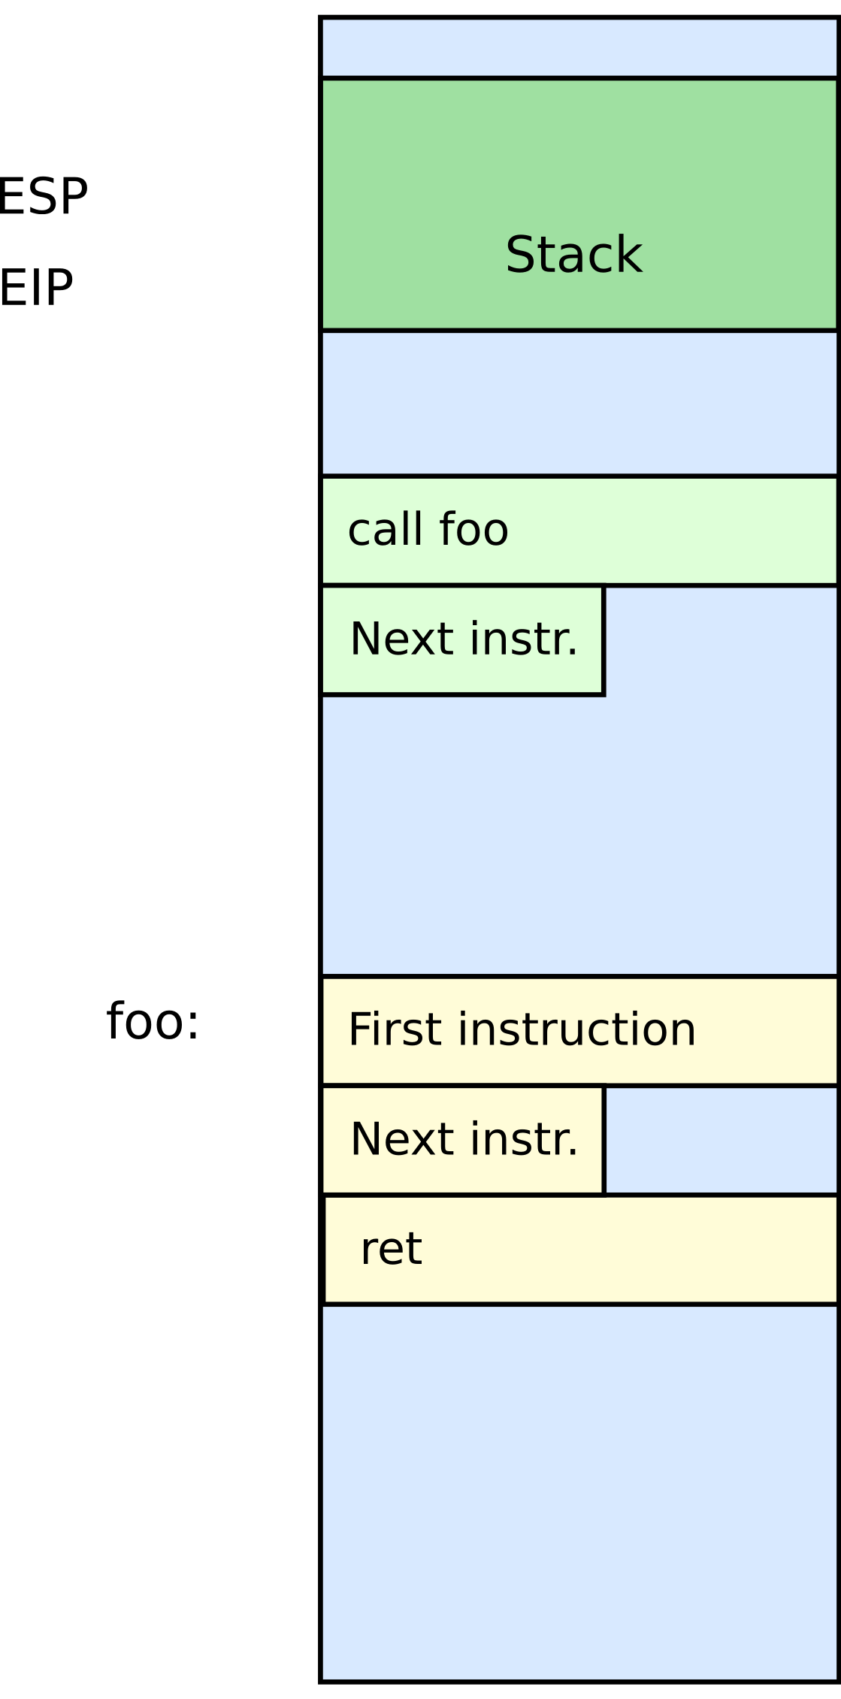
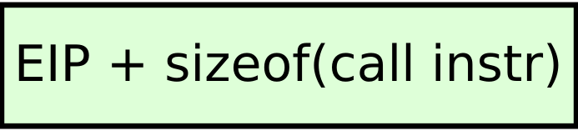


Stack
Main purpose:
Store the return address for the current procedure
Caller pushes return address on the stack
Callee pops it and jumps

Slide 8
Stack
Main purpose:
Store the return address for the current procedure
Caller pushes return address on the stack
Callee pops it and jumps

Slide 9
Calling functions
// some code...
foo();
// more code..
Stack contains information for how to return from a subroutine
i.e., from foo()
Functions can be called from different places in the program
if (a == 0) {
foo();
…
} else {
foo();
…
}

Slide 10
Stack
Main purpose:
Store the return address for the current procedure
Caller pushes return address on the stack
Callee pops it and jumps

Slide 11
Stack
Main purpose:
Store the return address for the current procedure
Caller pushes return address on the stack
Callee pops it and jumps

Slide 12
Example
foo(int a) {
if (a == 0)
return;
a--;
foo(a);
return;
}
foo(4);

Slide 13
Calling conventions

Slide 14
Calling conventions
Goal: re-entrant programs
How to pass arguments
On the stack?
In registers?
How to return values
On the stack?
In registers?
Conventions vary between compilers, optimizations, etc.

Slide 15
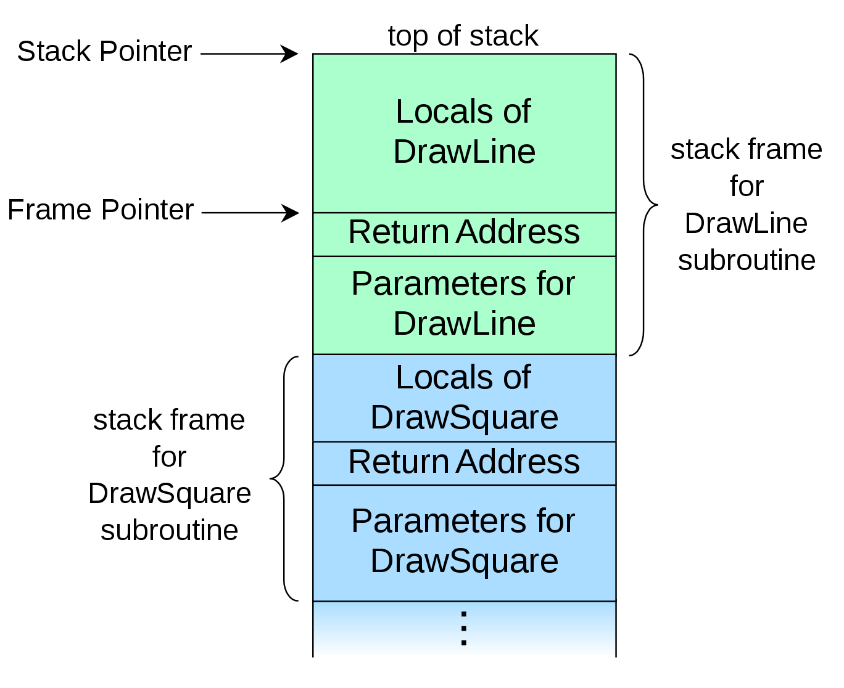
Idea 1: Maintain stack as frames
Each function has a new frame
void DrawSquare(...)
{
...
DrawLine(x, y, z);
}
Use dedicated register EBP (frame pointer)
Points to the base of the frame

Slide 16
Maintain stack as frames
Each function has a new frame
void DrawSquare(...)
{
...
DrawLine(x, y, z);
}
Use dedicated register EBP (frame pointer)
Points to the base of the frame

Slide 17
Maintain stack as frames
Each function has a new frame
void DrawSquare(...)
{
...
DrawLine(x, y, z);
}
Use dedicated register EBP (frame pointer)
Points to the base of the frame

Slide 18
Maintain stack as frames
Each function has a new frame
void DrawSquare(...)
{
...
DrawLine(x, y, z);
}
Use dedicated register EBP (frame pointer)
Points to the base of the frame

Slide 19
Stack consists of frames
Each function has a new frame
void DrawSquare(...)
{
...
DrawLine(x, y, z);
}
Use dedicated register EBP (frame pointer)
Points to the base of the frame

Slide 20
Prologue/epilogue
Each function maintains the frame
A dedicated register EBP is used to keep the frame pointer
Each function uses prologue code (blue), and epilogue (yellow) to maintain the frame
my_function:
push ebp ; save original EBP value on stack
mov ebp, esp ; new EBP = ESP
… ; function body
pop ebp ; restore original EBP value
ret

Slide 21
Local variables

Slide 22
What types of variables do you know?
Or where these variables are allocated in memory?

Slide 23
What types of variables do you know?
Global variables
Initialized → data section
Uninitalized → BSS
Dynamic variables
Heap
Local variables
Stack

Slide 24
Global variables
#include <stdio.h>
char hello[] = "Hello";
int main(int ac, char **av)
{
static char world[] = "world!";
printf("%s %s\n", hello, world);
return 0;
}

Slide 25
Global variables
#include <stdio.h>
char hello[] = "Hello";
int main(int ac, char **av)
{
static char world[] = "world!";
printf("%s %s\n", hello, world);
return 0;
}
Allocated in the data section
It is split in initialized (non-zero), and non-initialized (zero)
As well as read/write, and read only data section

Slide 26
Global variables

Slide 27
Dynamic variables (heap)
#include <stdio.h>
#include <string.h>
#include <stdlib.h>
char hello[] = "Hello";
int main(int ac, char **av)
{
char world[] = "world!";
char *str = malloc(64);
memcpy(str, "beautiful", 64);
printf("%s %s %s\n", hello, str, world);
return 0;
}

Slide 28
Dynamic variables (heap)
#include <stdio.h>
#include <string.h>
#include <stdlib.h>
char hello[] = "Hello";
int main(int ac, char **av)
{
char world[] = "world!";
char *str = malloc(64);
memcpy(str, "beautiful", 64);
printf("%s %s %s\n", hello, str, world);
return 0;
}
Allocated on the heap
Special area of memory provided by the OS from where malloc() can allocate memory

Slide 29
Dynamic variables (heap)

Slide 30
Local variables
Local variables
#include <stdio.h>
char hello[] = "Hello";
int main(int ac, char **av)
{
//static char world[] = "world!";
char world[] = "world!";
printf("%s %s\n", hello, world);
return 0;
}

Slide 31
Local variables...
Each function has private instances of local variables
foo(int x) {
int a, b, c;
...
return;
}
Function can be called recursively
foo(int x) {
int a, b, c;
a = x + 1;
if ( a < 100 )
foo(a);
return;
}

Slide 32
How to allocate local variables?
void my_function()
{
int a, b, c;
…
}

Slide 33
How to allocate local variables?
void my_function()
{
int a, b, c;
…
}
On the stack!

Slide 34

Poll Q1: Where do we allocate global variables

Slide 35
Poll Q2: Where do we allocate dynamic variables

Slide 36
Allocating local variables
Stored right after the saved EBP value on the stack
Allocated by subtracting the number of bytes required from ESP
_my_function:
push ebp ; save original EBP value on stack
mov ebp, esp ; new EBP = ESP
sub esp, LOCAL_BYTES ; = # bytes needed by locals
… ; function body
mov esp, ebp ; deallocate locals
pop ebp ; restore original EBP value
ret

Slide 37
Example
void my_function() {
int a, b, c;
…
_my_function:
push ebp ; save the value of ebp
mov ebp, esp ; ebp = esp, set ebp to be top of the stack (esp)
sub esp, 12 ; move esp down to allocate space for the
; local variables on the stack
With frames local variables can be accessed by de-referencing EBP
mov [ebp - 4], 10 ; location of variable a
mov [ebp - 8], 5 ; location of b
mov [ebp - 12], 2 ; location of c

Slide 38
Example
void my_function() {
int a, b, c;
…
_my_function:
push ebp ; save the value of ebp
mov ebp, esp ; ebp = esp, set ebp to be top of the stack (esp)
sub esp, 12 ; move esp down to allocate space for the
; local variables on the stack
With frames local variables can be accessed by de-referencing EBP
mov [ebp - 4], 10 ; location of variable a
mov [ebp - 8], 5 ; location of b
mov [ebp - 12], 2 ; location of c

Slide 39
How to pass arguments?
Possible options:
In registers
On the stack

Slide 40
How to pass arguments?
x86 32 bit
Pass arguments on the stack
Return value is in EAX and EDX
x86 64 bit – more registers!
Pass first 6 arguments in registers
RDI, RSI, RDX, RCX, R8, and R9
The rest on the stack
Return value is in RAX and RDX

Slide 41
x86_32: passing arguments on the stack
Example function
void my_function(int x, int y, int z)
{ … }
Example invocation
my_function(2, 5, 10);
Generated code
push 10
push 5
push 2
call _my_function

Slide 42
Example stack
: :
| 10 | [ebp + 16] (3rd function argument)
| 5 | [ebp + 12] (2nd argument)
| 2 | [ebp + 8] (1st argument)
| RA | [ebp + 4] (return address)
| FP | [ebp] (old ebp value)← EBP points here
| | [ebp - 4] (1st local variable)
: :
: :
| | [ebp - X] (esp - the current stack pointer)

Slide 43
Example: caller side code
caller:
; manage own stack frame
push ebp
mov ebp, esp
; push call arguments
push 3
push 2
push 1
; call subroutine 'callee'
call callee
; remove arguments from frame
add esp, 12
; use subroutine result
add eax, 5
; restore old call frame
pop ebp
; return
ret
int callee(int, int, int);
int caller(void)
{
int ret;
ret = callee(1, 2, 3);
ret += 5;
return ret;
}

Slide 44
Example: caller side code
caller:
; manage own stack frame
push ebp
mov ebp, esp
; push call arguments
push 3
push 2
push 1
; call subroutine 'callee'
call callee
; remove arguments from frame
add esp, 12
; use subroutine result
add eax, 5
; restore old call frame
pop ebp
; return
ret
int callee(int, int, int);
int caller(void)
{
int ret;
ret = callee(1, 2, 3);
ret += 5;
return ret;
}

Slide 45
Example: caller side code
caller:
; manage own stack frame
push ebp
mov ebp, esp
; push call arguments
push 3
push 2
push 1
; call subroutine 'callee'
call callee
; remove arguments from frame
add esp, 12
; use subroutine result
add eax, 5
; restore old call frame
pop ebp
; return
ret
int callee(int, int, int);
int caller(void)
{
int ret;
ret = callee(1, 2, 3);
ret += 5;
return ret;
}

Slide 46
Example: caller side code
caller:
; manage own stack frame
push ebp
mov ebp, esp
; push call arguments
push 3
push 2
push 1
; call subroutine 'callee'
call callee
; remove arguments from frame
add esp, 12
; use subroutine result
add eax, 5
; restore old call frame
pop ebp
; return
ret
int callee(int, int, int);
int caller(void)
{
int ret;
ret = callee(1, 2, 3);
ret += 5;
return ret;
}

Slide 47
Example: caller side code
caller:
; manage own stack frame
push ebp
mov ebp, esp
; push call arguments
push 3
push 2
push 1
; call subroutine 'callee'
call callee
; remove arguments from frame
add esp, 12
; use subroutine result
add eax, 5
; restore old call frame
pop ebp
; return
ret
int callee(int, int, int);
int caller(void)
{
int ret;
ret = callee(1, 2, 3);
ret += 5;
return ret;
}

Slide 48
Example: caller side code
caller:
; manage own stack frame
push ebp
mov ebp, esp
; push call arguments
push 3
push 2
push 1
; call subroutine 'callee'
call callee
; remove arguments from frame
add esp, 12
; use subroutine result
add eax, 5
; restore old call frame
pop ebp
; return
ret
int callee(int, int, int);
int caller(void)
{
int ret;
ret = callee(1, 2, 3);
ret += 5;
return ret;
}

Slide 49
Wait! Where is return ret;?
caller:
; manage own stack frame
push ebp
mov ebp, esp
; push call arguments
push 3
push 2
push 1
; call subroutine 'callee'
call callee
; remove arguments from frame
add esp, 12
; use subroutine result
add eax, 5
; restore old call frame
pop ebp
; return
ret
int callee(int, int, int);
int caller(void)
{
int ret;
ret = callee(1, 2, 3);
ret += 5;
return ret;
}

Slide 50
Example: callee side code
void my_function(int x, int y, int z)
{
int a, b, c;
…
return;
}
_my_function:
push ebp
mov ebp, esp
sub esp, 12 ; allocate local varaibles
; sizeof(a) + sizeof(b) + sizeof(c)
; x=[ebp + 8], y=[ebp + 12], z=[ebp + 16]
; a=[ebp-4]=[esp+8],
; b=[ebp-8]=[esp+4], c=[ebp-12] = [esp]
mov esp, ebp ; deallocate local variables
pop ebp
ret

Slide 51
leave instruction
void my_function(int x, int y, int z)
{
int a, b, c;
…
return;
}
_my_function:
push ebp
mov ebp, esp ; ebp = esp
sub esp, 12 ; allocate local varaibles
; sizeof(a) + sizeof(b) + sizeof(c)
; x = [ebp + 8], y = [ebp + 12], z = [ebp + 16]
; a=[ebp-4]=[esp+8],
; b=[ebp-8]=[esp+4], c=[ebp-12] = [esp]
mov esp, ebp
pop ebp
ret
x86 has a special instruction for this
leave

Slide 52
Back to stack frames, so why do we need them?
… They are not strictly required
GCC compiler option -fomit-frame-pointer can disable them
Don't keep the frame pointer in a register for functions that don't need one. This avoids the instructions to save, set up and restore frame pointers; it also makes an extra register available in many functions. It also makes debugging impossible on some machines.

Slide 53
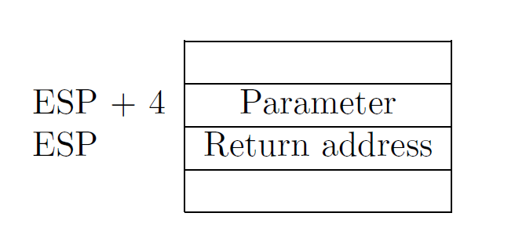
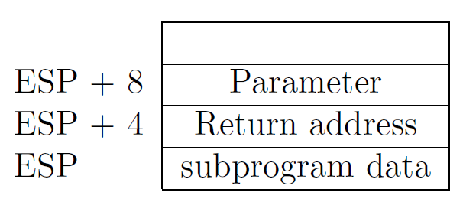
Referencing args without frames
Initially parameter is [ESP + 4]
Later as the function pushes things on the stack it changes, e.g., [ESP + 8]

Slide 54
Debugging becomes hard
As ESP changes one has to manually keep track where local variables are relative to ESP (ESP + 4 or +8)
Compiler can easily do this and generate correct code!
But it's hard for a human
It's hard to unwind the stack in case of a crash
To print out a backtrace

Slide 55
And you only save...
A couple instructions required to maintain the stack frame: one register (EBP)
x32 has 8 registers (and one is ESP, so 7 are left)
So taking another one is 1/7 or 14.28% of register space
Sometimes it makes sense!
x64 has 16 registers, so it doesn't really matter
That said, GCC sets -fomit-frame-pointer to “on”
At -O, -O1, -O2 …
Don't get surprised

Slide 56
Relevant part of the GCC manual
3.10 Options That Control Optimization
https://gcc.gnu.org/onlinedocs/gcc/Optimize-Options.html

Slide 57
Poll

Slide 58
Saving and restoring registers

Slide 59
Saving register state across invocations
Processor doesn't save registers
General purpose, segment, flags
Again, a calling convention is needed
Agreement on what gets saved by the callee and the caller

Slide 60
Saving register state across invocations
Registers EAX, ECX, and EDX are caller-saved
The function is free to use them
... the rest are callee-saved
If the function uses them it has to restore them to the original values

Slide 61
In general there multiple calling conventions
We described cdecl
Make sure you know what you're doing
https://en.wikipedia.org/wiki/X86_calling_conventions#cdecl
It's easy as long as you know how to read the table

Slide 62
Intel vs GNU ASM
Intel
Copy ebx into eax
mov eax, ebx
Move the 4 bytes in memory at the address contained in EBX into EAX
mov eax, [ebx]
Move 4 bytes at memory address ESI + (-4) into EAX
mov eax, [esi-4]
GNU
mov %ebx, %eax
mov (%ebx), %eax
mov -4(%esi), %eax

Slide 63
Questions?

Slide 64
References
https://en.wikibooks.org/wiki/X86_Disassembly/Functions_and_Stack_Frames
https://en.wikipedia.org/wiki/Calling_convention
https://en.wikipedia.org/wiki/X86_calling_conventions
http://stackoverflow.com/questions/14666665/trying-to-understand-gcc-option-fomit-frame-pointer

