Slide 1
cs5460/6460: Operating Systems Lecture: File systems
Anton Burtsev
April, 2025

Slide 2
The role of file systems

Slide 3
The role of file systems
Sharing
Sharing of data across users and applications
Persistent storage
Data is available after reboot

Slide 4
Architecture
On-disk and in-memory data structures that represent
The tree of named files and directories
Record identities of disk blocks which hold data for each file
Record which areas of the disk are free

Slide 5
Crash recovery
File systems must support crash recovery
A power loss may interrupt a sequence of updates
And leave the file system in an inconsistent state
E.g., a block both marked free and used

Slide 6
Speed
Access to a block device is several orders of magnitude slower
Memory: 200 cycles
Disk: 20 000 000 cycles
A file system must maintain a cache of disk blocks in memory

Slide 7
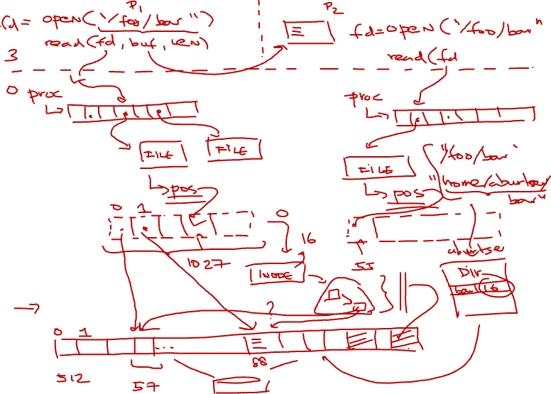

Slide 9
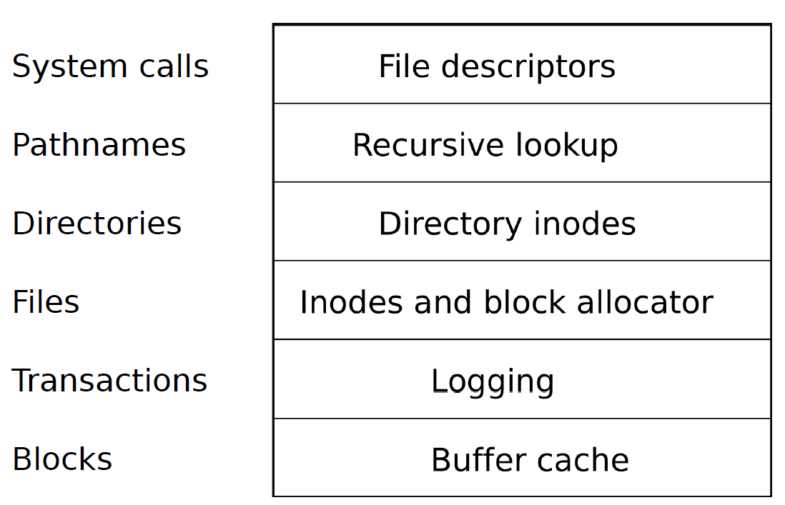
Block layer
Read and write data
From a block device
Into a buffer cache
Synchronize across multiple readers and writers

Slide 10
Transactions
Group multiple writes into an atomic transaction

Slide 11
Files
Unnamed files
Represented as inodes
Sequence of blocks holding file's data

Slide 12
Directories
Special kind of inode
Sequence of directory entries
Each contains name and a pointer to an unnamed inode

Slide 13
Pathnames
Hierarchical path names
/usr/bin/sh
Recursive lookup

Slide 14
System call
Abstract UNIX resources as files
Files, sockets, devices, pipes, etc.
Unified programming interface

Slide 15
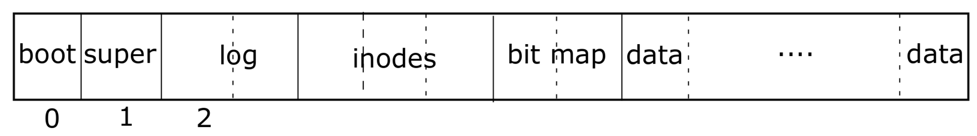
File system layout on disk
Block #0: Boot code

Slide 16
File system layout on disk
Block #0: Boot code
Block #1: (superblock) Metadata about the file system
Size (number of blocks)
Number of data blocks
Number of inodes
Number of blocks in log

Slide 17
File system layout on disk
Block #2: Log area: maintaining consistency in case of a power outage or system crash

Slide 18
File system layout on disk
Inode area
Unnamed files

Slide 19
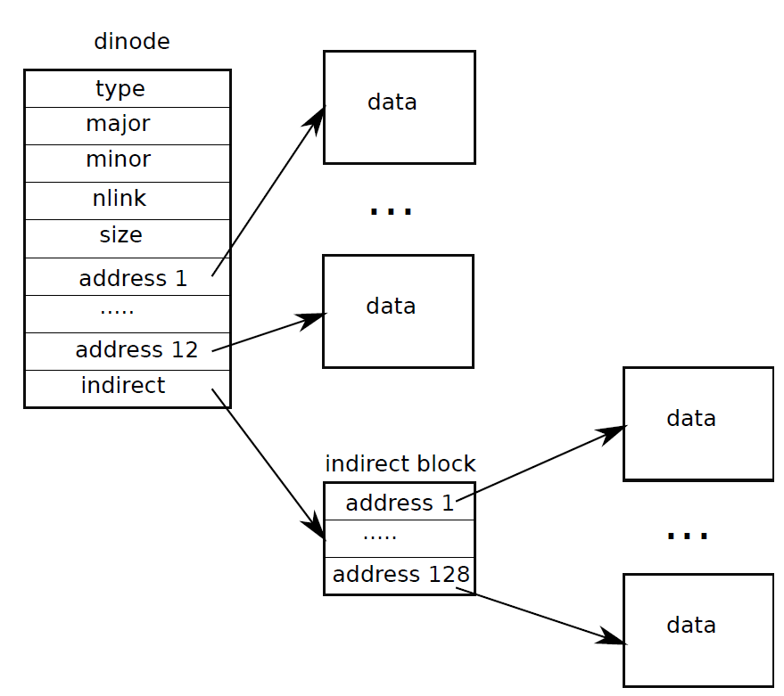
Representing files on disk
What is the max
file size?

Slide 20
File system layout on disk
Bit map area: tracks which blocks are in use

Slide 21
File system layout on disk
Data area: actual file data

Slide 22
File system layout on disk
Poll: PollEv.com/antonburtsev
What’s inside the bitmap area?

Slide 23
Buffer cache layer

Slide 24
Buffer cache layer
Two goals:
Synchronization:
Only one copy of a data block exist in the kernel
Only one writer updates this copy at a time
Caching
Frequently used copies are cached for efficient reads and writes

Slide 25
Buffer cache
3750 struct buf {
3751 int flags;
3752 uint dev;
3753 uint blockno;
3754 struct buf *prev; // LRU cache list
3755 struct buf *next;
3756 struct buf *qnext; // disk queue
3757 uchar data[BSIZE];
3758 };
3759 #define B_BUSY 0x1 // buffer is locked by some process
3760 #define B_VALID 0x2 // buffer has been read from disk
3761 #define B_DIRTY 0x4 // buffer needs to be written to disk
4329 struct {
4330 struct spinlock lock;
4331 struct buf buf[NBUF];
4332
4333 // Linked list of all buffers, through prev/next.
4334 // head.next is most recently used.
4335 struct buf head;
4336 } bcache;

Slide 26
Buffer cache
3750 struct buf {
3751 int flags;
3752 uint dev;
3753 uint blockno;
3754 struct buf *prev; // LRU cache list
3755 struct buf *next;
3756 struct buf *qnext; // disk queue
3757 uchar data[BSIZE];
3758 };
3759 #define B_BUSY 0x1 // buffer is locked by some process
3760 #define B_VALID 0x2 // buffer has been read from disk
3761 #define B_DIRTY 0x4 // buffer needs to be written to disk
4329 struct {
4330 struct spinlock lock;
4331 struct buf buf[NBUF];
4332
4333 // Linked list of all buffers, through prev/next.
4334 // head.next is most recently used.
4335 struct buf head;
4336 } bcache;
Array of buffers

Slide 27
Buffer cache
3750 struct buf {
3751 int flags;
3752 uint dev;
3753 uint blockno;
3754 struct buf *prev; // LRU cache list
3755 struct buf *next;
3756 struct buf *qnext; // disk queue
3757 uchar data[BSIZE];
3758 };
3759 #define B_BUSY 0x1 // buffer is locked by some process
3760 #define B_VALID 0x2 // buffer has been read from disk
3761 #define B_DIRTY 0x4 // buffer needs to be written to disk
4329 struct {
4330 struct spinlock lock;
4331 struct buf buf[NBUF];
4332
4333 // Linked list of all buffers, through prev/next.
4334 // head.next is most recently used.
4335 struct buf head;
4336 } bcache;
Cached data
512 bytes

Slide 28
Buffer cache
3750 struct buf {
3751 int flags;
3752 uint dev;
3753 uint blockno;
3754 struct buf *prev; // LRU cache list
3755 struct buf *next;
3756 struct buf *qnext; // disk queue
3757 uchar data[BSIZE];
3758 };
3759 #define B_BUSY 0x1 // buffer is locked by some process
3760 #define B_VALID 0x2 // buffer has been read from disk
3761 #define B_DIRTY 0x4 // buffer needs to be written to disk
4329 struct {
4330 struct spinlock lock;
4331 struct buf buf[NBUF];
4332
4333 // Linked list of all buffers, through prev/next.
4334 // head.next is most recently used.
4335 struct buf head;
4336 } bcache;
Flags

Slide 29
Buffer cache
3750 struct buf {
3751 int flags;
3752 uint dev;
3753 uint blockno;
3754 struct buf *prev; // LRU cache list
3755 struct buf *next;
3756 struct buf *qnext; // disk queue
3757 uchar data[BSIZE];
3758 };
3759 #define B_BUSY 0x1 // buffer is locked by some process
3760 #define B_VALID 0x2 // buffer has been read from disk
3761 #define B_DIRTY 0x4 // buffer needs to be written to disk
4329 struct {
4330 struct spinlock lock;
4331 struct buf buf[NBUF];
4332
4333 // Linked list of all buffers, through prev/next.
4334 // head.next is most recently used.
4335 struct buf head;
4336 } bcache;
Device
We might have multiple disks

Slide 30
Buffer cache
3750 struct buf {
3751 int flags;
3752 uint dev;
3753 uint blockno;
3754 struct buf *prev; // LRU cache list
3755 struct buf *next;
3756 struct buf *qnext; // disk queue
3757 uchar data[BSIZE];
3758 };
3759 #define B_BUSY 0x1 // buffer is locked by some process
3760 #define B_VALID 0x2 // buffer has been read from disk
3761 #define B_DIRTY 0x4 // buffer needs to be written to disk
4329 struct {
4330 struct spinlock lock;
4331 struct buf buf[NBUF];
4332
4333 // Linked list of all buffers, through prev/next.
4334 // head.next is most recently used.
4335 struct buf head;
4336 } bcache;
Block number on disk

Slide 31
Buffer cache
3750 struct buf {
3751 int flags;
3752 uint dev;
3753 uint blockno;
3754 struct buf *prev; // LRU cache list
3755 struct buf *next;
3756 struct buf *qnext; // disk queue
3757 uchar data[BSIZE];
3758 };
3759 #define B_BUSY 0x1 // buffer is locked by some process
3760 #define B_VALID 0x2 // buffer has been read from disk
3761 #define B_DIRTY 0x4 // buffer needs to be written to disk
4329 struct {
4330 struct spinlock lock;
4331 struct buf buf[NBUF];
4332
4333 // Linked list of all buffers, through prev/next.
4334 // head.next is most recently used.
4335 struct buf head;
4336 } bcache;
LRU list
To evict the oldest blocks

Slide 32
Buffer cache layer: interface
bread() and bwrite() - obtain a copy for reading or writing
Owned until brelse()
Locking with a flag (B_BUSY)
Other threads will be blocked and wait until brelse()

Slide 33
Common pattern
Read
Write
Release
bread()
bwrite()
brelse()

Slide 34
Example
4570 // Copy committed blocks from log to their home location
4571 static void
4572 install_trans(void)
4573 {
4574 int tail;
4575
4576 for (tail = 0; tail < log.lh.n; tail++) {
4577 struct buf *lbuf = bread(log.dev, log.start+tail+1); // read log block
4578 struct buf *dbuf = bread(log.dev, log.lh.block[tail]); // read dst
4579 memmove(dbuf−>data, lbuf−>data, BSIZE); // copy block to dst
4580 bwrite(dbuf); // write dst to disk
4581 brelse(lbuf);
4582 brelse(dbuf);
4583 }
4584 }

Slide 35
Block read and write operations
4401 struct buf*
4402 bread(uint dev, uint sector)
4403 {
4404 struct buf *b;
4405
4406 b = bget(dev, sector);
4407 if(!(b−>flags & B_VALID)) {
4408 iderw(b);
4409 }
4410 return b;
4411 }
4415 bwrite(struct buf *b)
4416 {
4417 if((b−>flags & B_BUSY) == 0)
4418 panic("bwrite");
4419 b−>flags |= B_DIRTY;
4420 iderw(b);
4421 }

Slide 36
Getting a block from a buffer cache (part 1)
4365 static struct buf*
4366 bget(uint dev, uint blockno)
4367 {
4368 struct buf *b;
4369
4370 acquire(&bcache.lock);
4371
4372 loop:
4373 // Is the block already cached?
4374 for(b = bcache.head.next; b != &bcache.head; b = b−>next){
4375 if(b−>dev == dev && b−>blockno == blockno){
4376 if(!(b−>flags & B_BUSY)){
4377 b−>flags |= B_BUSY;
4378 release(&bcache.lock);
4379 return b;
4380 }
4381 sleep(b, &bcache.lock);
4382 goto loop;
4383 }
4384

Slide 37
Getting a block from a buffer cache (part 2)
4385
4386 // Not cached; recycle some non−busy and clean buffer.
4387 // "clean" because B_DIRTY and !B_BUSY means log.c
4388 // hasn’t yet committed the changes to the buffer.
4389 for(b = bcache.head.prev; b != &bcache.head; b = b−>prev){
4390 if((b−>flags & B_BUSY)== 0 && (b−>flags & B_DIRTY)== 0){
4391 b−>dev = dev;
4392 b−>blockno = blockno;
4393 b−>flags = B_BUSY;
4394 release(&bcache.lock);
4395 return b;
4396 }
4397 }
4398 panic("bget: no buffers");
4399 }

Slide 38
Block read and write operations
4401 struct buf*
4402 bread(uint dev, uint sector)
4403 {
4404 struct buf *b;
4405
4406 b = bget(dev, sector);
4407 if(!(b−>flags & B_VALID)) {
4408 iderw(b);
4409 }
4410 return b;
4411 }
4415 bwrite(struct buf *b)
4416 {
4417 if((b−>flags & B_BUSY) == 0)
4418 panic("bwrite");
4419 b−>flags |= B_DIRTY;
4420 iderw(b);
4421 }

Slide 39
Release buffer
4423 // Release a B_BUSY buffer.
4424 // Move to the head of the MRU list.
4425 void
4426 brelse(struct buf *b)
4427 {
4428 if((b−>flags & B_BUSY) == 0)
4429 panic("brelse");
4430
4431 acquire(&bcache.lock);
4432
4433 b−>next−>prev = b−>prev;
4434 b−>prev−>next = b−>next;
4435 b−>next = bcache.head.next;
4436 b−>prev = &bcache.head;
4437 bcache.head.next−>prev = b;
4438 bcache.head.next = b;
4439
4440 b−>flags &= ~B_BUSY;
4441 wakeup(b);
4442
4443 release(&bcache.lock);
4444 }
Maintain least recently used list
Move to the head

Slide 40
What are the main flaws of the xv6 buffer cache? Poll: PollEv.com/antonburtsev
4365 static struct buf*
4366 bget(uint dev, uint blockno)
4367 {
4368 struct buf *b;
4369
4370 acquire(&bcache.lock);
4371
4372 loop:
4373 // Is the block already cached?
4374 for(b = bcache.head.next; b != &bcache.head; b = b−>next){
4375 if(b−>dev == dev && b−>blockno == blockno){
4376 if(!(b−>flags & B_BUSY)){
4377 b−>flags |= B_BUSY;
4378 release(&bcache.lock);
4379 return b;
4380 }
4381 sleep(b, &bcache.lock);
4382 goto loop;
4383 }
4384

Slide 41
Logging layer

Slide 42
Logging layer
Consistency
File system operations involve multiple writes to disk
During the crash, subset of writes might leave the file system in an inconsistent state
E.g. if crash happens during file delete operation it can leave the file system with:
Ex #1: Directory entry pointing to a free inode
Ex #2: Allocated but unlinked inode

Slide 44
Logging
Writes don't directly go to disk
Instead they are logged in a journal
Once all writes are logged, the system writes a special commit record
Indicating that log contains a complete operation
At this point file system copies writes to the on-disk data structures
After copy completes, log record is erased

Slide 45
Recovery
After reboot, copy the log
For operations marked as complete
Copy blocks to disk
For operations partially complete
Discard all writes
Information might be lost (output consistency, e.g. you can launch the missile twice since you lost the write saying you already did)

Slide 46
Typical use of transactions
begin_op();
...
bp = bread(...);
bp->data[...] = ...;
log_write(bp);
...
end_op();

Slide 47
Log (in memory)
4532 struct logheader {
4533 int n;
4534 int block[LOGSIZE];
4535 };
4536
4537 struct log {
4538 struct spinlock lock;
4539 int start;
4540 int size;
4541 int outstanding; // how many FS sys calls are
executing.
4542 int committing; // in commit(), please wait.
4543 int dev;
4544 struct logheader lh;
4545 };

Slide 48
Typical use of transactions
begin_op();
...
bp = bread(...);
bp->data[...] = ...;
log_write(bp);
...
end_op();

Slide 49
begin_op()
4626 // called at the start of each FS system call.
4627 void
4628 begin_op(void)
4629 {
4630 acquire(&log.lock);
4631 while(1){
4632 if(log.committing){
4633 sleep(&log, &log.lock);
4634 } else if(log.lh.n + (log.outstanding+1)*MAXOPBLOCKS > LOGSIZE){
4635 // this op might exhaust log space; wait for commit.
4636 sleep(&log, &log.lock);
4637 } else {
4638 log.outstanding += 1;
4639 release(&log.lock);
4640 break;
4641 }
4642 }
4643 }
Case #1
Log is being committed
Sleep

Slide 50
begin_op()
4626 // called at the start of each FS system call.
4627 void
4628 begin_op(void)
4629 {
4630 acquire(&log.lock);
4631 while(1){
4632 if(log.committing){
4633 sleep(&log, &log.lock);
4634 } else if(log.lh.n + (log.outstanding+1)*MAXOPBLOCKS > LOGSIZE){
4635 // this op might exhaust log space; wait for commit.
4636 sleep(&log, &log.lock);
4637 } else {
4638 log.outstanding += 1;
4639 release(&log.lock);
4640 break;
4641 }
4642 }
4643 }
Case #2
Not enough space for a new transaction
Sleep

Slide 51
begin_op()
4626 // called at the start of each FS system call.
4627 void
4628 begin_op(void)
4629 {
4630 acquire(&log.lock);
4631 while(1){
4632 if(log.committing){
4633 sleep(&log, &log.lock);
4634 } else if(log.lh.n + (log.outstanding+1)*MAXOPBLOCKS > LOGSIZE){
4635 // this op might exhaust log space; wait for commit.
4636 sleep(&log, &log.lock);
4637 } else {
4638 log.outstanding += 1;
4639 release(&log.lock);
4640 break;
4641 }
4642 }
4643 }
Case #3
All good
Reserve space for a new transaction

Slide 52
Typical use of transactions
begin_op();
...
bp = bread(...);
bp->data[...] = ...;
log_write(bp);
...
end_op();
log_write() replaces bwrite(); brelse()

Slide 53
log_write
4722 log_write(struct buf *b)
4723 {
4724 int i;
4725
4726 if (log.lh.n >= LOGSIZE || log.lh.n >= log.size − 1)
4727 panic("too big a transaction");
4728 if (log.outstanding < 1)
4729 panic("log_write outside of trans");
4730
4731 acquire(&log.lock);
4732 for (i = 0; i < log.lh.n; i++) {
4733 if (log.lh.block[i] == b−>blockno) // log absorbtion
4734 break;
4735 }
4736 log.lh.block[i] = b−>blockno;
4737 if (i == log.lh.n)
4738 log.lh.n++;
4739 b−>flags |= B_DIRTY; // prevent eviction
4740 release(&log.lock);
4741 }
Check if already in log

Slide 54
log_write
4722 log_write(struct buf *b)
4723 {
4724 int i;
4725
4726 if (log.lh.n >= LOGSIZE || log.lh.n >= log.size − 1)
4727 panic("too big a transaction");
4728 if (log.outstanding < 1)
4729 panic("log_write outside of trans");
4730
4731 acquire(&log.lock);
4732 for (i = 0; i < log.lh.n; i++) {
4733 if (log.lh.block[i] == b−>blockno) // log absorbtion
4734 break;
4735 }
4736 log.lh.block[i] = b−>blockno;
4737 if (i == log.lh.n)
4738 log.lh.n++;
4739 b−>flags |= B_DIRTY; // prevent eviction
4740 release(&log.lock);
4741 }
Add to the log
Prevent eviction

Slide 55
Typical use of transactions
begin_op();
...
bp = bread(...);
bp->data[...] = ...;
log_write(bp);
...
end_op();

Slide 56
end_op()
4653 end_op(void)
4654 {
4655 int do_commit = 0;
4656
4657 acquire(&log.lock);
4658 log.outstanding −= 1;
4661 if(log.outstanding == 0){
4662 do_commit = 1;
4663 log.committing = 1;
4664 } else {
4665 // begin_op() may be waiting for log space.
4666 wakeup(&log);
4667 }
4668 release(&log.lock);
4669
4670 if(do_commit){
4671 // call commit w/o holding locks, since not allowed
4672 // to sleep with locks.
4673 commit();
4674 acquire(&log.lock);
4675 log.committing = 0;
4676 wakeup(&log);
4677 release(&log.lock);
4678 }
4679 }

Slide 57
end_op()
4653 end_op(void)
4654 {
4655 int do_commit = 0;
4656
4657 acquire(&log.lock);
4658 log.outstanding −= 1;
4661 if(log.outstanding == 0){
4662 do_commit = 1;
4663 log.committing = 1;
4664 } else {
4665 // begin_op() may be waiting for log space.
4666 wakeup(&log);
4667 }
4668 release(&log.lock);
4669
4670 if(do_commit){
4671 // call commit w/o holding locks, since not allowed
4672 // to sleep with locks.
4673 commit();
4674 acquire(&log.lock);
4675 log.committing = 0;
4676 wakeup(&log);
4677 release(&log.lock);
4678 }
4679 }

Slide 58
commit()
4701 commit()
4702 {
4703 if (log.lh.n > 0) {
4704 write_log(); // Write modified blocks from cache to log
4705 write_head(); // Write header to disk −− the real commit
4706 install_trans(); // Now install writes to home locations
4707 log.lh.n = 0;
4708 write_head(); // Erase the transaction from the log
4709 }
4710 }

Slide 59
write_log()
4681 // Copy modified blocks from cache to log.
4682 static void
4683 write_log(void)
4684 {
4685 int tail;
4686
4687 for (tail = 0; tail < log.lh.n; tail++) {
4688 struct buf *to = bread(log.dev,
log.start+tail+1); // log block
4689 struct buf *from = bread(log.dev,
log.lh.block[tail]); // cache block
4690 memmove(to−>data, from−>data, BSIZE);
4691 bwrite(to); // write the log
4692 brelse(from);
4693 brelse(to);
4694 }
4695 }
Loop through the entire log

Slide 60
write_log()
4681 // Copy modified blocks from cache to log.
4682 static void
4683 write_log(void)
4684 {
4685 int tail;
4686
4687 for (tail = 0; tail < log.lh.n; tail++) {
4688 struct buf *to = bread(log.dev,
log.start+tail+1); // log block
4689 struct buf *from = bread(log.dev,
log.lh.block[tail]); // cache block
4690 memmove(to−>data, from−>data, BSIZE);
4691 bwrite(to); // write the log
4692 brelse(from);
4693 brelse(to);
4694 }
4695 }
Get a lock on the block of the log

Slide 61
write_log()
4681 // Copy modified blocks from cache to log.
4682 static void
4683 write_log(void)
4684 {
4685 int tail;
4686
4687 for (tail = 0; tail < log.lh.n; tail++) {
4688 struct buf *to = bread(log.dev,
log.start+tail+1); // log block
4689 struct buf *from = bread(log.dev,
log.lh.block[tail]); // cache block
4690 memmove(to−>data, from−>data, BSIZE);
4691 bwrite(to); // write the log
4692 brelse(from);
4693 brelse(to);
4694 }
4695 }
Read the actual block
It’s in the buffer cache

Slide 62
write_log()
4681 // Copy modified blocks from cache to log.
4682 static void
4683 write_log(void)
4684 {
4685 int tail;
4686
4687 for (tail = 0; tail < log.lh.n; tail++) {
4688 struct buf *to = bread(log.dev,
log.start+tail+1); // log block
4689 struct buf *from = bread(log.dev,
log.lh.block[tail]); // cache block
4690 memmove(to−>data, from−>data, BSIZE);
4691 bwrite(to); // write the log
4692 brelse(from);
4693 brelse(to);
4694 }
4695 }
Copy data between the blocks

Slide 63
write_log()
4681 // Copy modified blocks from cache to log.
4682 static void
4683 write_log(void)
4684 {
4685 int tail;
4686
4687 for (tail = 0; tail < log.lh.n; tail++) {
4688 struct buf *to = bread(log.dev,
log.start+tail+1); // log block
4689 struct buf *from = bread(log.dev,
log.lh.block[tail]); // cache block
4690 memmove(to−>data, from−>data, BSIZE);
4691 bwrite(to); // write the log
4692 brelse(from);
4693 brelse(to);
4694 }
4695 }
Write the “to” and release all locks

Slide 64
commit()
4701 commit()
4702 {
4703 if (log.lh.n > 0) {
4704 write_log(); // Write modified blocks from cache to log
4705 write_head(); // Write header to disk −− the real commit
4706 install_trans(); // Now install writes to home locations
4707 log.lh.n = 0;
4708 write_head(); // Erase the transaction from the log
4709 }
4710 }

Slide 65
write_head()
4600 // Write in−memory log header to disk.
4601 // This is the true point at which the
4602 // current transaction commits.
4603 static void
4604 write_head(void)
4605 {
4606 struct buf *buf = bread(log.dev, log.start);
4607 struct logheader *hb = (struct logheader *) (buf−>data);
4608 int i;
4609 hb−>n = log.lh.n;
4610 for (i = 0; i < log.lh.n; i++) {
4611 hb−>block[i] = log.lh.block[i];
4612 }
4613 bwrite(buf);
4614 brelse(buf);
4615 }
Read the log header block
It's in log.start

Slide 66
write_head()
4600 // Write in−memory log header to disk.
4601 // This is the true point at which the
4602 // current transaction commits.
4603 static void
4604 write_head(void)
4605 {
4606 struct buf *buf = bread(log.dev, log.start);
4607 struct logheader *hb = (struct logheader *) (buf−>data);
4608 int i;
4609 hb−>n = log.lh.n;
4610 for (i = 0; i < log.lh.n; i++) {
4611 hb−>block[i] = log.lh.block[i];
4612 }
4613 bwrite(buf);
4614 brelse(buf);
4615 }
Typecast the buf->data to the logheader

Slide 67
write_head()
4600 // Write in−memory log header to disk.
4601 // This is the true point at which the
4602 // current transaction commits.
4603 static void
4604 write_head(void)
4605 {
4606 struct buf *buf = bread(log.dev, log.start);
4607 struct logheader *hb = (struct logheader *) (buf−>data);
4608 int i;
4609 hb−>n = log.lh.n;
4610 for (i = 0; i < log.lh.n; i++) {
4611 hb−>block[i] = log.lh.block[i];
4612 }
4613 bwrite(buf);
4614 brelse(buf);
4615 }
Write the size of the log (log.lh.n) into the logheader block

Slide 68
write_head()
4600 // Write in−memory log header to disk.
4601 // This is the true point at which the
4602 // current transaction commits.
4603 static void
4604 write_head(void)
4605 {
4606 struct buf *buf = bread(log.dev, log.start);
4607 struct logheader *hb = (struct logheader *)
(buf−>data);
4608 int i;
4609 hb−>n = log.lh.n;
4610 for (i = 0; i < log.lh.n; i++) {
4611 hb−>block[i] = log.lh.block[i];
4612 }
4613 bwrite(buf);
4614 brelse(buf);
4615 }
Write all block numbers

Slide 69
write_head()
4600 // Write in−memory log header to disk.
4601 // This is the true point at which the
4602 // current transaction commits.
4603 static void
4604 write_head(void)
4605 {
4606 struct buf *buf = bread(log.dev, log.start);
4607 struct logheader *hb = (struct logheader *)
(buf−>data);
4608 int i;
4609 hb−>n = log.lh.n;
4610 for (i = 0; i < log.lh.n; i++) {
4611 hb−>block[i] = log.lh.block[i];
4612 }
4613 bwrite(buf);
4614 brelse(buf);
4615 }
Write the logheader back to disk into the log area
Release the lock

Slide 70
commit()
4701 commit()
4702 {
4703 if (log.lh.n > 0) {
4704 write_log(); // Write modified blocks from cache to log
4705 write_head(); // Write header to disk −− the real commit
4706 install_trans(); // Now install writes to home locations
4707 log.lh.n = 0;
4708 write_head(); // Erase the transaction from the log
4709 }
4710 }

Slide 71
install_trans()
4570 // Copy committed blocks from log to their home location
4571 static void
4572 install_trans(void)
4573 {
4574 int tail;
4575
4576 for (tail = 0; tail < log.lh.n; tail++) {
4577 struct buf *lbuf = bread(log.dev,
log.start+tail+1); // read log block
4578 struct buf *dbuf = bread(log.dev,
log.lh.block[tail]); // read dst
4579 memmove(dbuf−>data, lbuf−>data, BSIZE); // copy block
// to dst
4580 bwrite(dbuf); // write dst to disk
4581 brelse(lbuf);
4582 brelse(dbuf);
4583 }
4584 }
Read the block from the log area (log.start+tail+1)

Slide 72
install_trans()
4570 // Copy committed blocks from log to their home location
4571 static void
4572 install_trans(void)
4573 {
4574 int tail;
4575
4576 for (tail = 0; tail < log.lh.n; tail++) {
4577 struct buf *lbuf = bread(log.dev,
log.start+tail+1); // read log block
4578 struct buf *dbuf = bread(log.dev,
log.lh.block[tail]); // read dst
4579 memmove(dbuf−>data, lbuf−>data, BSIZE); // copy block
// to dst
4580 bwrite(dbuf); // write dst to disk
4581 brelse(lbuf);
4582 brelse(dbuf);
4583 }
4584 }
Read the block from the data area where the data should go

Slide 73
install_trans()
4570 // Copy committed blocks from log to their home location
4571 static void
4572 install_trans(void)
4573 {
4574 int tail;
4575
4576 for (tail = 0; tail < log.lh.n; tail++) {
4577 struct buf *lbuf = bread(log.dev,
log.start+tail+1); // read log block
4578 struct buf *dbuf = bread(log.dev,
log.lh.block[tail]); // read dst
4579 memmove(dbuf−>data, lbuf−>data, BSIZE); // copy block
// to dst
4580 bwrite(dbuf); // write dst to disk
4581 brelse(lbuf);
4582 brelse(dbuf);
4583 }
4584 }
Copy data between the blocks

Slide 74
install_trans()
4570 // Copy committed blocks from log to their home location
4571 static void
4572 install_trans(void)
4573 {
4574 int tail;
4575
4576 for (tail = 0; tail < log.lh.n; tail++) {
4577 struct buf *lbuf = bread(log.dev,
log.start+tail+1); // read log block
4578 struct buf *dbuf = bread(log.dev,
log.lh.block[tail]); // read dst
4579 memmove(dbuf−>data, lbuf−>data, BSIZE); // copy block
// to dst
4580 bwrite(dbuf); // write dst to disk
4581 brelse(lbuf);
4582 brelse(dbuf);
4583 }
4584 }
Write the block back to disk
Release locks

Slide 75
commit()
4701 commit()
4702 {
4703 if (log.lh.n > 0) {
4704 write_log(); // Write modified blocks from cache to log
4705 write_head(); // Write header to disk −− the real commit
4706 install_trans(); // Now install writes to home locations
4707 log.lh.n = 0;
4708 write_head(); // Erase the transaction from the log
4709 }
4710 }

Slide 76
commit()
4701 commit()
4702 {
4703 if (log.lh.n > 0) {
4704 write_log(); // Write modified blocks from cache to log
4705 write_head(); // Write header to disk
4706 install_trans(); // Now install writes to home locations
4707 log.lh.n = 0;
4708 write_head(); // Erase the transaction from the log
4709 }
4710 }
After which line transaction is comitted? Poll: PollEv.com/antonburtsev

Slide 77
Inode layer

Slide 78
Inode
Describes a single unnamed file
The inode on disk holds metadata
File type, size, # of links referring to it, list of blocks with data
In memory
A copy of an on-disk inode + some additional kernel information
Reference counter (ip->ref)
Synchronization flags (ip->flags)

Slide 79
Representing files on disk

Slide 80
File system layout on disk
Inodes are stored as an array on disk sb.startinode
Each inode has a number (indicating its position on disk)
The kernel keeps a cache of inodes in memory
Synchronization

Slide 81
Inode on disk
3927 // On−disk inode structure
3928 struct dinode {
3929 short type; // File type
3930 short major; // Major device number (T_DEV
only)
3931 short minor; // Minor device number (T_DEV
only)
3932 short nlink; // Number of links to inode in
file system
3933 uint size; // Size of file (bytes)
3934 uint addrs[NDIRECT+1]; // Data block addresses
3935 };

Slide 82
Representing files on disk
What is the max
file size?

Slide 83
Representing files on disk
What is the max
file size?
128*512 + 12*512
= 71680

Slide 84
Inode in memory
4011 // in−memory copy of an inode
4012 struct inode {
4013 uint dev; // Device number
4014 uint inum; // Inode number
4015 int ref; // Reference count
4016 int flags; // I_BUSY, I_VALID
4017
4018 short type; // copy of disk inode
4019 short major;
4020 short minor;
4021 short nlink;
4022 uint size;
4023 uint addrs[NDIRECT+1];
4024 };

Slide 85
In-memory cache of inodes
4912 struct {
4913 struct spinlock lock;
4914 struct inode inode[NINODE];
4915 } icache;

Slide 86
Lifecycle of inode
Allocation (on disk)
ialloc()
iput() -- deallocates
Referencing in cache
ip->ref tracks the number of active pointers to an inode in memory
iget()/iput()

Slide 87
Accessing inodes
4894 // Thus a typical sequence is:
4895 // ip = iget(dev, inum)
4896 // ilock(ip)
4897 // ... examine and modify ip−>xxx ...
4898 // iunlock(ip)
4899 // iput(ip)

Slide 88
iget()
5004 iget(uint dev, uint inum) {
...
5008 acquire(&icache.lock);
5010 // Is the inode already cached?
5011 empty = 0;
5012 for(ip = &icache.inode[0]; ip < &icache.inode[NINODE]; ip++){
5013 if(ip−>ref > 0 && ip−>dev == dev && ip−>inum == inum){
5014 ip−>ref++;
5015 release(&icache.lock);
5016 return ip;
5017 }
5018 if(empty == 0 && ip−>ref == 0) // Remember empty slot.
5019 empty = ip;
5020 }
...
5029 ip−>ref = 1;
...
5031 release(&icache.lock);
5033 return ip;
5034 }

Slide 89
Reading and writing inodes
Inode is a file
readi()/writei() read and write it

Slide 90
Example: sys_read()
5864 int
5865 sys_read(void)
5866 {
5867 struct file *f;
5868 int n;
5869 char *p;
5870
5871 if(argfd(0, 0, &f) < 0 || argint(2, &n) < 0 || argptr(1, &p, n) < 0)
5872 return −1;
5873 return fileread(f, p, n);
5874 }
Question:
Where does f come from?

Slide 91
argfd()
5816 // Fetch the nth word−sized system call argument as a file descriptor
5817 // and return both the descriptor and the corresponding struct file.
5818 static int
5819 argfd(int n, int *pfd, struct file **pf)
5820 {
5821 int fd;
5822 struct file *f;
5823
5824 if(argint(n, &fd) < 0)
5825 return −1;
5826 if(fd < 0 || fd >= NOFILE || (f=proc−>ofile[fd]) == 0)
5827 return −1;
5828 if(pfd)
5829 *pfd = fd;
5830 if(pf)
5831 *pf = f;
5832 return 0;
5833 }
Remember file descriptors?
Each process has a table
proc->ofile[]

Slide 92
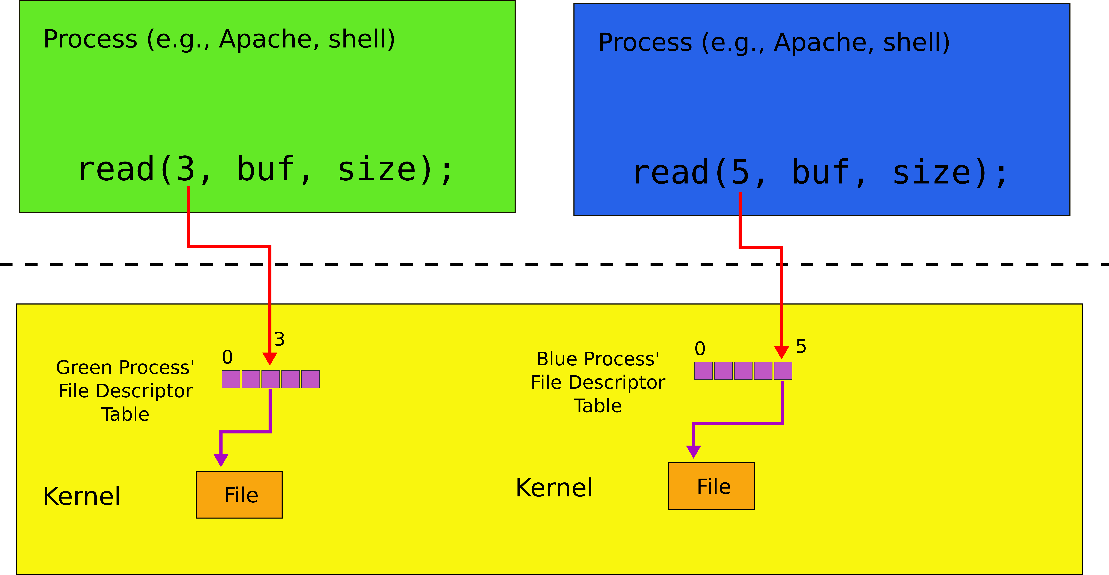
File descriptors: two processes

Slide 93
2353 struct proc {
2354 uint sz; // Size of process memory (bytes)
2355 pde_t* pgdir; // Page table
2356 char *kstack; // Bottom of kernel stack for this process
2357 enum procstate state; // Process state
2358 int pid; // Process ID
2359 struct proc *parent; // Parent process
2360 struct trapframe *tf; // Trap frame for current syscall
2361 struct context *context; // swtch() here to run process
2362 void *chan; // If non−zero, sleeping on chan
2363 int killed; // If non−zero, have been killed
2364 struct file *ofile[NOFILE]; // Open files
2365 struct inode *cwd; // Current directory
2366 char name[16]; // Process name (debugging)
2367 };
struct proc has an array of struct file pointers
Each element is a “file descriptor”

Slide 94
Reading and writing inodes
Inode is a file
readi()/writei() read and write it

Slide 95
struct file
4000 struct file {
4001 enum { FD_NONE, FD_PIPE, FD_INODE } type;
4002 int ref; // reference count
4003 char readable;
4004 char writable;
4005 struct pipe *pipe;
4006 struct inode *ip;
4007 uint off;
4008 };
A file can be a pipe or an inode
It can be readable and/or writable
Each file has current offset (off)

Slide 96
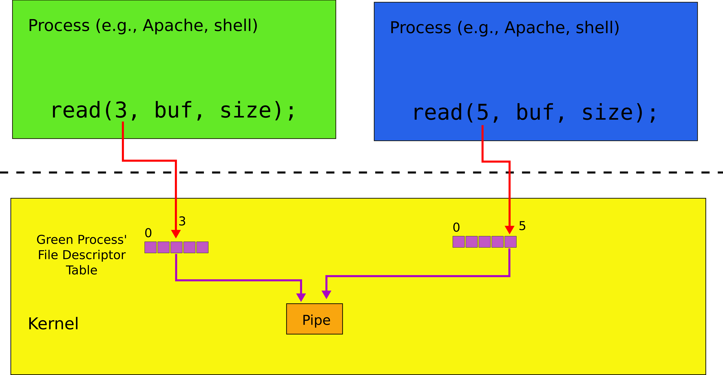
Two file descriptors pointing to a pipe

Slide 97
readi()
5714 int
5715 fileread(struct file *f, char *addr, int n)
5716 {
5717 int r;
5718
5719 if(f−>readable == 0)
5720 return −1;
5721 if(f−>type == FD_PIPE)
5722 return piperead(f−>pipe, addr, n);
5723 if(f−>type == FD_INODE){
5724 ilock(f−>ip);
5725 if((r = readi(f−>ip, addr, f−>off, n)) > 0)
5726 f−>off += r;
5727 iunlock(f−>ip);
5728 return r;
5729 }
5730 panic("fileread");
5731 }

Slide 98
readi()
5714 int
5715 fileread(struct file *f, char *addr, int n)
5716 {
5717 int r;
5718
5719 if(f−>readable == 0)
5720 return −1;
5721 if(f−>type == FD_PIPE)
5722 return piperead(f−>pipe, addr, n);
5723 if(f−>type == FD_INODE){
5724 ilock(f−>ip);
5725 if((r = readi(f−>ip, addr, f−>off, n)) > 0)
5726 f−>off += r;
5727 iunlock(f−>ip);
5728 return r;
5729 }
5730 panic("fileread");
5731 }

Slide 99
readi()
5714 int
5715 fileread(struct file *f, char *addr, int n)
5716 {
5717 int r;
5718
5719 if(f−>readable == 0)
5720 return −1;
5721 if(f−>type == FD_PIPE)
5722 return piperead(f−>pipe, addr, n);
5723 if(f−>type == FD_INODE){
5724 ilock(f−>ip);
5725 if((r = readi(f−>ip, addr, f−>off, n)) > 0)
5726 f−>off += r;
5727 iunlock(f−>ip);
5728 return r;
5729 }
5730 panic("fileread");
5731 }

Slide 100
readi()
5714 int
5715 fileread(struct file *f, char *addr, int n)
5716 {
5717 int r;
5718
5719 if(f−>readable == 0)
5720 return −1;
5721 if(f−>type == FD_PIPE)
5722 return piperead(f−>pipe, addr, n);
5723 if(f−>type == FD_INODE){
5724 ilock(f−>ip);
5725 if((r = readi(f−>ip, addr, f−>off, n)) > 0)
5726 f−>off += r;
5727 iunlock(f−>ip);
5728 return r;
5729 }
5730 panic("fileread");
5731 }
Note
Read starts with the current offset (f->off)

Slide 101
readi()
5252 readi(struct inode *ip, char *dst, uint off, uint n)
5253 {
5254 uint tot, m;
5255 struct buf *bp;
5256
...
5263 if(off > ip−>size || off + n < off)
5264 return −1;
5265 if(off + n > ip−>size)
5266 n = ip−>size − off;
5267
5268 for(tot=0; tot<n; tot+=m, off+=m, dst+=m){
5269 bp = bread(ip−>dev, bmap(ip, off/BSIZE));
5270 m = min(n − tot, BSIZE − off%BSIZE);
5271 memmove(dst, bp−>data + off%BSIZE, m);
5272 brelse(bp);
5273 }
5274 return n;
5275 }
What is this check for?

Slide 102
readi()
5252 readi(struct inode *ip, char *dst, uint off, uint n)
5253 {
5254 uint tot, m;
5255 struct buf *bp;
5256
...
5263 if(off > ip−>size || off + n < off)
5264 return −1;
5265 if(off + n > ip−>size)
5266 n = ip−>size − off;
5267
5268 for(tot=0; tot<n; tot+=m, off+=m, dst+=m){
5269 bp = bread(ip−>dev, bmap(ip, off/BSIZE));
5270 m = min(n − tot, BSIZE − off%BSIZE);
5271 memmove(dst, bp−>data + off%BSIZE, m);
5272 brelse(bp);
5273 }
5274 return n;
5275 }

Slide 103
readi()
5252 readi(struct inode *ip, char *dst, uint off, uint n)
5253 {
5254 uint tot, m;
5255 struct buf *bp;
5256
…
5263 if(off > ip−>size || off + n < off)
5264 return −1;
5265 if(off + n > ip−>size)
5266 n = ip−>size − off;
5267
5268 for(tot=0; tot<n; tot+=m, off+=m, dst+=m){
5269 bp = bread(ip−>dev, bmap(ip, off/BSIZE));
5270 m = min(n − tot, BSIZE − off%BSIZE);
5271 memmove(dst, bp−>data + off%BSIZE, m);
5272 brelse(bp);
5273 }
5274 return n;
5275 }
What is this bmap() function?

Slide 104
Representing files on disk

Slide 105
bmap()
5159 static uint
5160 bmap(struct inode *ip, uint bn)
5161 {
...
5165 if(bn < NDIRECT){
5166 if((addr = ip−>addrs[bn]) == 0)
5167 ip−>addrs[bn] = addr = balloc(ip−>dev);
5168 return addr;
5169 }
5170 bn −= NDIRECT;
5171
5172 if(bn < NINDIRECT){
5173 // Load indirect block, allocating if necessary.
5174 if((addr = ip−>addrs[NDIRECT]) == 0)
5175 ip−>addrs[NDIRECT] = addr = balloc(ip−>dev);
5176 bp = bread(ip−>dev, addr);
5177 a = (uint*)bp−>data;
5178 if((addr = a[bn]) == 0){
5179 a[bn] = addr = balloc(ip−>dev);
5180 log_write(bp);
5181 }
5182 brelse(bp);
5183 return addr;
5184 }
...
5187 }
Each inode has some number (NDIRECT) of direct pointers

Slide 106
bmap()
5159 static uint
5160 bmap(struct inode *ip, uint bn)
5161 {
...
5165 if(bn < NDIRECT){
5166 if((addr = ip−>addrs[bn]) == 0)
5167 ip−>addrs[bn] = addr = balloc(ip−>dev);
5168 return addr;
5169 }
5170 bn −= NDIRECT;
5171
5172 if(bn < NINDIRECT){
5173 // Load indirect block, allocating if necessary.
5174 if((addr = ip−>addrs[NDIRECT]) == 0)
5175 ip−>addrs[NDIRECT] = addr = balloc(ip−>dev);
5176 bp = bread(ip−>dev, addr);
5177 a = (uint*)bp−>data;
5178 if((addr = a[bn]) == 0){
5179 a[bn] = addr = balloc(ip−>dev);
5180 log_write(bp);
5181 }
5182 brelse(bp);
5183 return addr;
5184 }
...
5187 }
No it's beyond NDIRECT

Slide 107
bmap()
5159 static uint
5160 bmap(struct inode *ip, uint bn)
5161 {
...
5165 if(bn < NDIRECT){
5166 if((addr = ip−>addrs[bn]) == 0)
5167 ip−>addrs[bn] = addr = balloc(ip−>dev);
5168 return addr;
5169 }
5170 bn −= NDIRECT;
5171
5172 if(bn < NINDIRECT){
5173 // Load indirect block, allocating if necessary.
5174 if((addr = ip−>addrs[NDIRECT]) == 0)
5175 ip−>addrs[NDIRECT] = addr = balloc(ip−>dev);
5176 bp = bread(ip−>dev, addr);
5177 a = (uint*)bp−>data;
5178 if((addr = a[bn]) == 0){
5179 a[bn] = addr = balloc(ip−>dev);
5180 log_write(bp);
5181 }
5182 brelse(bp);
5183 return addr;
5184 }
...
5187 }
Read an indirect block

Slide 108
bmap()
5159 static uint
5160 bmap(struct inode *ip, uint bn)
5161 {
...
5165 if(bn < NDIRECT){
5166 if((addr = ip−>addrs[bn]) == 0)
5167 ip−>addrs[bn] = addr = balloc(ip−>dev);
5168 return addr;
5169 }
5170 bn −= NDIRECT;
5171
5172 if(bn < NINDIRECT){
5173 // Load indirect block, allocating if necessary.
5174 if((addr = ip−>addrs[NDIRECT]) == 0)
5175 ip−>addrs[NDIRECT] = addr = balloc(ip−>dev);
5176 bp = bread(ip−>dev, addr);
5177 a = (uint*)bp−>data;
5178 if((addr = a[bn]) == 0){
5179 a[bn] = addr = balloc(ip−>dev);
5180 log_write(bp);
5181 }
5182 brelse(bp);
5183 return addr;
5184 }
...
5187 }
Check if a pointer in the indirect block is already allocated

Slide 109
Block allocator

Slide 110
Block allocator
Bitmap of free blocks
balloc()/bfree()
Read the bitmap block by block
Scan for a “free” bit
Access to the bitmap is synchronized with bread()/bwrite()/brelse() operations

Slide 111
balloc()
4802 // Allocate a zeroed disk block.
4803 static uint
4804 balloc(uint dev)
4805 {
4806 int b, bi, m;
4807 struct buf *bp;
4808
4809 bp = 0;
4810 for(b = 0; b < sb.size; b += BPB){
4811 bp = bread(dev, BBLOCK(b, sb));
4812 for(bi = 0; bi < BPB && b + bi < sb.size; bi++){
4813 m = 1 << (bi % 8);
4814 if((bp−>data[bi/8] & m) == 0){ // Is block free?
4815 bp−>data[bi/8] |= m; // Mark block in use.
4816 log_write(bp);
4817 brelse(bp);
4818 bzero(dev, b + bi);
4819 return b + bi;
4820 }
4821 }
4822 brelse(bp);
4823 }
4824 panic("balloc: out of blocks");
4825 }

Slide 112
balloc()
4802 // Allocate a zeroed disk block.
4803 static uint
4804 balloc(uint dev)
4805 {
4806 int b, bi, m;
4807 struct buf *bp;
4808
4809 bp = 0;
4810 for(b = 0; b < sb.size; b += BPB){
4811 bp = bread(dev, BBLOCK(b, sb));
4812 for(bi = 0; bi < BPB && b + bi < sb.size; bi++){
4813 m = 1 << (bi % 8);
4814 if((bp−>data[bi/8] & m) == 0){ // Is block free?
4815 bp−>data[bi/8] |= m; // Mark block in use.
4816 log_write(bp);
4817 brelse(bp);
4818 bzero(dev, b + bi);
4819 return b + bi;
4820 }
4821 }
4822 brelse(bp);
4823 }
4824 panic("balloc: out of blocks");
4825 }
Check every bit (bi) of a block
BPB – bits per block

Slide 113
balloc()
4802 // Allocate a zeroed disk block.
4803 static uint
4804 balloc(uint dev)
4805 {
4806 int b, bi, m;
4807 struct buf *bp;
4808
4809 bp = 0;
4810 for(b = 0; b < sb.size; b += BPB){
4811 bp = bread(dev, BBLOCK(b, sb));
4812 for(bi = 0; bi < BPB && b + bi < sb.size; bi++){
4813 m = 1 << (bi % 8);
4814 if((bp−>data[bi/8] & m) == 0){ // Is block free?
4815 bp−>data[bi/8] |= m; // Mark block in use.
4816 log_write(bp);
4817 brelse(bp);
4818 bzero(dev, b + bi);
4819 return b + bi;
4820 }
4821 }
4822 brelse(bp);
4823 }
4824 panic("balloc: out of blocks");
4825 }

Slide 114
balloc()
4802 // Allocate a zeroed disk block.
4803 static uint
4804 balloc(uint dev)
4805 {
4806 int b, bi, m;
4807 struct buf *bp;
4808
4809 bp = 0;
4810 for(b = 0; b < sb.size; b += BPB){
4811 bp = bread(dev, BBLOCK(b, sb));
4812 for(bi = 0; bi < BPB && b + bi < sb.size; bi++){
4813 m = 1 << (bi % 8);
4814 if((bp−>data[bi/8] & m) == 0){ // Is block free?
4815 bp−>data[bi/8] |= m; // Mark block in use.
4816 log_write(bp);
4817 brelse(bp);
4818 bzero(dev, b + bi);
4819 return b + bi;
4820 }
4821 }
4822 brelse(bp);
4823 }
4824 panic("balloc: out of blocks");
4825 }
Why do we need log_write() instead of bwrite()?

Slide 115
Directory layer

Slide 116
Directory inodes
A directory inode is a sequence of directory entries and inode numbers
Each name is max of 14 characters
Has a special inode type T_DIR
dirlookup() - searches for a directory with a given name
dirlink() - adds new file to a directory

Slide 117
Directory entry
3965 struct dirent {
3966 ushort inum;
3967 char name[DIRSIZ];
3968 };

Slide 118
dirlookup()
5360 struct inode*
5361 dirlookup(struct inode *dp, char *name, uint *poff)
5362 {
...
5366 if(dp−>type != T_DIR)
5367 panic("dirlookup not DIR");
5368
5369 for(off = 0; off < dp−>size; off += sizeof(de)){
5370 if(readi(dp, (char*)&de, off, sizeof(de)) != sizeof(de))
5371 panic("dirlink read");
5372 if(de.inum == 0)
5373 continue;
5374 if(namecmp(name, de.name) == 0){
5375 // entry matches path element
5376 if(poff)
5377 *poff = off;
5378 inum = de.inum;
5379 return iget(dp−>dev, inum);
5380 }
5381 }
5382
5383 return 0;
5384 }
Inode is a directory

Slide 119
dirlookup()
5360 struct inode*
5361 dirlookup(struct inode *dp, char *name, uint *poff)
5362 {
...
5366 if(dp−>type != T_DIR)
5367 panic("dirlookup not DIR");
5368
5369 for(off = 0; off < dp−>size; off += sizeof(de)){
5370 if(readi(dp, (char*)&de, off, sizeof(de)) != sizeof(de))
5371 panic("dirlink read");
5372 if(de.inum == 0)
5373 continue;
5374 if(namecmp(name, de.name) == 0){
5375 // entry matches path element
5376 if(poff)
5377 *poff = off;
5378 inum = de.inum;
5379 return iget(dp−>dev, inum);
5380 }
5381 }
5382
5383 return 0;
5384 }
Iterate through all entries?

Slide 120
dirlookup()
5360 struct inode*
5361 dirlookup(struct inode *dp, char *name, uint *poff)
5362 {
...
5366 if(dp−>type != T_DIR)
5367 panic("dirlookup not DIR");
5368
5369 for(off = 0; off < dp−>size; off += sizeof(de)){
5370 if(readi(dp, (char*)&de, off, sizeof(de)) != sizeof(de))
5371 panic("dirlink read");
5372 if(de.inum == 0)
5373 continue;
5374 if(namecmp(name, de.name) == 0){
5375 // entry matches path element
5376 if(poff)
5377 *poff = off;
5378 inum = de.inum;
5379 return iget(dp−>dev, inum);
5380 }
5381 }
5382
5383 return 0;
5384 }
Read the inode
Compare names

Slide 121
Path names layer
Series of directory lookups to resolve a path
E.g. /usr/bin/sh
namei() - resolves a path into an inode
If path starts with “/” evaluation starts at the root
Otherwise current directory

Slide 122
namei()
5539 struct inode*
5540 namei(char *path)
5541 {
5542 char name[DIRSIZ];
5543 return namex(path, 0, name);
5544 }

Slide 123
namex()
5505 namex(char *path, int nameiparent, char *name)
5506 {
...
5509 if(*path == ’/’)
5510 ip = iget(ROOTDEV, ROOTINO);
5511 else
5512 ip = idup(proc−>cwd);
5513 // skipelem("a/bb/c", name) = "bb/c", setting name = "a"
5514 while((path = skipelem(path, name)) != 0){
5515 ilock(ip);
5516 if(ip−>type != T_DIR){
5517 iunlockput(ip);
5518 return 0;
5519 }
...
5525 if((next = dirlookup(ip, name, 0)) == 0){
5526 iunlockput(ip);
5527 return 0;
5528 }
5529 iunlockput(ip);
5530 ip = next;
5531 }
5532 if(nameiparent){
5533 iput(ip);
5534 return 0;
5535 }
5536 return ip;
5537 }
If path == “/” start with the inode number of the root

Slide 124
namex()
5505 namex(char *path, int nameiparent, char *name)
5506 {
...
5509 if(*path == ’/’)
5510 ip = iget(ROOTDEV, ROOTINO);
5511 else
5512 ip = idup(proc−>cwd);
5513 // skipelem("a/bb/c", name) = "bb/c", setting name = "a"
5514 while((path = skipelem(path, name)) != 0){
5515 ilock(ip);
5516 if(ip−>type != T_DIR){
5517 iunlockput(ip);
5518 return 0;
5519 }
...
5525 if((next = dirlookup(ip, name, 0)) == 0){
5526 iunlockput(ip);
5527 return 0;
5528 }
5529 iunlockput(ip);
5530 ip = next;
5531 }
5532 if(nameiparent){
5533 iput(ip);
5534 return 0;
5535 }
5536 return ip;
5537 }
Get the prefix
“a/bb/c”
name = a
path = “bb/c”

Slide 125
namex()
5505 namex(char *path, int nameiparent, char *name)
5506 {
...
5509 if(*path == ’/’)
5510 ip = iget(ROOTDEV, ROOTINO);
5511 else
5512 ip = idup(proc−>cwd);
5513 // skipelem("a/bb/c", name) = "bb/c", setting name = "a"
5514 while((path = skipelem(path, name)) != 0){
5515 ilock(ip);
5516 if(ip−>type != T_DIR){
5517 iunlockput(ip);
5518 return 0;
5519 }
...
5525 if((next = dirlookup(ip, name, 0)) == 0){
5526 iunlockput(ip);
5527 return 0;
5528 }
5529 iunlockput(ip);
5530 ip = next;
5531 }
5532 if(nameiparent){
5533 iput(ip);
5534 return 0;
5535 }
5536 return ip;
5537 }
Lookup that name in the directory

Slide 126
Eaxmple: sys_open
6101 sys_open(void)
6102 {
...
6108 if(argstr(0, &path) < 0 || argint(1, &omode) < 0)
6109 return −1;
6110
6111 begin_op();
6112
...
6120 if((ip = namei(path)) == 0){
6121 end_op();
6122 return −1;
6123 }
...
6132 if((f = filealloc()) == 0 || (fd = fdalloc(f)) < 0){
6133 if(f)
6134 fileclose(f);
6135 iunlockput(ip);
6136 end_op();
6137 return −1;
6138 }
6139 iunlock(ip);
6140 end_op();
6141
6142 f−>type = FD_INODE;
6143 f−>ip = ip;
...
6147 return fd;
6148 }

Slide 127
File descriptor layer

Slide 128
File descriptors
Uniform access to
Files
Devices, e.g., console
Pipes
4000 struct file {
4001 enum { FD_NONE, FD_PIPE, FD_INODE } type;
4002 int ref; // reference count
4003 char readable;
4004 char writable;
4005 struct pipe *pipe;
4006 struct inode *ip;
4007 uint off;
4008 };

Slide 129
Eaxmple: sys_open
6101 sys_open(void)
6102 {
...
6108 if(argstr(0, &path) < 0 || argint(1, &omode) < 0)
6109 return −1;
6110
6111 begin_op();
6112
...
6120 if((ip = namei(path)) == 0){
6121 end_op();
6122 return −1;
6123 }
...
6132 if((f = filealloc()) == 0 || (fd = fdalloc(f)) < 0){
6133 if(f)
6134 fileclose(f);
6135 iunlockput(ip);
6136 end_op();
6137 return −1;
6138 }
6139 iunlock(ip);
6140 end_op();
6141
6142 f−>type = FD_INODE;
6143 f−>ip = ip;
...
6147 return fd;
6148 }
Allocate new file data structure

Slide 130
Files and filealloc()
5612 struct {
5613 struct spinlock lock;
5614 struct file file[NFILE];
5615 } ftable;
...
5624 struct file*
5625 filealloc(void)
5626 {
5627 struct file *f;
5628
5629 acquire(&ftable.lock);
5630 for(f = ftable.file; f < ftable.file + NFILE; f++){
5631 if(f−>ref == 0){
5632 f−>ref = 1;
5633 release(&ftable.lock);
5634 return f;
5635 }
5636 }
5637 release(&ftable.lock);
5638 return 0;
5639 }
Linear search for an available element of the ftable array
f->ref == 0

Slide 131
Eaxmple: sys_open
6101 sys_open(void)
6102 {
...
6108 if(argstr(0, &path) < 0 || argint(1, &omode) < 0)
6109 return −1;
6110
6111 begin_op();
6112
...
6120 if((ip = namei(path)) == 0){
6121 end_op();
6122 return −1;
6123 }
...
6132 if((f = filealloc()) == 0 || (fd = fdalloc(f)) < 0){
6133 if(f)
6134 fileclose(f);
6135 iunlockput(ip);
6136 end_op();
6137 return −1;
6138 }
6139 iunlock(ip);
6140 end_op();
6141
6142 f−>type = FD_INODE;
6143 f−>ip = ip;
...
6147 return fd;
6148 }
Allocate a new file descriptor

Slide 132
File descriptors and fdalloc()
5835 // Allocate a file descriptor for the given file.
5836 // Takes over file reference from caller on success.
5837 static int
5838 fdalloc(struct file *f)
5839 {
5840 int fd;
5841
5842 for(fd = 0; fd < NOFILE; fd++){
5843 if(proc−>ofile[fd] == 0){
5844 proc−>ofile[fd] = f;
5845 return fd;
5846 }
5847 }
5848 return −1;
5849 }
Allocate a file descriptor

Slide 133
Thank you!

Slide 134
Example: write system call

Slide 135
Write() syscall
5476 int
5477 sys_write(void)
5478 {
5479 struct file *f;
5480 int n;
5481 char *p;
5482
5483 if(argfd(0, 0, &f) < 0
|| argint(2, &n) < 0 || argptr(1, &p, n) < 0)
5484 return −1;
5485 return filewrite(f, p, n);
5486 }

Slide 136
Write several blocks at a time
5352 filewrite(struct file *f, char *addr, int n)
5353 {
5360 if(f−>type == FD_INODE){
...
5368 int i = 0;
5369 while(i < n){
...
5373
5374 begin_trans();
5375 ilock(f−>ip);
5376 if ((r = writei(f−>ip, addr + i, f−>off, n1)) > 0)
5377 f−>off += r;
5378 iunlock(f−>ip);
5379 commit_trans();
5386 }
5390 }

