Slide 1
cs5460/6460 Operating Systems Lecture 03: x86 instruction set
Anton Burtsev
January, 2025

Slide 2
How do CPUs work internally?

Slide 3
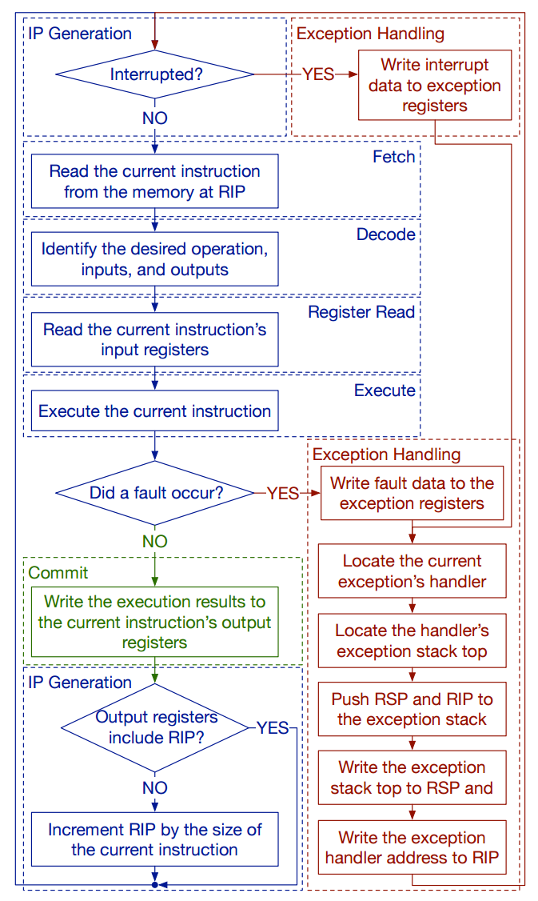
CPU execution loop
CPU repeatedly reads instructions from memory
Executes them
Example
ADD EDX, EAX
// EDX = EAX + EDX

Slide 4
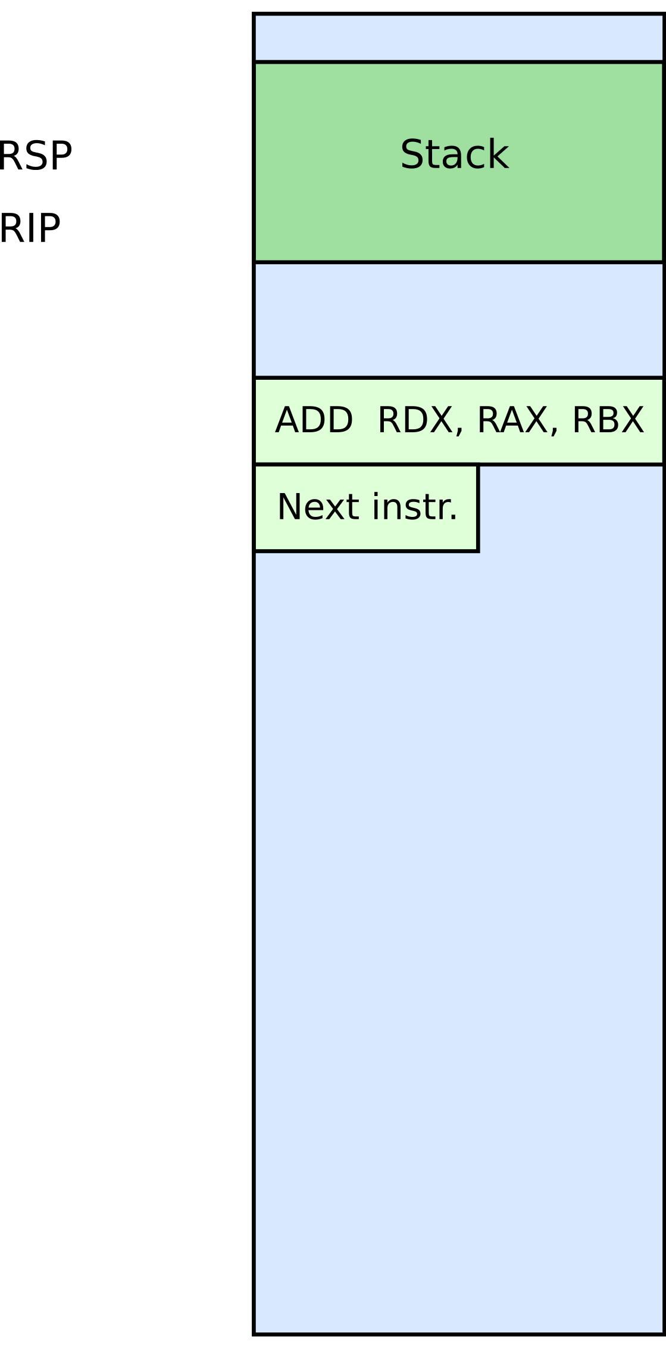



Slide 5
What are those instructions?
(a brief introduction to x86 instruction set)
This part is based on David Evans’ x86 Assembly Guide
http://www.cs.virginia.edu/~evans/cs216/guides/x86.html
and Yale FLINT’s group version of the same manual converted to GNU ASM syntax
https://flint.cs.yale.edu/cs421/papers/x86-asm/asm.html

Slide 6
Note
We’ll be talking about 32bit x86 instruction set
The version of xv6 we will be using in this class is a 32bit operating system
You’re welcome to take a look at the 64bit port

Slide 7
x86 instruction set
The full x86 instruction set is large and complex
But don’t worry, the core part is simple
The rest are various extensions (often you can guess what they do, or quickly look it up in the manual)

Slide 8
x86 instruction set
Three main groups
Data movement (from memory and between registers)
Arithmetic operations (addition, subtraction, etc.)
Control flow (jumps, function calls)

Slide 9
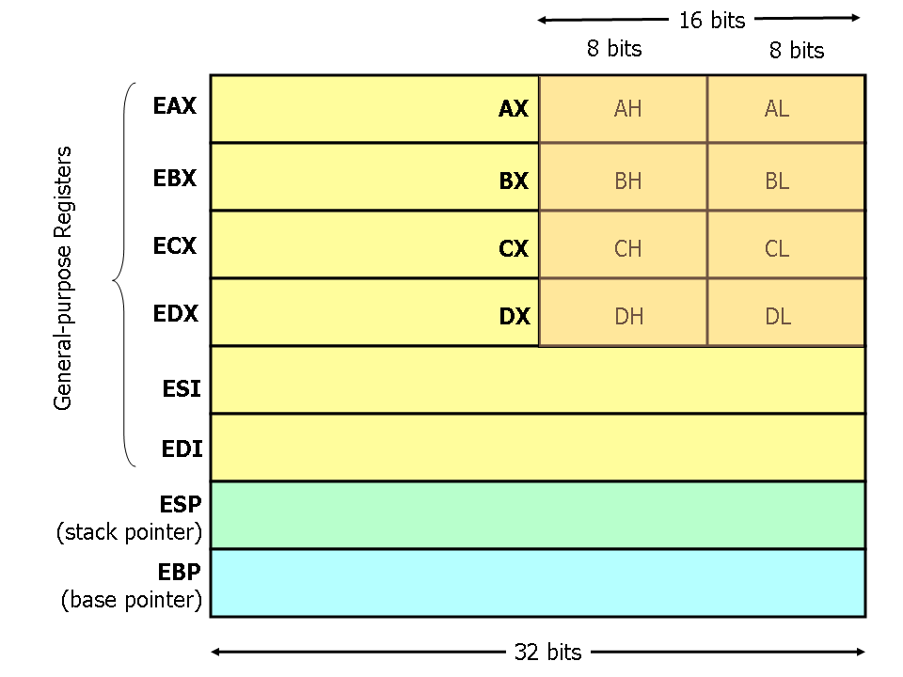
General registers
8 general registers
32bits each
Two (ESP and EBP) have a special role
Others are more or less general
Used in arithmetic instructions, control flow decisions, passing arguments to functions, etc.

Slide 10
BTW, where are these registers?

Slide 11
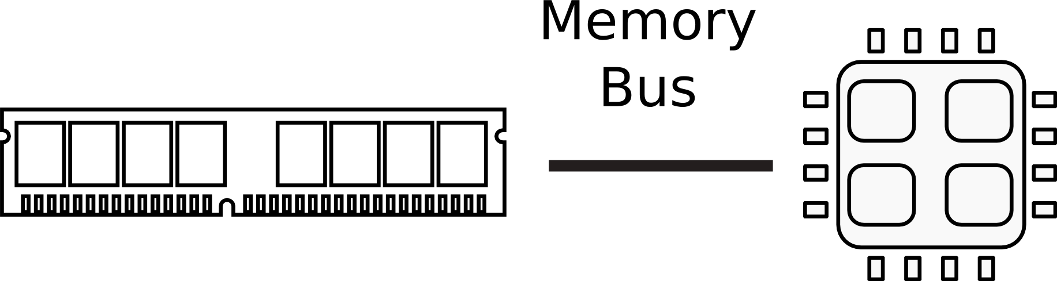
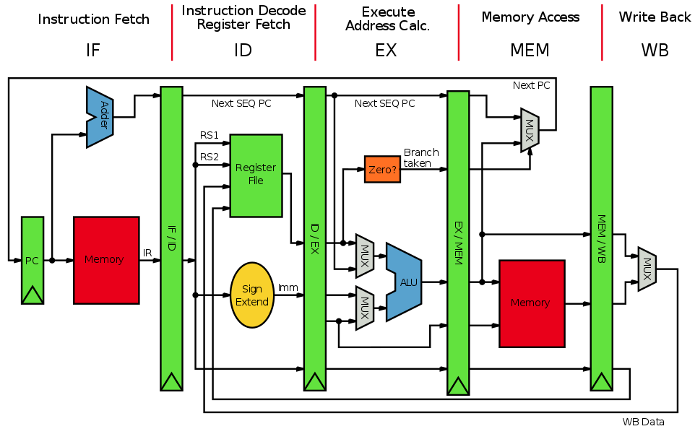
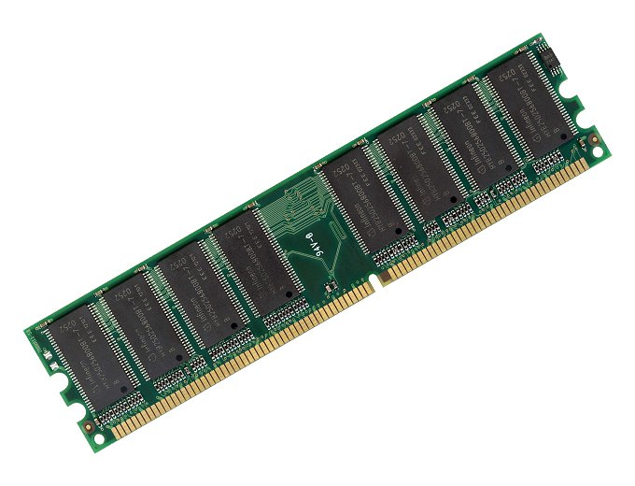
Registers and Memory

Slide 12
Global (static) variables

Slide 13
Declaring static data regions
Data declarations are preceded by the .DATA directive
DB (declare byte)
DW (declare two byte location aka word)
DD (declare four byte locattion aka double word)
.DATA
var DB 64 ; Declare a byte, referred to as location var,
; containing the value 64
var2 DB ? ; Declare an uninitialized byte,
; referred to as location var2
DB 10 ; Declare a byte with no label, containing the value 10
; Its location is var2 + 1
X DW ? ; Declare a 2-byte uninitialized value, location X
Y DD 30000 ; Declare a 4-byte value, location Y, initialized to 30000

Slide 14
Arrays
Simply a number of cells in memory
Z DD 1, 2, 3 ; Declare three 4-byte values, initialized to
; 1, 2, and 3. The value of location Z + 8 is 3
DUP – duplicate expression a given number of times
bytes DB 10 DUP(?) ; Declare 10 uninitialized bytes starting at
; location bytes
arr DD 100 DUP(0) ; Declare 100 4-byte words starting at location
; arr, all initialized to 0
String literals
str DB 'hello',0 ; Declare 6 bytes starting at the address str,
; initialized to the ASCII character values for
; hello and the null (0) byte

Slide 15
Data movement instructions

Slide 16
We use the following notation
<reg32> Any 32-bit register (EAX,EBX,ECX,EDX,ESI,EDI,ESP,EBP)
<reg16> Any 16-bit register (AX, BX, CX, or DX)
<reg8> Any 8-bit register (AH, BH, CH, DH, AL, BL, CL, DL)
<reg> Any register
<mem> A memory address (e.g., [eax], [var + 4],
or dword ptr [eax+ebx])
<con32> Any 32-bit constant
<con16> Any 16-bit constant
<con8> Any 8-bit constant
<con> Any 8-, 16-, or 32-bit constant

Slide 17
mov instruciton
Copies the data item referred to by its second operand (i.e. register contents, memory contents, or a constant value) into the location referred to by its first operand (i.e. a register or memory).
Register-to-register moves are possible
Direct memory-to-memory moves are not
Syntax
mov <reg>,<reg>
mov <reg>,<mem>
mov <mem>,<reg>
mov <reg>,<const>
mov <mem>,<const>

Slide 18
mov examples
mov eax, ebx ; copy the value in ebx into eax
mov byte ptr [var], 5 ; store 5 into the byte at location var
mov eax, [ebx] ; Move the 4 bytes in memory at the address
; contained in EBX into EAX
mov [var], ebx ; Move the contents of EBX into the 4 bytes
; at memory address var.
; (Note, var is a 32-bit constant).
mov eax, [esi-4] ; Move 4 bytes at memory address ESI + (-4)
; into EAX
mov [esi+eax], cl ; Move the contents of CL into the byte at
; address ESI+EAX

Slide 19
mov: access to data structures
struct point {
int x; // x coordinate (4 bytes)
int y; // y coordinate (4 bytes)
}
struct point points[128]; // array of 128 points
// load y coordinate of i-th point into y
int y = points[i].y;
; ebx is address of the points array, eax is i
mov edx, [ebx + 8*eax + 4] ; Move y of the i-th
; point into edx

Slide 20
lea load effective address
The lea instruction places the address specified by its second operand into the register specified by its first operand
The contents of the memory location are not loaded, only the effective address is computed and placed into the register
This is useful for obtaining a pointer into a memory region

Slide 21
lea vs mov access to data structures
mov
// load y coordinate of i-th point into y
int y = points[i].y;
; ebx is address of the points array, eax is i
mov edx, [ebx + 8*eax + 4] ; Move y of the i-th point into edx
lea
// load the address of the y coordinate of the i-th point into p
int *p = &points[i].y;
; ebx is address of the points array, eax is i
lea esi, [ebx + 8*eax + 4] ; Move address of y of the i-th point
; into esi

Slide 22
lea is often used instead of add
Compared to add, lea can
perform addition with either two or three operands
store the result in any register; not just one of the source operands.
Examples
LEA EAX, [ EAX + EBX + 1234567 ]
; EAX = EAX + EBX + 1234567 (three operands)
LEA EAX, [ EBX + ECX ] ; EAX = EBX + ECX
; Add without overriding EBX or ECX with the result
LEA EAX, [ EBX + N * EBX ] ; multiplication by constant
; (limited set, by 2, 3, 4, 5, 8, and 9 since N is
; limited to 1,2,4, and 8).

Slide 23
Arithmetic and logic instructions

Slide 24
add Integer addition
The add instruction adds together its two operands, storing the result in its first operand
Both operands may be registers
At most one operand may be a memory location
Syntax
add <reg>,<reg>
add <reg>,<mem>
add <mem>,<reg>
add <reg>,<con>
add <mem>,<con>

Slide 25
add examples
add eax, 10 ; EAX ← EAX + 10
add BYTE PTR [var], 10 ; add 10 to the
; single byte stored at
; memory address var

Slide 26
sub Integer subtraction
The sub instruction stores in the value of its first operand the result of subtracting the value of its second operand from the value of its first operand.
Examples
sub al, ah ; AL ← AL - AH
sub eax, 216 ; subtract 216 from the value
; stored in EAX

Slide 27
inc, dec Increment, decrement
The inc instruction increments the contents of its operand by one
The dec instruction decrements the contents of its operand by one
Examples
dec eax ; subtract one from the contents
; of EAX
inc DWORD PTR [var] ; add one to the 32-
; bit integer stored at
; location var

Slide 28
and, or, xor Bitwise logical and, or, and exclusive or
These instructions perform the specified logical operation (logical bitwise and, or, and exclusive or, respectively) on their operands, placing the result in the first operand location
Examples
and eax, 0fH ; clear all but the last 4
; bits of EAX
xor edx, edx ; set the contents of EDX to
; zero

Slide 29
shl, shr shift left, shift right
These instructions shift the bits in their first operand's contents left and right, padding the resulting empty bit positions with zeros
The shifted operand can be shifted up to 31 places. The number of bits to shift is specified by the second operand, which can be either an 8-bit constant or the register CL
In either case, shifts counts of greater then 31 are performed modulo 32.
Examples
shl eax, 1 ; Multiply the value of EAX by 2
; (if the most significant bit is 0)
shr ebx, cl ; Store in EBX the floor of result of dividing
; the value of EBX by 2^n
; where n is the value in CL.

Slide 30
More instructions… (similar)
Multiplication imul
imul eax, [var] ; multiply the contents of EAX by the
; 32-bit contents of the memory
; location var. Store result in EAX
imul esi, edi, 25 ; ESI ← EDI * 25
Division idiv
not - bitvise logical not (flips all bits)
neg - negation
neg eax ; EAX ← - EAX

Slide 31
This is enough to do arithmetic

Slide 32

Poll Q1: What is inside ebx?
After we execute the mov instruction?
; eax = 2
; ebx = 3
mov ebx, eax
; what is the value of eax here?

Slide 33
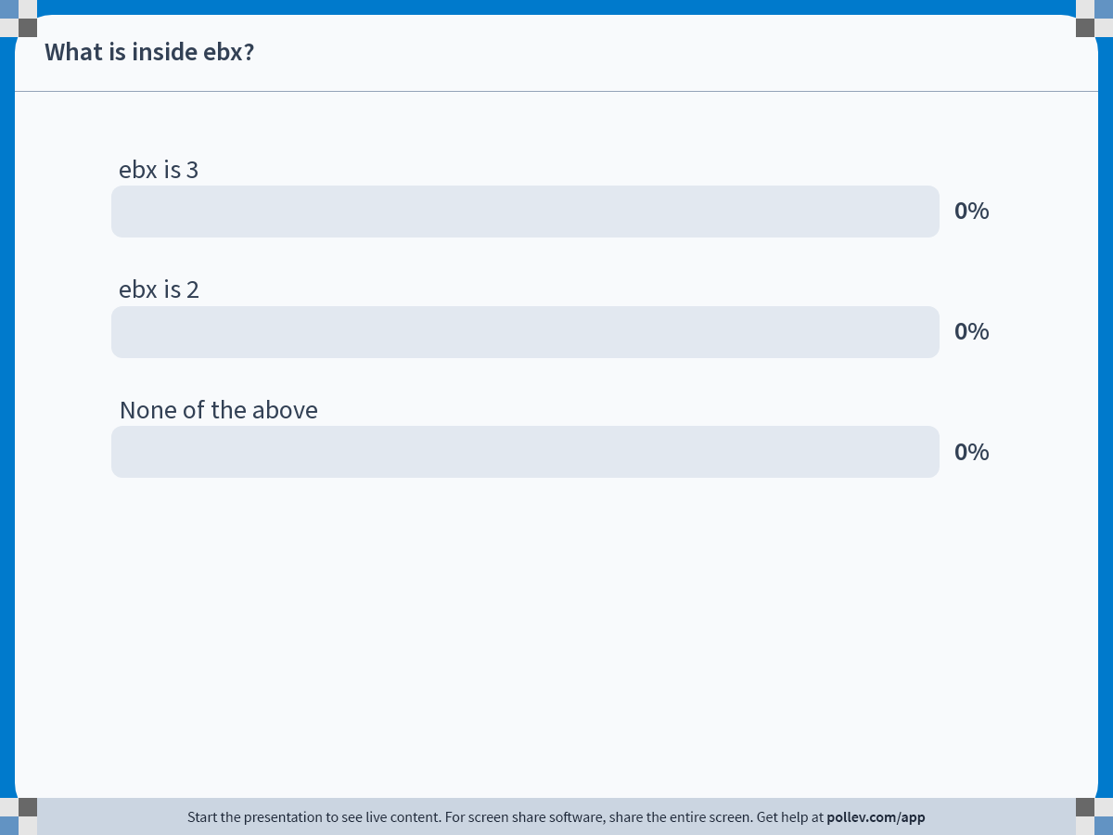
Notes:
Do not modify the notes in this section to avoid tampering with the Poll Everywhere activity. More info at polleverywhere.com/support What is inside ebx?
https://www.polleverywhere.com/multiple_choice_polls/lrCccnGm68FB3B7E5O6Sj?state=opened&flow=Default&onscreen=persist

Slide 34
Poll Q2: What is this instruction doing?
mov ebx, [eax]
; Is it writing memory? Or reading it?

Slide 35
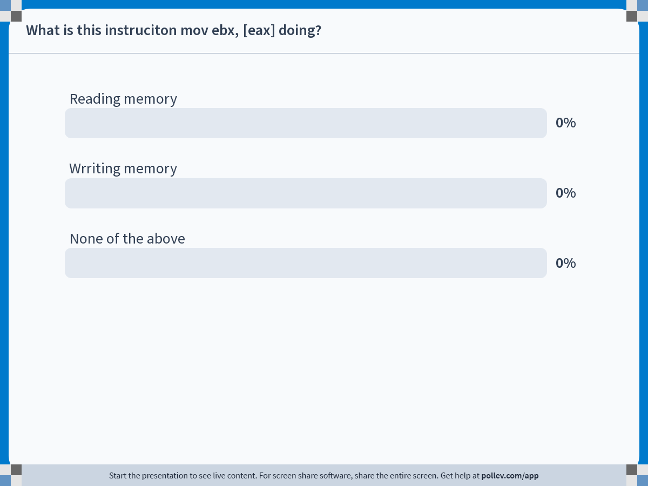
Notes:
Do not modify the notes in this section to avoid tampering with the Poll Everywhere activity. More info at polleverywhere.com/support What is this instruciton mov ebx, [eax] doing?
https://www.polleverywhere.com/multiple_choice_polls/Nu5xKXhHLrsm0NopeA8pm?state=opened&flow=Default&onscreen=persist

Slide 36
Poll Q3: Is this a legal instruction
mov [ebx], [eax]

Slide 37
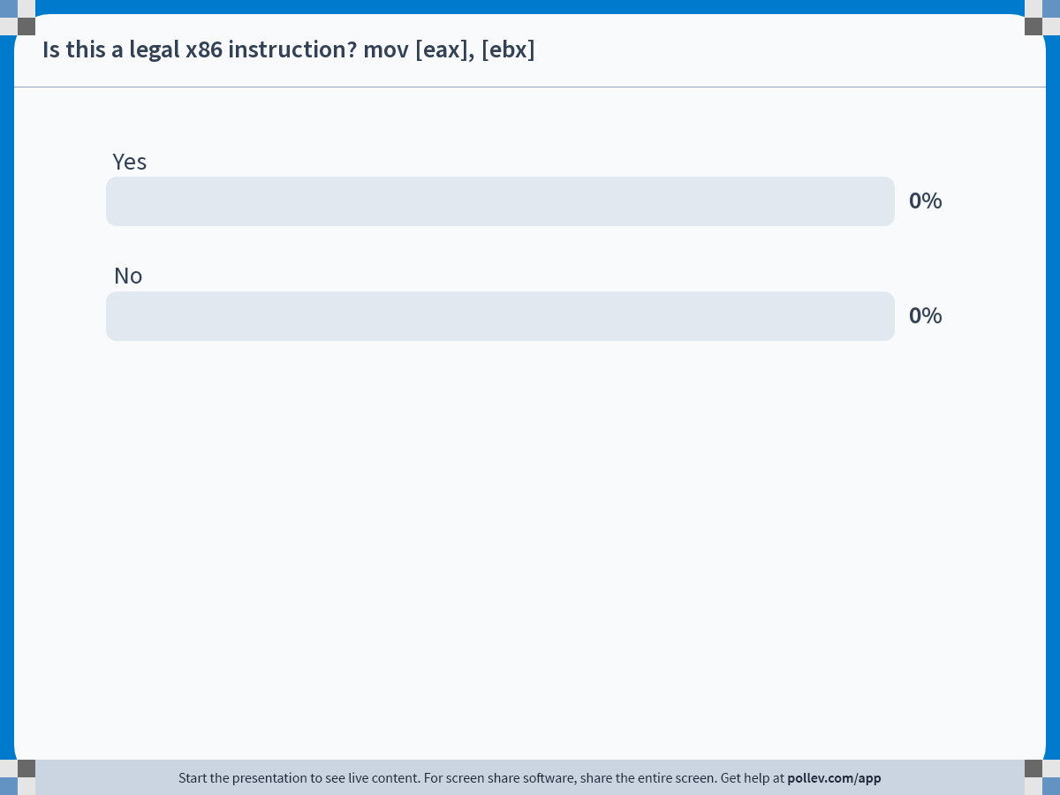
Notes:
Do not modify the notes in this section to avoid tampering with the Poll Everywhere activity. More info at polleverywhere.com/support Is this a legal x86 instruction? mov [eax], [ebx]
https://www.polleverywhere.com/multiple_choice_polls/kDWvtqhRVLbMKc48fwMVg?state=opened&flow=Default&onscreen=persist

Slide 38
Control flow instructions

Slide 40
EIP instruction pointer
EIP is a 32bit value indicating the location in memory where the current instruction starts (i.e., memory address of the instruction)
EIP cannot be changed directly
Normally, it increments to point to the next instruction in memory
But it can be updated implicitly by provided control flow instructions

Slide 41
Labels
<label> refers to a labeled location in the program text (code).
Labels can be inserted anywhere in x86 assembly code text by entering a label name followed by a colon
Examples
mov esi, [ebp+8]
begin: xor ecx, ecx
mov eax, [esi]

Slide 42
jump: jump
Transfers program control flow to the instruction at the memory location indicated by the operand.
Syntax
jmp <label>
Example
begin: xor ecx, ecx
...
jmp begin ; jump to instruction labeled
; begin

Slide 43
jcondition: conditional jump
Jumps only if a condition is true
The status of a set of condition codes that are stored in a special register (EFLAGS)
EFLAGS stores information about the last arithmetic operation performedm for example,
Bit 6 of EFLAGS indicates if the last result was zero
Bit 7 indicates if the last result was negative
Based on these bits, different conditional jumps can be performed
For example, the jz instruction performs a jump to the specified operand label if the result of the last arithmetic operation was zero
Otherwise, control proceeds to the next instruction in sequence

Slide 44
Conditional jumps
Most conditional jump follow the comparison instruction (cmp, we’ll cover it below)
Syntax
je <label> (jump when equal)
jne <label> (jump when not equal)
jz <label> (jump when last result was zero)
jg <label> (jump when greater than)
jge <label> (jump when greater than or equal to)
jl <label> (jump when less than)
jle <label> (jump when less than or equal to)
Example: if EAX is less than or equal to EBX, jump to the label done. Otherwise, continue to the next instruction
cmp eax, ebx
jle done

Slide 45
cmp: compare
Compare the values of the two specified operands, setting the condition codes in EFLAGS
This instruction is equivalent to the sub instruction, except the result of the subtraction is discarded instead of replacing the first operand.
Syntax
cmp <reg>,<reg>
cmp <reg>,<mem>
cmp <mem>,<reg>
cmp <reg>,<con>
Example: if the 4 bytes stored at location var are equal to the 4-byte integer constant 10, jump to the location labeled loop.
cmp DWORD PTR [var], 10
jeq loop

Slide 46
Poll Q1: What is inside ebx?
After we execute the mov instruction?
; eax = 2
; ebx = 3
mov ebx, eax
; what is the value of ebx here?

Slide 47
Notes:
Do not modify the notes in this section to avoid tampering with the Poll Everywhere activity. More info at polleverywhere.com/support What is inside ebx?
https://www.polleverywhere.com/multiple_choice_polls/lrCccnGm68FB3B7E5O6Sj?state=opened&flow=Default&onscreen=persist

Slide 48
Poll Q2: What is this instruction doing?
mov ebx, [eax]
; Is it writing memory? Or reading it?

Slide 49
Notes:
Do not modify the notes in this section to avoid tampering with the Poll Everywhere activity. More info at polleverywhere.com/support What is this instruciton mov ebx, [eax] doing?
https://www.polleverywhere.com/multiple_choice_polls/Nu5xKXhHLrsm0NopeA8pm?state=opened&flow=Default&onscreen=persist

Slide 50
Poll Q3: Is this a legal instruction
mov [ebx], [eax]

Slide 51
Notes:
Do not modify the notes in this section to avoid tampering with the Poll Everywhere activity. More info at polleverywhere.com/support Is this a legal x86 instruction? mov [eax], [ebx]
https://www.polleverywhere.com/multiple_choice_polls/kDWvtqhRVLbMKc48fwMVg?state=opened&flow=Default&onscreen=persist

Slide 52
Stack and procedure calls

Slide 53
What is stack?

Slide 54
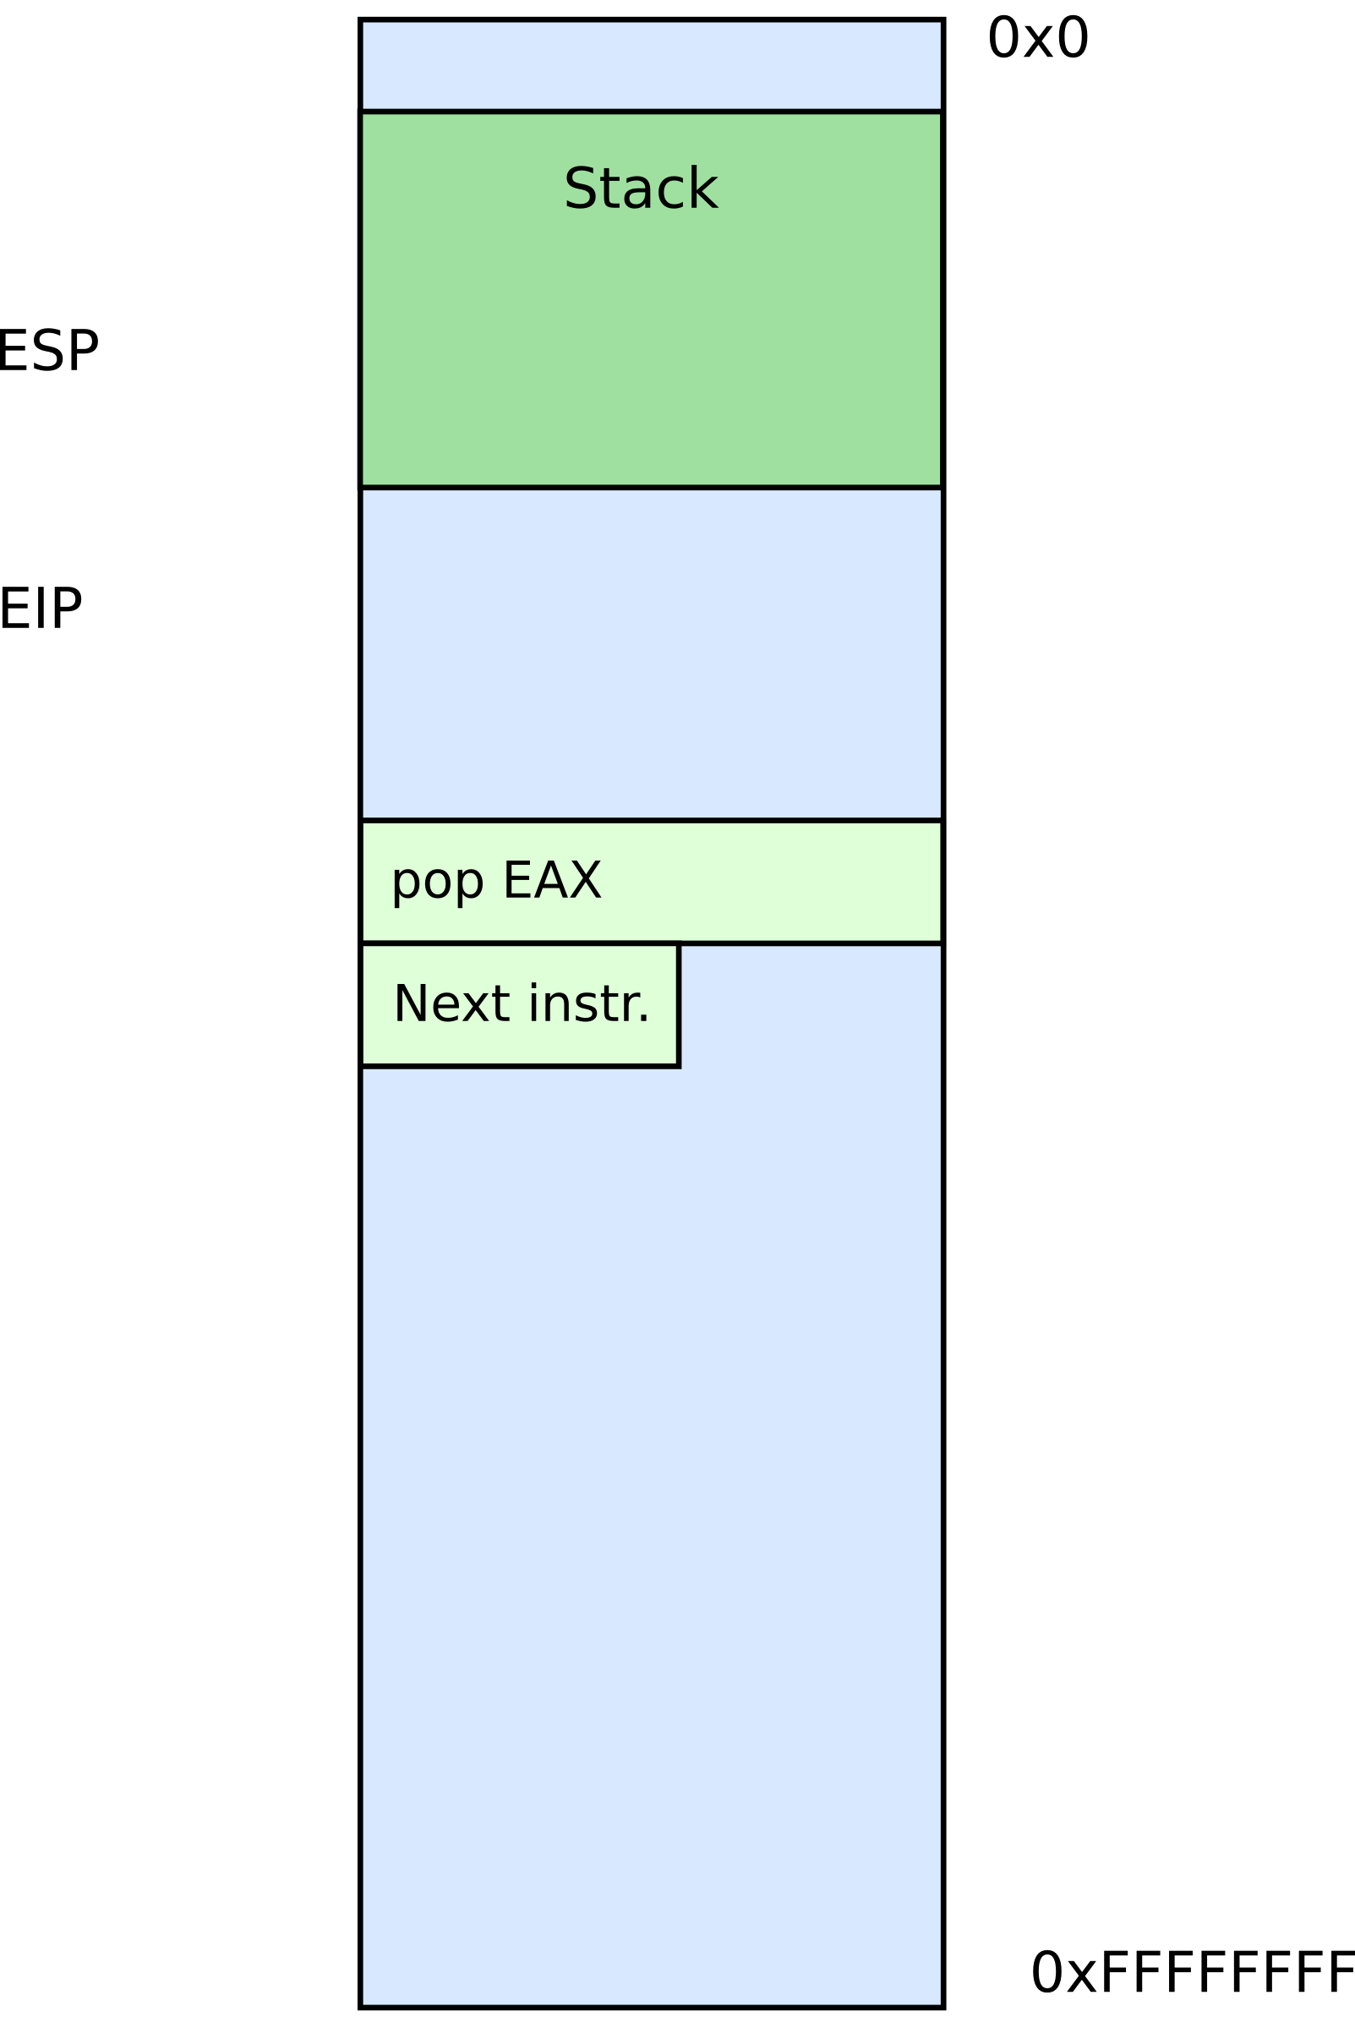


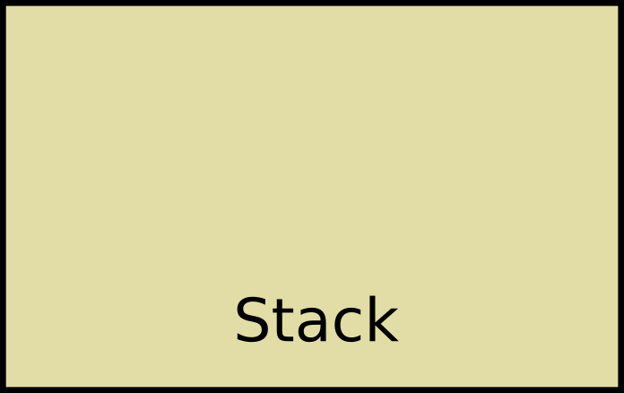
Stack
It's just a region of memory
Pointed by a special register ESP
You can change ESP
Get a new stack

Slide 55
Why do we need stack?

Slide 56
Calling functions
// some code...
foo();
// more code..
Stack contains information for how to return from a subroutine
i.e., from foo()
Functions can be called from different places in the program
if (a == 0) {
foo();
…
} else {
foo();
…
}

Slide 57
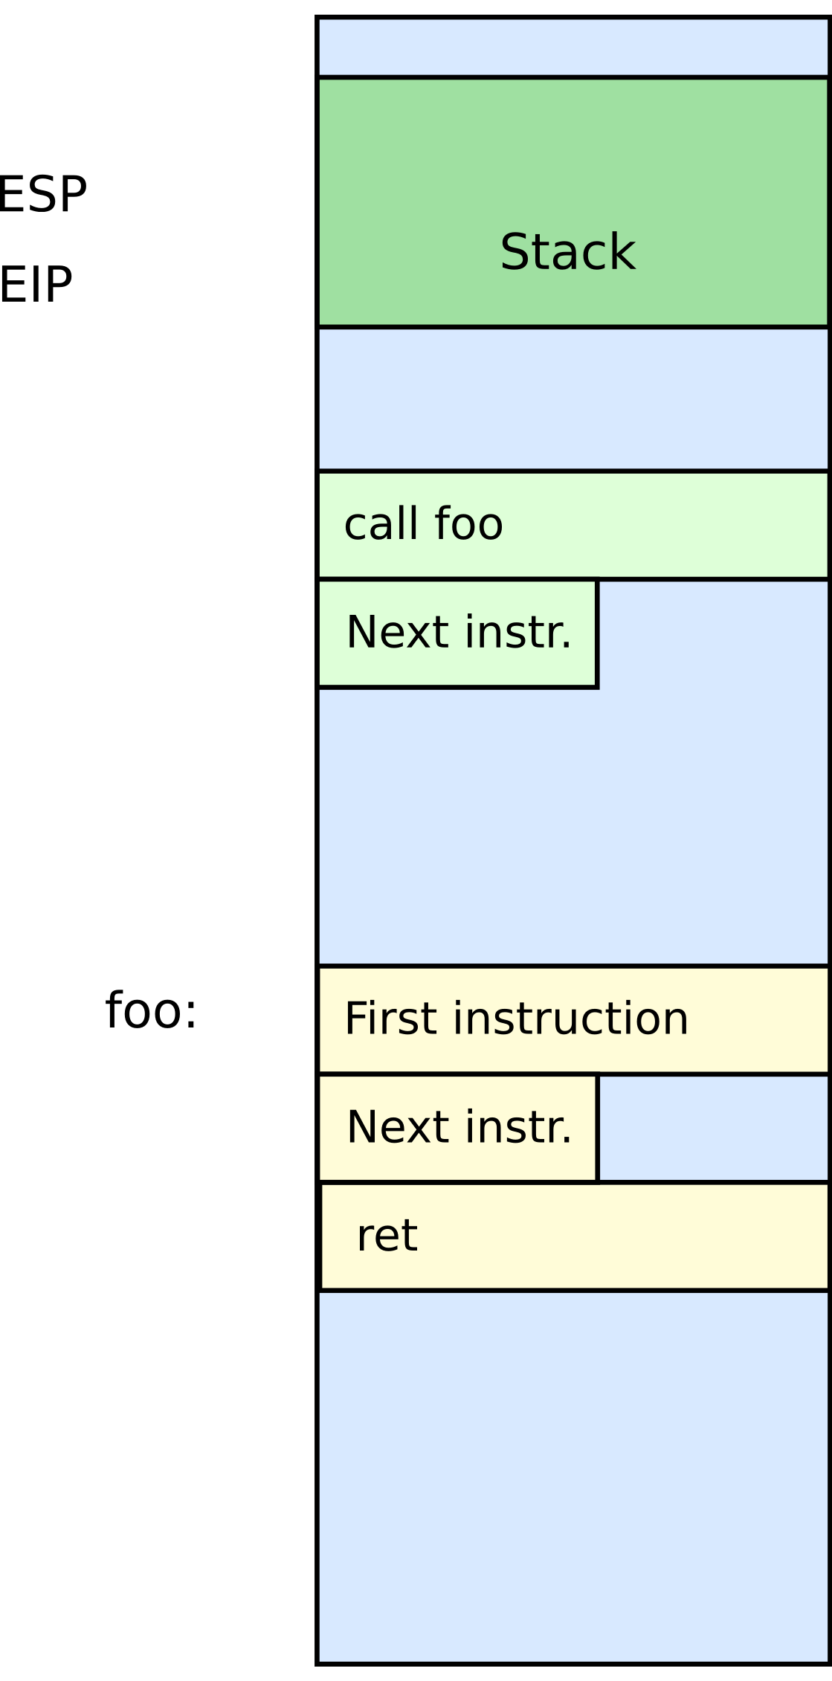
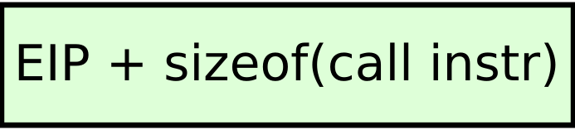


Stack
Main purpose:
Store the return address for the current procedure
Caller pushes return address on the stack
Callee pops it and jumps

Slide 58
Stack
Main purpose:
Store the return address for the current procedure
Caller pushes return address on the stack
Callee pops it and jumps

Slide 59
Call/return
CALL instruction
Makes an unconditional jump to a subprogram and pushes the address of the next instruction on the stack
push eip + sizeof(CALL) ; save return
; address
jmp _my_function
RET instruction
Pops off an address and jumps to that address

Slide 60
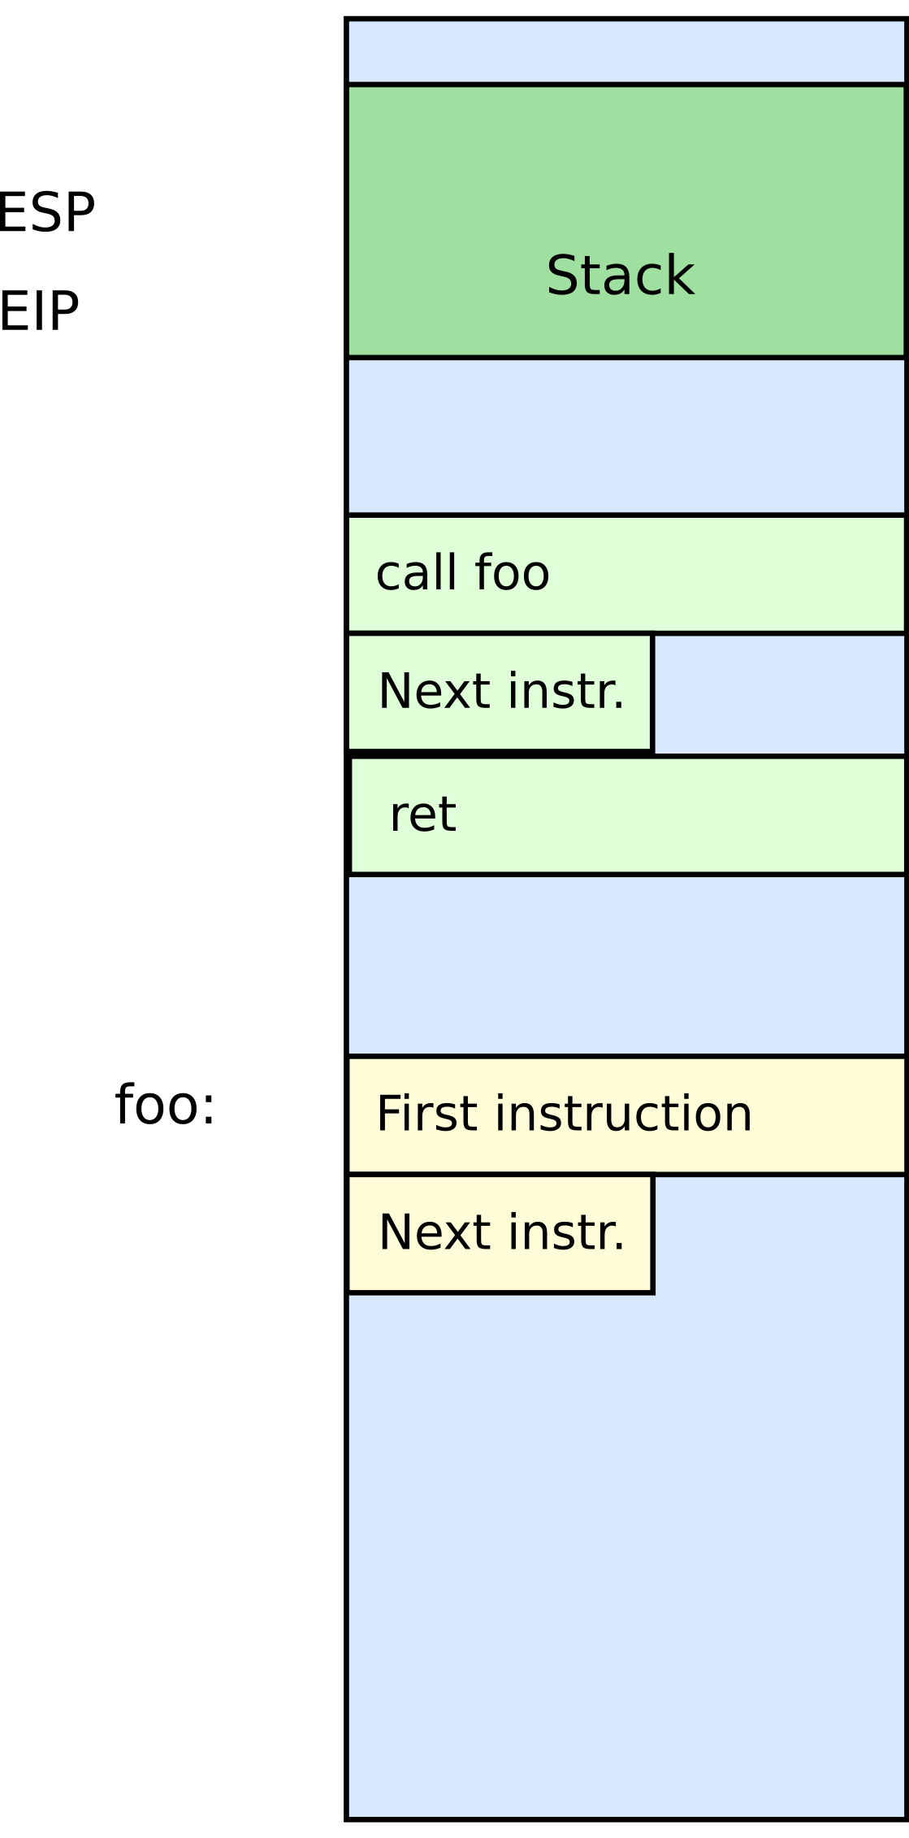
Stack
Other uses:
Local data storage
Parameter passing
Evaluation stack
Register spill

Slide 61
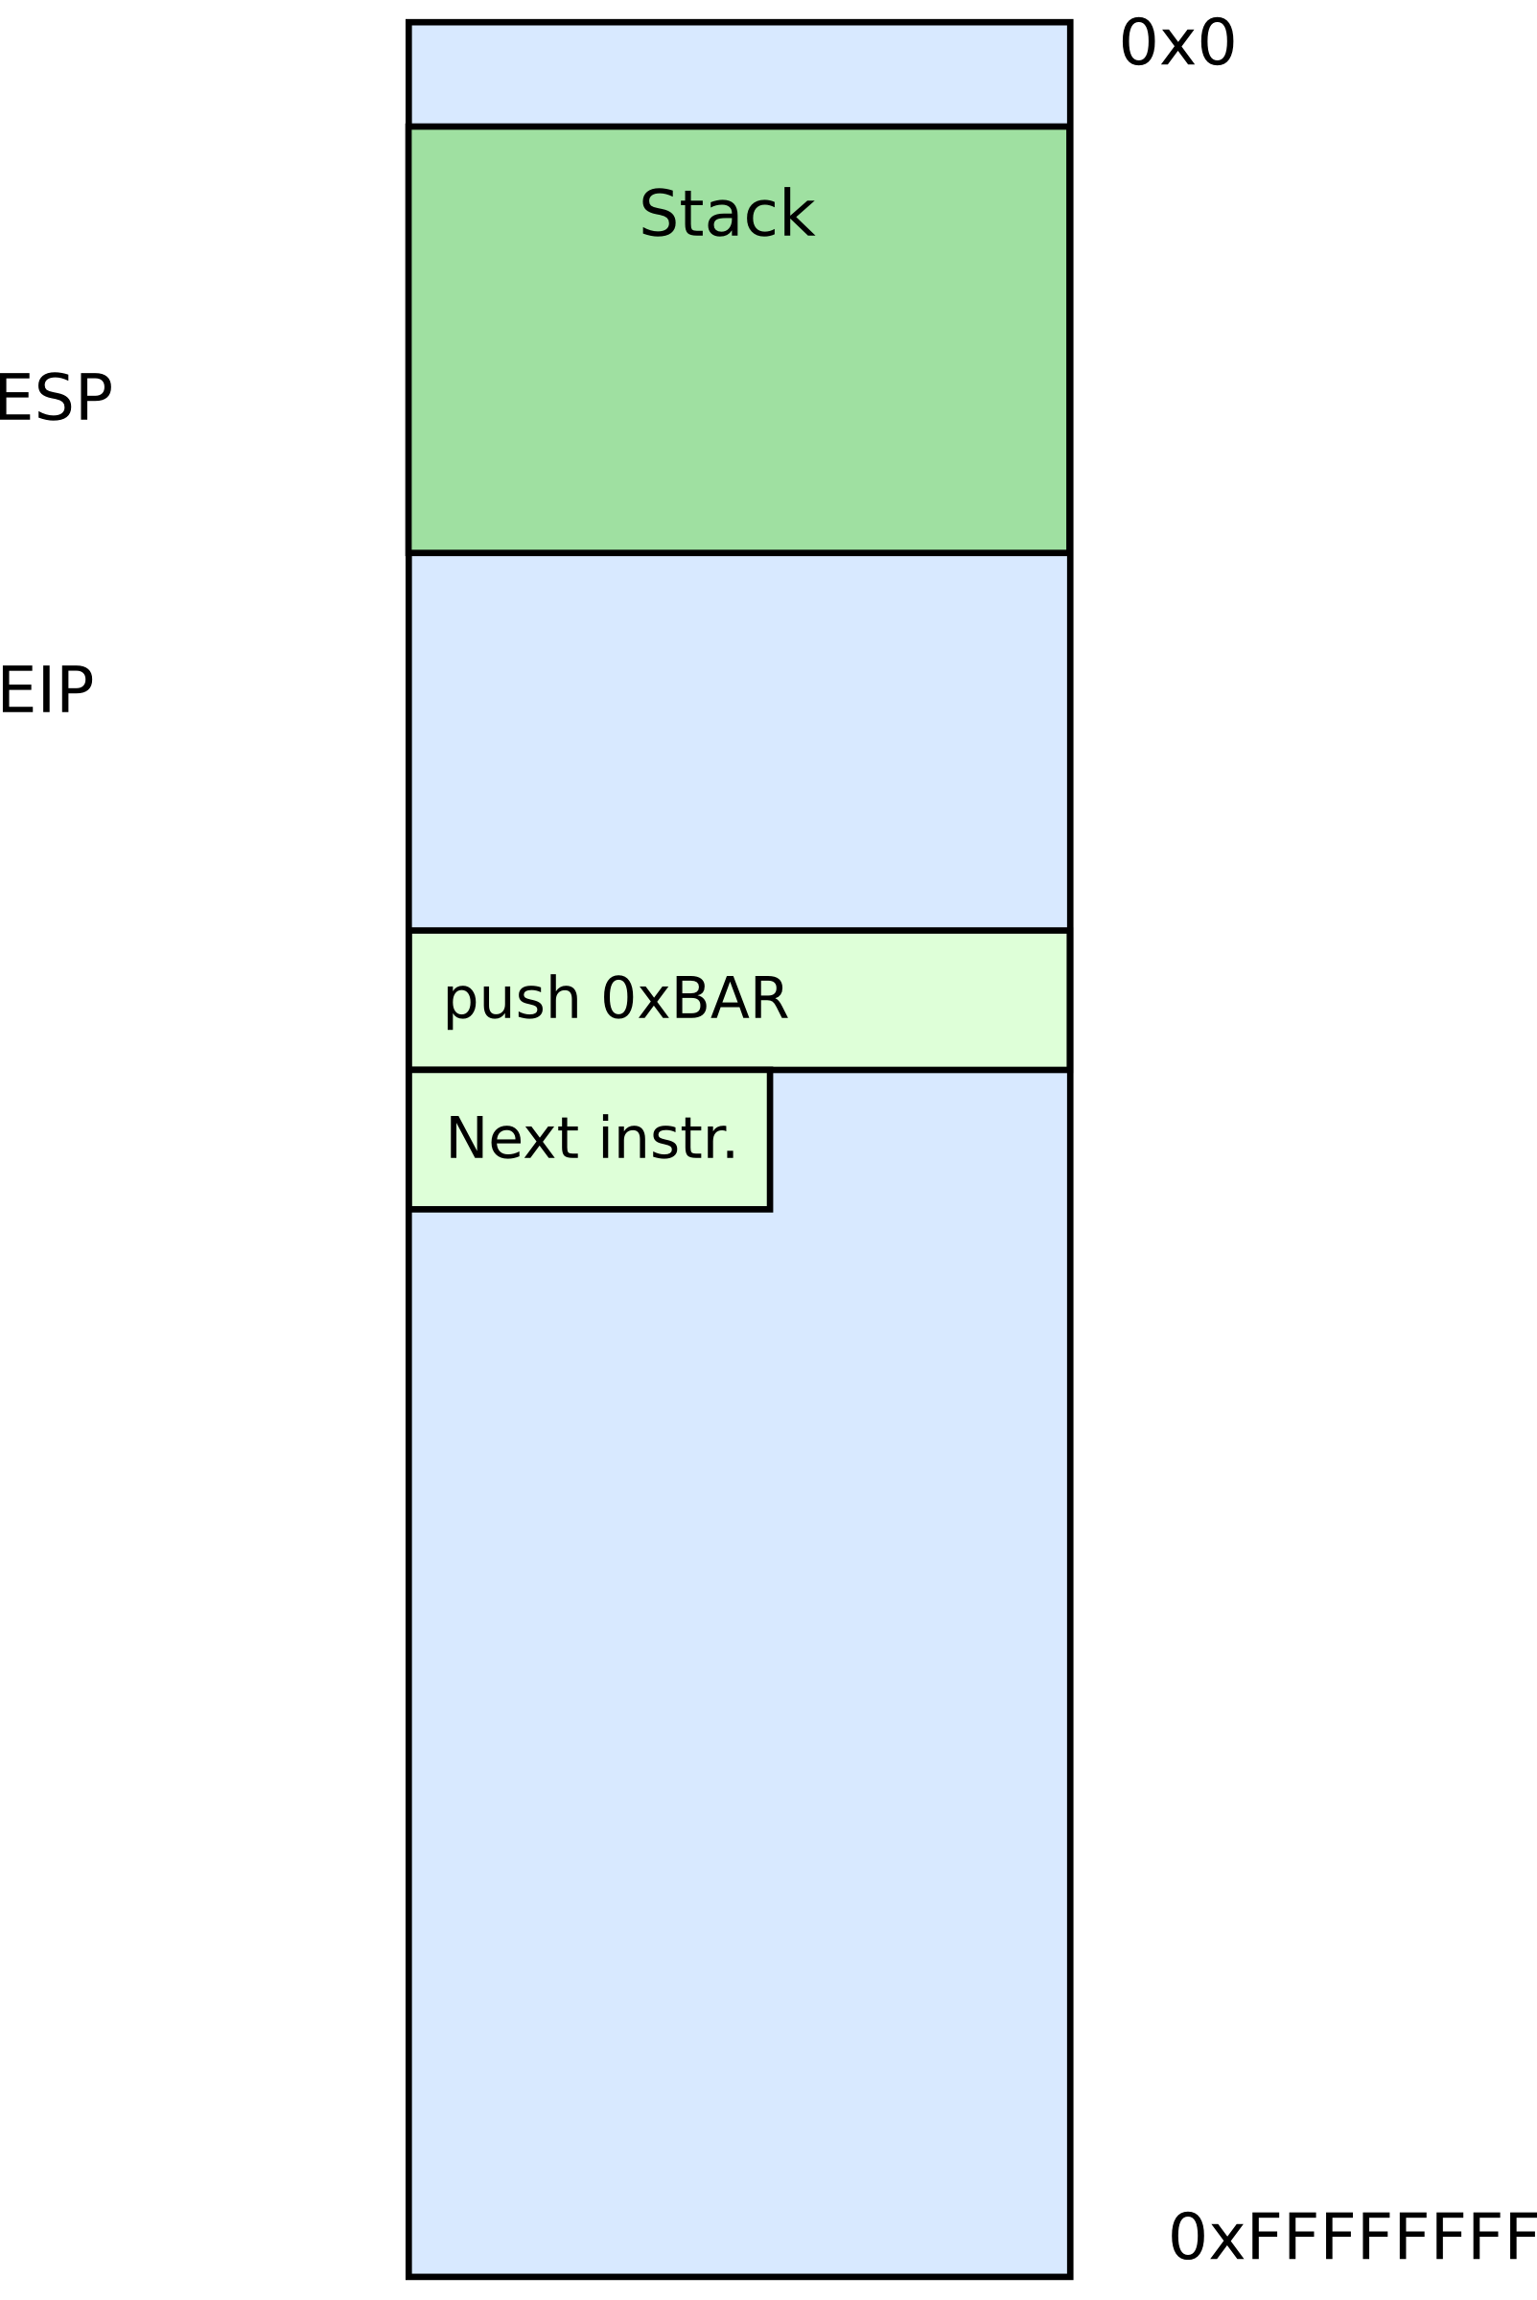

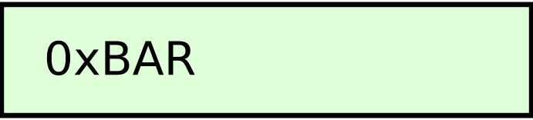
Manipulating stack
ESP register
Contains the memory address of the topmost element in the stack
PUSH instruction
push 0xBAR
Subtract 4 from ESP
Insert data on the stack

Slide 62
Manipulating stack
POP instruction
pop EAX
Removes data from the stack
Saves in register or memory
Adds 4 to ESP

Slide 63
Thank you!

Slide 64
Some examples

