Slide 1
cs5460/6460: Operating Systems Final recap, sample questions
Anton Burtsev
April, 2025

Slide 2
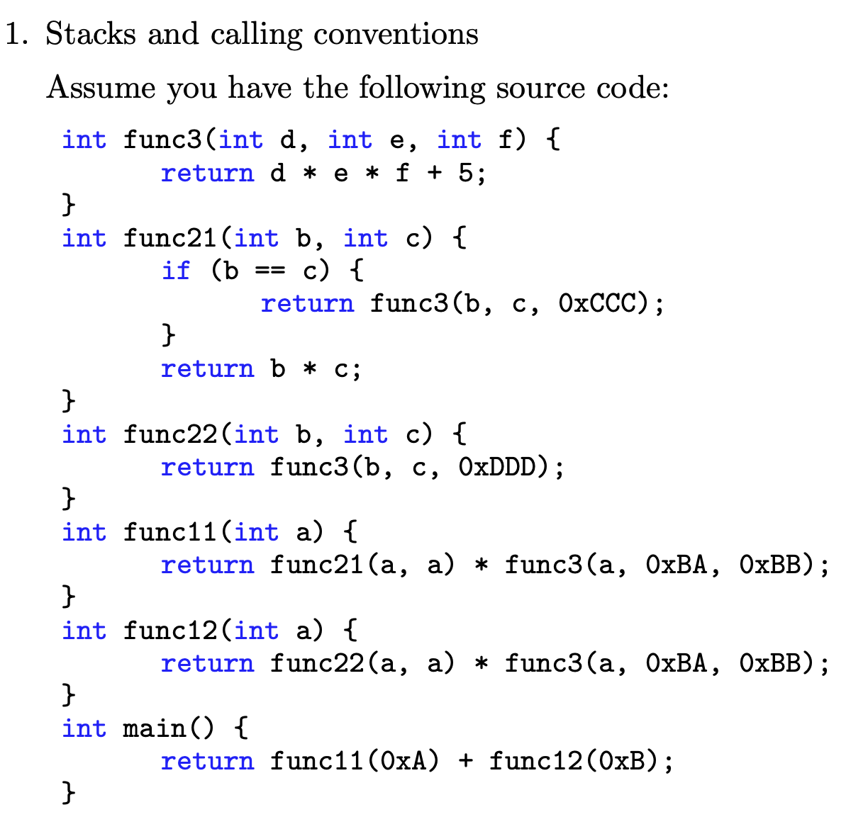
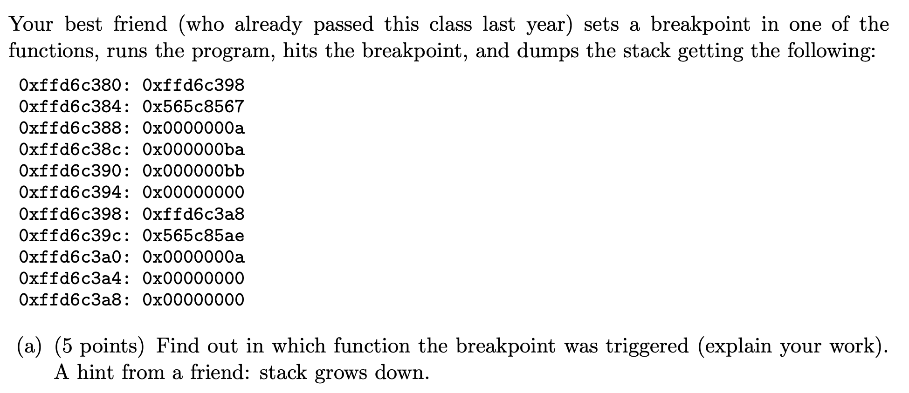
PollEv.com​/antonburtsev

Slide 4
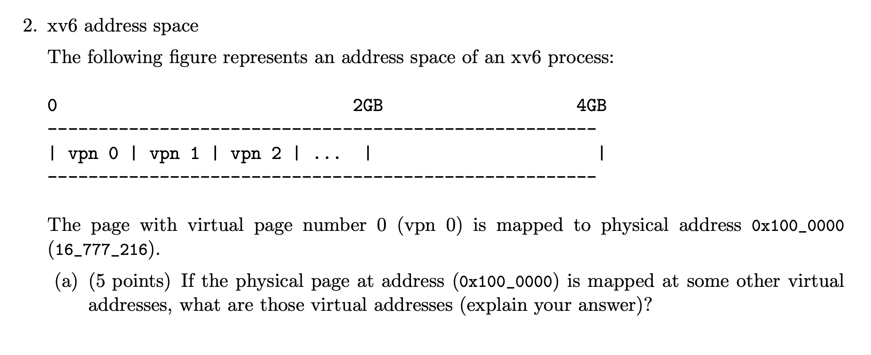
PollEv.com​/antonburtsev

Slide 5


Slide 6
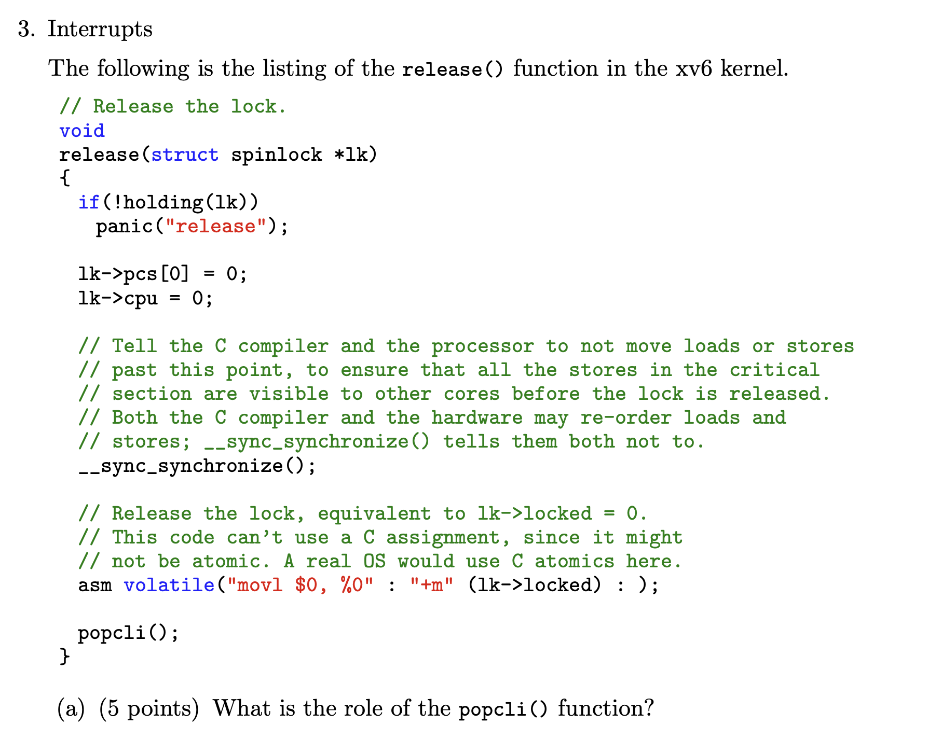

Slide 8


Slide 9



Slide 10


Slide 11
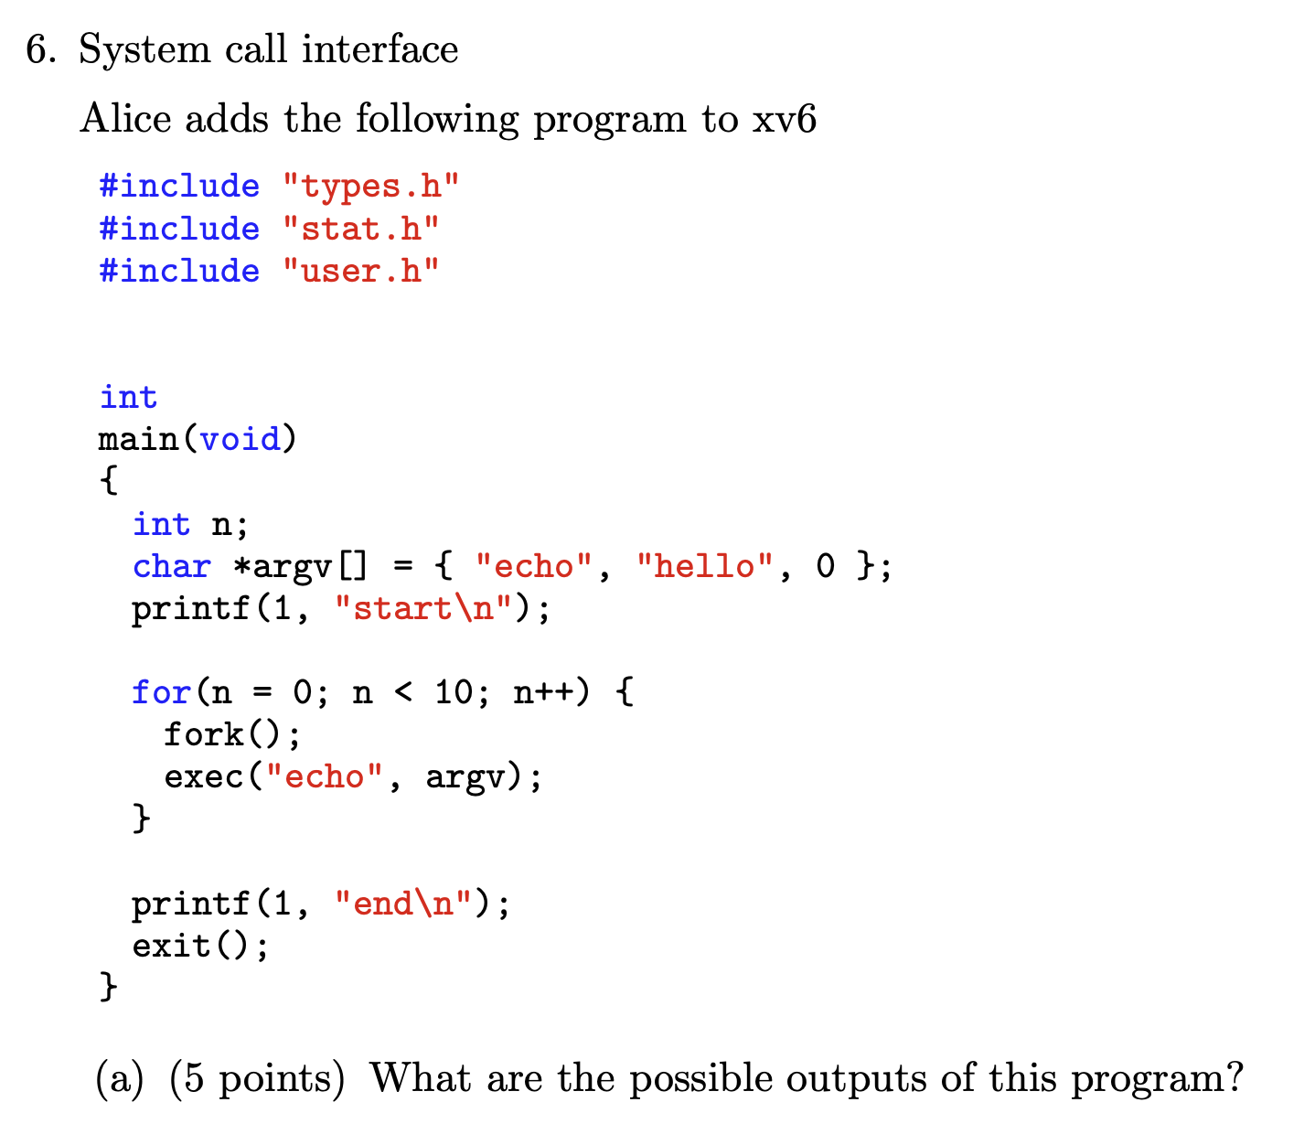

Slide 12
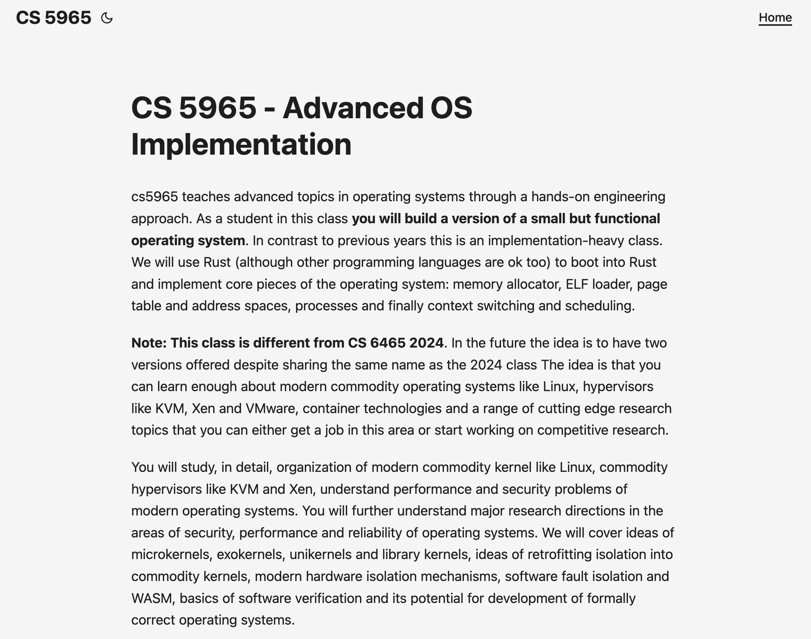

Slide 13


Slide 14
Thank you!

