Slide 1
cs5460/6460 Operating Systems
Lecture 00 – Logistics
Anton Burtsev

Slide 2
Welcome to cs5460/6460
Mixed undergrad/grad class
    107 students
  Instructor: Anton Burtsev
    https://mars-research.github.io/aburtsev/
  Class web page:
    https://mars-research.github.io/cs5460/

Slide 3
Short intro
I build operating systems
Clean slate
  Atmosphere: formally verified microkernel in Rust
    https://mars-research.github.io/projects/atmo/
  RedLeaf: language safety of Rust for isolation
    https://mars-research.github.io/projects/redleaf/
Extensions to Linux
  LXDs/LVDs/Ksplit: isolation of device drivers in the Linux kernel
  https://mars-research.github.io/projects/ksplit/
Extensions to Xen
  XenTT: detersministic replay of virtual machines

Slide 4
This course
Inspired by
  MIT 6.828: Operating System Engineering
  https://pdos.csail.mit.edu/6.828/2018/
Adapted for undergraduate students
We will use xv6
  Relatively simple OS kernel (only 9K lines of code)
  Reasonably complete UNIX kernel
  Started at MIT https://pdos.csail.mit.edu/6.1810/2025/xv6.html

Slide 5
This course
MIT moved to the RISC-V-based class
We will use x86-64 bit version
xv6 comes with a book
  https://xv6-64.gitlab.io/xv6-64-book/xv6-64-book.pdf
Another book we’re going to use:
  “Operating Systems: Three Easy Pieces” (OSTEP) Remzi H. Arpaci-Dusseau and Andrea C. Arpaci-Dusseau
  Free online version http://pages.cs.wisc.edu/~remzi/OSTEP/

Slide 6
Course organization
Live lectures
  High level concepts and abstractions
  Recorded
Reading
  Xv6 book + source code
  Bits of OSTEP book
  Other materials
Homeworks
  Coding real parts of the xv6 kernel
Weekly quizzes
  Help to keep on track

Slide 7
Grading
Your grade
  Homework: 30%
  In-class activities: 10%
  Weekly quizzes 15%
  Midterm exam: 20%
  Final exam: 25%
You can submit late homework 3 days after the deadline for 60% of your grade

Slide 8
More details
5-6 homework assignments
  Build a shell
  Build an ELF loader
  Setup QEMU debugging environment and boot into “hello world”
  Implement new system calls in xv6
  Implement changes to the xv6 file system, maybe threading
A weekly quiz
  Assigned on Friday, due Monday
In class PollEV

Slide 9
Exams
Exams are on paper
  Open book (you can print anything you like)
  Closed computers

Slide 10
Plagiarism
All work should be your own
  You can discuss approaches to any assignments
  Ask questions on Piazza

Slide 11
AI Use
This year we plan on using Codex + VS code
  Students are using AI anyway…
  We are trying to find a creative way of letting you to use it

Slide 12
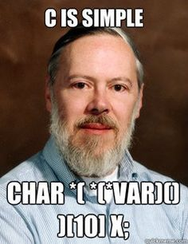
Prerequisites
Solid C coding skills
  Xv6 is written in C
  You need to read, code, and debug
  AI can help explaining the code but still
All homeworks are in C
  Many questions will require explaining xv6 code
Be able to work and code in Linux/UNIX
Some assembly skills

Slide 13
How to succeed?
Read the source
  This is the ultimate skill of any systems researcher

Slide 14
How to succeed (continued)?
Don’t get scared
  The class is hard
  The goal is to teach you how real OS works, and it’s non-trivial
Homework assignments and exams are challenging
  AI helps for homeworks but don’t overdo it
  Exams will require in-depth understanding of all homework assignments

Slide 15
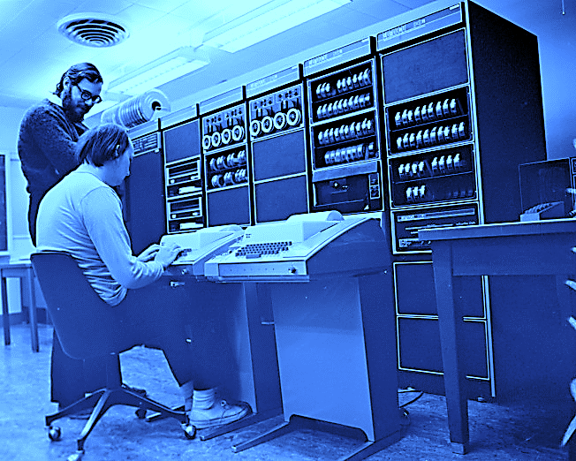
Thank you!
Hey, you can’t use AI on the exam
I don’t even have a screen

