Slide 1
cs5460/6460: Operating Systems Final recap, sample questions
Anton Burtsev
April, 2025

Slide 2
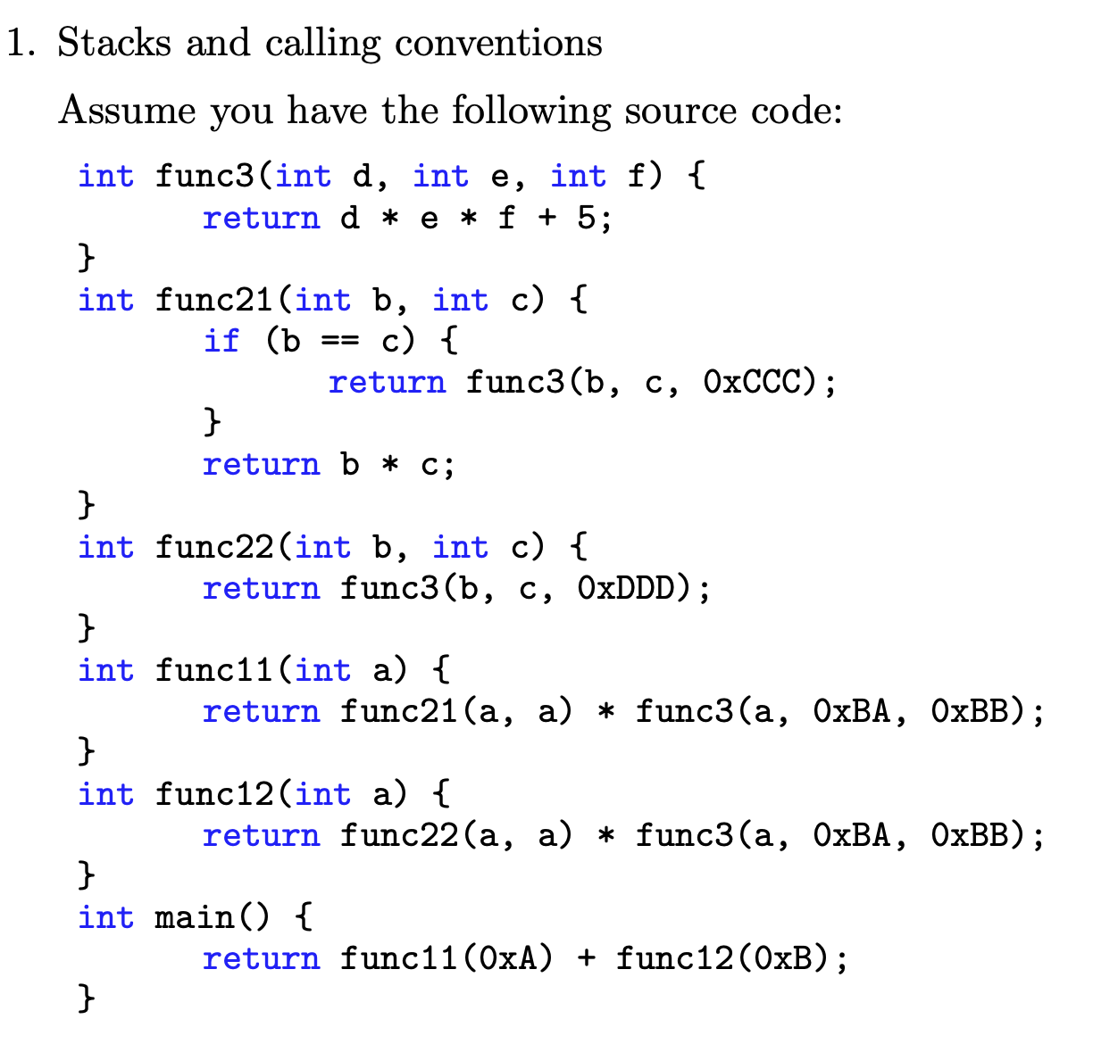
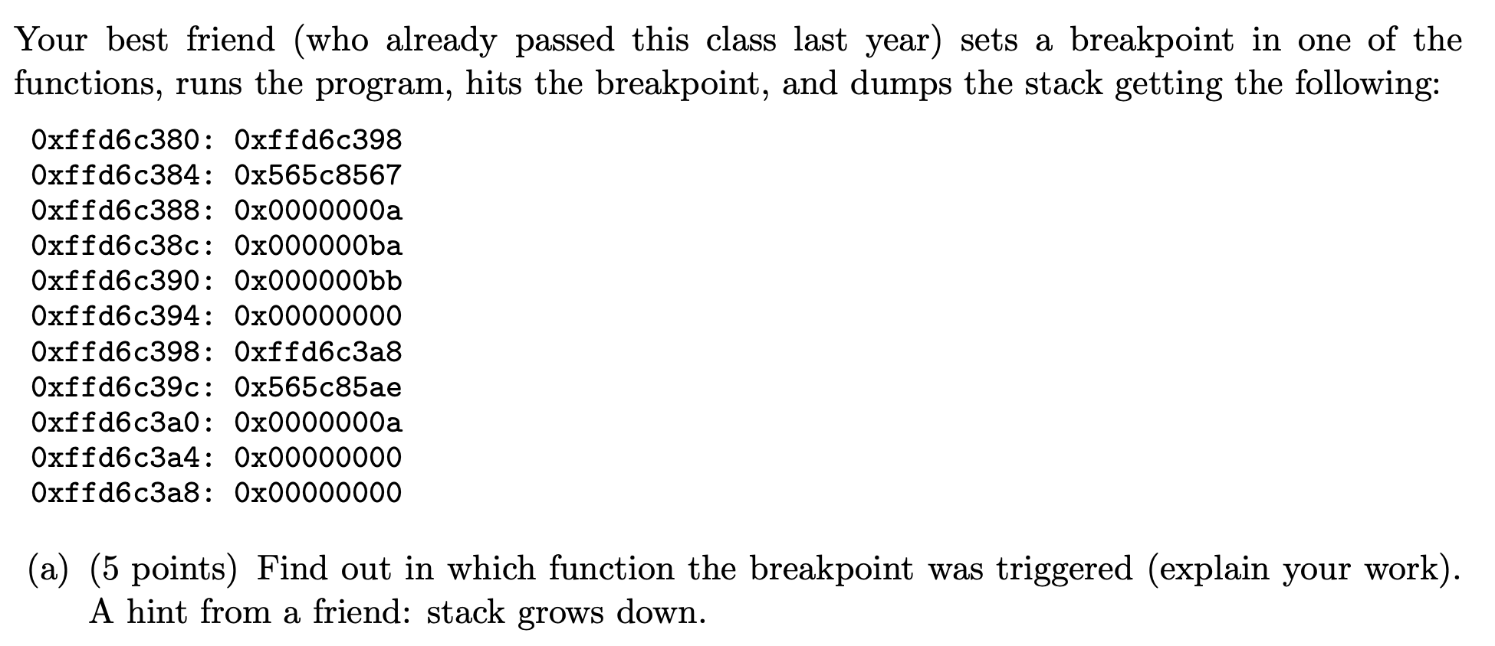
PollEv.com​/antonburtsev

Slide 3
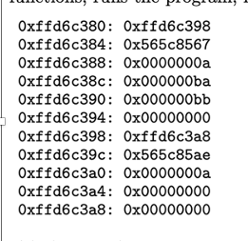
PollEv.com​/antonburtsev

Slide 5
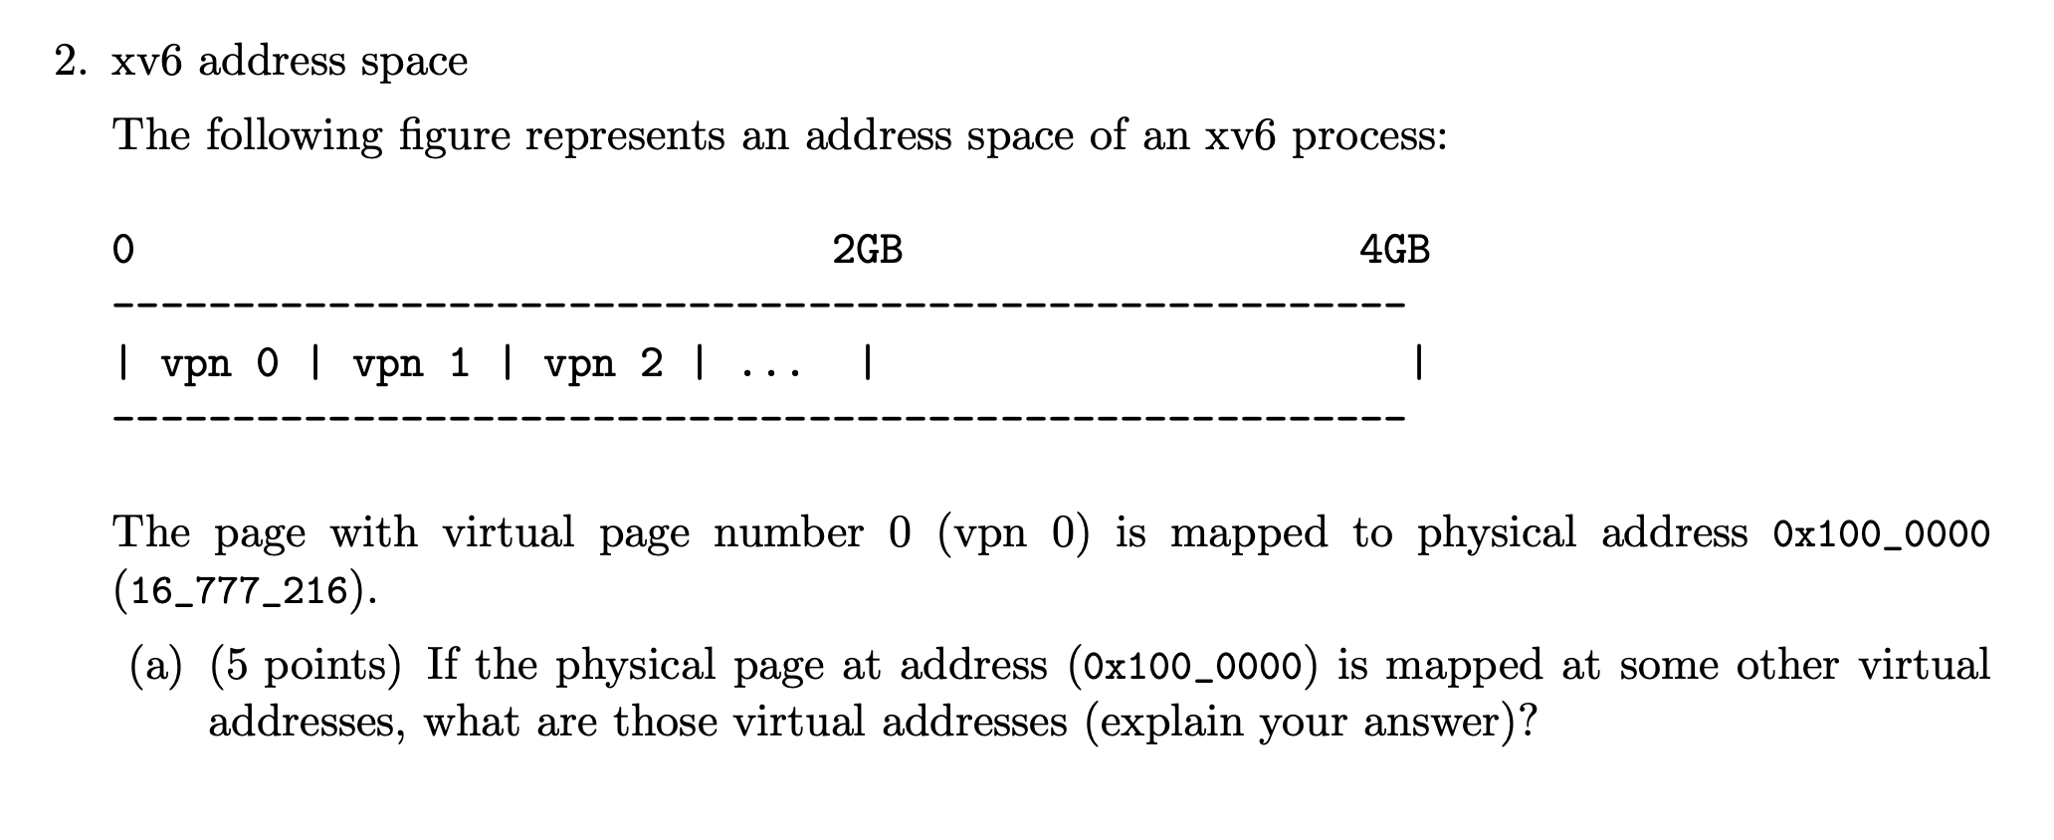
PollEv.com​/antonburtsev

Slide 6


Slide 7
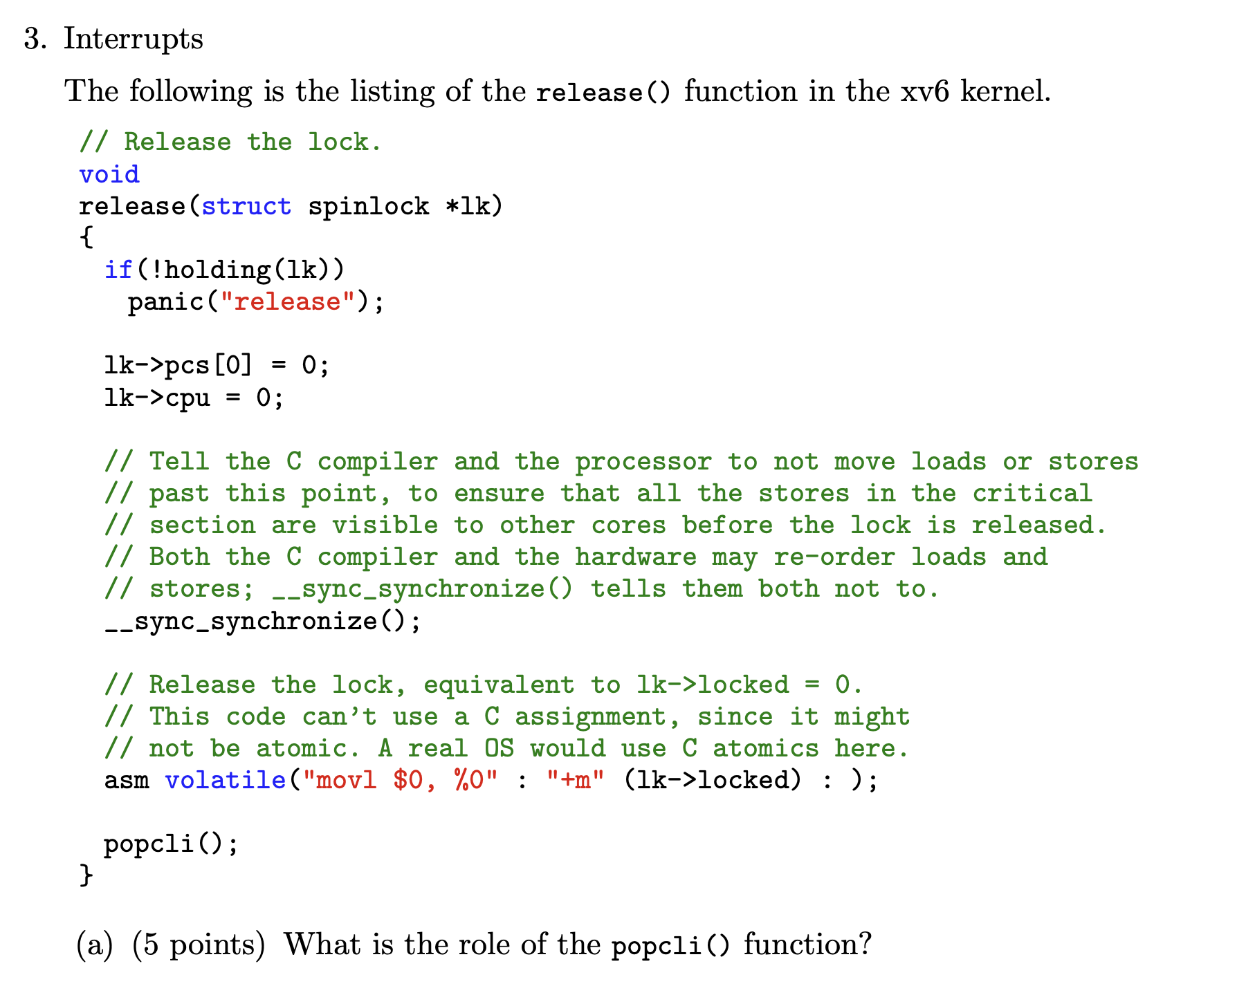

Slide 9


Slide 10



Slide 11


Slide 12
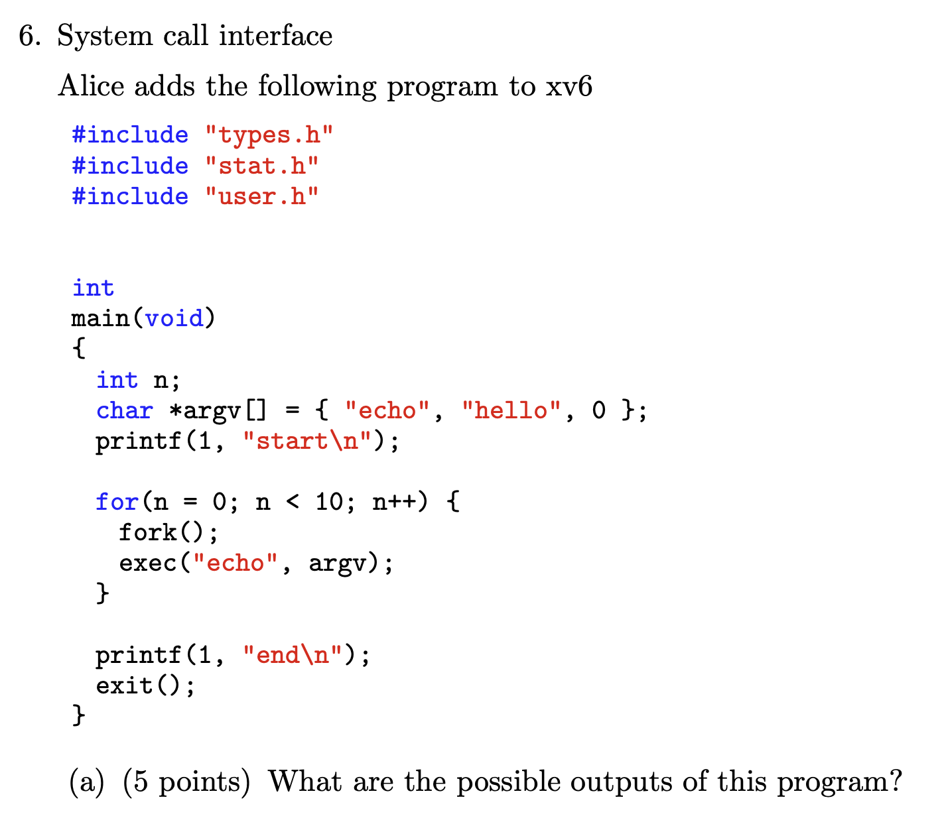

Slide 13
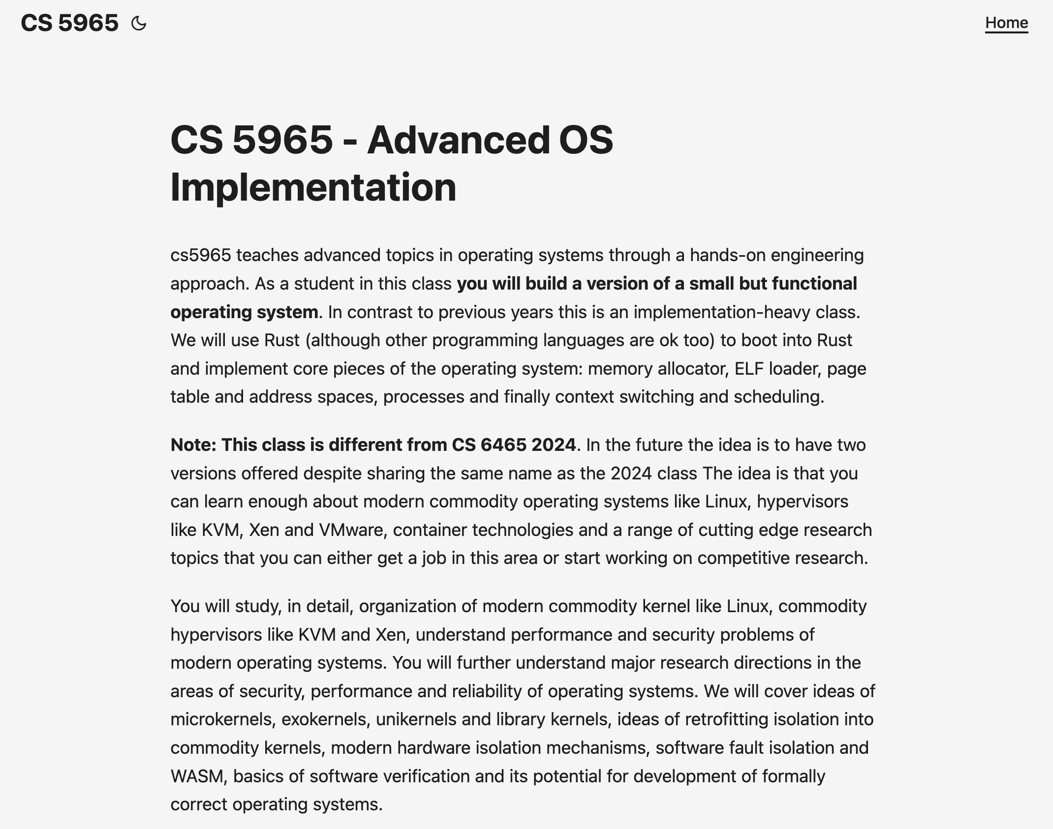

Slide 14


Slide 15
Thank you!

