Slide 1

Atmosphere:
Practical Verified Kernels with Rust and Verus
Xiangdong Chen, Zhaofeng Li, Jerry Zhang,
Vikram Narayanan, Anton Burtsev,
University of Utah
Notes:
Overall flow of the talk:
Quick intro to verification (we are the first in the track)
Why is our work important? SMT is good at lowering verification cost, but we need to somehow make it work with a kernel
Our goals

Slide 2
ITPs used to be the only way…
☹️
In the post, the only way to build complex verified systems was to use ITPs (interactive theorems provers).
Programmers break down the proof into smaller, manageable pieces for the provers
High manual effort
SMT(satisfiability modulo theories) solvers offer better automation
Verifier translates the proof of the program into SMT queries which are checked by the SMT solver
Automatic but require hints for complex proofs
For building a complex system, guiding the SMT solvers through complex proofs requires as much (and often times more) effort than building it in ITPs.

Slide 3
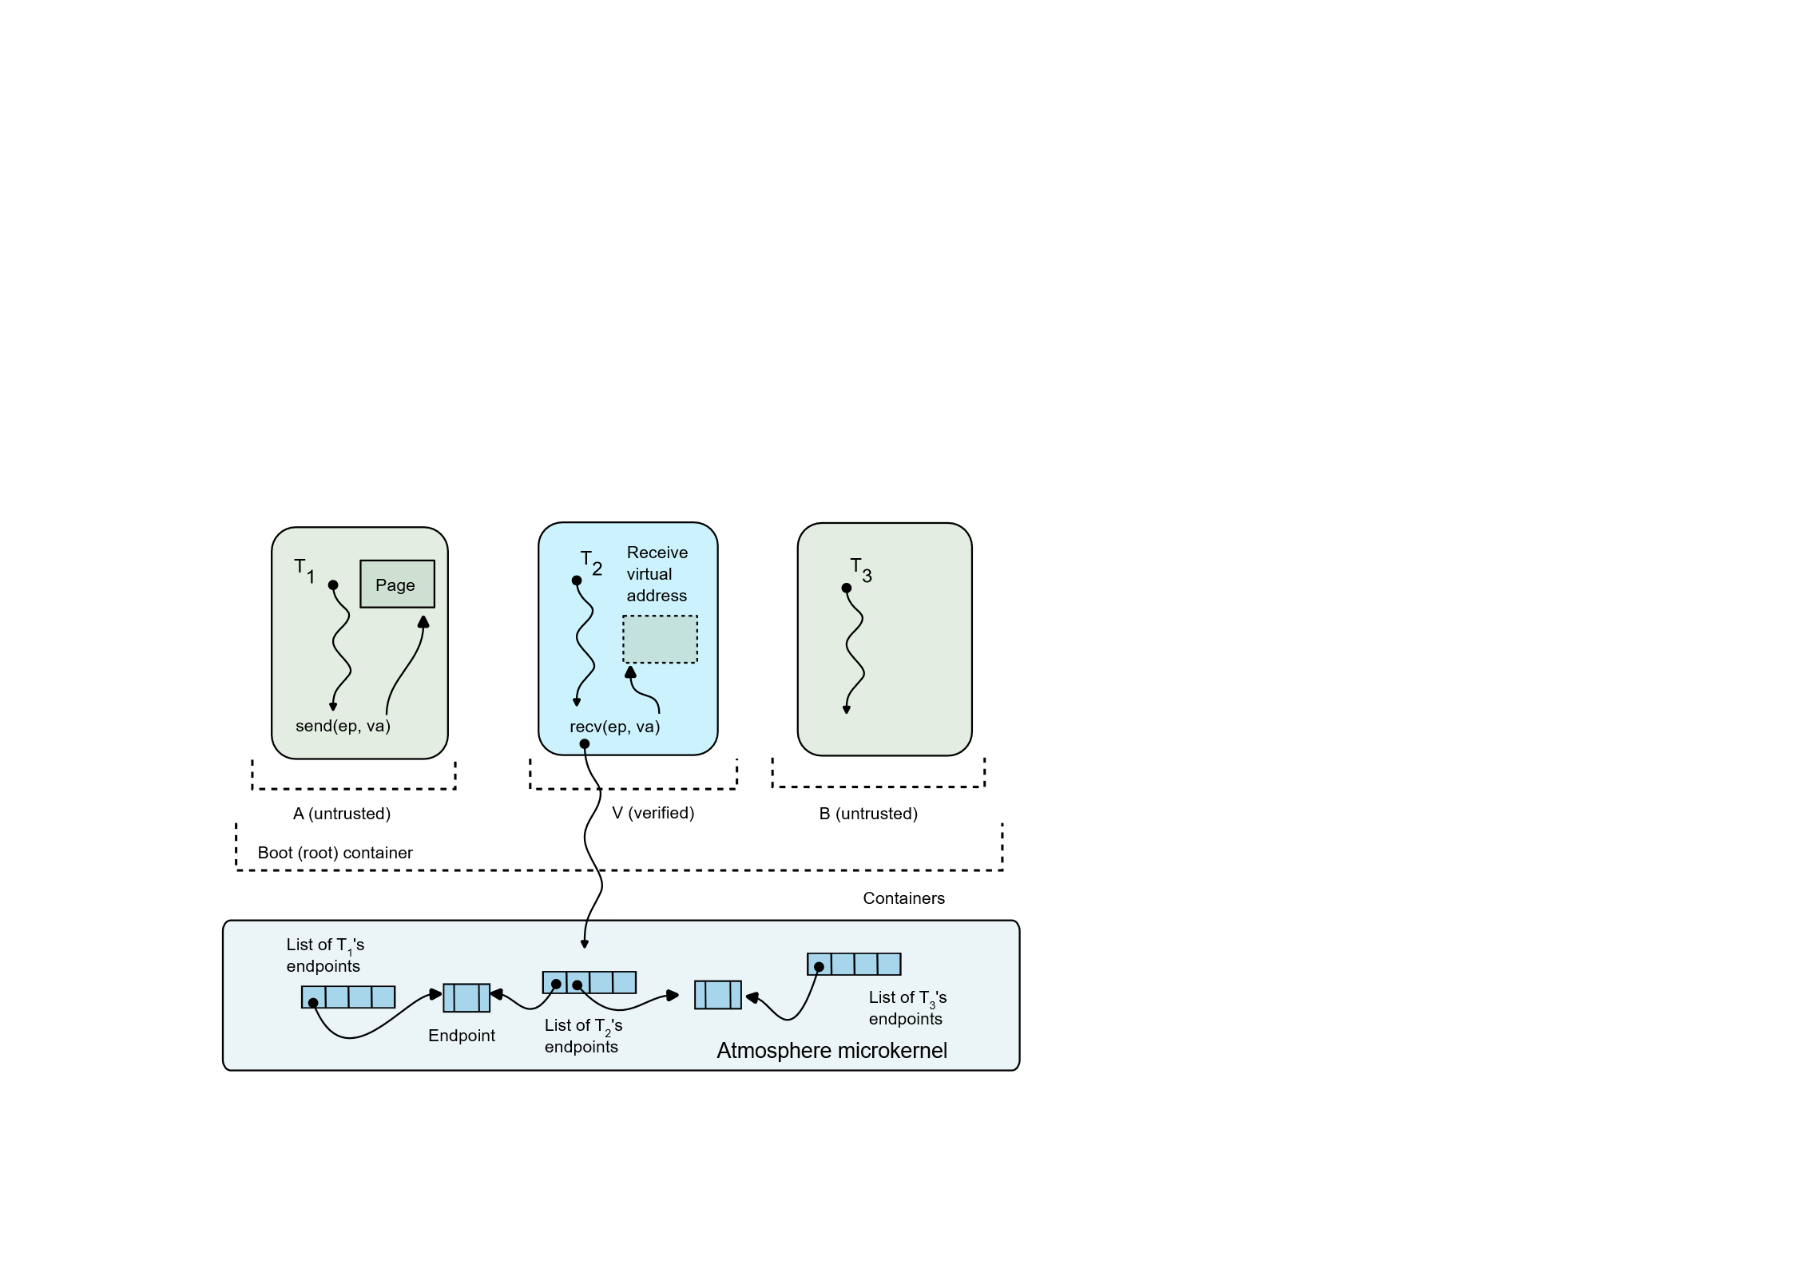
Not anymore.
Atmosphere:
Built with Rust and Verus
7k lines of exec code
23k lines of proof + spec
Support all the complexity of classical microkernels
Complex data structures: Page tables, Process tress, etc.
Safety, correctness, and memory leak freedom
Fast verification time ~20 seconds

Slide 4
Mini intro: Verus
A new SMT based verification framework for Rust
Verus offloads reasoning about heap and aliasing to the Rust linear ownership system
No need to reason about it with SMT
Verification is orders of magnitude faster
Support for reasoning about raw pointers
Linear ghost permissions: PointsTo<V>
Ownership and states of objects behind the raw pointers
Follow Rust linear lifetime rules
Only exist at verification stage to help verifying the raw pointers
Are erased during compile stage – no runtime overhead

Slide 5
Mini intro: Linear ghost permission
Ownership and states of objects behind the raw pointers
The raw pointer can be freely moved around or copied
To use the linear permission, a matching raw pointer has to be provided
Follow Rust linear lifetime rules
Only exist at verification stage to help verifying the raw pointers
let (ptr, Tracked(perm): Tracked<PointsTo<V>>)
= PPtr::new(V::new(...));
// accessing the state
proof{ assert(perm@ == ... ) }
let ptr_copy = ptr.clone();
proof{assert(ptr.addr() == perm.addr());}
forget(Tracked(perm));
let ref = ptr.borrow(perm);

Slide 6
There are still some challenges

Slide 7
Challenge #1: Non-linear lifetimes
The kernel requires non-linear lifetimes
Doubly-linked list
Reference-counted objects
Pages mapped by different address spaces
Endpoint shared by multiple processes
And almost everything else …
Rust is too restrictive
3

Slide 8
Design choice #1: Pointer-centric design
pub struct Container {
pub parent: Option<CtnrPtr>,
pub children: List<CtnrPtr>,
pub depth: usize,
pub root_process: Option<ProcPtr>,
pub owned_procs: List<ProcPtr>,
pub owned_endpoints: Ghost<Set<EdptPtr>>,
pub owned_threads: Ghost<Set<ThrdPtr>>,
...
}
Everything is a raw pointer, like in C
Therefore, bypassing Rust linear ownership rules
We establish memory safety through the proofs
Freedom for object lifetimes

Slide 9
Challenge #2: Verification complexity
How to manage so many linear permissions and invariants.
SMT is not good for recursive reasoning
SMT solvers unroll a recursive proof a finite number of times
E.g., the process tree in Linux is an unbounded data structure
Verus supports inductive proof functions
But verification complexity is high
Every recursive property requires a separate proof function

Slide 10
Design choice #2: Flat permission storage
Permissions are stored at the topmost level of the subsystem
A single map of each type of the object
Key: raw pointer.
Value: linear permission
pub struct ProcessManager {
pub root_container: CtnrPtr,
pub cntr_perms:
Tracked<Map<CtnrPtr, PointsTo<Container>>>,
pub proc_perms:
Tracked<Map<ProcPtr, PointsTo<Process>>>,
pub thrd_perms:
Tracked<Map<ThrdPtr, PointsTo<Thread>>>,
pub edpt_perms:
Tracked<Map<EdptPtr, PointsTo<Endpoint>>>,
...}

Slide 11
Why not nested ownership model
Root
Spec: All containers are well-formed
The containers form a tree – similar to the process tree in Linux
👀
pub struct ProcessManager {
pub root_container: CtnrPtr,
pub root_container_perm: Tracked<PointsTo<Container>>
...}
Unrolling the recursive spec infinite number of times
pub struct Container {
pub children: List<CtnrPtr>,
pub children_perms: Tracked<Map<CtnrPtr, PointsTo<Container>>>,
...}
pub spec childern_wf_recur(c: &Container) -> bool {
c.value().wf() &&
forall|child:Container|
c.childern@.contains(child)
==>
childern_wf_recur(child)}

Slide 12
With flat storage model
Root
👀
Spec: All containers are well-formed
Direct access to object states without navigating the hierarchy of objects
Freedom for invariants encoding and optimization
Invariants isolation
Hide parts of the invariants for complex proofs
Better verification performance
Aggressive triggers
Better automation
Most proofs requires no hints
pub spec containers_wf_flat(pm: &ProcessManager) -> bool {
forall|container:Container|
pm.containers@.contains(container)
==>
pm.containers@[container].value().wf()
}
No spec function unrolling!

Slide 13
Challenge #3: Memory management
Rust allocator and the state of the memory are implicit
Global properties require explicit knowledge of all memory in the system
fn main() {
{
// allocating memory
let heap_box = Box::new([1, 2, 3]);
}
// freed memory
}
We don’t know much memory we are using.
We don’t know how much memory we still have in the system.

Slide 14
Challenge #3: Memory management
Rust allocator and the state of the memory are implicit
Global properties require explicit knowledge of all memory in the system
Memory leaks still possible in Rust
Dropping linear permissions and forgetting Rust object in general are considered as safe Rust
Reference cycles

Slide 15
Design choice #3: Manual memory management
Abandon Rust allocator
Explicit memory allocator as a subsystem of the kernel
Allocate and deallocate kernel objects manually
Establish memory safety and leak freedom through the state of the allocator and the state of the kernel
Use invariants to ensure
Memory safety of kernel objects and user-mapped pages
Correctness of reference counters
Leak freedom
Express any desirable memory properties

Slide 16
Takeaways
Verus (SMT + Rust) is great for verifying system code
Three key ideas
Pointer-centric design
Non-linear lifetimes for kernel objects
Flat permission model
Freedom in organizing and optimizing invariants
Better verification performance
Manually manage memory
More info about system memory
Express any memory-related properties
Hope our findings are beneficial for future verified systems❤️

Slide 17
Thank you! Questions?

