Slide 1
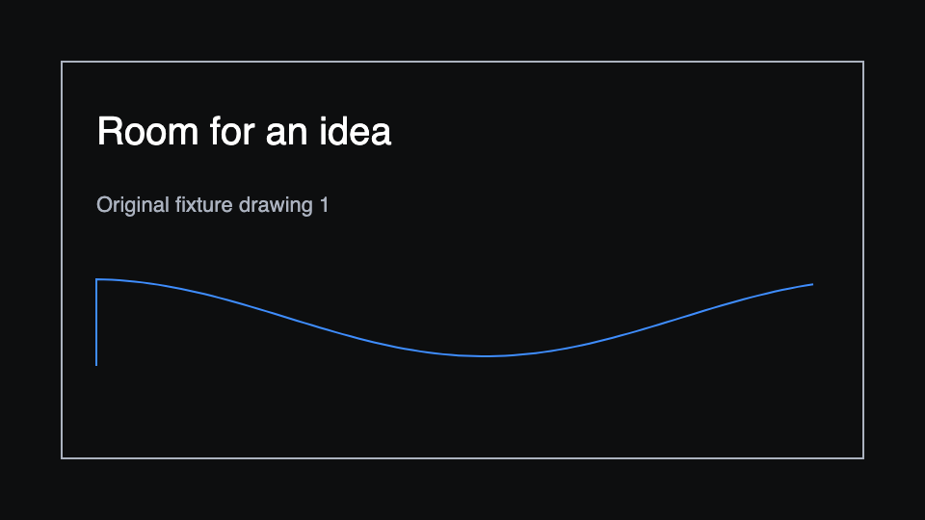
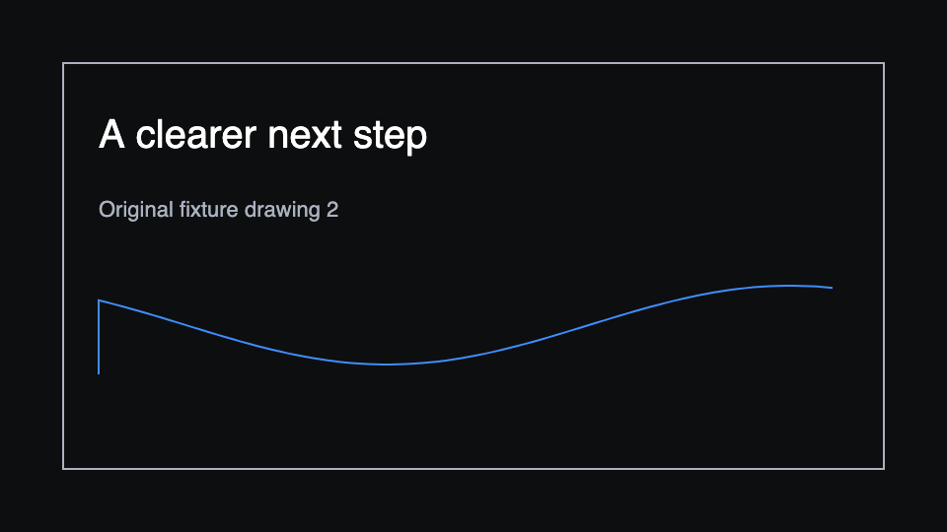
First import slide
First slide body stays editable.

Slide 2
Second import slide
Second slide body stays editable.

