Slide 1

Indian institute of information technology, Lucknow
Fake News Detection System
Submitted to, Submitted by,
Dr. Deepak Kumar varun pratap singh
MCS20013

Slide 2
Time Line
Literature Review (week-1)
Data gathering (week-2)
Data pre-processing (week-3)
Training with Naive bayes Classifier (week-4)

Slide 3
Traing with Random Forest (week-5)
Traing with Logistic Regression (week-6)
Traing with Passive Aggressive classifier (week-7)
Web deployment (week 8-9-10)

Slide 4
System Architecture
Static Search
The architecture of Static part of fake news detection system is quite simple and is done keeping in mind the basic machine learning process flow.
Dynamic Search
The second search field of the site asks for specific keywords to be searched on the net upon which it provides a suitable output for thepercentage probability of that term actually being present in an article or a similar article with those keyword references in it.
URL Search
The third search field of the site accepts a specific website domain name upon which the implementation looks for the site in our true sites database or the blacklisted sites database. The true sites database holds the domain names which regularly provide proper and authentic news and vice versa. If the site isn’t found in either of the databases then the implementation doesn’t classify the domain it simply states that the news aggregator does not exist.

Slide 5
Implementation
LIAR: This dataset is collected from fact-checking website PolitiFact through its API . It includes 12,836 human labelled short statements, which are sampled from various contexts, such as news releases, TV or radio interviews, campaign speeches, etc. The labels for news truthfulness are fine-grained multiple classes: pants-fire, false, barely-true, half-true, mostly true, and true.The data source used for this project is LIAR dataset which contains 3 files with .csv format for test, train and validation.

Slide 6
Algorithms Going to be used
Naive Bayes classifier
Random Forest
Logistic Regression
Multinomial naive bayes classifier
Passive Agressive classifier

Slide 7
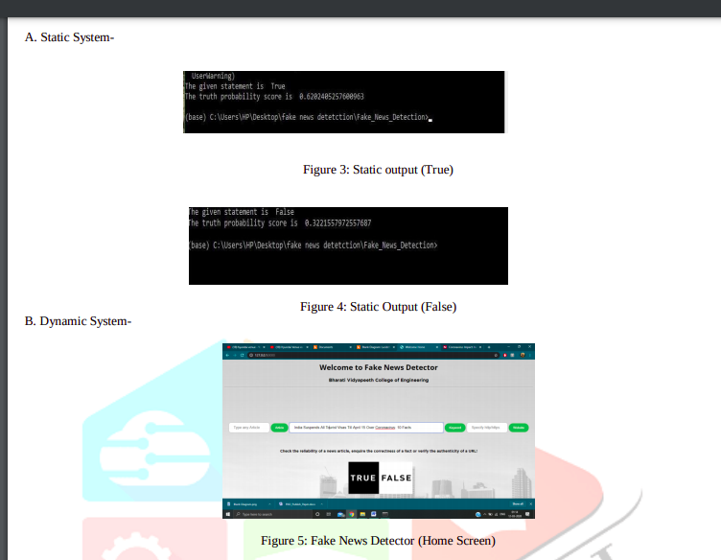
How final product looks like

Slide 8
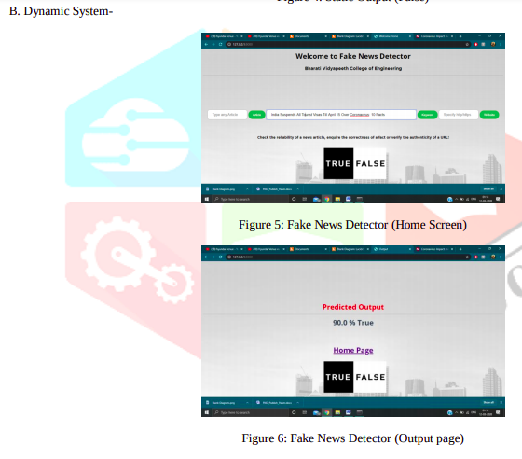

Slide 9
References taken
Paper:
https://www.researchgate.net/publication/343916946_Fake_News_Detection_Using_Machine_Learning_Algorithms

Slide 10
Thanks for Your precious Time

