Slide 1
COMPUTER VISION TEAM PROJECT
PC-FLOW / 01
TOPIC #14
FRAME / MASK / TRACK / DECIDE
People Counting &
Flow Direction
ID 02
ID 01
ID 04
OpenCV pipeline for overhead camera people-flow analysis
ID 03
ID 05
ID 07
ID 06
ID 08
MOG2 + OTSU / CENTROID TRACKER

Slide 2
TEAM
PC-FLOW / 02
Roles and contribution
Member
Role
Contribution
Maksim Ahafonau
Lead CV Engineer
architecture, Detect, run.py
Aron Shapialevich
Image Processing
Enhance, Segment
Aleksei Karpukovich
Morphology & Report
Clean, Visualization, report
Nick Sinazhenski
Decision & Tracking
Tracker, Decide, direction rose
Ulada Malets
Data & Testing
dataset, QA, failure cases

Slide 3
PROBLEM
PC-FLOW / 03
Motivation
Why
Task
- visitor counting
- people flow analysis (malls, squares, transport)
- input: overhead video, static camera
- output: total_people + dominant_direction
- constraint: classic OpenCV only

Slide 4
ARCHITECTURE
PC-FLOW / 04
Architecture piepliene
Enhance
Segment
Clean
Detect
Decide
→
→
→
→
contrast + noise
foreground mask
morphology
bbox + split
count + direction

Slide 5
METHODS
PC-FLOW / 05
Enhance
Input frame
Enhanced frame
raw overhead camera image
low contrast / floor noise / shadows
- CLAHE on LAB L-channel
- bilateral filter preserves edges
- gamma correction boosts contrast
→

Slide 6
METHODS
PC-FLOW / 06
Segment
MOG2
Otsu
background subtraction:
extracts foreground,
objects that differ from the background
threshold on background difference:
helps recover people
that MOG2 can miss

Slide 7
METHODS
PC-FLOW / 07
Clean
- MORPH_OPEN removes salt-and-pepper noise
- MORPH_CLOSE reconnects broken silhouettes
- connectedComponentsWithStats filters components
- geometry features: area, height, circularity, aspect, solidity
80-550
noisy components before clean
5-11
stable silhouettes after clean

Slide 8
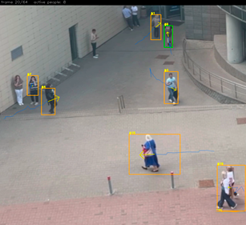
METHODS
PC-FLOW / 08
Visualization
Overlay
- bbox around each person
- track ID
- trajectory tail
- direction arrow

Slide 9
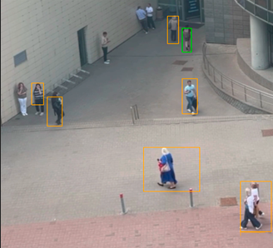
METHODS
PC-FLOW / 09
Detect + Tracking
Components
mask blobs become bbox
Watershed
merged groups are split
CentroidTracker
IDs follow centroids and speed
hits
phantom tracks are filtered out

Slide 10
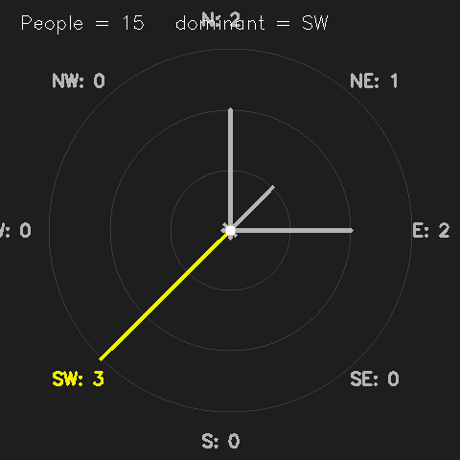
DECISION LOGIC
PC-FLOW / 10
How the final answer is made
Count
Direction
A person is counted if the track matches detection at least 10 times.
The vector goes from the first to the last track point, angle via atan2.
hits >= 10
8 sectors
15 people / dominant SW
People Counting & Flow Direction / 10

Slide 11
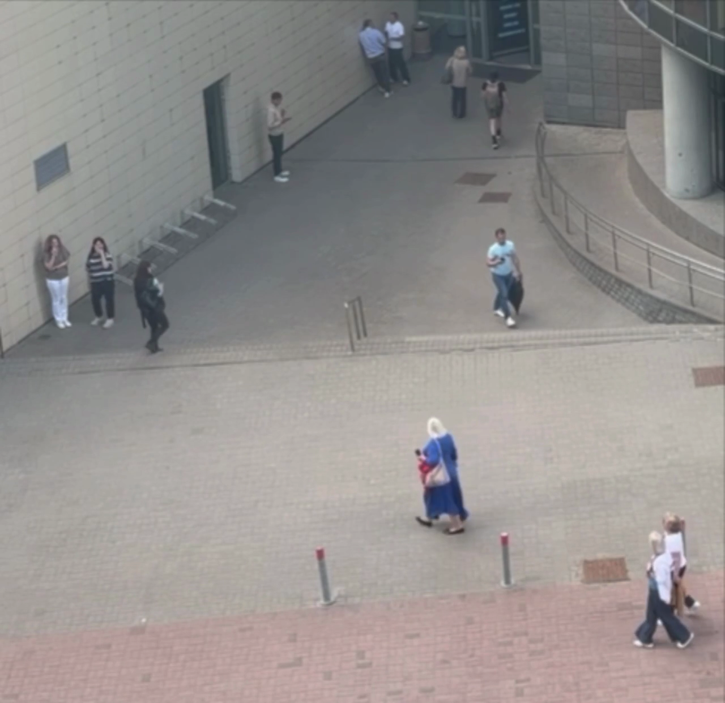
TESTING
PC-FLOW / 11
Dataset
Own dataset
- own video: video_my.MP4
- sampled every 4th frame
- 65 frames, resized to 1280 px
- 6 PNG outputs per frame

Slide 12
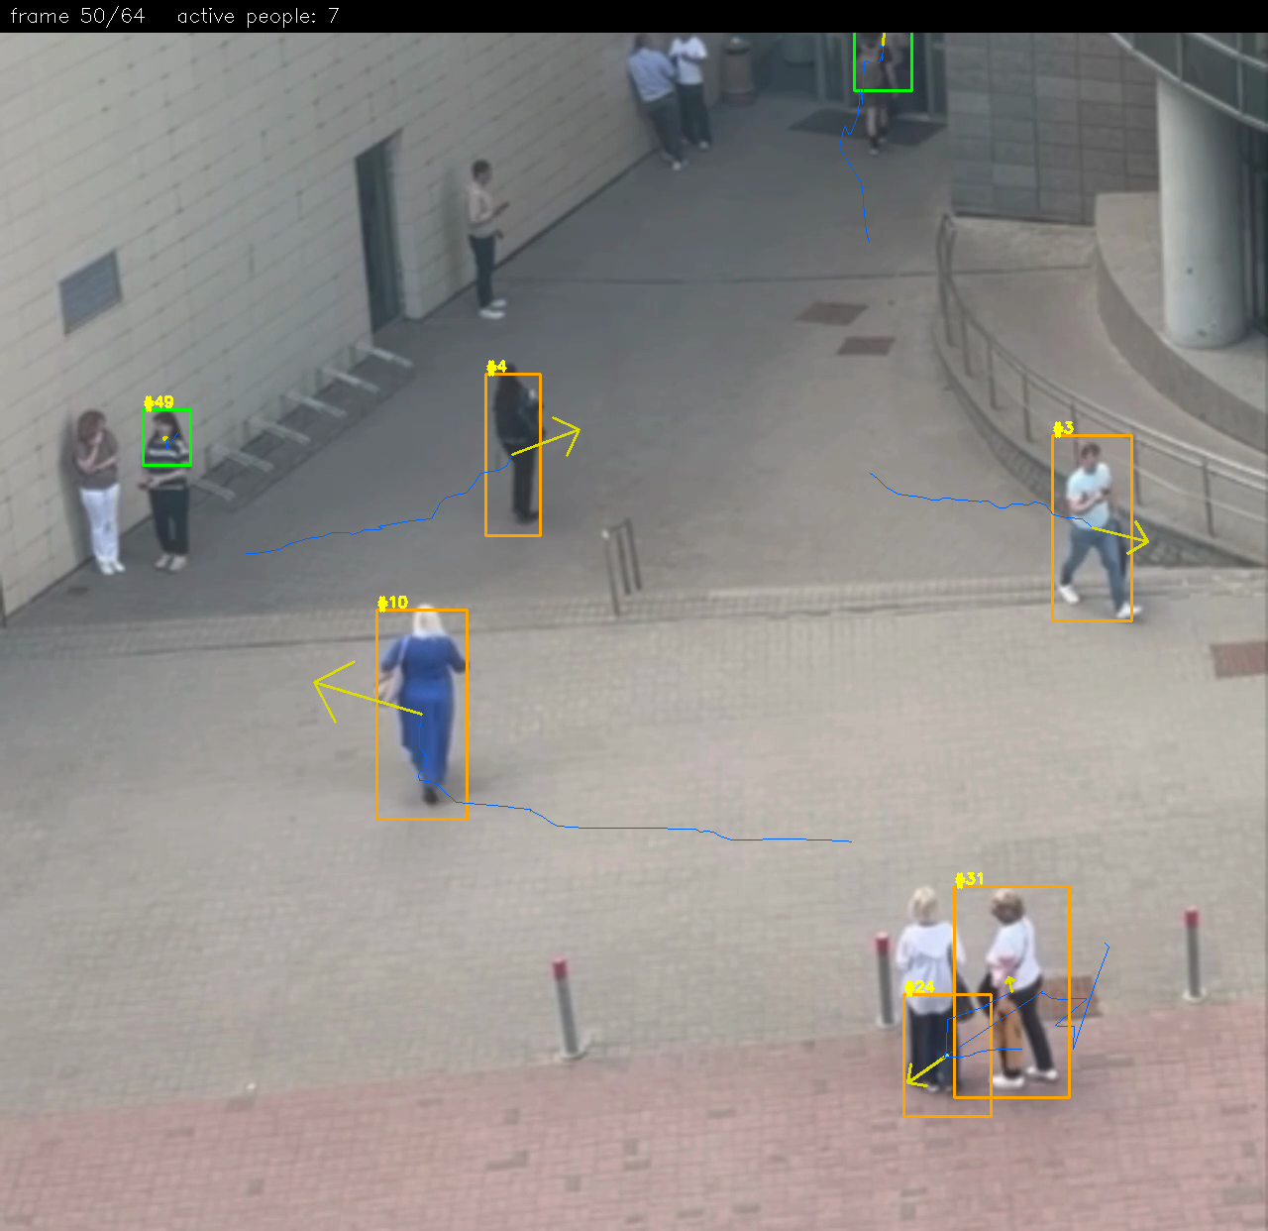
TESTING
PC-FLOW / 12
Failure analysis
Phantom IDs
low FPS caused extra IDs; fixed with prediction + hits
Static people
people standing too long may disappear: MOG2 absorbs them into background
Crowded groups
groups of 4+, shadows, and highlights can still pass filters

Slide 13
LIVE
PC-FLOW / 13
LIVE DEMO

Slide 14
FINAL
PC-FLOW / 14
Results and bonuses
What we built
Bonus parts
Next steps
- all 5 pipeline stages
- automatic result
- 15 people + dominant SW
- 6 outputs per frame
- method comparison
- real-time demo
- own dataset
- Hungarian matching
- Kalman filter
- adaptive background freeze
- better stationary people handling
main requirements
bonus requirements
possible improvements

