Slide 1
Kubernetes 101
Marcial White
www.SoFree.us

Slide 2
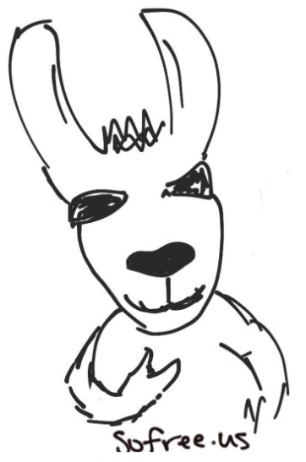
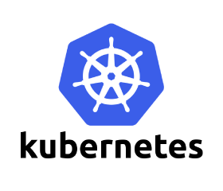
Introductions!
Marcial White
DevOps Engineer @ Return Path, Inc.
Four k8s clusters (2 datacenter/2 AWS)
This koolaide is delicious
Mind the compendium!

Slide 3
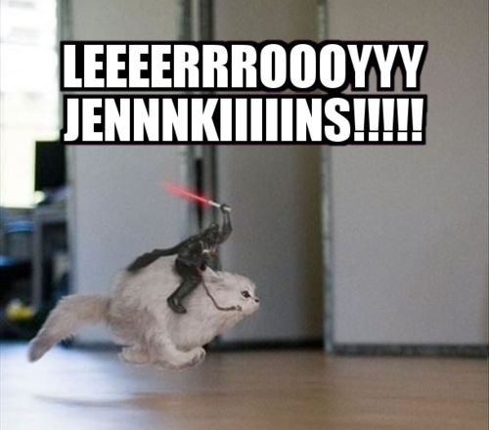

Slide 4
Kuberwhaties?
Kubernetes is an open-source platform for automating deployment, scaling, and operations of application containers across clusters of hosts, providing container-centric infrastructure.

Slide 5
Kuberwhaties?
Kubernetes (from κυβερνήτης: Greek for "helmsman" or "pilot", pronounced 'koo-ber-nay'-tace') was founded by Joe Beda, Brendan Burns and Craig McLuckie, was quickly joined by other Google engineers including Brian Grant and Tim Hockin, and was first announced by Google in mid-2014.
Its development and design are heavily influenced by Google's Borg system, and many of the top contributors to the project previously worked on Borg. The original codename for Kubernetes within Google was Project Seven, a reference to a Star Trek character that is a 'friendlier' Borg. The seven spokes on the wheel of the Kubernetes logo is a nod to that codename.
Donuts!

Slide 6
Kuberwhaties?
12 Factor Application Design
‘Properly’ designed apps that reside in containers:
  Can be deployed and managed in a high flexible and automatic way
  Provide greater uptime of your app
  Better and more predictable performance
  All with less hands-on management

Slide 7
Kuberwhaties?
This course will:
  Explore containers and docker
  Get you up and running with a single-node cluster using MiniKube
By the end of this course you will be able to launch a collection of containers called a ‘pod’, to serve a local internet radio station using Icecast.

Slide 8
Kuberwhaties?
  More advanced topics and room for growth include:
    Multi-node deployments
    Monitoring with Prometheus
    Alerting with AlertManager
    Sidecar pod design
    Release management with Helm
    Cloud provisioners and their annotations

Slide 9
Kuberwhaties?
  Much of this course was taken directly from the Kubernetes.io and Docker.io sites. They're great and you should totally check them out!
  Constantly evolving, get in on the discussion!

Slide 10
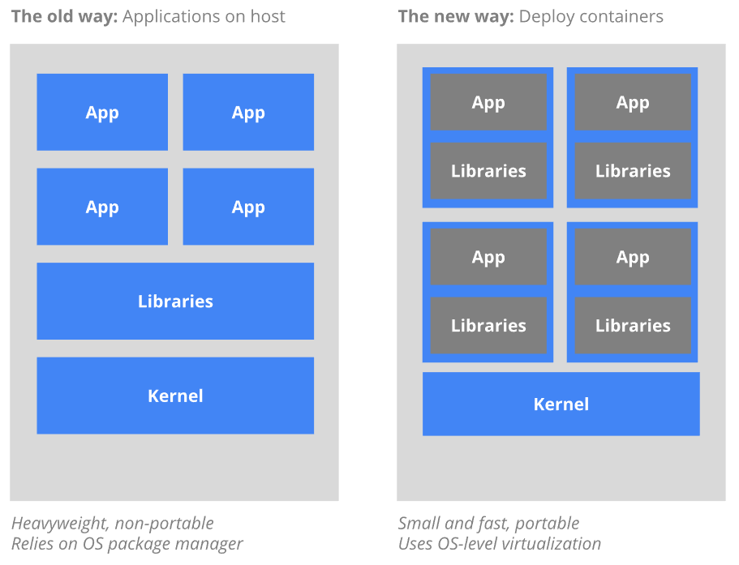
Kuberwhaties?

Slide 11
12 Factor Design
The twelve-factor app is a methodology for building software-as-a-service apps that:
  Use declarative formats for setup automation, to minimize time and cost for new developers joining the project;
  Have a clean contract with the underlying operating system, offering maximum portability between execution environments;
  Are suitable for deployment on modern cloud platforms, obviating the need for servers and systems administration;
  Minimize divergence between development and production, enabling continuous deployment for maximum agility;
  And can scale up without significant changes to tooling, architecture, or development practices.

Slide 12
12 Factor Design
1) Codebase
  always tracked in a version control system
  a copy of the revision tracking database is known as a code repository, often shortened to code repo or just repo
  A codebase is any single repo (in a centralized revision control system like Subversion), or any set of repos who share a root commit (in a decentralized revision control system like Git)
  always a one-to-one correlation between the codebase and the app
    Multiple codebases? Not an app – a distributed system! Each component of a distributed system is an app, each individually comply with 12 factor
    Shared code? Violation! Use libraries!
  1 codebase, many deploys (prod/staging/dev/etc)
  Codebase is the same across deploys, though different versions may be active

Slide 13
12 Factor Design
2) Dependencies
  Explicitly declare and isolate dependencies!
  never rely on implicit existence of system-wide packages
  No matter what the toolchain, dependency declaration and isolation must always be used together – only one or the other is not sufficient to satisfy twelve-factor.
    Python: Pip + VirtualEnv
    Ruby: Gemfile + bundle exec
  simplifies setup for developers new to the app
  Should be able to set up everything needed for an app with a deterministic build command
  No dropping shells! If the app needs to shell out to a system tool, that tool should be vendored into the app.

Slide 14
12 Factor Design
3) Config
  An app’s config is everything that is likely to vary between deploys
    Resource handles to the database, Memcached, and other backing services
    Credentials to external services such as Amazon S3 or Twitter
    Per-deploy values such as the canonical hostname for the deploy
  Config varies substantially across deploys, code does not
  Can the codebase be made open source at any moment, without compromising any credentials?
  The twelve-factor app stores config in environment variables (often shortened to env vars or env)

Slide 15
12 Factor Design
4) Backing services
  Treat backing services as attached resources
  A backing service is any service the app consumes over the network as part of its normal operation
    Datastores, queuing systems, SMTP, caching, etc
  no distinction between local and third party services
  To the app, both are attached resources, accessed via a URL or other locator/credentials stored in the config
  Each distinct backing service is a resource
  Resources can be attached/detached to deploys at will
  Misbehaving app? Spin up a new db based on a snapshot, attach to new db – all without code changes

Slide 16
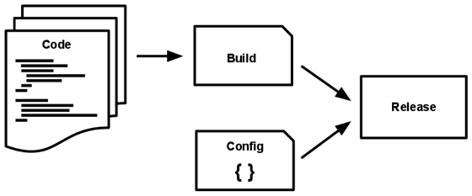
12 Factor Design
5) Build, release, run
  Strictly separated build/release/run stages
    Build stage transforms code repo into executable bundle known as a build. Using a version of the code at a commit specified by the deployment process, the build stage fetches vendors dependencies and compiles binaries and assets
    Release stage takes the build produced by the build stage and combines it with the deploy’s current config. The resulting release contains both the build and the config and is ready for immediate execution in the execution environment.
    The run stage (also known as “runtime”) runs the app in the execution environment, by launching some set of the app’s processes against a selected release
  Rollback-ability
  Unique Release ID’s

Slide 17
12 Factor Design
6) Processes
  Execute the app as one or more stateless processes
  Twelve-factor processes are stateless and share-nothing. Any data that needs to persist must be stored in a stateful backing service, typically a database.
  single-transaction cache via memory space or filesystem, but never assume that data will be available for future transactions
  Sticky sessions? Out! Use a datastore like Memcached or Redis

Slide 18
12 Factor Design
7) Port binding
  Export services via port binding
  Need to expose a service? Build in the server library as a dependency declaration!
  the port-binding approach means that one app can become the backing service for another app, by providing the URL to the backing app as a resource handle in the config for the consuming app (which we’ll see with icecast later!)

Slide 19
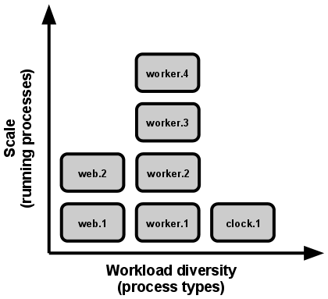
12 Factor Design
8) Concurrency
  Scale out via the process model
  processes are a first class citizen, and take strong cues from the unix process model for running service daemons
  share-nothing, horizontally partitionable
  No daemons! Use OS process managers (upstart, systemd, etc)

Slide 20
12 Factor Design
9) Disposability
  Maximize robustness with fast startup and graceful shutdown
  processes are disposable, meaning they can be started or stopped at a moment’s notice
  minimize startup time
  shut down gracefully when they receive a SIGTERM signal
  For web processes, allow any current requests to finish, then exit
  For worker processes, returning the current job to the work queue
  Processes should also be robust against sudden death, in the case of a failure in the underlying hardware.
  A recommended approach is use of a robust queueing backend, such as Beanstalkd, that returns jobs to the queue when clients disconnect or time out.

Slide 21
12 Factor Design
10) Dev/prod parity
  Keep development, staging, and production as similar as possible
  designed for continuous deployment by keeping the gap between development and production small
  The twelve-factor developer resists the urge to use different backing services between development and production, even when adapters theoretically abstract away any differences in backing services.
  Adapters to different backing services are still useful, because they make porting to new backing services relatively painless. But all deploys of the app (developer environments, staging, production) should be using the same type and version of each of the backing services.

Slide 22
12 Factor Design
11) Logs
  Treat logs as event streams
  A twelve-factor app never concerns itself with routing or storage of its output stream. It should not attempt to write to or manage logfiles. Instead, each running process writes its event stream, unbuffered, to stdout.
  Essentially, decouple log management from ‘the server’. Ship to a log aggregation and analysis engine like Splunk, ELK, etc

Slide 23
12 Factor Design
12) Run admin/management tasks as one-off processes
  DB migrations? Live console sessions? One-off scripts? Use the same dependency isolation techniques!
  Twelve-factor strongly favors languages which provide a REPL (Read-Eval-Print-Loop) shell out of the box, and which make it easy to run one-off scripts.

Slide 24
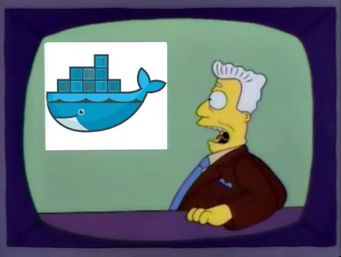
Docker Lab!

Slide 25
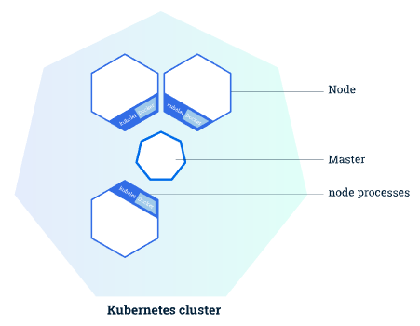
Kubernetes System Design
In it's most simple form, a Kubernetes cluster consists of two types of resources:
  The Master coordinates the cluster
  Nodes are the workers that run applications

Slide 26
Kubernetes System Design
Master(s)
  responsible for managing the cluster
  coordinates all activities in your cluster using components that work together to provide services (e.g. scheduling applications, maintaining applications' desired state, scaling applications, and rolling out new updates)
  This is also where the apiserver runs.
Node(s) (aka workers)
  Each node runs a Kubelet, (an agent for managing the node and communicating with the Kubernetes master)
  Will run a container manager like Docker or rkt.

Slide 27
Kubernetes System Design
In our MiniKube example, all components run on the same master. The components are:
  kubelet
  apiserver
  proxy
  controller-manager
  etcd
  scheduler

Slide 28
Kubernetes System Design
To deploy into Kubernetes, you apply a configuration script that describes a resource
This notifies the master that it needs to schedule a resource on a node
Interface with the system through the API using kubectl or write your own!

Slide 29
Kubernetes System Design
Kubernetes Resources (or 'objects') are persistent entities in the Kubernetes system
Kubernetes uses these entities to represent the state (both desired and current) of your cluster.
Resources describe:
  What containerized applications are running (and on which nodes)
  The resources available to those applications
  The policies around how those applications behave, such as restart policies, upgrades, and fault-tolerance

Slide 30

Kubernetes System Design
A Kubernetes object is a “record of intent”: once you create the object, the Kubernetes system will constantly work to ensure that that object exists.
By creating an object, you’re effectively telling the Kubernetes system what you want your cluster’s workload to look like; this is your cluster’s desired state.

Slide 31
Kubernetes System Design
Object fields:
  Spec
  Status
Specs:
  Defines the characteristics that you want the object to have
Status:
  Describes the actual state for the object
The Kubernetes Control Plane actively manages an object’s actual state to match the desired state you supplied.

Slide 32
Kubernetes System Design
Specs are defined in yaml format
Required fields include:
  apiVersion
  Kind
  Metadata (starting with name)
The rest depends on what you’re building

Slide 33
Kubernetes System Design
---
apiVersion: apps/v1beta1
kind: Deployment
metadata:
name: nginx-deployment
spec:
replicas: 3
template:
metadata:
labels:
app: nginx
spec:
containers:
- name: nginx
image: nginx:1.7.9
ports:
- containerPort: 80

Slide 34
Kubernetes System Design
Check the user-guide for the complete list of Resource Types. Some of the more common resources include:
  configmaps
  deployments
  events
  namespaces
  nodes
  pods
  replicasets
  services

Slide 35
Kubernetes System Design
Resource collision domains:
  Names
  Namespaces
  Labels and selectors
  Annotations

Slide 36
Kubernetes System Design
Names
  Spatially unique
  Maximum of 253 charactors
  Lower case alphanumeric, a dash (-) or a period (.)
UID
  Generated by Kubernetes
  Every object created gets a distinct UID
  spatially and temporally unique

Slide 37
Kubernetes System Design
Namespaces
  multiple virtual clusters backed by the same physical cluster
  provide scope for Names
  intended for use in environments with many users spread across multiple teams
  Less than 10 users? You probably don’t need namespaces.

Slide 38
Kubernetes System Design
Namespaces
  default: The default namespace for objects with no other namespace
  kube-system: The namespace for objects created by the Kubernetes system

Slide 39
Kubernetes System Design
Namespaces
  With minikube, the kube-dns pod is enabled by default, in the kube-system namespace
  When you create a Service, it creates a corresponding DNS entry
  <service-name>.<namespace-name>.svc.cluster.local
  Not everything requires a namespace (nodes, persistentVolumes, etc)

Slide 40
Kubernetes System Design
Labels & Selectors
  Key/value pairs attached to objects for the purpose of identification
  Relevant to users, but do not directly imply semantics to the core system
  Used to organize and select subsets of objects
  Each Key must be unique for a given object
  Do not provide uniqueness of an object
  Mostly small, unstructured data

Slide 41
Kubernetes System Design
Example labels:
  "release" : "stable", "release" : "canary"
  "environment" : "dev", "environment" : "qa", "environment" : "production"
  "tier" : "frontend", "tier" : "backend", "tier" : "cache"
  "partition" : "customerA", "partition" : "customerB"
  "track" : "daily", "track" : "weekly“
Example URL query string usage:
  equality-based requirements: ?labelSelector=environment%3Dproduction,tier%3Dfrontend
  set-based requirements: ?labelSelector=environment+in+%28production%2Cqa%29%2Ctier+in+%28frontend%29

Slide 42
Kubernetes System Design
Example kubectl query
  Equality-based:
    $ kubectl get pods -l environment=production,tier=frontend
  Set-based:
    $ kubectl get pods -l 'environment in (production),tier in (frontend)'

Slide 43
Kubernetes System Design
Annotations
  key/value maps that attach arbitrary non-identifying metadata to objects
  tools and libraries can retrieve this metadata
  use either labels or annotations to attach metadata to Kubernetes objects
  Structured or unstructured, small or large data
  Allows characters not permitted by labels

Slide 44
Kubernetes System Design
---
apiVersion: v1
kind: Service
metadata:
name: nginx
annotations:
service.beta.kubernetes.io/aws-load-balancer-internal: 0.0.0.0/0
service.beta.kubernetes.io/aws-load-balancer-backend-protocol: http
service.beta.kubernetes.io/aws-load-balancer-ssl-cert: arn:aws:acm:us-east-1:XXXXXXXX
service.beta.kubernetes.io/aws-load-balancer-ssl-ports: "443"
spec:
type: LoadBalancer
ports:
- port: 80
name: http
- port: 443
name: https
targetPort: 80
selector:
app: nginx

Slide 45
Kubernetes System Design
Liveness
  The kubelet uses liveness probes (aka checks) to know when to restart a container.
  Written into the deployment spec
  Generally involves making some request of a port or location, comparing the output received and declaring the state of the object
Readiness
  tells the kubelet when a pod is ready to serve traffic
    Pods can be alive but not yet ready to serve content
  configured similarly to liveness probes
  should refer to some endpoint that can ensure the pod is ready to serve traffic

Slide 46
Kubernetes System Design
  … within a spec:
  livenessProbe:
  tcpSocket:
  port: 80
  initialDelaySeconds: 10
  periodSeconds: 10
  readinessProbe:
  httpGet:
  path: /customer_facing_page/db_is_ready.php
  port: 80
  initialDelaySeconds: 5
  timeoutSeconds: 1
  periodSeconds: 20

Slide 47
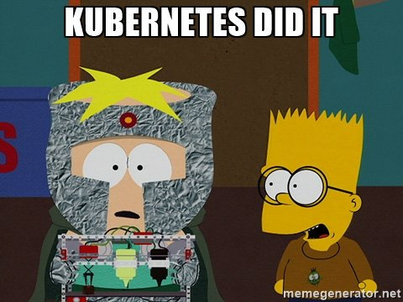
Kubernetes Lab 1 – MiniKube

Slide 48

Kubernetes Lab 2 - Icecast
(Brought to you by Mc McMuffins)

Slide 49
Productionization
Open Discussion!
Some ideas:
On-premises/Cloud
Split out the key/value store
Multi-master
Multi-node
Annotations
Monitoring/Metrics/Alerting
Build/Deploy - CI/CD
Pod Design - Sidecars

Slide 50
Productionization
Thank you for your time!
github.com/mars64
binary.stereo@gmail.com
Jungletrain.net
DnBRadio.com

