Slide 1
Kubernetes 101
Marcial White
www.SoFree.us

Slide 2
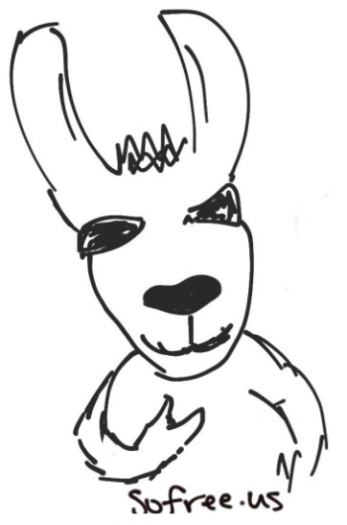
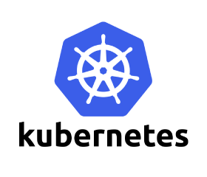
Introductions!
Marcial White
Senior Engineer @ Return Path, Inc.
Five k8s clusters (2 datacenter/3 AWS)
This koolaide is delicious!
Mind the compendium!
Bagels!

Slide 3
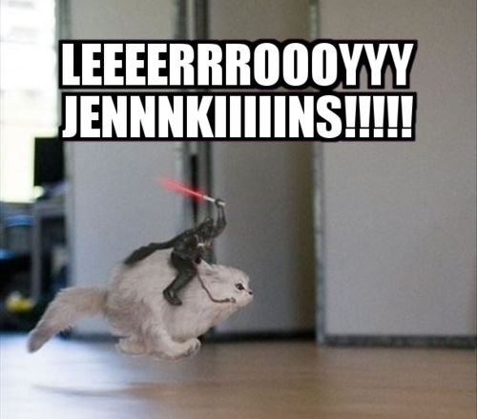

Slide 4
Kuberwhaties?
Kubernetes is an open-source platform for automating deployment, scaling, and operations of application containers across clusters of hosts, providing container-centric infrastructure.

Slide 5
Kuberwhaties?
Kubernetes (Greek for "helmsman" or "pilot", pronounced 'koo-ber-nay'-tace')
Founded by Joe Beda, Brendan Burns and Craig McLuckie, quickly joined by other Google engineers including Brian Grant and Tim Hockin
1.0 first announced by Google in mid-2014.
Heavily influenced by Google's Borg system
The original codename within Google was Project Seven, a reference to a Star Trek character that is a 'friendlier' Borg.
The seven spokes on the wheel of the Kubernetes logo is a nod to the original codename.

Slide 6
Kuberwhaties?
This course will:
  Explore containers and docker
  Get you up and running with a single-node cluster using MiniKube
By the end of this course you will be able to launch a collection of containers called a ‘pod’, to serve a local internet radio station using Icecast.

Slide 7
Kuberwhaties?
  More advanced topics and room for growth include:
    Multi-node deployments
    Monitoring with Prometheus
    Alerting with AlertManager
    Sidecar pod design
    Release management with Helm
    Cloud provisioners and their annotations

Slide 8
Kuberwhaties?
  Much of this course was taken directly from the Kubernetes.io and Docker.io sites. They're great and you should totally check them out!
  Constantly evolving, get in on the discussion!

Slide 9
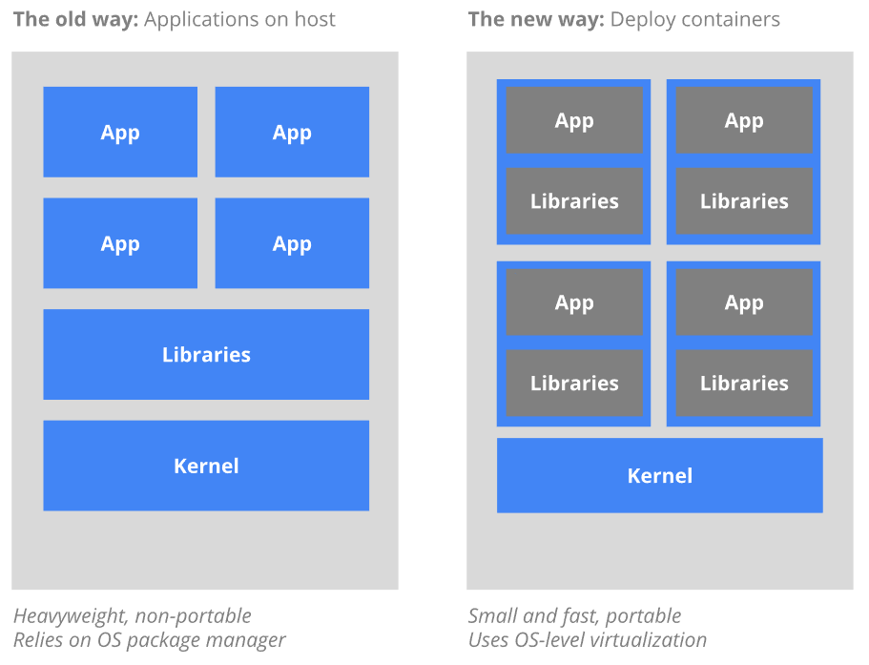
Kuberwhaties?

Slide 10
State of Clustering
Docker Swarm
  Easy to start, harder to customize
CoreOS Fleet
  Low-level orchestration, lacks features
  Discontinued Feb 1, 2018, focus on k8s
Apache Mesos
  Highly scalable, more complex
Kubernetes
  Opinionated, use 12 factor!

Slide 11
Kuberwhaties?
12 Factor Application Design
‘Properly’ designed apps that reside in containers:
  deployed and managed in a highly flexible and automatic way
  Provide greater uptime of your app
  Better and more predictable performance
  All with less hands-on management

Slide 12
12 Factor Design
The twelve-factor app is a methodology for building software-as-a-service apps that:
  Uses declarative formats for setup automation, minimizing time and cost for new developers joining the project
  Provides clean contracts with the underlying operating system; maximum portability between execution environments
  Are suitable for modern cloud platforms; no ‘servers’ or ‘classic’ systems administration
  Minimize divergence between development and production; maximum agility
  scale up without significant changes to tooling, architecture, or development practices.

Slide 13
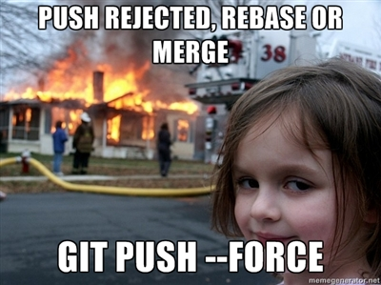
12 Factor Design
1) Codebase
  ALWAYS USE SOURCE CONTROL
  Single codebase, multiple deploys
  github.com/mars64
  https://gitlab.com/sofreeus
  etc …

Slide 14
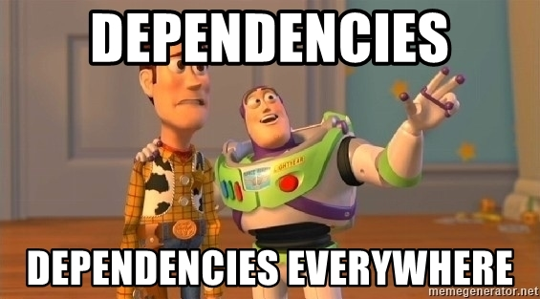
12 Factor Design
2) Dependencies
  Explicitly declare and isolate dependencies!
  never rely on implicit existence of system-wide packages
  No dropping shells! If the app needs to shell out to a system tool, that tool should be vendored into the app.
  Bake into a container!

Slide 15

12 Factor Design
3) Config
  Config varies across deploys, code does not
  Can the codebase be made open source at any moment, without compromising any credentials?
  The twelve-factor app stores config in environment variables (often shortened to env vars or env)
  Helm is awesome for this

Slide 16

12 Factor Design
4) Backing services
  Treat backing services as attached resources
  no distinction between local and third party services
  Expect to interface with external services at a simple URL
    memcache.default.svc.cluster.local
    memcache

Slide 17
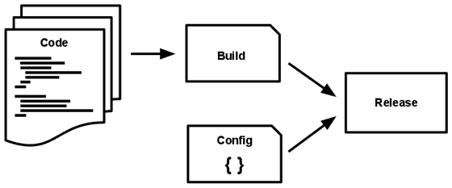
12 Factor Design
5) Build, release, run
  Strictly separated build/release/run stages
    Build: transform code into executable build (aka image)
      Like a `docker build –t mars64/thingy:v1.0 .`
    Release: combine the build and config into a release.
      Like env vars mounted into the container
    Run: deploy the app in the execution environment
      Like `kubectl apply –f myawesomeapp.yaml`
  Rollback-ability with unique release ID’s

Slide 18
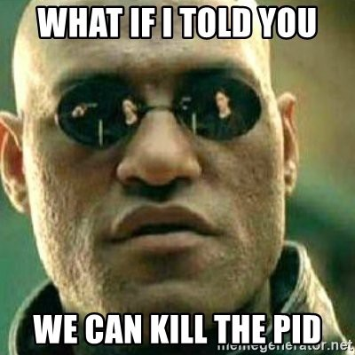
12 Factor Design
6) Processes
  App: one or more stateless processes
  share-nothing! (use a db/block store/queue)
  Crash-only design
  Sticky sessions? Out! Use a datastore like Memcached or Redis

Slide 19

12 Factor Design
7) Port binding
  Export services via port binding
  If Backing Services is the expectation of interfacing with external services at a simple URL, then Port Binding implies an agreement to provide a simple URL to be contacted by other services
  Think dockerfile expose or kubernetes spec ports

Slide 20
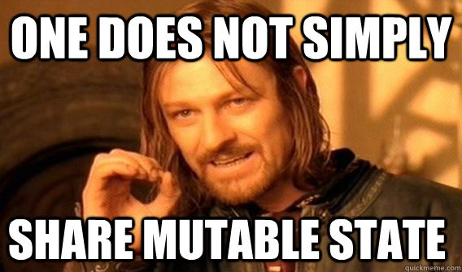
12 Factor Design
8) Concurrency
  Scale out via the process model
  Stateless! share-nothing, crash-only, horizontally partitionable workloads

Slide 21
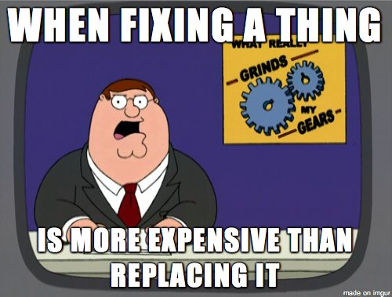
12 Factor Design
9) Disposability
  Maximize robustness w/ fast startup & graceful shutdown
  CRASH-ONLY!!!

Slide 22
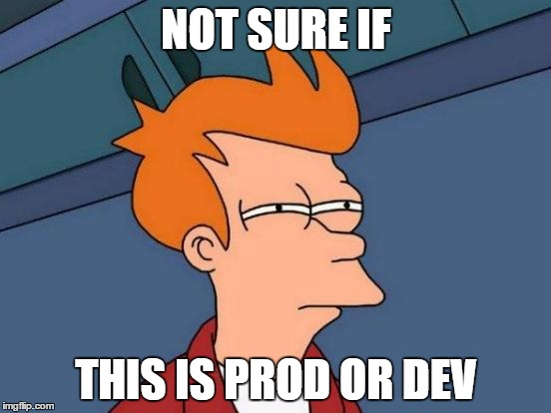
12 Factor Design
10) Dev/prod parity
  All environments should be as similar as possible
  Makes continuous delivery easy
  Backing service names should still be relevant regardless of env… ‘memcache’ just points to different places

Slide 23
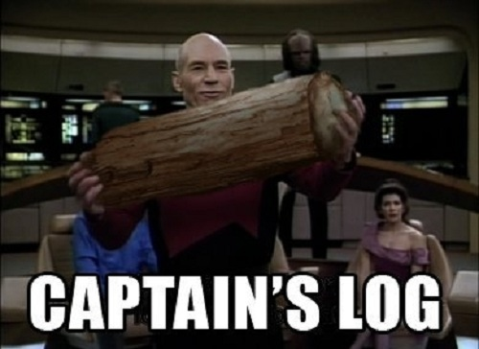
12 Factor Design
11) Logs
  Logs = event streams
  ABC: Always Be … Logging to stdout 😐
  Splunk, ELK, Scalyr, etc …

Slide 24

12 Factor Design
12) Run admin tasks as one-off processes
  DB migrations? Live console sessions? One-off scripts? Use the same dependency isolation techniques!
  Don’t run pods just for admin tasks!!!

Slide 25
Docker
In 2017, “Docker (the company) decided to differentiate Docker (the commercial software products Docker CE and Docker EE) from Docker (the open source project)” ~ El Reg
1.12.x -> 17.x -> 18.x
Kubernetes bundling

Slide 26
Docker
image: a lightweight, stand-alone, executable package that includes everything needed to run a piece of software, including the code, a runtime, libraries, environment variables, and config files
Build an image

Slide 27
Docker
container: a runtime instance of an image – what the image becomes in memory when actually executed. It runs completely isolated from the host environment by default, only accessing host files and ports if configured to do so
Run a container

Slide 28
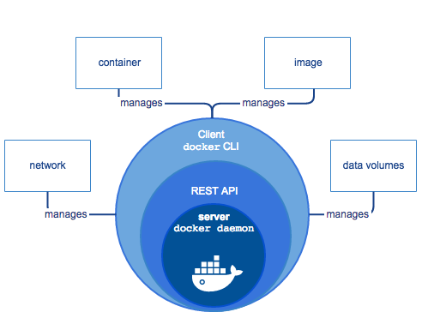
Docker

Slide 29
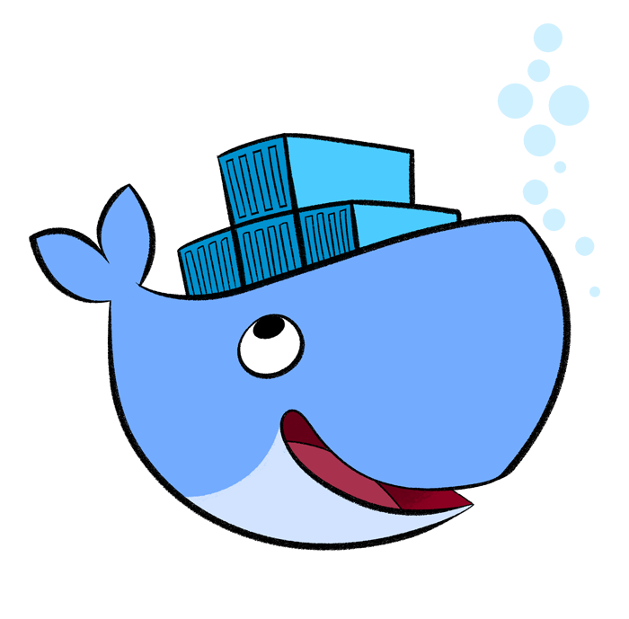
Docker
Docker Engine is a client-server application that provides:
  A server, daemon process (dockerd)
  A REST API to communicate with the daemon
  A CLI client (docker). Check the cli reference

Slide 30
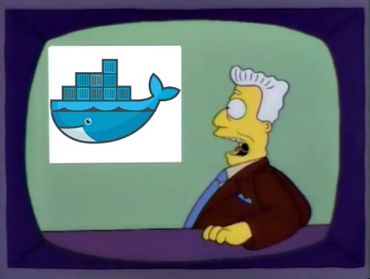
Docker Lab!

Slide 31
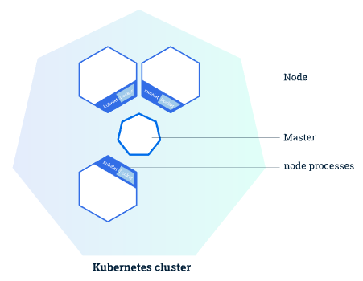
Kubernetes System Design
In it's most simple form, a Kubernetes cluster consists of two types of resources:
  The Master coordinates the cluster
  Nodes are the workers that run applications

Slide 32
Kubernetes System Design
Master(s)
  responsible for managing the cluster
  coordinates all activities in your cluster using components that work together to provide services (e.g. scheduling applications, maintaining applications' desired state, scaling applications, and rolling out new updates)
  This is also where the apiserver runs.
Node(s) (aka workers)
  Each node runs a Kubelet, (an agent for managing the node and communicating with the Kubernetes master)
  Will run a container manager like docker or rkt.

Slide 33
Kubernetes System Design
In our MiniKube example, all components run on the same master. The components are:
  kubelet
  apiserver
  proxy
  controller-manager
  etcd
  scheduler

Slide 34
Kubernetes System Design
To deploy into Kubernetes, you apply a configuration script that describes a resource
This notifies the master that it needs to schedule a resource on a node
Interface with the system through the API using kubectl or write your own!

Slide 35
Kubernetes System Design
Kubernetes Resources (or 'objects') are persistent entities in the Kubernetes system
Kubernetes uses these entities to represent the state (both desired and current) of your cluster.
Resources describe:
  What containerized applications are running (and on which nodes)
  The resources available to those applications
  The policies around how those applications behave, such as restart policies, upgrades, and fault-tolerance

Slide 36

Kubernetes System Design
A Kubernetes object is a “record of intent”: once you create the object, the Kubernetes system will constantly work to ensure that that object exists.
By creating an object, you’re effectively telling the Kubernetes system what you want your cluster’s workload to look like; this is your cluster’s desired state.

Slide 37
Kubernetes System Design
Object fields:
  Spec
  Status
Specs:
  Defines the characteristics that you want the object to have
Status:
  Describes the actual state for the object
The Kubernetes Control Plane actively manages an object’s actual state to match the desired state you supplied.

Slide 38
Kubernetes System Design
Specs are defined in yaml format
Required fields include:
  apiVersion
  Kind
  Metadata (starting with name)
The rest depends on what you’re building

Slide 39
Kubernetes System Design
---
apiVersion: apps/v1beta1
kind: Deployment
metadata:
name: nginx-deployment
spec:
replicas: 3
template:
metadata:
labels:
app: nginx
spec:
containers:
- name: nginx
image: nginx:1.7.9
ports:
- containerPort: 80

Slide 40
Kubernetes System Design
Check the user-guide for the complete list of Resource Types. Some of the more common resources include:
  configmaps
  deployments
  events
  namespaces
  nodes
  pods
  replicasets
  services

Slide 41
Kubernetes System Design
Resource collision domains:
  Names
  Namespaces
  Labels and selectors
  Annotations

Slide 42
Kubernetes System Design
Names
  Spatially unique
  Maximum of 253 charactors
  Lower case alphanumeric, a dash (-) or a period (.)
UID
  Generated by Kubernetes
  Every object created gets a distinct UID
  spatially and temporally unique

Slide 43
Kubernetes System Design
Namespaces
  multiple virtual clusters backed by the same physical cluster
  provide scope for Names
  intended for use in environments with many users spread across multiple teams
  Less than 10 users? You probably don’t need namespaces.

Slide 44
Kubernetes System Design
Namespaces
  default: The default namespace for objects with no other namespace
  kube-system: The namespace for objects created by the Kubernetes system

Slide 45
Kubernetes System Design
Namespaces
  With minikube, the kube-dns pod is enabled by default, in the kube-system namespace
  When you create a Service, it creates a corresponding DNS entry
  <service-name>.<namespace-name>.svc.cluster.local
  Not everything requires a namespace (nodes, persistentVolumes, etc)

Slide 46
Kubernetes System Design
Labels & Selectors
  Key/value pairs attached to objects for the purpose of identification
  Relevant to users, but do not directly imply semantics to the core system
  Used to organize and select subsets of objects
  Each Key must be unique for a given object
  Do not provide uniqueness of an object
  Mostly small, unstructured data

Slide 47
Kubernetes System Design
Example labels:
  "release" : "stable", "release" : "canary"
  "environment" : "dev", "environment" : "qa", "environment" : "production"
  "tier" : "frontend", "tier" : "backend", "tier" : "cache"
  "partition" : "customerA", "partition" : "customerB"
  "track" : "daily", "track" : "weekly“
Example URL query string usage:
  equality-based requirements: ?labelSelector=environment%3Dproduction,tier%3Dfrontend
  set-based requirements: ?labelSelector=environment+in+%28production%2Cqa%29%2Ctier+in+%28frontend%29

Slide 48
Kubernetes System Design
Example kubectl query
  Equality-based:
    $ kubectl get pods -l environment=production,tier=frontend
  Set-based:
    $ kubectl get pods -l 'environment in (production),tier in (frontend)'

Slide 49
Kubernetes System Design
Annotations
  key/value maps that attach arbitrary non-identifying metadata to objects
  tools and libraries can retrieve this metadata
  use either labels or annotations to attach metadata to Kubernetes objects
  Structured or unstructured, small or large data
  Allows characters not permitted by labels

Slide 50
Kubernetes System Design
---
apiVersion: v1
kind: Service
metadata:
name: nginx
annotations:
service.beta.kubernetes.io/aws-load-balancer-internal: 0.0.0.0/0
service.beta.kubernetes.io/aws-load-balancer-backend-protocol: http
service.beta.kubernetes.io/aws-load-balancer-ssl-cert: arn:aws:acm:us-east-1:XXXXXXXX
service.beta.kubernetes.io/aws-load-balancer-ssl-ports: "443"
spec:
type: LoadBalancer
ports:
- port: 80
name: http
- port: 443
name: https
targetPort: 80
selector:
app: nginx

Slide 51
Kubernetes System Design
Liveness
  The kubelet uses liveness probes (aka checks) to know when to restart a container.
  Written into the deployment spec
  Generally involves making some request of a port or location, comparing the output received and declaring the state of the object
Readiness
  tells the kubelet when a pod is ready to serve traffic
    Pods can be alive but not yet ready to serve content
  configured similarly to liveness probes
  should refer to some endpoint that can ensure the pod is ready to serve traffic

Slide 52
Kubernetes System Design
  … within a spec:
  livenessProbe:
  tcpSocket:
  port: 80
  initialDelaySeconds: 10
  periodSeconds: 10
  readinessProbe:
  httpGet:
  path: /customer_facing_page/db_is_ready.php
  port: 80
  initialDelaySeconds: 5
  timeoutSeconds: 1
  periodSeconds: 20

Slide 53
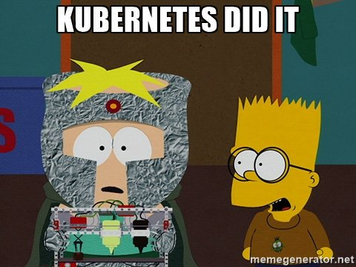
Kubernetes Lab 1 – MiniKube

Slide 54

Kubernetes Lab 2 - Icecast
(Brought to you by Mc McMuffins)

Slide 55
Productionization
Open Discussion!
Some ideas:
On-premises/Cloud
Split out the key/value store
Multi-master
Multi-node
Annotations
Monitoring/Metrics/Alerting
Build/Deploy - CI/CD
Pod Design - Sidecars

Slide 56
Productionization
Thank you for your time!
github.com/mars64
binary.stereo@gmail.com
Jungletrain.net
DnBRadio.com

