Slide 1
Indian Institute of Information Technology Una
Text-to-Image Generation using Stable Diffusion
By – Kavin Moudgil (23329)
Kush Gupta (23134)
Mirat Parmar (23345)

Slide 2
Outline
1
What is Stable Diffusion?
2
Motivation
3
Project Objectives
4
Innovation in the Project
5
Literature Review/
Currently available
solutions
6
Work Progress

Slide 3

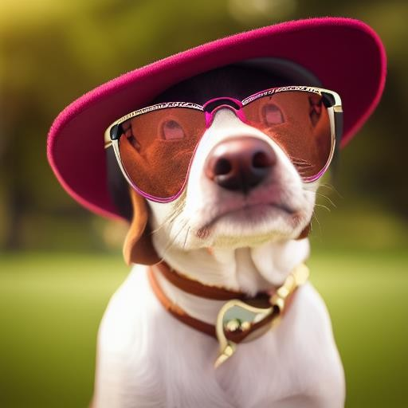
What is Stable Diffusion?
Stable Diffusion is a text-to-image deep learning model, based on diffusion models. Introduced in 2022, developed by the CompViz Group at LMU Munich. https://github.com/Stability-AI/stablediffusion
Output
Prompt
Picture of a dog with glasses

Slide 4
Motivation
Diffusion models overcome these issues by progressively denoising from pure noise to generate high-quality images.
However, traditional diffusion models are computationally expensive because they operate in pixel space.
Stable Diffusion innovates by performing the process in a compressed latent space using a Variational Autoencoder (VAE):
  Reduces computational cost and memory usage.
  Enables faster and more efficient generation of high-resolution images.
The project enables automatic text-to-image generation, allowing easier content creation, rapid prototyping, and creative expression.

Slide 5
Project Objectives
Implement forward and reverse diffusion processes as defined in DDPM (Denoising Diffusion Probabilistic Models).
Build and train a U-Net backbone with attention mechanisms to perform denoising effectively.
Incorporate CLIP-based text embeddings for text-conditioned image generation.
Support multiple tasks:
                Text-to-Image
                Image-to-Image
                Inpainting (filling missing parts of images).
  5. Evaluate the generated images using FID (Fréchet Inception Distance) and Inception Score for quality assessment.

Slide 6
Innovation in the Project
Latent Space Diffusion
  Diffusion operates in compressed latent space using VAE, reducing computation.
Text Conditioning via CLIP
  Precise text-to-image generation using powerful text embeddings.
Unified Architecture
Supports text-to-image, image-to-image, and inpainting in a single model.
Classifier-Free Guidance
Combines conditioned and unconditioned outputs for better image diversity.

Slide 7
Literature Review/
Currently available
solutions
Variational Autoencoders (VAEs)
Stable training but tend to produce blurry images.
Diffusion Models (DDPM)
Generate high-quality images by iterative denoising but are computationally expensive in pixel space.
Stable Diffusion
Performs diffusion in latent space using VAE + U-Net architecture, making the process faster and more efficient.
CLIP-based Conditioning
Uses text-image embedding alignment to guide generation from text prompts without needing separate models.

Slide 8
Work Progress

Slide 9
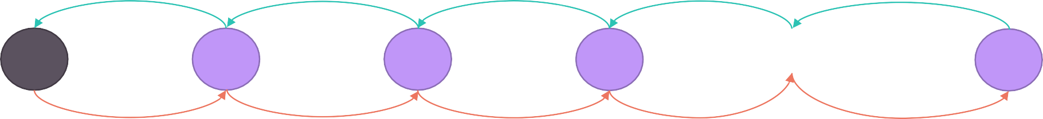
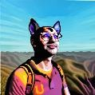


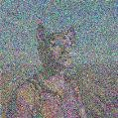

Reverse process: Neural network
Original image
Pure noise
X₀
Z₁
Z₂
…
Z₃
Z_{T}
Forward process: Fixed

Slide 10
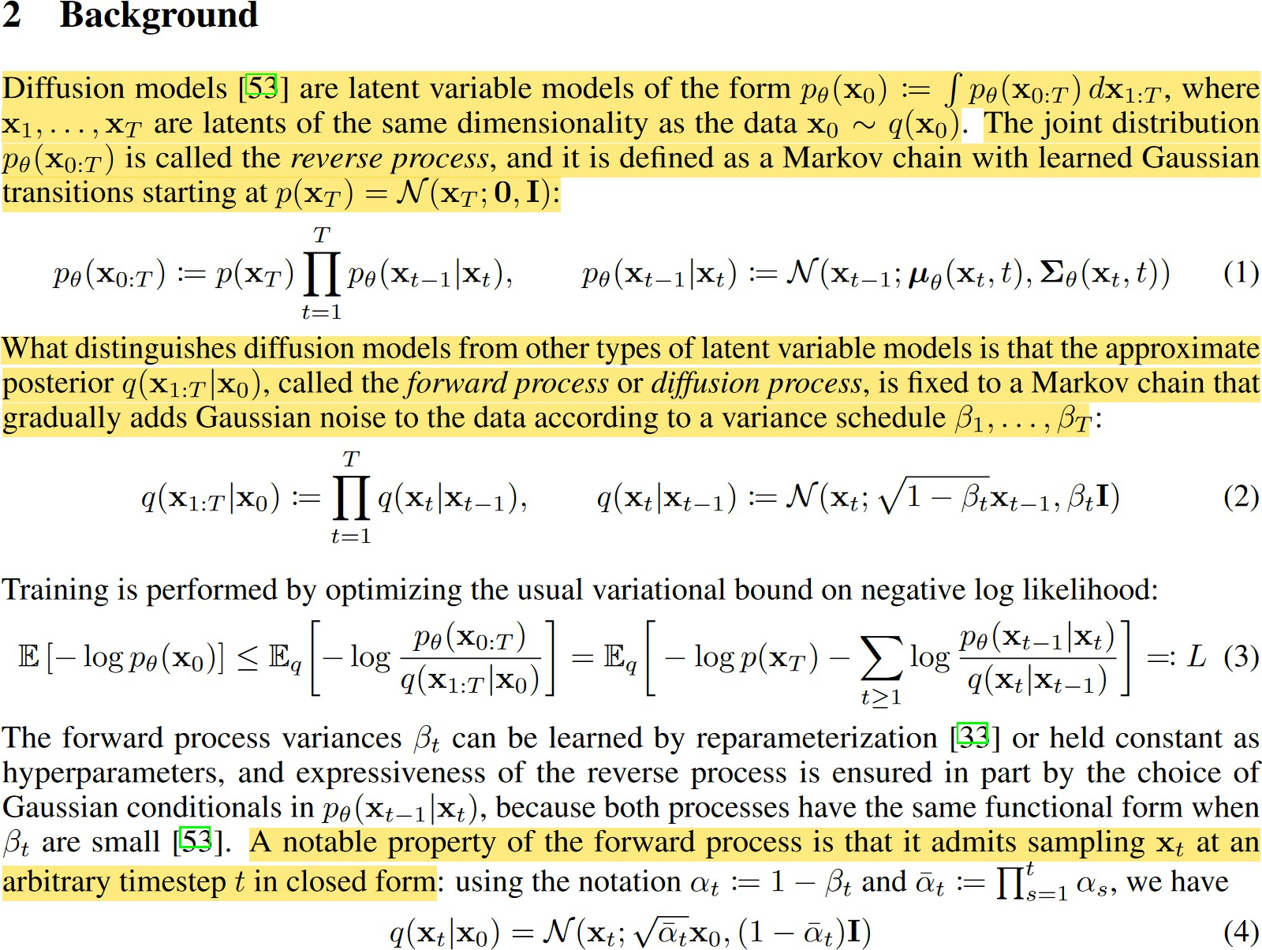
Just like with a VAE, we want to learn the parameters of the latent space
Reverse process p
Evidence Lower Bound (ELBO)
Forward process q
Ho, J., Jain, A. and Abbeel, P., 2020. Denoising diffusion probabilistic models. Advances in Neural Information Processing Systems, 33, pp.6840-6851.

Slide 11
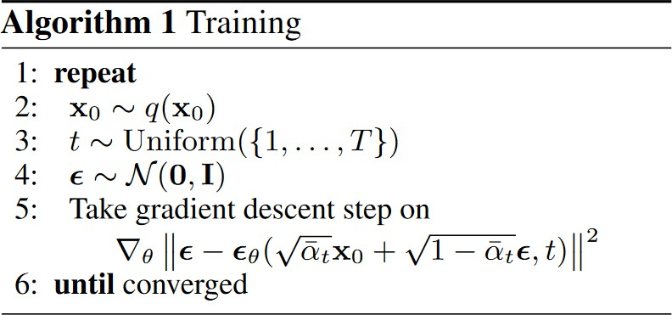
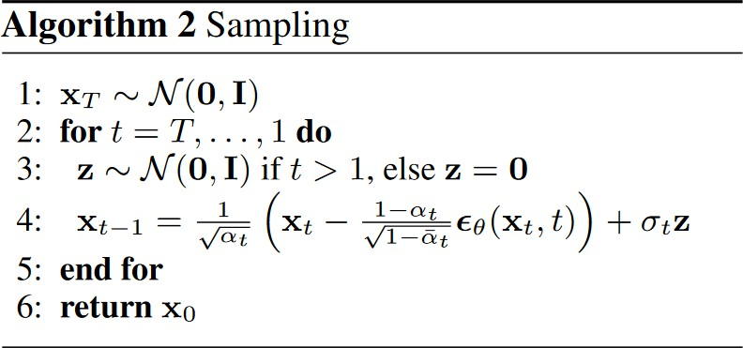
We take a sample from our dataset
We generate a random number t, between 1 and T
We sample some noise
We add noise to our image, and we train the model to learn to predict the amount of noise present in it.
We sample some noise
We keep denoising the image progressively for T steps.

Slide 12
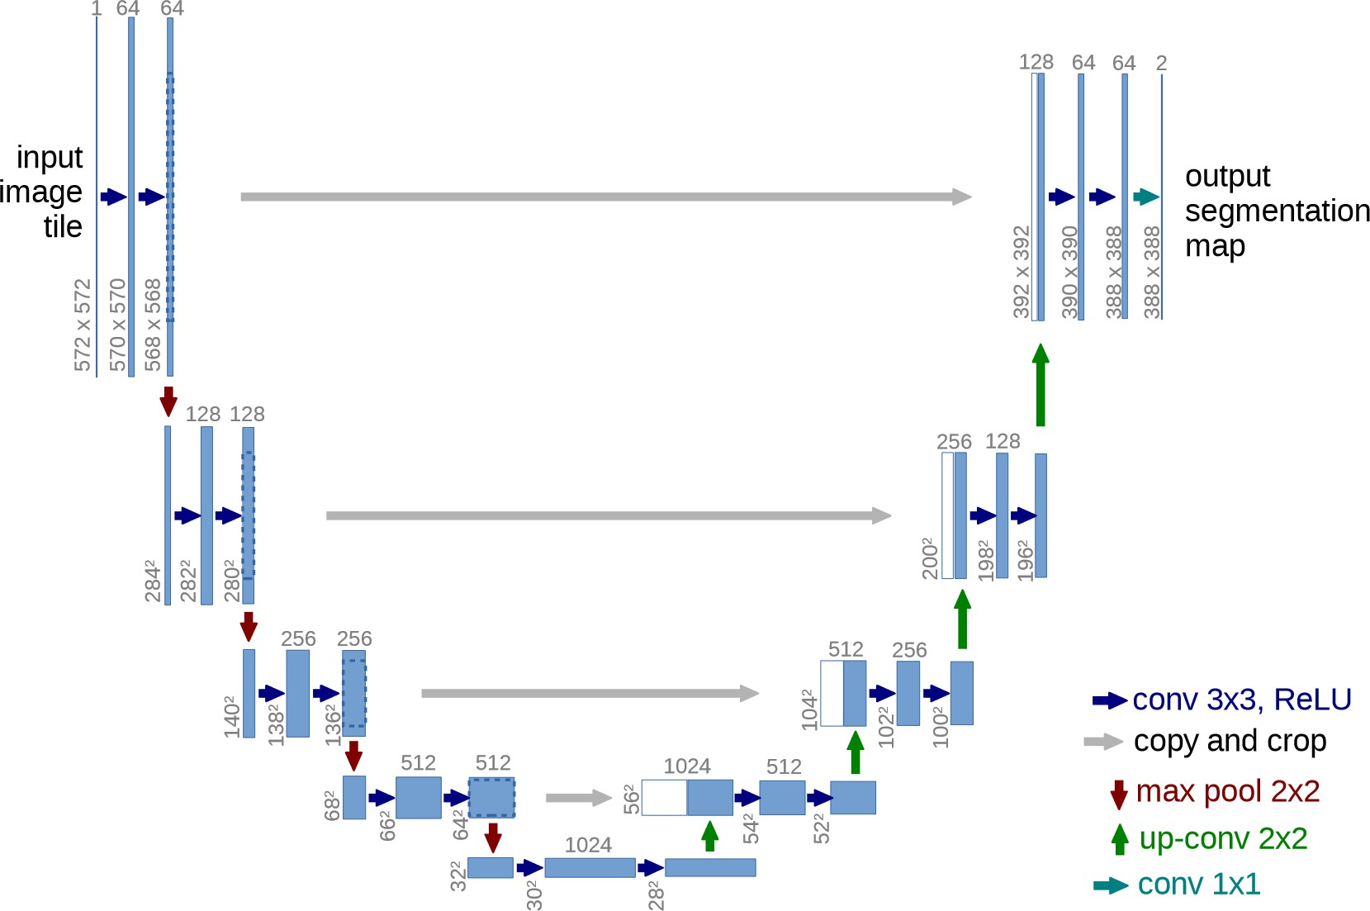
U-Net

Slide 13
How to generate new data?
Reverse process: Neural network
Original image
Pure noise
X₀
Z₁
Z₂
…
Z₃
Z_{T}
Forward process: Fixed

Slide 14
How to condition the reverse process?
Since we start from noise in the reserve process, how can the model know what we want as output? How can the model understand our prompt? This is why we need to condition the reverse process.
If we want to condition our network, we could train a model to learn a joint distribution of the data and the conditioning signal 𝑝(𝑥, 𝑐), and then sample from this joint distribution. This, however, requires the training of a model for each separate conditioning signal.
Another approach, called classifier guidance, involves the training of a separate model to condition the output.
The latest and most successful approach is called classifier-free guidance, in which, instead of training two networks, one conditional network and an unconditional network, we train a single network and during training, with some probability, we set the conditional signal to zero, this way the network becomes a mix of conditioned and unconditioned network, and we can take the conditioned and unconditioned output and combine them with a weight that indicates how much we want the network to pay attention to the conditioning signal.

Slide 15
Classifier Free Guidance (Training)

Slide 16
Classifier Free Guidance (Inference)

Slide 17
Classifier Free Guidance (Combine output)
o𝑢𝑡𝑝𝑢𝑡 = 𝑤 ∗
^{𝑜𝑢𝑡𝑝𝑢𝑡}𝑐𝑜𝑛𝑑𝑖𝑡𝑖𝑜𝑛𝑒𝑑 ^{− 𝑜𝑢𝑡𝑝𝑢𝑡}𝑢𝑛𝑐𝑜𝑛𝑑𝑖𝑡𝑖𝑜𝑛𝑒𝑑
^{+ 𝑜𝑢𝑡𝑝𝑢𝑡}𝑢𝑛𝑐𝑜𝑛𝑑𝑖𝑡𝑖𝑜𝑛𝑒𝑑
A weight that indicates how much we want the model to pay attention to the conditioning signal (prompt).

Slide 18
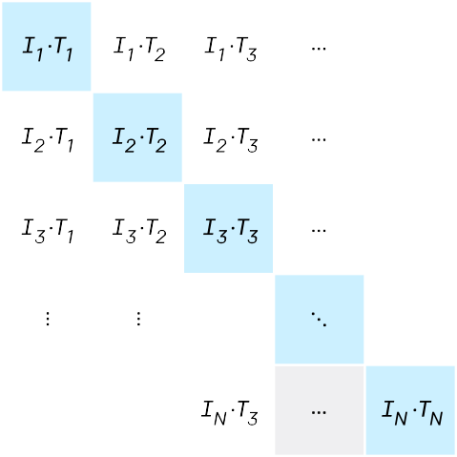
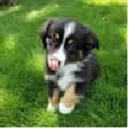
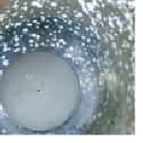
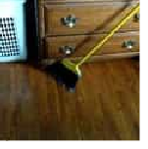
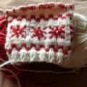
CLIP (Contrastive Language–Image Pre-training)

Slide 19
Performing many steps on big images is slow
Reverse process: Neural network
Original image
Pure noise
X₀
Z₁
Z₂
…
Z₃
Z_{T}
Forward process: Fixed
Since the latent variables have the same dimension (size of the vector) as the original data, if we want to perform many steps to denoise an image, that would result in a lot of steps through the Unet, which can be very slow if the matrix representing our data/latent is large. What if we could “compress” our data before running it through the forward/reverse process (UNet)?

Slide 20
Latent Diffusion Model
Stable Diffusion is a latent diffusion model, in which we don’t learn the distribution p(x) of our data set of images, but rather, the distribution of a latent representation of our data by using a Variational Autoencoder.
This allows us to reduce the computation we need to perform the steps needed to generate a sample, because each data will not be represented by a 512x512 image, but its latent representation, which is 64x64.

Slide 21
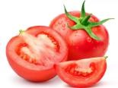
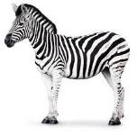
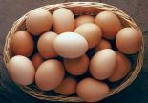

What is an Autoencoder?
X
X’
* The values are random and have no meaning
Encoder
Z
Decoder
Code
[1.2, 3.65, …]
[1.6, 6.00, …]
[10.1, 9.0, …]
[2.5, 7.0, …]
Input
Reconstructed Input

Slide 22





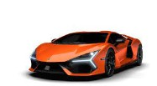


What’s the problem with Autoencoders?
The code learned by the model makes no sense. That is, the model can just assign any vector to the inputs without the numbers in the vector representing any
pattern. The model doesn’t capture any semantic relationship between the data.
X
X’
Z
Encoder
Decoder
Code
Input
Reconstructed Input

Slide 23
Introducing the Variational Autoencoder
The variational autoencoder, instead of learning a code, learns a “latent space”. The latent space represents the parameters of a (multivariate) distribution.
X
X’
Z
Encoder
Decoder
Latent Space
Input
Reconstructed Input

Slide 24
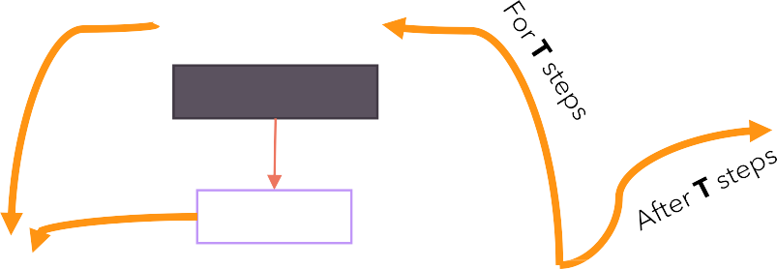
Architecture (Text-To-Image)
Random Noise
Scheduler
Time
X’
Encoder
Z
Z’
Decoder
Time Embeddings
A dog with glasses
CLIP
Encoder
Prompt Embeddings
Text Prompt

Slide 25
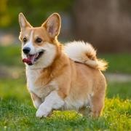
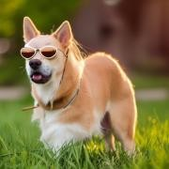

Architecture (Image-To-Image)
X
Add noise to latent
Scheduler
Time
X’
Encoder
Z
Z’
Decoder
Time Embeddings
A dog with glasses
CLIP
Encoder
Prompt Embeddings
Text Prompt

Slide 26
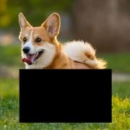
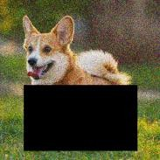

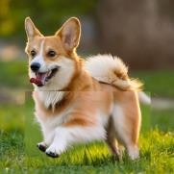
Architecture (In-Painting): how to fool models
Add noise
Combine with latent at current time step
X
Scheduler
Time
X’
Encoder
Z
Z’
Decoder
Time Embeddings
A dog running
CLIP
Encoder
Prompt Embeddings
Text Prompt

Slide 27



Layer Normalization
𝜇
_{𝜎}2
f1 f2 f3
f1 f2 f3
Item 1
a₁ | a₂ | a₃
𝜇₁ | _{𝜎}2 1
Item 1
a'₁ | a'₂ | a'₃
Item 2
Item 2
Item 3
Item 3
Each item is updated with its normalized value, which will turn it into a normal distribution with 0 mean and variance of 1.
The two parameters gamma and beta are learnable parameters that allow the model to “amplify” the scale of each feature or apply a translation to the feature according to the needs of the loss function.
X =
(10, 3)
X’ =
With batch normalization we normalize by columns (features)
With layer normalization we normalize by rows (data items)
Item 10
Item 10

Slide 28
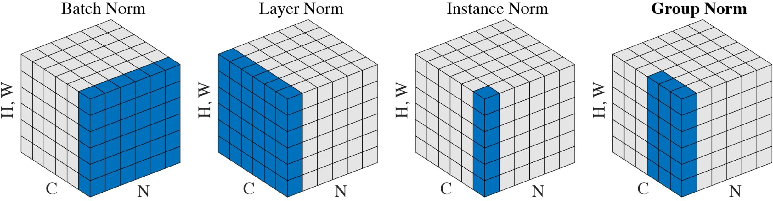
Group Normalization

Slide 29
Thanks!
Questions and Answers
Kush Gupta (23134)
Kavin Moudgil (23329)
Mirat Parmar (23345)

