Slide 1
A Study of San Francisco Bay Area Food Map
Part of Applied Data Science Course provided by IBM
Shiyi Wang
7/27/2019

Slide 2
Problem statement
To recommend a suitable location or neighborhood to operate a restaurant for its manager
To recommend a community to live in for food-lovers who decide to move to Bay
Tool and Methods used:
FourSquare API
Python folium, Python Pandas Data Frame, Python Plots
One hot encoding
k-means clustering method

Slide 3
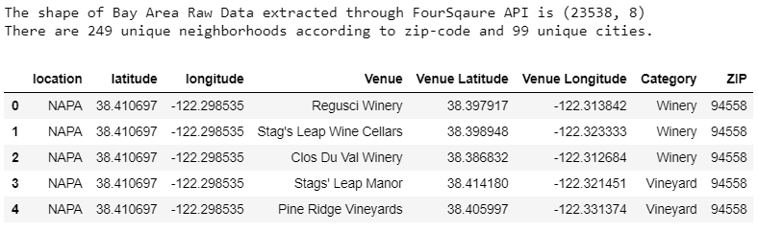
Data clean and process
PO_NAME | the_geom | ZIP | STATE | Area__ | Length__
NAPA | MULTIPOLYGON (((-122.10329200180091 38.51328299864645, -122.10348400246679 38.51190700043408, …))) | 94558 | CA | 1.23E+10 | 995176.2
FAIRFIELD | MULTIPOLYGON (((-121.947475002335 38.30151100055196, -121.94717500296504 38.299311999636366, …))) | 94533 | CA | 9.92E+08 | 200772.6
DIXON | MULTIPOLYGON (((-121.65335500334429 38.31338700062926, -121.69340200238318 38.313735999442926, …))) | 95620 | CA | 7.24E+09 | 441860.2
SONOMA | MULTIPOLYGON (((-122.406843003057 38.1556819994161, -122.40757000042267 38.155718998957866, …))) | 95476 | CA | 3E+09 | 311318.5
NAPA | MULTIPOLYGON (((-122.406843003057 38.1556819994161, -122.40757000042267 38.155718998957866, …))) | 94559 | CA | 1.19E+09 | 359104.6
Based on pandas.DataFrame, convert the raw data to FourSqaure API preferred data with data cleaning functions (as below)
The main input of FourSqaure API includes latitude, longitude, location names
The output includes 23538 data points with 249 unique towns as below

Slide 4
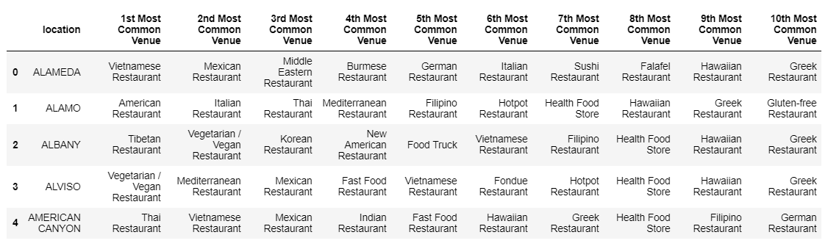
Bay Area Restaurants in the form of “most common venue”

Slide 5
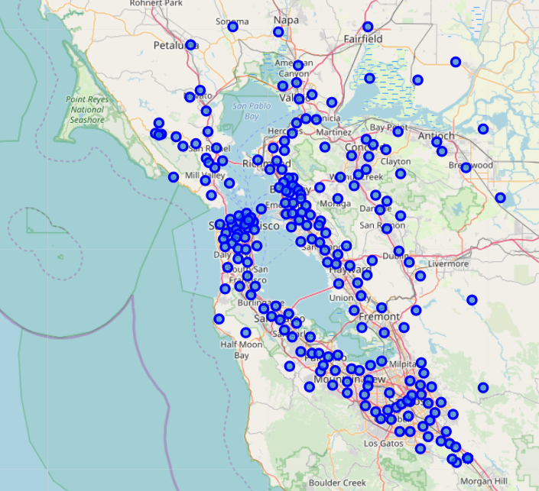
Baseline folium map for Bay Area
**Blue circles represent each zip-code area

Slide 6
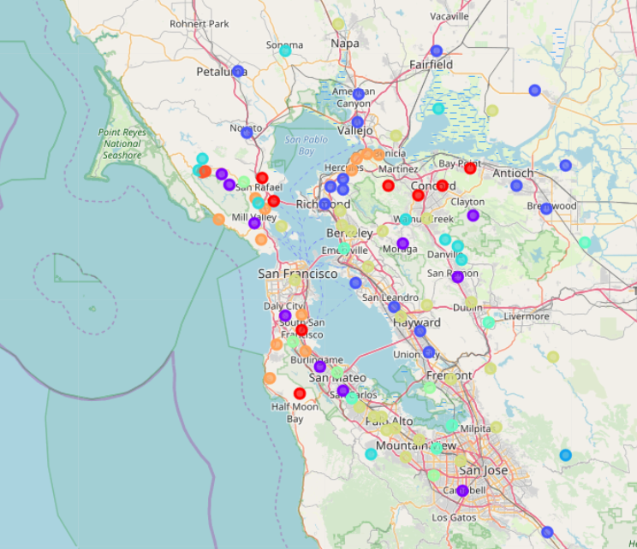
Bay Area Restaurant Clusters shown in interactive map
** Apply k-means clustering method

Slide 7
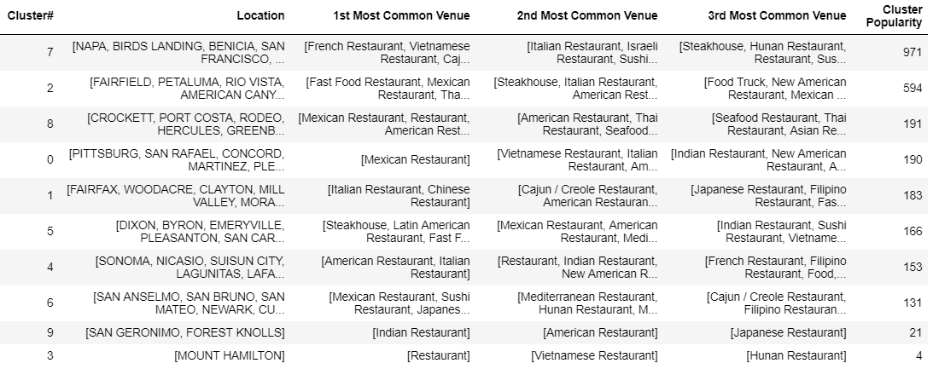
Clustered Bay Area Restaurant Data (10 clusters are used)

Slide 8
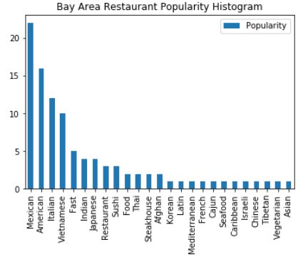
Bay area restaurant popularity
Top Group
Second Group
Third Group

Slide 9
Result discussions
Cluster 7: This is the top 1 cluster with highest popularity (light yellow circle in Figure 2).
Diverse Food Category: French, Vietnamese, Japanese, Italian, American, Chinese and etc
San Francisco, Napa, Mountain View, Oakland, Los Altos, Palo Alto, Milpitas, Fremont and Santa Clara. We can see most of the cities in this cluster has a very dense population.
Cluster 2: Ranked as No.2 cluster in popularity, this cluster shows strong preference to
Mexican food and Vietnamese food followed by American food and fast food (blue circle in Figure 2).
The main cities include San Jose, Union City, Hayward and etc.
Cluster 8: Ranked as No.3 cluster in popularity,
Mexican food, Vietnamese food, American food, Chinese food and Seafood.
Cluster 0: (Red circle in Figure 2) No.4 cluster in popularity.
solid Mexican food-lovers.
Cluster 1: No.5 cluster in popularity.
Chinese food and Italian food (purple circle in Figure 2).
The key cities in this cluster include Campbell and Daly City.
Cluster 5: (Green blue in Figure 2) No.6 cluster in popularity.
steakhouse, Latin restaurant, Mediterranean Restaurant and Vegetarian restaurant.
The key city is Sunnyvale.
Cluster 4: (Light blue in Figure 2) No.7 cluster in popularity.
American Restaurant and Italian Restaurant.
Cluster 6: (Yellow green in Figure 2) No.8 cluster in popularity. They love
Sushi or Japanese Restaurant, and also some Mexican Restaurant.
The key cities in cluster include Cities: San Anselmo, San Bruno, San Mateo, Newark and Cupertino.

Slide 10
Conclusions
In summary, the favorite cuisine of bay area people includes Mexican food, American food, Italian food and Vietnamese food. People has also shown their preference in the categories of Indian food, Japanese/Sushi food, Thai food and steakhouse.
The food-lovers or restaurant managers can select the cities under Cluster 7 according to the clustered food map for a diverse environment, and also pick up the area with strong preferences under Cluster2, Cluster0, Cluster1, Cluster5 and Cluster4 based on the selector’s own favorite.
This food map can also provide a community distribution, as the cluster with more food categories tend to have diverse residents with different backgrounds. On the other hand, the cluster with few food categories may also indicate a concentrated community with single background.

Slide 11
Thank you !

