Slide 1


ASE '26
Kozuchi Agent
A Language-Agnostic Open-Weight Agent
for Software Repair
Mehdi Bahrami et al.,
Fujitsu Research of Ameria
October 12–16, 2026

Slide 2
Overview
Problem statement
Related Works
Thesis and our approach
Evaluation results
Conclusion
This work reflects a multi-lab collaboration effort across Fujitsu Research teams in Japan, the United States, Europe, and China, that led to 2026 Fujitsu Research Award and an accepted paper at ASE’26, Germany.

Slide 3
Problem statement: model capability is only one failure surface
1
Long-horizon drift
2
Tool-grammar drift
3
Cluster heterogeneity
4
Evaluation cost
Agents skip reproduction, repeat analysis, or patch before understanding.
A small syntax mismatch can invalidate a sound action and waste turns.
Inference, testing, and grading run on different hardware and runtimes.
Multi-hour runs make full recomputation too expensive for rapid iteration.
A benchmark-ready agent must be:
auditable • recoverable • selectable

Slide 4
What the Agent Must Implement
Existing idea: `safeseq` marks each sequence element safe.
New behavior:
escapeseq(value)
should apply Django's escaping operation to EACH element.
Conceptually:
return [conditional_escape(obj) for obj in value]
Why?
`join` can combine sequence elements when template
autoescaping is disabled. `escapeseq` makes each element
safe by escaping it before the downstream `join`.
Example:
["x&y", "<p>"]
↓ escapeseq
["x&amp;y", "&lt;p&gt;"]
↓ join:","
"x&amp;y,&lt;p&gt;"

Slide 5
Actual Regression Tests
class EscapeseqTests(SimpleTestCase):
# representative ground-truth cases
test_basic
["&", "<"] → "&amp;, &lt;"
test_autoescape_off
{% autoescape off %}
{{ a|escapeseq|join:", " }}
{% endautoescape %}
→ "&amp;, &lt;"
test_chain_join
verifies escapeseq works before join
test_chain_join_autoescape_off
["x&y", "<p>"]
→ "x&amp;y<br/>&lt;p&gt;"

Slide 6
Repository-level repair is a systems problem, not a code-completion task
Issue
Reproduce
Localize
Patch
Validate
natural-language
report
observable
failure
root cause
in a repository
minimal
code change
fix bug +
preserve behavior
Resolved = issue-revealing tests pass AND existing regression tests still pass
Failure surfaces span the whole path:
REASONING
TOOL USE
CONTEXT STATE
ENVIRONMENT
SELECTION

Slide 7
Related work: four lines of research shape the design space
Agentic repair loops
Structured pipelines
SWE-agent • OpenHands • AutoCodeRover
AGENTLESS
Flexible shell-based reasoning and acting over repositories.
Localization–fix–verify decomposition reduces open-ended search.
Test-time selection
Industry coding agents
CodeT • R2E-Gym • BEST@K
Copilot • Q Developer • Jules • Codex • Devin
Generated tests or verifiers rank multiple candidate solutions.
Product systems demonstrate demand for asynchronous issue-to-patch agents.

Slide 8
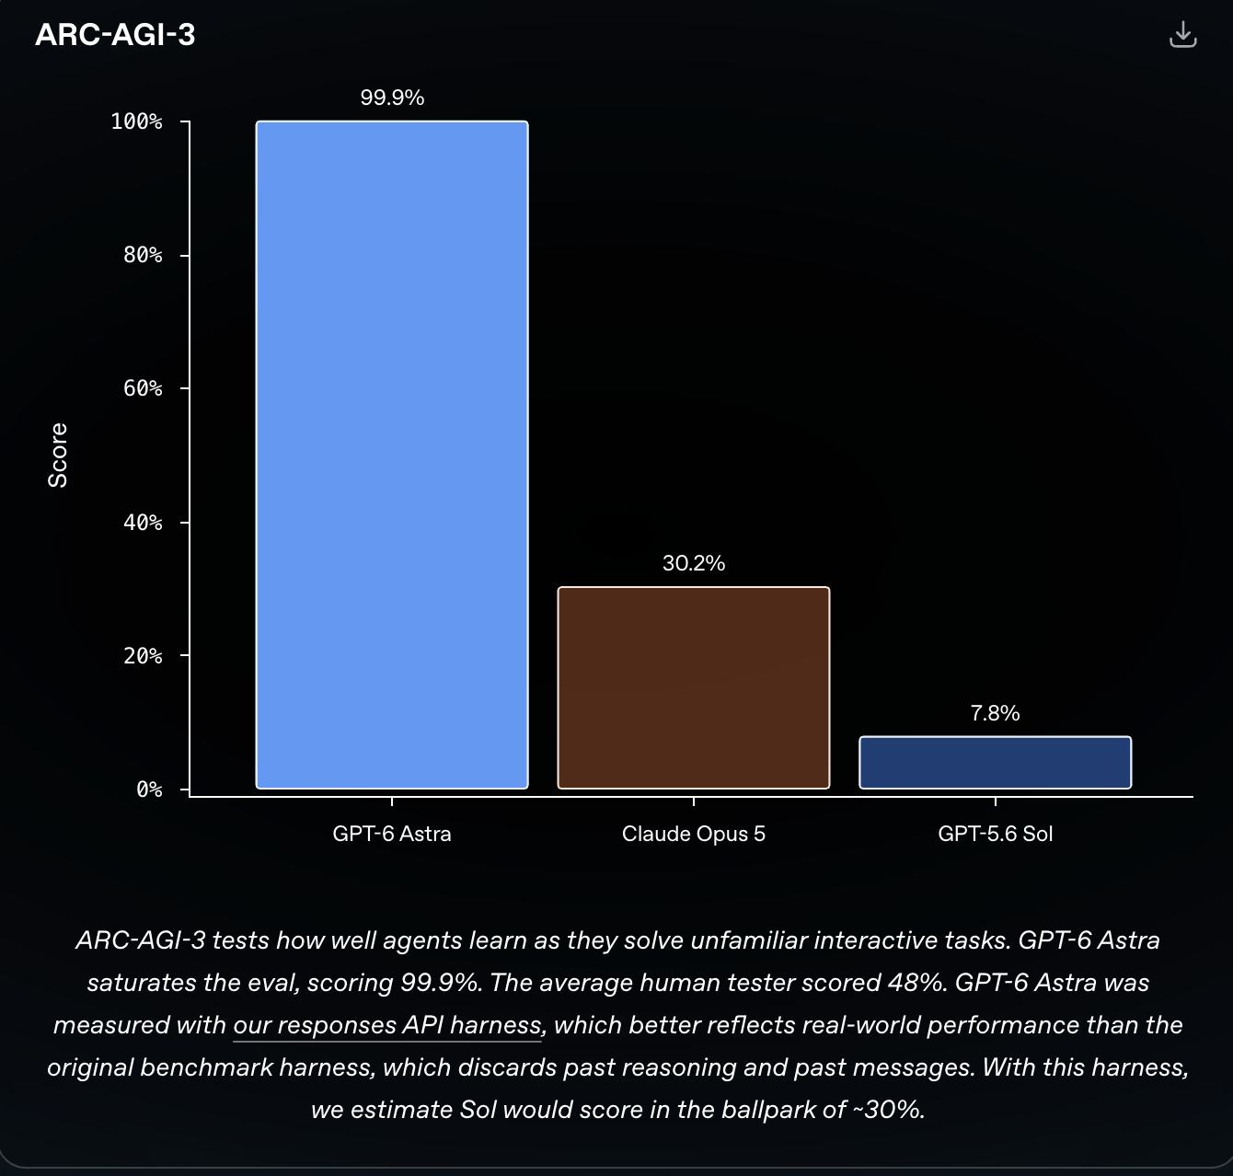
THESIS
The next performance gain
came from the harness—not the weights.
+7.1 pp
27B • no fine-tuning • no learned verifier
vs. mean pass@1
Execution evidence selects among diverse candidate trajectories.
Target
Benchmark
Performance
Models
https://openai.com/index/gpt-6-astra

Slide 9
Positioning: scale inference with execution evidence, not extra training
Model customization
Learned verification
Single trajectory
Fine-tuning can improve capability, but adds data, training, and model-maintenance cost.
Specialized reward models or LLM judges add another model and another failure surface.
One long attempt is fragile: early mistakes propagate and useful diversity is discarded.
Our target: training-free • model-free selection • auditable test-time scaling

Slide 10
Design goal: turn an open-ended repair into a controlled workflow
1
Structure
2
Persist
3
Normalize
4
Select
Explicit phases and fallback edges
Filesystem-backed evidence and handovers
One action contract across model families
Cross-test candidates using execution
issue description + repository
auditable, test-passing patch

Slide 11
Our approach: engineer the harness
C1
C2
C3
C4
Phase-driven runtime
Reusable CI pipeline
Cross-agent testing
Evidence and diagnosis
Eight phases, persistent handovers, normalized actions, and deterministic tools.
Candidate generation, grading, selection, and reporting across heterogeneous clusters.
Each run contributes a patch and tests; all usable tests are cross-applied.
Official accuracy, selector ablations, reliability, and failure-mode analysis.
One model configuration → auditable trajectories → execution-grounded selection → one patch

Slide 12
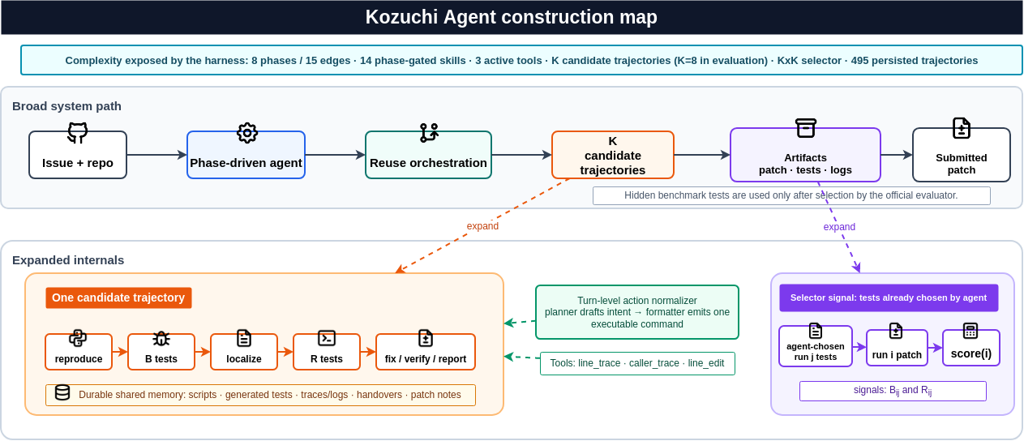
Solution overview: one harness, two scales of control

Slide 13
Method I: define the agent as an explicit runtime contract
R = ⟨ P, S, T, A, F, H ⟩
Phases
Shared state
Tools
P
S
T
local goals + explicit transitions
tests, traces, notes, and diffs
fixed deterministic operations
Action format
Parser
Handover
A
F
H
one logical command per turn
record malformed actions explicitly
compress evidence across phases
The configuration declares the contract before execution; trajectories become auditable against it.

Slide 14
Method: one action → one auditable state update per turn
1
2
3
4
5
6
Render
Model
Parse
Execute
Persist
Decide
phase + skills
+ shared state
draft next
repair action
enforce one
action grammar
sandbox command
or tool
observation +
artifacts
continue, compress,
or hand over
Format error? record it—do not execute. Over budget? compress into shared state.
Phase exit? write a handover.
next phase
same phase: observation returns to the next rendered turn

Slide 15
Kozuchi SWE Harness:
Eight explicit phases make long repairs auditable and restartable
01
02
03
04
05
06
07
08
Reproduce
issue
Synthesize
failing tests
Localize
code
Localize
regression tests
Implement
fix
Verify
patch
Clean up
+ review
Final
report
late-stage failure → repair loop
Every exit writes a handover: tests • traces • root-cause notes • patch diffs • open risks

Slide 16
Control long trajectories with durable state and a small tool surface
DURABLE MEMORY
DETERMINISTIC TOOLS
The filesystem is the source of truth.
Keep the tool set small, inspectable, and phase-gated.
Reproduction scripts
line_trace
runtime values at suspect lines
Generated tests
Traces and logs
caller_trace
paths from symptom to code
Handover memos
line_edit
guarded edits against expected text
Patch notes

Slide 17
Cross-agent testing: use each run’s tests to judge the other patches
8 independent runs
K × K execution matrix
Execution score
Δ1
0.3 × bug tests
+
0.7 × regression tests
Δ2
Δ3
Δ4
SELECTED PATCH
one patch + two test suites per run
tests from run j × patch from run i
Hidden benchmark tests are never used during selection.

Slide 18
Evaluation: fixed model, eight trajectories, official benchmark
27B
K = 8
500
Official
Qwen3.5 open-weight backbone
independent candidate runs
SWE-bench Verified issues
cloud evaluator headline
1
Generate
2
Cross-test
3
Evaluate
patch + tests + trajectory
21,635 patch–suite executions
one selected patch per issue
No fine-tuning before deployment; model weights remain unchanged.

Slide 19
HEADLINE RESULT
74.8%
70.82–78.41
Wilson 95% confidence interval
374 / 500 resolved
SWE-bench Verified • official evaluator
#1
27B
open-weight system in frozen peer snapshot
parameters
Competitive performance without model customization.

Slide 20
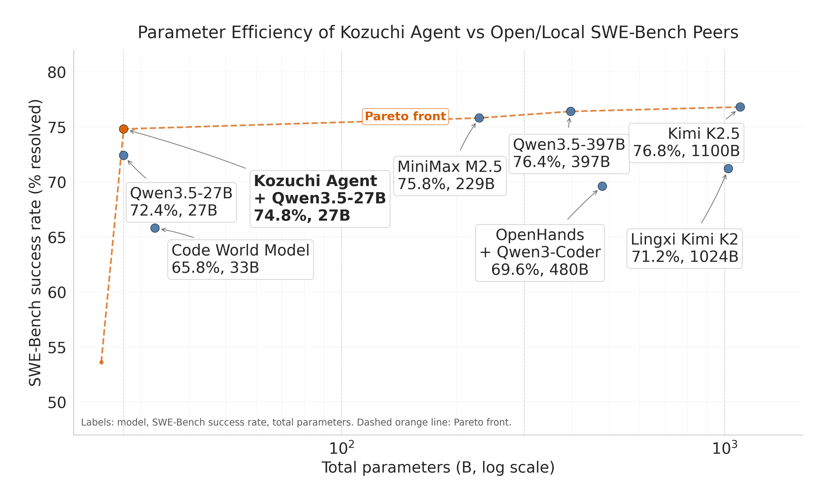
Result: the 27B system sits on the open/local Pareto frontier
74.8%
success rate

Slide 21
Selection lift: diversity first, cross-agent ranking second
+7.5 PP VS MEAN PASS@1
+2.8 PP VS ORDER BASELINE
Selection captures 376 of the 408 issues solved by at least one run.
81.6%
75.2%
72.4%
67.7%
Mean
pass@1
Order
baseline
Cross-agent
selector
Oracle
pass@8

Slide 22
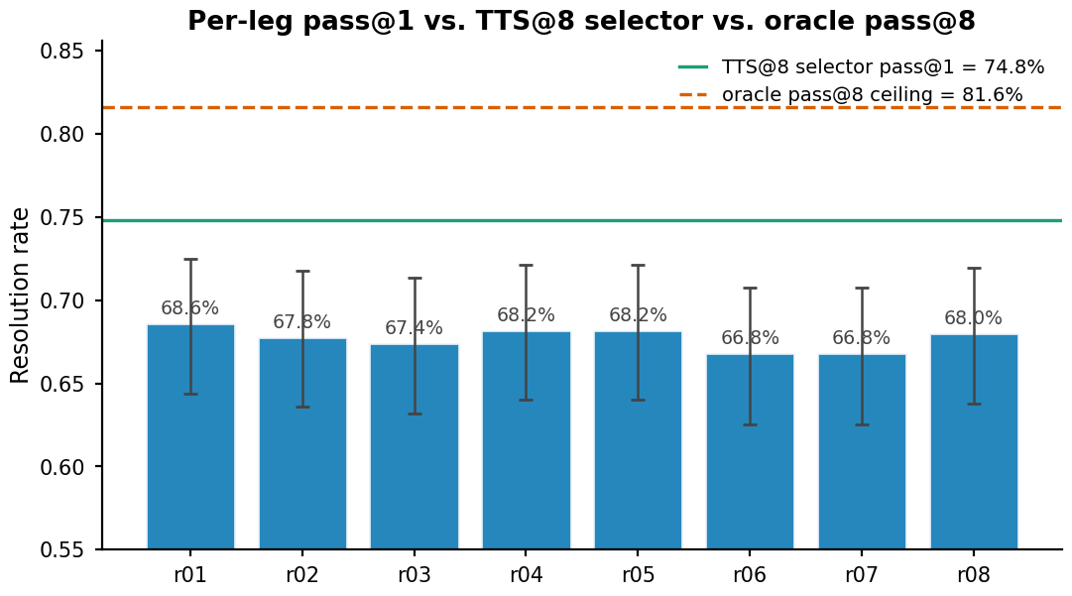

Slide 23
Reliability: formatting is solved; semantics is the bottleneck
494/495
91.3%
34
produced patches apply cleanly
of unresolved cases are clean-applying WRONG_FIX patches
oracle-solved issues missed by final selection
Unresolved outcome composition (model quality)
WRONG_FIX 115
Next frontier: semantic correctness + better selection signals.

Slide 24
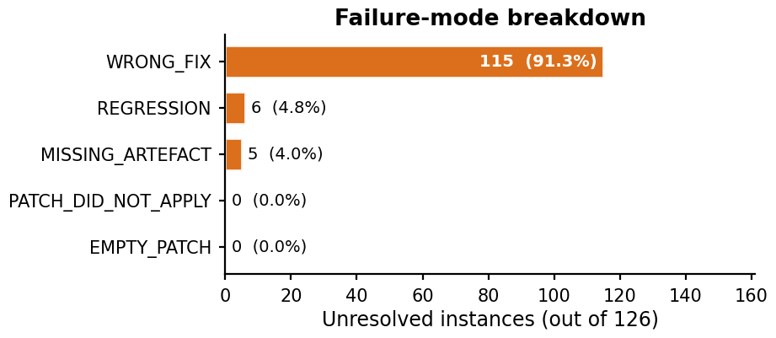
Failure taxonomy for the 126 unresolved issues
BACKUP
0
empty patches
0
patch-did-not-apply failures
Five missing artifacts remain in the canonical 500 denominator.

Slide 25
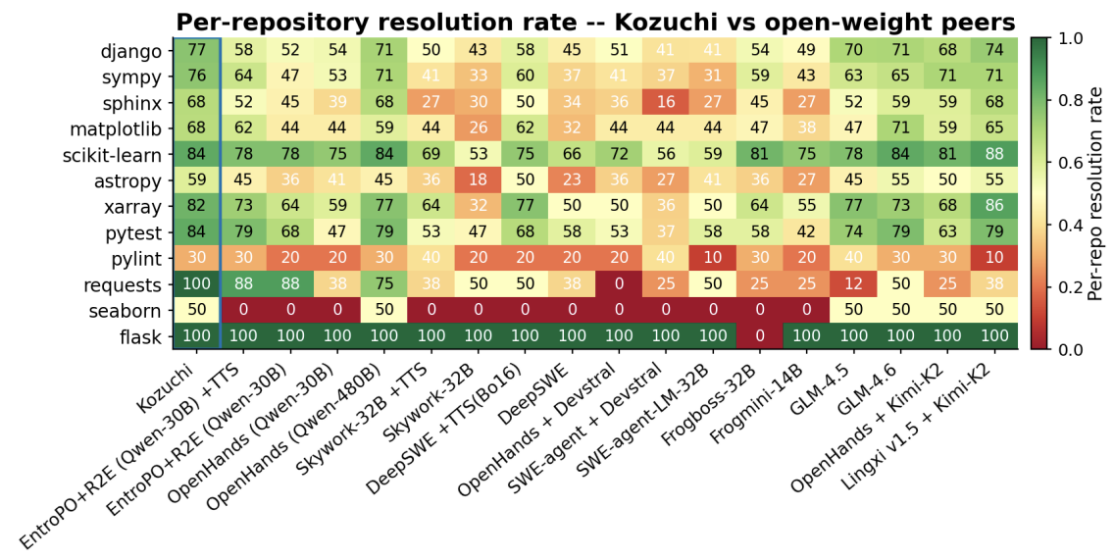
Per-run pass@1, selected result, and oracle ceiling
BACKUP

Slide 26
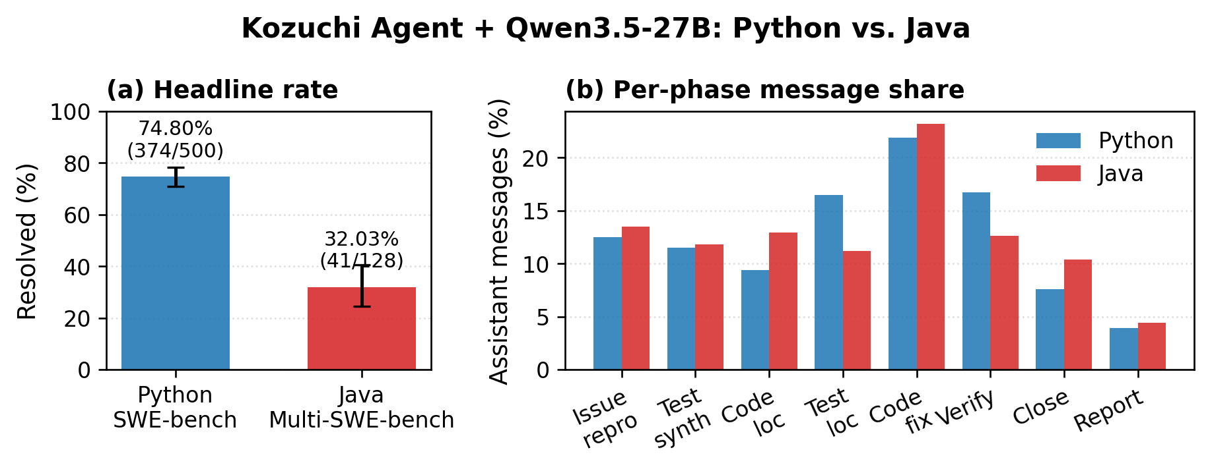
Cross-language transfer: same scaffold, different absolute difficulty
32.03%
Java • 41 / 128
#1
strict open-weight Java
Per-phase message share stays within ±5 pp.

Slide 27
Operational impact: manual workflow → reusable CI
BEFORE
WITH KOZUCHI
5
operator touch-points
1
CI push
0 / 9
reusable stages
6 / 9
reusable stages
ad hoc
cluster scripts
5
ENV_NAME targets
manual
score log
495
trajectories + selection JSON

Slide 28
TAKEAWAYS
Summary
Workflow is a capability multiplier.
01
Phases and durable state keep long repairs coherent.
Diversity needs executable evidence.
02
Cross-agent tests beat order and self-test selection.
System quality is measurable.
03
74.8% official; 494/495 clean apply; residual gap is semantic.

Slide 29
Questions?
From Phases to Patches
http://github.com/marscod/kozuchi-agent-artifact

Slide 30
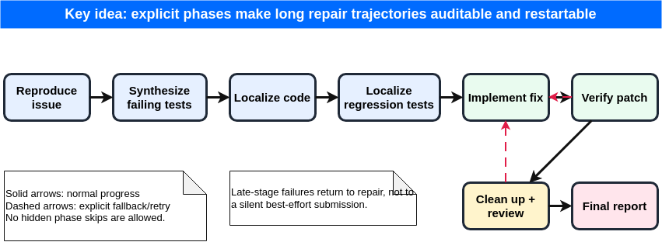
Detailed phase graph
BACKUP

Slide 31
Selector details and guardrails
BACKUP
No leakage
Deduplicate
score(i) = 1/K Σⱼ (0.3 Bᵢⱼ + 0.7 Rᵢⱼ)
Hidden benchmark tests unavailable at selection time
Content-identical patches are scored once
B: bug-revealing pass rate R: regression pass rate
Apply gate
Conservative tie
Tie rate
304 / 495
Non-applying patches are excluded
Prefer the shortest patch within ε = 0.001
The selector actively reorders 302 / 495 instances.

Slide 32
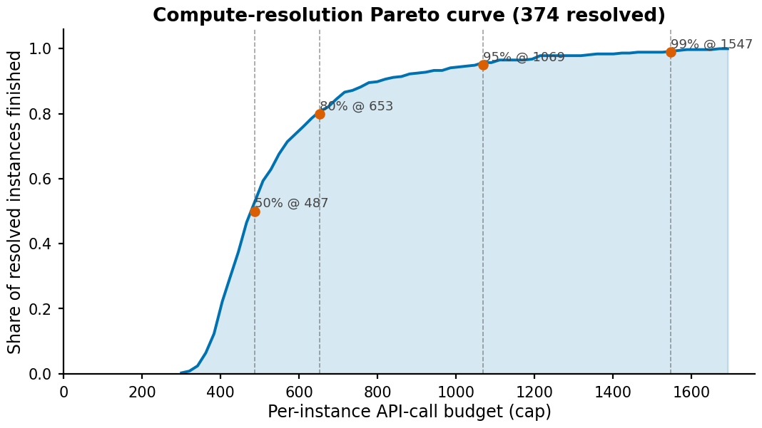
Compute–resolution envelope
BACKUP
653
calls capture 80% of resolved issues
1,069
calls capture 95%

Slide 33
Reproducibility configuration
BACKUP
Backbone
Candidate runs
Qwen/Qwen3.5-27B
r01_s1001 … r08_s1008
Agent limits
Serving
1,000 steps • 6 h instance timeout
2-GPU tensor parallel • max context 150k
Tools
Analysis seed
line_trace • caller_trace • line_edit
20260427
Artifacts pin model identity and run provenance; model weights are external.

Slide 34
Evidence boundary and threats to validity
BACKUP
Ablated
Candidate count K=8; cross-agent selector
Sensitivity
Selector weights: ≤ 5 / 500 outcome change nearby
Operational
Phase graph, handover, formatter, tools, CI reuse
Estimate
Engineer-minute saving; wall-clock-derived GPU bound
Out of scope
Production deployment and developer field study

Slide 35
Paper Figure 2 — Kozuchi Agent construction map
BACKUP
The broad pipeline and the expanded internals of one auditable candidate trajectory.
K = 8 candidate trajectories • durable shared state • deterministic tools • K×K selector

Slide 36
Algorithm 1 — phase-driven repair orchestration
BACKUP
Inputs: issue I, repository R, phase graph Φ, skills K, tools T, grammar A, state S, limits B.
01 p ← p_reproduce; H,M,τ ← ∅
02 while p ≠ p_final do
03 Kp ← phase/tool-gated skills
04 Cp ← Render(I,R,Φ[p],Kp,S,M,H)
05 e ← ⊥
06 while e = ⊥ do
07 y ← LLM(Cp,H)
08 a ← Parse_A(y)
09 if a = ⊥:
10 o ← FormatError(y,A)
11 else:
12 o ← SandboxExec(a,R,T)
13 S ← UpdateArtifacts(S,p,a,o)
14 H,τ ← append(y,a,o,S)
15 e ← ExitMarker(y,o)
16 if e = ⊥ ∧ OverBudget(...):
17 m ← Compress(H,S,p)
18 S ← S ∪ {m}; H ← ∅
19 Cp ← Render(...,S,M,H)
20 end if
21 end while
22 (p,M) ← PhaseHandover(
23 Φ,p,e,H,S,M)
24 // write memo + follow next/fallback
25 end while
26 (Δ,ρ) ← CollectFinalArtifacts(S,M)
27 return (Δ,ρ,τ)
Every malformed action is recorded.
Every phase exit persists evidence.
Output: candidate patch Δ • final report ρ • complete trajectory bundle τ

Slide 37
Selector algorithm — turn candidate diversity into execution evidence
BACKUP
No hidden benchmark tests and no learned verifier are available at selection time.
1
Collect
2
Gate
3
Cross-apply
4
Score
5
Select
K patches + each run’s
bug and regression tests
Deduplicate patches;
exclude apply failures
Run suite j against
candidate patch i
0.3 × bug pass rate
+ 0.7 × regression rate
arg max; shortest patch
within ε = 0.001
score(i) = (1/K) Σⱼ [0.3 Bᵢⱼ + 0.7 Rᵢⱼ]
21,635 matrix executions • 302/495 candidates reordered

Slide 38
Paper Table 2 — per-evaluation-cycle workflow comparison
BACKUP
Operational impact is scoped to the internal benchmark pipeline replacement.
Aspect | Pre-Kozuchi agent | Kozuchi agent
Operator touch-points / cycle | 5: vLLM, launch, wait, grade, log | 1: CI push
Operator effort / cycle | ≈75 min (estimate) | ≈5 min (estimate)
Backend integrations | Separate integration effort | 4 formats × 17 model configs
Reusable pipeline stages | 0 of 9 | 6 of 9
Cluster targets / abstraction | Per-cluster scripts | 5 via ENV_NAME
Score provenance | Manual score log | 495 trajectories + selection JSON
Patch applicability | Not measured | 494/495 clean apply
The ≈70 engineer-minute reduction is an order-of-magnitude estimate, not a controlled developer study.

Slide 39
Paper Table 3 — cross-agent selector summary
BACKUP
The selector actively re-ranks patches on execution evidence and uses a conservative tie-break.
Quantity | Value | Quantity | Value
Expected (Verified) | 500 | wB | 0.3
Selected / covered | 495 | wR | 0.7
Resolved (xcheck) | 376 | Tie ε | 0.001
Score / expected | 75.2% | Tie-breaker | shortest patch
Order baseline | 362 (72.4%) | Tie applied | 304 / 495
Unique patches | 5.59 / 8 mean | Matrix executions | 21,635
Reordered | 302 / 495 | Official evaluator | 374 / 500
Cross-agent selection adds +14 resolved over the first-run-wins order baseline.

Slide 40
Paper Table 4 — candidate-level TTS@8 decomposition
BACKUP
Only the 174 marginal instances expose a genuine selector choice.
Quantity | Interpretation | Value
Mean pass@1 | Average over eight runs | 67.7%
All-run solved | ri = 8: scaffold-easy | 234 / 500
Zero-run solved | ri = 0: scaffold-hard | 92 / 500
Marginal instances | 1 ≤ ri ≤ 7: selector-sensitive | 174 / 500
Oracle pass@8 | Any run resolves | 408 / 500 = 81.6%
Cross-agent selector | Official evaluator | 374 / 500 = 74.8%
Selector regret | Oracle minus submitted result | 34 / 500 = 6.8 pp
376/408 = 92.2% of the internal Docker oracle union is captured; 92 issues have no solving candidate.

Slide 41
Paper Table 5 — SWE-bench Verified resolution by repository
BACKUP
Canonical denominator: 500 instances; official evaluator headline: 374 resolved.
Repository | Resolved | Rate
astropy | 13 / 22 | 59.1%
django | 177 / 231 | 76.6%
matplotlib | 23 / 34 | 67.7%
seaborn | 1 / 2 | 50.0%
flask | 1 / 1 | 100.0%
requests | 8 / 8 | 100.0%
Repository | Resolved | Rate
xarray | 18 / 22 | 81.8%
pylint | 3 / 10 | 30.0%
pytest | 16 / 19 | 84.2%
scikit-learn | 27 / 32 | 84.4%
sphinx | 30 / 44 | 68.2%
sympy | 57 / 75 | 76.0%
OVERALL 374 / 500 = 74.8%

Slide 42
Paper Table 6 — failure taxonomy and edit-layer reliability
BACKUP
The residual gap is semantic correctness, not malformed or empty patches.
Category | Count | Share
WRONG_FIX | 115 | 91.3%
REGRESSION | 6 | 4.8%
MISSING_ARTEFACT | 5 | 4.0%
PATCH_DID_NOT_APPLY | 0 | 0.0%
EMPTY_PATCH | 0 | 0.0%
Total unresolved | 126 | 100.0%
494 / 495
produced patches apply cleanly
0
malformed-diff or empty-patch failures
All 495 persisted trajectories reach exit_status = Submitted; five missing artifacts remain unresolved.

Slide 43
Paper Table 7 — artifact-based TTS@8 ablation
BACKUP
This comparison isolates candidate count and selector design; scaffold mechanisms are not ablated.
Variant | Resolved | Rate | Interpretation
K=1, no selector (mean) | 338.6 | 67.7% | Eight-run mean
K=1, no selector (best) | 343 | 68.6% | Best candidate leg
K=8, order baseline | 362 | 72.4% | No cross-agent ranking
K=8, self-tests only | 346 | 69.2% | Estimated from archived tables
K=8, cross-agent selector | 376 | 75.2% | Execution-grounded selected
K=8, oracle | 408 | 81.6% | Upper bound
Measured lift: +14 resolved vs. order baseline; +30 vs. self-tests-only; 32 internal wins remain to oracle.

Slide 44
Paper Table 8 — Python–Java cross-track evidence
BACKUP
Same Qwen3.5-27B agent configuration; different corpus and evaluation harness.
Signal | Python | Java
Benchmark | SWE-bench Verified (n=500) | Multi-SWE-bench Java (n=128)
Resolved (Wilson 95% CI) | 374/500 = 74.8% [70.82, 78.41] | 41/128 = 32.03% [24.57, 40.54]
Leaderboard position | 12 / 135 overall | 4 / 42 overall
Open-weight rank | 1st curated open-weight | 1st strict open-weight
BH-FDR peer wins | 16 / 17 open-weight peers | 34 / 41 Java peers
Same-family open margin | +26 vs. Qwen3-Coder-480B | +38 vs. Qwen2.5-72B
Median LLM calls | 490 | 529
Applying patch output | 494/495 = 99.8% | 124/128 = 96.9%
Globally novel solves | 1 | 1

Slide 45
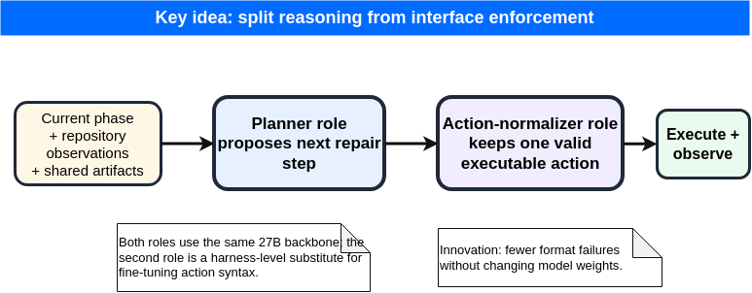
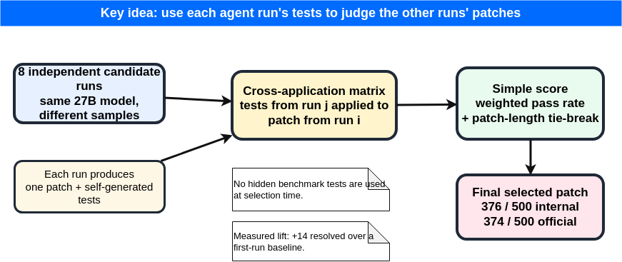
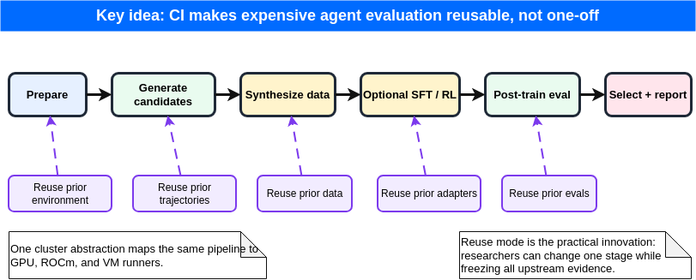
Additional paper mechanism figures
BACKUP
Editable source figures are retained in the paper package; these renders are presentation-ready.
Explicit phase graph
Planner + action normalizer
Cross-agent test selection
CI reuse pipeline

