Slide 1

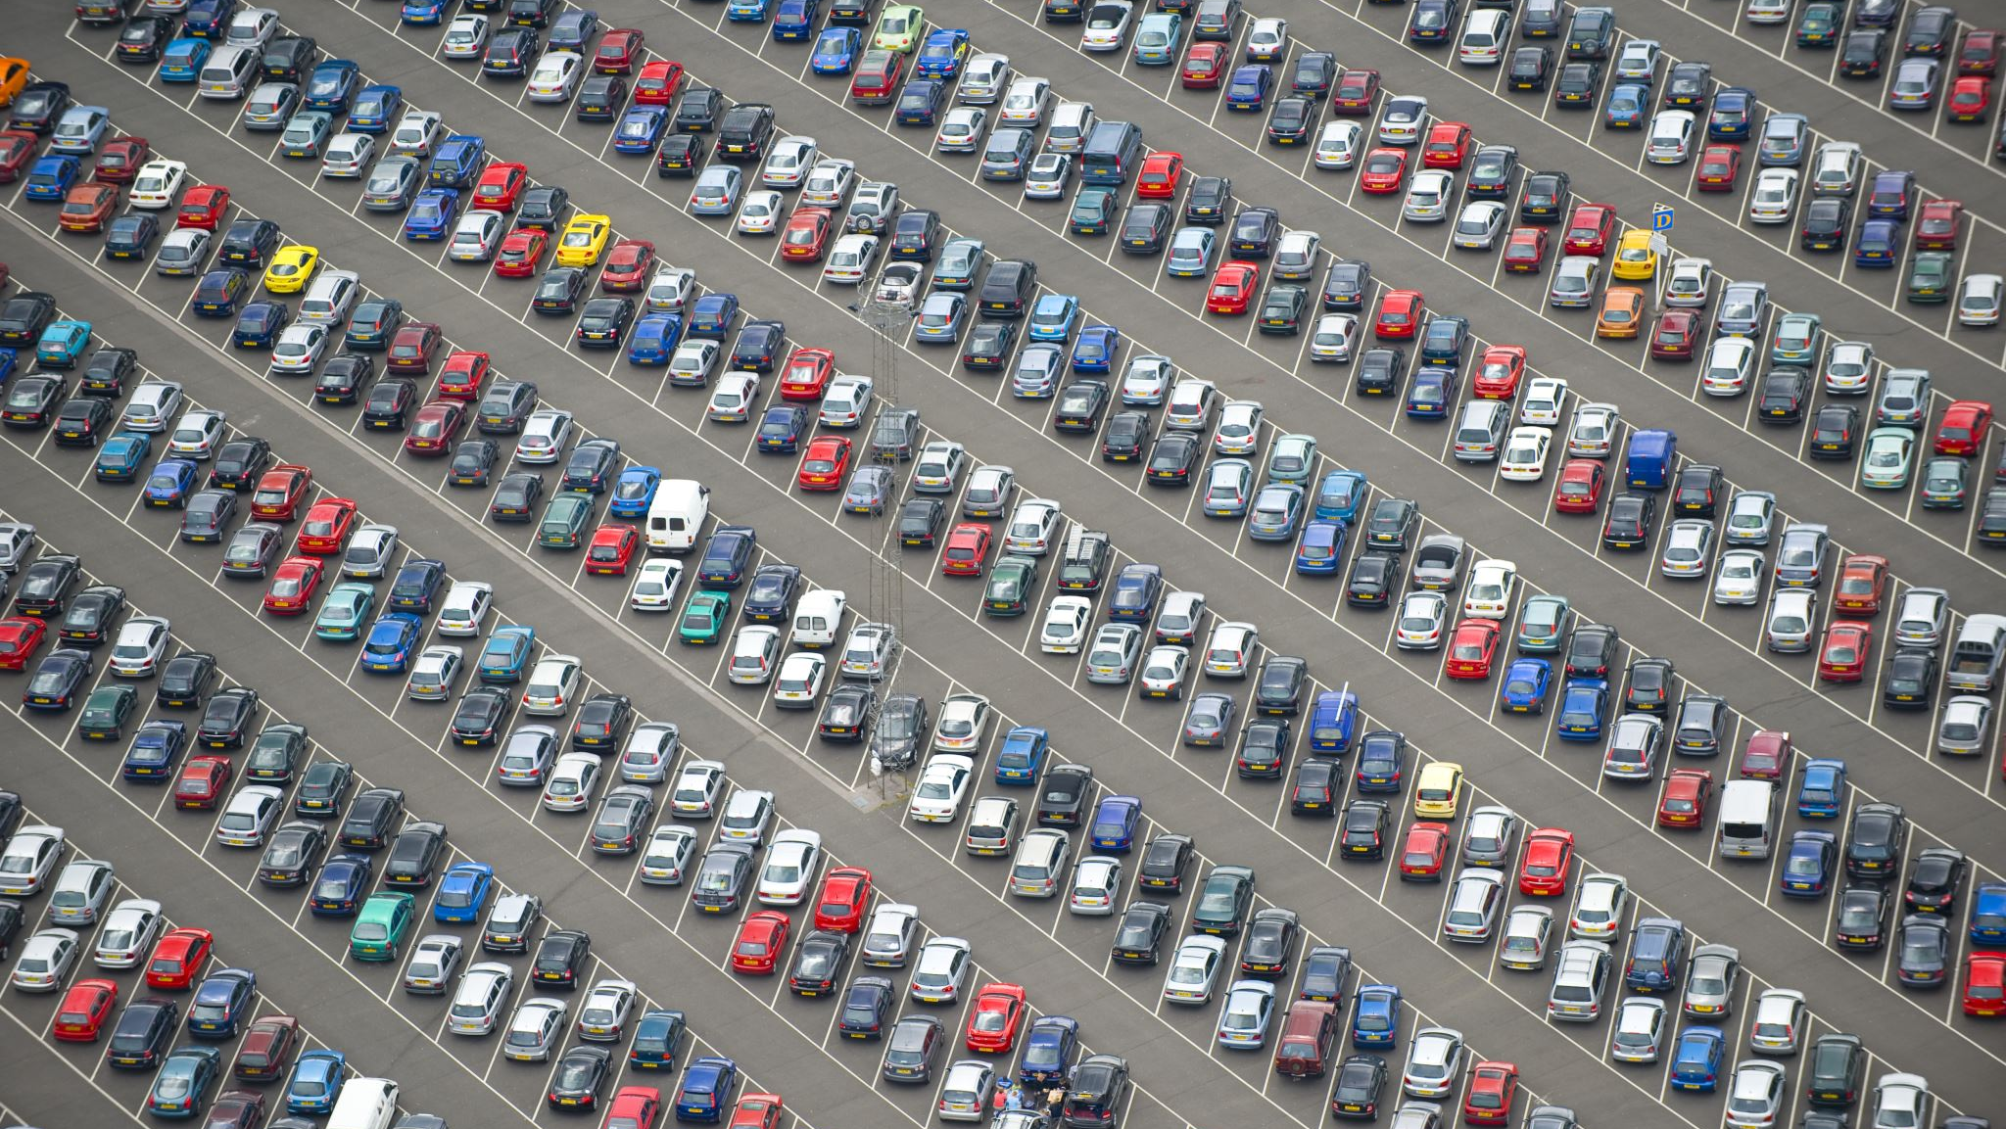
Vehicle Sales Analysis
Nathan Guevara, Francisco Bou, Wisdom Mbaluka,
Marshall Prose, Alfred Savio

Slide 2
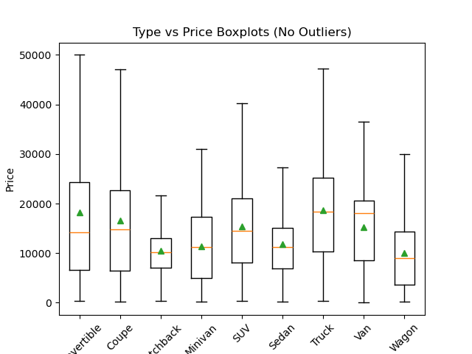
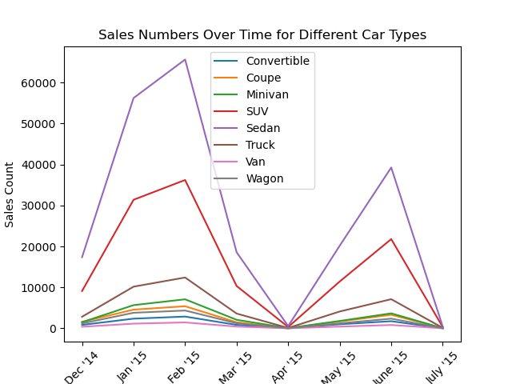
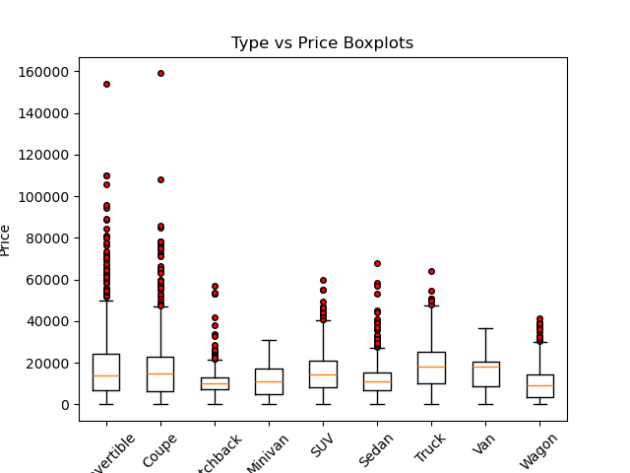
Vehicle Type vs Sales
Are there correlations between type and sales performance?

Slide 3
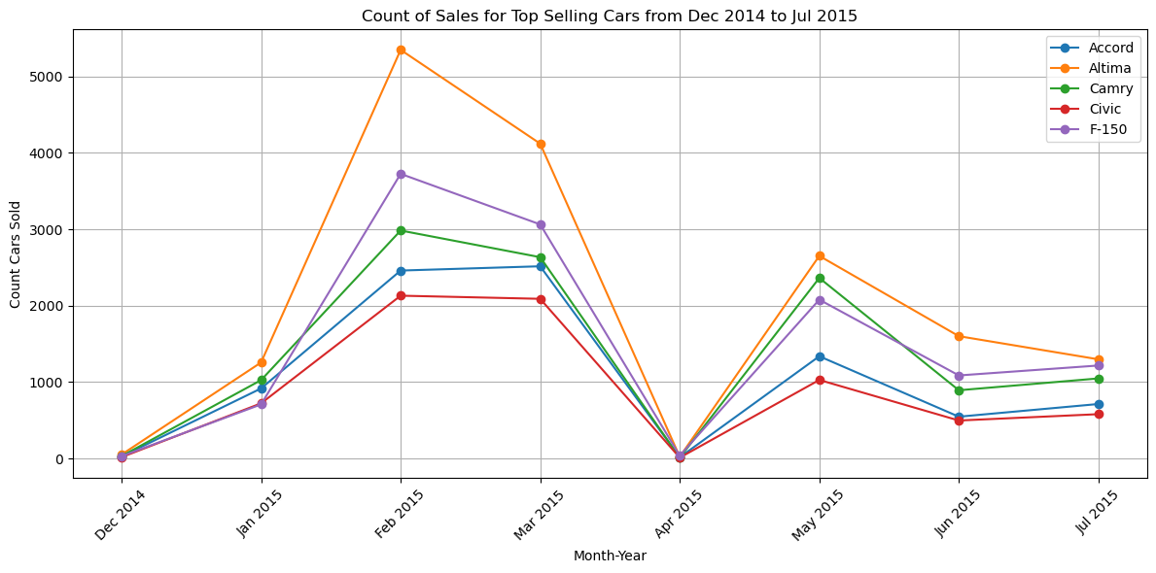
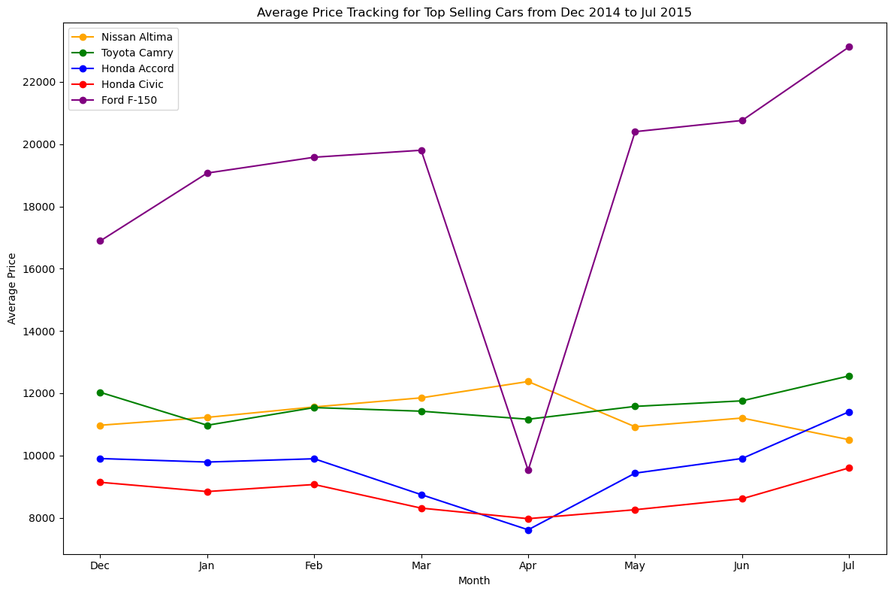
TOP VEHICLE MODEL SALES
How do top selling vehicle models trend over time? Does a change in sales indicate a change in price?

Slide 4
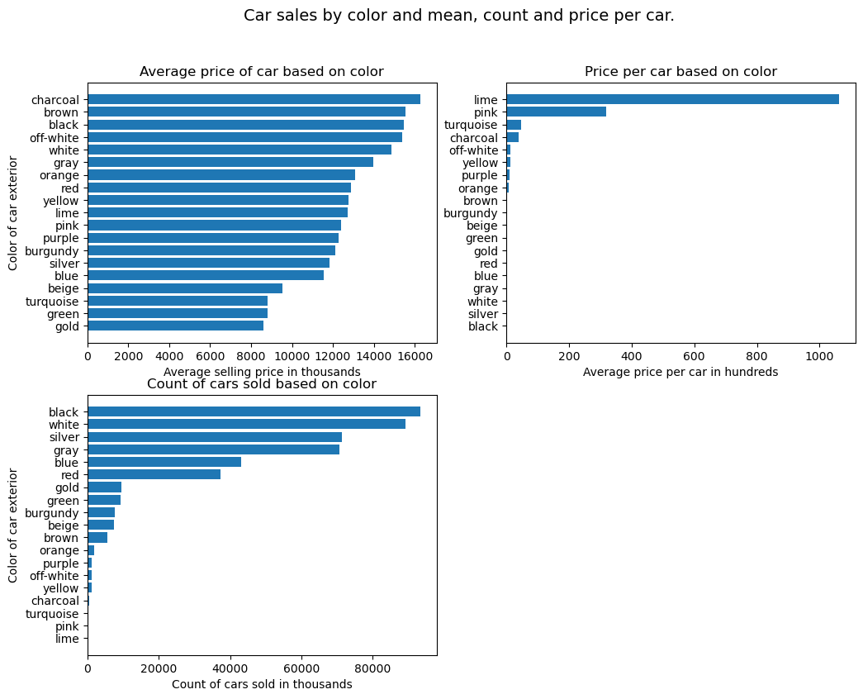
Cars Sales vs Exterior Color
Are there any correlations between exterior color and vehicle sales?

Slide 5
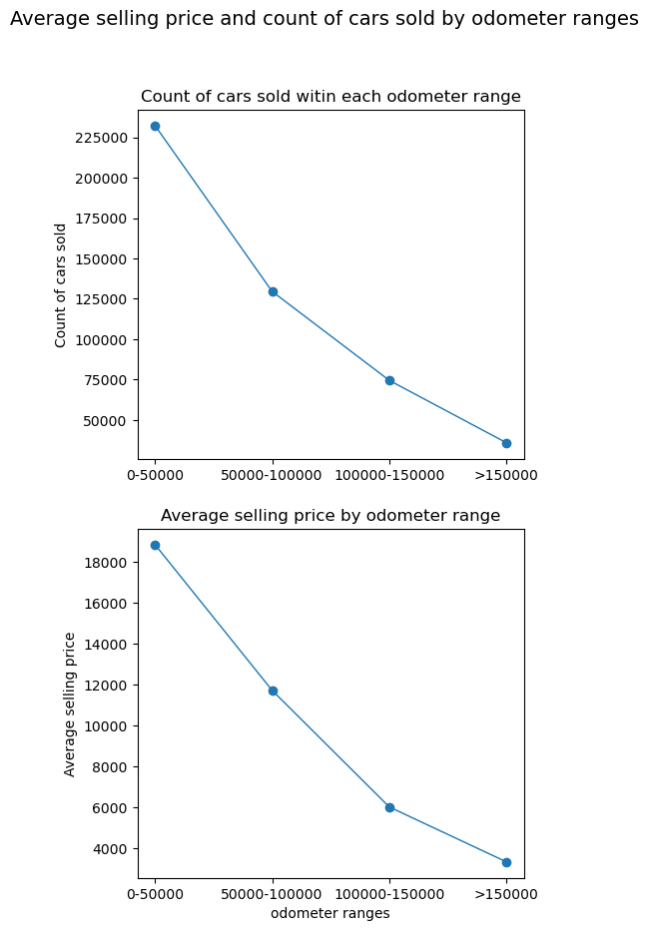
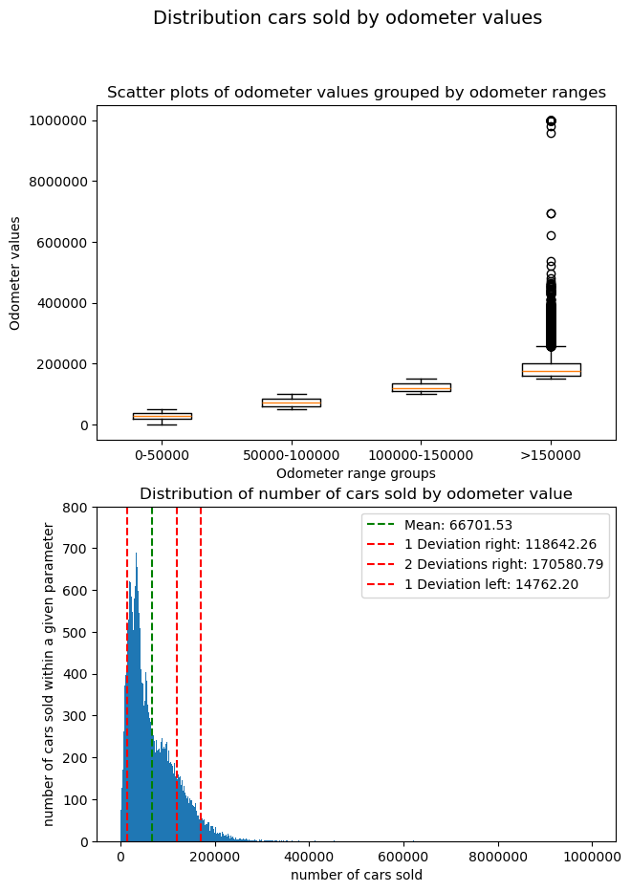
Car Sales vs Odometer
Are there any correlations between odometer values and sales performance?

Slide 6
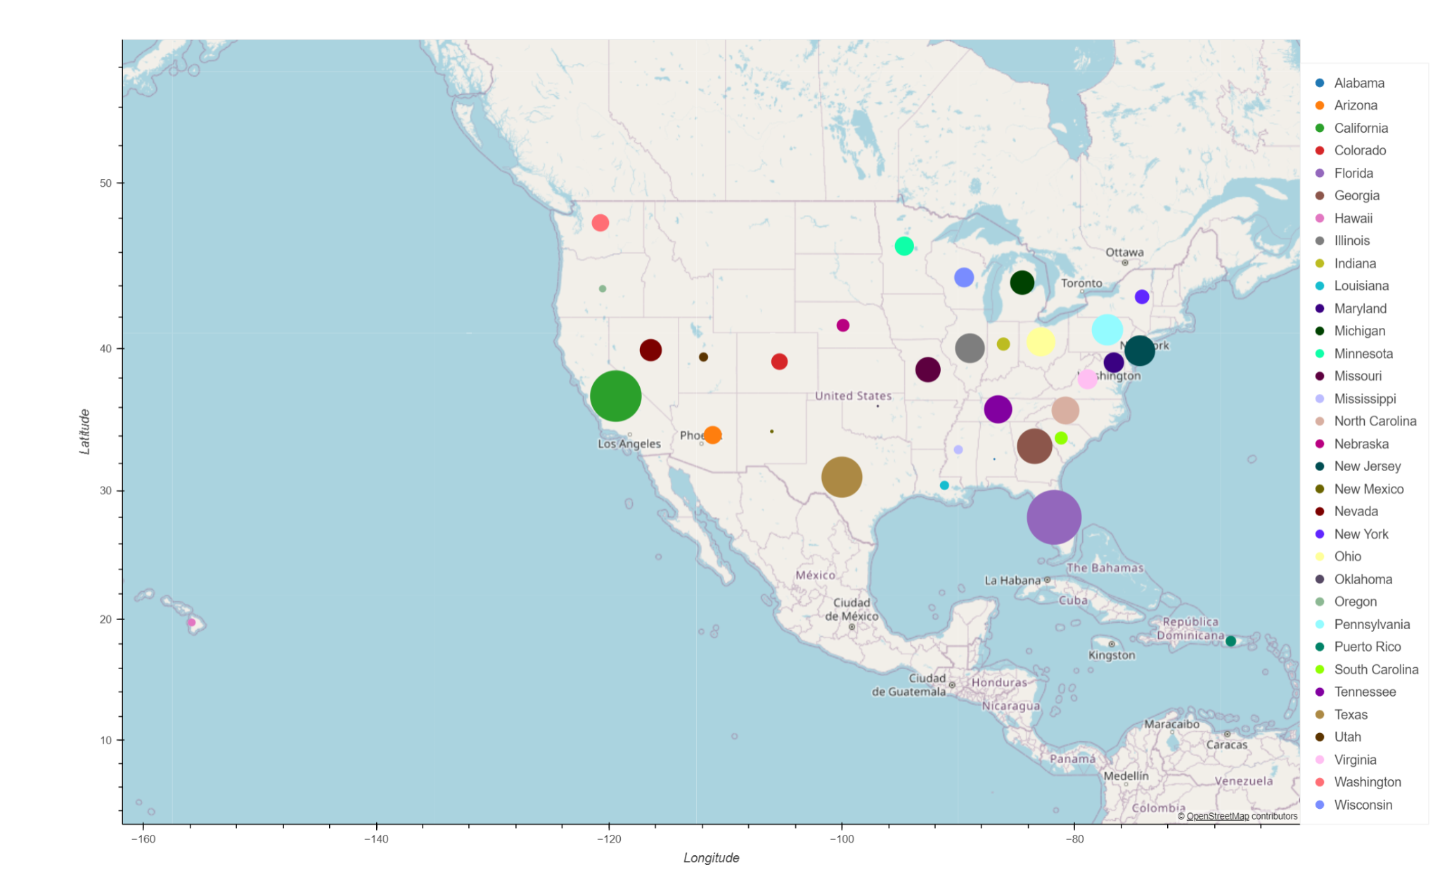
Sales Volume by Region
How do vehicle sales vary by region?
Dot size represents number of sales

Slide 7
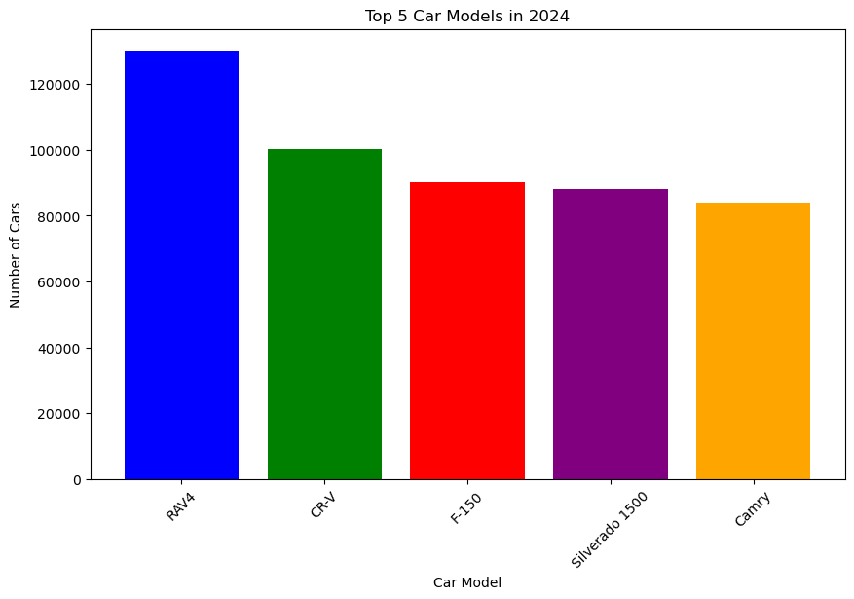
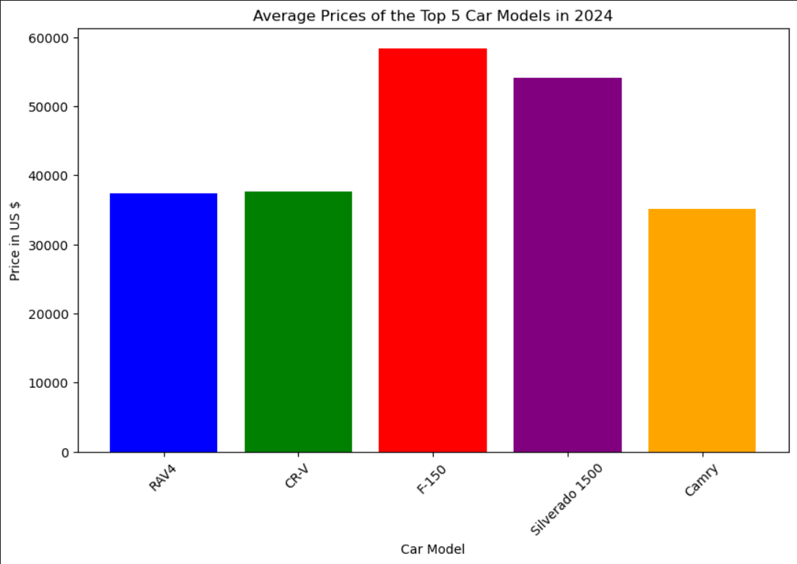
2024 Top Selling Models
Using marketcheck API to investigate today’s vehicle market

