Slide 1

Portfolio case study
SHELF
SENSE
What should sell,
what may spoil,
and what to do next
Food waste prevention
and markdown planning
A practical Streamlit dashboard for bakery operations
Built with Python, Pandas, SQLite, Plotly, and Streamlit
Live demo: shelfsense-food-waste.streamlit.app

Slide 2

The operating problem
Perishable inventory creates a trade off between availability and waste
Bakery teams need to make decisions before products expire. A useful tool has to show the evidence behind the decision, not only a final score.
Too much production
Too little production
Creates surplus stock
and higher waste risk
Increases stockout risk
and missed sales
ShelfSense keeps the decision visible: production, sales, stock, expiry, waste, and markdown are read together.
ShelfSense | Portfolio project
02

Slide 3
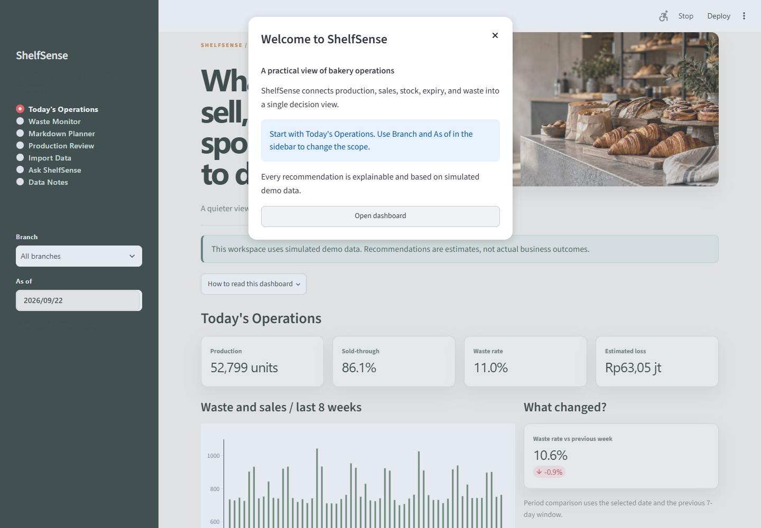
The dashboard in use
A manager starts with the current operational picture
The home screen answers three questions
1 How much was produced and sold?
2 Where is waste moving?
3 Which product needs attention before expiry?
The Branch and As of filters keep the view grounded in a specific operating scope.
ShelfSense | Portfolio project
03

Slide 4
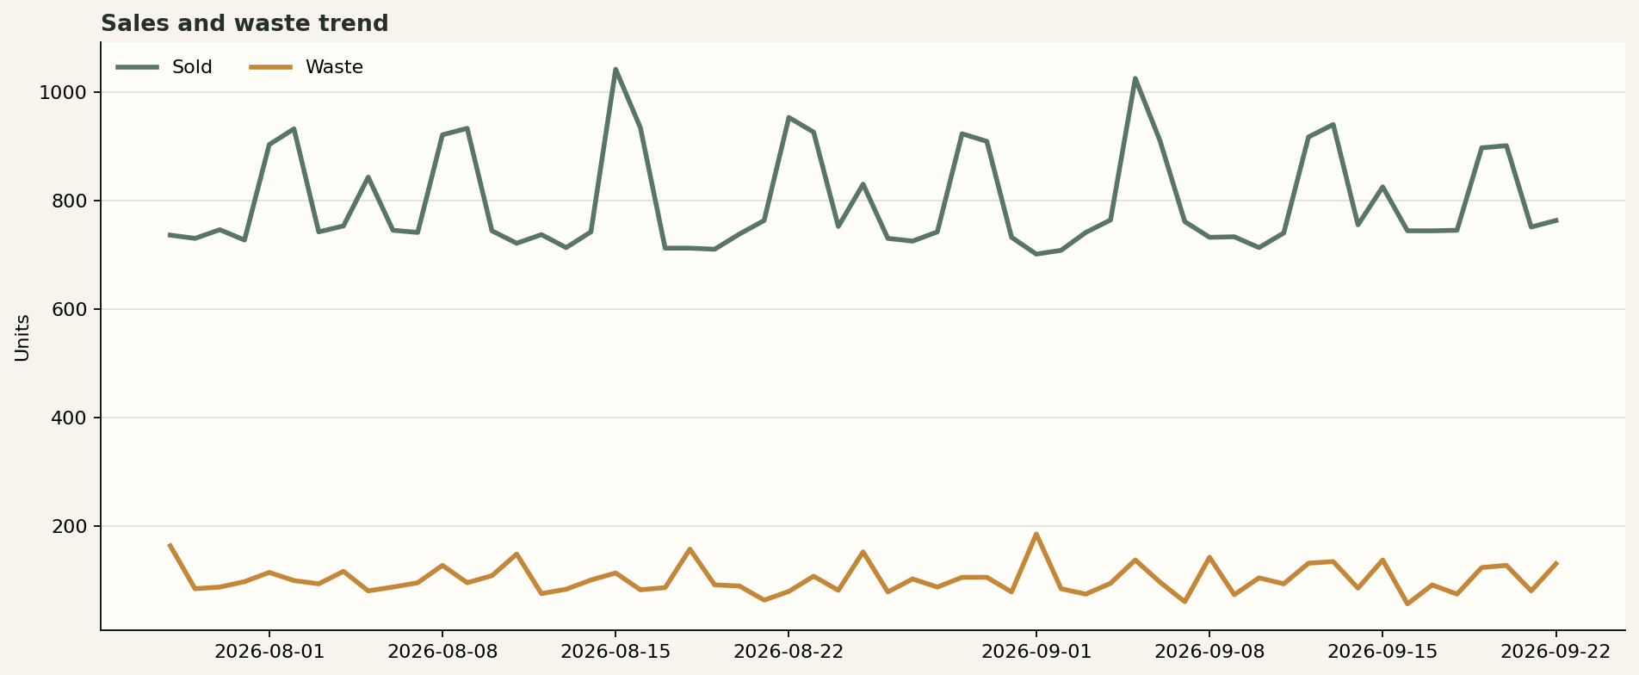
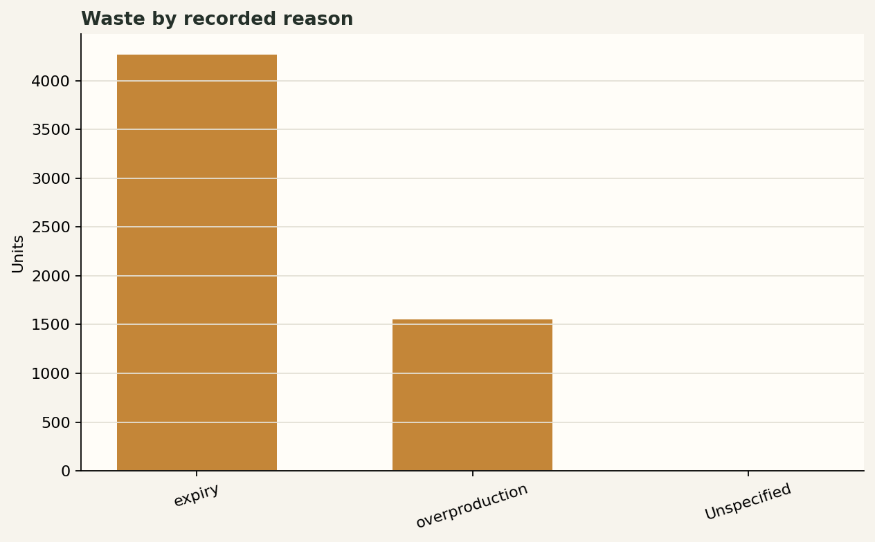
The analysis behind the screen
Simple formulas keep the recommendations explainable
Sold-through rate
sold quantity / production quantity
Waste rate
waste quantity / production quantity
Estimated loss
waste quantity × unit cost
Stock gap
current stock − demand baseline
ShelfSense | Portfolio project
04

Slide 5
From transaction to recommendation
The pipeline keeps data, rules, and presentation separate
01
02
03
04
05
06
Excel
Validation
SQLite
Analytics
Decision engine
Dashboard
Incoming transactions
Clean rows only
Local source of truth
KPI and demand baseline
Markdown and production rules
Manager view and notes
This separation makes the project easier to test and extend. A rule can change without rewriting the interface, and the interface can evolve without changing the database schema.
ShelfSense | Portfolio project
05

Slide 6
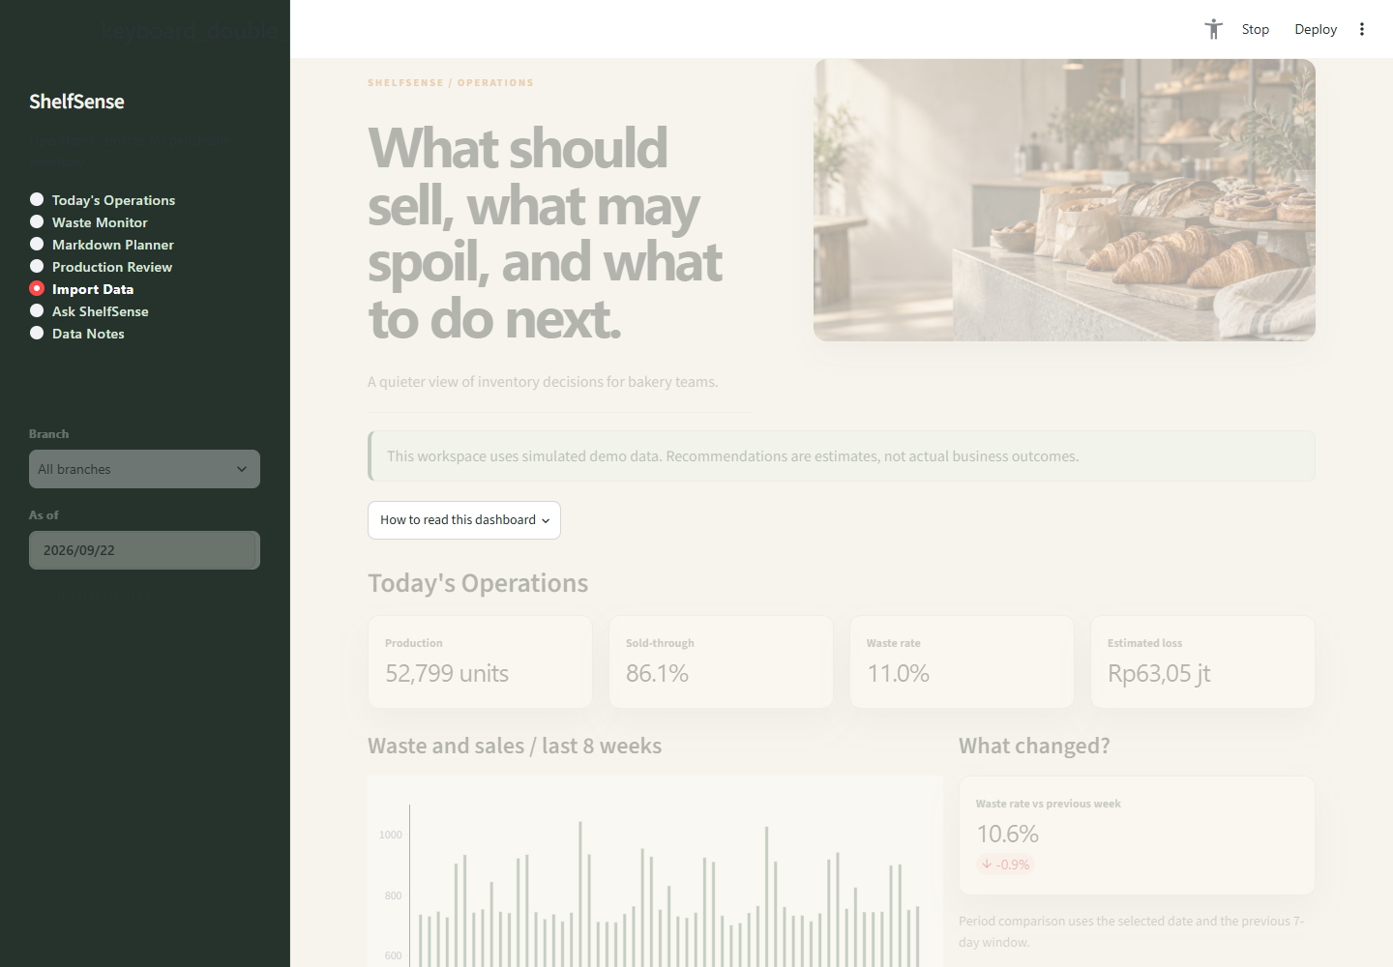
Excel upload and auditability
The upload flow is part of the product, not an afterthought
A new workbook is checked before it can change the dashboard.
The system checks required columns, dates, numeric values, negative quantities, duplicate transaction IDs, discount ranges, and production limits.
Only valid rows are inserted
The dashboard then refreshes from SQLite.
ShelfSense | Portfolio project
06

Slide 7
What this project demonstrates
A portfolio project should show judgment as well as implementation.
DATA
Simulated data with clear assumptions and validation
DECISIONS
Explainable rules connect metrics to manager actions
DELIVERY
A usable dashboard, exportable workbook, tests, and documentation
Current scope: local MVP with SQLite and a moving average baseline. The next production steps are authenticated access, a managed database, validated forecasting, and deployment.
ShelfSense | Portfolio project
07

Slide 8
Thank you for exploring ShelfSense
See the working dashboard and explore the decision flow in the live demo.
LIVE DEMO
https://shelfsense-food-waste.streamlit.app/
Let's connect
marshaauliaworks@gmail.com
Portfolio project | Food waste prevention and dynamic pricing
ShelfSense | Portfolio project
08

