Slide 1
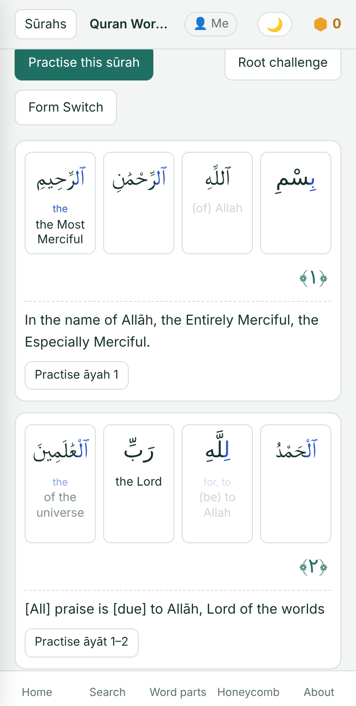
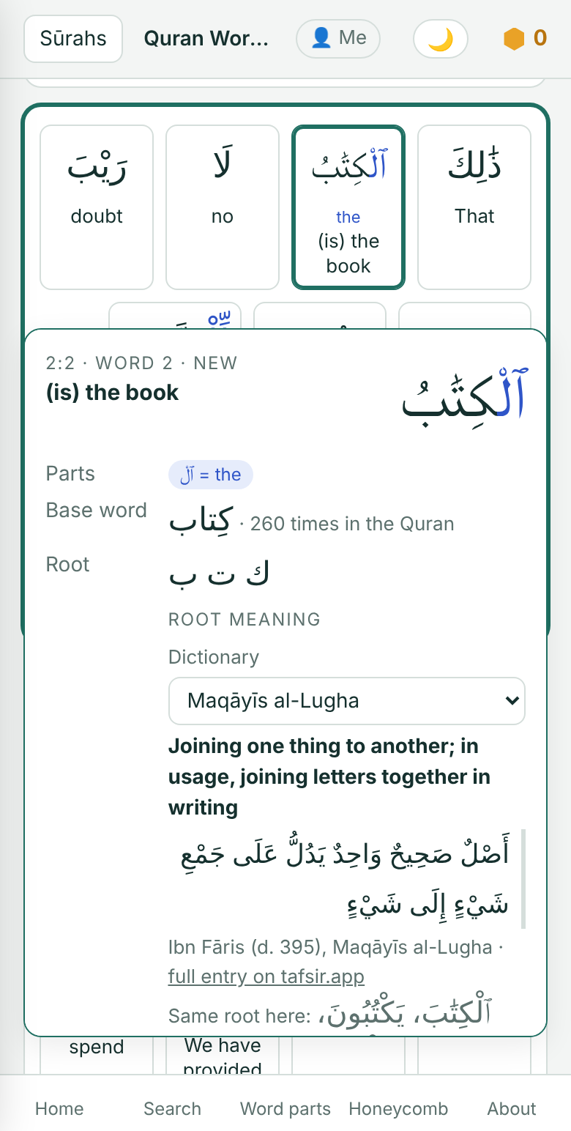
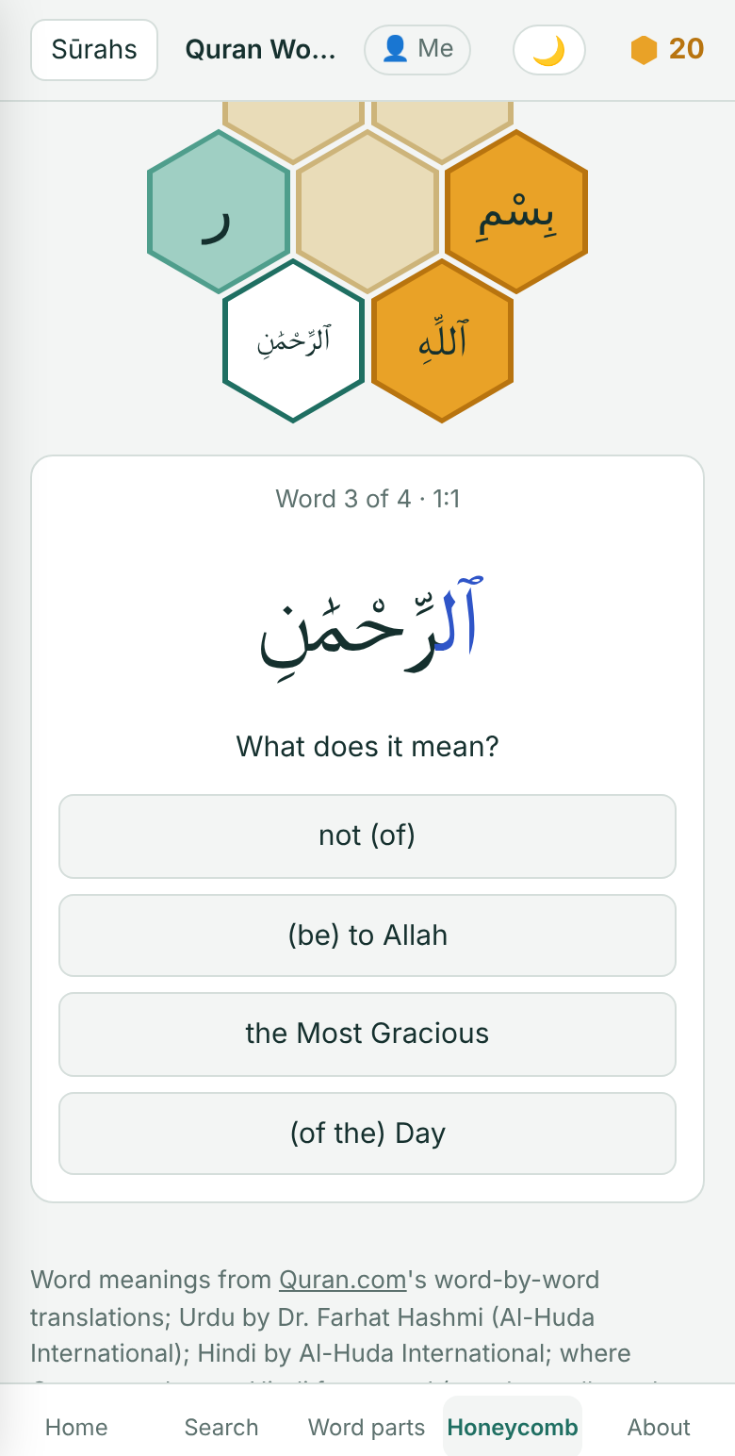
Quran Word Reader
Understand the Quran in its own words
Learn the meaning of every Arabic word, and read the Quran without a translation.
marshadkc.github.io/quranreader
Free · No ads · English · اردو‎ · हिंदी

Slide 2
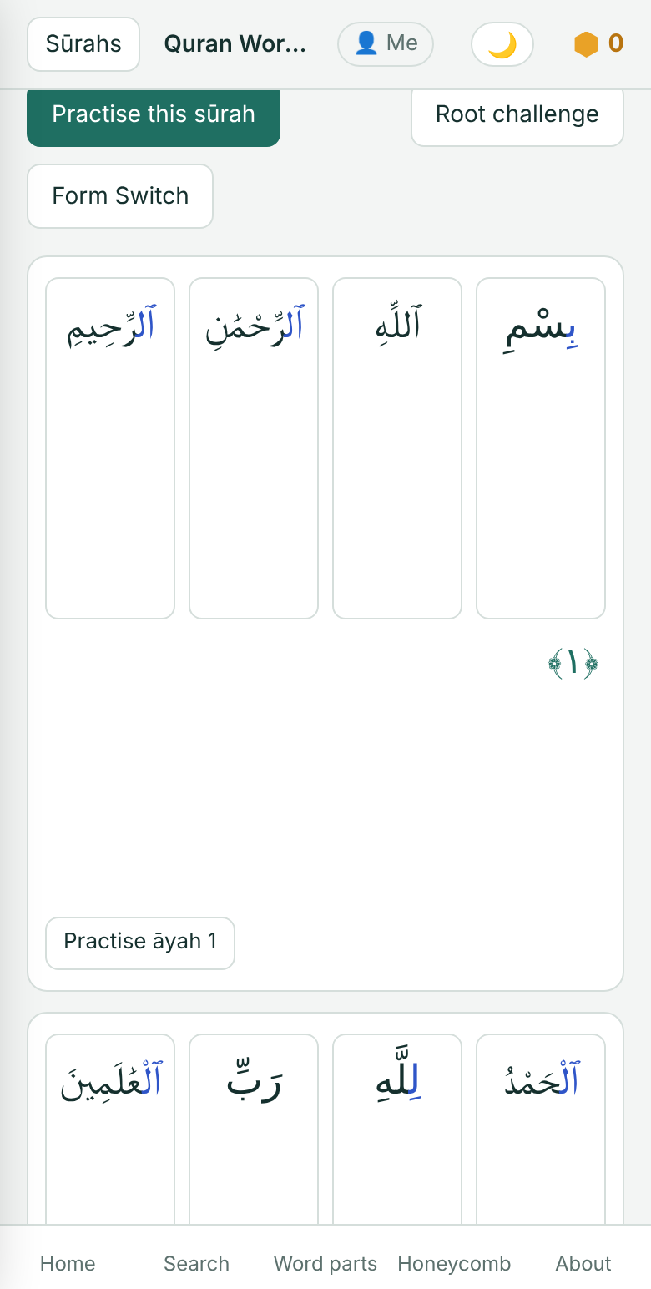
WHY
You recite it every day. Now understand every word.
Most of us read the Quran in Arabic but understand it only through a translation. Quran Word Reader teaches the words themselves, so the Arabic page speaks to you directly.
Free · Non-commercial · marshadkc.github.io/quranreader
2

Slide 3
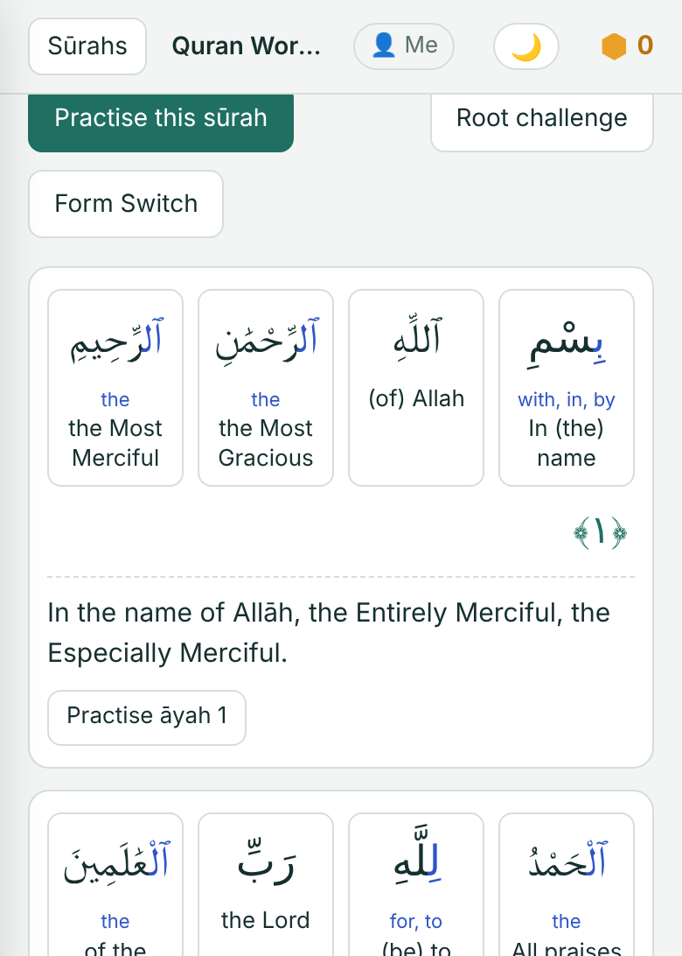
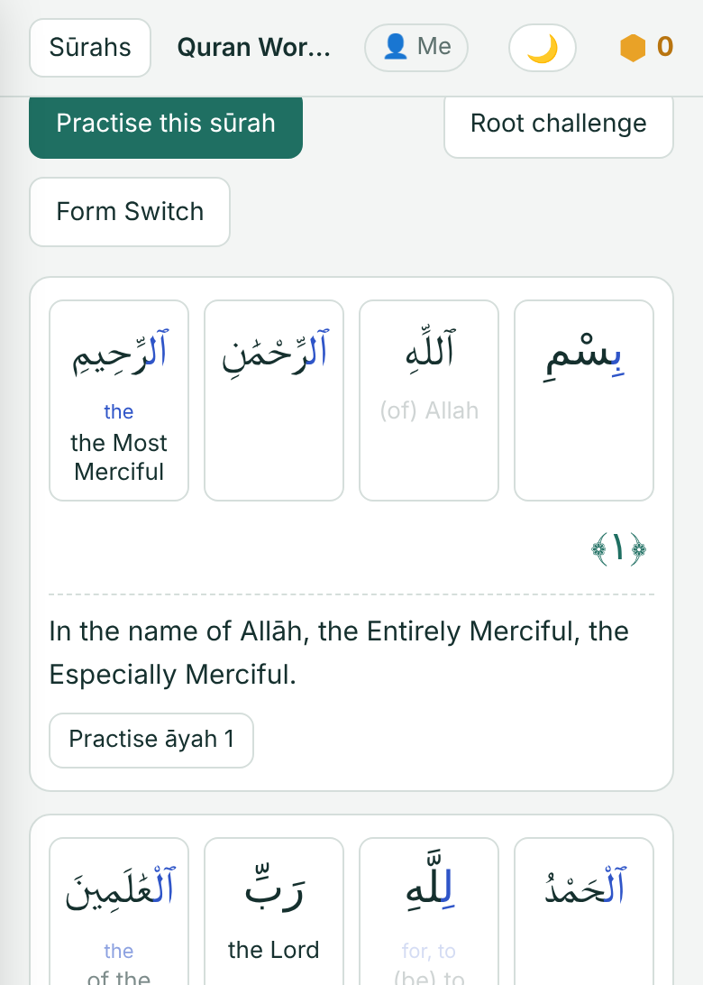
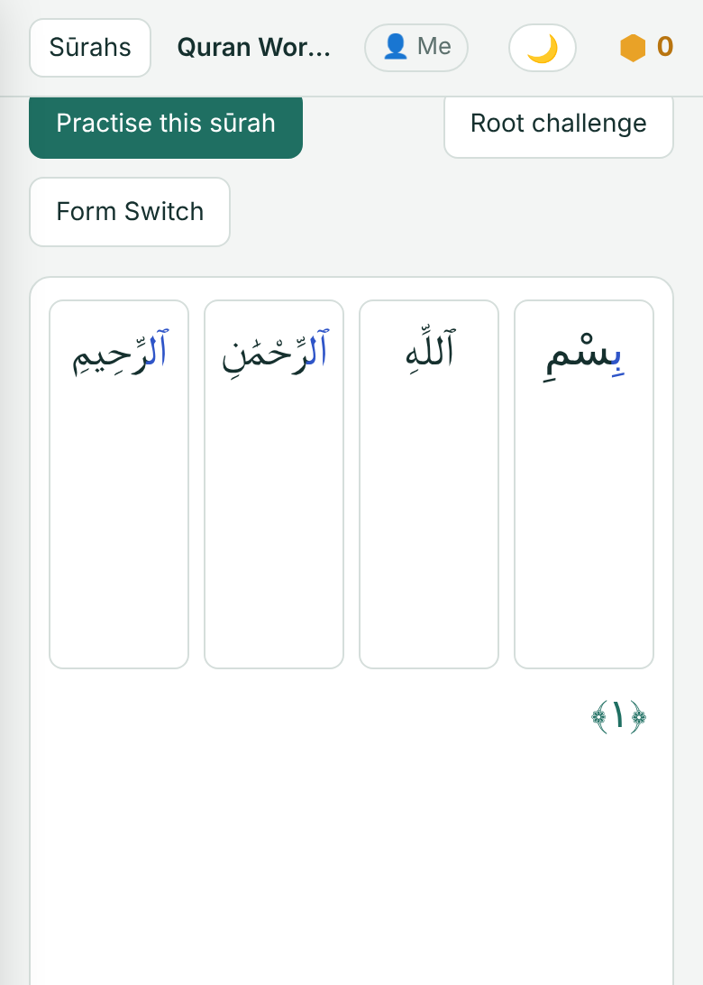
01
THE IDEA
Watch the translation fade away
Start
A meaning under every word
Learning
Meanings fade as you learn them
Goal
Plain Arabic, and you understand it
Free · Non-commercial · marshadkc.github.io/quranreader
3

Slide 4
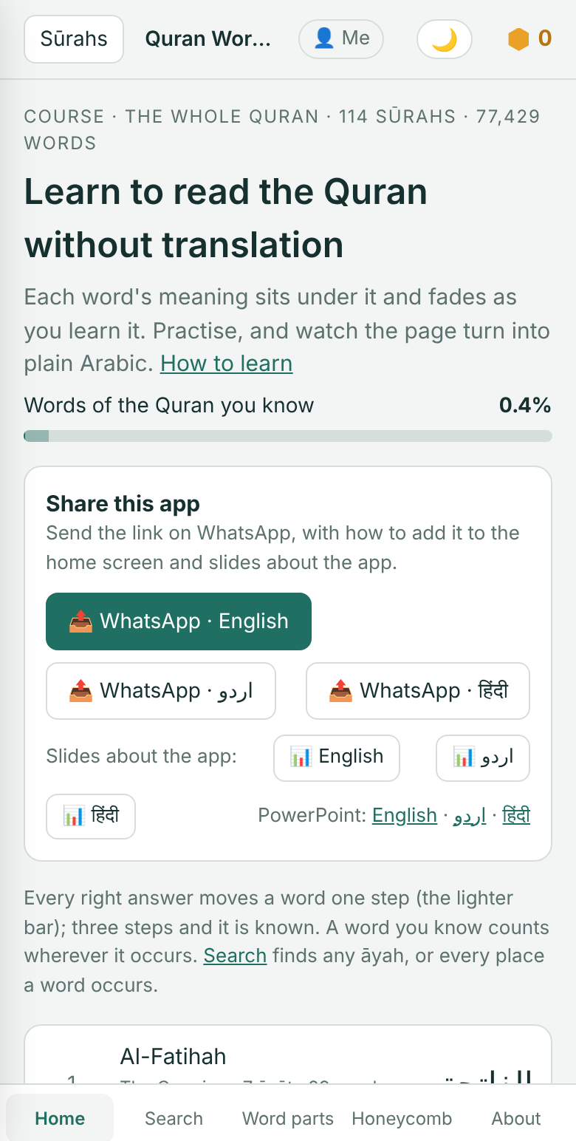
02
AT A GLANCE
The whole Quran, word by word
114
77,429
sūrahs: the whole Quran, from Al-Fātiḥah to An-Nās
words, every one with its meaning
7
3
classical Arabic dictionaries for the meaning of each root
languages: English, اردو‎ and हिंदी
Free, with no ads and no sign-up.
Free · Non-commercial · marshadkc.github.io/quranreader
4

Slide 5
03
THE METHOD
A simple daily habit
1
2
3
Take 3, 5 or 10 āyāt a day.
Say each word aloud, then its meaning.
Repeat the set 7 times.
4
5
6
Hide the meanings (None) and read again.
Practise the set in a quick quiz.
Read a muṣḥaf without translation.
Then go on through the sūrah, and the whole Quran, the same way.
Free · Non-commercial · marshadkc.github.io/quranreader
5

Slide 6
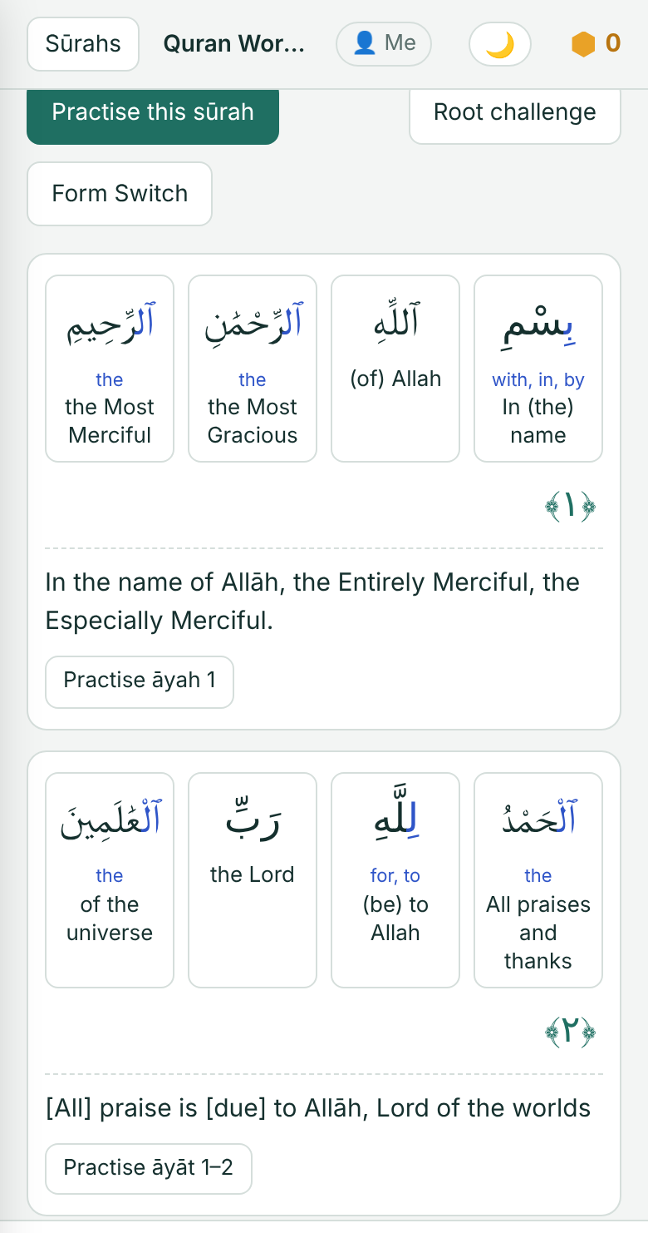
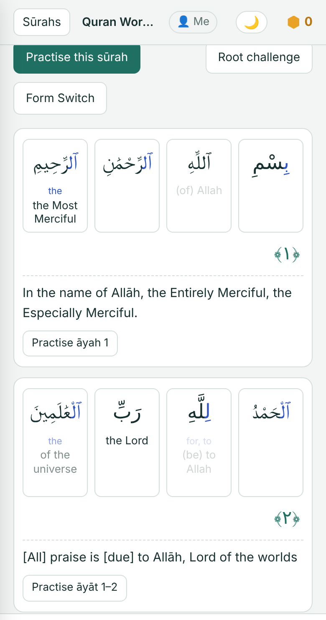
04
READER
A meaning under every word
Read any sūrah word by word, in English, Urdu or Hindi.
Show one or two languages, with the full āyah translation below.
Meanings fade as you learn them.
Tap None to test yourself, and tap a word to peek.
Free · Non-commercial · marshadkc.github.io/quranreader
6

Slide 7
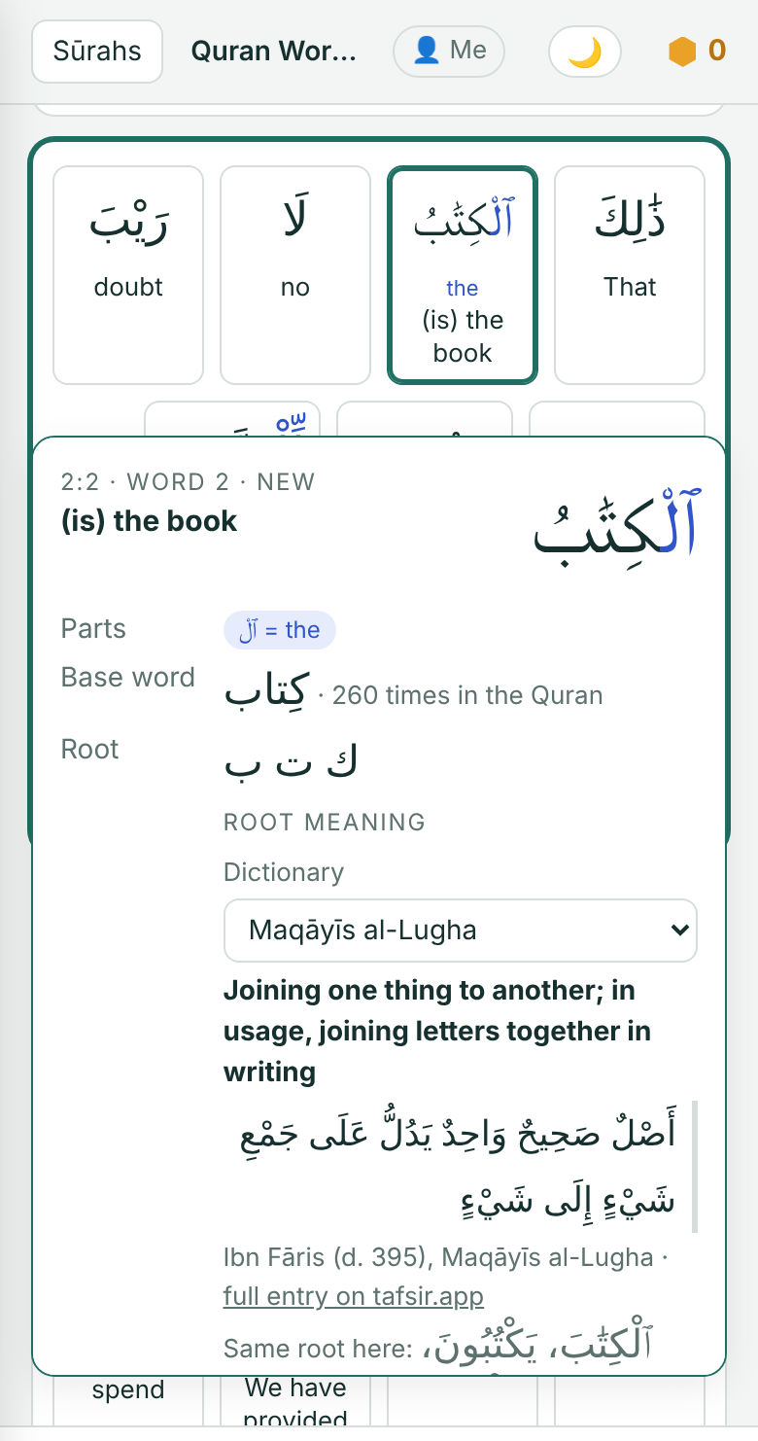
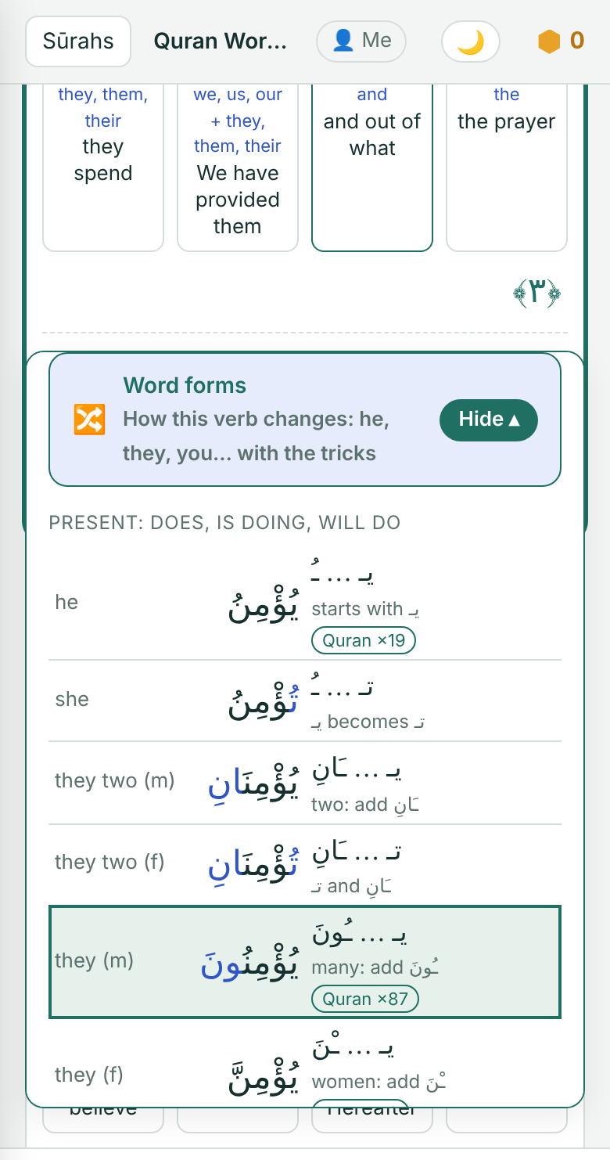
05
WORD CARD
Every word opens up
Tap a word to see how it is built and what its root means.
Its parts in colour: وَ‎, فَ‎, ٱل‎ and the endings.
The root's meaning from 7 classical Arabic dictionaries.
Word forms: how the verb changes, with the forms used in the Quran marked.
Free · Non-commercial · marshadkc.github.io/quranreader
7

Slide 8
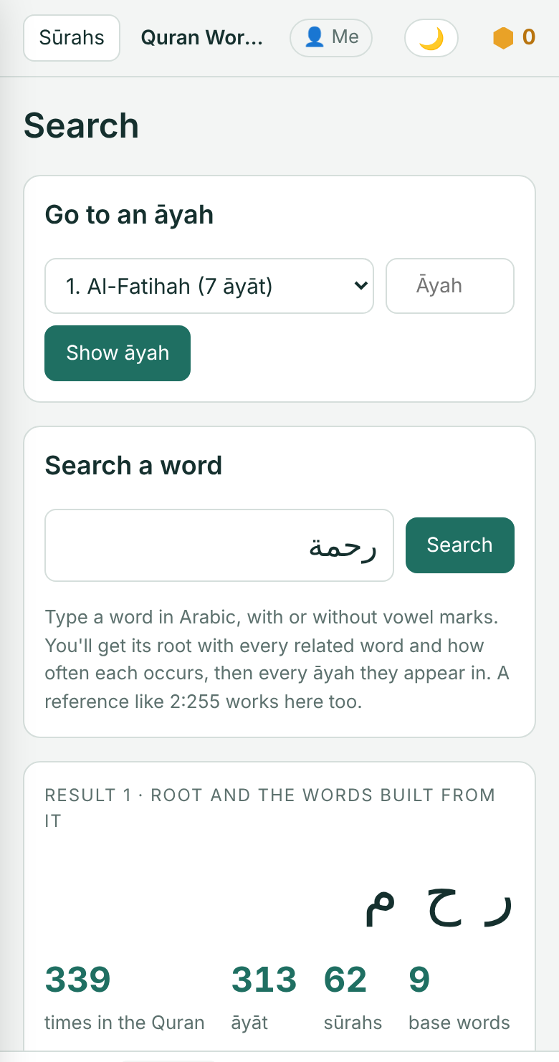
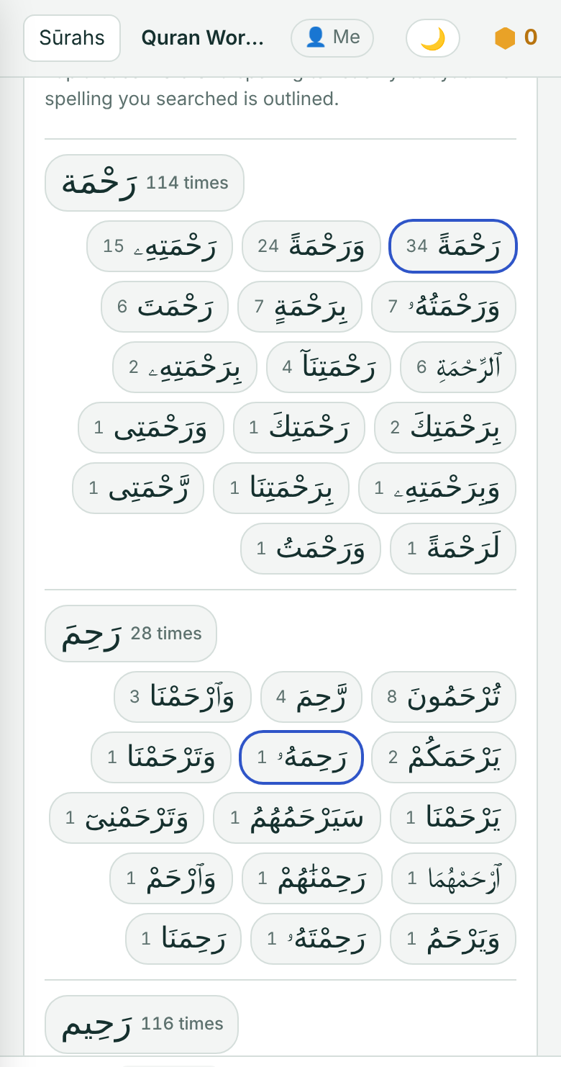
06
SEARCH
The whole Quran at your fingertips
Find any āyah, or every place a word or its root appears.
Type 2:255 to jump straight to Āyat al-Kursī.
رحمة‎: 339 times in 313 āyāt, with every form and spelling.
Open any result in its sūrah or on its muṣḥaf page.
Free · Non-commercial · marshadkc.github.io/quranreader
8

Slide 9
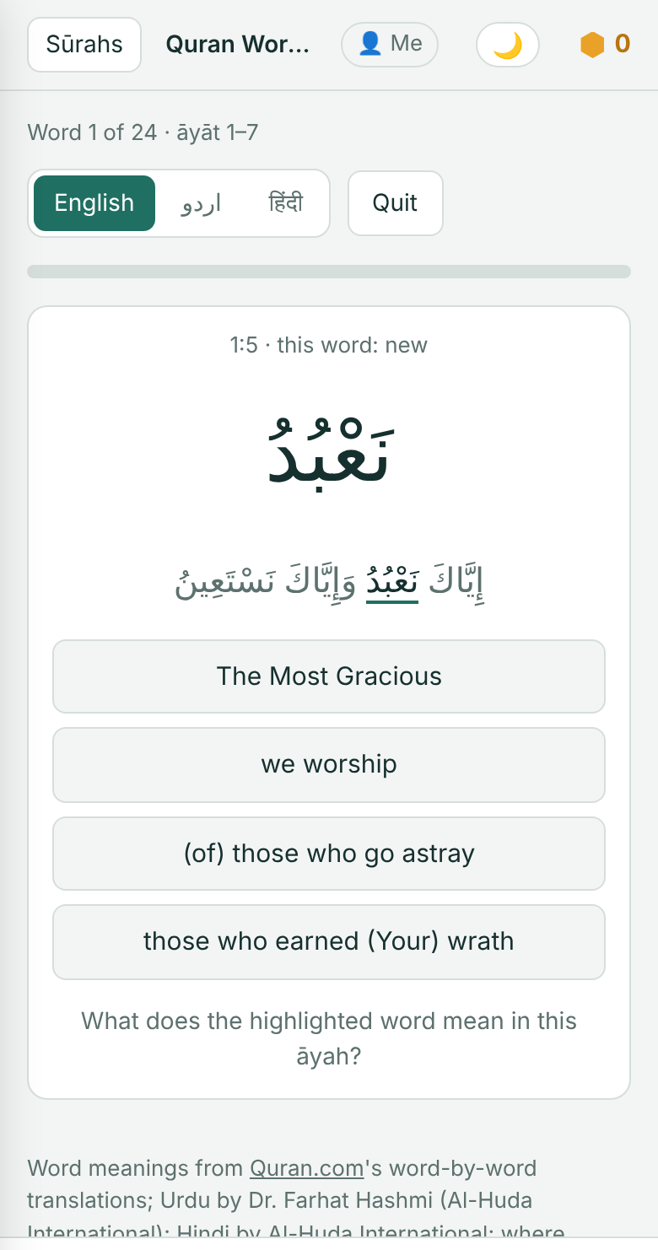
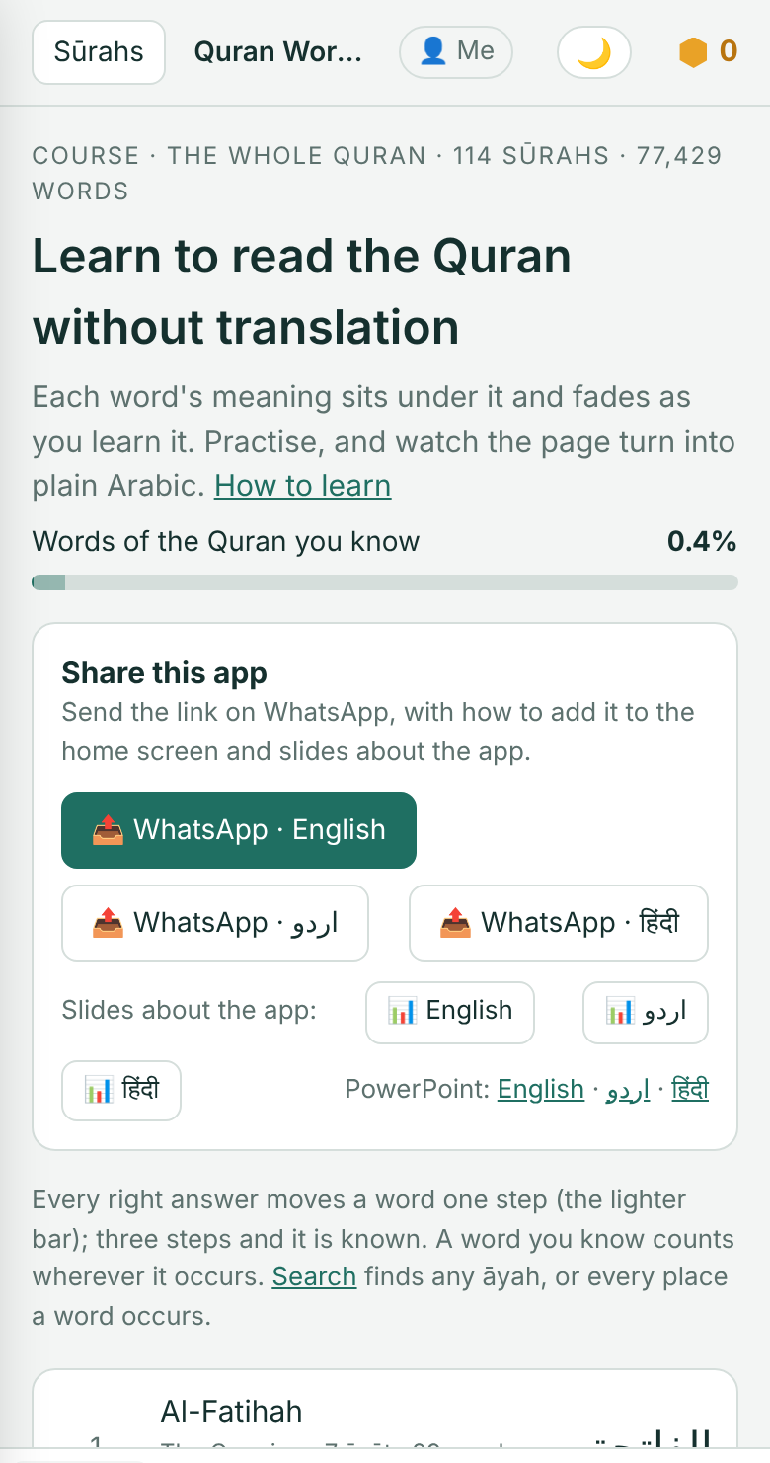
07
PROGRESS
See how far you have come
Practise any set of āyāt and watch your share of the Quran grow.
Pick the meaning of each word. Mistakes come back at the end.
3 right answers and the word is yours, wherever it appears.
Progress for every sūrah, and for the whole Quran.
Free · Non-commercial · marshadkc.github.io/quranreader
9

Slide 10
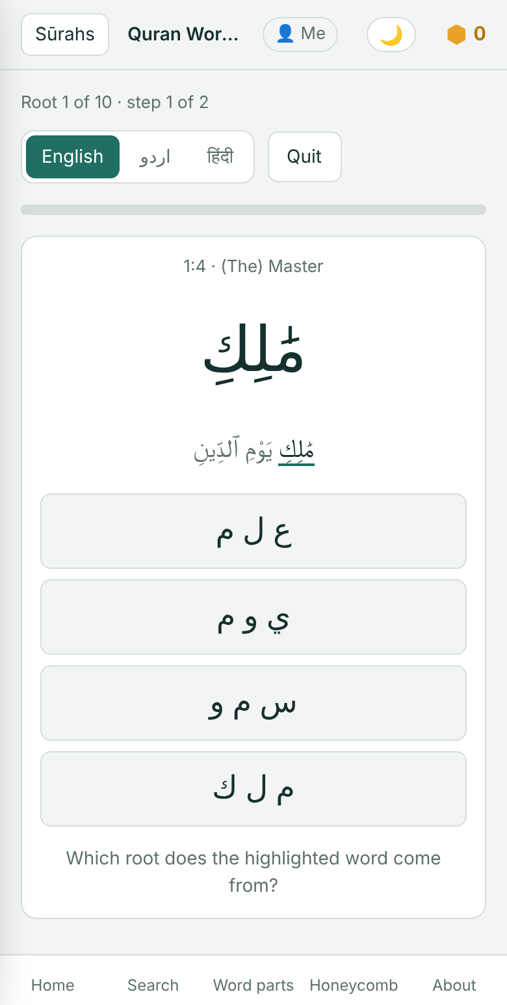
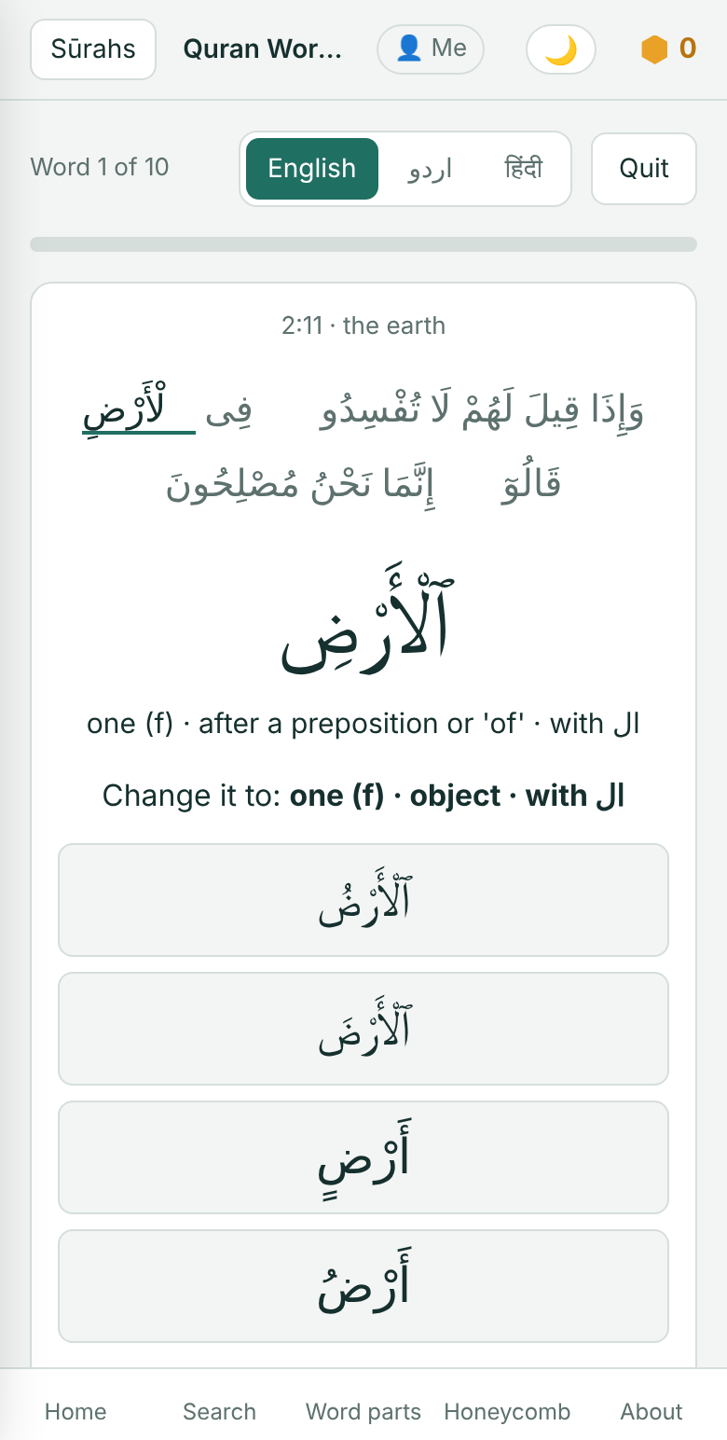
08
GAMES
Learning that feels like play
Three quizzes and a honey jar keep you coming back.
Honeycomb: answer the words of an āyah to cross the comb.
Root challenge: find each word's root and its deep meaning.
Form Switch: turn a verb or a noun into another form.
Free · Non-commercial · marshadkc.github.io/quranreader
10

Slide 11
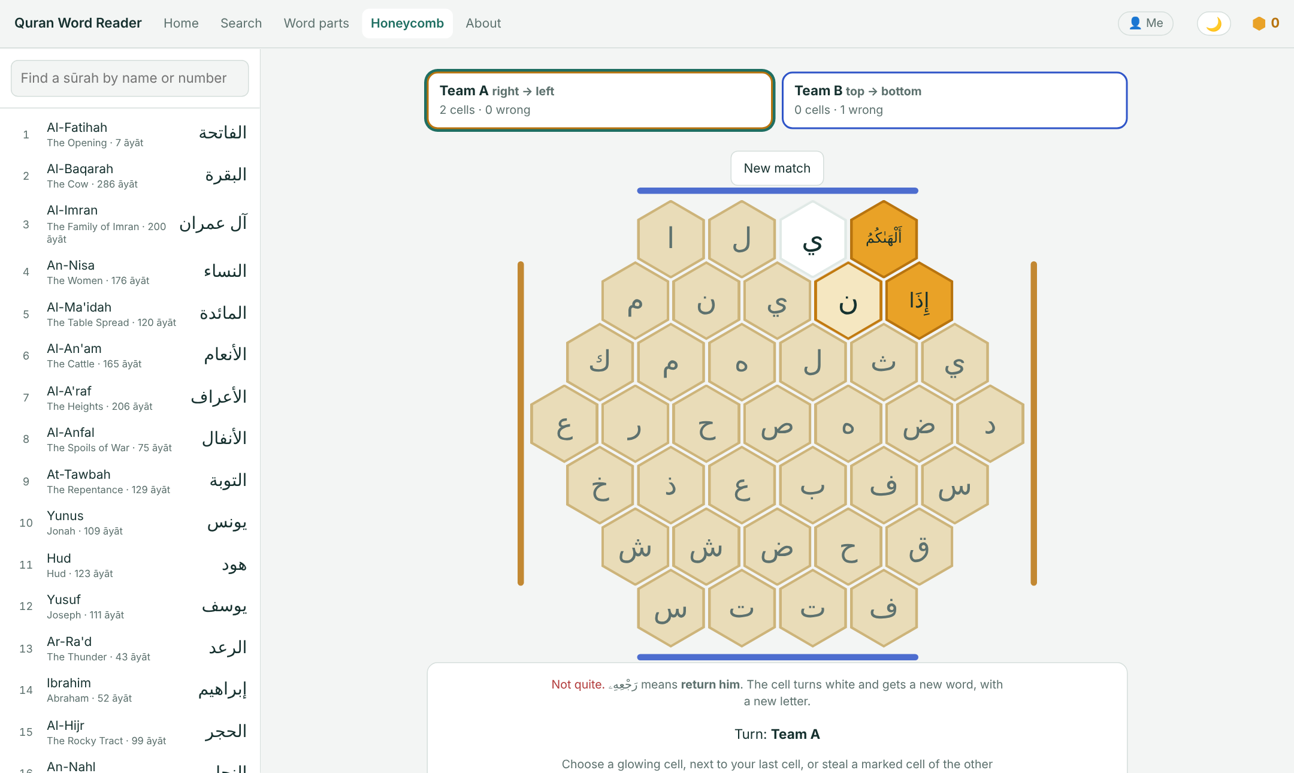
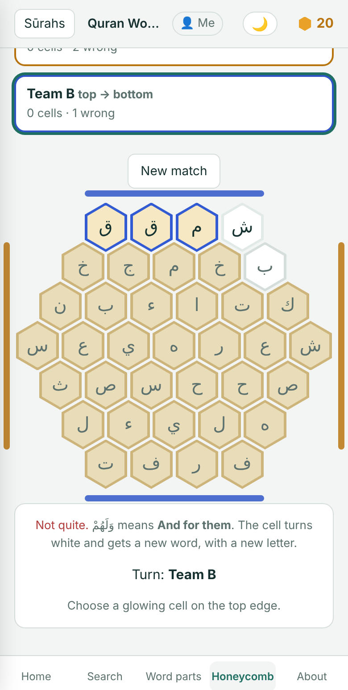
09
CLASSROOM
Built for the classroom
A team game for the class screen, and a profile for each class.
Two teams race across a 37-cell honeycomb and steal cells with right answers.
Each cell shows its word's first letter as a clue.
Clear a class's progress after the lesson.
Free · Non-commercial · marshadkc.github.io/quranreader
11

Slide 12
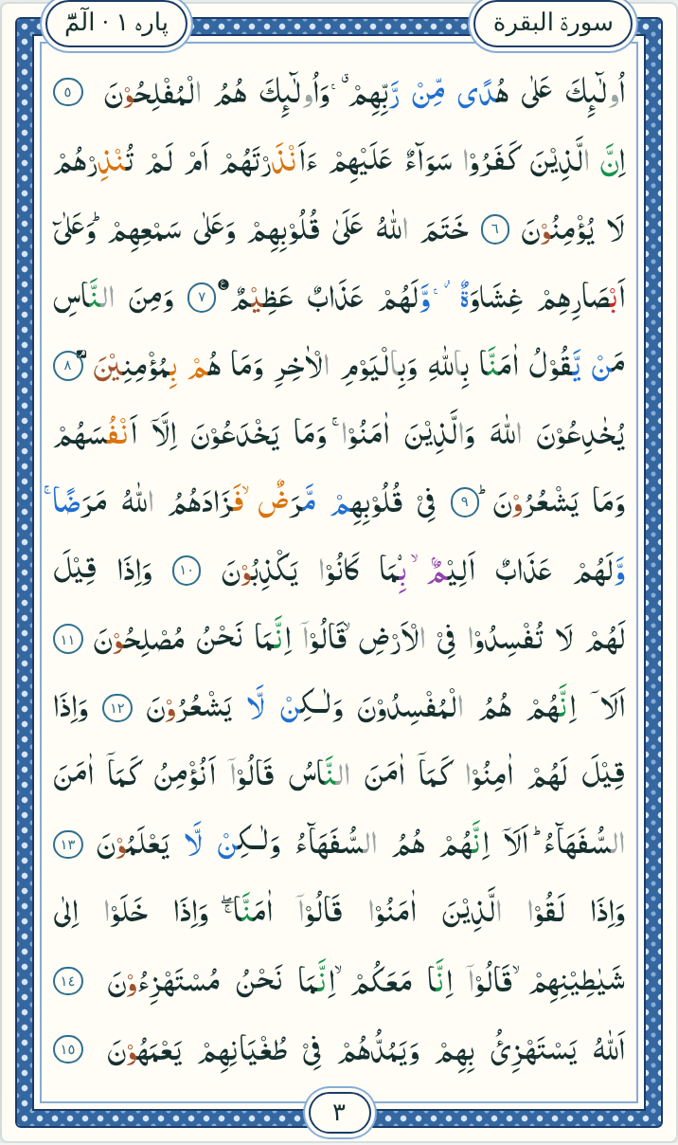
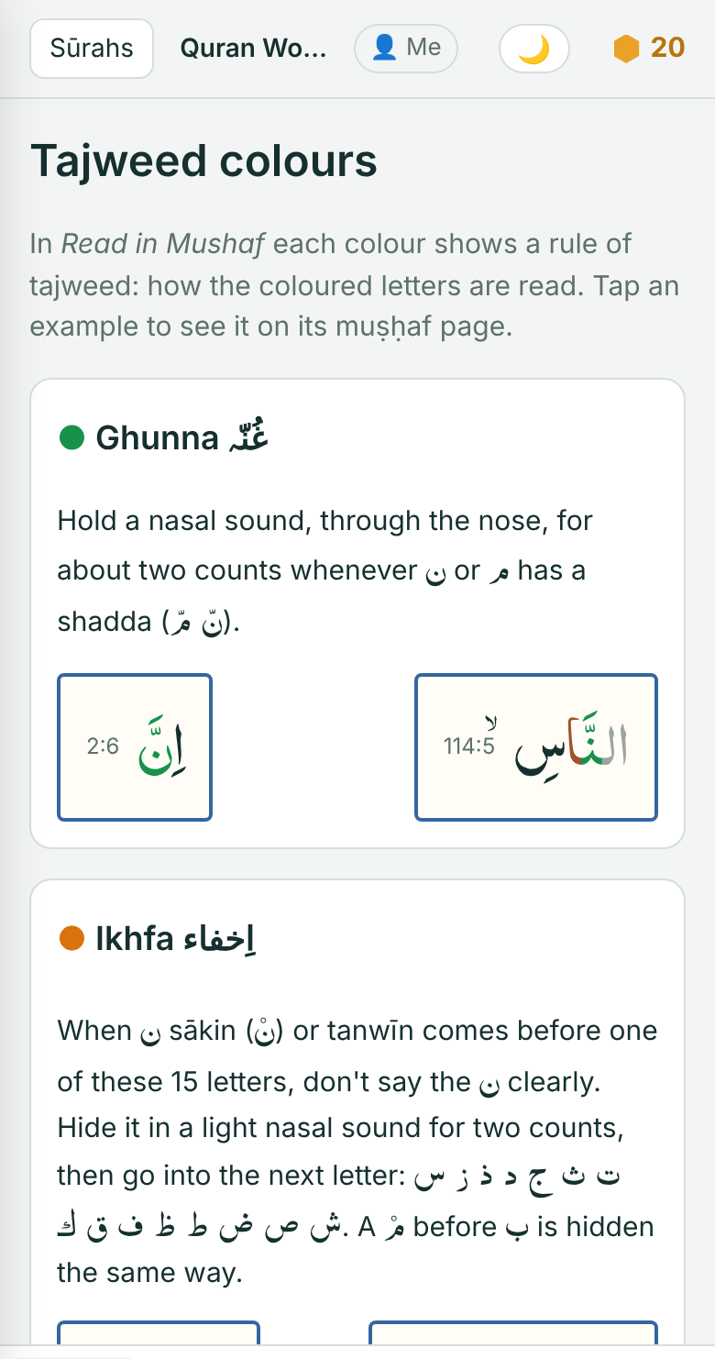
10
MUṢḤAF
Read the real muṣḥaf, in colour
The Indo-Pak 15-line hifz muṣḥaf, with tajweed colours.
610 pages, and every page ends on an āyah.
A guide to every tajweed colour, with examples.
Tap any word on the page for its meaning.
Free · Non-commercial · marshadkc.github.io/quranreader
12

Slide 13
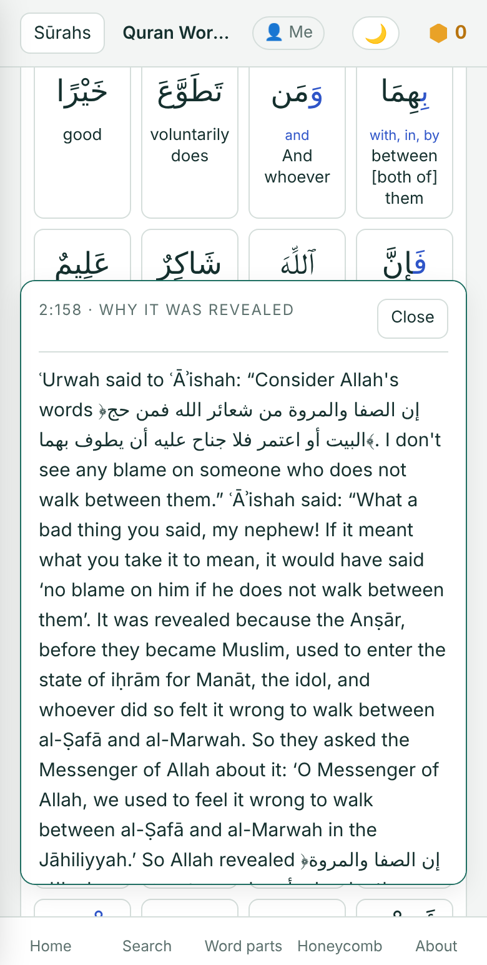
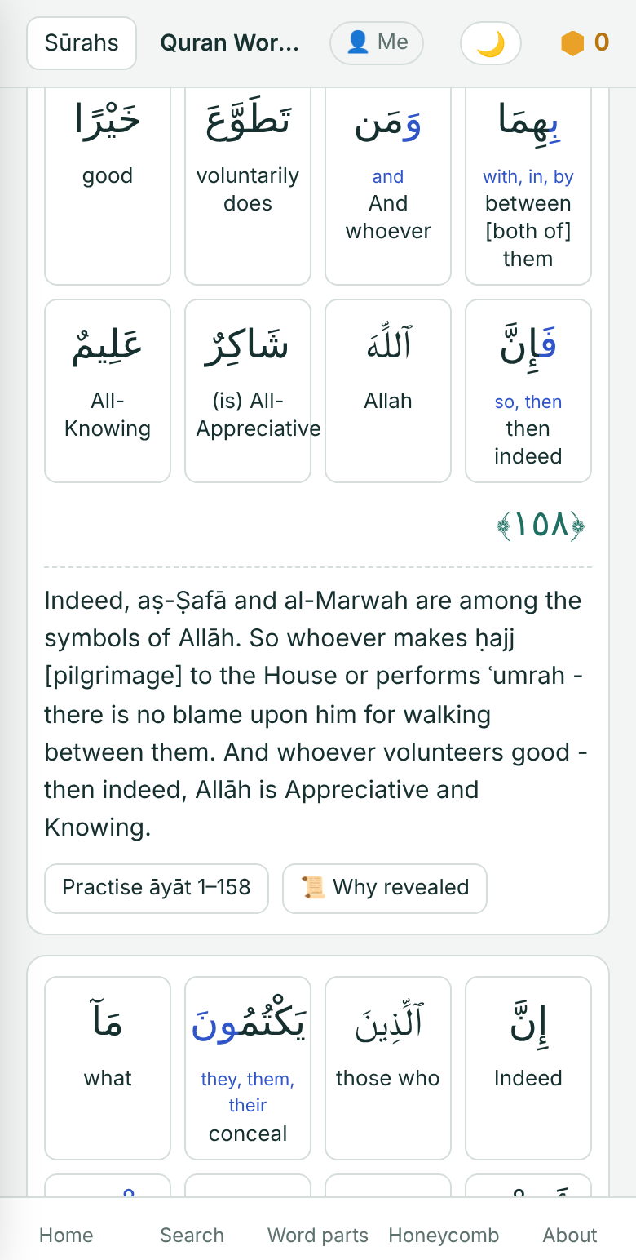
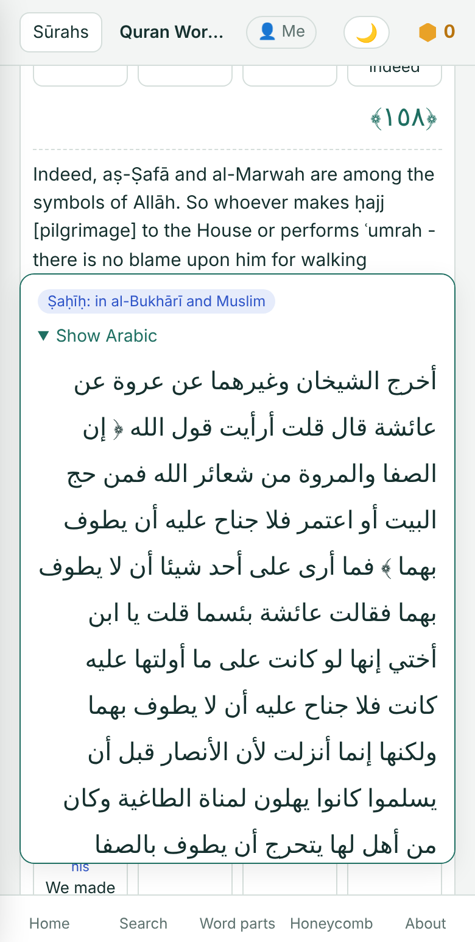
11
WHY REVEALED
The story behind the āyah
Tap 📜 Why revealed to read what happened when an āyah came down.
Only authentic reports, from al-Suyūṭī's Lubāb al-Nuqūl.
Each report shows its grade, such as Ṣaḥīḥ: al-Bukhārī and Muslim.
Read it in English, Urdu or Hindi. The Arabic is one tap away.
Free · Non-commercial · marshadkc.github.io/quranreader
13

Slide 14
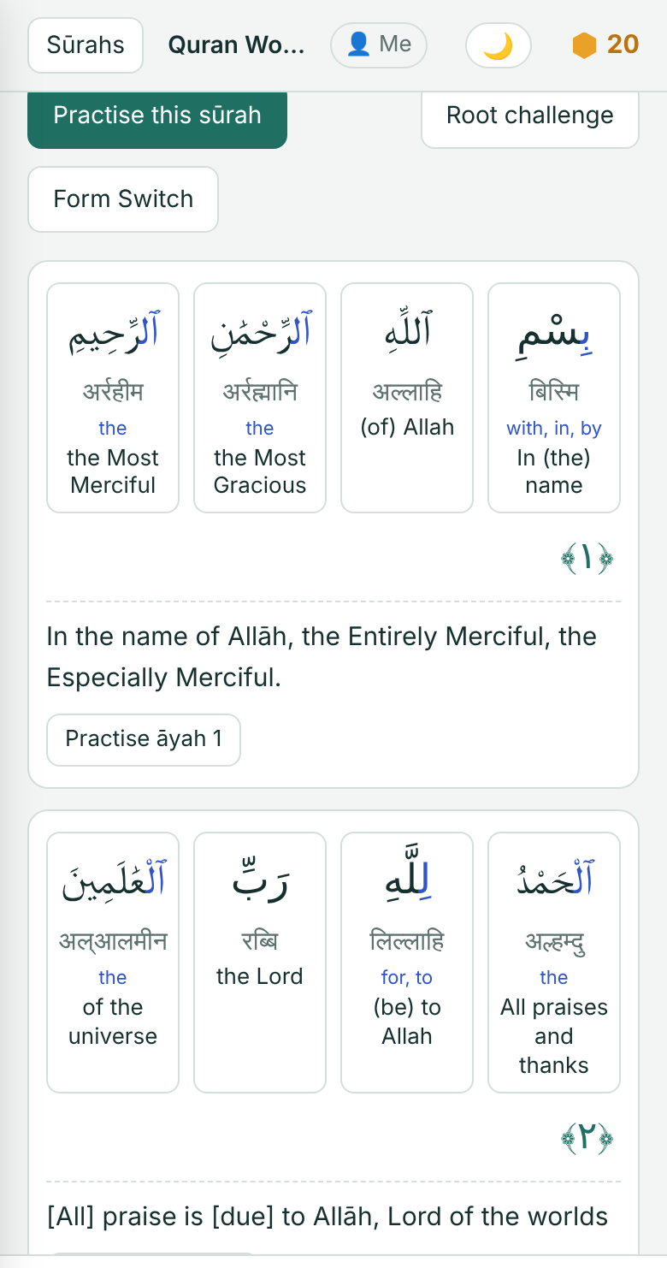
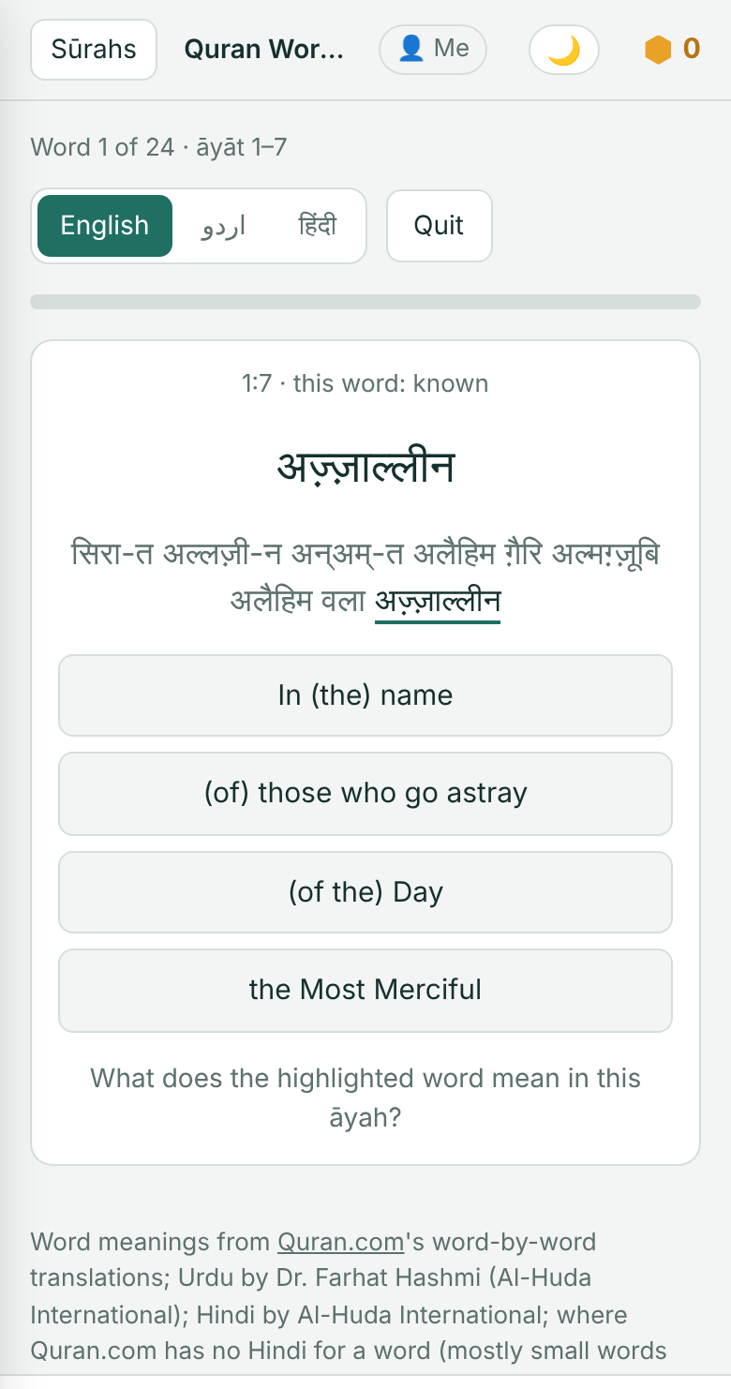
12
HINDI LETTERS
No Arabic letters yet? Start anyway.
Every word can be shown in Hindi letters, alone or under the Arabic.
ٱلَّذِينَ‎ is written अल्लज़ी-न. The "-" marks a short "a" that is said.
An āyah's last word is written as read at a stop: लिल्मुत्तक़ीन.
Quizzes switch to Hindi letters too.
Free · Non-commercial · marshadkc.github.io/quranreader
14

Slide 15
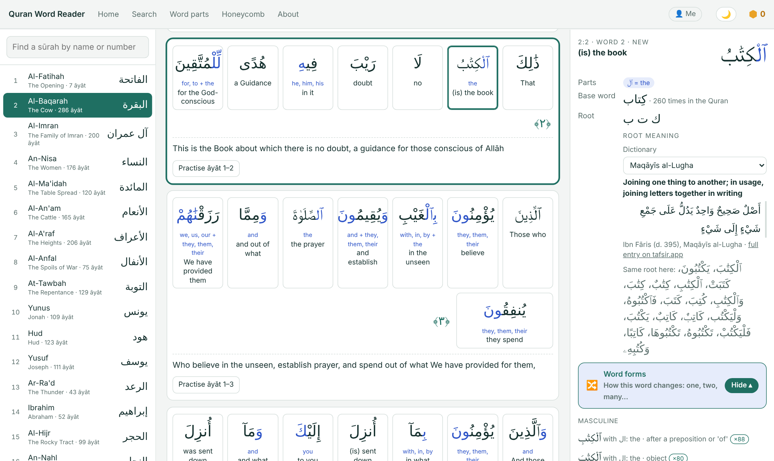
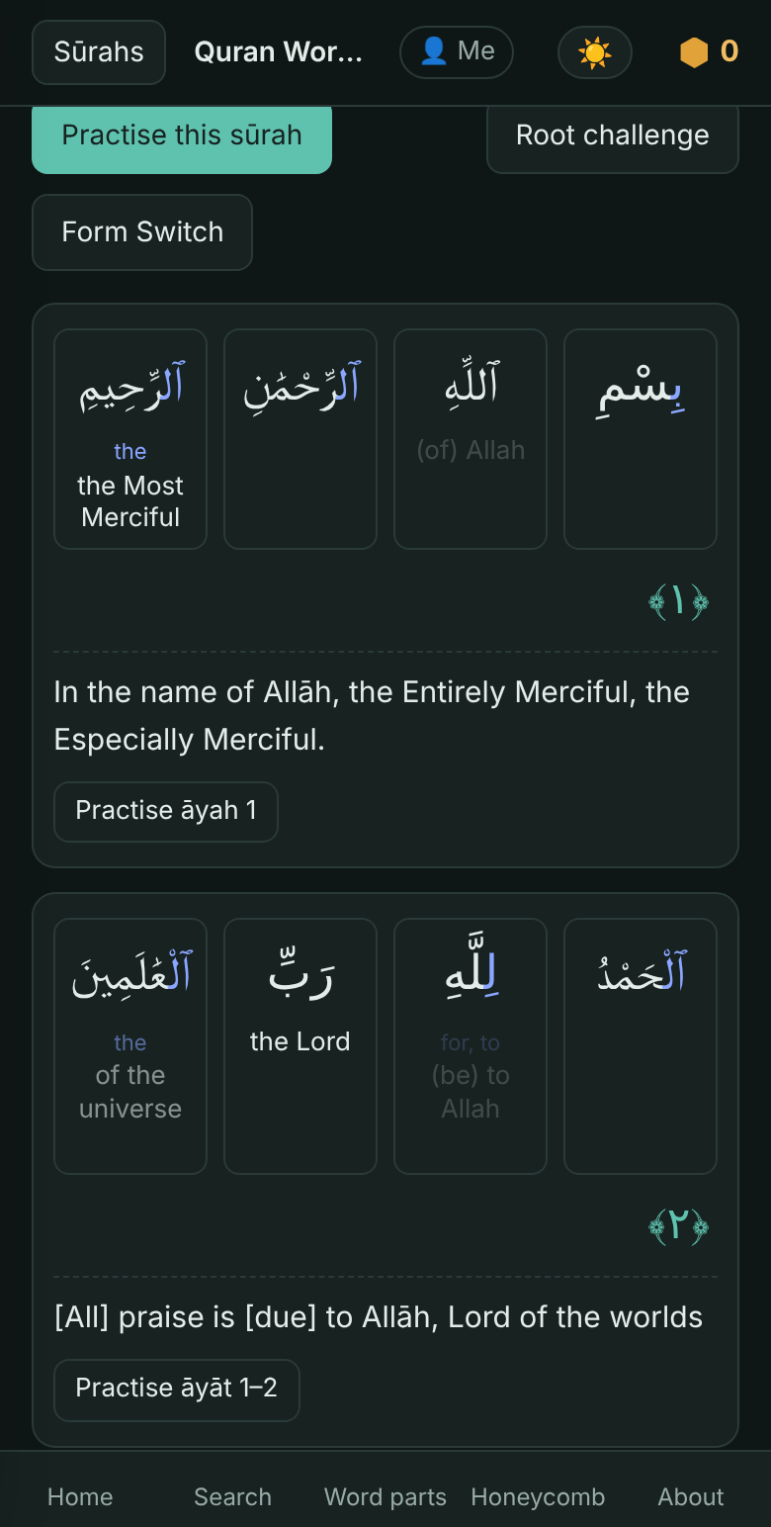
13
ANYWHERE
On your phone, tablet or computer
Install it once and read anywhere, even without internet.
Works offline after the first visit.
Light or dark, whatever the phone's setting.
On a computer the word card opens beside the page.
Free · Non-commercial · marshadkc.github.io/quranreader
15

Slide 16
14
WHO IT'S FOR
For everyone who loves the Quran
Learners
Hifz students
Teachers
Anyone who reads Arabic letters and wants the meaning.
Understand what you memorise, on the same 15-line page.
Team games and class profiles for the classroom.
Families
New readers
Free for all
Learn together, a few āyāt a day.
Start in Hindi letters, before the Arabic script.
No ads, no sign-up, no tracking. Non-commercial.
Free · Non-commercial · marshadkc.github.io/quranreader
16

Slide 17
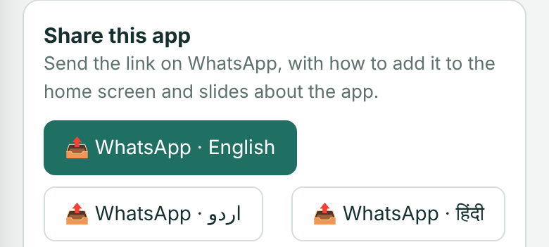
15
START TODAY
Open it. Add it. Share it.
https://marshadkc.github.io/quranreader
Android
Open the link in Chrome, tap ⋮ and choose "Add to Home screen".
iPhone
Open it in Safari, tap Share and choose "Add to Home Screen".
Share
Tap "Share this app" on the home page to send it on WhatsApp.
Credits
Arabic text, word parts and roots: Quranic Arabic Corpus (quran-morphology). Word meanings: Quran.com; Urdu and Hindi by Al-Huda International. Āyah translations: Saheeh International, Fateh Muhammad Jalandhari, Azizul Haque al-Umari. Muṣḥaf layout: QUL by Tarteel. Root meanings: classical dictionaries via tafsir.app. IndoPak font: QuranWBW.
Free · Non-commercial · marshadkc.github.io/quranreader
17

