Slide 1

HERCULES

Slide 2
Team
Ana Letycia de Lima Parente
Augusto Belina Morais
Diego Nicacio Marques
Gabrielle Oliveira S. Pellegrini Souza
Gustavo Sergio Fernandes

Slide 3
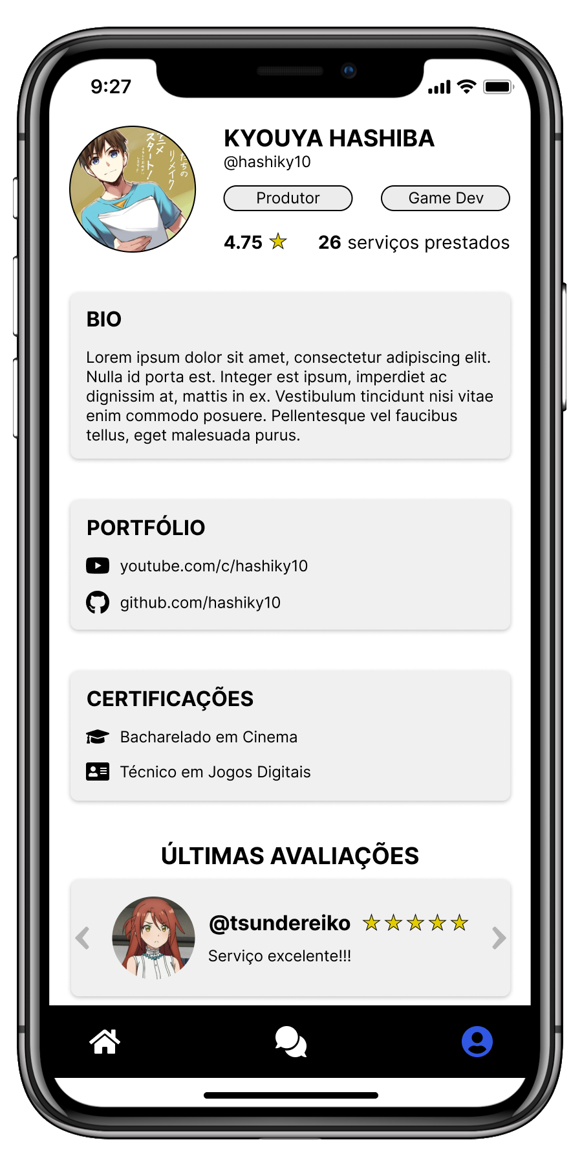
What is HERCULES?
Hercules is a platform that connects people and help them find a professional for any kind of service.

Slide 4
MARKET ANALYSIS
With the scenario provided by the “uberization of things”, a digital platform that offers the most diverse types of services has proved attractive to the users – the analysis made by the team points out that 85% of them would use a platform of like that.
The analysis also pointed out that users expect a friendly interface, the possibility of evaluating the portfolio of professionals and the security of their data and information.

Slide 5
MARKETING PLAN
HERCULES

Slide 6
OPERATIONAL PLAN
Regarding the platform's production process, we can point out the practices related to production planning and control and the organization's (social and environmental) responsibilities.
It is also worth to point out the use of tools to control the production and quality of the platform – like Trello, Notion, Git and Discord.

Slide 7

I.T. PLAN

Slide 8
DISCRIMINATION | VALUE
Operating income | R$ 903.393,61
Variable Costs | R$ 463.109,04
Direct Material Costs | R$ 0,00
Labor Cost | R$ 327.600,00
Marketing Cost | R$ 135.509,04
Contribution Margin | R$ 440.284,57
Fixed Costs | R$ 349.945,21
Operating Profit | R$ 90.339,36
Income Taxes (30%) | R$ 27.101,81
ANNUAL NET INCOME | R$ 63.237,55
FINANCIAL PLAN

Slide 9
STRATEGIC ASSESSMENT
STRENGTH Does not require skilled labor Maintenance practicality Comprehensive platform | WEAKNESS Lack of control over service providers Maintenance costs start-up company
OPORTUNITIES Access to professional courses Exemption from certain taxes Popularization of applications favorable competition | THREATS Unstable economy Relevant only in urban centers New laws over applications Issues with outsourced infrastructure

Slide 10
Thanks!
Any questions?

