Slide 1
Tex1 Holdem
Team:
Hong, Thaya, Simon, Marshall

Slide 2
Why are we changing our game?
Poker is hard to implement
There are lots of open source engines but we want to figure out all the client server/node.js/spine stuff first
What’s a simple game that we can hook up that has the attributes we want?
Multiplayer
Has a shared board state
Has a “secret” aspect to be controlled by a 2nd screen

Slide 3
Answer: Rock Paper Scissors
Simple game logic
Has a multiplayer version
Has a “secret” aspect – the player’s move

Slide 4
Tex1 Holdem Fingers of Fury – Enter the 36 Chambers of Death
Team:
Hong, Thaya, Simon, Marshall

Slide 5
TV View

Slide 6



No players
FINGERS OF FURY
Join on your iPhone by visiting:
fof.com

Slide 7
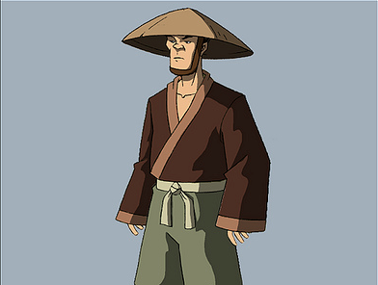
One player
Waiting for other warriors...
Thaya
0

Slide 8
Two players
Simon
0
Round 1
Choose your
technique!
Thaya
0

Slide 9
Four players
Simon
0
Marshall
0
Hong
0
Round 1
Choose your
technique!
Thaya
0

Slide 10
Players pick on their screen...
Simon
0
Marshall
0
Hong
0
Round 1
Choose your
technique!
Thaya
0

Slide 11
Until everyone picks!
Simon
0
Marshall
0
Hong
0
JUDGMENT!
Thaya
0

Slide 12


Result screen
Simon
1
Marshall
1
Hong
0
ROCK WINS!
Thaya
0

Slide 13
Four players
Simon
1
Marshall
1
Hong
0
Round 2
Choose your
technique!
Thaya
0

Slide 14
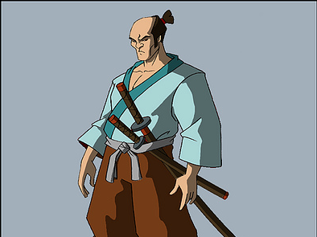
Until we have a single winner
Marshall has defeated Simon, Thaya and Hong.
Marshall’s victory will go down in legend!
Hit “Fight again” on your phone to play again.
Marshall became a SAMURAI

Slide 15
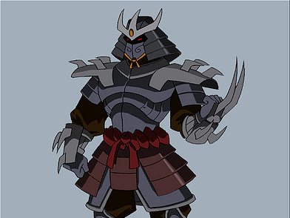
Or multi-winners
Marshall and Simon have defeated Thaya and Hong.
Their victory will go down in legend!
Hit “Fight again” on your phone to play again.
Marshall became a SAMURAI
Simon became a SHOGUN

Slide 16
Controller Screen

Slide 17
Controller Screen

Slide 18


Join
FINGERS OF FURY
Enter your warrior name...
Join the battle
Wuss Out

Slide 19
Waiting
Be patient, warrior...
There are none who are brave enough to face you... yet.
Wuss Out

Slide 20

Chooser Screen
Choose your technique!
Score: 0
Wuss Out

Slide 21

Technique Chosen
Waiting for judgment...
Score: 0
Wuss Out

Slide 22
Win
You win! Well fought, warrior.
You, Simon, Marshall
Thaya
Score: 1
Wuss Out

Slide 23
Lose
You lose! Get up and fight!
You, Simon, Marshall
Thaya
Score: 1
Wuss Out

Slide 24
Draw
It’s a draw! Fight again!
You, Simon, Marshall
Thaya
Score: 1
Wuss Out

Slide 25


Draw
Tie. Try again, warrior!
The gods stand in judgment. Do you really want to wuss out?
Yes, leave with tail between legs
No, continue on to glory
Score: 0
Wuss Out

Slide 26
Win
You and Thaya have vanquished
Simon and Marshall!
Warrior ranking: SAMURAI
(10 out of 12 fights won)
Fight again
Wuss Out

Slide 27
Lose
You have been defeated by
Marshall and Thaya!
Warrior ranking: PEASANT
(2 out of 12 fights won)
Fight again
Wuss Out

Slide 28
Warrior Rankings
0-10% - VILLAGE FOOL
10-20% - PEASANT
20-30% - ROOKIE
30-40% - BRAWLER
40-50% - MILITIAMAN
50-60% - RONIN
60-70% - SAMURAI
70-80% - SHOGUN
80-90% - TITAN
90-100% - IMMORTAL

