Slide 1
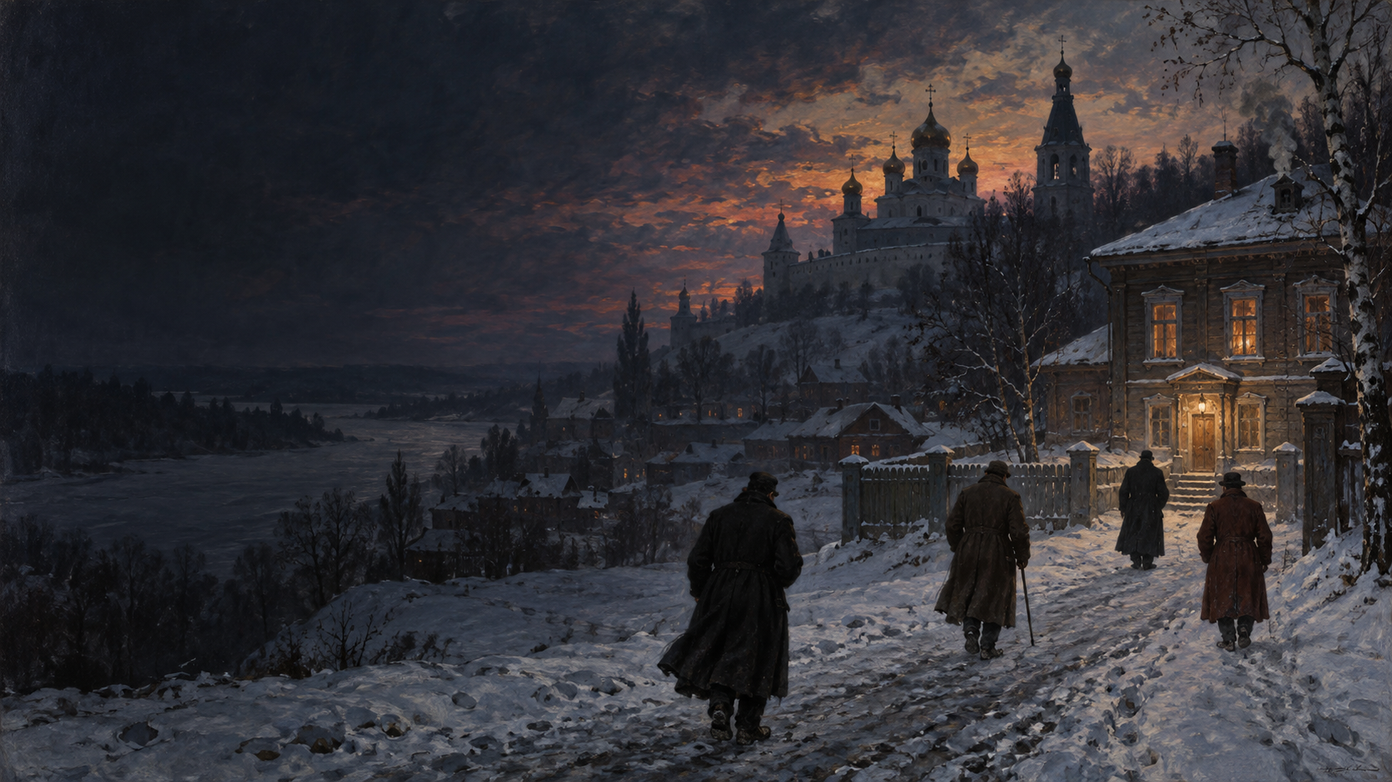
THE BROTHERS
KARAMAZOV
FYODOR DOSTOEVSKY
Story first. Philosophy after.
15-MINUTE WORLD LITERATURE PRESENTATION
Notes:
SPEAKER 1 | TARGET TIME: 0:20
Good morning. We are presenting Fyodor Dostoevsky's The Brothers Karamazov. We will first tell the story in chronological order through four speakers. Our fifth speaker will then explain how the murder plot becomes a debate about faith, suffering, freedom, guilt, and responsibility.
HANDOFF: I will begin with Dostoevsky and the book's publication.
Sources:
- https://www.gutenberg.org/ebooks/28054
- https://www.bloomsbury.com/us/dostoevskys-the-brothers-karamazov-9781441108470/
- Visual: AI-generated for this presentation.

Slide 2
SPEAKER 1
INTRODUCTION 0:50
02
Dostoevsky and publication
1880
1821
Born in Moscow
1849
Arrest and Siberian exile
Final completed novel
Serialized in The Russian Messenger
1879–1880
Novel serialized
1881
Dostoevsky dies
A lifetime of religious and political conflict enters the novel.
THE BROTHERS KARAMAZOV
02
Notes:
SPEAKER 1 | TARGET TIME: 0:50
The novel appeared in installments from 1879 to 1880 and became Dostoevsky's final completed novel. He died in 1881. His own life included arrest, a mock execution, years of imprisonment and exile in Siberia, epilepsy, and a difficult return to Christian faith. Those experiences help explain why the book treats belief, crime, punishment, and freedom as personal crises rather than distant ideas.
HANDOFF: Now we need the family whose conflict drives the story.
Sources:
- https://www.bloomsbury.com/us/dostoevskys-the-brothers-karamazov-9781441108470/
- https://www.gutenberg.org/ebooks/28054

Slide 3
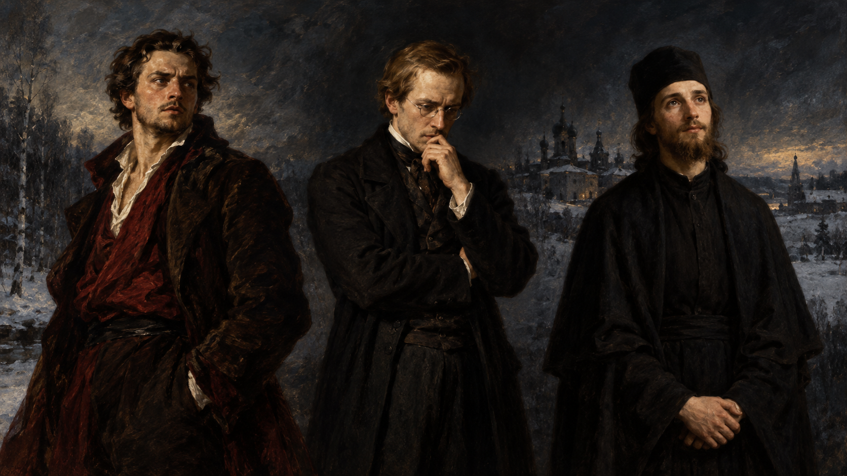
SPEAKER 1
STORY I 0:45
THE FAMILY
DMITRI
IVAN
ALYOSHA
eldest: passion
middle: intellect
youngest: faith
FYODOR PAVLOVICH: their neglectful father
Notes:
SPEAKER 1 | TARGET TIME: 0:45
Fyodor Pavlovich Karamazov is a wealthy but vulgar and neglectful father. His eldest son Dmitri acts through emotion and appetite. Ivan is the intellectual skeptic. Alyosha is a novice at the local monastery. A fourth figure, Smerdyakov, works as Fyodor's servant and is widely believed to be his illegitimate son. These are full characters, but the three brothers also represent competing ways of living.
HANDOFF: Their conflict becomes public when the family meets at the monastery.
Sources:
- https://www.gutenberg.org/ebooks/28054
- Visual: AI-generated for this presentation.

Slide 4
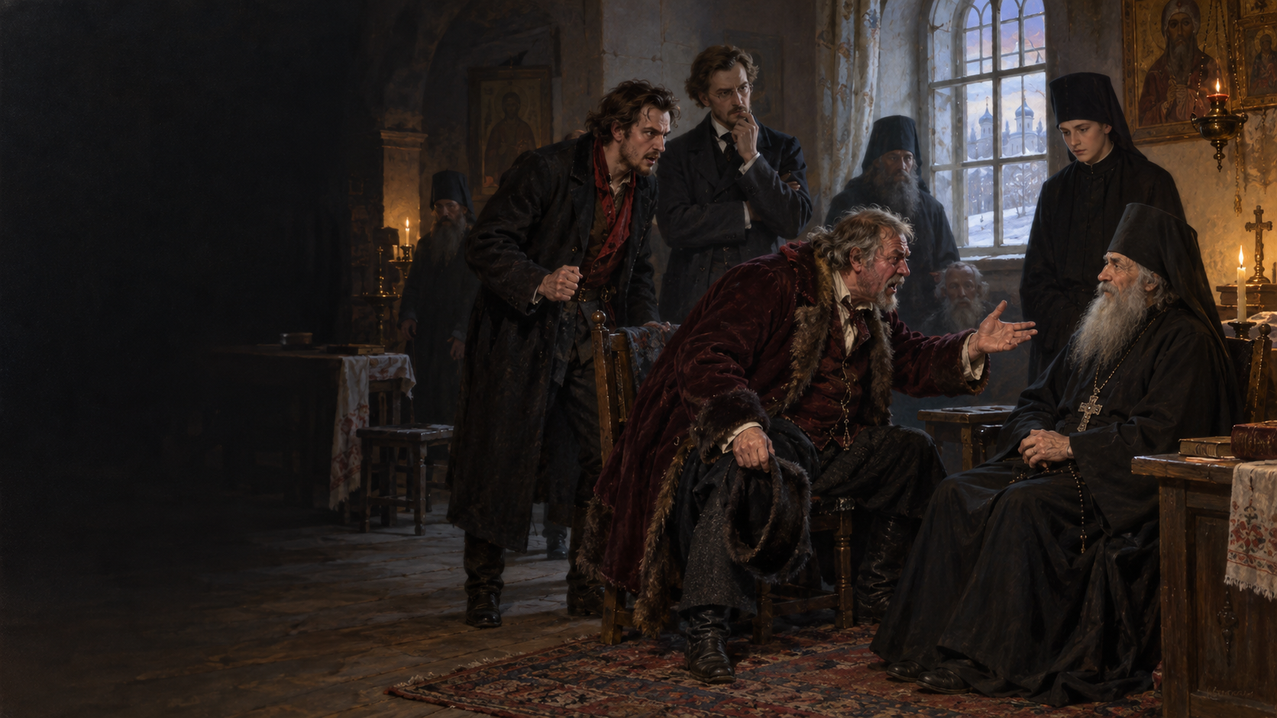
SPEAKER 1
STORY I 0:55
THE MONASTERY MEETING
A family dispute
becomes a public scandal
Dmitri demands his inheritance. Fyodor mocks everyone. Zosima senses approaching tragedy.
THE BROTHERS KARAMAZOV
04
Notes:
SPEAKER 1 | TARGET TIME: 0:55
The family gathers at the monastery to settle Dmitri's financial dispute with his father. Instead, Fyodor turns the meeting into a spectacle and insults the monks. Dmitri arrives late and accuses his father of cheating him. Both men also desire Grushenka, which turns money into sexual rivalry. Elder Zosima unexpectedly bows before Dmitri, as if he foresees the suffering that is coming.
HANDOFF: Speaker 2 will follow Dmitri as money and jealousy push the family toward violence.
Sources:
- https://www.gutenberg.org/ebooks/28054
- Visual: AI-generated for this presentation.

Slide 5
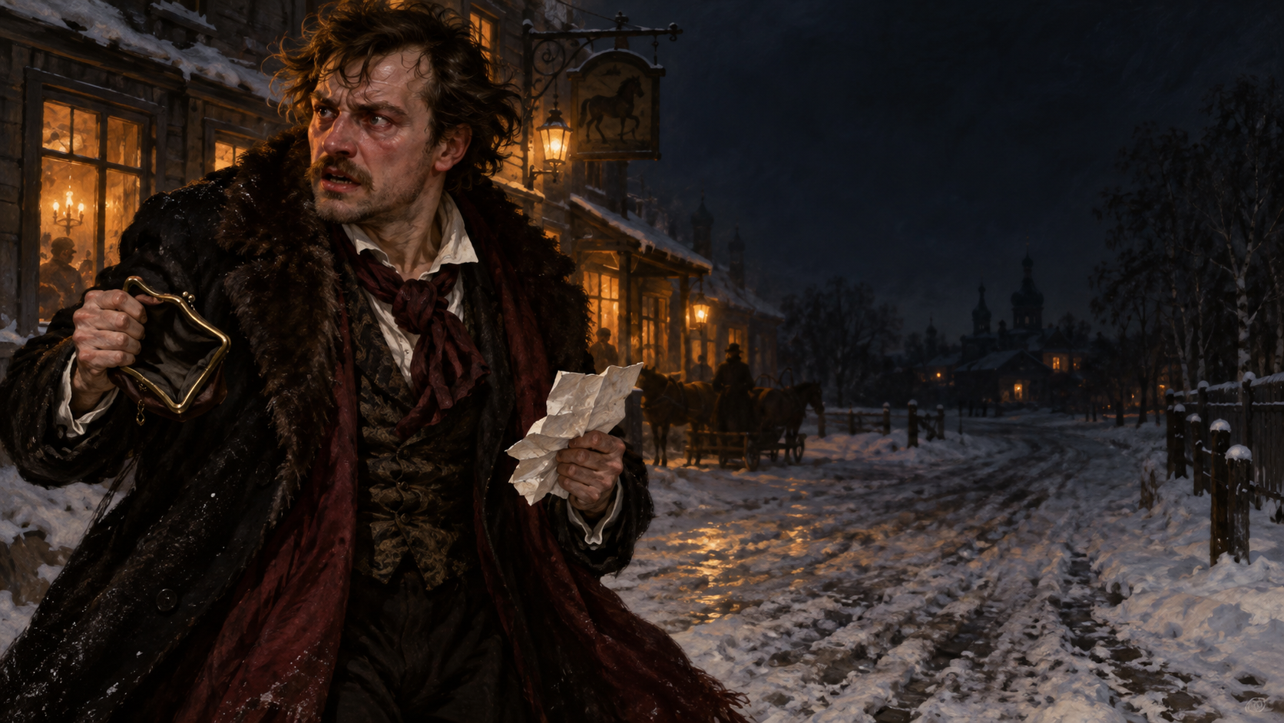
SPEAKER 2
STORY II 0:55
DMITRI'S CRISIS
Money, jealousy,
and a desperate promise
He needs 3,000 roubles and fears Grushenka will choose his father.
THE BROTHERS KARAMAZOV
05
Notes:
SPEAKER 2 | TARGET TIME: 0:55
Dmitri believes Fyodor still owes him money. At the same time, he has spent 3,000 roubles entrusted to him by his fiancée, Katerina. He wants to repay her and escape with Grushenka, but he fears Grushenka may visit Fyodor instead. His desperation produces threats, violence, and repeated claims that he could kill his father. These statements later become powerful evidence.
HANDOFF: Meanwhile, Ivan's ideas begin to influence Smerdyakov.
Sources:
- https://www.gutenberg.org/ebooks/28054
- Visual: AI-generated for this presentation.

Slide 6
SPEAKER 2
STORY II 0:50
06
Ivan leaves town
IVAN
SMERDYAKOV
Questions whether morality
can survive without God
Hears permission
inside the argument
Ivan leaves. Smerdyakov now knows the house will be unprotected.
THE BROTHERS KARAMAZOV
06
Notes:
SPEAKER 2 | TARGET TIME: 0:50
Ivan has long conversations with Smerdyakov about belief and moral law. Smerdyakov interprets Ivan's skepticism as meaning that everything becomes permitted if God does not exist. Before the murder, Ivan leaves town even though Smerdyakov hints that something may happen. Ivan does not order a crime, but his departure later makes him feel that he silently allowed it.
HANDOFF: That night, several actions happen at once.
Sources:
- https://www.gutenberg.org/ebooks/28054

Slide 7
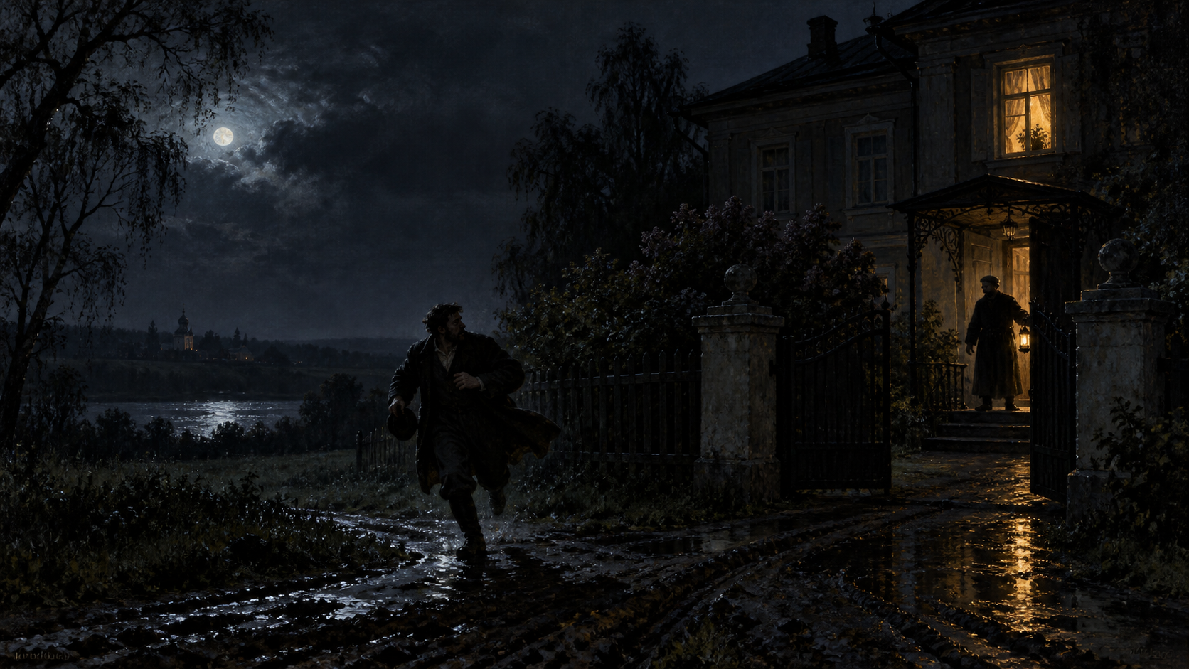
SPEAKER 2
STORY II 1:00
THE NIGHT OF THE MURDER
The wrong man looks guilty
Dmitri attacks Grigory and runs. Smerdyakov kills Fyodor and takes the money.
THE BROTHERS KARAMAZOV
07
Notes:
SPEAKER 2 | TARGET TIME: 1:00
Dmitri goes to his father's house searching for Grushenka. He does not find her. While escaping through the garden, he strikes the servant Grigory and leaves him bleeding. Dmitri then rushes away, believing he may have killed him. After Dmitri leaves, Smerdyakov murders Fyodor and steals the 3,000 roubles. Dmitri's threats, presence at the house, bloodstained clothing, and sudden money make him appear responsible.
HANDOFF: Speaker 3 will explain how Dmitri's celebration turns into an arrest and how the truth reaches Ivan.
Sources:
- https://www.gutenberg.org/ebooks/28054
- Visual: AI-generated for this presentation.

Slide 8
SPEAKER 3
STORY III 0:50
08
Mokroye and the arrest
Before dawn
At the inn
Dmitri finds Grushenka
and spends money wildly
Police arrive
with a murder charge
His money appears to be the stolen 3,000 roubles.
THE BROTHERS KARAMAZOV
08
Notes:
SPEAKER 3 | TARGET TIME: 0:50
Dmitri discovers that Grushenka has gone to the village of Mokroye to meet a former lover. He follows her, arrives with money, and organizes a lavish celebration. Grushenka finally chooses him. Their happiness lasts only hours. Investigators arrive and arrest Dmitri for Fyodor's murder. His sudden spending looks like proof that he stole the missing 3,000 roubles.
HANDOFF: The investigation builds a convincing case from several true facts.
Sources:
- https://www.gutenberg.org/ebooks/28054

Slide 9
SPEAKER 3
STORY III 0:55
09
The case against Dmitri
01
02
03
04
MOTIVE
THREATS
BLOOD
CASH
money and Grushenka
heard by witnesses
from attacking Grigory
appears after the murder
Every fact is real. Their combined story is false.
THE BROTHERS KARAMAZOV
09
Notes:
SPEAKER 3 | TARGET TIME: 0:55
The investigators have motive, public threats, blood, and money. Dmitri's explanation sounds unbelievable: he says he had saved half of Katerina's original 3,000 roubles in a cloth pouch and carried it for weeks. The novel deliberately makes the false case psychologically persuasive. Dmitri did many violent and dishonest things, but he did not commit this murder.
HANDOFF: The actual murderer finally explains the crime to Ivan.
Sources:
- https://www.gutenberg.org/ebooks/28054

Slide 10
SPEAKER 3
STORY III 0:55
10
Smerdyakov's confession
SMERDYAKOV
IVAN
admits the murder
accepts moral guilt
He returns the stolen money to Ivan.
His illness and hallucinations intensify.
Before the trial, Smerdyakov dies by suicide.
THE BROTHERS KARAMAZOV
10
Notes:
SPEAKER 3 | TARGET TIME: 0:55
Smerdyakov meets Ivan three times and finally confesses. He says that Ivan's ideas and departure gave him confidence that the murder would be tolerated. He hands Ivan the stolen money. Ivan decides to testify, but his mental and physical condition collapses. Soon afterward, Smerdyakov dies by suicide, removing the one person who could directly prove Dmitri's innocence.
HANDOFF: Speaker 4 will take us through the trial, verdict, and final scene.
Sources:
- https://www.gutenberg.org/ebooks/28054

Slide 11
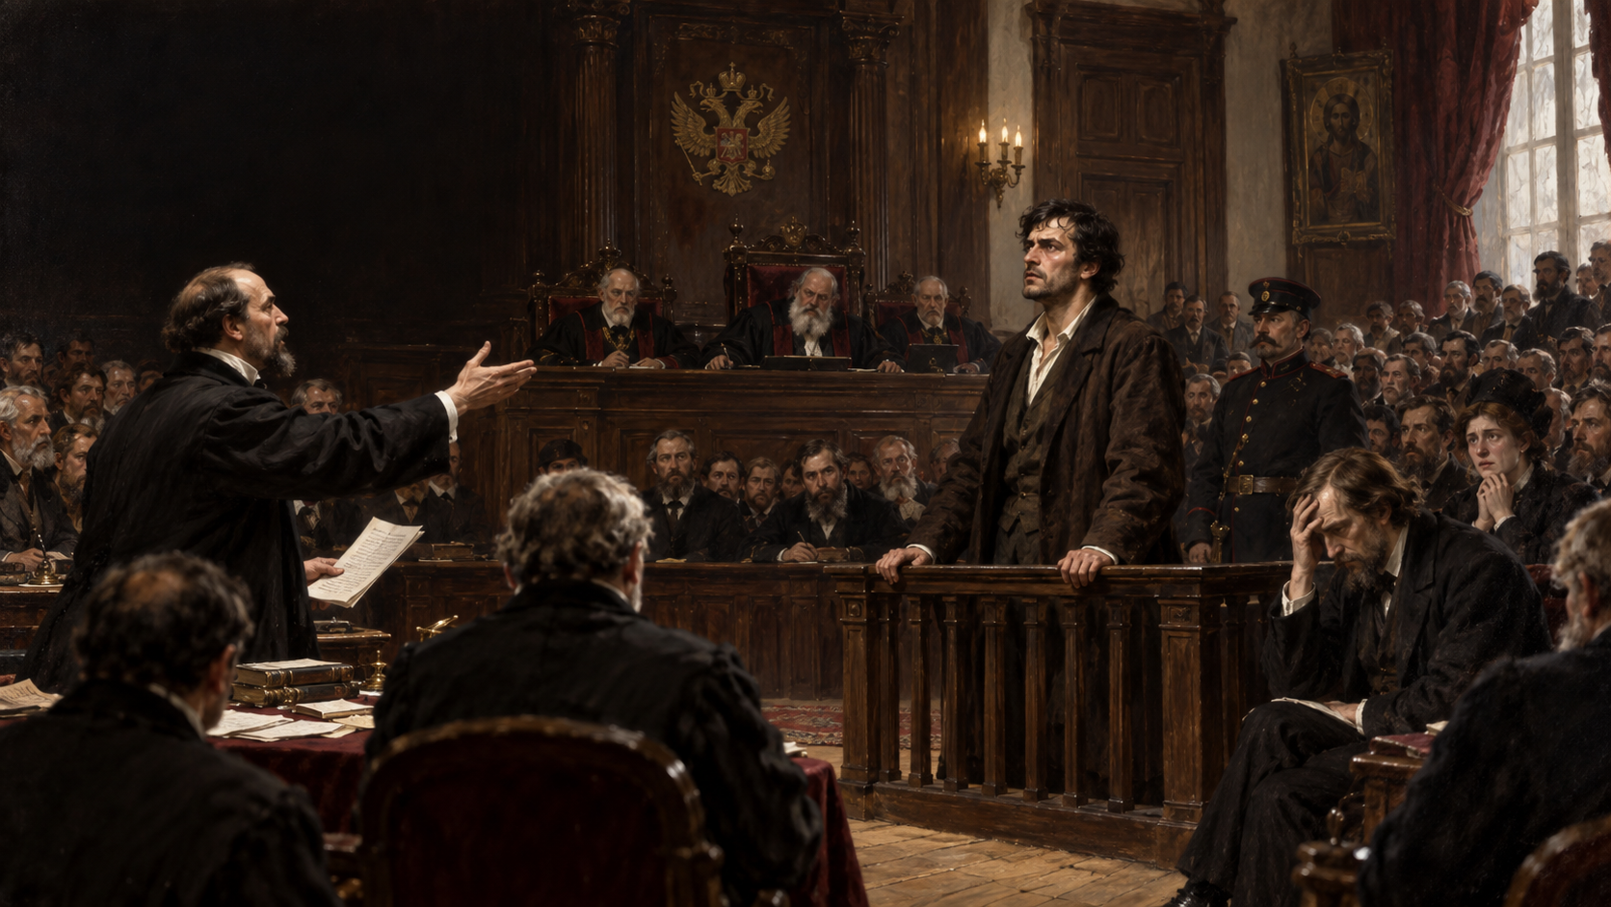
SPEAKER 4
STORY IV 1:00
THE TRIAL
A persuasive story
defeats the truth
The prosecution explains Dmitri perfectly. The defense cannot explain the money.
THE BROTHERS KARAMAZOV
11
Notes:
SPEAKER 4 | TARGET TIME: 1:00
The trial becomes a public drama. The prosecutor presents Dmitri as the natural product of the violent Karamazov family. The defense argues that strong suspicion cannot replace proof. Ivan enters in a feverish state, produces Smerdyakov's money, and declares his own moral responsibility. Katerina then reveals a letter in which Dmitri had threatened to kill Fyodor. Her testimony destroys much of the defense.
HANDOFF: The jury now chooses between legal evidence and the hidden truth.
Sources:
- https://www.gutenberg.org/ebooks/28054
- Visual: AI-generated for this presentation.

Slide 12
SPEAKER 4
STORY IV 0:45
12
The verdict
GUILTY
Twenty years of penal servitude in Siberia
Dmitri plans an escape, but the novel leaves his future unresolved.
THE BROTHERS KARAMAZOV
12
Notes:
SPEAKER 4 | TARGET TIME: 0:45
The jury finds Dmitri guilty, and the court sentences him to twenty years of penal servitude in Siberia. Alyosha, Ivan, Katerina, and Grushenka discuss helping him escape, but the novel ends before any escape occurs. Dostoevsky therefore closes the criminal case without fully closing Dmitri's future.
HANDOFF: The final chapter moves away from the courtroom to Alyosha and a group of children.
Sources:
- https://www.gutenberg.org/ebooks/28054

Slide 13
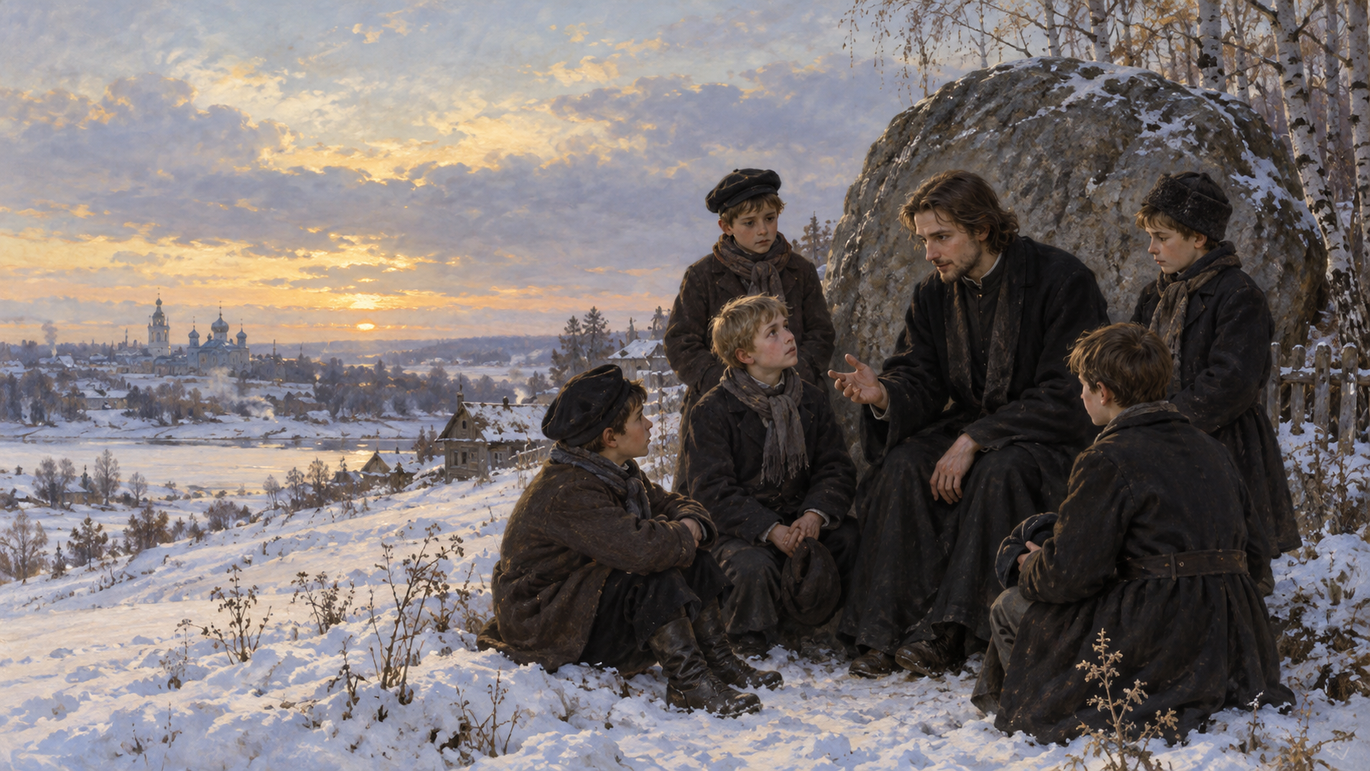
SPEAKER 4
STORY IV 0:55
THE FINAL SCENE
A funeral becomes
a promise to remember
Alyosha asks the boys to preserve one good memory and remain kind to one another.
THE BROTHERS KARAMAZOV
13
Notes:
SPEAKER 4 | TARGET TIME: 0:55
The novel's emotional ending concerns Ilyusha, a schoolboy who dies after illness. After the funeral, Alyosha gathers the boys beside a stone. He asks them to remember Ilyusha and to keep one honest, loving memory from childhood. That memory may prevent cruelty later in life. The story therefore ends with grief, friendship, and a small community rather than with the convicted brother.
HANDOFF: The story is complete. Speaker 5 will now show how its events carry the book's philosophical argument.
Sources:
- https://www.gutenberg.org/ebooks/28054
- Visual: AI-generated for this presentation.

Slide 14
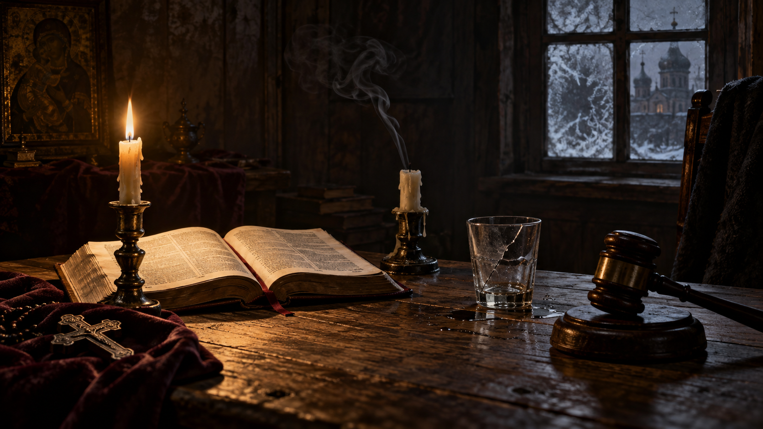
SPEAKER 5
PHILOSOPHY 1:00
FOUR QUESTIONS INSIDE THE STORY
SUFFERING
RESPONSIBILITY
Can any harmony justify innocent pain?
Who shares guilt for one act?
FREEDOM
REDEMPTION
Do people want choice or security?
Can active love repair damage?
The murder plot turns each question into a human consequence.
Notes:
SPEAKER 5 | TARGET TIME: 1:00
The philosophy grows directly from the story. Ivan's anger at innocent suffering creates the problem of evil. The Grand Inquisitor asks whether human beings truly want freedom. Smerdyakov's crime makes responsibility wider than physical action. Alyosha and the boys suggest that redemption begins through active love and memory. The novel never pauses for a simple lesson. It tests every idea through consequences.
HANDOFF: The deepest debate occurs between Ivan's rebellion and Alyosha's response.
Sources:
- https://www.gutenberg.org/ebooks/28054
- Visual: AI-generated for this presentation.

Slide 15
SPEAKER 5
PHILOSOPHY 1:35
15
Ivan and Alyosha
IVAN'S REBELLION
ALYOSHA'S RESPONSE
No future harmony can repay the suffering of an innocent child.
Love must become an action before it becomes an explanation.
The Grand Inquisitor adds another fear: people may surrender freedom for comfort and authority.
He listens, forgives, stays present, and builds community around grief.
THE BROTHERS KARAMAZOV
15
Notes:
SPEAKER 5 | TARGET TIME: 1:35
Ivan gives one of literature's strongest protests against religious explanations of suffering. He refuses to accept a final harmony if it requires the torture of even one innocent child. In the Grand Inquisitor, he argues that freedom may be too painful and that institutions gain power by offering certainty. Alyosha does not defeat Ivan with a logical proof. His answer is practical and relational. He remains with suffering people and chooses active love. Dostoevsky gives Ivan intellectual force while allowing Alyosha's actions to shape the ending.
HANDOFF: The final philosophical issue returns us to the murder: guilt and responsibility.
Sources:
- https://www.gutenberg.org/ebooks/28054

Slide 16
SPEAKER 5
CONCLUSION 1:20
WHO KILLED FYODOR?
Smerdyakov acted
Ivan influenced the killer
Dmitri desired the death
Fyodor created the damage
The novel separates criminal guilt from shared moral responsibility.
Final question: does shared responsibility create compassion, or weaken justice?
THANK YOU
Notes:
SPEAKER 5 | TARGET TIME: 1:20
Smerdyakov alone commits the murder, so criminal guilt belongs to him. Yet the novel spreads moral responsibility across the family. Ivan's ideas influence the killer. Dmitri desires the death and creates evidence against himself. Fyodor's neglect and humiliation shape the household. Alyosha accepts responsibility for responding to suffering even when he did not cause it. Dostoevsky's closing emphasis is active love: responsibility should lead toward compassion and repair, not erase legal distinctions. Our final question is whether that shared responsibility strengthens justice or makes it less clear.
HANDOFF: Thank the class and invite questions.
Sources:
- https://www.gutenberg.org/ebooks/28054
- https://boap.uib.no/books/sb/catalog/download/10/9/183?inline=1
- Visual: AI-generated for this presentation.

