Slide 1
INTERSECTION COUNTER
Operator guide — from raw traffic video to a TMC Excel workbook
AI detection and tracking, trajectory-based turn classification, and built-in QA — running entirely on your machine. Slides marked ▶ carry animated walkthroughs (they play in slideshow mode).
No cloud · no login · local web app at http://127.0.0.1:5000

Slide 2
OVERVIEW
The workflow at a glance
1 Launch — py start_server.py, then open http://127.0.0.1:5000
2 Upload videos — drag the day's files in — camera, date, start time and intersection auto-fill from filenames
3 Open the intersection card — one card per intersection × date
4 Check card settings — name, number of legs (3 for T-junctions), cameras, trims, two-pass readiness
5 Calibrate each camera — legs → channels → road paths → Save
6 Set clip trims — the wall-clock windows to count
7 Confirm & process — pick a mode; full days run overnight
8 Work the QA queue — corridor checks, spot count, flag cards — keyboard-first
9 Export — Excel / PDF from the card; a 5-sheet TMC workbook

Slide 3
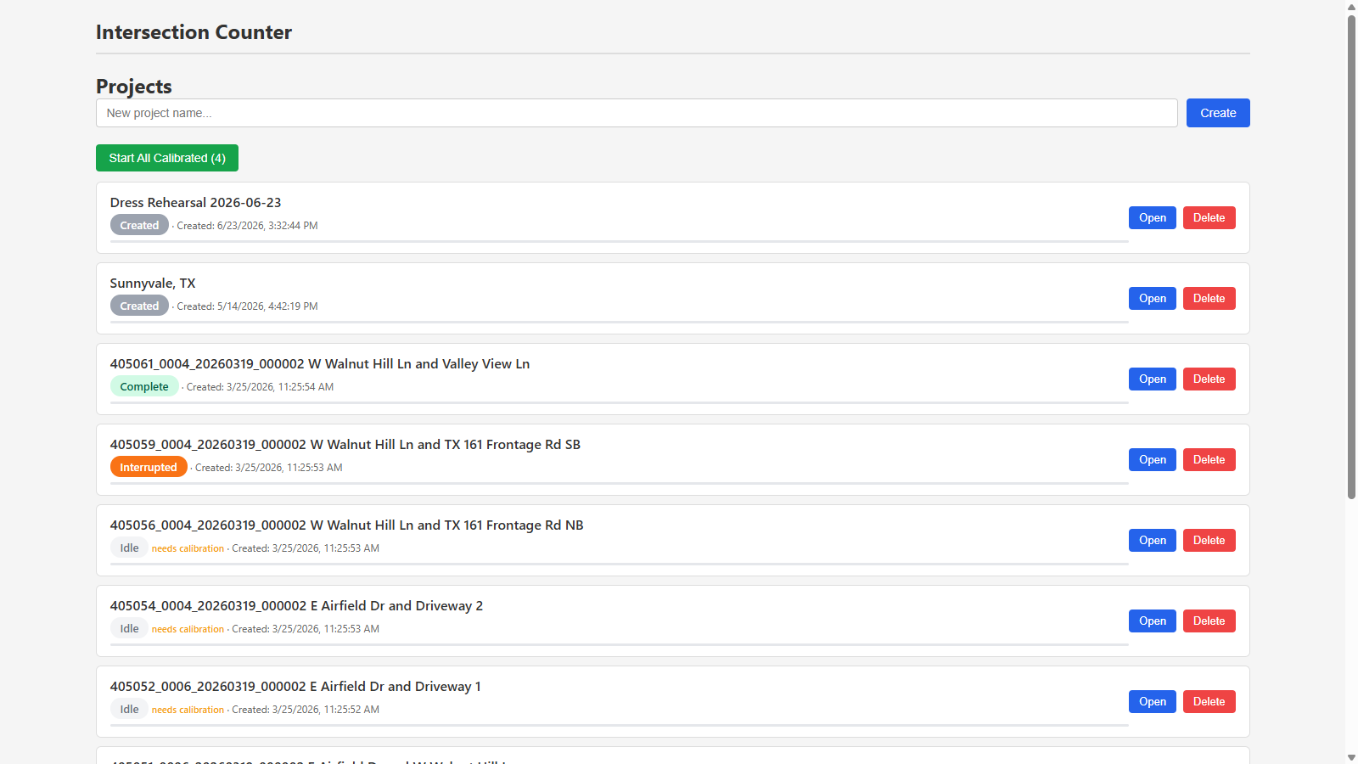
STEP 1 · LAUNCH
Start the server and pick a project
Getting in
• Run py start_server.py in the install folder, then browse to http://127.0.0.1:5000 (this exact port).
• Every project is a site visit: one per study, named after the corridor or client.
• Status chips: created, idle, complete, interrupted, needs calibration, needs video.
• “Start All Calibrated” batch-runs every ready project.
⚠ Deleting a project deletes its data — there is no undo.
The projects list. Open resumes exactly where you left off.

Slide 4
STEP 1 · ▶ IN MOTION
From the projects list into a card
Four clicks to the work
• Open the project → it lands on Videos.
• Switch to the Intersections tab.
• Open the card you're working — everything for that intersection × date lives inside.
• The animation plays in slideshow mode; the orange ring marks each click.
▶ Projects → project → Intersections tab → card.

Slide 5
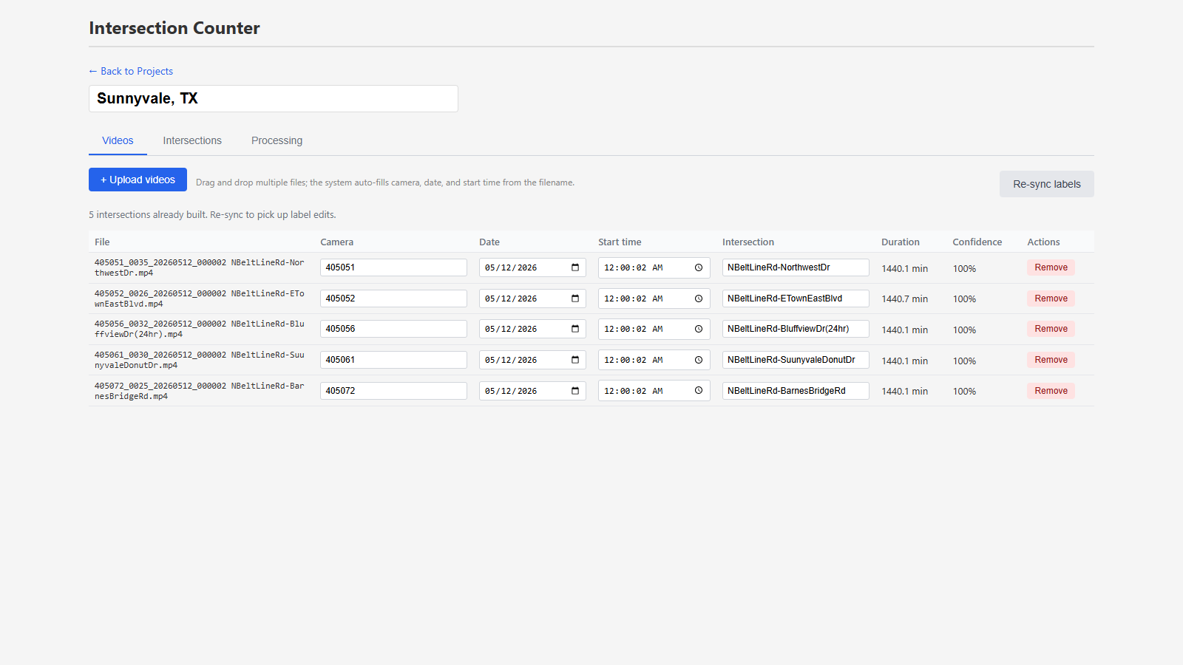
STEP 2 · VIDEOS
Upload the day's footage
One drag-and-drop
• Drop all cameras' files at once; camera, date, start time and intersection auto-fill from the filename.
• Confidence under 100%? Verify and fix the fields inline.
• The Intersection field groups videos into cards — same spelling, same card.
• Renamed a label later? “Re-sync labels”.
⚠ Set the true wall-clock start time — every trim and count bin hangs off it.
Five 24-hour cameras parsed straight from their filenames.

Slide 6
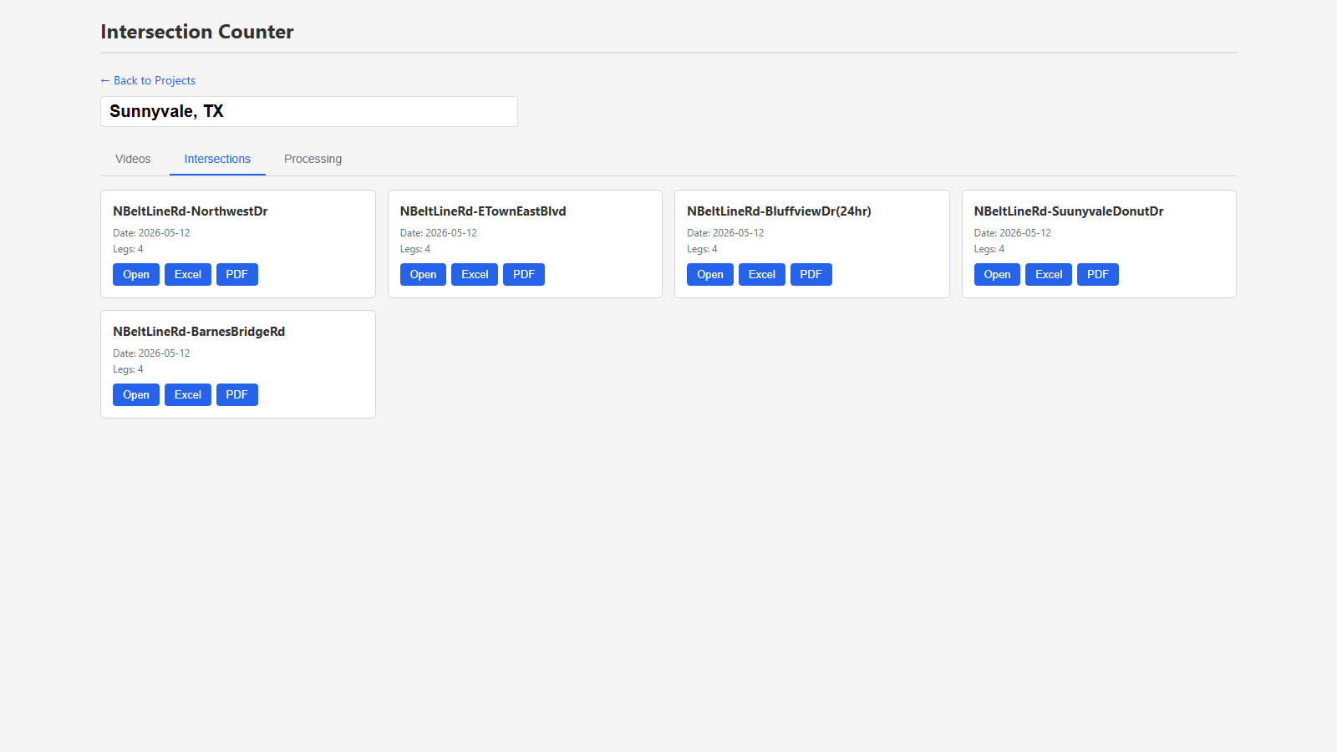
STEP 3 · INTERSECTIONS
One card per intersection × date
The card is the unit of work
• Each card bundles that intersection's cameras, calibration, trims, QA and exports for one study date.
• Open drills in; Excel / PDF export straight from this list once processing is done.
• Legs count is a sanity check — a T-junction should say 3.
• Multiple cameras on one intersection live in the same card and de-duplicate at count time.
The five Belt Line Rd cards for the 2026-05-12 study.

Slide 7
STEP 4 · CARD SETTINGS
Check the basics; learn the readiness panel
Thirty seconds of setup
• Confirm the name and the number of legs (4 default; T-junctions 3).
• “Two-pass readiness” lists every camera × trim window: pass-1 is detection + tracking (the slow overnight part); pass-2 is classification + merge (fast, re-runnable).
• “pass-2 stale — will re-run” just means classification will refresh on the next run — pass-1 work is preserved.
• “Confirm & process” launches exactly what the panel lists — read it first.
The ▶ card-tabs animation: Settings → Cameras → Clip trim → QA.
▶ The four sub-tabs of an intersection card.

Slide 8
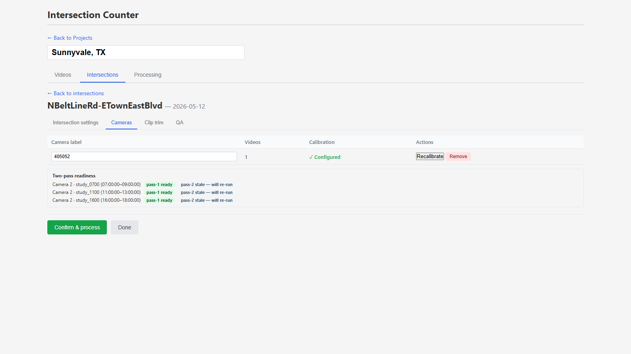
STEP 5 · CAMERAS
Each camera gets its own calibration
Per-camera geometry
• Every camera sees the intersection from its own angle; legs and channels are drawn per camera.
• ✓ Configured = geometry exists; Recalibrate opens the editor.
• Footage rating stars say whether this video supports the count guarantee — 1080p-class earns the full per-movement guarantee.
One camera on this card, already calibrated.

Slide 9
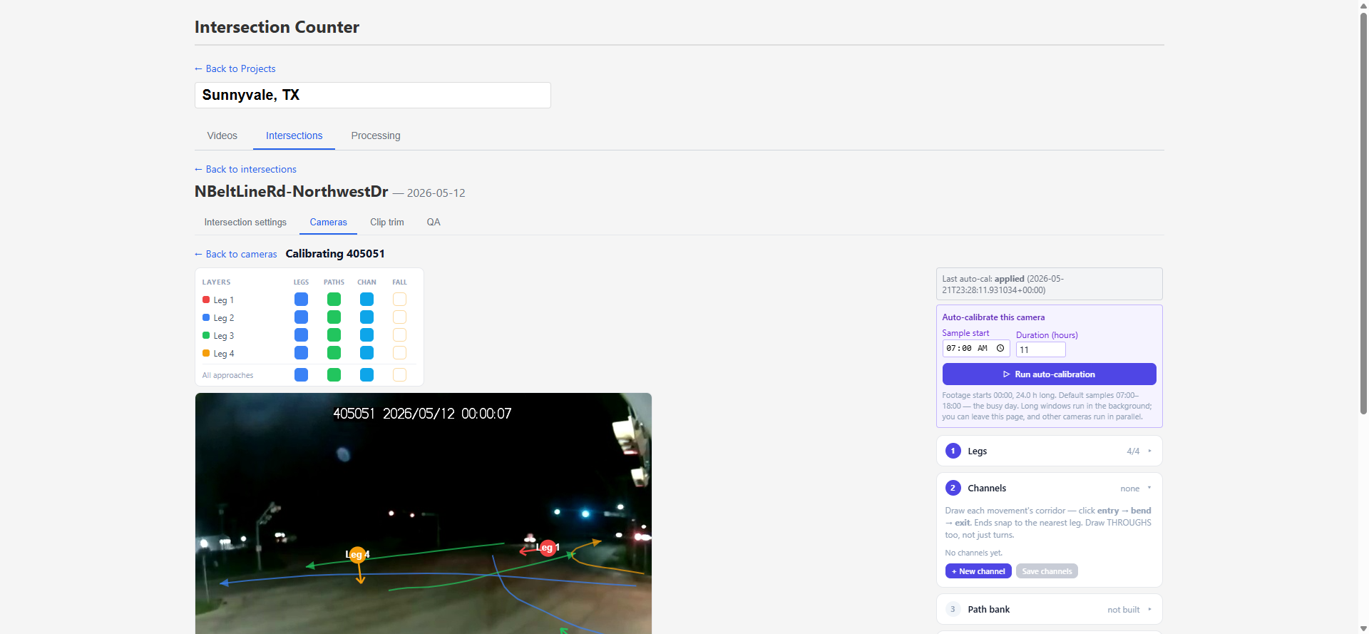
STEP 5A · CALIBRATION
Legs — let auto-calibration make the first pass
Pick the window, then run
• Auto-calibration watches real traffic across YOUR sample window — set the wall-clock start and duration (15 min – 15 h) right in the panel.
• The default is the busy day: 07:00 for 11 h on a midnight-start file (+7 h into the footage otherwise) — prefilled for you.
• Long windows are background jobs with a live % and time-left readout — leave the page freely; other cameras run in parallel (two at a time, the rest queue in order).
• When the proposal lands: Preview on canvas, then Apply or Reject.
⚠ Get the cardinal labels right — every movement name (NB left, EB through…) derives from them.
The sample-window controls, prefilled with the 07:00–18:00 default.

Slide 10
STEP 5A · ▶ IN MOTION
Open the editor, light the layers, scrub
The editor tour
• Recalibrate opens the editor on the calibration frame.
• The layers panel lights Legs / Paths / Channels overlays per approach — or all at once.
• Drag the timeline scrubber to any wall-clock moment; the frame refreshes — judge geometry against BUSY video, not an empty midnight frame.
▶ Recalibrate → overlays on → scrubbed to 08:00.

Slide 11
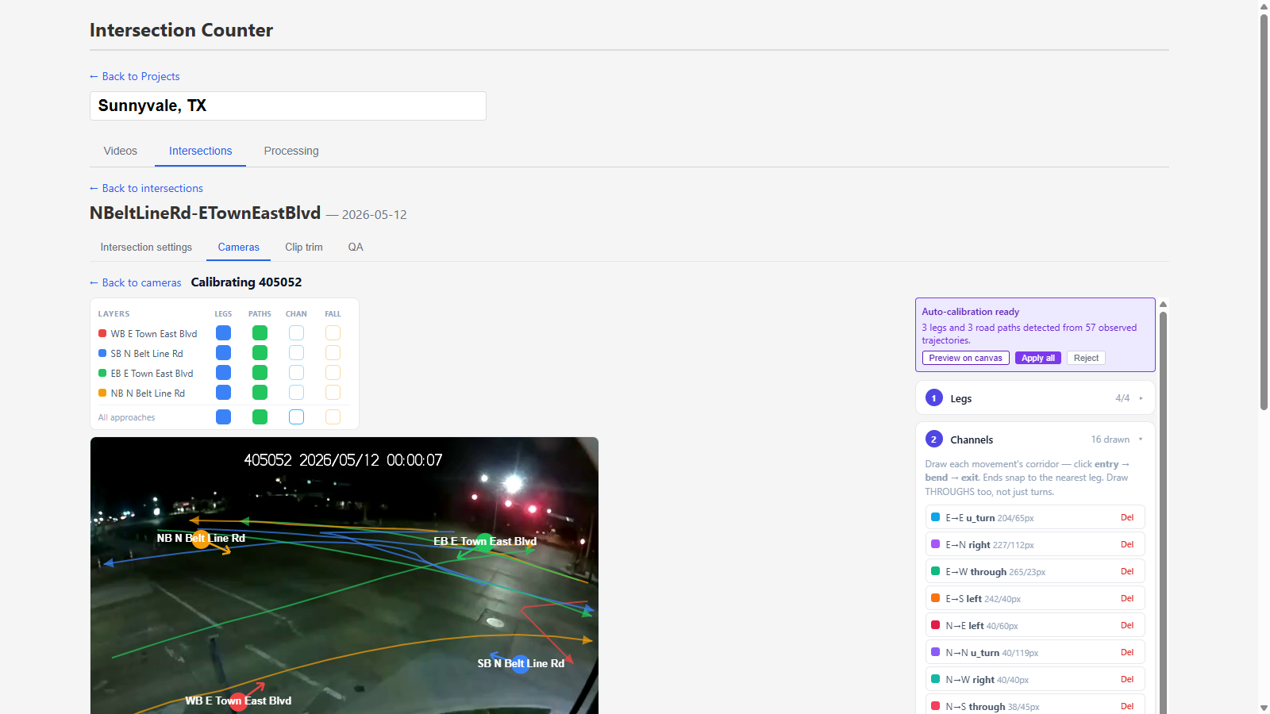
STEP 5B · CALIBRATION
Channels — sketch how traffic moves
Guidelines, not fences
• A channel is a movement's corridor: click entry → bend → exit; ends snap to the nearest leg.
• Draw THROUGHS too, not just turns.
• Channels are layout guidance — cars share mouths and drift across lanes; the trajectory over time decides the turn.
• 16 channels = all movements incl. U-turns at a 4-leg intersection.
All 16 movement corridors overlaid on the frame.

Slide 12
STEP 5B · ▶ IN MOTION
Drawing a channel, click by click
Three clicks minimum
• “+ New channel” arms drawing.
• Click the ENTRY at the mouth the movement uses, a BEND wherever the path curves (as many as needed), then the EXIT.
• Both ends snap to the nearest leg; the list shows the new row immediately.
⚠ Nothing persists until “Save channels” — leaving the editor discards the draft (this demo was discarded).
▶ Entry → bend → exit; the draft appears in the channel list.

Slide 13
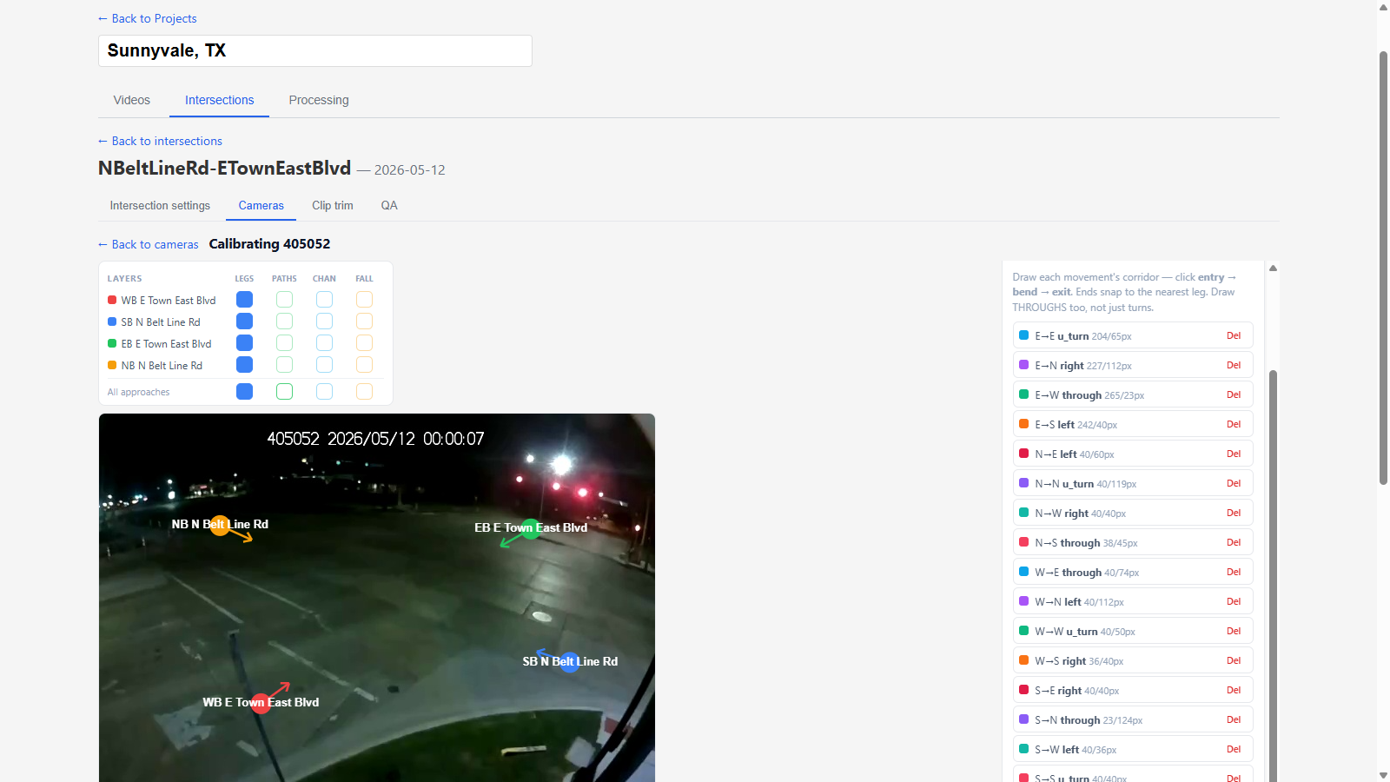
STEP 5C · CALIBRATION
Road paths — then save
The observed geometry
• Road paths are machine-derived center-lines from real observed journeys — review them against the video.
• A missing path for a real movement is worth fixing: draw it, or re-run auto-calibration on busier video.
• Click Save calibration — nothing persists until you do.
Derived road paths for every approach, ready to save.

Slide 14
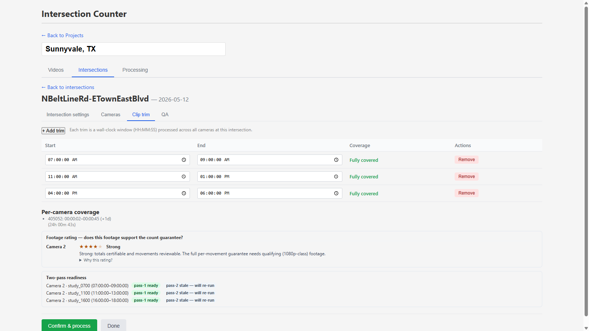
STEP 6 · TRIMS
Choose the windows to count
Wall-clock windows
• Each trim is a HH:MM:SS window processed across ALL cameras on the card — classic peaks here: 07–09, 11–13, 16–18.
• Coverage confirms footage actually spans the window.
• Per-camera coverage shows each camera's true recording span.
• Fewer, tighter trims = faster processing; full-day = overnight.
Three two-hour study windows, all fully covered.

Slide 15
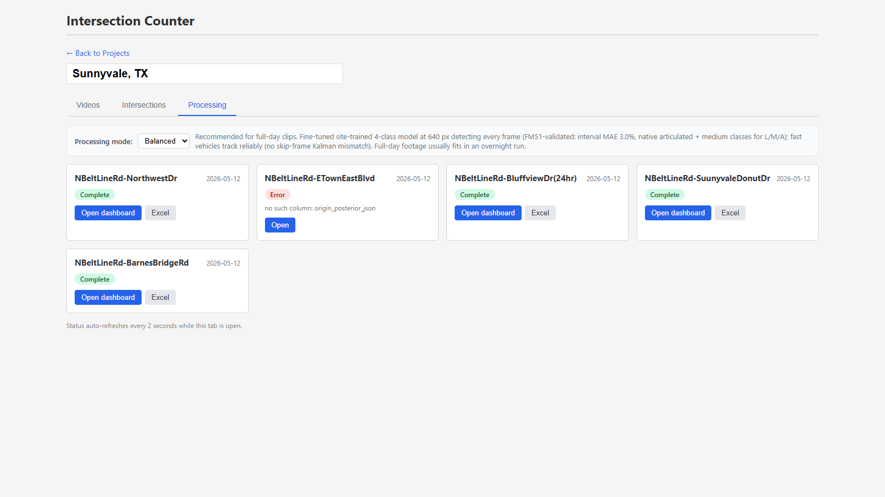
STEP 7 · PROCESS
Confirm & process, then leave it alone
Pick a mode and go
• Balanced is the default for full-day clips; Accurate trades speed for the hardest sites; Fast is for previews.
• The Processing tab tracks every intersection live (2 s refresh).
• Single-frame glitches never stop a run; real errors surface on the status card with the reason.
⚠ While a run is active, don't edit the app's files or restart the server — the dev auto-reload kills in-flight jobs.
Project-level status: four complete, one surfaced error.

Slide 16
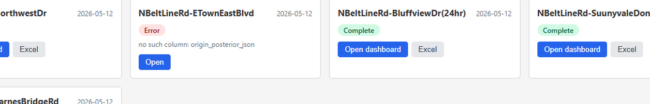
STEP 7A · STATUS CARDS
Reading a surfaced error (the one on screen)
Status = the LAST run's result
• Each card stores its most recent run's outcome and timestamp — an Error stays displayed until the next run replaces it.
• This one: “no such column: origin_posterior_json”, dated 2026-07-31 — that run raced an app update (the database column now exists). It is stale, not live.
• Counts already produced for this intersection are unaffected — the error describes the failed run, not the data.
Fix: simply run “Confirm & process” again when you next process this card; the fresh run replaces the status. If the same error recurs on a current version, report it — that means the project file predates the app.
Zoom of the error card: the reason and the Open shortcut.

Slide 17
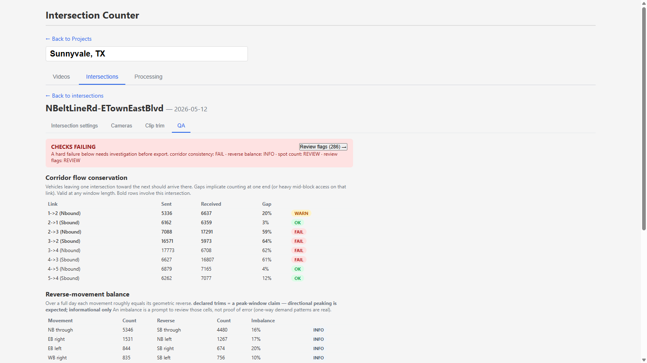
STEP 8 · QA
The built-in checks run before you export
Trust, then verify
• Corridor flow conservation: vehicles leaving one intersection should arrive at the next — big gaps implicate counting at one end, or heavy mid-block access.
• Reverse-movement balance is informational in peak windows.
• Manual spot count: hand-count a stretch of raw video and compare — the zero-ground-truth accuracy estimate. Certifying ±10% needs ~850 vehicles (20–40 min busy).
⚠ A hard FAIL needs investigation before export — work the QA tab for the implicated link; flags alone won't clear it.
The QA tab: conservation with per-link OK / WARN / FAIL.

Slide 18
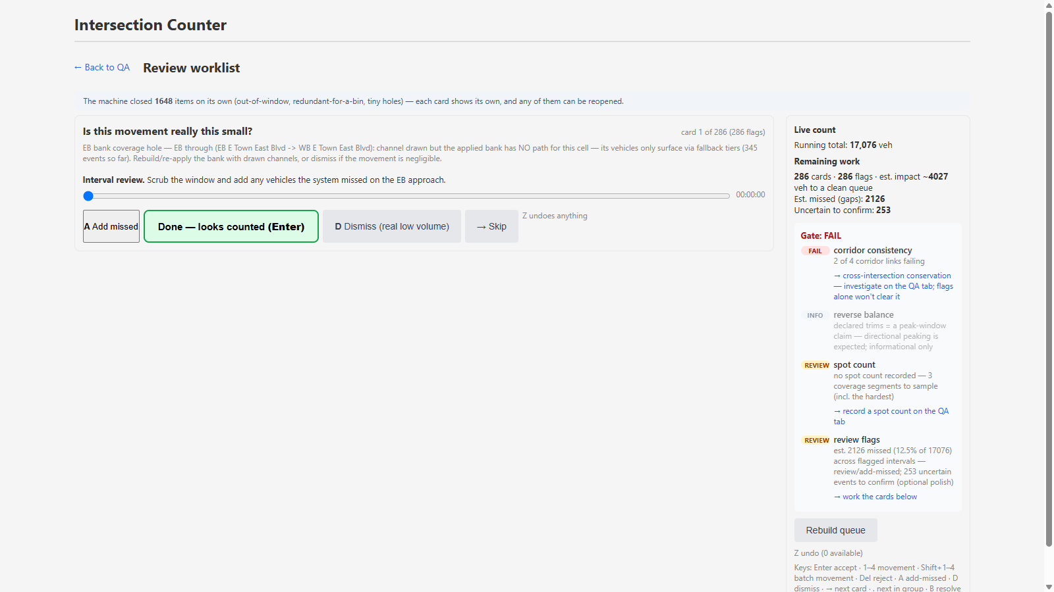
STEP 8A · THE FLAG QUEUE
Anatomy of a review card
One card = one question
• Header: the question (“Is this movement really this small?”, “Did the system miss vehicles here?”).
• Evidence line: exactly why it was flagged, with numbers — which approach, which 15-min bin, how big the suspected gap is.
• Interval player: the raw video for that exact window — scrub it and watch the flagged approach.
• Actions: A add-missed · Done · D dismiss · → skip.
• The machine already closed 1,648 items on its own (out-of-window, redundant, tiny holes) — you only see what needs human eyes.
Card 1 of 286 with the live-count sidebar and gate panel.

Slide 19
STEP 8A · CARD TYPES
The three card families and the right response
Card family
What it means
Your job
Resolve with
Coverage hole
“Is this movement really this small?”
A movement has a drawn channel but little or no counted volume — either genuinely tiny, or the applied bank missed it.
Scrub the interval; decide whether traffic is really that light.
D Dismiss if real low volume · A add any missed vehicles · rebuild bank if systemic
Interval undercount
“Did the system miss vehicles here?”
A corridor-conservation gap localized to one 15-min bin (e.g. “Sbound short by 176 this bin”).
Watch the flagged approach in that window; add what the tracker missed.
A Add missed for each vehicle · Enter when the bin looks right
Echo suspect
“counts repeat the same vehicle”
Track-fragment echoes make a movement read HIGHER than reality (e.g. ~101 repeats this day).
Review the failing bins; remove duplicates.
Del reject the duplicate events · Enter when clean
Skip (→) defers a card without resolving — it stays in the queue. Z undoes any resolution. “.” jumps to the next card in the same group; B resolves the whole group at once.

Slide 20
STEP 8B · ▶ IN MOTION
Working the queue, keyboard-first
The rhythm
• Read the question and the evidence line.
• Scrub the interval — watch the flagged approach only.
• Enter accepts (“looks counted”) · A adds a missed vehicle · D dismisses · → skips for later.
• The queue counter drops as you resolve; Z undoes anything, immediately.
This demo resolved a card (286 → 285) and undid it (back to 286) — the database was verified unchanged.
▶ Three cards, a scrub, a resolve, and the undo.

Slide 21
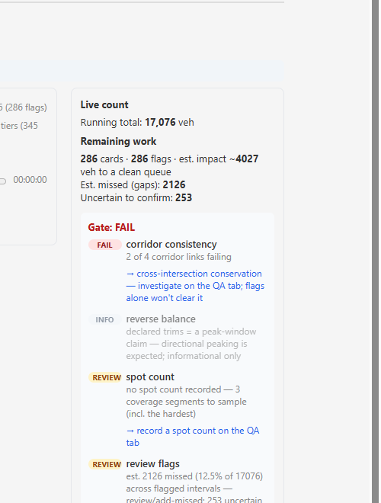
STEP 8C · THE GATE PANEL
What flags can clear — and what they can't
The sidebar keeps score
• Live count: the running total as you work.
• Remaining work: cards left and their estimated vehicle impact (here: ~4,027 veh to a clean queue).
• Gate list: each export check with its state and the route to fix it.
⚠ corridor consistency FAIL points at cross-intersection conservation — investigate on the QA tab (spot count the implicated link); working flag cards will NOT clear it.
• review flags REVIEW clears exactly by working the cards below.
• “Rebuild queue” re-derives the cards after big changes.
The gate panel: FAIL / INFO / REVIEW with fix routes.

Slide 22
STEP 9 · ▶ EXPORT
Excel and PDF, straight from the card
The deliverable
• Excel / PDF buttons sit on each intersection card — export once the QA gate is clean.
• The file downloads as TMC_<intersection>_<date>.xlsx.
• Every export reflects the current reviewed state — re-export freely after more review.
▶ One click; the workbook lands in Downloads.

Slide 23
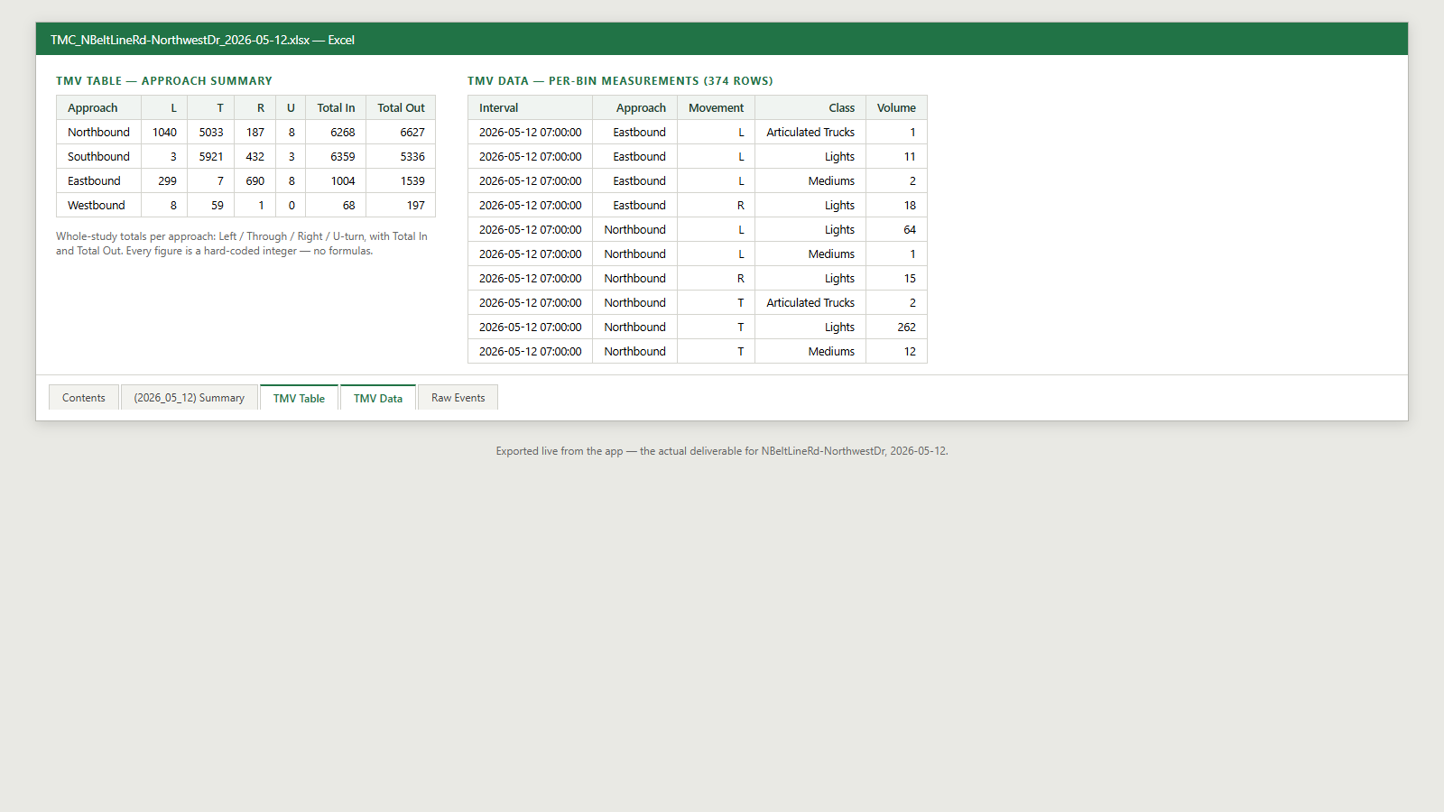
STEP 9A · THE WORKBOOK
What's inside the export
Five sheets
• Contents — what each sheet holds.
• Summary — a TMC overview for the study date.
• TMV Table — per-approach L / T / R / U totals with Total In and Total Out (shown right: the real NorthwestDr export).
• TMV Data — every 15-min bin × approach × movement × vehicle class (Lights / Mediums / Articulated), 374 rows here.
• Raw Events — the event-level base data.
Every figure is a hard-coded integer — no formulas — safe for any client tool.
Rendered from the actual exported workbook.

Slide 24
REFERENCE
Tips, traps, and the keyboard
Launching
• http://127.0.0.1:5000 — that port only. Desktop window: python run.pyw.
• Everything runs locally; footage never leaves the machine.
Calibration
• T-junction? Set legs to 3 on the card first.
• Draw every movement incl. throughs; channels guide, trajectories decide.
• Auto-cal samples YOUR window — default 07:00–18:00. Pick the busy day, never midnight; jobs run in the background with an ETA.
• Nothing persists until Save — deliberate exits discard drafts.
Processing
• Full-day + Balanced = overnight; start it at end of day.
• Don't edit app files or restart the server mid-run.
• An Error status is the LAST run's result — a fresh run replaces it.
Review keyboard
• Enter — accept (“done, looks counted”)
• A — add a missed vehicle · D — dismiss (real low volume)
• Del — reject a duplicate/false event
• 1–4 — set movement · Shift+1–4 — batch movement
• → — skip · . — next in group · B — resolve group
• Z — undo anything
QA & export
• Corridor FAIL: investigate on the QA tab — flags won't clear it.
• Record a spot count on every study (~850 veh certifies ±10%).
• Export per card; re-export freely after review.

