Slide 1

Structural Bioinformatics Training Workshop & Hackathon 2018
Apache Spark Introduction
Structural Bioinformatics Laboratory
San Diego Supercomputer Center
UC San Diego

Slide 2
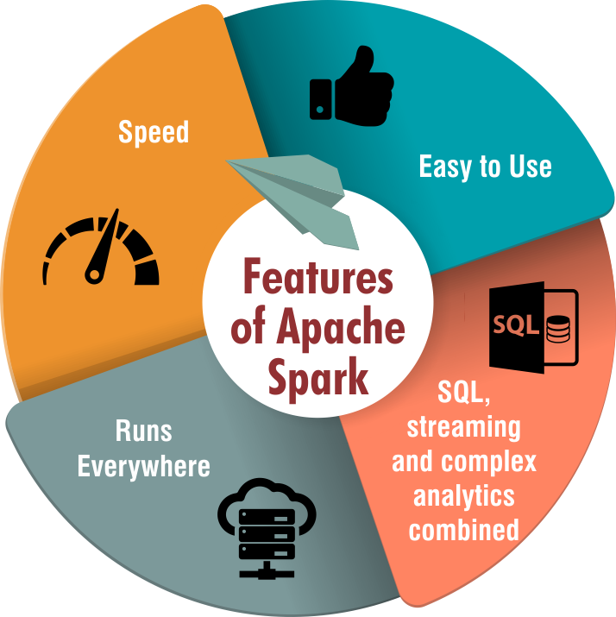
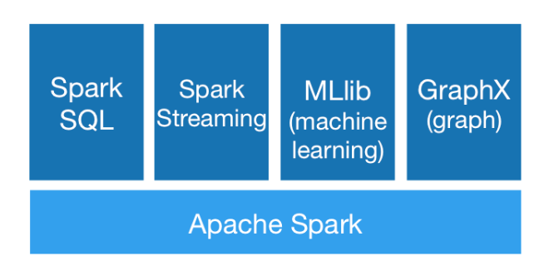
Introduction to Apache Spark
Apache Spark is an open-source software framework that provides a distributed environment designed to store and process big data.
Apache Spark Ecosystem
Core API: Python, Java, R, Scala
Spark offers support for multiple languages and makes it easy to build parallel applications.
Notes:
Spark is an open-source framework for large-scale data processing.
Spark ecosystem is big. It has multiple components. The underlying execution engine is Spark Core, that all other functionality is built upon. It offers support for multiple languages.
Spark is designed to cover a wide range of workloads.
The main feature of Spark is its in-memory cluster computing that increases the processing speed of an application.

Slide 3
Initialize and close Spark
from pyspark import SparkContext, SparkConf
SparkConf object contains information about your application
conf = SparkConf().setAppName(”myAppName").setMaster("local[*]")
SparkContext is the entry point for interacting with Spark
sc = SparkContext(conf=conf)
...
sc.stop()
More information:
https://spark.apache.org/docs/latest/configuration.html#available-properties
Notes:
The first thing a Spark program must do is to create a SparkContext object, which tells Spark how to access a cluster. To create a SparkContext you first need to build a SparkConf object that contains information about your application.
Spark properties control most application settings and are configured separately for each application. These properties can be set directly on a SparkConf passed to your SparkContext.
A SparkContext class represents the connection to our existing Spark cluster and provides the entry point for interacting with Spark.
The master URL to connect to, such as "local" to run locally with one thread, "local[4]" to run locally with 4 cores, or "spark://master:7077" to run on a Spark standalone cluster.
Only one SparkContext may be active per JVM. You must stop() the active SparkContext before creating a new one.

Slide 4
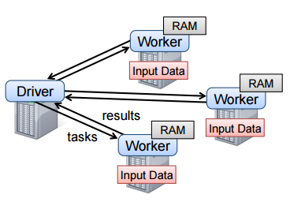
Distributed data structures
Spark revolves around the concept of a resilient distributed dataset (RDD):
core Spark abstraction
represents partitions across the cluster nodes
enables parallel processing of datasets
partitions can be in-memory or on-disk
partitions can be recomputed on failure
There are two ways to create RDDs:
parallelizing an existing collection in your driver program
referencing a dataset in an external storage system
Notes:
Spark revolves around the concept of a resilient distributed dataset (RDD), which is a fault-tolerant collection of elements that can be operated on in parallel.
There are two ways to create RDDs: parallelizing an existing collection in your driver program, or referencing a dataset in an external storage system

Slide 5
Create RDD
Parallelizing an existing collection:
data = [1, 2, 3, 4, 5]
distData = sc.parallelize(data, 5)
Collection
Number of partitions
Problem01
Referencing to a datasets on external storage:
distFile = sc.textFile(“data.txt”)
Problem02

Slide 6
RDD operations
Spark provides a rich set of operators to manipulate RDDs
Actions return final results of RDD computations
Transformations create new RDD from existing RDD
rdd1 = sc.parallelize(data)
rdd2 = rdd1.filter(func1)
rdd2.count()
rdd2.collect()
Notes:
Spark provides a rich set of operators to manipulate RDDs. RDD performs 2 operations mainly, transformations and actions. Let’s understand them next.
Transformations create new RDD from existing RDD like map and filter. Transformations are executed on demand, they are computed lazily. Lazy evaluation means that when if we call a transformation or an action on an RDD (for instance, calling map()), the operation is not immediately performed. Instead, Spark internally records metadata to indicate that this typical operation has been requested.
Actions return final results of RDD computations. Actions triggers execution using lineage graph to load the data into original RDD, carry out all intermediate transformations and return final results. Each time new action is been called, the entire RDD must be computed “from scratch”. To avoid this type of inefficiency, users can persist intermediate results.

Slide 7
RDD actions: collect()
Spark RDD collect function returns all the elements of the dataset as an array
rdd = sc.parallelize([1, 2, 3, 4, 5])
output_array = rdd.collect()
Note:
Collect function is used in most of the problems in the exercise section.

Slide 8
RDD transformations: filter()
Filter : | filter(f : T ⇒ Bool) | Return a new dataset formed by selecting those elements of the source on which func returns true.
Passing anonymous functions:
rdd2 = rdd1.filter(lambda x: x % 2 == 0)
Problem03
The interfaces available in the org.apache.spark.api.java.function package
Notes:
anonymous functions are really helpful for short snippets of code, hey are not very helpful when you want to request the framework for a complex data manipulation.
to create a function you will have to implement the interfaces available in the org.apache.spark.api.java.function package
Important points to note are:
filter is lazily evaluated
filter will filter out the elements from source RDD which are not satisfied by predicate function

Slide 9
RDD transformations: map() and flatMap()
Map : | map(f : T ⇒ U)
FlatMap : | flatMap(f : T ⇒ List<U>)
rdd1 = sc.parallelize(data,2)
rdd2 = rdd1.map(lambda x: 2*x)
rdd3 = rdd1.map(lambda x: "Number " + str(x))
rdd4 = rdd1.flatMap(lambda x: [x**2, x**3])
Problem04

Slide 10
Working with Key-Value Pairs: PairRDD
Calling a function that returns a key-value pair, for instance, the map ():
lines = sc.textFile(“data1.txt”)
lines.map(lambda x: (len(x.split(" ")), x)).collect()
Problem05
Some methods on SparkContext produce pair RDD by default for reading files in certain Hadoop formats
sc.sequenceFile(path).collect()
Notes:
Spark provides special type of operations on RDDs containing key or value pairs. These RDDs are called pair RDDs operations. Pair RDDs are a useful building block in many programming language, as they expose operations that allow you to act on each key operations in parallel

Slide 11
Working with PairRDD
pairRDD.keys()
pairRDD.values()
Pass each value in the pair RDD through a map function without changing the keys;
pairRDD.mapValues(Function f)
Problem06, 08
Pass each value in the pair RDD through a flatMap function without changing the keys
pairRDD.flatMapValues(Function f)
Problem09
Notes:
Pass each value in the key-value pair RDD through a map function without changing the keys;

Slide 12
Transformations on PairRDDs
When called on a dataset of (K, V) pairs, returns a dataset of (K, V) pairs where the values for each key are aggregated using the given reduce function func: (V,V) => V
pairRDD.reduceByKey(Function f)
Problem07

Slide 13
Actions on PairRDDs
collect() | Return all the elements of the dataset as an array at the driver program. This is usually useful after a filter or other operation that returns a sufficiently small subset of the data.
count() | Return the number of elements in the dataset.
first() | Return the first element of the dataset (similar to take(1)).
take(n) | Return an array with the first n elements of the dataset.
pairRDD.count()
saveAsTextFile(path) | Write the elements of the dataset as a text file (or set of text files) in a given directory in the local filesystem
saveAsSequenceFile(path) | Write the elements of the dataset as a Hadoop SequenceFile in a given path in the local filesystem

Slide 14
Word count with Spark
The overall word count process:
pairRdd = rdd.map(func)
Input
Splitting
Mapping
Shuffling
Reducing
Final
Result
Car,1
Car,1
Cat,1
Car(1,1)
Car,2
Car Car Cat
Car Car Cat Cat Deer Bear River Bear Cat
Cat,1
Deer,1
Bear,1
Cat(1,1,1)
Cat,3
Car,2
Cat,3
Bear,2
Deer,3
Cat Deer Bear
Bear(1,1)
Bear,2
Deer,1
Bear,1
Cat,1
Deer Bear Cat
Deer(1,1)
Deer,2
rdd = sc.parallelize(data)
pairRdd.reduceByKey(lambda x,y: x+y)
Notes:
Even though moving data is expensive, sometimes it’s necessary. For example, certain operations need to consolidate data on a single node so that it can be co-located in memory, such as when you want to perform a reduce operation across all values associated with a particular key of a key-value RDD (reduceByKey()). This expensive reorganization of data is known as the shuffle.

Slide 15
Resources
Apache Spark Programming Guide
https://spark.apache.org/docs/latest/programming-guide.html
Pyspark cheatsheet:
https://s3.amazonaws.com/assets.datacamp.com/blog_assets/PySpark_Cheat_Sheet_Python.pdf
UC Berkeley Ampcamp
http://ampcamp.berkeley.edu/
Coursera
https://www.coursera.org/learn/hadoop/lecture/9cq0R/introduction-to-apache-spark
https://www.coursera.org/learn/hadoop/lecture/v7hd5/architecture-of-spark
edX
https://www.edx.org/course/introduction-apache-spark-uc-berkeleyx-cs105x

Slide 16

Funding
This workshop was supported by the National Cancer Institute of the National Institutes of Health under Award Number U01CA198942. The content is solely the responsibility of the authors and does not necessarily represent the official views of the National Institutes of Health.

