Slide 1

Constraint Satisfaction Problem
The Logic behind Map Coloring using Python

Slide 2
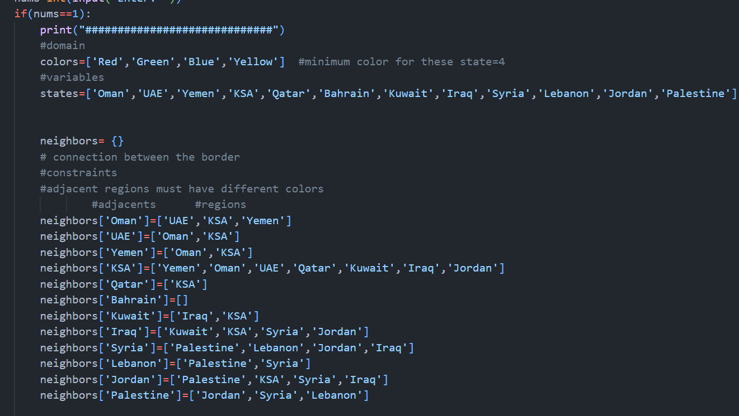
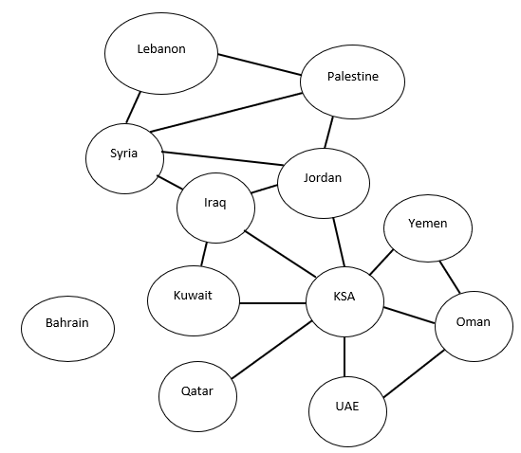
Notes:
In problem 1 case 1 :
There are 4 domains
And 12 variables
Partial assignment Oman:Red and Oman is the root the first node
And here we have created an empty dictionary called neighbors

Slide 3
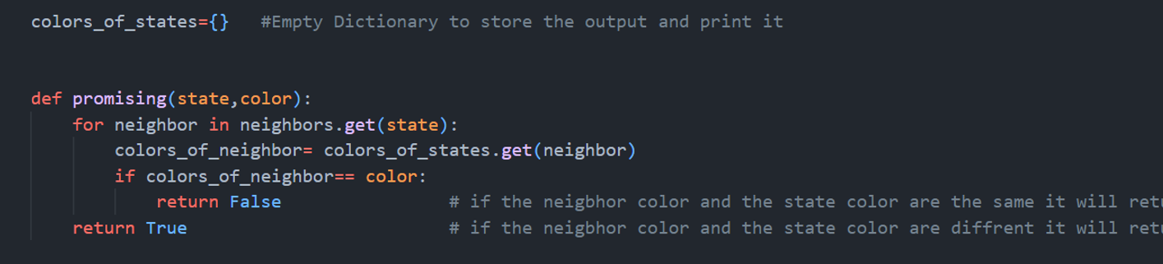
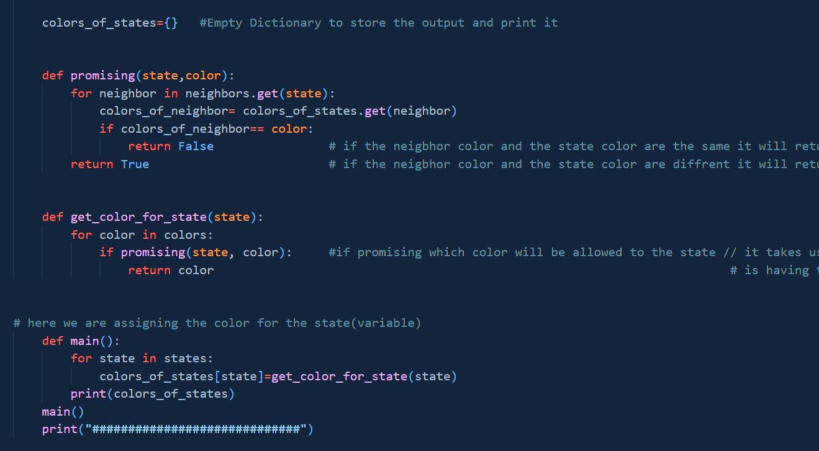
Notes:
Here we have created an empty dictionary to store the final output and print it called color_of_state
Then we have defined a function called promising
We have used for loop to get the state of each neighbor
And store in Color_of_State
The promising function is going to check whether the neighbor have the same color or not
If it’s the same its going to return false
If there are difference, then its going to return True

Slide 4
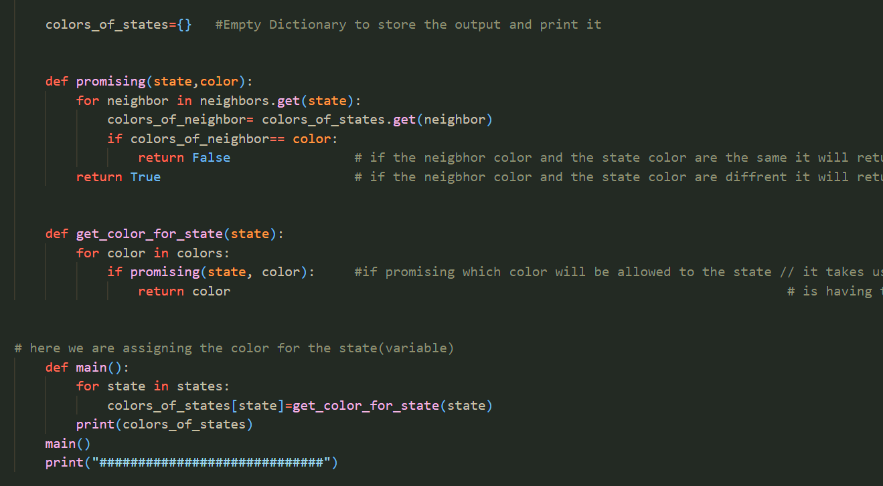
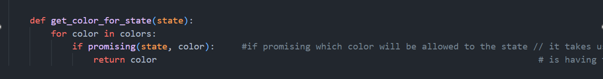
Notes:
we have defined a function called get_color_for_state
If the condition of promising is True
Then it moves to this function to get the color of states from the domain

Slide 5
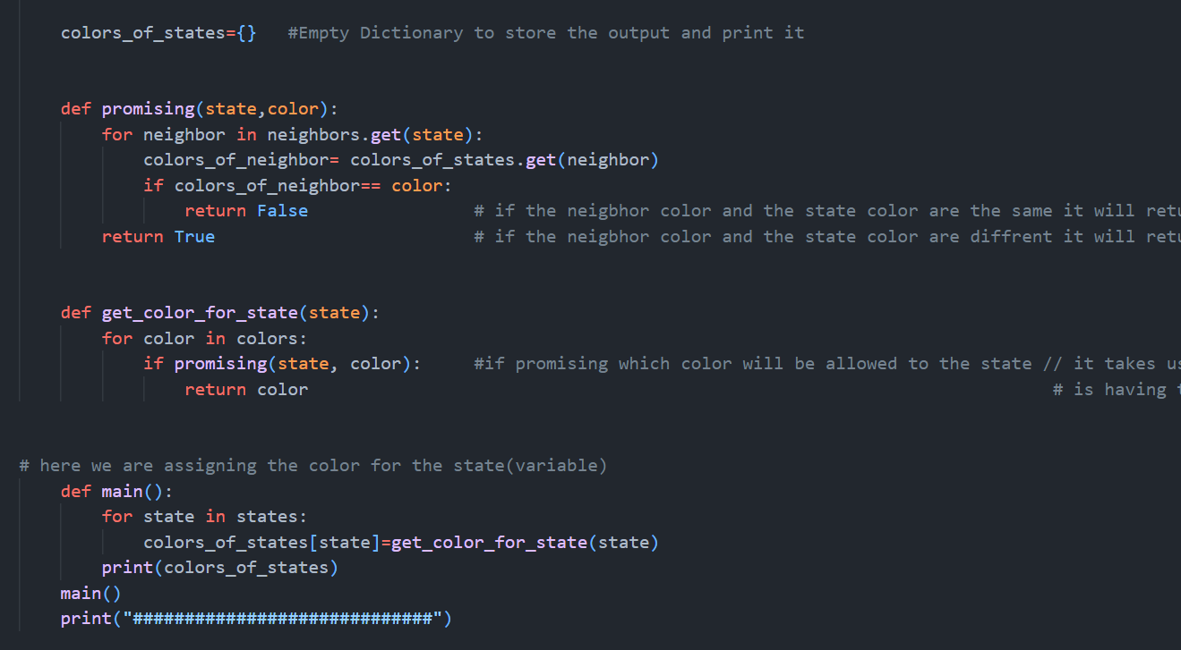
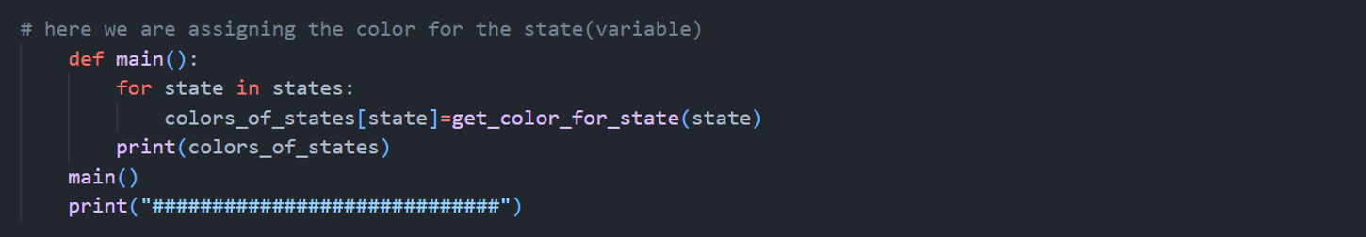
Notes:
After that we have defined a function which is the Main to combine the Variables and Domain together into an empty dictionary and print it out!

Slide 6

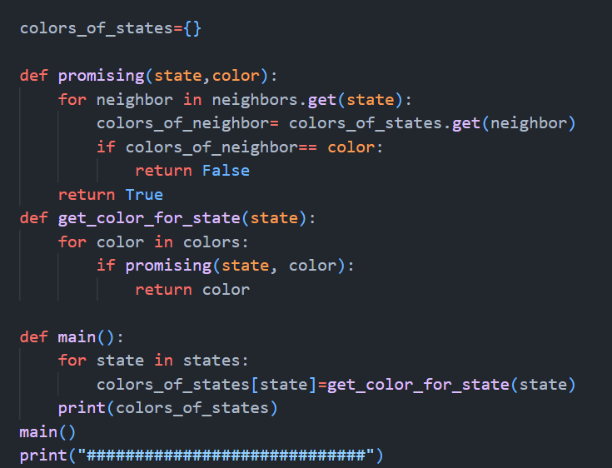
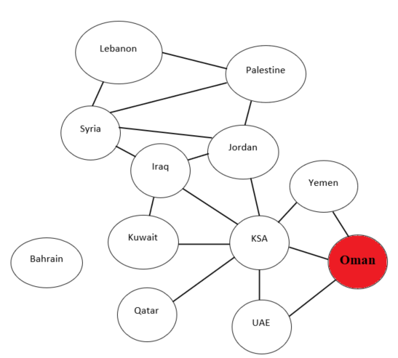

Partial Assignment
Red
Not
Colored
yet
Notes:
First, this is our domain and variables
Second, our algorithms that is going to check the neighbors and the constraint which is no two adjacent have the same color using backtracking search
Our partial assignment is Oman: Red
And then we are going to check the neighbors of Oman which is the constraint no two adjacent have the same color

Slide 7

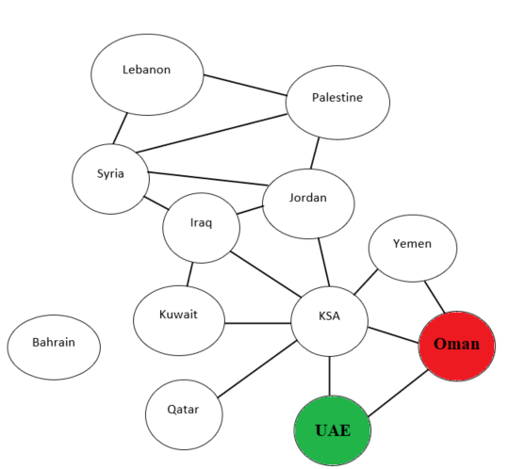
Green
Not
Colored
yet
Red
Notes:
First, this is our domain and variables
Second, our algorithms that is going to check the neighbors and the constraint which is no two adjacent have the same color
Our partial assignment is Oman: Red
And then we are going to check the neighbors of Oman which is the constraint no two adjacent have the same color

Slide 8
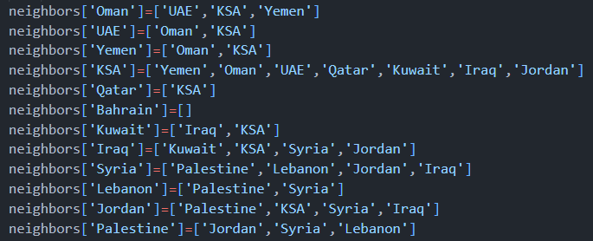

1
2
3
4
5
6
7
8
9
10
11
12
Our Constraints : Adjacent regions must have different colors;
That Means:
Oman ≠ UAE, KSA , Yemen
UAE ≠ Oman, KSA
Yemen ≠ Oman, KSA
And so on……
And as We can see Bahrain is an independent sub-problem
So it will take the first color in the domain Which is Red
Notes:
To sum up with it will go through systematic way (in order)
Our Constraint is : no two adjacent have the same color
That means:
And as we can see bahrian has no constraint
So it will take the first color in the domain which is red

Slide 9
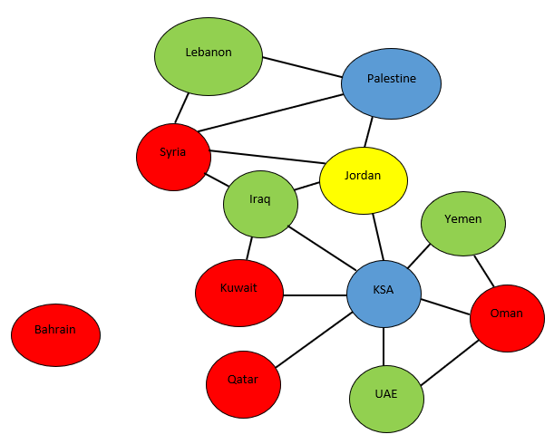
Our Constraint
Our Final Output
Notes:
This is Our Constraint
And This is our final Output

Slide 10
As for the Second problem
Let's consider that there are two Domain instead of four
Using the same variables and algorithms, and constraint, the only difference is the domain
Here is how the process will work and what the output will be

Slide 11
Partial Assignment
Red
Not
Colored
yet
Notes:
Our Partial assignment will be the same

Slide 12
Green
Not
Colored
yet
Red

Slide 13


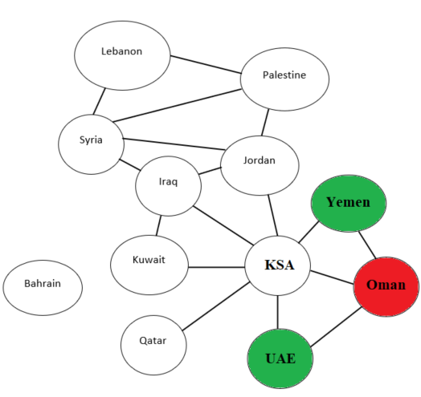
Green
Red
Not
Colored
yet

Slide 14
Green
Red
Green
Not
Colored
yet
In this situation:
KSA ≠ Yemen, Oman, UAE, Qatar, Kuwait, Iraq, Jordan
And only we have Two colors in the Domain
So, it will break the Constraint
That leads to…..
Uncolored node
Means: We didn’t reach the goal

Slide 15
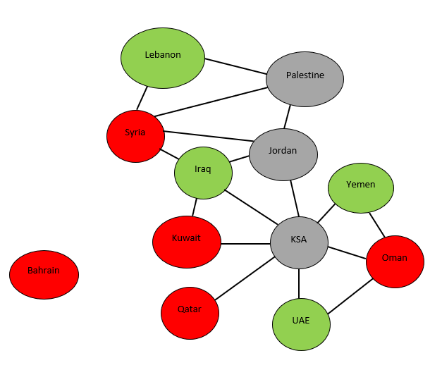
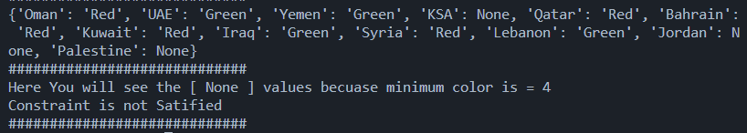

But in The Program, we didn’t stop if we break the constraint
It will continue coloring the map even if we break the constraint
And as for the broken Constraint Variable the Domain will be assigned ‘None’
{Variable: None}

Slide 16
We could write a condition to check the Domain
If we didn’t want to proceed with an output
Pseudocode:
If (Domain==None):
print ‘The constraint is not satisfied’
Else:
main()

